Slide 1

Welcome to MSSC CPT!
Mr. Fernandez
Catalyst (Bell Work):
What does MSSC and CPT stand for?
What value is there for you in gaining the 5 certificates in this program?
What is the first domain that we will master?

Slide 2
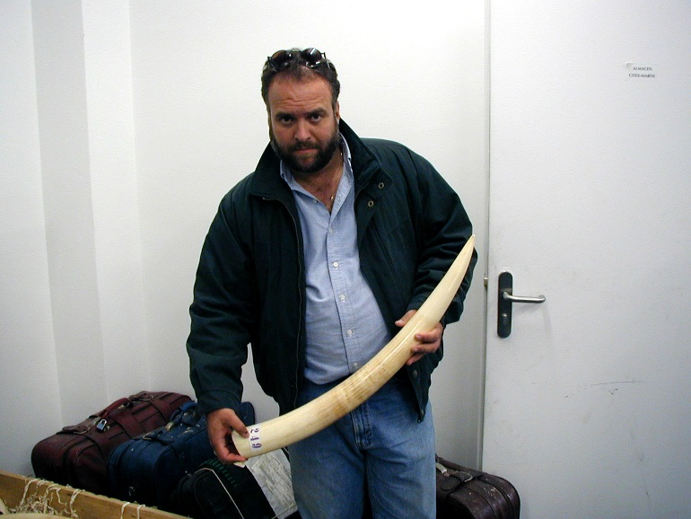
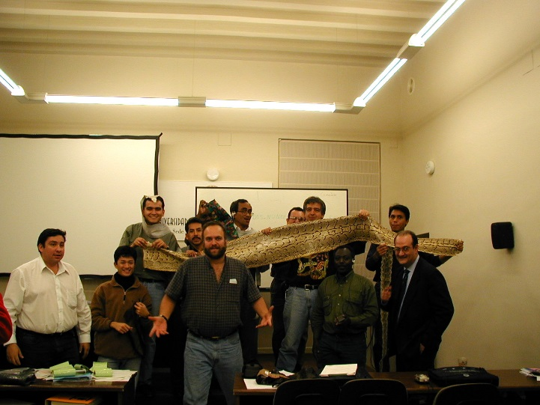

General Science
Who is Mr. Fernandez?
Paleontologist
Archaeologist
MSSC CPT
Investigator
PADI RESCUE DIVER
Researcher
Conservation
Electronics Ecology
MPA’s
Teacher
ETC.

Slide 4
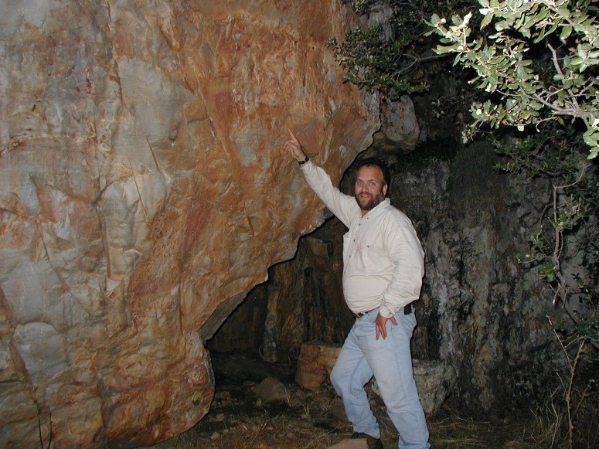
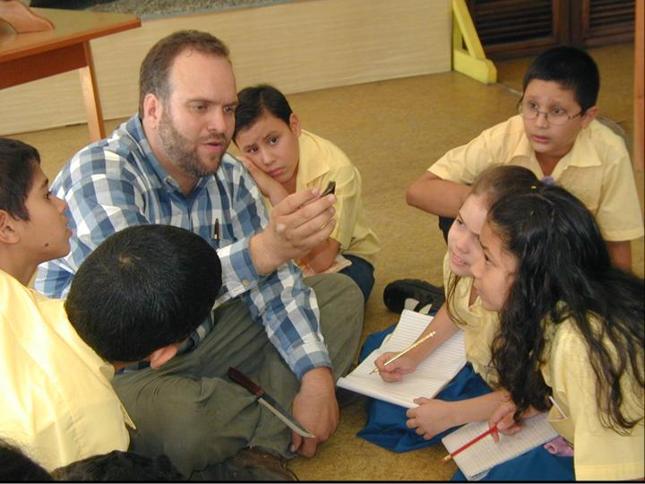
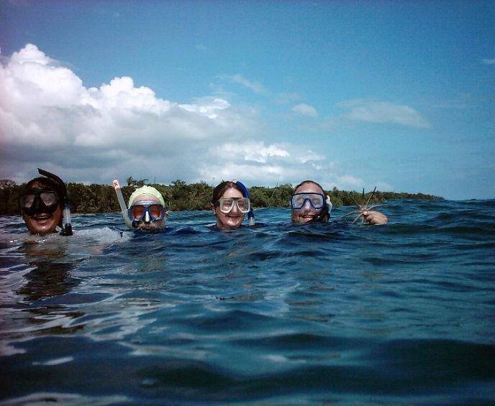
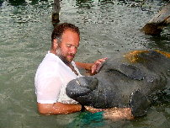

Slide 5



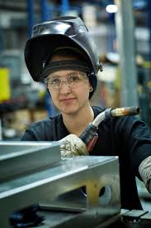
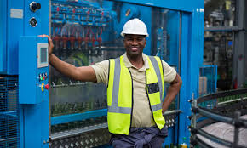

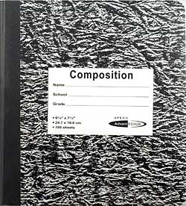
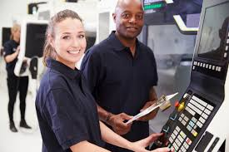
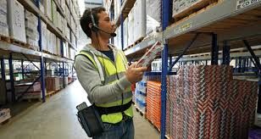
Course Syllabus & Expectations
Materials
Course Content
Expectations

Slide 6
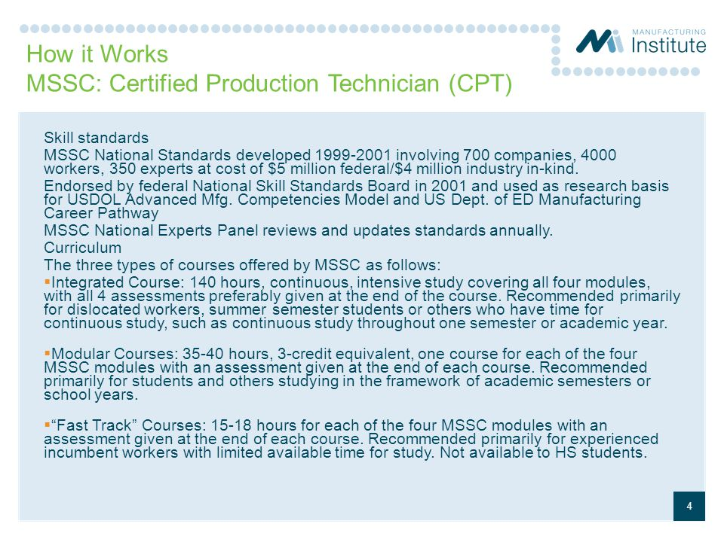

Slide 7
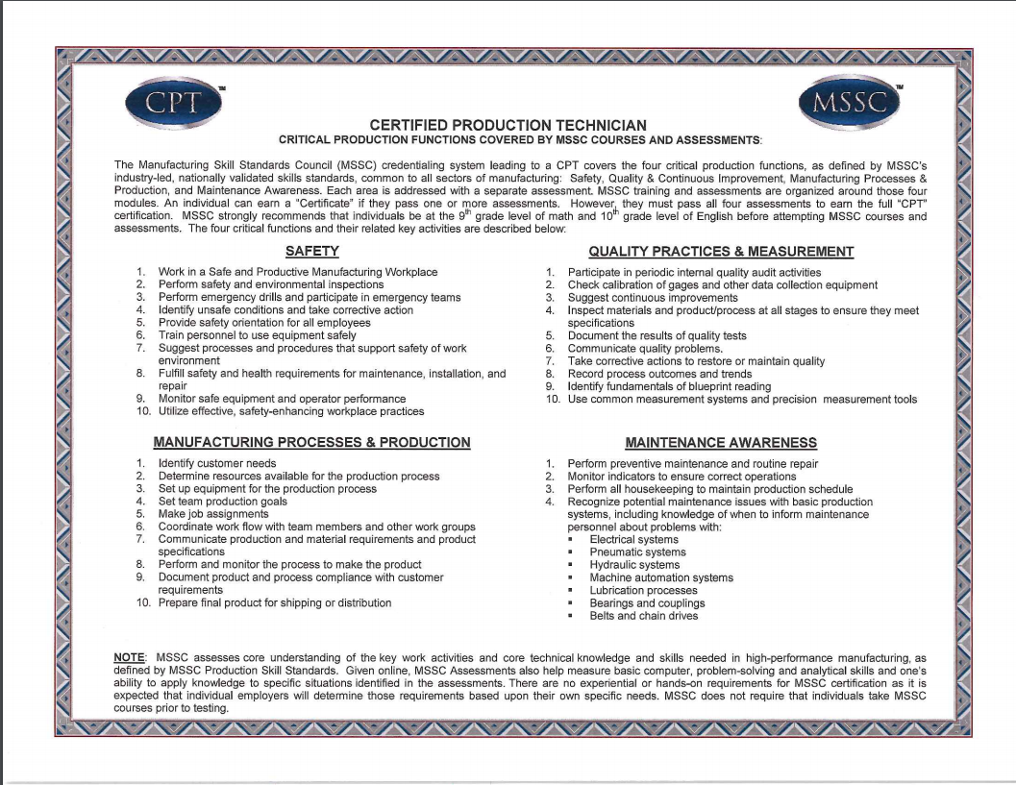

Slide 8
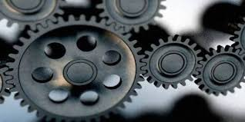
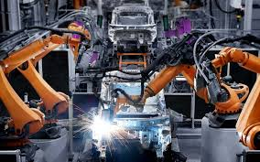
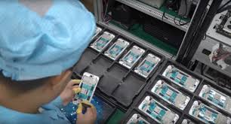
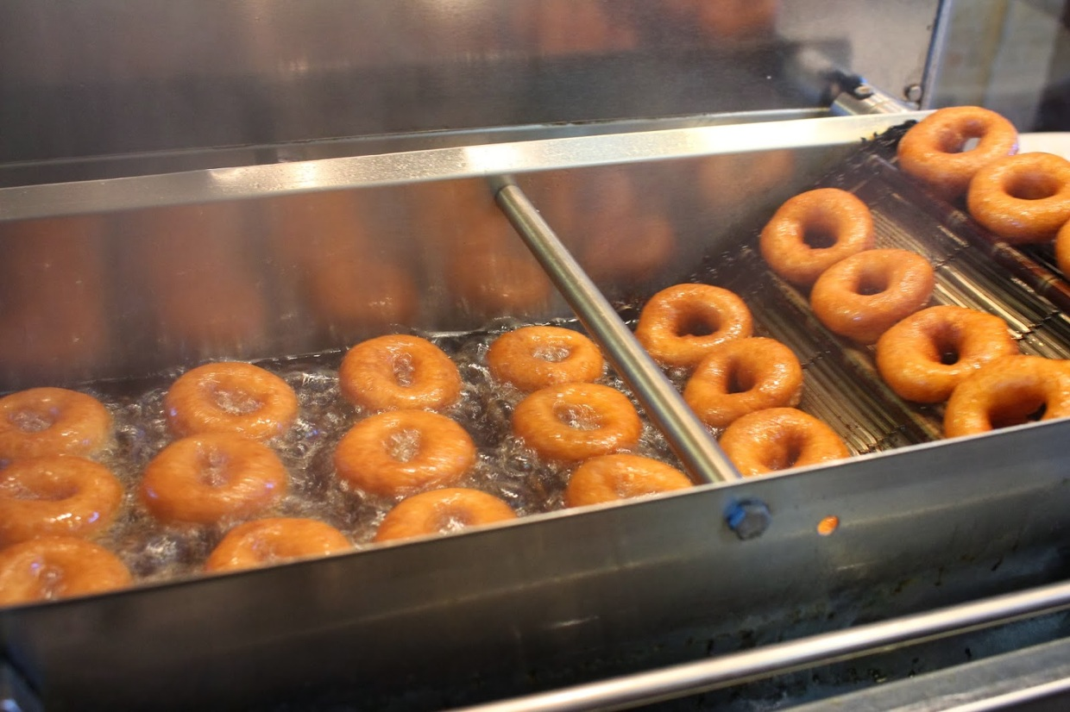
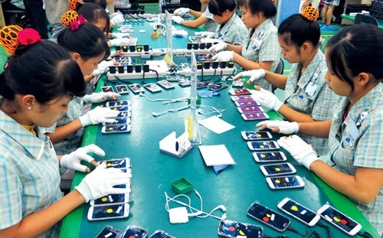
Course Syllabus & Expectations
Grading
Attendance
Passes
Classroom Behavior

Slide 9
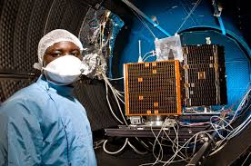
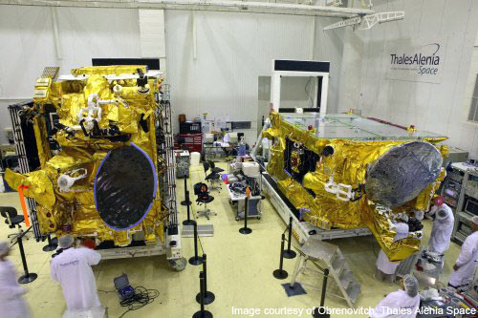
Course Syllabus & Expectations
Any questions?

