Slide 1

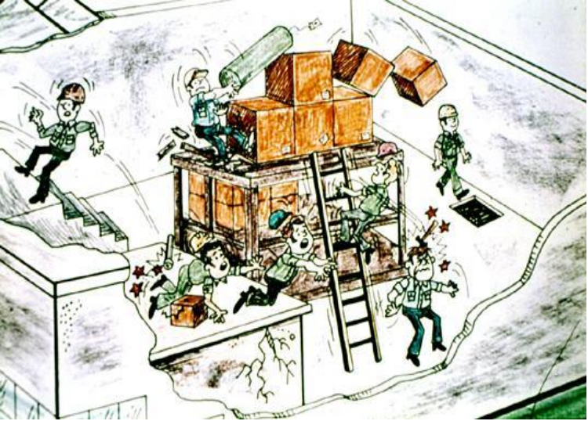
Foundations of
Manufacturing
Domain 1: Safety Awareness
Section 1: Introduction to OSHA
Notes:
This presentation is designed to assist trainers conducting OSHA 10-hour General Industry outreach training for workers. Since workers are the target audience, this presentation emphasizes hazard identification, avoidance, and control – not standards. No attempt has been made to treat the topic exhaustively. It is essential that trainers tailor their presentations to the needs and understanding of their audience.
This presentation is not a substitute for any of the provisions of the Occupational Safety and Health Act of 1970 or for any standards issued by the U.S. Department of Labor. Mention of trade names, commercial products, or organizations does not imply endorsement by the U.S. Department of Labor.

Slide 2
Domain 1 Safety Awareness
Table of Contents
Section 1 Introduction to OSHA
Section 2 Managing Safety Programs
Section 3 Walking Working Surfaces
Section 4 Fire Safety and Exit Routes
Section 5 Personal Protective Equipment
Section 6 Hazard Communication
Section 7 Electrical Safety
Section 8 Hand and Power Tool Safety
Section 9 Machine Guarding
Section 10 Lockout Tagout
Section 11 Ergonomics
Section 12 Powered Industrial Trucks
Section 13 Material Handling Equipment and Rigging
Section 14 Bloodborne Pathogens

Slide 3
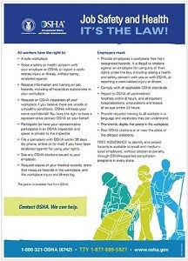
Introduction to
OSHA
Directorate of Training and Education
OSHA Training Institute

Slide 4
General Industry Outreach Training
This training is intended to provide entry level general industry workers information about their rights, employer responsibilities and how to file a complaint as well as how to identify, abate, avoid, and prevent job related hazards on a job site.
Training will emphasize Hazard Identification, avoidance, control and prevention, NOT OSHA standards, although the 29CFR 1910 OSHA General Industry Regulations are discussed.

Slide 5
Lesson Overview
Purpose:
To provide workers with introductory information about OSHA
Topics:
  Why is OSHA important to you?
  What rights do you have under OSHA?
  What responsibilities does your employer have under OSHA?
  What are OSHA standards?
  How are OSHA inspections conducted?
  Where can you go for help?

Slide 6
Topic 1:
Why is OSHA Important to You?
OSHA Makes a Difference
Worker deaths in America are down–on average, from about 38 worker deaths a day in 1970 to 12 a day in 2013.
Worker injuries and illnesses are down–from 10.9 incidents per 100 workers in 1972 to 3.0 per 100 in 2012.
4,405 workers were killed on the job in 2013 (3.2 per 100,000 full-time equivalent workers)
An average of nearly 12 workers die every day
797 Hispanic or Latino workers were killed from work-related injuries in 2013
Nearly 3.0 million serious workplace injuries and illnesses were reported by private industry employers in 2012

Slide 7
Quotes
“With every one of these fatalities, the lives of a worker's family members were shattered and forever changed. We can't forget that fact.”
-Hilda Solis, Former Secretary of Labor
“No one should have to sacrifice their life for their livelihood, because a nation built on the dignity of work must provide safe working conditions for its people.”
Secretary of Labor Thomas E. Perez

Slide 8

Discussion Questions
When, during your work experience, did you first hear about OSHA?
What did you think about OSHA then?
What do you think OSHA’s job is?

Slide 9



Group Activity: FAT/CAT Report
Handout #1: Weekly
Fatality/Catastrophe Report
Each group reviews the handout and selects an incident to discuss
Have full class share what they discussed in the groups
http://www.osha.gov/dep/fatcat/dep_fatcat.html
Notes:
Refer to Handout #1: Weekly Fatality/Catastrophe Report and/or Fatality/Catastrophe list of weekly reports online at:
http://www.osha.gov/dep/fatcat/dep_fatcat.html
Have the class break up into groups of 3-5 people.
1. Refer students to the Weekly Fatality/Catastrophe Report and explain its purpose. (Emphasize that this represents one week of worker fatalities reported to OSHA.) Show where the current report is located on the website, if available.
2. Tell the class to look at the list and see if they know or have heard of any similar incidents or near misses. Allow a minute or so for the class to scan the report.
3. Ask each group to discuss an incident from the report, or a similar incident that they know of or have heard about on their job.
4. After a few minutes, bring class back together.
5. Ask for a few volunteers to share an experience they may have heard of, what they discussed in their group, and how an incident was or may have been prevented.
Sum up the exercise by stating that hazard prevention is OSHA’s priority. If workers know their rights, and employers meet their responsibilities, lives and limbs can be saved. Focus on how important this training is to the participants

Slide 10

History of OSHA
OSHA stands for the Occupational Safety and Health Administration, an agency of the U.S. Department of Labor
OSHA’s responsibility is worker safety and health protection
On December 29, 1970, President Nixon signed the OSH Act
This Act created OSHA, the agency, which formally came into being on April 28, 1971
Notes:
Some events that led to the OSHA law include:
▪ The 1911 Triangle Shirtwaist Company fire in New York City killed 146 of 500 employees in one of the worst work-related disasters in our country’s history. Factory workers, mainly young, female immigrants working long hours for low wages, died because doors were locked and there were no fire escapes. This tragedy outraged the public, who called for safety and health reform. Frances Perkins, who later became the first Secretary of Labor, investigated the Triangle fire and tried to find ways to prevent future occurrences.
▪ Production for World War I caused a crisis in workplace safety and health conditions. The government created a Working Conditions Service to help states inspect plants and reduce hazards.
▪ In the 1930’s, as part of President Roosevelt’s New Deal, additional laws increased the federal government’s role in job safety and health. But the federal role was mainly to provide service and information to state governments. By the late 1950’s, the Federal-State partnership could no longer deal with the growing workforce and increasing hazards. Additional federal laws were enacted, but only covered certain industries.
▪ By the 1960’s, 14,000 workers died every year and more than 2.2 million workers were not able to work from injuries and illnesses.
Many thought that the only solution was a Federal law with the same rules and enforcement for everyone. On December 29, 1970, President Nixon signed the OSH Act. This Act created OSHA, the agency, which formally came into being on April 28, 1971. With the creation of OSHA, for the first time, all employers in the United States had the legal responsibility to provide a safe and healthful workplace for employees. And, there were now uniform regulations that applied to all workplaces.
The OSH Act is also known as Public Law 91-596. It covers all private sector employers and their workers in the 50 states and all territories and jurisdictions under federal authority. Employers and workers in many fields, including but not limited to manufacturing, construction, longshoring, agriculture, law, medicine, charity and disaster relief are covered by OSHA. Religious groups are covered if they employ workers for secular purposes, such as maintenance or gardening.
Which groups do not come under OSHA’s coverage?
▪ The self-employed;
▪ Immediate members of farming families not employing outside workers;
▪ Mine workers, certain truckers and transportation workers, and atomic energy workers who are covered by other federal agencies;
▪ Public employees in state and local governments, although some states have their own plans that cover these workers.

Slide 11

OSHA Coverage Activity
Covered by OSHA? | Worker
YES NO | Harry Adams, a miner at Below Ground Inc.
YES NO | Adrian Smith, one of 3 employees of ABC landscaping.
YES NO | Taylor Dell, an accountant in business for herself.
YES NO | Rob Jones, one of 10 carpenters working for Woody, Inc.
Notes:
Answers:
1. No, miners are covered by MSHA;
2. Yes.
3. No, the self-employed are not covered.
4. Yes.

Slide 12
OSHA’s Mission
The mission of OSHA is to assure safe and healthful working conditions for working men and women by setting and enforcing standards and by providing training, outreach, education and assistance.
Some of the things OSHA does to carry out its mission are:
  Developing job safety and health standards and enforcing them through worksite inspections
  Providing training programs to increase knowledge about occupational safety and health

Slide 13
Questions for Review
Why was OSHA necessary?
What is OSHA’s mission?
Why is this training important?
Notes:
Answers:
1. Workplace injuries, illnesses and death were increasing and no uniform or comprehensive law existed to protect against workplace hazards.
2. To save lives, prevent injuries and protect the health of America’s workers.
3. You’ll know your rights, if there are hazards in your workplace, and where to get help.

Slide 14
Topic 2:
What Rights Do You Have Under OSHA?
You have the right to:
  A safe and healthful workplace
  Know about hazardous chemicals
  Information about injuries and illnesses in your workplace
  Complain or request hazard correction from employer
  Training
  Hazard exposure and medical records
  File a complaint with OSHA
  Participate in an OSHA inspection
  Be free from retaliation for exercising safety and health rights
Notes:
Refer to Handout #2: Copy of OSHA Poster

Slide 15

Worker Rights
Handout #1:
OSHA Poster
Have you seen this poster at your place of work?
Creation of OSHA provided workers the right to a safe and healthful workplace
Notes:
NOTES:
Ask the class if they have seen the OSHA poster in their workplace. If so, ask where it is posted.
Tell the class that all employers covered by the OSHA Act must display the OSHA poster. (Employers in states operating OSHA-approved state plans should obtain and post the state’s equivalent poster.)
Ask the class to provide examples of how a safe and healthful workplace is provided [or should be provided] at their workplace or worksite.

Slide 16


Your Right to…
The creation of OSHA provided workers the right to a safe and healthful workplace.
Section 5(a)(1) of the OSH Act states: “Each employer shall furnish to each of his employees employment and a place of employment which are free from recognized hazards that are causing or are likely to cause death or serious physical harm to his employees."

Slide 17


Your Right to…
Worker Protection is Law: The Occupational Safety and Health Act of 1970 (OSH Act)
OSHA was created to provide workers the right to a safe and healthful workplace
It is the duty of the employers to provide workplaces that are free of known dangers that could harm their employees
This law also gives workers important rights to participate in activities to ensure their protection from job hazards

Slide 18

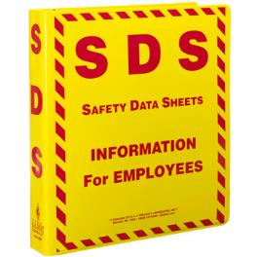
Your Right to…
Employers must have a written, complete hazard communication program that includes information on:
  Container labeling,
  Safety Data Sheets (SDSs), and
  Worker training. The training must include the physical and health hazards of the chemicals and how workers can protect themselves; including specific procedures the employer has implemented to protect workers, such as work practices, emergency procedures, and personal protective equipment.
The Hazard Communication Standard (HCS) requires chemical manufacturers, distributors, or importers to provide Safety Data Sheets (SDSs) (formerly known as Material Safety Data Sheets or MSDSs) to communicate the hazards of hazardous chemical products. As of June 1, 2015, the HCS will require new SDSs to be in a uniform format.
Notes:
Refer to Handout #3: SDS Example for student. Use Appendix A: SDS Explanation if needed.
NOTE: Safety Data Sheet: The Hazard Communication Standard (HCS) requires chemical manufacturers, distributors, or importers to provide Safety Data Sheets (SDSs) (formerly known as Material Safety Data Sheets or MSDSs) to communicate the hazards of hazardous chemical products. As of June 1, 2015, the HCS will require new SDSs to be in a uniform format.
Sum up the exercise by emphasizing that the SDS provides important information to workers about hazardous chemicals in the workplace.

Slide 19

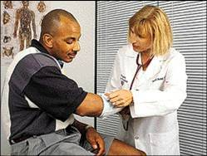
Your Right to…
OSHA’s Recordkeeping rule requires most employers with more than 10 workers to keep a log of injuries and illnesses.
Workers have the right to review the current log, as well as the logs stored for the past 5 years.
Workers also have the right to view the annually posted summary of the injuries and illnesses (OSHA 300A).
Notes:
NOTES:
Ask the class if their employer has set up a way for them to report injuries and illnesses.
The right to review the log includes former employees, their personal representatives, and authorized employee representatives.
“Privacy concern cases” are those involving an intimate body part, mental illness, HIV, etc. For more detail, see 1904.29(b)(7).

Slide 20

Your Right to…
Workers may bring up safety and health concerns in the workplace to their employers without fear of discharge or discrimination, as long as the complaint is made in good faith.
OSHA regulations [29CFR 1977.9(c)] protect workers who complain to their employer about unsafe or unhealthful conditions in the workplace.
Notes:
Ask the class if they have ever reported a hazard to their supervisor. If so, what was the outcome?
1977.9(c) states: “the principles of the Act would be seriously undermined if employees were discouraged from lodging complaints about occupational safety and health matters with their employers. Such complaints to employers, if made in good faith, therefore would be related to the Act, and an employee would be protected against discharge or discrimination caused by a complaint to the employer.”

Slide 21

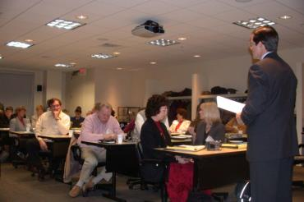
Your Right to…
Workers have a right to get training from employers on a variety of health and safety hazards and standards that employers must follow.
Some required training covers topics such as, lockout-tagout, bloodborne pathogens, noise, confined spaces, fall hazards in construction, personal protective equipment, along with a variety of other subjects.
Training must be in a language and vocabulary workers can understand

Slide 22

Your Right to…
1910.1020: right to examine & copy records
Examples of toxic substances and harmful physical agents are:
  Metals and dusts, such as, lead, cadmium, and silica.
  Biological agents, such as bacteria, viruses, and fungi.
  Physical stress, such as noise, heat, cold, vibration, repetitive motion, and ionizing and non-ionizing radiation.
Notes:
Access means the right to examine and copy medical and exposure records.

Slide 23

Your Right to…
Note:
Often the best and fastest way to get a hazard corrected is to notify your supervisor or employer.
Workers may file a complaint with OSHA if
they believe a violation of a safety or health standard, or an imminent danger situation,
exists in the workplace.
Workers may request that their name not be revealed to the employer.
If a worker files a complaint, they have the
right to find out OSHA’s action on the complaint and request a review if an inspection is not made.
Notes:
NOTES:
Filing a complaint is covered later in this session.

Slide 24

Your Right to…
Employee representative can accompany OSHA inspector
Workers can talk to the inspector privately.
Workers may point out hazards, describe injuries, illnesses or near misses that resulted from those hazards and describe any concern you have about a safety or health issue.
Workers can find out about inspection results, abatement measures and may object to dates set for violation to be corrected.
Notes:
CONTEST: If an employer disagrees with the results of the OSHA inspection, he or she may submit a written objection to OSHA, called a Notice of Contest.

Slide 25

Your Right to…
Workers have the right to be free from retaliation for exercising safety and health rights.
Workers have a right to seek safety and health on the job without fear of punishment.
This right is spelled out in Section 11(c) of the OSH Act.
Workers have 30 days to contact OSHA if they feel they have been punished for exercising their safety and health rights.
Notes:
NOTES:
Refer to Handout #4: Your Rights as a Whistleblower Fact Sheet
Refer to Handout #5: Refusing to Work because Conditions are Dangerous

Slide 26
Questions for Review
What does an SDS tell you?
What are some worker rights related to injury and illness reporting?
Name some standards or hazards where workers must be trained.
Notes:
Answers:
Chemical name, hazardous ingredients, physical and chemical characteristics, fire and explosion hazards, compatibility and reactivity, health hazards, precautions for safe use and handling, and control measures.
2. Know how to report injuries/illnesses, see the annual summary, and review the log.
3. Lockout/Tagout, fall hazards in construction, hazard communication, confined spaces, bloodborne pathogens, and personal protective equipment.

Slide 27

Provide a workplace free from recognized hazards and comply with OSHA standards
Provide training required by OSHA standards
Keep records of injuries and illnesses
Provide medical exams when required by OSHA standards and provide workers access to their exposure and medical records
Not discriminate against workers who exercise their rights under the Act (Section 11(c))
Post OSHA citations and abatement verification notices
Provide and pay for most PPE
Notes:
See the publication, Training Requirements in OSHA Standards and Training Guidelines for additional information.
Ask the class about safety and health training they have received prior to this course.
Ask the class to recall some of their rights under OSHA. Rights include: right to a workplace free of hazards, receiving training, access to injury/illness and medical records, complaining to your employer or OSHA about a safety and health problem, participating in an OSHA inspection, and participating or testifying in any proceeding related to an OSHA inspection.
OSHA also administers the whistleblower provisions of 17 other statutes, protecting workers who report violations of various trucking, airline, nuclear power and environmental laws.
See Abatement Verification Regulation, 1903.19, for additional information.

Slide 28
Employers are Required to:
KEEP RECORDS OF INJURIES AND ILLNESSES
REPORTING AND RECORDING CHECKLIST
Employers must: Report each worker death Report each incident that hospitalizes 3 or more workers Maintain injury & illness records Inform workers how to report an injury or illness to the employer Make records available to workers Allow OSHA access to records Post annual summary of injuries & illnesses
Notes:
Employers exempt from recordkeeping requirements must still report deaths and the hospitalization of 3 or more to OSHA.

Slide 29
Reporting Revisions effective Jan 1, 2015
Under the revised rule, employers will be required to notify OSHA of work-related fatalities within eight hours, and work-related in-patient hospitalizations, amputations or losses of an eye within 24 hours.
Previously, OSHA's regulations required an employer to report only work-related fatalities and in-patient hospitalizations of three or more employees. Reporting single hospitalizations, amputations or loss of an eye was not required under the previous rule.

Slide 30
Examples of PPE that employers must pay for include:
▪ Metatarsal foot protection
▪ Rubber boots with steel toes
▪ Non-prescription eye protection
▪ Prescription eyewear inserts/lenses for full face
respirators
▪ Goggles and face shields
▪ Fire fighting PPE (helmet, gloves, boots, proximity suits,
(full gear)
▪ Hard hat
Hearing protection
Welding PPE

Slide 31
Payment Exceptions under the OSHA Rule
Employers are not required to pay for some PPE in certain circumstances:
▪ Non-specialty safety-toe protective footwear (including steel-toe shoes or boots) and non-specialty prescription safety eyewear provided that the employer permits such items to be
worn off the job site. (OSHA based this decision on the fact that this type of equipment is
very personal, is often used outside the workplace, and that it is taken by workers from
jobsite to jobsite and employer to employer.)
▪ Everyday clothing, such as long-sleeve shirts, long pants, street shoes, and normal work
boots.
▪ Ordinary clothing, skin creams, or other items, used solely for protection from weather,
such as winter coats, jackets, gloves, parkas, rubber boots, hats, raincoats, ordinary
sunglasses, and sunscreen
▪ Items such as hair nets and gloves worn by food workers for consumer safety.
▪ Lifting belts because their value in protecting the back is questionable.
▪ When the employee has lost or intentionally damaged the PPE and it must be replaced.

Slide 32
Questions for Review
What are some of the responsibilities employers have related to OSHA recordkeeping?
Which section of the OSH Act prohibits employers from discriminating against workers for exercising their safety and health rights?
What are some types of PPE for which employers must pay?
Notes:
Answers:
1. Employers must set up a reporting system and inform workers of how to report, maintain an OSHA-300 log and make it available to workers, post the annual summary and report fatalities and the hospitalization of 3 or more workers to OSHA.
2. Section 11(c)
3. Hardhats, hearing protection, etc.

Slide 33
Topic 4:
What are OSHA Standards?
Four Groups of OSHA Standards
General Industry*
Construction
Maritime
Agriculture
*General Industry is the set that applies to the largest number of workers and worksites
OSHA standards are:
Rules that describe the methods employers must use to protect employees from hazards
Designed to protect workers from a wide range of hazards
Where there are no specific standards, employers must comply with the General Duty Clause of the OSH Act.

Slide 34
OSHA Standards (Cont.)
These standards also:
Limit the amount of hazardous chemicals, substances, or noise that workers can be exposed to
Require the use of certain safe work practices and equipment
Require employers to monitor certain hazards and keep records of workplace injuries and illnesses

Slide 35
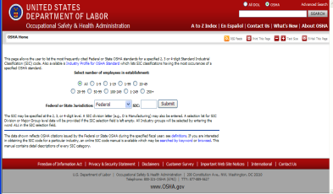
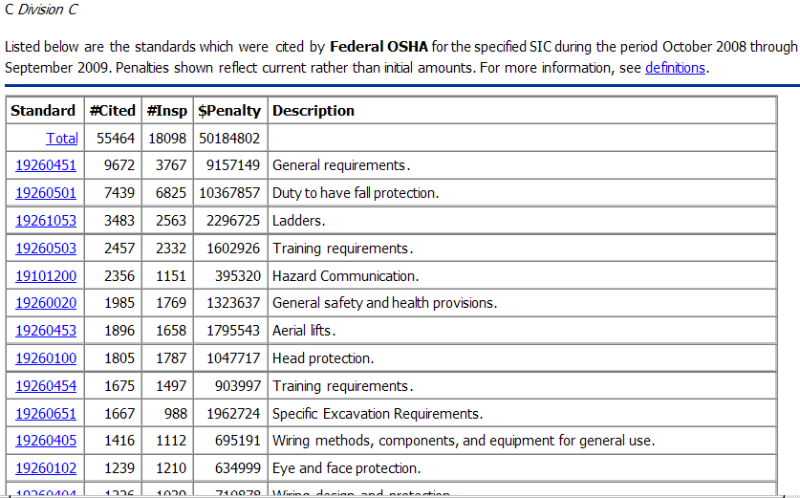
Most Frequently Cited Standards
Click: Most Frequently Cited (MFC) Standards to view current data
To search MFC data on this webpage:
“Select number of employees in establishment,” select ALL or one of the options listed
“Federal or State Jurisdiction,” select Federal or, from the dropdown menu, a specific state
“SIC,” select ALL for all Industry groups, C for Construction, D for Manufacturing (General Industry), or 373 and 449 for Maritime
Shown are search results for: All sizes of establishments, in Federal jurisdiction, with Construction SIC codes
Notes:
Discuss/Show: Copy of the OSHA standards book (General Industry or Construction)

Slide 36
OSHA 2013 Top 10
Standards Violations
(10/1/12 to 9/30/13; regulation number in brackets, citations issued)
Fall Protection [1926.501]: 8,241
Hazard Communication [1910.1200]: 6,156
Scaffolding [1926.451]: 5,423
Respiratory Protection [1910.134]: 3,879
Electrical, Wiring Methods [1910.305]: 3,452
Powered Industrial Trucks [1910.178]: 3,340
Ladders [1926.1053]: 3,311
Lockout/Tagout [1910.147]: 3,254
Electrical, General Requirements [1910.303]: 2,745
Machine Guarding [1910.212]: 2,701

Slide 37
OSHA 2013 Top 10
Willful Violations
(10/1/12 to 9/30/13; regulation number in brackets, citations issued)
Fall Protection [1926.501]: 73
Excavations [1926.652]: 34
Lead [1910.62]: 25
Machine Guarding [1910.212]: 23
Lockout/Tagout [1910.147]: 20
Scaffolding [1910.451]: 19
Guarding Floor & Wall Openings & Holes [1910.23]: 18
Respiratory Protection [1910.134]: 17
Process Safety Management [1910.119]: 14
Powered Industrial Trucks [1910.178]: 10

Slide 38

The OSH Act authorizes OSHA compliance safety and health officers (CSHOs) to conduct workplace inspections at reasonable times.
OSHA conducts inspections without advance notice, except in rare circumstances (e.g. Imminent Danger)
In fact, anyone who tells an employer about an OSHA inspection in advance can receive fines and a jail term.

Slide 39
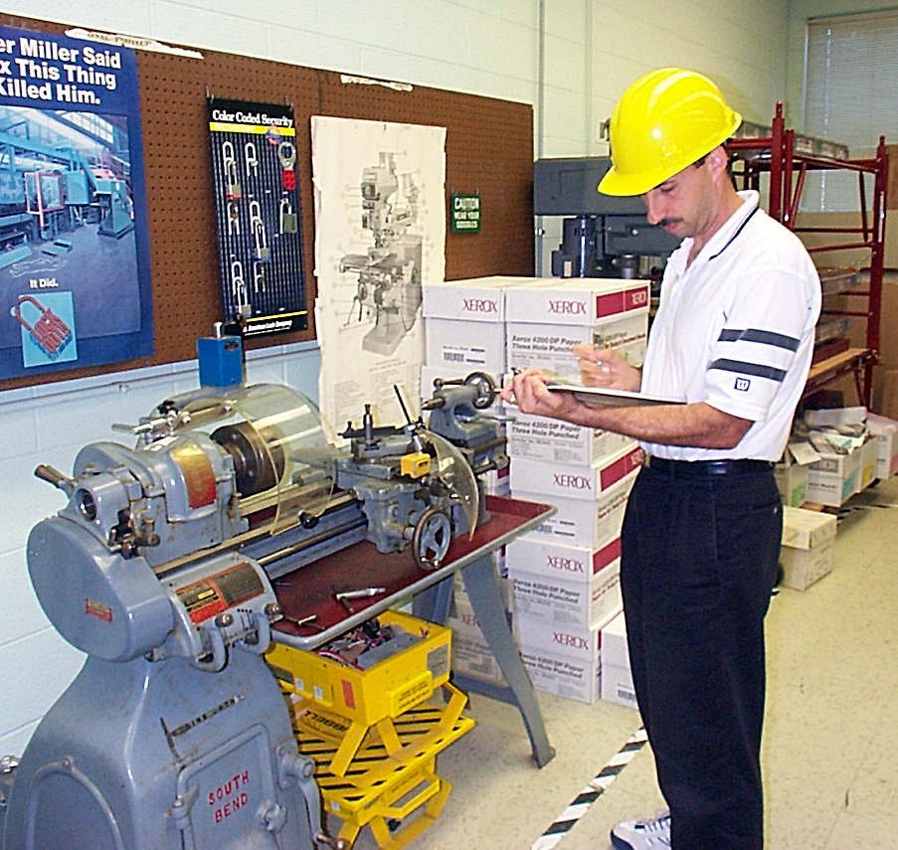
Workplace Inspections
Every establishment covered by the OSH Act is subject to inspection by OSHA Compliance Safety and Health Officers (CSHO's)
Most inspections are conducted without advance notice
Notes:
OSHA Inspections in FY 2006-
Federal OSHA
38,579 inspections
83,913 violations
$84,413,006 in penalties
State OSHA programs
58,058 inspections
127,284 violations
$71,037,356
in penalties

Slide 40
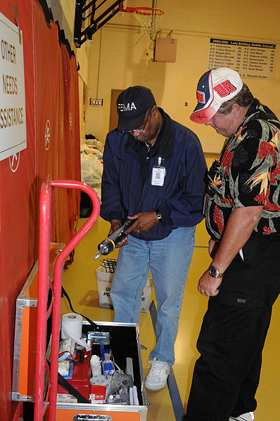
What Prompts an OSHA Inspection?
Report of
imminent danger
Fatalities or catastrophes
Employee complaints
Referrals from
other agencies
Targeted inspections
Notes:
Inspection Priorities:
- Imminent Danger (any condition where there is a reasonable certainty that a danger exists that can be expected to cause death or serious physical harm immediately, or before the danger can be eliminated through normal enforcement procedures.)
- Fatalities and Catastrophes (resulting in hospitalization of three or more employees)
- Employee Complaints/Referrals
- Programmed High-Hazard Inspections
- Follow-ups to previous inspections

Slide 41

When the CSHO Arrives
Implement OSHA Inspection Action Plan
Check CSHO’s credentials
Alert key personnel
Prepare meeting room
Notes:
I. Speaker’s Notes
The first person to greet an OSHA CSHO is usually a receptionist. The receptionist must be trained on your company’s OSHA inspection action plan so that he or she knows which personnel to contact, how to prepare the conference room, and what other responsibilities are required of him or her.
The OSHA inspector will want to meet with the owner, general manager, or person in charge of the operations at your facility. Other key people to contact might include your safety director, human resources manager, production manager, engineering manager, safety consultant, etc.
Before leading the CSHO into a conference room, make sure the room is sanitized. Erase any notes on black or white boards, remove papers from previous meetings, and make sure no extra information is in the room.
Check the CSHO credentials. You may also verify the credentials by calling the nearest federal or state OSHA office. This phone number should be listed in your OSHA Inspection Action Plan.

Slide 42
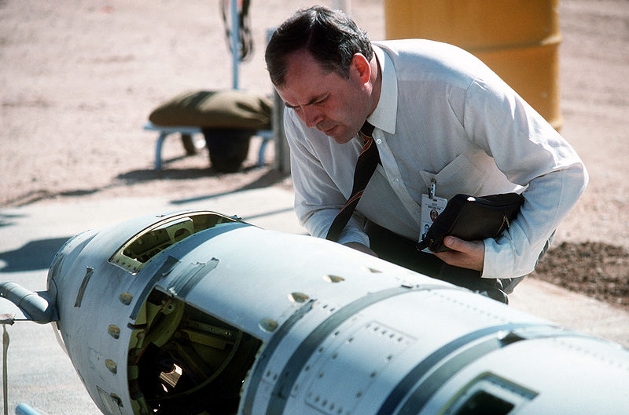
Inspection Process
Opening conference
Walkaround inspection
Closing conference

Slide 43
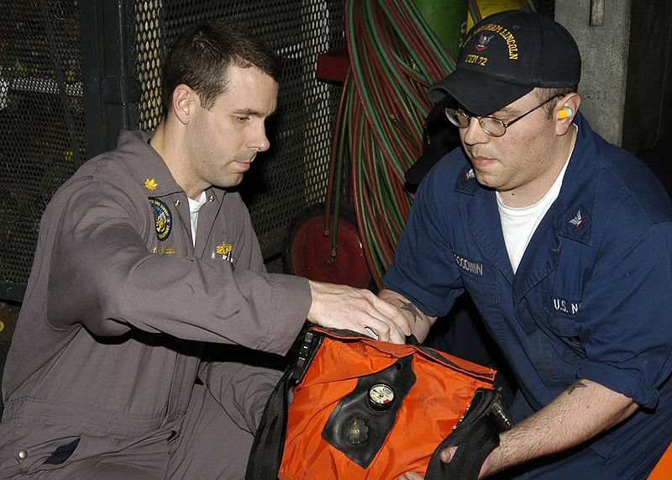
OSHA Inspection Action Plan
Procedures for handling the
inspection process
Responsibilities of key personnel
Equipment needed for the inspection
Notes:
I. Speaker’s Notes
Now that we know why OSHA might select your facility for an inspection, we should take steps to prepare your facility and personnel.
An OSHA inspection plan will help your company successfully manage an OSHA inspection. The plan should focus on three key areas to help ensure that the inspection goes smoothly. However, remember that the focus of your safety resources should be on developing an effective safety program, because having an excellent OSHA Inspection Plan will not compensate for a poor safety program.
The plan should discuss how your company will manage the inspection process. For example, who will be called when the CSHO arrives? Where is the location of the paperwork that the CSHO may ask for? On which route will you take the inspector through your facility? Where will you have the opening and closing conferences?
The plan should determine the responsibilities of key individuals in your
facility. Who will escort the CSHO through the plant? Who will be responsible for providing documentation to the CSHO? Who will take the minutes of the meeting?
The plan should also explain what equipment is necessary for an inspection.
Is a camera needed? Is notepaper available? Do you have required personal protective equipment (PPE) available for the CSHO to wear?
In this training session, we will answer many of these questions to enable you to develop a solid OSHA inspection action plan and train your employees on the plan so that you are prepared for an OSHA inspection.

Slide 44


Inspection Tool Box Essentials
Camera
Clipboard
and notepads
Flashlights
PPE
Facility map
Notes:
I. Speaker’s Notes
Another part of preparing for an OSHA inspection is to put together an Inspection Tool Box that contains some items that you will need so that you do not have to spend time scrambling for these items. The tool box should include:
A camera so that you can take pictures of what the CSHO takes pictures of or is focusing his or her attention on
Clipboards, notepads, and plenty of pens
Flashlights to help look in those hard-to-see areas
Extra PPE for both the inspector and your key people so that they are sure to have the right equipment on before entering the facility
A current facility map that will help the CSHO get the feel for your facility and understand how your operations are set up
Other information that might be included is a list of the location of monitoring equipment (include keys in the tool box if the equipment is locked up), location of key safety documents (keys for filing cabinets if necessary), etc.

Slide 45

Documentation Requested
Injury and illness logs
Written safety programs
Training records
Documents related to
safety programs
Notes:
I. Speaker’s Notes
After the opening conference, the CSHO may want to look at documentation that relates to your safety program.
The OSHA inspector will request injury and illness logs, such as the OSHA 200 form. The inspector will not only check to make sure you have accurately completed the form, he or she will also look at your accident history to get a feel for what types of injuries and illnesses occur at your facility.
The CSHO will also ask for your written safety programs to ensure that you have them, they are current and reflect OSHA’s requirements, etc. The inspector will look to see if the written safety programs are being followed out in the plant during the walkaround. For example, if your program says safety glasses are required in a certain area, the workers in that area had better be wearing safety glasses. If not, the inspector may think that your written programs are just for show and do not accurately reflect your overall safety program and culture.
The CSHO may also ask to see documentation of employee training. He or she will want to ensure that employees receive regular training that meets the requirements of OSHA standards and also follows what is written in your safety programs.
The OSHA inspector may also ask to see documents relating to specific safety programs, including MSDSs, lockout/tagout assessments, respirator fit tests, and PPE assessments.
Control the flow of documents to prevent providing the inspector with unnecessary information. Consider asking for a written list of the documents that the inspector will require to make sure there is no confusion. Do not just give the inspector a stack of safety documents. Give one file or document at a time as requested to keep the inspection focus on one aspect at a time.
Take careful notes of which documents were reviewed by the inspector.

Slide 46

Priority | Category of Inspection
1st | Imminent Danger: Reasonable certainty an immediate danger exists
2nd | Fatality/Catastrophe: Reported to OSHA; inspected ASAP
3rd | Complaints/Referrals: Worker or worker representative can file a complaint about a safety or health hazard
4th | Programmed Inspections: Cover industries and employers with high injury and illness rates, specific hazards, or other exposures.

Slide 47

VIOLATION TYPE | PENALTY
WILLFUL A violation that the employer intentionally and knowingly commits or a violation that the employer commits with plain indifference to the law. | OSHA may propose penalties of up to $70,000 for each willful violation, with a minimum penalty of $5,000 for each willful violation.
SERIOUS A violation where there is substantial probability that death or serious physical harm could result and that the employer knew, or should have known, of the hazard. | There is a mandatory penalty for serious violations which may be up to $7,000.
OTHER-THAN-SERIOUS A violation that has a direct relationship to safety and health, but probably would not cause death or serious physical harm. | OSHA may propose a penalty of up to $7,000 for each other-than-serious violation.
REPEATED A violation that is the same or similar to a previous violation. | OSHA may propose penalties of up to $70,000 for each repeated violation.
Notes:
Criminal Willful violations, which involve the death of a worker, may have a penalty of up to $250,000 for an individual and $500,000 for an organization, or by up to 6 months in jail.
Ask the class if they can think of an example of:
▪ a serious violation. (An example would be not providing guarding or fall protection for workers on a 25 foot scaffold. The resulting fall would most likely result in death, broken bones and/or other serious injuries.)
▪ an “other-than-serious” violation. (An example of this type of violation could be an area with poor housekeeping, creating a tripping hazard. The most likely result would be abrasions or bruises. However, this would only be the case if there were no sharp objects, broken glass, etc. in the area.),
Employers have the right to request an extension of time for an abatement date if they cannot meet the time stated on the citation for a cited item. This is called a petition for modification of abatement, or PMA
If a violation or abatement date is contested by the employer, the situation does not have to be fixed until there is a final legal order. If only the penalty is contested, the violation must be fixed by the date in the citation.

Slide 48
Questions for Review
Give an example of a reason why OSHA would conduct an inspection at your workplace.
What are the types of OSHA violations?
Notes:
Answers
1. If a worker files a complaint, if there is a fatality, if there is an imminent danger situation, etc.
2. Willful, serious, other-than-serious, repeated and Criminal/Willful.

Slide 49

Sources within the workplace/worksite
Sources outside the workplace/worksite
How to file an OSHA complaint
Notes:
Refer to Handout #9: Safety & Health Resources
Refer to Handout #10: Navigating the OSHA Website
OSHA website: http://www.osha.gov ; Show the links to OSHA en Español, Fact Sheets and QuickCards, etc. If time permits, show how to conduct a search on a safety and health topic or hazard. For example, if you put “Lead” in the Search Box, you get results including the standards in General Industry and Construction, as well as Safety and Health Topics pages and a publication on lead exposure in construction.
Locate the appropriate OSHA area or regional office contact information for your audience and provide it to the class.
Show the class the NIOSH website: www.cdc.gov/niosh
For additional information on OTI Education Centers, see http://www.osha.gov/ dte/edcenters/index.html
For additional information on COSH groups, see: http://www.coshnetwork.org/
A representative can also be an attorney or any person acting in a bona fide representative capacity, such as clergy, social workers, spouses, government officials and nonprofit groups.
Refer to Handout #11:
Identifying Safety and Health Problems in the Workplace
The complaint will be evaluated by OSHA to determine if an inspection will be conducted. For OSHA to conduct an inspection, there must be reasonable grounds to believe that a violation of the OSH Act or an OSHA standard exists.

Slide 50

Employer or supervisor, co-workers and union representatives
Safety Data Sheet (SDS) for information on chemicals
Labels and warning signs
Employee orientation manuals or other training materials
Work tasks and procedures instruction

Slide 51

OSHA website: http://www.osha.gov and OSHA offices (you can call or write)
Compliance Assistance Specialists in the area offices
National Institute for Occupational Safety and Health (NIOSH) – OSHA’s sister agency
OSHA Training Institute Education Centers
Doctors, nurses, other health care providers
Public libraries
Other local, community-based resources
Notes:
NOTES:
Refer to Handout #9: Safety & Health Resources
Refer to Handout #10: Navigating the OSHA Website
OSHA website: http://www.osha.gov ; Show the links to OSHA en Español, Fact Sheets and QuickCards, etc. If time permits, show how to conduct a search on a safety and health topic or hazard. For example, if you put “Lead” in the Search Box, you get results including the standards in General Industry and Construction, as well as Safety and Health Topics pages and a publication on lead exposure in construction.
You can contact OSHA by calling or visiting your local area or regional office for safety and health information or to discuss filing a complaint. Compliance Assistance Specialists in the area offices conduct many training sessions and have training materials and information that can be useful. Locate the appropriate OSHA area or regional office contact information for your audience and provide it to the class.
NIOSH is OSHA’s sister agency, with a focus on research and training. NIOSH can be a great resource for workers. NIOSH also conducts Health Hazard Evaluations (HHEs) of workplaces in cases where workers are getting sick from an unknown source.
Other Local Community –Based Resources – this can be fire departments (HAZMAT Response Teams), local health departments and hospitals/clinics, local industry representatives and vendor/suppliers, local Red Cross offices or other emergency response identities.

Slide 52
How to Raise a Concern
Handout #7: Identifying
Safety and Health Problems
in the Workplace
Review handout to become more aware of workplace hazards
Discuss if anyone has discovered safety and/or health problems in the workplace/site

Slide 53

Download the OSHA complaint form from OSHA’s website
File the complaint online
  Workers can file a complaint
  A worker representative can file a complaint
Telephone or visit local regional or area offices to discuss your concerns
Complete the form – be specific and include appropriate details
OSHA determines if an inspection is necessary
Workers do not have to reveal their name
Notes:
NOTES:
A representative can also be an attorney or any person acting in a bona fide representative capacity, such as clergy, social workers, spouses, government officials and nonprofit groups.
Refer to Handout #11:
Identifying Safety and Health Problems in the Workplace
The complaint will be evaluated by OSHA to determine if an inspection will be conducted. For OSHA to conduct an inspection, there must be reasonable grounds to believe that a violation of the OSH Act or an OSHA standard exists.

Slide 54
Group Activity: Filing a Complaint
Handout #8a:
General Industry
Each group reviews the handout and discusses the industry-specific scenario
Groups need to determine what information would be important to include in their complaint
Have the class discuss the group’s results:
  What was included in the complaint?
  What was added to the complaint?
Notes:
Refer to Handout #12a, #12b, or #12c Filing an OSHA Complaint: Use #12a for General Industry; Explain to the students the handout consists of tips on completing the form, the scenario specific to their industry, and the OSHA Complaint form.
Sum up the activity by stressing that it is important to be specific and accurate when completing an OSHA complaint, as this is the information the CSHO will use to research, plan and begin the investigation.

Slide 55
Questions for Review
What are some resources inside the workplace that will help you find information on safety and health issues?
What are some resources outside the workplace that will help you find information on safety and health issues?
Notes:
Answers:
1. Co-workers, union rep, supervisor, SDS, labels, manuals, etc.
2. OSHA, NIOSH, Educational Centers, Community Organizations, etc.

Slide 56

This lesson covered:
The importance of OSHA, including the history of safety and health regulation leading to the creation of OSHA and OSHA’s mission;
Worker rights under OSHA;
Employer responsibilities;
OSHA standards;
OSHA inspections; and
Safety and health resources, including how to file a complaint.
Notes:
Ask the class if there is any material that needs to be covered in more detail.

Slide 57
Summary
An effective safety program is a vital part of a company’s success. The primary need for safety training is due to a change in people or process. Job training should always include safety information.
Violations are costly and time consuming.
Have a working knowledge of OSHA requirements and safety standards and a proven inspection action plan.
OSHA’s mission is to ensure that employers furnish a workplace free of hazards.
It is every employee’s responsibility to follow OSHA safety standards, report violations, and correct discrepancies when they occur.
Notes:
History of accidents or near-misses
New people or job change
Demonstrated lack of knowledge

Slide 58

Thank You!

Slide 59
1. OSHA’s mission is to:
a. Protect the safety and health of the general public.
b. Protect the safety and health of America’s workers.
c. Ensure that all workers receive the federal minimum wage.
d. Ensure that all workers receive adequate workers’ compensation payments.

Slide 60
2. The creation of OSHA provided this important right to workers:
a. The right to equal employment opportunities.
b. The right to privacy.
c. The right to pension benefits.
d. The right to a safe and healthful workplace.

Slide 61
3. A Safety Data Sheet (SDS) gives information about:
a. Hazardous chemicals.
b. Injuries in the workplace.
c. Medical examinations.
d. Machinery maintenance

Slide 62
4. Among the rights related to OSHA recordkeeping, workers have the right to review:
a. All first aid treatment forms.
b. All Workers Compensation forms.
c. The OSHA 300 Log and the OSHA 300A Summary.
d. Medical and exposure records for all workers

Slide 63
5. During an OSHA inspection:
a. Worker representatives are not permitted to accompany the inspector.
b. You may not describe safety and health concerns you have to the inspector.
c. Employers determine which workers are interviewed.
d. You have the right to talk to the inspector privately.

Slide 64
6. The right of workers to seek safety and health on the job without fear of punishment is spelled out in:
a. State laws.
b. The OSHA standards.
c. Section 11(c) of the OSH Act.
d. The General Duty Clause.

Slide 65
7. One of the main responsibilities employers have under
OSHA is to:
a. Provide training required by OSHA standards.
b. Reduce air pollution in the environment.
c. Conduct energy audits.
d. Notify OSHA of any workplace injury or illness.

Slide 66
8. OSHA requires that employers pay for most required personal protective equipment (PPE), including:
a. Uniforms.
b. Logging boots.
c. Hard hats.
d. Weather-related gear.

Slide 67
9. The OSHA standards for Construction and General Industry are also known as:
a. Part 1926 and Part 1910.
b. Part 1915 and Part 1917.
c. Codes 501 through 1000.
d. Construction and GI Registers.

Slide 68
10. What type of OSHA inspection is conducted when immediate death or serious harm is likely?
a. Complaint.
b. Programmed.
c. Referral.
d. Imminent danger.

Slide 69
11. When the employer receives an OSHA citation, it must be:
a. Copied and mailed to each worker.
b. Posted for 3 days or until the violation is fixed.
c. Contested and filed with the courts.
d. Signed and returned to OSHA.

Slide 70
12. If you feel that an OSHA inspection is needed to get hazards corrected at your workplace, which is your best option?
a. File a complaint online.
b. Submit a written, signed complaint with specific hazard information.
c. Request a Health Hazard Evaluation from NIOSH.
d. Submit an unsigned complaint form to OSHA.

Slide 71

STAY SAFE

Slide 72
