Slide 1

Domain 1: Safety Awareness
Foundations of
Manufacturing
Section 10:
Lockout/Tagout (LOTO) Safety
CFR Part 1910 Subpart J
(§1910.147 )
Notes:
Read Lesson Link aloud to students:
OSHA estimates that about 122 fatalities, 28,400 lost workday injuries, and 31,900 non-lost workday injuries are prevented each year by properly using the procedures contained in OSHA’s lockout/tagout standard. Moreover, the strict implementation of and adherence to these procedures can eliminate nearly two percent of all workplace deaths.

Slide 2
Learning Objectives
Determine the requirements and need of a hazardous energy control program.
Discuss proper selection of devices for control of hazardous energy.
Identify uses of devices intended to control hazardous energy.
Examine proper training methods for hazardous energy control.
2/34
Notes:
Direct students to turn to page 1-10-1 in their Foundations of Manufacturing, Domain 1: Safety Awareness, Section 10- Lockout/Tagout (LOTO) Safety, Student Workbook and continue with the discussion.

Slide 3

Energy Control Program
Employer’s Responsibility
Consists of:
  Energy control procedures
  Employee training
  Periodic inspections
3/34

Slide 4
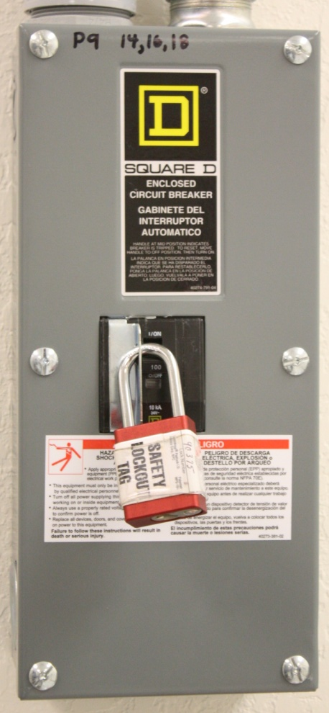
Lockout/Tagout
Referred to as LOTO
Lockout is the act of blocking the flow of energy from the power source to the equipment
Tagout is the act of warning (tagging) equipment that is being worked on – DO NOT ENERGIZE
4/34

Slide 5
Purpose of LOTO Procedures
Prevent unexpected energizing or starting of equipment
Prevent accidental release of stored energy
Prevent injury and/or death of employees
5/34
Notes:
Question: What does “energized” mean?
Answer: Connected to an energy source or containing residual or stored energy.
Question: What is an energy source?
Answer: Any source of electrical, mechanical, hydraulic, pneumatic, chemical, thermal, or other energy.

Slide 6

Hazardous Energy Control Plan
Written plan available to all employees
Scope and application
LOTO device guidelines
LOTO exceptions
6/34
Notes:
Question: Why is it the employer’s responsibility to have an energy control plan and not the employee’s?
Answers will vary.

Slide 7
Scope and Application
Employees servicing and/or conducting maintenance
Not applicable to:
  Construction, agriculture, and maritime
  Electric utility and installations
  Oil and gas well drilling and servicing
7/34

Slide 8
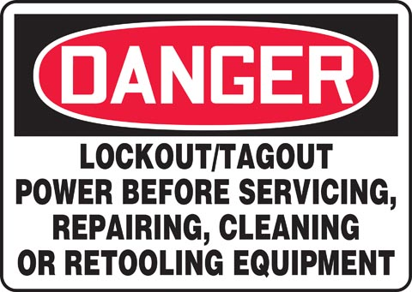
Scope and Application (Cont’d.)
Servicing Operations
  Hazardous energy exists and/or unexpected start-up could occur
  (Either of these could harm an employee)
  Guard removed or bypassed
  Body contact with equipment
  Body in a danger zone
8/34
Notes:
Note: It is important that a company abide by regulations. Failure to follow LOTO procedures is a cause of industrial fatalities.

Slide 9

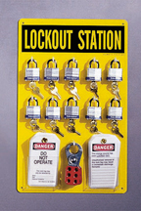
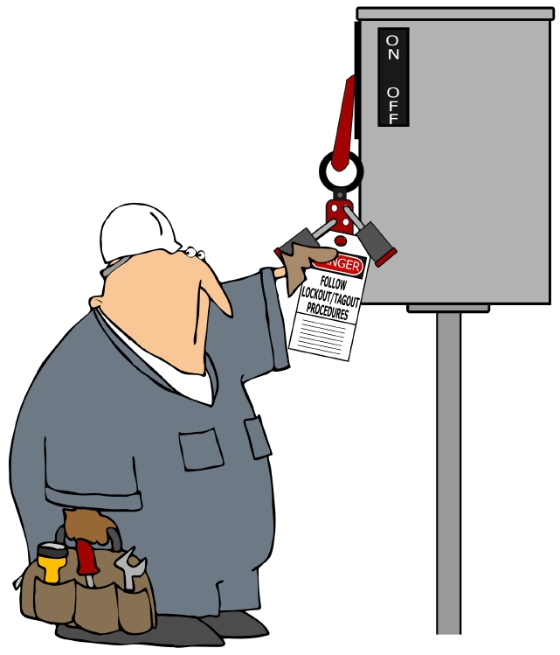
LOTO Device Guidelines
LOTO devices must be:
Durable
Standardized
Substantial
Identifiable
9/34

Slide 10
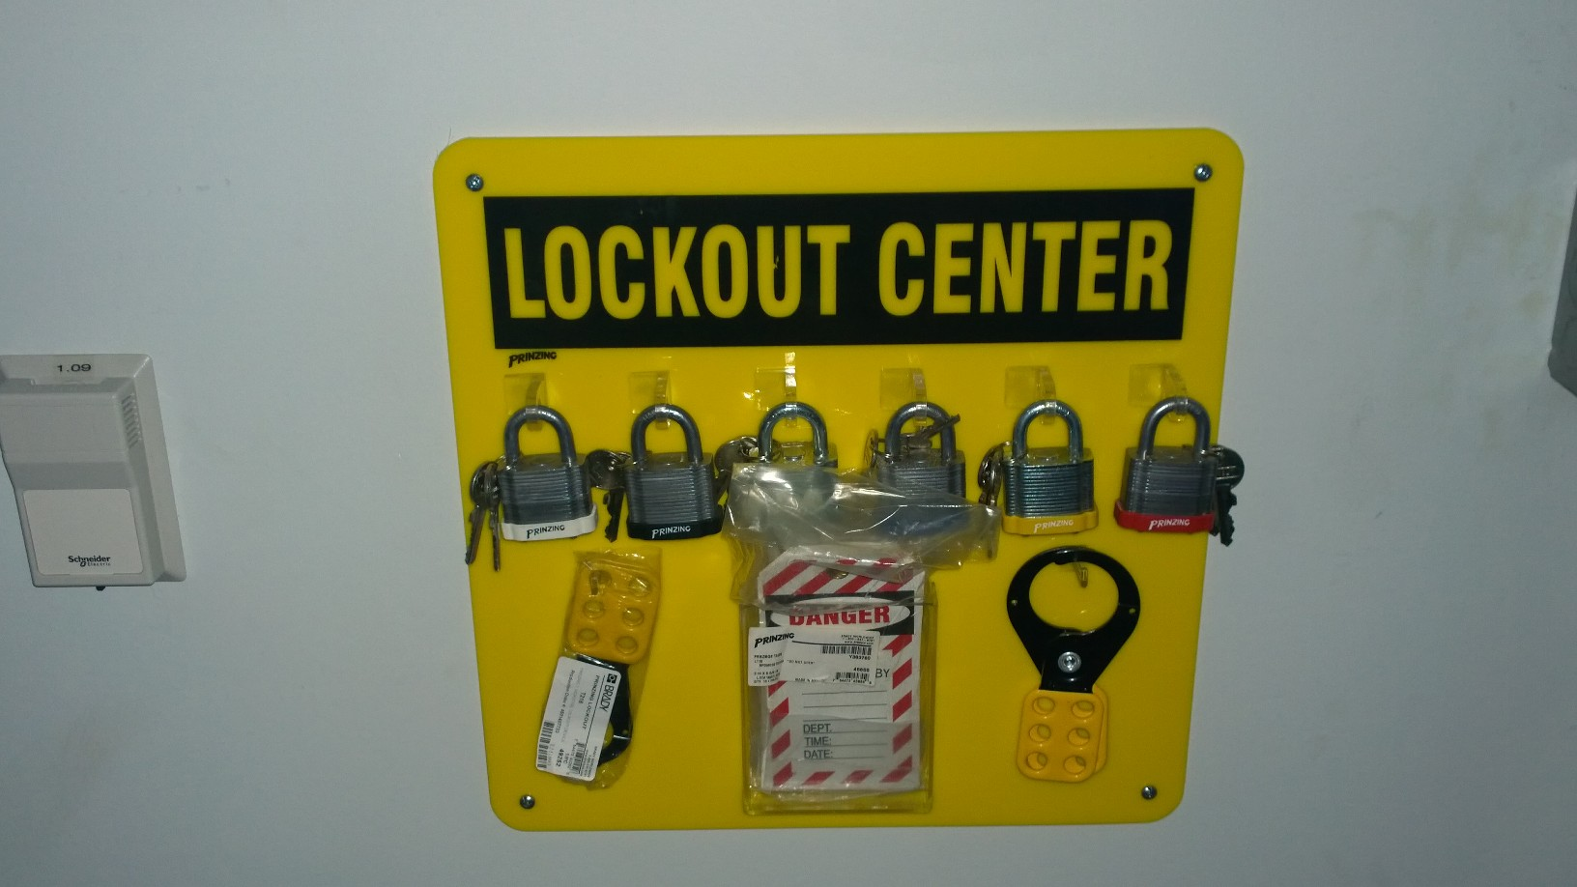
What’s Wrong with this Picture?
10/34
Notes:
Keys attached to locks
2 keys for each lock

Slide 11
LOTO Exceptions
Hazardous energy does not exist
Cord-controlled devices
Limited hot tap operations
Routine/normal production processes
  Printing press
  Minor tool changes and adjustments
11/34
Notes:
Define limited hot tap operations-
”when continuity of service or process operation is essential, and complete shutdown of the system is impractical.”

Slide 12
Typical LOTO Procedures
Perform shutdown
  Locate all energy sources
    Steam
    Hydraulic
    Pneumatic
    Electrical
    Spring-loaded
    Weight-loaded
12/34

Slide 13
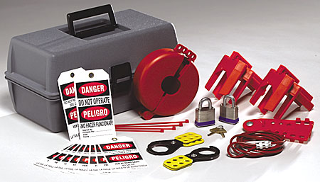
Typical LOTO Procedures (Cont’d.)
Isolate equipment
  Apply LOTO devices
  Safely release stored energy
  Verify equipment is isolated
Perform maintenance/work
Re-energize to check work
Remove LOTO devices
13/34
Notes:
Question: Can you effectively isolate all energy sources from the equipment being worked on?
Answer: Isolate? No. Control? Yes.

Slide 14
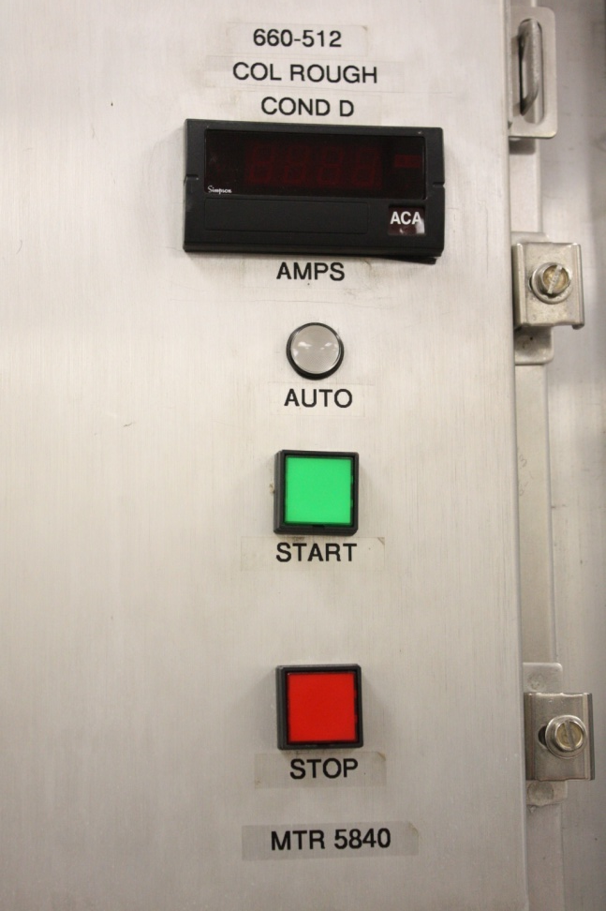
Energy Control Program and Procedures
Energy control procedures
Training program
Periodic inspections
Maintenance responsibilities
14/34

Slide 15
Training Program
Must provide the following:
  Initial training
    Purpose and function
    Knowledge and skills required for safe application, usage and removal of energy controls
  Retraining
    Authorized and affected employees when:
      Change in job assignment or equipment
      New hazards develop
      Change in energy control procedures
  Supplemental training when required
15/34
Notes:
Question: What should the training program consist of?
Answer: Each authorized employee shall receive training in the recognition of applicable hazardous energy sources, the type and magnitude of the energy available in the workplace, and the methods and means necessary for energy isolation and control.

Slide 16

Maintenance Responsibilities
LOTO procedures completed prior to service or repair
Remove or cut locks
off isolation devices
Proper training provided
for all authorized employees
16/34
Notes:
Question: What responsibilities do maintenance technicians have concerning lockout/tagout?
Answers:
Complete proper LOTO procedures.
Remove locks from isolation devices.
Lockout/tagout equipment prior to beginning work.

Slide 17
Lock Removal
Only by the employee who applied the device
If not possible the EMPLOYER may direct its removal IF:
  Verified that employee who applied the device is not at the facility
  All reasonable efforts have been made to contact the employee and inform him or her that his or her locks are to be removed
  Ensure that the employee has this knowledge before resuming work
17/34

Slide 18

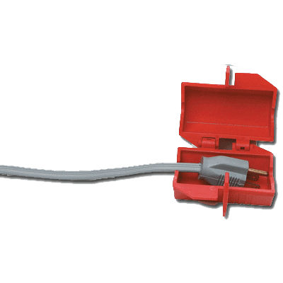
Affected Employee
Employee who:
Operates/uses machine or equipment on which servicing/maintenance is being performed under LOTO
Is working in affected area
18/34

Slide 19
Affected Employee Responsibilities
Notify maintenance when equipment needs repair or adjustment.
Leave all LOTO devices in place.
Verify equipment is safe to operate following LOTO.
Follow all safety rules while operating the equipment.
19/34

Slide 20
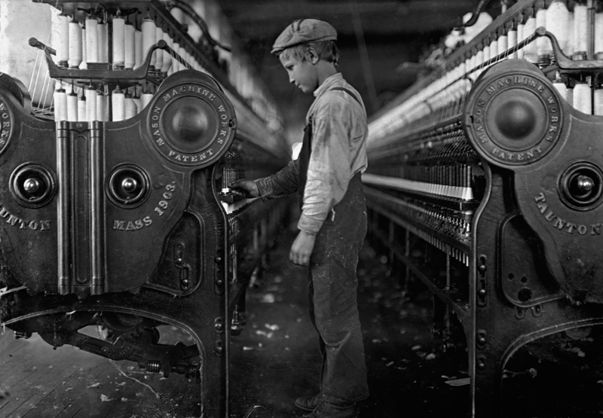
Authorized Employee
Employee who:
Locks out or tags out machines or equipment to perform servicing or maintenance
20/34

Slide 21

Authorized Employee Responsibilities
Maintains equipment
Services equipment
Trained to use LOTO
Recognizes hazardous energy sources
Knows type and magnitude of the energy available in the workplace
Knows methods and means necessary for energy isolation and control
21/34

Slide 22
Authorized Employee Responsibilities (Cont’d.)
Repairs or services equipment as needed
Ensures that all energy sources are locked out
Tests equipment to verify residual energy is dissipated
Places “Danger – Do Not Operate” tag on equipment
22/34

Slide 23

Authorized Employee Responsibilities (Cont’d.)
Obtains assistance
when necessary
Removes locks and/or tags following LOTO
Coordinates
multi-shift repair
23/34

Slide 24
Training Requirements
LOTO training
  Affected employees – at least initially
  Authorized employees – initially and at least annually
  Affected and authorized – whenever changes are made to jobs procedures and when program deficiencies are noted
24/34

Slide 25
How to Perform LOTO
Follow company safety procedures.
Refer to procedures on how to lockout specific equipment.
Keep everyone informed when equipment is being repaired or serviced.
Stay alert.
Use common sense.
25/34

Slide 26
LOTO Devices
Lockout devices are used when equipment is lockable.
Tagout devices are used when equipment is not lockable.
Tagout devices include a legend.
26/34
Notes:
Note: Legend is included in student text.
Question: Why is performing LOTO so important to your workplace and you?
Answer: If LOTO is not performed, you are compromising the integrity of the system and putting your life in danger.

Slide 27
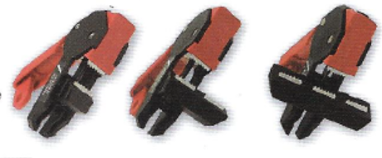
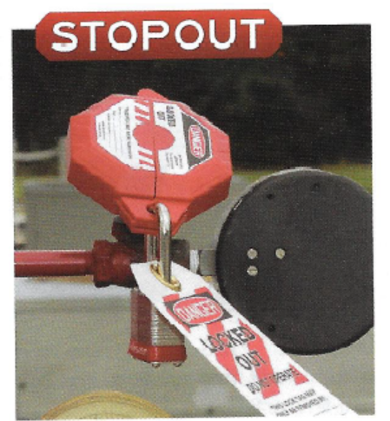
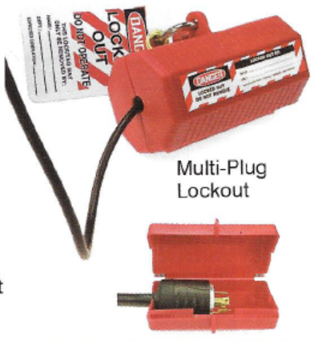
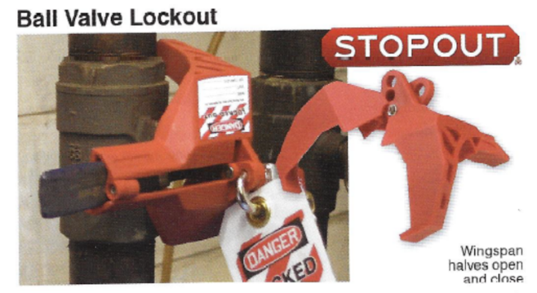
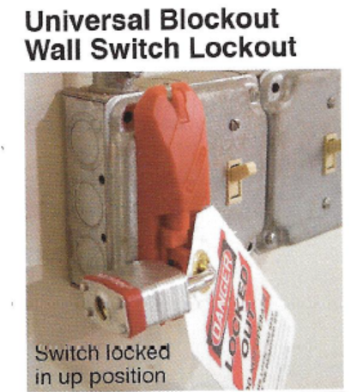
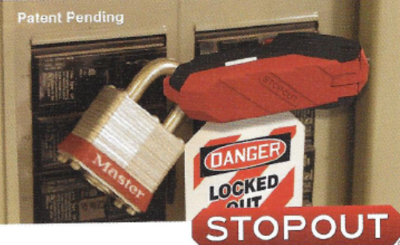

LOTO Devices
27/34

Slide 28
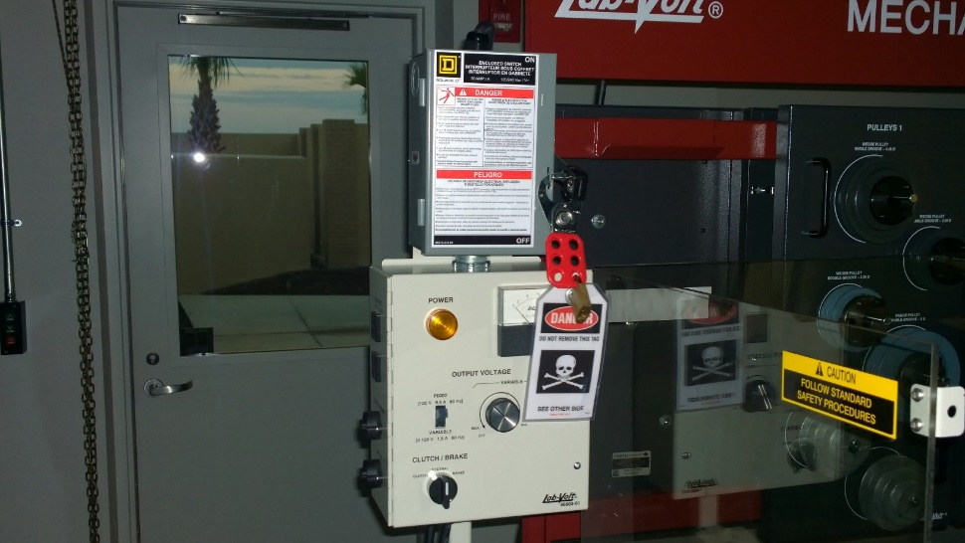
LOTO Device in Work
28/34

Slide 29


Sample LOTO Card
13.3
FIELD CHECKLIST - Cropper
Department:
Work Area:
Equipment/Machine:
Process:
Research Laboratory West
Clean Room
MOCVD Research
Reactor
ENERGY
Type
Stored or
Magnitude
Initial Shutdown
Direct
On/Off switch at Ion Gauge
A
Electrical
Direct
12,000 VDC
Controller Panel
B
Electrical
Direct
208 VAC
Quick Disconnect power connector
at Cryo-Pump
C
Vacuum
Stored
10
-8
D
Chemical
Direct
House
On/Off switch at Helium compressor
(Helium)
Supply
in basement support area
E
Thermal
Direct
Heat
Flexible electric heating tape
Step
Isolation
Energy
LOTO Device
Comments
Verification
Device
Type &
Device
Location
1
On/Off switch
Disconnect
Attach exhaust
Devices in
Operate
at Ion Gauge
pump power
hose to the
"Off"
Start Button
Controller
connector
pressure relief
Position
on Panel
Panel
valve
Page 1
of 3
Initial
29/34

Slide 30
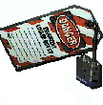





Sample LOTO Card (Cont’d.)
Step
Isolation
Energy
LOTO Device
Comments
Verification
Device
Type &
Device
Location
2
Hydraulic
Direct -
None:
Pumps
Operate
Valves
CRV1-5 on
Insure
Isolated by
Valves
CRV1,CRV2,
USL System
Automatic
Electrical
CRV1 thru 6
CRV3,CRV4,
and CRV6
Bleed Down of
Disconnect
CRV5, CRV6
on Cutter
Line Pressure
Blade
Assembly
3
Pneumatic
Direct -
Lock, Tag,
Apply
Operate
Gate Valve
Air Line to
Gate Valve cover
LOTO
Start Button
CAS1
Cropper and
Devices in
on Panel
USL on Wall
"Off"
Load End of
Position
Cropper
and Bleed
Line
4
Pneumatic
Direct -
Lock, Tag, 1/4
Apply
Operate
CAS2
Air Line to
Turn Valve
LOTO
Start Button
Graphite
Cover
Devices in
on Panel
Supply
"Off"
Pump on
Position &
Side of Tub
Bleed Line
Loader
Page 2
of 3
Initial
30/34

Slide 31




Sample LOTO Card (Cont’d.)
Step
Isolation
Energy
LOTO Device
Comments
Verification
Device
Type &
Device
Location
5.
Cooling
Direct -
2 Locks, 2
Apply
Bleed Line
Water - Gate
Water Line
Tags, 2 Gate
LOTO
Valves
to Cropper
Valve Covers
Devices in
CHWR1 and
"Off"
CHWR2
Position &
Bleed Line
6.
None
Stored -
None
Release of
Remove
USL System
Hydraulic
Bars From
Pressure
USL
Could Allow
Pins
Holding
Bars to
Release
I certify that I have followed all procedures in the Energy Control Program and have
investigated the potential of any other hazardous energy or hazardous movement that
may occur during this operation.
Authorized Employee
31/34

Slide 32
Compliance Exception
No potential for stored energy
A single energy source
Completely de-energizing
Isolated from energy source
Single lockout device achieves required safety
Device under exclusive control of authorized employee performing servicing or does not create hazards for other employees
No accident history
32/34

Slide 33
Periodic Inspections of Control Procedures
Required annually
Serve to correct findings
Performed by authorized employee
Certify inspection
Certification information
Review employee lockout and tagout responsibilities
33/34

Slide 34
Summary
It is important that a company lives up to its regulatory responsibility.
Improper use of LOTO is a cause of industrial fatalities and must be taken seriously.
Program requirements include
  Annual review of program
  Training program
  Appropriate disciplinary action for violators
34/34

