Slide 1

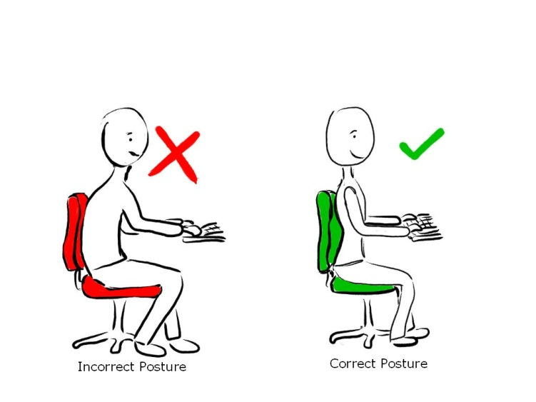
Domain 1: Safety Awareness
Foundations of
Manufacturing
Section 11: Ergonomics
Notes:
Read Lesson Link aloud to students:
Ergonomics is commonly thought of as how companies design tasks and work areas to maximize the efficiency and quality of the employee’s work. However, ergonomics applies to everything that involves people; work systems, sports and leisure, health and safety should all embody ergonomic principles. By definition, ergonomics is the applied science of equipment design intended to maximize productivity by reducing operator fatigue and discomfort. An effective ergonomics program reduces medical costs by eliminating injuries and disabilities caused by processes that result in musculoskeletal disorders (MSDs).

Slide 2
Learning Objectives
Determine how ergonomics will improve the workplace.
Identify the types, signs, and symptoms of MSDs.
Discuss the mismatch between the physical requirements of the job and the human body, and loss of workdays as a result of MSD-related injuries.
Notes:
Direct students to turn to page 1-11-1 in their Foundations of Manufacturing, Domain 1: Safety Awareness, Section 11: Ergonomics, Student Workbook and continue with the discussion.
Background for the Trainer
Appendix A of OSHA’s Ergonomics Standard contains some basic information about MSDs. This appendix could be posted in the workplace or handed out for employees to read in order to help reinforce this training session.
Appendix B of OSHA’s Ergonomics Standard contains a summary of the Ergonomics Program Standard that could be posted in the workplace or handed out for employees to read in order to help reinforce this training session.
Speaker’s Notes
We will start by discussing musculoskeletal disorders (MSDs), their signs or symptoms, or risk factors and MSD hazards.
Then we will talk about the basics of OSHA’s Ergonomics Standard, how it effects your jobs and our company, and what the company will do if employees report MSDs.
Finally, we will wrap up this training session with a quiz.

Slide 3

Ergonomics Improves the Workplace
Ergonomics is the science of how humans work in their environments.
“The science of fitting jobs to the people who do them”
Safe ergonomic conditions can help reduce the muscular skeleton disorders (MSDs) from repetitive motions.
Notes:
Speaker’s Notes
Ergonomics is the science of fitting jobs to the people who do them. Work-related MSDs result when there is a mismatch between the physical capacity of the workers and the physical demands of their jobs.
The goal of ergonomics is to reduce work-related musculoskeletal disorders (MSDs) that are caused when the worker’s job requires repetitive reaching, bending, lifting, using force, working with vibrating equipment, and doing other repetitive motions.
OSHA estimates that each year 1.8 million workers in the United States report work-related MSDs such as carpal tunnel syndrome, tendinitis, and back injuries. About 600,000 MSDs are serious enough to result in workers having to take time off work to recover. Ergonomics, implemented effectively, will reduce these numbers.

Slide 4
Ergonomics Can Reduce Stress in the Workplace
Select proper lighting
Set work surfaces at ideal height for employees
Keep noise at acceptable levels per frequency range and number of hours exposed

Slide 5
Assessing Ergonomics
Work demands excessive?
Machine guards in the way?
Speed too fast for quality?
Employees dissatisfied?
Employees ignoring procedures?
Employees should report obvious ergonomic problems to immediate supervisor or to company safety team member.

Slide 6
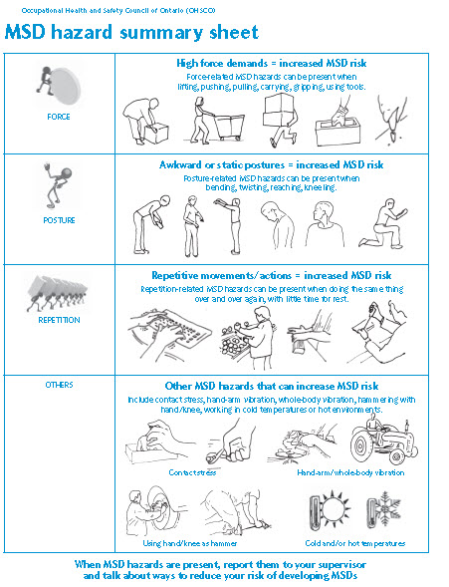
Mismatch Between Job and Human Body
Proper technique can help avoid 60,000 MSD injuries per year and 210,000 heavy lifting injuries.

Slide 7
Resolving Mismatch
Perform Job Hazard Analysis (JHA):
    Postures
    Lifting methods
    Hand positions
    Tool handling
    Environmental conditions
Institute Control Methods (CM):
    Engineering controls (EC)
    Work practice controls
    Administrative controls

Slide 8
Reducing MSDs
Workstation layout can reduce MSDs:
  Locate tools for easy access
  Provide space for legs and feet to move
  Match height of work space to employee
  Use full spectrum lighting
  Adjust chairs to employee
Organize work for limiting MSDs:
  Allow recovery time
  Keep shifts regular
  Allow workers time for home life
  Limit overtime

Slide 9
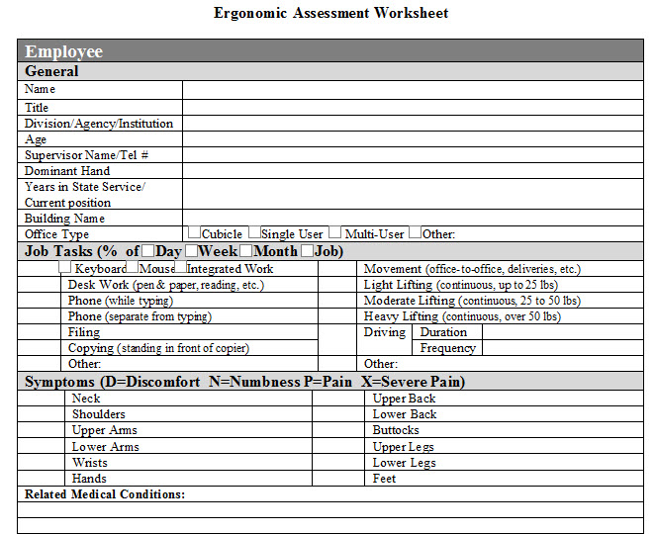
Ergonomic Improvement Ideas

Slide 10
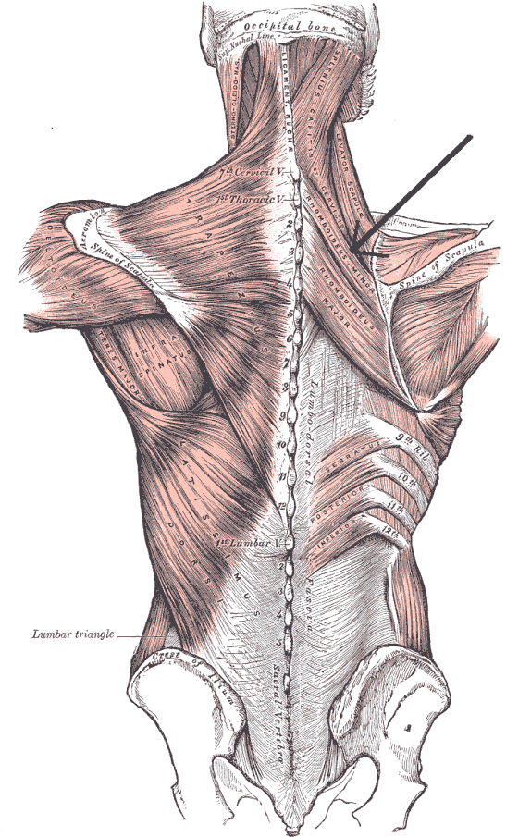
Musculoskeletal Disorders (MSDs)
Injuries resulting from repeated strains not afforded sufficient recovery and healing time
Over half a million reported cases in the US in 2001
Overexertion to the back accounts for nearly 67% of all cases
Financial costs of MSDs run into the billions of dollars
Notes:
Speaker’s Notes
MSDs are injuries and illnesses of the soft tissue and nervous system that effect your body’s:
Muscles
Nerves
Tendons
Ligaments
Joints
Spinal discs
Can any of you think of some specific examples of MSDs?
Invite students to share how they feel. Ask how their joints and muscles feel. Are they comfortable sitting in those chairs? Is the table a comfortable height?

Slide 11
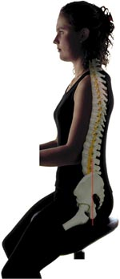
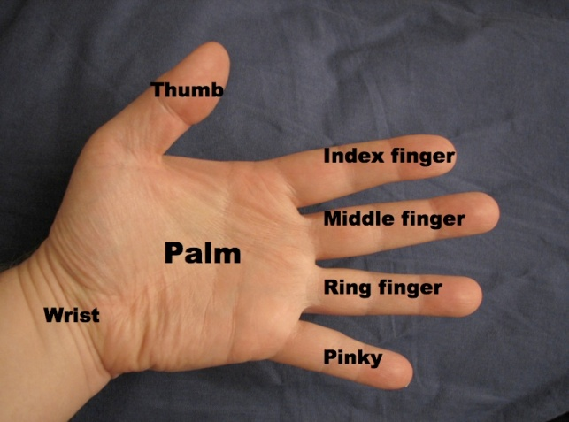
Types of MSDs
Carpal tunnel syndrome
Tendonitis
Trigger finger
Raynaud’s syndrome
De Quervain’s disease
Rotator cuff tendonitis
Carpet layers’ knee (Bursitis)
Herniated spinal disc
Low back pain
Notes:
Speaker’s Notes
Here is a list of some common MSDs that you may have heard of. However, this list is not all inclusive. I’ll give a brief explanation of some of these, but it is more important to remember the signs and symptoms that we will discuss later.
Carpal tunnel syndrome is the compression of the median nerve where it passes through the wrist and into the hand. The median nerve extends down the arm and into the hand and provides the sense of touch in the thumb and most of the fingers.
Tendinitis is tendon inflammation that occurs when a muscle or tendon is repeatedly tensed from overuse of the wrist or shoulder.
Trigger finger is a tendon disorder that occurs in the flexing tendon of the finger. Attempts to move the finger cause snapping and jerking movements. This is usually associated with using tools that have handles with hard or sharp edges.
Raynaud’s syndrome is when blood vessels of the hand are damaged from repeated exposure to vibration for long periods of time. Skin and muscles in the hands do not get their needed blood or oxygen. Symptoms include numbness, tingling, pale skin, loss of sensation in the hand, and loss of control in the hand.
De Quervain’s disease is the inflammation of the tendon sheath of the thumb attributed to excessive friction between two thumb tendons, usually caused by twisting and forceful gripping motions with the hands.
Rotator cuff tendinitis occurs from working with the hands above the head repeatedly over a long period of time.

Slide 12
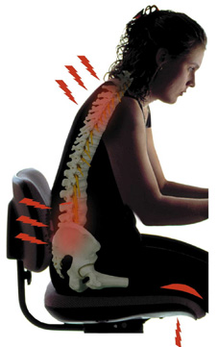
Causes of MSDs
Repetition
Forceful exertion
Awkward posture
Contact stress
Vibrations

Slide 13

Causes of MSDs (Cont’d.)
Repetition
  Same motion performed over and over
  Severity of injury based on:
    how often the movement is repeated
    speed of the movement
    number of muscles
    involved
    required force
Notes:
Question: What are some repetitive motions you perform in your workplace?
Answers will vary.
Background for the Trainer
Try to think of specific examples of repetition that employees at your company may be exposed to and discuss them.
Speaker’s Notes
Repetition on the job is a major contributor to MSDs. Doing the same motion over and over puts stress on muscles and tendons.
Some of the factors that determine whether the repetition is likely to cause an MSD include:
How often the movement is repeated
Speed of the movement
Number of muscles involved
Required force
Some examples include repeating the same motion every few seconds for two hours at a time on an assembly line or using a keyboard or mouse steadily for more than four hours daily.

Slide 14
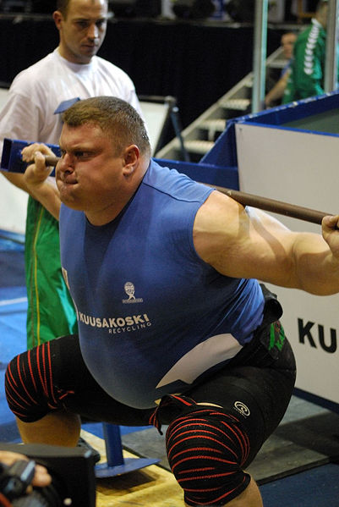
Causes of MSDs (Cont’d.)
Forceful exertion
  Amount of physical effort
  required to perform a task
  Effort needed to control
  equipment/tools involves:
    Type of grip
    Weight of object
    Body posture
    Type and duration of the task
Notes:
Question: What is a forceful exertion?
Answer: The amount of physical effort needed to complete a task.
Background for the Trainer
Try to think of specific examples of forceful exertions that employees at your company may be exposed to and discuss them.
Speaker’s Notes
Jobs that require forceful exertions, defined as the amount of physical effort required to perform a task, may also be susceptible to MSDs.
Some of the factors that determine whether the forceful exertions are likely to cause a MSD include:
Effort needed to control equipment or tools (e.g., jackhammers require effort to control)
Type of grip (do you have a natural or awkward grip when exerting force?)
Weight of object
Body posture
Type and duration of the task
Examples of forceful exertions include lifting more than 75 pounds at any one time or pushing/pulling more than 20 pounds of initial force for more than two hours a day.

Slide 15

Causes of MSDs (Cont’d.)
Awkward Postures
  Reaching
  Twisting
  Bending
  Kneeling
  Squatting
  Working overhead
  Holding fixed positions
Notes:
Question: What types of awkward postures are required for you to perform your job?
Answers will vary, but should include reaching, bending, twisting, working overhead while maintain a fixed neck/shoulder position.
Question: How can awkward postures lead to MSDs?
Answer: Twisting or bending while carrying heavy loads can cause muscle strains or tears.
Background for the Trainer
Try to think of specific examples of awkward postures that employees at your company may be exposed to and discuss them.
Speaker’s Notes
Jobs that require repeated awkward postures may also be susceptible to MSDs.
Some of the awkward postures that are likely to cause an MSD include:
Reaching (e.g., across work benches, table, or conveyor belts)
Twisting your back, arms, or legs repeatedly
Bending over repeatedly to reach or pick up low objects
Kneeling on the ground
Squatting
Working overhead (i.e., arms raised)
Holding fixed positions for long periods of time can also contribute to MSDs.

Slide 16

Causes of MSDs (Cont’d.)
Contact stress
  Pressing the body against
  a hard or sharp edge
  Puts pressure on nerves,
  tendons, and blood vessels
  Allowing wrists to rest on the keyboard while typing
  Holding tools with hard handles
Notes:
Question: What areas in your workplace might expose you to contact stress? Think of anything that might put pressure on nerves, tendons, and blood vessels.
Answers will vary.
Background for the Trainer
Try to think of specific examples of contact stress that employees at your company may be exposed to and discuss them.
Speaker’s Notes
Jobs that require contact stress, defined as pressing your body against a hard or sharp edges, may also be susceptible to MSDs.
Contact stress puts pressure on nerves, tendons, and blood vessels causing damage over long periods of time.
Some examples of contact stress include:
Allowing your wrists to rest on the keyboard when typing
Holding tools with hard handles

Slide 17
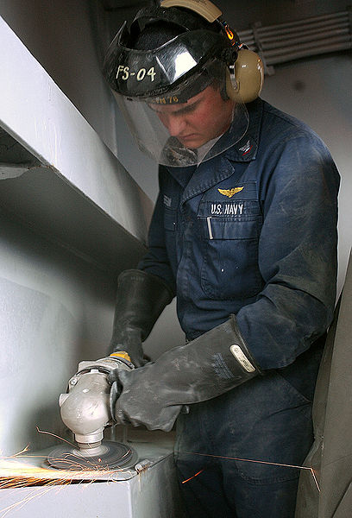
Causes of MSDs (Cont’d.)
Vibration
  Sanders
  Grinders
  Chippers
  Routers
  Drills
  Saws
Notes:
Question: What items cause vibrations in the workplace and contribute to MSDs?
Answer: Machinery, tools, etc.
Background for the Trainer
Try to think of specific examples of vibration that employees at your company may be exposed to and discuss them.
Speaker’s Notes
Jobs that expose workers to vibration for long periods of time may result in MSDs.
Examples of tools that vibrate include:
Sanders
Grinders
Chippers
Routers
Drills
Saws

Slide 18
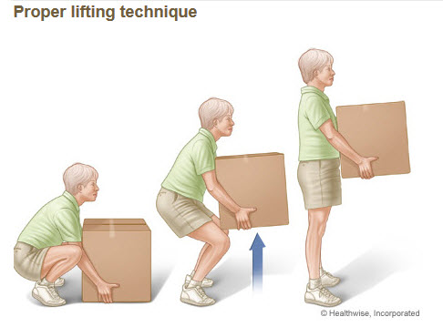
Proper Lifting Technique to Avoid Injuries
Eyes forward and not facing down
Knees slightly wider than shoulder width, feet close to object
Point toes outward at 45 degrees
Bend at knees, going down to grasp object
Look upward while pressing up with thigh muscles; back straight, shoulders back, stomach tight
With object lifted, keep back straight, avoid twisting, move with small steps
Reverse procedure to lower object

Slide 19
Injuries From Improper Lifting
Nursing, EMS, factory, construction, and transportation workers are frequently injured through lifting during work
More than 1 million workers suffer back injuries per year--most of these occur during lifting
Using correct lifting techniques can reduce back injuries and muscle strains significantly
,

Slide 20
Twisting While Lifting Increases Chance of Injury
Twisting increases the compressive load on the spine significantly
Position to avoid twisting; keep the load close to your body
Shift feet in small steps to reorient instead of twisting
Keep back straight throughout lifting and dropping object

Slide 21
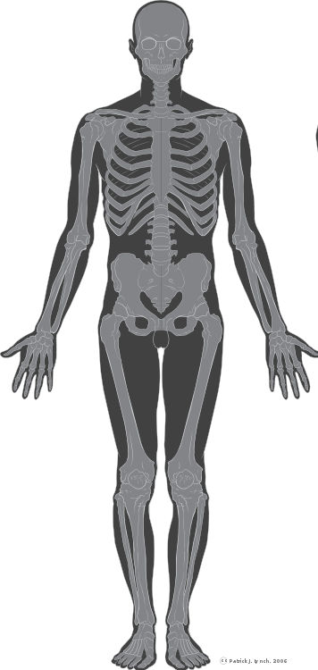
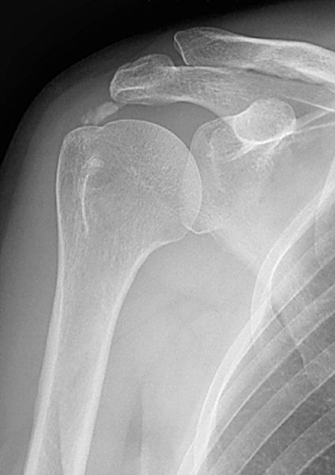
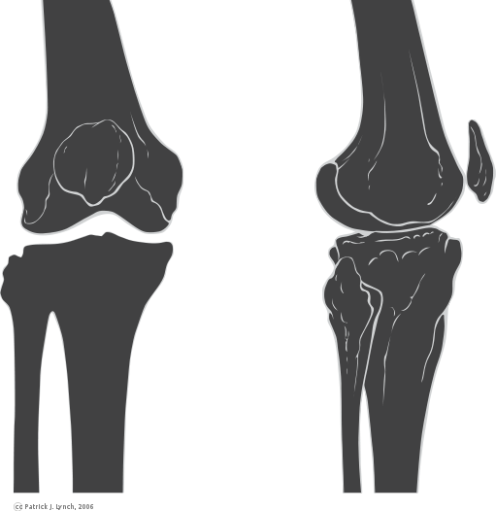
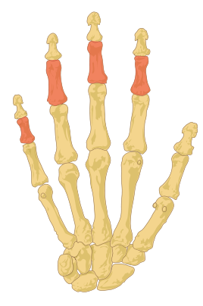
Early Indicators of MSDs
Decreased strength for gripping
Decreased range of motion
Loss of skeletal muscle function
Inability to do everyday tasks
Notes:
Question: What are some early indicators of MSDs?
Answers will vary, but should include decreased strength, diminished range of motion, and weakness.
Speaker’s Notes
Some signs that you may be developing an MSD include:
Less strength for gripping. You may have trouble gripping your car’s steering wheel or holding a pen to write a check.
Less range of motion. You find that you can’t lift your arm as high as you could before.
Loss of muscle function might include having trouble flexing your fingers.
Inability to do everyday tasks such as holding a pencil, gripping a glass of water, etc.

Slide 22
Common Symptoms of MSDs
Painful joints such as wrists, shoulders, forearms, knees
Pain, tingling, numbness in hands or feet
Shooting pain in arms or legs
Swelling, inflammation, burning sensation
Fingers or toes changing color
Back or neck pain/stiffness
Notes:
Question: What are some common symptoms of MSDs?
Answer:
Persistent pain and swelling
Numbness
Tingling sensation in the extremities
Dropping objects/clumsiness
Waking with numb hands or fingers
Speaker’s Notes
Common symptoms of MSDs include the following:
Painful joints such wrists, shoulders, forearms, knees
Pain, tingling, numbness in hands or feet
Shooting pain in arms or legs
Swelling, inflammation, burning sensation
Fingers or toes turning white
Back or neck pain or stiffness
If you find yourself holding the sides of your wrist, rubbing your arm or wrist, cradling your arm, or shaking your hands during work, you may be experiencing symptoms of MSDs.

Slide 23
Report Signs of MSDs
Report MSD hazards
Employer is required to respond promptly to your report
Report signs or symptoms of MSDs to your supervisor or human resources representative
Permanent disability may result if not reported early
Notes:
Background for the Trainer
Change the third bullet in the above slide to reflect exactly to whom employees are to report any signs or symptoms of MSDs.
Speaker’s Notes
Now that you have some information regarding the signs and symptoms of MSDs, it is your responsibility to report them promptly. If these symptoms are not addressed, you may suffer needless permanent disability.
Your employer is required to respond promptly to your report. We discuss this in more detail later in this training.
Report signs or symptoms of MSDs to your supervisor or Human Resources representative.
Even if you do not have signs or symptoms of MSDs, your job may represent an MSD hazard or have hazardous elements. In order to prevent an MSD from occurring, you also need to report MSD hazards so that the company can take steps of prevention. We will discuss some of the MSD hazards in the next few slides.

Slide 24
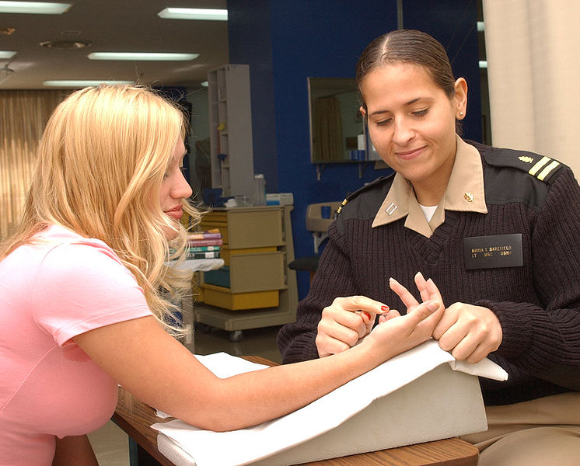
MSD Incident
Work-related and requires
medical treatment beyond
first aid
Work-related and signs or symptoms last seven or more consecutive days after reported
Notes:
Question: Are all MSDs work related?
Answer: No. They can develop outside the workplace.
Speaker’s Notes
The employer must determine if the reported MSD or MSD sign or symptom meets the definition of an MSD incident.
Both the employer and the employee reporting the MSD may request the assistance of a health care provider to make the determination of an MSD incident.
MSD incidents are work-related MSDs that meet one of the following:
Requires medical treatment beyond first aid
Assignment to light duty or temporary time off work for recovery
MSD signs or symptoms that last seven or more consecutive days

Slide 25
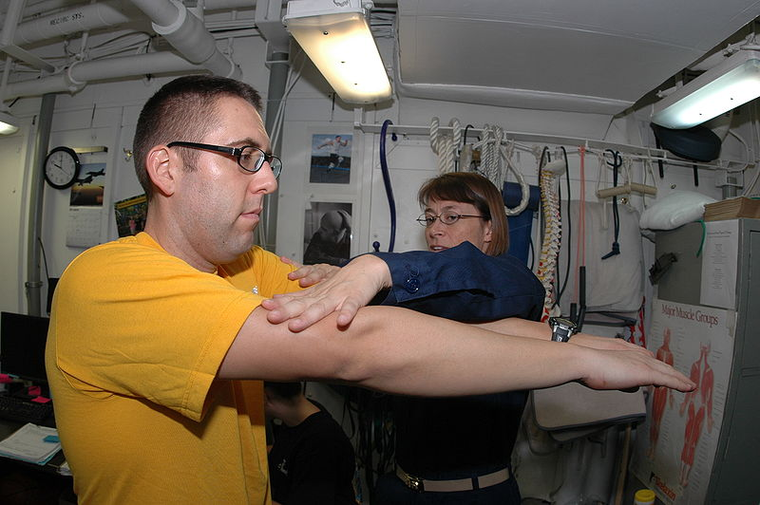
Is the Incident Work-Related?
Requires an approved tracking method, including the following:
  Identifying specific hazards
  Work place conditions
  Exposures
Determining if a specific injury is work-related may include the following:
  Conducting a thorough medical examination
  Taking a careful history of the patient and the illness
  Considering the factors on and off the job that contribute to the MSD
Notes:
Question: How does the employer prove that an MSD is work-related?
Answer:
Conduct a thorough medical exam (patient history).
Check job hazard analysis results.
Examine history related to the workplace.

Slide 26

Employer’s Responsibility
Determines if report is an MSD incident
Provides access to a healthcare provider
Ensures that wages and benefits are protected
Analyzes job for MSD hazards
Takes steps to reduce MSD hazards
Identifies risk factors: action trigger
Notes:
Question: What kind of response do you think you would get from your employer if you reported an MSD incident?
Answers will vary.
Speaker’s Notes
Beyond the requirement for this initial training, the Ergonomics Program Standard does not really kick in until an employee reports having an MSD or having signs or symptoms of an MSD.
Once this is reported to the employer, a number of steps must be taken that we will discuss in detail in the following slides:
Employer determines if report is an MSD incident
Employer provides access to a healthcare provider
Wages and benefits protected while on light duty or off work to recover
Employer analyzes your job for MSD hazards
Employer takes steps to reduce MSD hazards

Slide 27
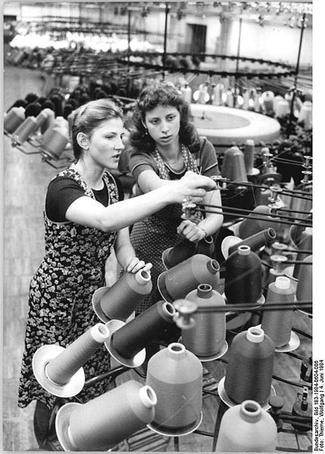
Job Hazard Analysis
OSHA-approved hazard identification tools
Talk with employees
Observe employees’ job performance to identify and evaluate risk factors
Notes:
Question: What is the purpose of a job hazard analysis?
Answer: A job hazard analysis breaks a job into its various elements or actions, describes them, measures and quantifies the ergonomics risk factors inherent in the elements, identifies conditions contributing to the risk factors, and determines corrective measures.
Speaker’s Notes
A job hazard analysis is conducted on the job where an MSD incident occurred.
The job hazard analysis determines whether the MSD hazard exists and what type of hazard it is.
The next step is to implement control measures to reduce the hazards.
Employee involvement in identification and control of the hazards is not only required, it is fundamental for properly identifying and controlling the hazard, because they know the hazards, may have experienced MSD signs/symptoms, and probably have ideas to control the hazards.
Once hazards have been identified and control measures implemented, employees and supervisors in affected jobs must be trained in order to prevent MSDs.

Slide 28
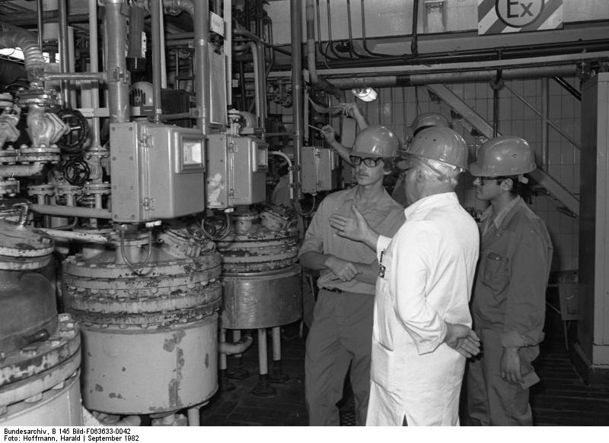
Management Leadership and
Employee Participation
MSD reporting and response system
Designated persons with authority and resources to run the program
Policies do not discourage employee participation or reporting
of MSDs
Employees participate in
development, implementation,
and evaluation of ergonomics
program
Notes:
Question: What should management do to get participation?
Answer: Designate a person(s) with authority to run the program and involve the employees in that process of development and evaluation of the ergonomics program.
Speaker’s Notes
The first step of an ergonomics program is the MSD management system.
Develop an MSD reporting and response system.
Designate persons with the authority, resources, and training to run the ergonomics program.
Ensure company policies do not discourage employee participation or reporting of MSDs.
Make sure employees have the opportunity to participate in the development, implementation, and evaluation of the ergonomics program.

Slide 29
Managing MSDs
Access to a health
care professional (HCP)
Evaluation and
follow-up of
MSD incident
Appropriate work
restriction and protection
Notes:
Speaker’s Notes
The ergonomics program must provide for the management of reported MSDs.
The employees that report MSDs are provided with access to a health care professional at no cost to the employee.
The health care professional will provide evaluation and follow-up of the incident.
The health care professional may also require temporary work restriction or time off of work to recover.

Slide 30

Work Restriction
Protection Program (WRP)
100% wages/benefits while on light duty
90% wages and full benefits if removed from work
90-calendar-day limit
Company-provided HCP determines
work restrictions
Second opinion can be obtained by employee
Notes:
Question: Will someone on light duty receive full benefits and wages?
Answers will vary, but the most common answer is “yes.”
Speaker’s Notes
If the health care provider determines that work restrictions are required for recovery, then those restrictions are protected according to the OSHA Ergonomics Standard.
While on light duty, the employee receives 100% wages/benefits.
If removed from work, the employee receives 90% wages and full benefits.
The work restriction protection (WRP) benefits last until:
The employee can return to the job
It is determined that the employee is too disabled to return to the job
90 calendar days
Whichever comes first
The employee or employer can obtain second opinions from a health care provider on whether the employee needs work restrictions.

Slide 31

Evaluating the Ergonomics Program
Ask employees about the program.
Perform functional review.
Ensure that hazards are identified and addressed.
Correct deficiencies.
Notes:
Question: Why should you evaluate your ergonomics program?
Answer: To ensure that you are getting the most from the program and that it is accomplishing what it was designed to do.
Speaker’s Notes
Although an effective ergonomics program will be continuously evaluated and improved, OSHA requires that it be evaluated at least every three years.
Employer must make sure the program is effective in controlling hazards and preventing MSDs.
The employer must get input from employees.
The program must ensure all hazards are being addressed.
Make necessary changes.

Slide 32

Recordkeeping
Reports of MSDs, signs/symptoms of MSDs, and MSD hazards
Responses to reports
Job hazard analyses
Hazard control measures
Ergonomics program evaluations
Work restrictions and HCP’s written opinions
Employees may have access to these records
Notes:
Question: Why is recordkeeping so important?
Answer: Without the true numbers and/or incidents how can you come up with fair answers and make good decisions about MSDs?
Speaker’s Notes
The ergonomics program also has a number of recordkeeping requirements that employees may have access to.
Reports of MSDs or signs/symptoms of MSDs.
Responses to reports.
Job hazard analyses.
Hazard control measures.
Ergonomics program evaluations.
Records of work restrictions and doctor’s written opinions.

Slide 33


Afterthought . . .

Slide 34
Summary
Understand MSD hazards.
Recognize MSD signs and symptoms.
Report MSDs.
Participate in the ergonomics program.

