Slide 1

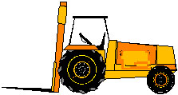
Powered Industrial Trucks
Foundations of
Manufacturing
Domain 1: Safety Awareness
Section 12:

Slide 2
Disclaimer
This presentation is intended as a resource for providing training on OSHA’s revised powered industrial truck operator standards. It is not a substitute for any of the provisions of the Occupational Safety and Health Act of 1970, or for any standards issued by the U.S. Department of Labor’s Occupational Safety and Health Administration (OSHA). It is also not a substitute for a powered industrial truck operator training program.

Slide 3
Acknowledgment
OSHA’s Office of Training and Education wishes to acknowledge the following for contributing some of the graphics used in this presentation:
  Caterpillar Lift Trucks
  Mason Contractors Association of America
  Industrial Truck Association
  State of Utah Labor Commission - Occupational Safety & Health Division
  Steamship Trade Association of Baltimore
  Taylor Machine Works, Inc.
  UAW - Ford National Joint Committee on Health and Safety
Appearance of products does not imply endorsement by the U.S. Department of Labor.

Slide 4
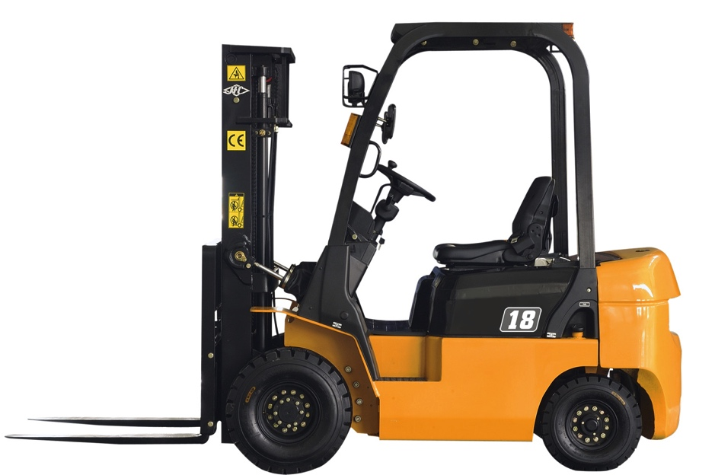
Learning Objectives
What is a Powered Industrial Truck?
Is there a proper way to drive or operate one?
Why is Materials Handling important?
What can I do to stay safe?

Slide 5
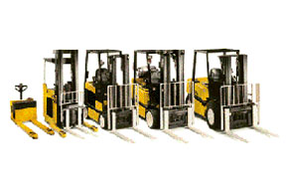
Powered Industrial Truck - Definition
A mobile, power-propelled truck used to carry, push, pull, lift, stack or tier materials. [American Society of Mechanical Engineers (ASME) definition]
Commonly known as forklifts, pallet trucks, rider trucks, forktrucks, or lifttrucks.
Can be powered through electric or combustion engines.
Excluded are vehicles used for earth moving and over-the-road hauling.

Slide 6
Scope of Standard
The scope provisions of 1910.178(a), which are based on ANSI B56.1 - 1969, remain in effect and cover:
  ... fork trucks, tractors, platform lift trucks, motorized hand trucks, and other specialized industrial trucks powered by electric motors or internal combustion engines.
  It does not apply to compressed air or nonflammable compressed gas-operated industrial trucks, farm vehicles, nor vehicles intended primarily for earth moving or over-the-road hauling.

Slide 7
Scope of Standard (cont’d.)
This scope covers general industry, construction and shipyards
For marine terminal and longshoring industries, all powered industrial trucks are covered, no matter what specialized name they are given.
This includes, but is not limited to, straddle carriers, hustlers, toploaders, container reach stackers, and other vehicles that carry, push, pull, lift, or tier loads.

Slide 8
Background
The previous OSHA standards, while requiring operator training, did not define the type of training or authorization required.
March 15, 1988 - Industrial Truck Association (ITA) petitioned OSHA for specific training requirements.

Slide 9
Background (cont’d.)
American National Standards Institute (ANSI), in cooperation with ASME, has revised its standard 4 times, including current lifttruck technology and specific training topics.

Slide 10
Background (cont’d.)
OSHA published a proposed ruling on March 14, 1995 for General Industry, Shipyard, Marine Terminals, and Longshoring regulations, adding specific training requirements.
On January 30, 1996, OSHA proposed a revision of the construction standards, mandating the development of an operator training program based on the prior knowledge and skills of the trainee and requiring a periodic evaluation.

Slide 11
Reasons for New Standard
Powered industrial truck accidents cause approximately 100 fatalities and 36,340 serious injuries in general industry and construction annually.
It is estimated that 20 - 25% of the accidents are, at least in part, caused by inadequate training.

Slide 12
Additional Reasons for New Standard
Updated consensus standards have been published.
OSHA has been petitioned to improve the requirements for industrial truck training.
Advisory Committee on Construction Safety and Health has recommended improving the standard.
Resolutions have been introduced in the Senate and House urging OSHA to revise its outdated standard.

Slide 13
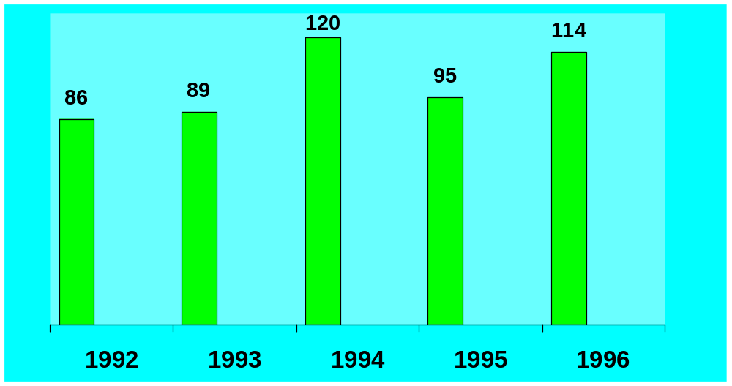
Forklift Fatalities, 1992-1996
Source: Bureau of Labor Statistics, Job Related Fatalities Involving Forklifts
13/59

Slide 14
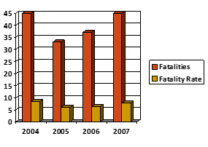
Forklift Fatalities, 2004-2007
Source: Bureau of Labor Statistics, Job Related Fatalities Involving Forklifts
14/59

Slide 15
Forklift Accidents
85 fatalities annually
35,000 serious injuries
860,000 forklifts in use in America
Over 11% will be involved in an accident
15/59

Slide 16
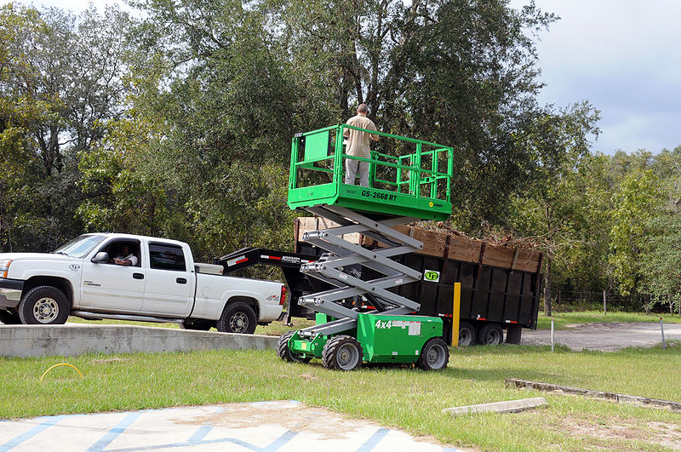
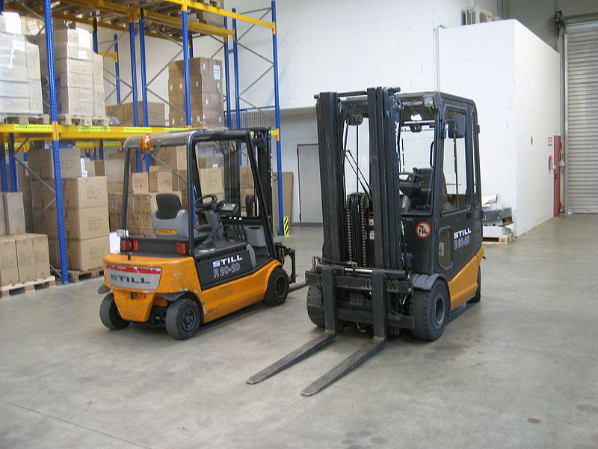
Industries Where Powered Industrial Truck Accidents Occurred
Manufacturing - 42%
Construction – 23.8%
Wholesale Trades – 12.5%
Transportation – 11%
Retail Trade – 9%
Mining – 1.2%
16/59

Slide 17
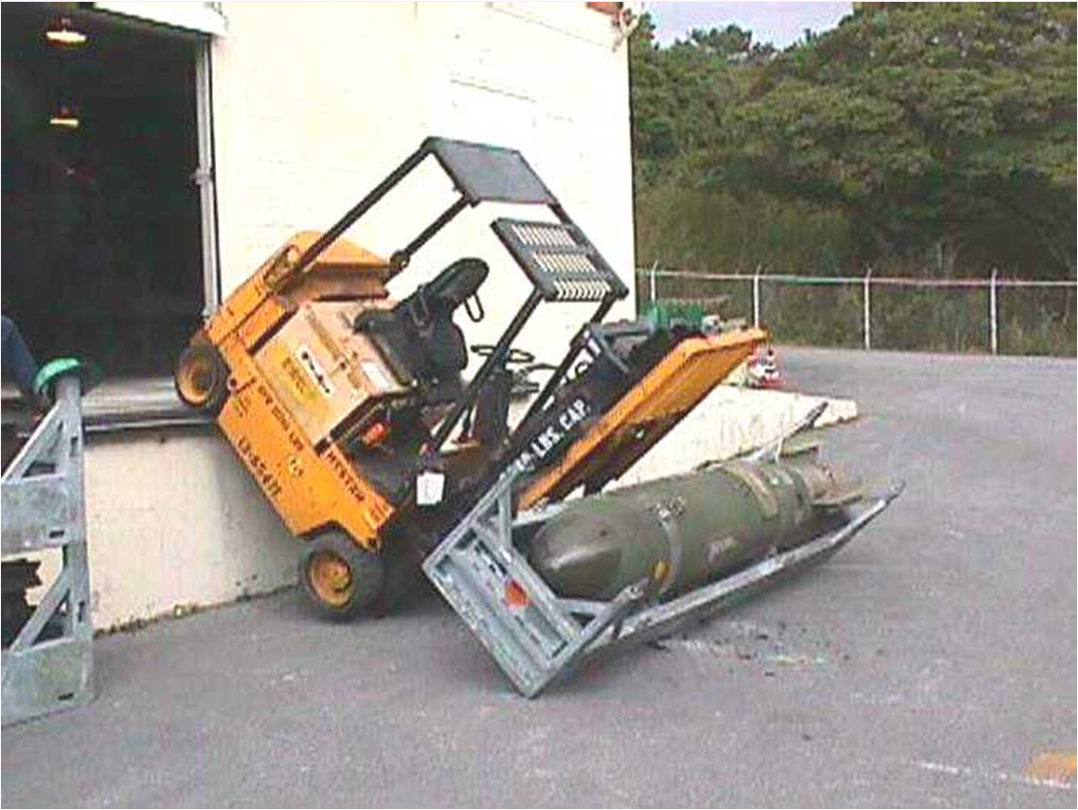
OOPS!!!
17/59

Slide 18
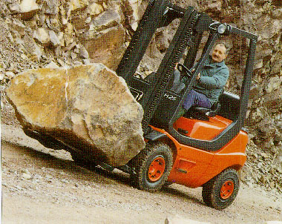
Safety of Powered Industrial Trucks
Differences between cars and forklifts
General Maneuverability
Basic Principles of Use
Stability Triangle
Inspections
Usage
Limitations
NOTE: a forklift should be driven in reverse when the load obscures the forward view.
18/59

Slide 19
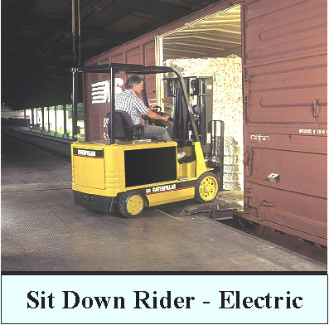
Safety Precautions
Overhead Guard
Vertical Load Backrest
Charging Areas
Servicing Areas
Hoists for Battery Change
Lighting
19/59

Slide 20
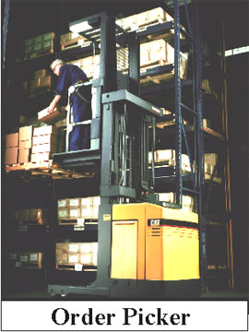
Safety Precautions (Cont’d.)
Brakes
Headroom (Facility)
Auxiliary Cut-Off
Dockboards/ Bridgeplates
Stable Loads
Disabled if broken
20/59

Slide 21
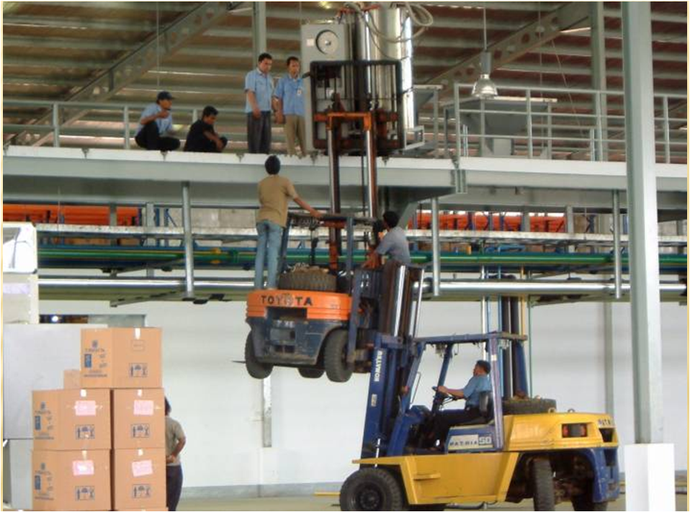
What Wrong with This Picture?
21/59
Notes:
Everything

Slide 22
Effective Powered Industrial Truck Operator Training Program
Four major areas of concern must be addressed:
  The general hazards that apply to the operation of all or most powered industrial trucks;
  The hazards associated with the operation of particular types of trucks;
  The hazards of workplaces generally; and,
  The hazards of the particular workplace where the vehicle operates.
22/59

Slide 23
Operator Training
Safe operations
  The employer shall ensure that each powered industrial truck operator is competent to operate a powered industrial truck safely, as demonstrated by successful completion of the training and evaluation specified in the OSHA standard.
  Prior to permitting an employee to operate a powered industrial truck (except for training purposes), the employer shall ensure that each operator has successfully completed the required training (or previously received appropriate training).
23/59

Slide 24
Training Program Content
Operators shall receive initial training in the following topics, except in topics which the employer can demonstrate are not applicable to safe operation in the employer’s workplace.
  Truck-related topics
  Workplace-related topics
  The requirements of the standard
24/59

Slide 25
Training Program Content (Cont’d.)
Truck-related topics
  Fork and attachment adaptation, operation, use
  Vehicle capacity and stability
  Vehicle inspection and maintenance that the operator will be required to perform
  Refueling/Charging/ Recharging batteries
  Operating limitations
  Other instructions, etc.
  Operating instructions, warnings and precautions
  Differences from automobile
  Controls and instrumentation
  Engine or motor operation
  Steering and maneuvering
  Visibility
25/59

Slide 26
Training Program Content (Cont’d.)
Workplace-related topics
  Surface conditions
  Composition and stability of loads
  Load manipulation, stacking, unstacking
  Pedestrian traffic
  Narrow aisles and restricted areas
  Operating in hazardous (classified) locations
  Operating on ramps and sloped surfaces
  Potentially hazardous environmental conditions
  Operating in closed environments or other areas where poor ventilation or maintenance could cause carbon monoxide or diesel exhaust buildup
26/59

Slide 27
Training Program Content (Cont’d.)
The requirements of the OSHA standard on powered industrial trucks must also be included in the initial operator training program.
The Department of Transportation (DOT) requires daily forklift inspections, not OSHA
27/59

Slide 28
Certification
The employer shall certify that each operator has been trained and evaluated as required by the standard.
Certification shall include:
  Name of operator
  Date of training
  Date of evaluation
  Identity of person(s) performing the training or evaluation
28/59

Slide 29
Appendix A - Stability of Powered Industrial Trucks
Appendix A provides non-mandatory guidance to assist employers in implementing the standard.
This appendix does not add to, alter, or reduce the requirements of this section.
29/59

Slide 30
Appendix A - Stability of Powered Industrial Trucks
Definitions
General
Basic Principles
Stability Triangle
Longitudinal Stability
Lateral Stability
Dynamic Stability
30/59

Slide 31
Stability Triangle - Figure 1
Notes: When the vehicle is loaded, the combined center of gravity (CG) shifts toward line B-C. Theoretically the maximum load will result in the CG at the line B-C. In actual practice, the combined CG should never be at line B-C.
Vehicle Center of
Gravity (Unloaded)
B
A
C
Center of Gravity
of Vehicle and
Maximum Load
(Theoretical)
Notes. The addition of additional counterweight will cause the truck CG to shift toward point A and result in a truck that is less stable laterally
31/59

Slide 32
Stability Triangle - Figure 2
This vehicle is unstable and
will continue to tip over
The vehicle is stable
Load CG
Load CG
Vertical
Stability
Line
(Line of Action)
Combined CG
Combined CG
Vertical
Stability
Line
(Line of Action)
Truck CG
Truck CG
32/59

Slide 33
Types of Powered Industrial Trucks
There are many different types of powered industrial trucks covered by the OSHA standard.
Commonly used types include:
  High lift trucks, counterbalanced trucks, cantilever trucks, rider trucks, forklift trucks, high lift trucks, high lift platform trucks, low lift trucks, motorized hand trucks, pallet trucks, straddle trucks, reach rider trucks, high lift order picker trucks, motorized hand/rider trucks, and counterbalanced front/side loader lift trucks.
A single type of truck can only be described by calling it by all of its characteristics, (e.g., a high lift, counterbalanced, sit down rider truck).
33/59

Slide 34
Unique Characteristics of Powered Industrial Trucks
Each type of powered industrial truck has its own unique characteristics and some inherent hazards.
To be effective, training must address the unique characteristics of the type of vehicle the employee is being trained to operate.
34/59

Slide 35
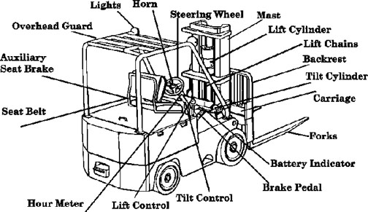
Components of a Forklift Truck*
*One of the most common types of powered industrial trucks
35/59

Slide 36
Classes of Commonly-Used Powered Industrial Trucks*
The Industrial Truck Association has placed powered industrial trucks into 7 classes.
  Class I - Electric motor rider trucks
  Class II - Electric motor narrow aisle trucks
  Class III - Electric motor hand trucks or hand/rider trucks
  Class IV - Internal combustion engine trucks (solid/cushion tires)
  Class V - Internal combustion engine trucks (pneumatic tires)
  Class VI - Electric and internal combustion engine tractors
  Class VII - Rough terrain forklift trucks
* Note that this classification refers to commonly-used vehicles and does not include all powered industrial trucks covered by the OSHA standard.
36/59

Slide 37
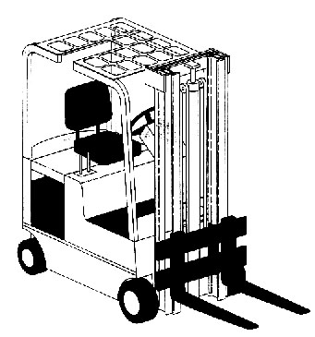
Class I - Electric Motor Rider Trucks
37/59

Slide 38
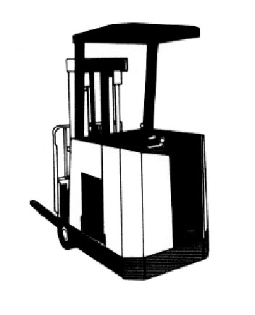
Class I - Electric Motor Rider Trucks
Counterbalanced Rider Type, Stand-Up
38/59

Slide 39
Class II - Electric Motor Narrow Aisle Trucks
High lift straddle
Order picker
Reach type outrigger
Side loaders, turret trucks, swing mast and convertible turret/stock pickers
Low lift pallet and platform (rider)
39/59

Slide 40
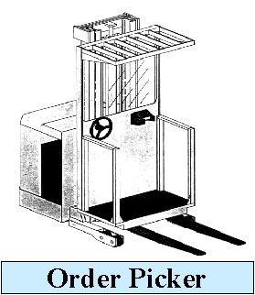
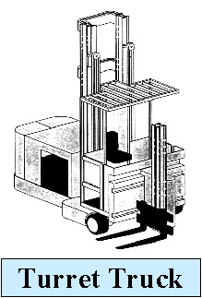
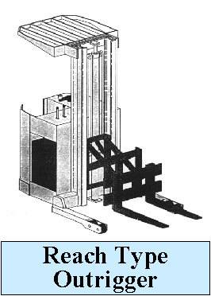
Class II - Electric Motor Narrow Aisle Trucks
40/59

Slide 41
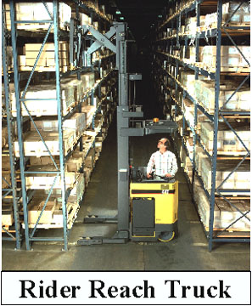
Class II - Narrow Aisle Trucks
41/59

Slide 42
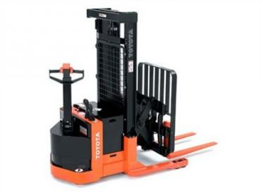
Class III - Electric Motor Hand or Hand/Rider Trucks
Low lift platform
Low lift walkie pallet
Reach type outrigger
High lift straddle
High lift counterbalanced
Low lift walkie/rider pallet
42/59

Slide 43
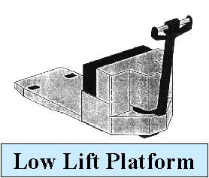
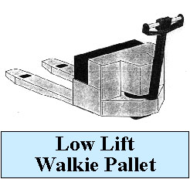
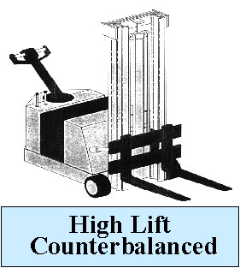
Class III - Electric Motor Hand or Hand/Rider Trucks
43/59

Slide 44
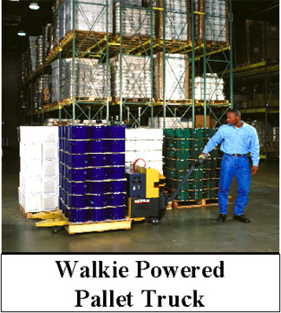
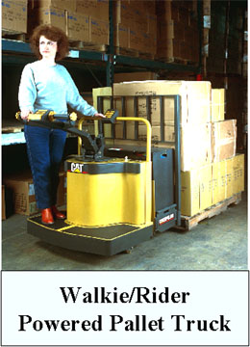
Class III - Hand & Hand/Rider Trucks
44/59

Slide 45
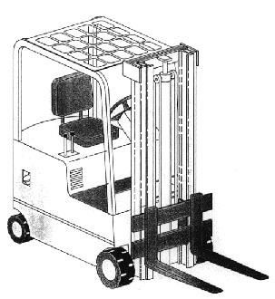
Class IV - Internal Combustion Engine Trucks - Cushion (Solid) Tires
Fork, counterbalanced (cushion/solid tires)
45/59

Slide 46
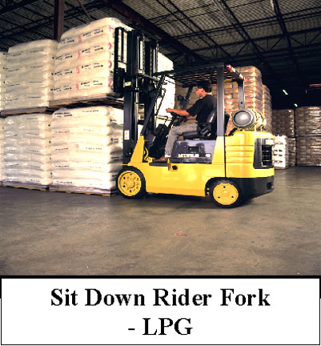
Class IV - Internal Combustion Engine Trucks - Cushion (Solid) Tires
46/59

Slide 47
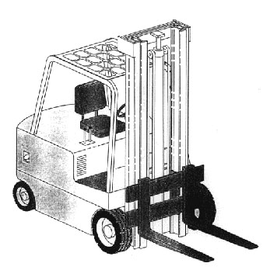
Class V - Internal Combustion Engine Trucks - Pneumatic Tires
Fork, counterbalanced (pneumatic tires)
47/59

Slide 48
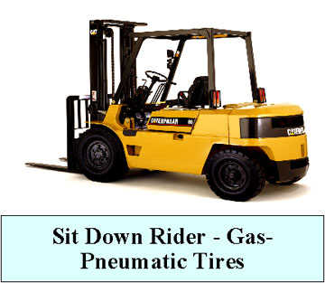
Class V - Internal Combustion Engine Trucks (Pneumatic Tires)
48/59

Slide 49
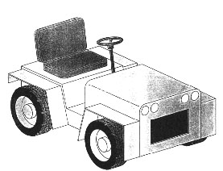
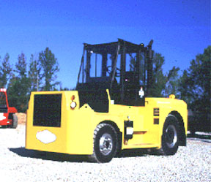
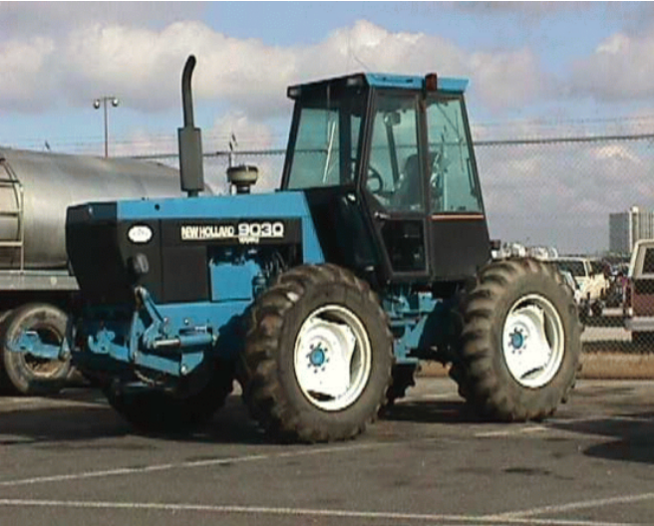
Class VI - Electric & Internal Combustion Engine Tractors
Sit-down rider
49/59

Slide 50
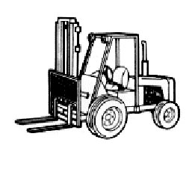
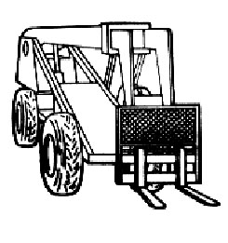
Class VII - Rough Terrain Forklift Trucks
  Straight-mast forklift
  Extended-reach forklift
All rough terrain forklift trucks
50/59

Slide 51
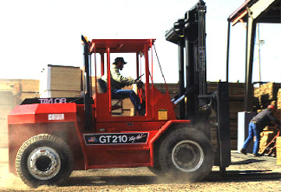
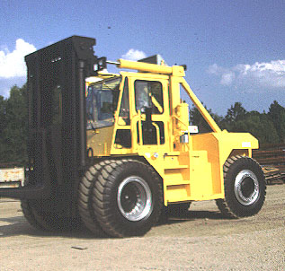
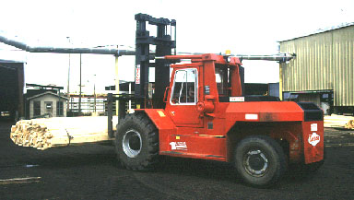
Rough Terrain Straight Mast Forklifts
51/59

Slide 52
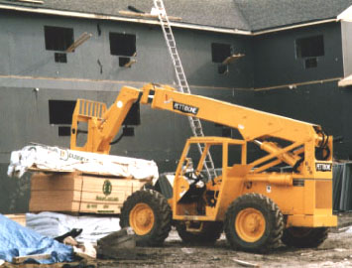
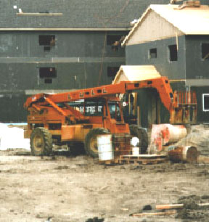
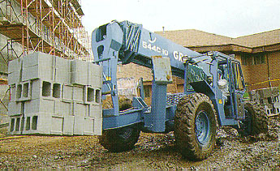
Rough Terrain Extended-Reach Forklifts
52/59

Slide 53
Some Types of Powered Industrial Trucks Used in Maritime
The following types of vehicles are covered by the OSHA standard if the vehicles carry, push, pull, lift, or tier loads.
  Container top handlers
  Container reach stackers
  Straddle carriers
  Semi-tractors/ Utility vehicles
  Sidehandlers
  Combination vacuum lifts
  Yard tractors
53/59

Slide 54
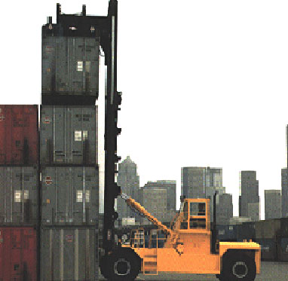
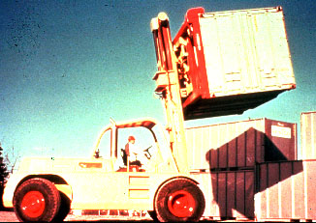
Powered Industrial Trucks Used in Maritime
Container Handlers
54/59

Slide 55
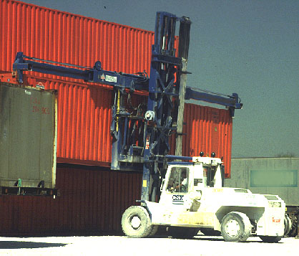
Powered Industrial Trucks Used in Maritime
Empty-Container Handler
55/59

Slide 56
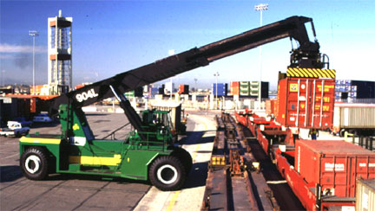
Powered Industrial Trucks Used in Maritime
Container Reach Stacker
56/59

Slide 57
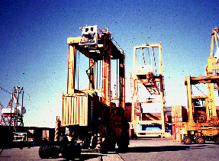
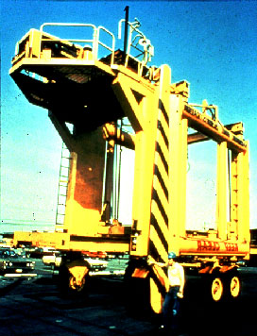
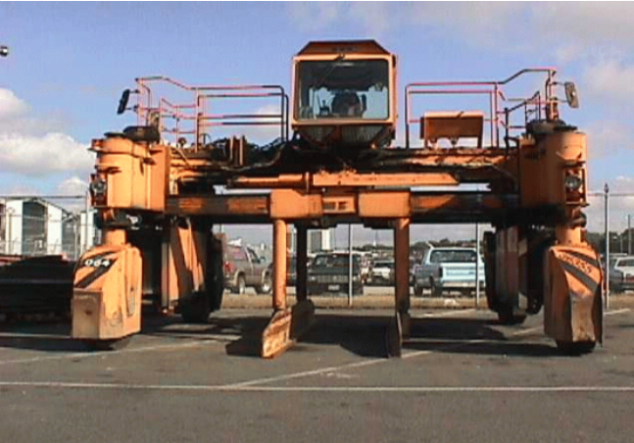
Powered Industrial Trucks Used in Maritime
Straddle Carriers
57/59

Slide 58
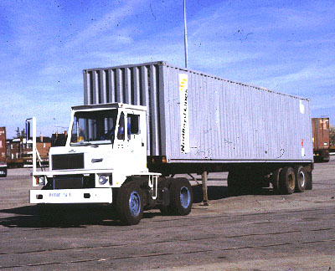
Powered Industrial Trucks Used in Maritime
Yard Tractor
58/59

Slide 59
Summary
Using cranes, forklifts, and slings to move materials
  Watch for potential struck by and crushed by dangers
  For slings, check their load capacity, inspect them, and remove them from service when they display signs of stress or wear
Also
  Keep work areas free from debris and materials
  Store materials safely to avoid struck by/crushed by hazards
59/59

