Slide 1

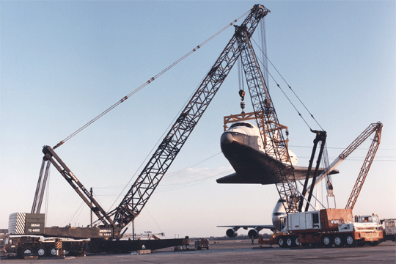
Materials Handling/Rigging
Foundations of
Manufacturing
Domain 1: Safety Awareness
Section 13:

Slide 2
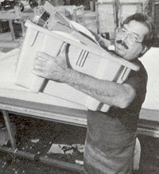
Injuries
Lifting objects is a major cause of back injuries in the work place
Improper storing and handling of material and equipment can cause struck by and crushed by injuries
2/37
Notes:
The weight and bulkiness of objects lifted is a major contributing factor to injuries. Workers also frequently cited body movement as contributing to their injuries. Bending, followed by twisting and turning, were the more commonly cited movements that caused back injuries.
In 2000, 410,000 workplace accidents resulted in back injuries.
Back injuries accounted for more than 20 percent of all occupational illnesses, according to data from the National Safety Council.
By 1994, the U.S. Bureau of Labor Statistics reported there were 613,251 over-exertion cases with lost-workdays. The majority of those cases were due to lifting (367,424), pushing/pulling (93,325), and carrying (68,992). Those cases represent 27 percent of all lost-workday cases.
Struck by accidents accounted for 22% of all injuries in construction in 2000.

Slide 3
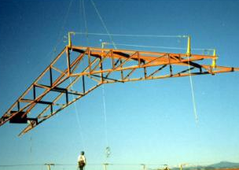
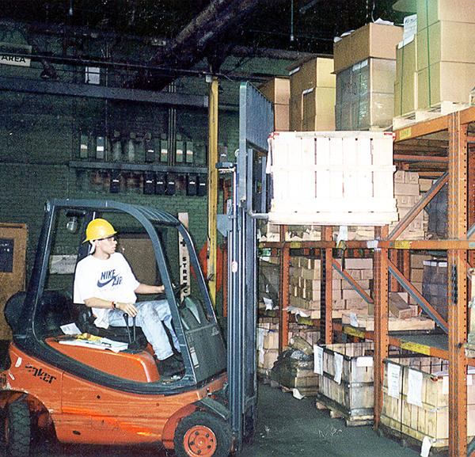
Hazards
Improper manual lifting or carrying loads that are too large or heavy
Being struck by materials or being caught in pinch points
Crushed by machines, falling materials or improperly stored materials
Incorrectly cutting ties or securing devices
3/37
Notes:
Employers and employees can and should examine their workplaces to detect any unsafe or unhealthful conditions, practices, or equipment and take the necessary steps to correct them.
General safety principles can help reduce workplace accidents. These include work practices, ergonomic principles, and training and education. Whether moving materials manually or mechanically, employees should be aware of the potential hazards associated with the task at hand and know how to control their workplaces to minimize the danger.

Slide 4
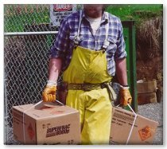
Manual Handling
Seek help:
When a load is too bulky to properly grasp or lift
When you can’t see around or over the load
When you can’t safely handle the load
Attach handles to loads to reduce the chances of getting fingers smashed.
4/37
Notes:
Manual materials handling is the principal source of compensable injuries in the American work force, and four out of five of these injuries will affect the lower back.

Slide 5
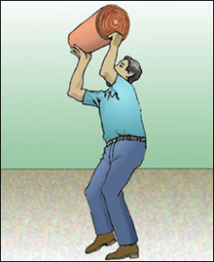
Safe Lifting
Break load into parts
Get help with heavy or bulky items
Lift with legs, keep back straight, do not twist
Use handling aids - such as steps, trestles, shoulder pads, handles, and wheels
Avoid lifting above shoulder level
5/37
Notes:
Material handling tasks should be designed to minimize the weight, range of motion, and frequency of the activity.
Work methods and stations should be designed to minimize the distance between the person and the object being handled.
Repetitive or sustained twisting, stretching, or leaning to one side are undesirable. Corrections could include repositioning bins and moving employees closer to parts and conveyors.
Store heavy objects at waist level.
Provide lift-assist devices, and lift tables.
When placing blocks under a load:
- Ensure the load is not released until hands are removed from under the load.
- Blocking materials should be large and strong enough to support the load safely.
Reference – OSHA Technical Manual - Back Disorders and Injuries
www.osha.gov/dts/osta/otm/otm_vii/otm_vii_1.html

Slide 6

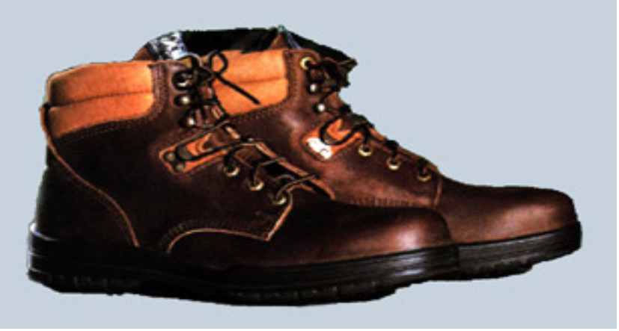
Personal Protective Equipment
For loads with sharp or rough
edges, wear gloves or other
hand and forearm protection.
When loads are heavy or bulky,
wear steel-toed safety shoes to
prevent foot injuries if the load
is dropped.
6/37

Slide 7
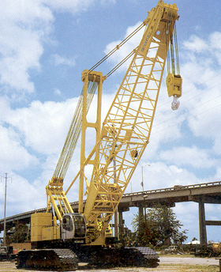
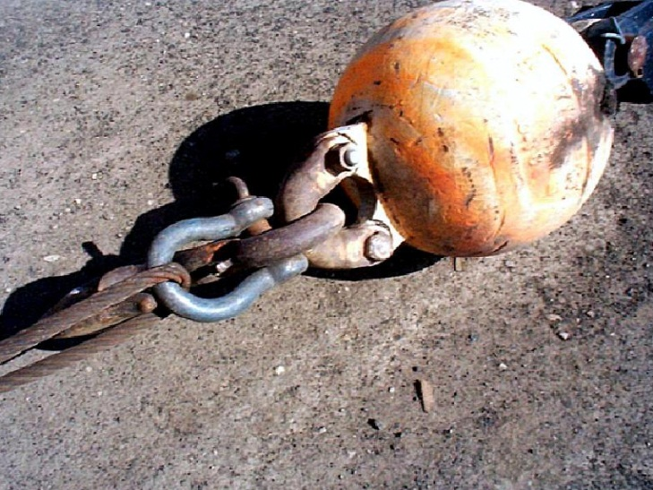
Materials Handling Equipment
Employees must be
trained in the proper use and limitations of the equipment they operate.
This includes knowing how to effectively use
equipment such as
forklifts, cranes,
and slings.
7/37

Slide 8

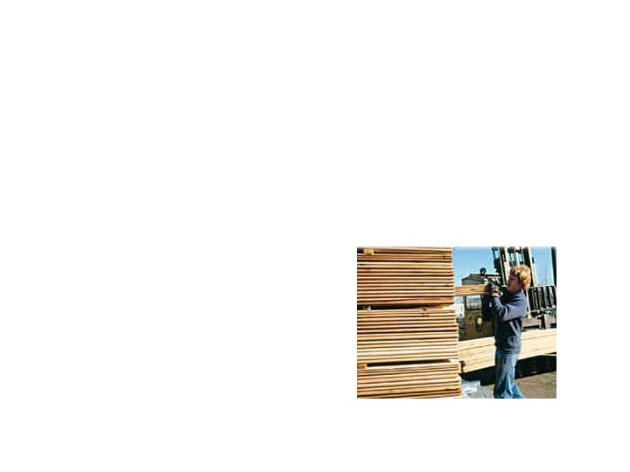
Lumber
Remove nails before stacking
Stack on sills
Stack lumber so that it is stable and self supporting
8/37
Notes:
1926.250(b)(8)
Lumber piles shall not exceed 20 feet in height provided that lumber to be handled manually shall not be stacked more than 16 feet high.

Slide 9
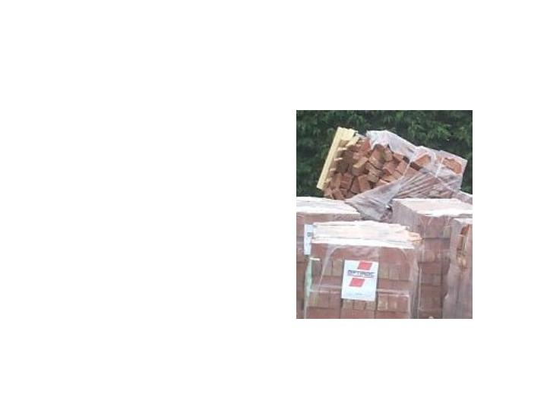
Brick Storage
Stack bricks in a manner that will keep them from falling
Do not stack them more than 7 feet high
Taper back a loose brick stack after it is 4 feet high
9/37
Notes:
1926.250(b)(6)
When a loose brick stack reaches a height of 4 feet, taper it back 2 inches in every foot of height above the 4-foot level.

Slide 10

Drums and Barrels
Stacked symmetrically
Blocked if on sides
Stacking Caution-product availability
10/37

Slide 11
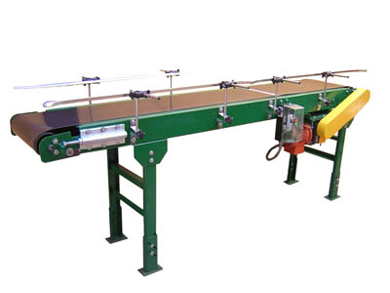
Conveyors
Protect Hands
No loose clothing
E-Stops
Not a ride!
Signs and Guards
Interlocks
11/37

Slide 12
Cranes
Check the load chart in the cab
Frequently inspect
Never lift people
Check overhead power lines
Ensure area of travel is clear
12/37
Notes:
Cranes are an important piece of equipment on a construction site.
The OSHA 10-hour program recommends a separate presentation on cranes. A separate lesson plan and presentation is provided on OSHA’s web site.

Slide 13
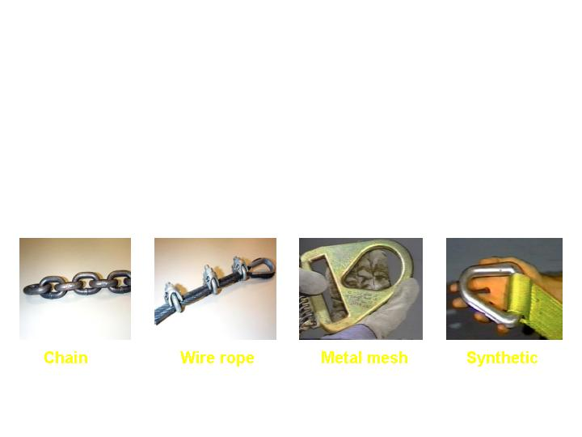
Rigging Equipment Slings
Types of slings covered are those made from alloy steel chain, wire rope, metal mesh, natural or synthetic fiber rope, and synthetic web.
Chain
Wire rope
Metal mesh
Synthetic
13/37
Notes:
1926.251(a)(5)
Reference - Technical links page for sling safety www.osha.gov/doc/outreachtraining/htmlfiles/slings.html
This section applies to slings used in conjunction with other material handling equipment for the movement of material by hoisting, in employments covered by this part.
The types of slings covered are those made from alloy steel chain, wire rope, metal mesh, natural or synthetic fiber rope (conventional three strand construction), and synthetic web (nylon, polyester, and polypropylene).
Three types of slings are discussed in detail in this presentation: alloy steel chain, wire rope and synthetic web.

Slide 14
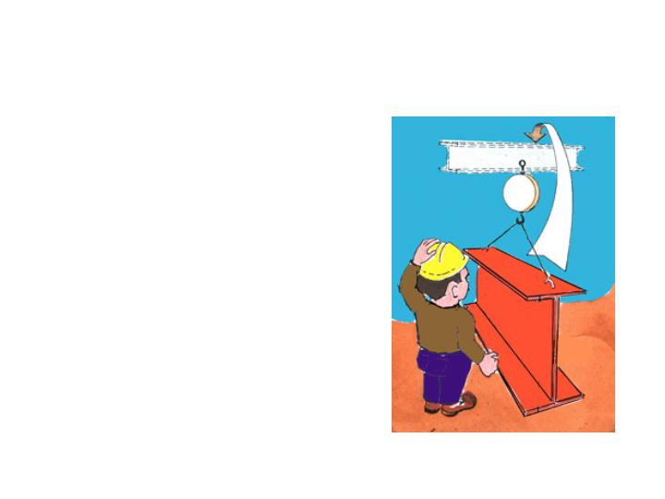
Sling Inspection
Inspect slings:
Each day before use
Where service conditions warrant
Remove them from service if
damaged or defective
14/37
Notes:
1926.251(a)(6)
Each day before being used, the sling and all fastenings and attachments shall be inspected for damage or defects by a competent person designated by the employer. Additional inspections shall be performed during sling use, where service conditions warrant. Damaged or defective slings shall be immediately removed from service.

Slide 15
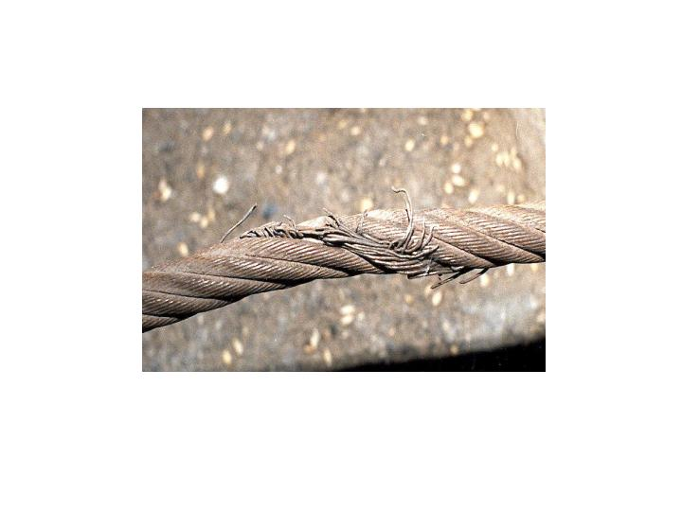
  Remove From Service
Immediately remove damaged or
defective slings from service
15/37

Slide 16
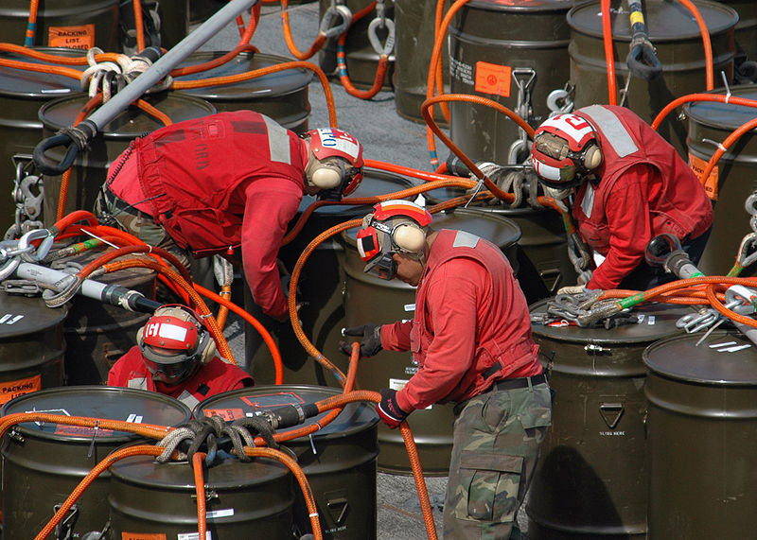
Importance of Operator
Inspection of Slings
Selection of Proper
Sling/Hardware
Safety-Minded
Proper Operation- No Jerks!
16/37

Slide 17
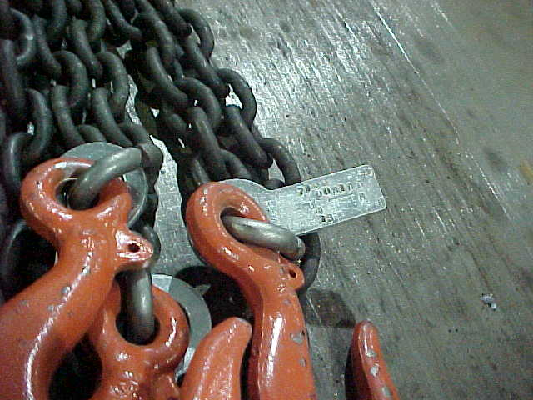
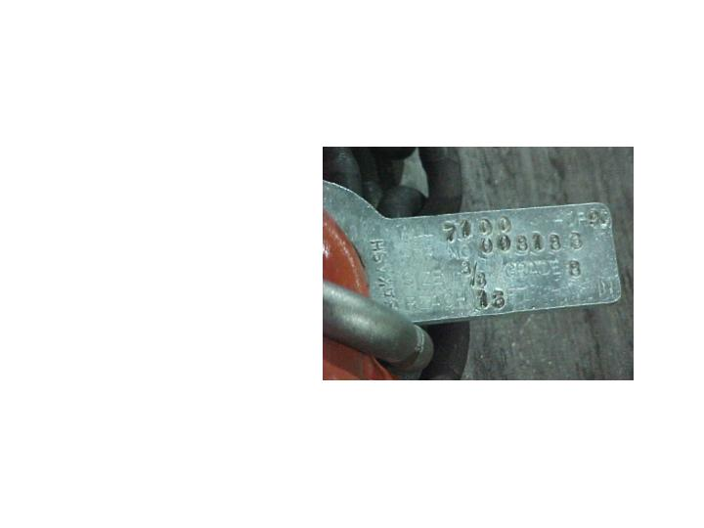
Alloy Steel Chains
Adapts to shape of the load
Can damage by sudden shocks
Best choice for hoisting very hot materials
Must have an affixed tag stating size, grade, rated capacity, and sling manufacturer
17/37
Notes:
1926.251(b)(1)
Welded alloy steel chain slings shall have permanently affixed durable identification stating size, grade, rated capacity, and sling manufacturer.

Slide 18
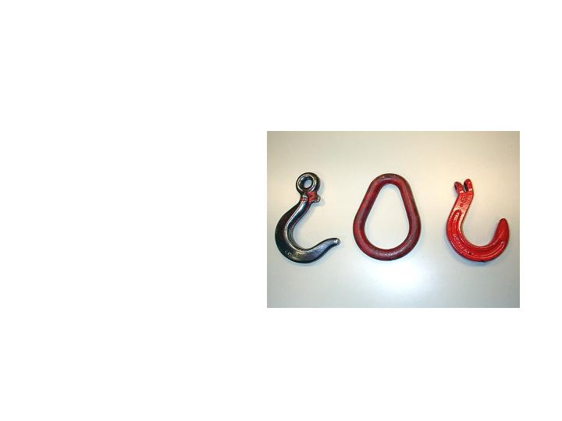
Alloy Steel Chain Attachments
Rated Capacity
Hooks, rings, oblong links, or other attachments, when used with alloy steel chains, must have a rated capacity at least equal to that of the chain
18/37
Notes:
1926.251(a)(2)

Slide 19
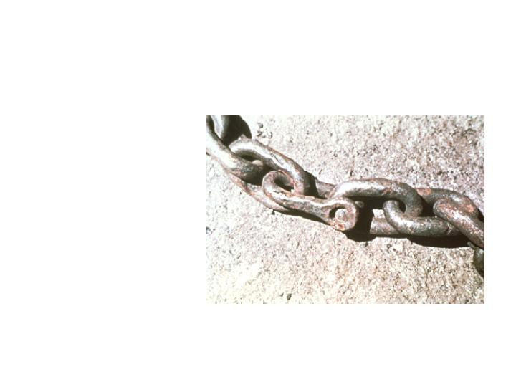
Chain Wear
  When a chain shows excessive wear, or is cracked or pitted, remove it from service.
  Non-alloy repair links
  can not be used.
19/37
Notes:
1926.251(b)(5)

Slide 20
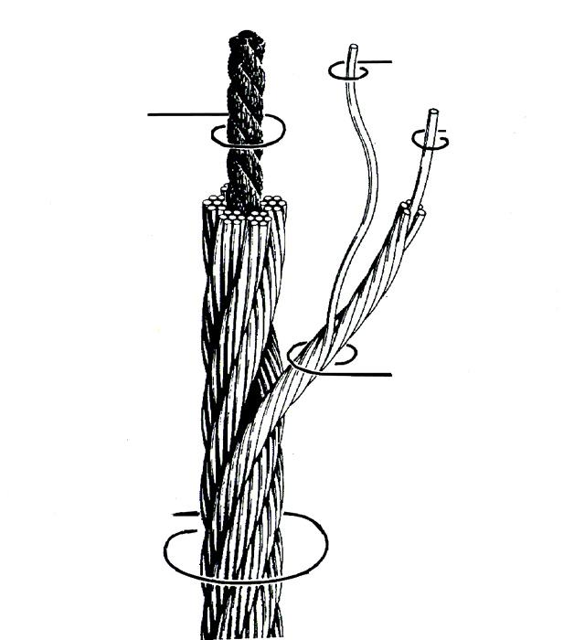
Wire Rope Slings
Used to hoist materials
Selection considerations:
strength
ability to bend without cracking
ability to withstand abrasive wear
ability to withstand abuse
Wire
Core
Center
Strand
Wire rope
20/37
Notes:
Strength — Function of size, grade, and construction. It must be sufficient to accommodate the maximum load that will be applied. The maximum load limit is determined by means of a multiplier. This multiplier is the number by which the ultimate strength of a wire rope is divided to determine the working load limit. Thus a wire rope sling with a strength of 10,000 pounds and a total working load of 2,000 pounds has a design factor (multiplier) of 5. New wire rope slings have a design factor of 5. As a sling suffers from the rigors of continued service, the design factor and the sling's ultimate strength are proportionately reduced.
Fatigue — A wire rope must have the ability to withstand repeated bending without the failure of the wires from fatigue. Failure is the result of the development of small cracks under repeated applications of bending loads. It occurs when ropes make small radius bends. The best way to prevent this is to use blocking or padding to increase the radius of the bend.
Abrasive Wear — The ability to withstand abrasion is determined by the size, number of wires, and construction of the rope. Smaller wires bend more readily and therefore offer greater flexibility but are less able to withstand abrasive wear. Conversely, larger wires of less flexible ropes are better able to withstand abrasion.
Abuse — Abuse will cause a wire rope sling to become unsafe long before any other factor. Abusing a wire rope sling can cause serious structural damage to the wire rope, such as kinking or bird caging which reduces the strength of the wire rope. (In bird caging, the wire rope strands are forcibly untwisted and become spread outward.) Therefore, in order to prolong the life of the sling and protect the lives of employees, the manufacturer's suggestion for safe and proper use of wire rope slings must be strictly adhered to.

Slide 21
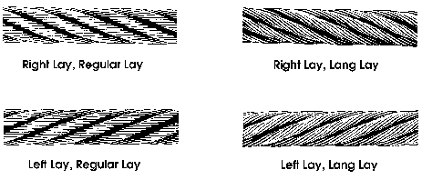
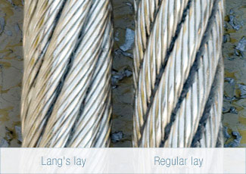
Wire Rope Lay
21/37
Notes:
Lay is a term used to define the pattern of the twist within a wire or rope. A Regular lay is determined by the wrap direction of each coil running opposite to the wrap direction of the entire rope or bundle. A Lang’s Lay is determined when the wrap of each coil is the same as the wrap direction of the overall rope or bundle. PHOTO above shows a Right Lang’s Lay on the left and a Right Regular Lay on the right. Which Lay to select is based on the use of the rope- Regular is most common and works best in stand-alone lift operations, while the Lang’s Lay is best used when ropes or cables will come in contact with each other on rolls or in sliding lifts or moves.

Slide 22

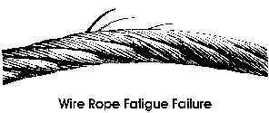
Wire Rope Selection
Strength
Fatigue
Abrasive Wear
Abuse
Volty
22/37

Slide 23
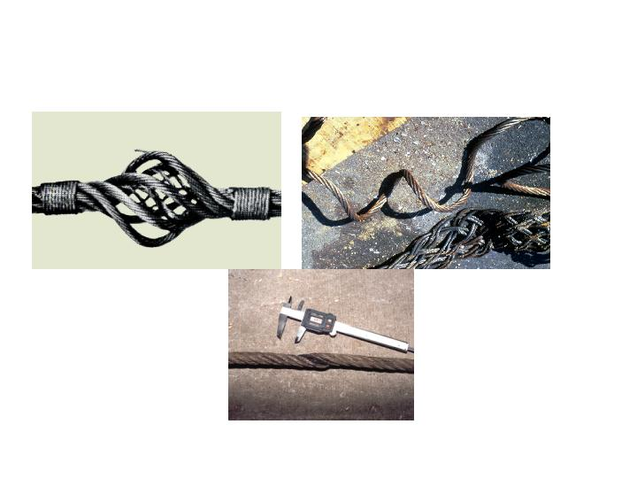
Wire Rope Slings
Remove From Service
If these happen, remove the wire rope sling from service
Bird Caging
Kinking
Crushing
23/37
Notes:
Wire Rope Sling Inspection. Visually inspect before each use. Check the twists or lay of the sling. If ten randomly distributed wires in one lay are broken, or five wires in one strand of a rope lay are damaged, do not use the sling. End fittings and other components should also be inspected for any damage that could make the sling unsafe.
Bird cage -- Wire rope strands are untwisted and become spread outward. Caused by sudden release of tension and the rebound of the rope from the overloaded condition. These strands and wires will not return to their original positions.

Slide 24
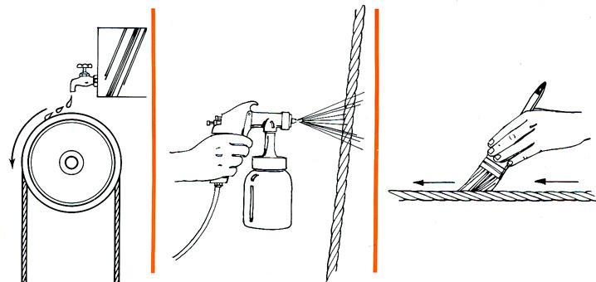
Lubrication
Regularly lubricate ropes and chains
24/37
Notes:
Although every wire rope sling is lubricated during manufacture, to lengthen its useful service life it must also be lubricated "in the field."
There is no set rule on how much or how often this should be done. It depends on the conditions under which the sling is used. The heavier the loads, the greater the number of bends, or the more adverse the conditions under which the sling operates, the more frequently lubrication will be required.

Slide 25
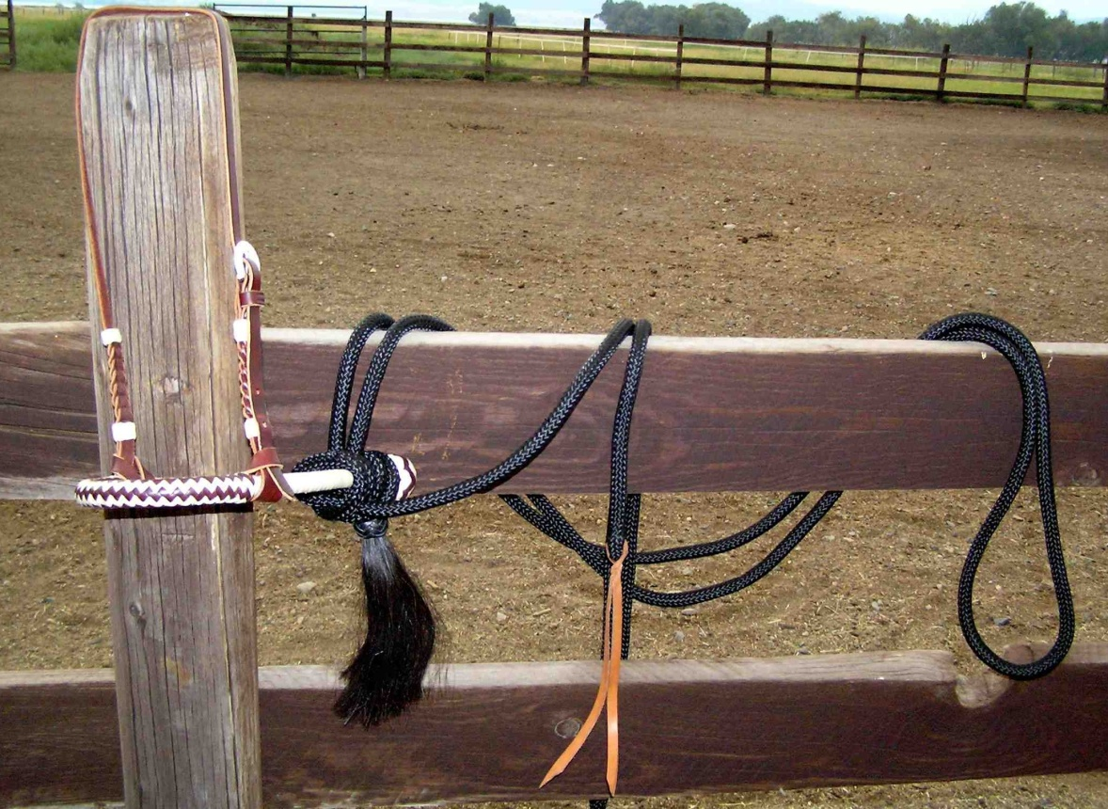
Fiber Rope
Pliant, non-marking
Sensitive to stress, heat
Inexpensive
Less strength than wire
Impacted by chemicals
Easy to detect-shiny fibers
Climbing ropes, slings
25/37

Slide 26
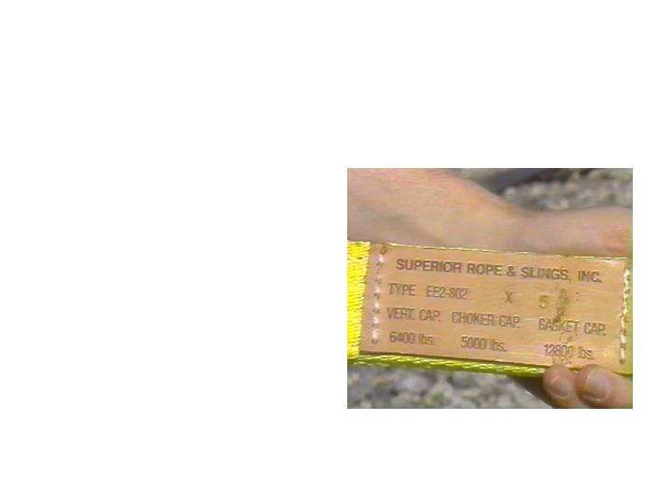
Synthetic Web Sling
Markings
Mark or code to show:
  Name or trademark of manufacturer
  Rated capacities for the type of hitch
  Type of material
26/37
Notes:
1926.251(e)
Synthetic webbing (nylon, polyester, and polypropylene).
Synthetic webbing shall be of uniform thickness and width and selvage edges shall not be split from the webbing's width.

Slide 27

Synthetic Web Slings
Fittings
Fittings must be:
  At least as strong as that of the sling
  Free of sharp edges that could damage the webbing
27/37
Notes:
1926.251(e)(4)

Slide 28
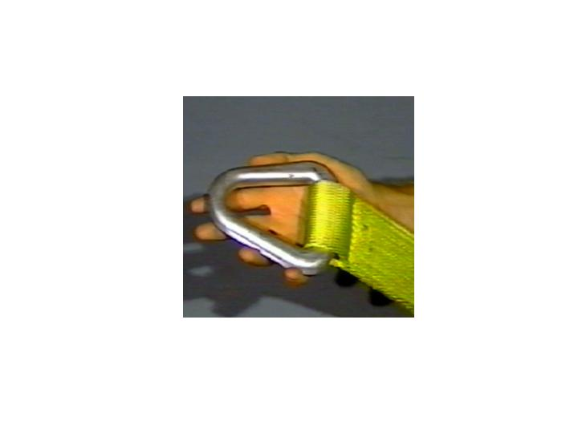
Synthetic Web Sling
Stitching
Stitching
Stitching is the only method allowed to attach end fittings to webbing, or to form eyes
28/37
Notes:
Reference 1926.251(e)(5)
The thread shall be in an even pattern and contain a sufficient number of stitches to develop the full breaking strength of the sling.
When using synthetic web slings, take the following precautions:
- Nylon web slings shall not be used where fumes, vapors, sprays, mists or liquids of acids or phenolics are present.
- Polyester and polypropylene web slings shall not be used where fumes, vapors, sprays, mists or liquids of caustics are present.
- Web slings with aluminum fittings shall not be used where fumes, vapors, sprays, mists or liquids of caustics are present.
Do not use synthetic web slings of polyester and nylon at temperatures in excess of 180 deg. F (82 deg. C). Polypropylene web slings shall not be used at temperatures in excess of 200 deg. F (93.33 deg. C).

Slide 29
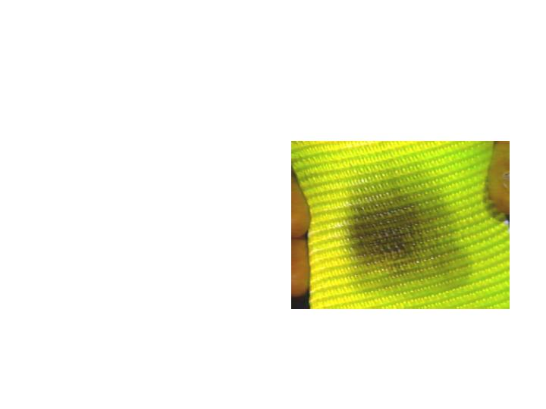
Synthetic Web Slings -
Remove from Service
Remove from service if any of these are present:
  Acid or caustic burns
  Melting or charring of any part
  Snags, punctures, tears or cuts
  Broken or worn stitches
  Distortion of fittings
Heat Damage
29/37
Notes:
1926.251(d)(8)

Slide 30
Synthetic Web Slings -
Remove from Service
Remove from service if any of these are present:
  Look for damage- fittings, bindings, threads
  Check label for load rating and age
  Look for abrasions from dragging
  Inspect load for sharp edges
30/37

Slide 31
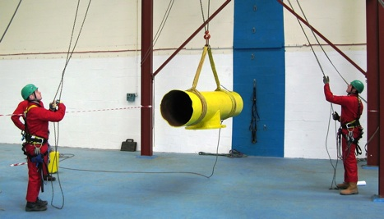
Safe Lifting Practices
Size, Weight and Center of Gravity
Number of Legs and Angles with the Horizontal
Rated Capacity of the Sling
History of Care and Usage of the Sling
31/37

Slide 32



Three Hitches
Vertical
  Least capacity
Choker
Basket
  Most capacity
32/37
Notes:
Straight: A sling is used to link a lifting hook to its load. The entire lifting capacity of the sling may be used, but cannot be surpassed. To keep the load from rotating, a tagline is used. When a spreader bar or more than one leg is used, the entire assembly must be balanced equally among the slings.
Choker
Choker: A hitch whereby the sling wraps around or "chokes" a load. The diameter of the load is critical in determining the capacity of this hitch. Choker hitches have reduced capacity compared to straight or basket-type hitches. The "choke" must be tight and secure prior to the lift.
Basket
Basket: A "cradle" -style hitch where the fittings or eyes are attached to the lifting device such as a crane hook. The effect is to increase capacity from a straight lift and provide greater load bearing and stability to a lift.

Slide 33
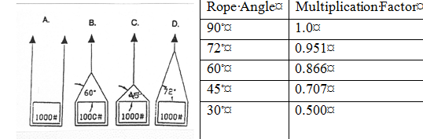
Sling Angles
33/37
Notes:
It is critical therefore, that rated capacities be reduced to account for sling angles. Angles less than 45 degrees are not recommended and those below 30 degrees should be avoided whenever possible.

Slide 34
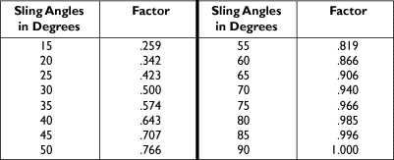
Angle Capacity Chart
Actual Sling Capacity = Factor x Rated Capacity
34/37

Slide 35
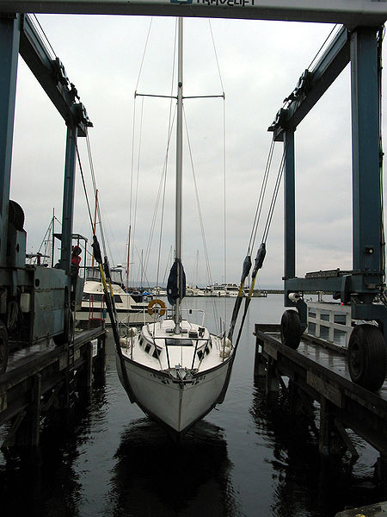
Sling Procedures
Refer to list in Student Workbook from ANSI B30.9
35/37

Slide 36

NEVERS
…allow more than one control person except hazard
…raise load more than necessary
…leave load suspended in the air
…work under a suspended load
Attempt to lift a load greater than
the rating of the hoist
Allow an untrained person to operate a crane
36/37

Slide 37
Summary
Manually handling materials
  When lifting objects, lift with your legs, keep your back straight, do not twist, and use handling aids
Using cranes, forklifts, and slings to move materials
  Watch for potential struck by and crushed by dangers
  For slings, check their load capacity, inspect them, and remove them from service when they display signs of stress or wear
Also
  Keep work areas free from debris and materials
  Store materials safely to avoid struck by/crushed by hazards
37/37

