Slide 1

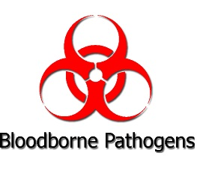
Unit 1: Safety Awareness
Foundations of
Manufacturing
Section 14:
Bloodborne Pathogens

Slide 2
Learning Objectives
Examine the following as it applies to BBP:
  Potential exposure and modes of transmission
  Requirements of the employee and employer
  Protection from exposure through safe work practices
Discuss the following elements of BBP programs:
  An exposure control plan
  Regulated medical waste
2/40

Slide 3
Learning Objectives (Cont’d.)
Determine the safety steps required when an employee is exposed to a BBP.
Describe the following requirements as they pertain to BBP:
  Proper labeling of waste
  Recordkeeping
  Training elements required by OSHA
3/40

Slide 4
Introduction
Millions of workers are at risk of exposure to bloodborne pathogens such as human immunodeficiency virus (HIV – the virus that causes AIDS), the hepatitis B virus (HBV), and the hepatitis C virus (HCV).
OSHA’s Bloodborne Pathogens standard prescribes safeguards to protect workers against the health hazards from exposure to blood and other potentially infectious materials, and to reduce their risk from this exposure.
4/40
Notes:
29 CFR 1910.1030
“Bloodborne pathogens” means pathogenic microorganisms that are present in human blood and can cause disease in humans. These pathogens include among others hepatitis B virus (HBV), which causes hepatitis B; human immunodeficiency virus (HIV), which causes AIDS; hepatitis C virus and other pathogens, such as those that cause malaria.
“Other potentially infectious materials” means:
The following human body fluids: semen, vaginal secretions, cerebrospinal fluid, synovial fluid, pleural fluid, pericardial fluid, peritoneal fluid, amniotic fluid, saliva in dental procedures, any body fluid that is visibly contaminated with blood, and all body fluids in situations where it is difficult or impossible to differentiate between bodily fluids;
Any unfixed tissue or organ (other than intact skin) from a human (living or dead); and
HIV-containing cell or tissue cultures, organ cultures, and HIV- or HBV-containing culture medium or other solutions; and blood, organs, or other tissues from experimental animals infected with HIV or HBV.

Slide 5
Who is covered by the standard?
All employees who could be “reasonably anticipated” as the result of performing their job duties to face contact with blood and other potentially infectious materials
“Good Samaritan” acts such as assisting a co-worker with a nosebleed would not be considered occupational exposure.
5/40
Notes:
OSHA’s Bloodborne Pathogens standard, 29 CFR 1910.1030, does not apply to construction, agriculture or maritime.
The term “reasonably anticipated” contact means potential contact as well as actual contact with blood or other potentially infectious materials.

Slide 6
Some Workers Who are at Risk
Physicians, nurses and emergency room personnel
Orderlies, housekeeping personnel, and laundry workers
Dentists and other dental workers
Laboratory and blood bank technologists and technicians
Medical examiners
Morticians
Law enforcement personnel, Firefighters
Paramedics and emergency medical technicians
Anyone providing first-response medical care
Medical waste treatment employees
Home healthcare workers
6/40
Notes:
The scope of the Bloodborne Pathogens standard is not limited to employees in these jobs. The hazard of exposure to infectious materials affects employees in many types of industries and is not restricted to the health care industry.

Slide 7
How does exposure occur?
Most common: puncture wounds (may need tetanus shot)
Cuts from other contaminated sharps (needlesticks, scalpels, broken glass, etc.)
Contact of mucous membranes (for example, the eye, nose, mouth) or broken (cut or abraded) skin with contaminated blood
7/40
Notes:
It is estimated that 600,000 to 800,000 needlestick injuries occur each year in the United States.
“Contaminated sharps” means any contaminated object that can penetrate the skin including, but not limited to, needles, scalpels, broken glass, broken capillary tubes, and exposed ends of dental wires.

Slide 8
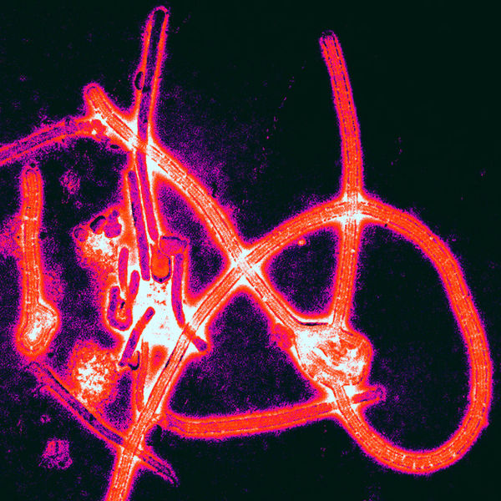
What are Bloodborne Pathogens?
Disease-producing
microorganisms
Present in human
blood
Present in human
body fluids
8/40

Slide 9
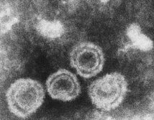
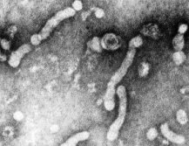
Hepatitis B Virus (HBV)
  HBV infects the liver
  Infected person may or may not show signs or symptoms
      Fatigue
      Nausea
      Jaundice
      Darkening of the urine
      Similar to flu
  1.25 million Americans are chronically infected
9/40

Slide 10
Hepatitis C Virus (HCV)
Most common chronic bloodborne infection in the United States
Infected person may or may not show signs or symptoms
  Jaundice
  Fatigue
  Abdominal pain
  Loss of appetite
  Intermittent nausea, vomiting
May lead to chronic liver disease and death
10/40

Slide 11
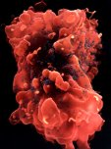
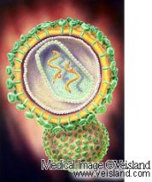
Human Immunodeficiency Virus (HIV)
  Breaks down the immune system
  Leads to acquired immunodeficiency syndrome (AIDS)
  HIV-infected persons may or may not have any signs or symptoms
    Swollen lymph nodes
    Fatigue
    Weight loss
    Diarrhea
    Chronic dry cough
    Fever
11/40

Slide 12

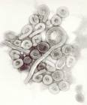
Other Bloodborne Pathogens
Bacteria, viruses, and other microorganisms that could potentially be transmitted to the bloodstream are:
    Hepatitis D
    Malaria
    Syphilis
    Viral hemorrhagic fever
    Ebola
12/40

Slide 13
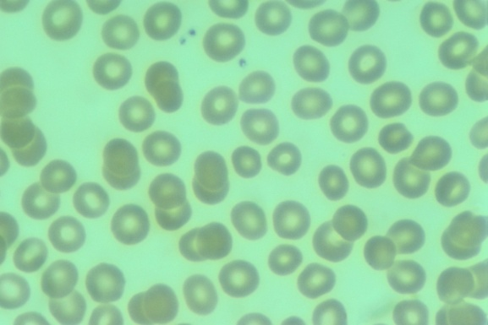
Other Potentially Infectious Materials (OPIMs)
Blood products
Saliva, vomit, urine
Semen or vaginal secretions
Skin, tissue, cell cultures
13/40

Slide 14
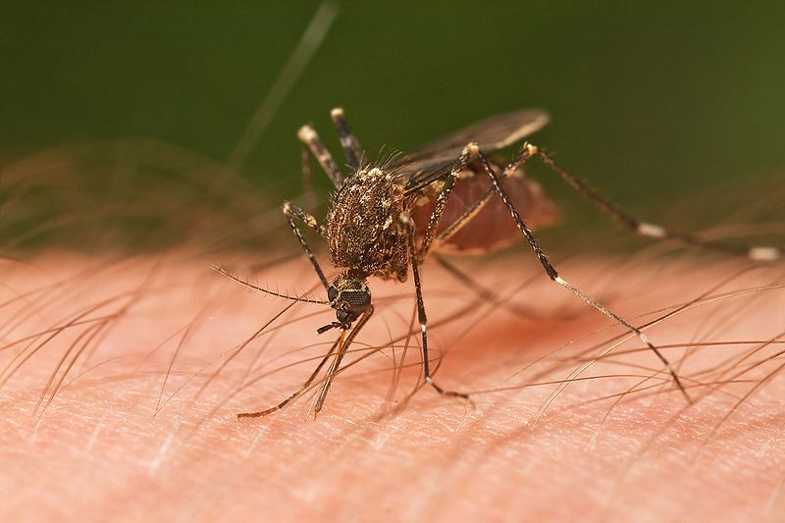
Potential Transmission Routes
Infectious blood or OPIM makes direct/indirect contact with bloodstream through:
  Break in the skin
    cut
    abrasion
    dermatitis
  Mucous membranes
    eyes
    mouth
    nose
Something as small as an insect bite is a break in the skin, and is considered skin that is “not intact”
14/40

Slide 15
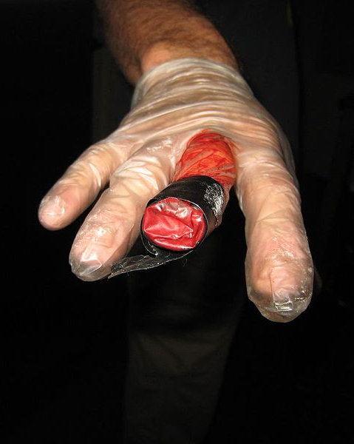
Potential Exposure
  Working in areas where blood or OPIMs are present or there is a potential for spilled BBPs such as:
      Industrial accident
      Assisting an injured co-worker
      Post accident clean-up
      Providing janitorial or maintenance services
Remember: It’s not your blood, but Other Peoples Infectious Material (OPIM) that causes the problem!
15/40

Slide 16

Exposure Control Plan (ECP)
ECP must address how the employer will comply with the regulations regarding bloodborne pathogens
Addresses the following:
  Determine employee exposure
  Limit/eliminate employee exposure
  Create vaccination program and post-exposure follow-up
  Detail procedures to follow when an accidental exposure occurs
16/40

Slide 17

Exposure Control Plan (ECP) (Cont’d.)
  Communicate hazards using
  warning signs/labels
  Keep good records
  Provide training
  Conduct annual reviews and updates
  Changes in workplace
  Document use of safer medical devices
  Employee involvement
17/40

Slide 18
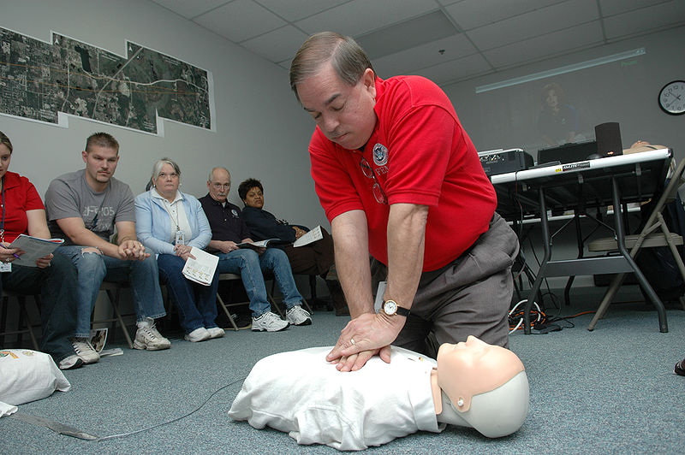
Training
All employees with occupational exposure to blood or OPIM
Employees who are
trained in first aid
and CPR
18/40

Slide 19
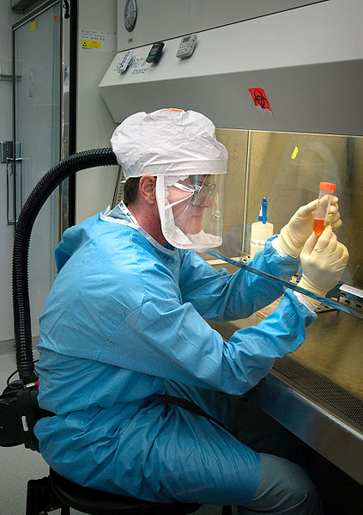
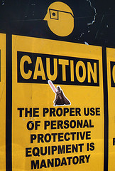
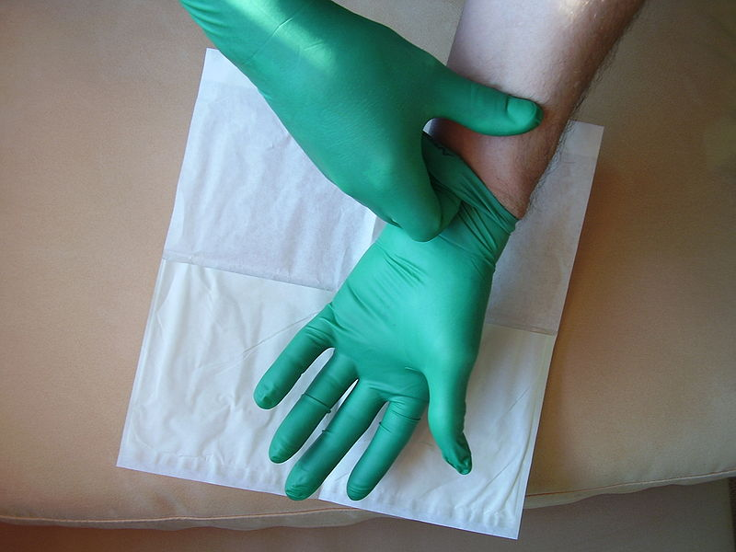
Universal Precautions
Approach to infection control
Treat all blood and OPIMs as infectious
Use appropriate PPE
Decontamination of all involved employees, equipment and tools,
and affected area
19/40

Slide 20
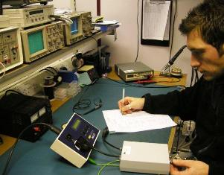
Engineering Controls
Limiting/eliminating exposure by equipment or machinery that can minimize exposure
20/40

Slide 21
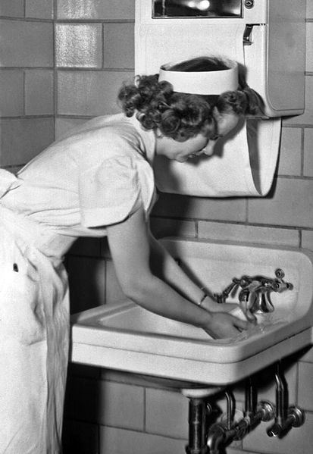
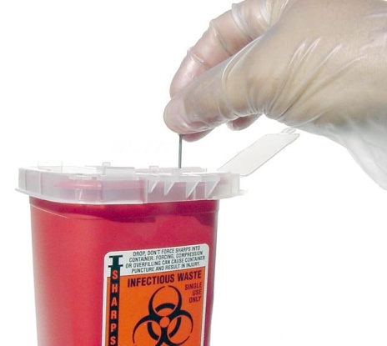
Administrative Controls
Personnel Exposure
  Remove contaminated PPE
  Clean and disinfect contaminated equipment and work surfaces
  Wash up after exposure
  Dispose of contaminated items
21/40

Slide 22

Administrative Controls (Cont’d.)
  Work Areas
      Do not eat or drink in areas containing infectious materials.
      Do not store food or drink where blood or other infectious materials are kept.
      Do not apply cosmetics, lip balm, or contact lenses in areas that contain infectious wastes.
22/40

Slide 23

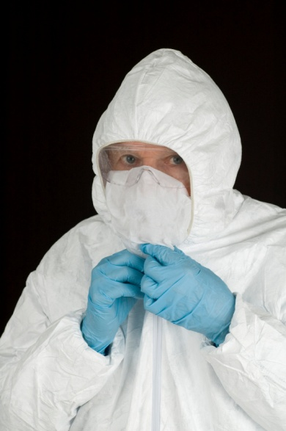
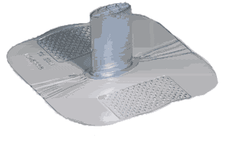
PPE Controls
Reduce the likelihood of exposure to BBPs
Safety equipment provided by the employer for all affected personnel:
        Gloves
        Goggles
        CPR mouth barriers
        Aprons
        Respirators
23/40

Slide 24
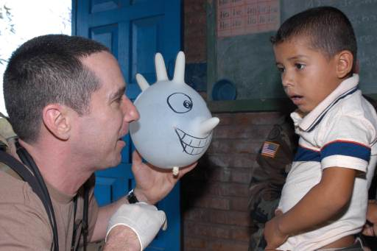
PPE Controls (Cont’d.)
Always check PPE for defects or tears before using
If PPE becomes torn or defective remove and get new
Do not reuse disposable equipment
24/40

Slide 25
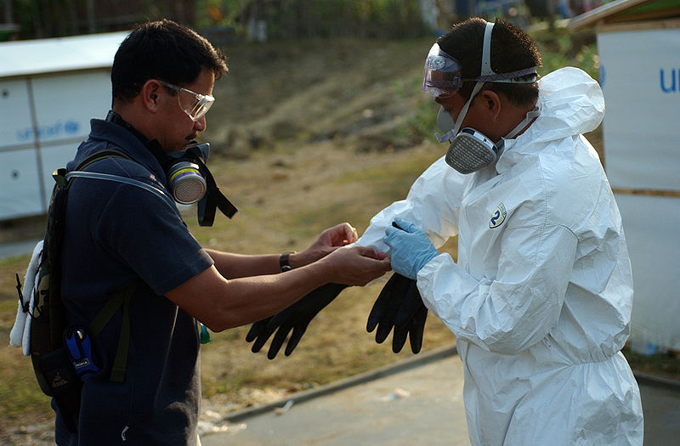

PPE Controls (Cont’d.)
Disposable PPE includes:
    Gloves
    Tyvek gowns
    Tyvek sleeves
    Surgical face shields
    Safety glasses
25/40

Slide 26
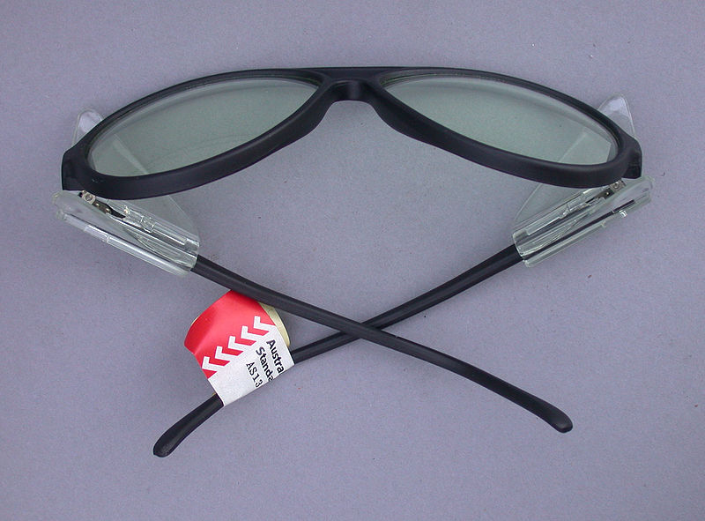
PPE Controls (Cont’d.)
Safety glasses
  Used when risk of splashing blood or OPIM is present
  Ideally, wear on the job at all times
26/40

Slide 27



Decontamination Procedures
Wear protective gloves
Disinfectant/cleaner provided in bodily fluid disposal kit or
    CDC recommended solution of one part bleach to 10 parts water (1:10)
Properly dispose of contaminated PPE, towels, rags
27/40

Slide 28
Regulated Medical Waste (RMW)
RMW, sometimes called bio-hazard waste, may contain blood, bodily fluids, or infectious materials, making it a transmitter of disease
Includes needles, swabs, bandages, sharps, medical bags, etc.
28/40

Slide 29
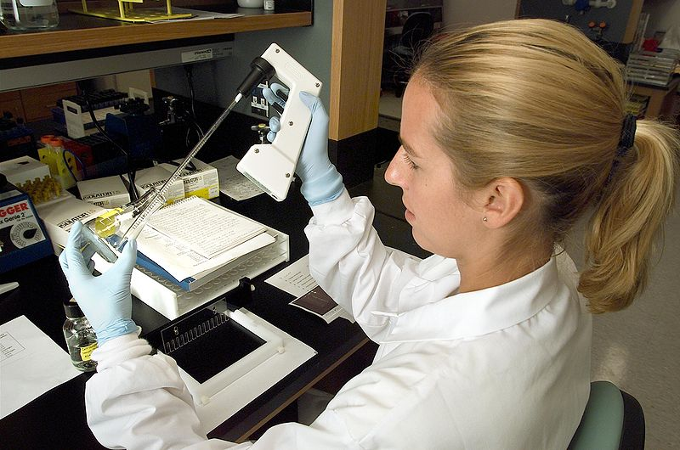
Regulated Medical Waste
Liquid or semi-liquid blood or OPIM
Contaminated items that would release
blood or OPIM when compressed
Contaminated sharps
Pathological and microbiological waste containing blood or OPIM
29/40

Slide 30
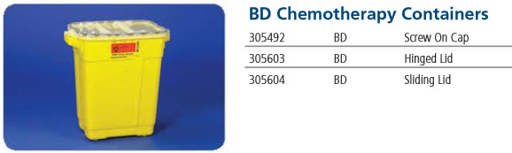
Hazardous Waste (HW)
  This type of container, defined by yellow color or a sticker, must be used for HW
  Each state has specific rules for RMW and HW that must be followed.
30/40

Slide 31
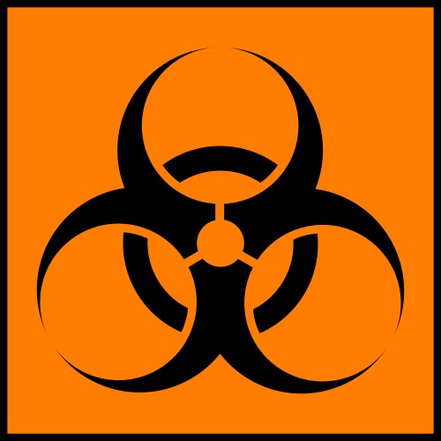


Labels and Signs
What to Look For:
  Biohazard labels
    This labeling will appear on any equipment that may be contaminated with potential infectious materials.
  Also seen on regulated waste including:
    Contaminated needles or other items
    Contaminated containers
    Potentially infectious materials
31/40

Slide 32
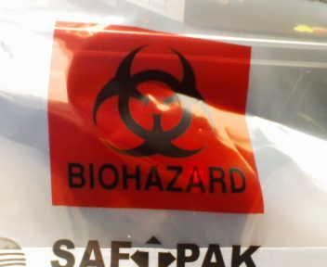
Labels and Signs (Cont’d.)
Universal biohazard symbol must be attached to:
  Containers of regulated
  biohazard waste
  Refrigerators or freezers
  containing blood or OPIM
  Containers used to store,
  transport, or ship blood or OPIM
32/40

Slide 33
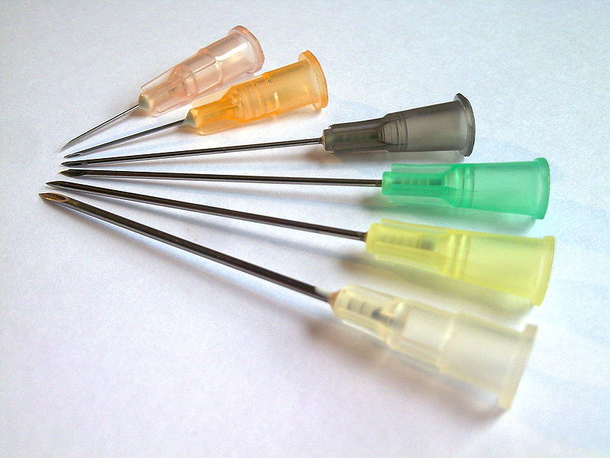
Hepatitis B Vaccination
  First line of defense against infection
  Series of 3 injections over several months
  For employees at risk of exposure
  Company sponsored
33/40

Slide 34
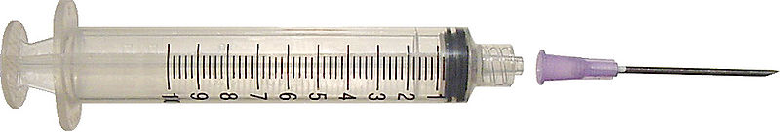
Hepatitis B Vaccination (Cont’d.)
  Strongly endorsed by medical communities
  Must be offered to all potentially exposed employees
  Must be provided at no cost to the employee
  A declination form must be signed if employee refuses vaccination
34/40

Slide 35
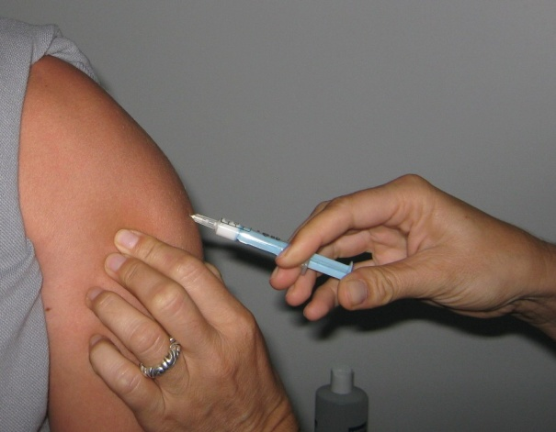
Hepatitis B Vaccination (Cont’d.)
  95% effective in preventing Hepatitis B for people who are vaccinated prior to an exposure incident
  You should not receive the
  vaccine if you:
      are allergic to yeast or thermisol
      have a serious active infection
35/40

Slide 36
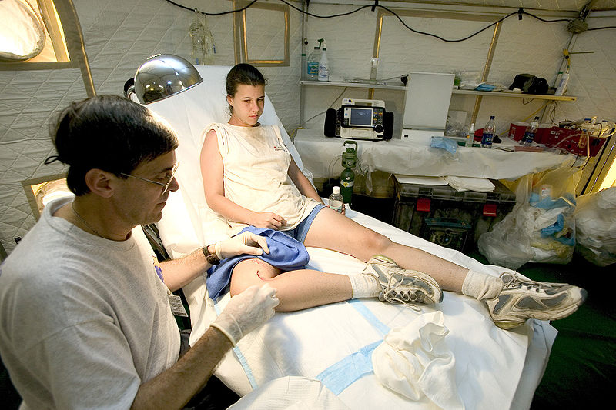
Exposure Incident
  Contact with blood or OPIM involving your skin, eyes, or other mucous membranes
  Immediately wash affected area
  Splash with large amounts of water if eyes are exposed
  Immediately notify your manager or supervisor and ask for assistance
  Post-exposure medical evaluation must be offered
36/40

Slide 37

Post-Exposure Evaluation
  Confidential medical evaluation
  Document route of exposure
  Identify source individual
  Test source individual’s blood (with consent)
  Provide results to exposed employee
  Test employee’s blood (with consent)
  Provide follow-up
37/40

Slide 38

Recordkeeping
  Sharps injury log
  Medical records
      HBV vaccination status
      Post-exposure evaluation and follow-up
    Training records
      Training dates and content
      Trainer information
      Names and job titles of trainees
38/40

Slide 39


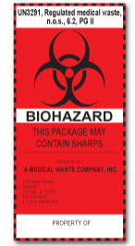
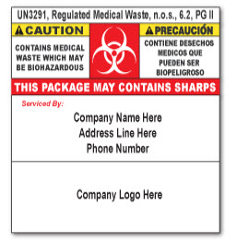
Sample Labels
39/40

Slide 40

Summary
In the workplace, there is always a possibility that you will be exposed to BBPs.
Knowing what to do, who to call, and how to protect yourself and others is essential to reducing your risk and the risk to your co-workers.
40/40

