Slide 1

Domain 1: Safety Awareness
Foundations of
Manufacturing
Section 6:
Hazard Communication / SDS

Slide 2
Learning Objectives
Describe how, when, and where chemicals are encountered.
Identify storage and use of chemicals.
Decipher chemical hazards, exposure, burns, hazard identification, and product warning labels.

Slide 3
Learning Objectives (Cont’d.)
Examine your “right-to-know” about what hazardous chemicals are used in your environment.
Describe the use of Safety Data Sheets (SDSs). (Previously MSDS)
Discuss toxicology and exposure guidelines and who establishes them.

Slide 4
Introduction
About 32 million workers work with and are potentially exposed to one or more chemical hazards.
There are approximately 650,000 existing chemical products, and hundreds of new ones being introduced annually.
Chemical exposure may cause or contribute to many serious health effects such as heart ailments, central nervous system damage, kidney and lung damage, sterility, cancer, burns, and rashes.
Some chemicals may also be safety hazards and have the potential to cause fires and explosions and other serious accidents.
Notes:
This is one of the most frequently cited OSHA standards.
This program is intended for workplaces that do not manufacture, import, or distribute hazardous chemicals. Notes have been provided that highlight some of the requirements for these employers. For complete requirements, consult 29 CFR 1910.1200.

Slide 5
Purpose of OSHA’s Hazard Communication Standard
To ensure that employers and employees know about work hazards and how to protect themselves so that the incidence of illnesses and injuries due to hazardous chemicals is reduced.
Hazard Communication
Program
Container
Labeling
Safety
Data Sheet
SDS
Program
Label
Notes:
29 CFR 1910.1200
The Hazard Communication (HazCom) standard establishes uniform requirements to make sure that the hazards of all chemicals imported into, produced, or used in U.S. workplaces are evaluated, and that this hazard information is transmitted to affected employers and exposed employees.
The HazCom standard is different from other OSHA health rules because it covers all hazardous chemicals. The rule also incorporates a “downstream flow of information,” which means that producers of chemicals have the primary responsibility for generating and disseminating information, whereas users of chemicals must obtain the information and transmit it to their employees.

Slide 6
Who is covered?
OSHA’s Hazard Communication (HazCom) standard applies to general industry, shipyard, marine terminals, longshoring, and construction employment and covers chemical manufacturers, importers, employers, and employees exposed to chemical hazards.
Notes:
1910.1200(b)
Does the standard apply to an office environment?
Office workers who encounter hazardous chemicals only in isolated instances are not covered by the rule. OSHA considers most office products (such as pens, pencils, adhesive tape) to be exempt under the provisions of the rule. OSHA has stated that intermittent or occasional use of a copying machine does not result in coverage under the rule. However, if an employee handles the chemicals to service the machine, or operates it for long periods of time, then the standard would apply.
“Hazardous Chemical” is any chemical which is a physical or health hazard.

Slide 7
Employer Responsibilities
Identify and list hazardous chemicals in their workplaces
Obtain Safety Data Sheets (SDSs) and labels for each hazardous chemical, if not provided by the manufacturer, importer, or distributor
Implement a written HazCom program, including labels, MSDSs, and employee training
Communicate hazard information to employees through labels, SDSs, and formal training programs

Slide 8
How can Workplace Hazards be
Minimized?
The first step in minimizing workplace hazards is to perform a thorough hazard assessment.
Employers can rely on the evaluations performed by the manufacturers or importers to establish the hazards of the chemicals they use.
  This information is obtained from SDSs and labels
Notes:
Chemical manufacturers and importers must review scientific evidence on the hazards of chemicals they produce or import and report findings to their employees and to employers who distribute or use their products.

Slide 9

Why is a Written Program Required?
Ensures that all employers receive the information they need to inform and train their employees
Provides necessary hazard information to employees
HazCom Program
(f) "Labels and other forms of warning."
(g) “Safety data sheets."
(h) "Employee information and training."
Notes:
1910.1200(e)

Slide 10
Written HazCom Program
Requirements
Describes container labeling, SDSs, and employee training for each workplace
List of the hazardous chemicals
Make information regarding hazards and protective measures available to other employers onsite
Notes:
Employer also required to describe how they will inform employees of the hazards of non-routine tasks (for example, cleaning reactor vessels), and the hazards associated with chemicals in unlabeled pipes.

Slide 11

How Must Chemicals be Labeled?
Each container of hazardous chemicals entering the workplace must be labeled or marked with:
Identity of the chemical
Appropriate hazard warnings
Name and address of the responsible party
Notes:
1910.1200(f)
Chemical manufacturers and importers must convey the hazard information to downstream employers by means of labels on containers and Material Safety Data Sheets (MSDSs). Language used on the warning label does not have to be identical to that on the MSDS.
Chemical manufacturers, importers, and distributors must be sure that containers of hazardous chemicals leaving the workplace are labeled, tagged, or marked with:
- the identity of the chemical,
- appropriate hazard warnings, and
- the name and address of the chemical manufacturer, importer, or other responsible party
Consumer products having labels meeting requirements of the Consumer Product Safety Act do not have to have additional labeling under the HazCom Standard.
Various other chemical products (for example, pesticides, foods, drugs, cosmetics, beverage alcohols) that are subject to labeling laws administered by other Federal agencies are also exempt from the labeling requirements of the HazCom Standard.

Slide 12
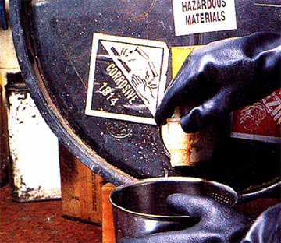
Container Labeling in the Workplace
The hazard warning can be any type of message, picture, or symbol that provides information on the hazards of the chemical(s) and the targeted organs affected, if applicable
Labels must be legible, in English (plus other languages, if desired), and prominently displayed
Notes:
Exemptions to the requirement for container labeling:
- Can post signs/placards that convey hazard information if there are a number of stationary containers within a work area with similar contents and hazards
- Can substitute various types of standard operating procedures, process sheets, and similar written materials for container labels on stationary process equipment if they contain the same information and are readily accessible to employees in the work area
- Not required to label portable containers into which hazardous chemicals are transferred from labeled containers and are intended only for the immediate use of the employee who makes the transfer
- Pipes or piping systems, and engines, fuel tanks, or other operating systems in a vehicle, are not considered to be containers

Slide 13


Hazard Communication
Right-to-Understand
Every employee has the right to know what hazardous chemicals are used on the job and how to work safely with those chemicals.
Notes:
Question: What types of corrosive chemicals exist, either at work or at home? Toxic chemicals?
Answers may vary, but should include:
Corrosive: nitric acid, as well as many strong household cleaners like bleach, ammonia, and floor cleaners
Toxins: Pesticides, benzene in gasoline, many solvents, lead-based paint

Slide 14

Hazard Communication Responsibilities
Chemical manufacturers must determine a chemical’s hazards and provide an SDS.
Employers must make the SDS available and train employees on the hazards of the chemical and how to protect themselves from those hazards.
Employees must read the SDS so that they can identify the hazards and understand how to work safely with the chemical.
Notes:
Question: As a consumer, what are your rights to an MSDS?
Answer: Many manufacturers or distributors will provide an MSDS to anyone who asks, but they are under no OSHA obligation to distribute these to consumers.

Slide 15
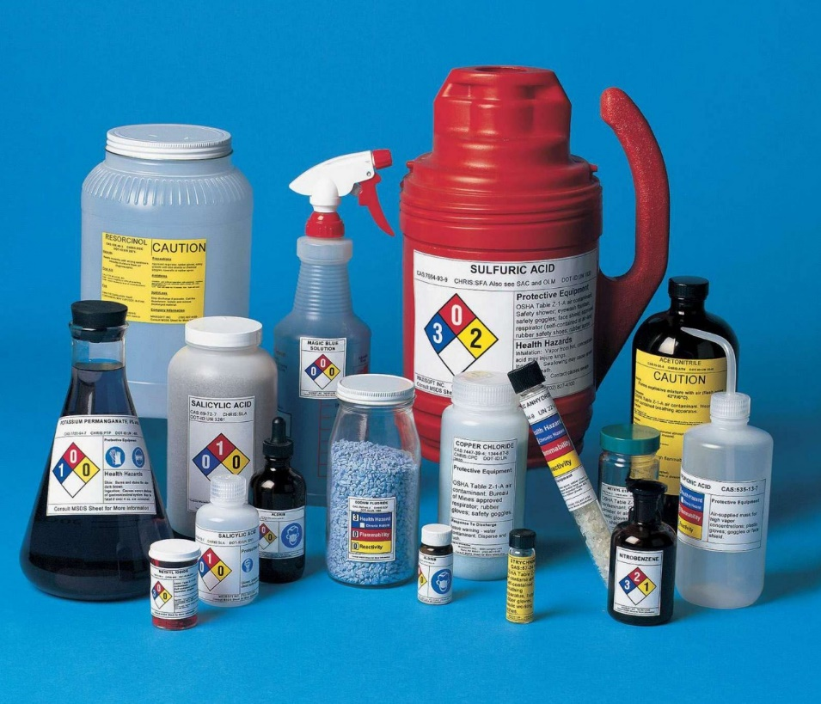
HAZCOM Training
Initial Training required at time employee is assigned to work with a hazardous chemical
Refresher training required annually

Slide 16
What is a SDS (Safety Data Sheet)?
Document that contains information about a chemical product, specifically:
  Potential hazards
  Safe use of the chemical
Additional information in the SDS includes:
  Use, storage, handling, and emergency procedures related to the chemical’s hazards
The supplier of the chemical prepares the SDS

Slide 17
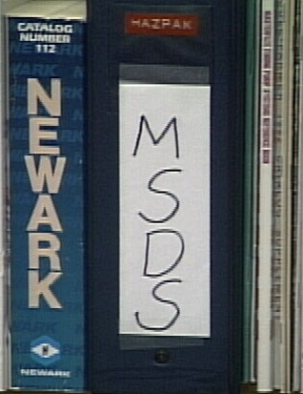
SDS Purpose
Identifies the hazardous
ingredients
Describes physical and
health hazards
Discusses procedures and
equipment that enable you
to work safely with the chemical

Slide 18

SDS Access
List of chemicals used by the facility
Methods of access
  Binders
  Computer log
Method of listing
  Alphabetically
  By chemical type
  Assigned an in-house number that is referenced in the index
Notes:
Note: Employees must have “ready access” to MSDS’s while they are in the workplace. Therefore, if a workplace operates 24 hours a day, the MSDS’s cannot be in the office of someone who only works during the day and locks the office door at night.

Slide 19

New Hazard Communication Rule
New changes to the Occupational Safety and Health Administration's (OSHA) Hazard Communication Standard are bringing the United States into alignment with the Globally Harmonized System of Classification and Labeling of Chemicals (GHS), further improving safety and health protections for America's workers.

Slide 20
New Hazard Communication Rule (Cont’d.)
Building on the success of OSHA's current Hazard Communication Standard, the GHS is expected to prevent injuries and illnesses, save lives and improve trade conditions for chemical manufacturers.
The Hazard Communication Standard in 1983 gave the workers the ‘right to know,' but the new Globally Harmonized System gives workers the ‘right to understand.'

Slide 21
Effective Completion Date Requirement(s)
Employers: Train employees on the new label elements and SDS format by December 1, 2013.
Chemical mfgrs., importers, distributors and employers
Comply with all modified provisions of this final rule by June 1, 2015 except: Distributors may ship products labeled by manufacturers under the old system until December 1, 2015.
Employers: Update alternative workplace labeling and hazard communication program as necessary, and provide additional employee training for newly identified physical or health hazards by June 1, 2016.
Additional information: More information on the hazard communication standard, including the link to the Federal Register notice, can be found on OSHA's hazard communication safety and health topics page at ww.osha.gov/dsg/hazcom/index.html.

Slide 22
Hazard Communication Safety Data Sheets
The Hazard Communication Standard (HCS) requires chemical manufacturers, distributors, or importers to provide Safety Data Sheets (SDSs) (formerly known as Material Safety Data Sheets or MSDSs) to communicate the hazards of hazardous chemical products.
As of June 1, 2015, the HCS will require new SDSs to be in a uniform format, and include the section numbers, the headings, and associated information under the following headings:

Slide 23
Section 1, Identification includes product identifier; manufacturer or distributor name, address, phone number; emergency phone number; recommended use; restrictions on use.
Section 2, Hazard(s) identification includes all hazards regarding the chemical; required label elements.
Section 3, Composition/information on ingredients includes information on chemical ingredients; trade secret claims.
Section 4, First-aid measures includes important symptoms/ effects, acute, delayed; required treatment.
Section 5, Fire-fighting measures lists suitable extinguishing techniques, equipment; chemical hazards from fire.

Slide 24
Section 6, Accidental release measures lists emergency procedures; protective equipment; proper methods of containment and cleanup.
Section 7, Handling and storage lists precautions for safe handling and storage, including incompatibilities.
Section 8, Exposure controls/personal protection lists OSHA's Permissible Exposure Limits (PELs); Threshold Limit Values (TLVs); appropriate engineering controls; personal protective equipment (PPE).
Section 9, Physical and chemical properties lists the chemical's characteristics.
Section 10, Stability and reactivity lists chemical stability and possibility of hazardous reactions

Slide 25
Section 11, Toxicological information includes routes of exposure; related symptoms, acute and chronic effects; numerical measures of toxicity.
Section 12, Ecological information*
Section 13, Disposal considerations*
Section 14, Transport information*
Section 15, Regulatory information*
Section 16, Other information, includes the date of preparation or last revision.
*Note: Since other Agencies regulate this information, OSHA will not be enforcing Sections 12 through 15(29 CFR 1910.1200(g)(2)).
Employers must ensure that SDSs are readily accessible to employees.
See Appendix D of 1910.1200 for a detailed description of SDS contents.

Slide 26
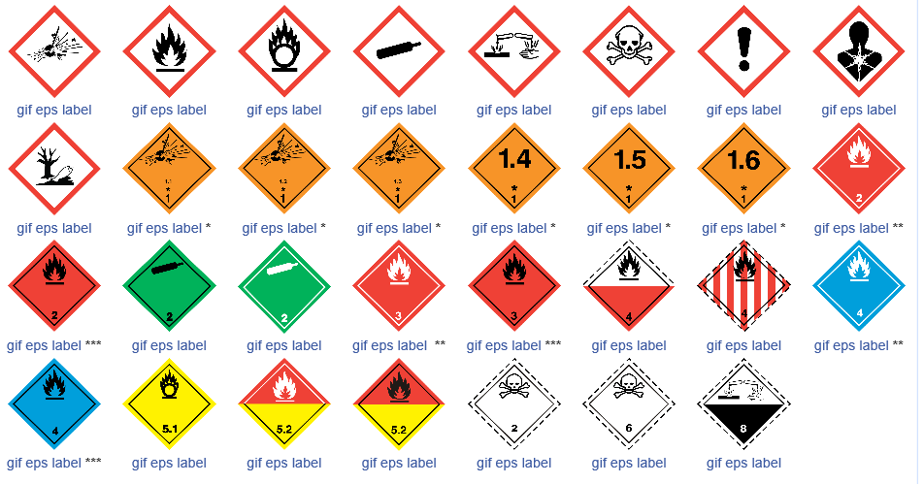
Sample GHS pictograms

Slide 27
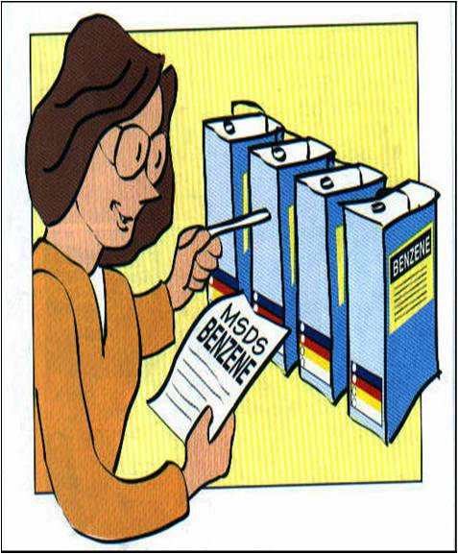
SDS vs. MSDS Confusion
OSHA did not officially recognize any standard format for MSDS.
Manufacturers must include information required by OSHA.
MSDSs can range from one page to twenty pages.
  This makes finding information on each MSDS a challenge.
Notes:
Question: Where, on the MSDS, would you find information on first aid?
Answer: There is no set format. The information may be anywhere on MSDS.
Invite students to discuss specifically how employees access the MSDSs at their workplaces.
Discuss the different aspects of the MSDS and how they differ from manufacturer to manufacturer.

Slide 28
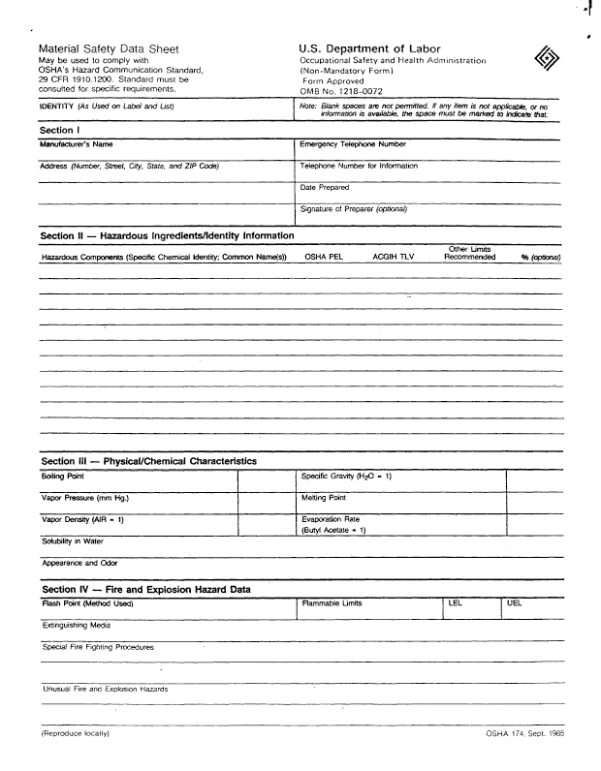
SDS / Section 1
Manufacturer’s information
Emergency phone
number
Date of SDS /MSDS
Name of the chemical
Notes:
Question: Why it so important to know the correct name of the chemical you are using or exposed to?
Answer: Many chemicals share similar names. Knowing the exact name and number of the product is essential to obtaining the right information from the correct manufacturer.

Slide 29

SDS / Section 2 Hazards Identification
Hazardous chemical ingredients
Non-hazardous ingredients
Ingredients may be listed as “trade secrets”

Slide 30
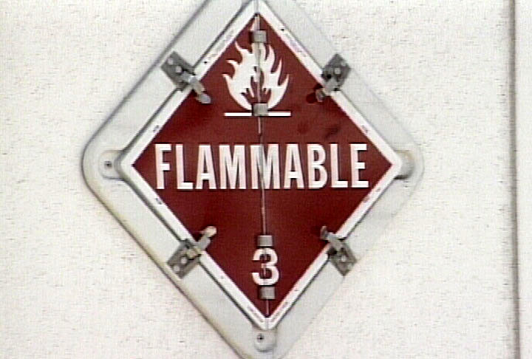
Other Physical and Chemical Data
Other Data
  Boiling or melting point
  Vapor pressure
  Vapor density
  Solubility
  Density or specific gravity
Notes:
Note: Currently there are 23,000,000 known chemicals. It is not possible to establish a standard that can effectively anticipate the potential toxic effects each compound and mixture of chemicals may produce.
Note: Not every MSDS contains all of the categories discussed above. Some MSDSs may contain information not discussed in this module.

Slide 31
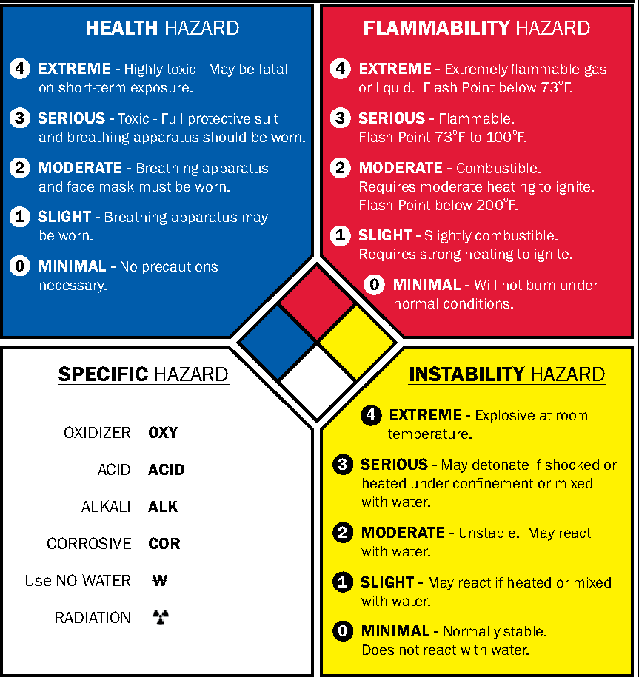
Hazardous Material Identification System (HMIS)
BLUE = Health
RED = Flammability
YELLOW = Stability
WHITE = Other hazards or special handling
Scale = 0 (no hazard) to 4 (extreme hazard)

Slide 32

SDS / Section 3
Composition/Information on Ingredients
Chemical names

Slide 33

SDS / Section 4
First Aid Measures
Eye Contact
Skin Contact
Inhalation
Ingestion

Slide 34



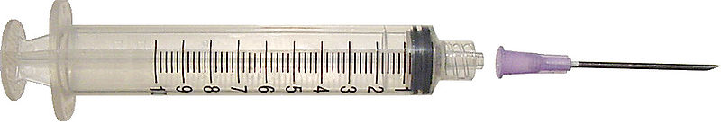

Exposure Methods
Eye
Skin contact
Swallowing
Penetration
Inhalation (most common)

Slide 35

Exposure Limits
PEL (Permissible Exposure Limit)
STEL (Short Term Exposure Limit)
TLV (Threshold Limit Value)
Notes:
Question: Why is it important to stay within exposure limits of a certain chemicals?
Answer: Overexposure can be deadly.

Slide 36

Signs and Symptoms of Exposure
Immediate
  Eye and skin contact:
    Eye irritation (red, swollen, itchy, watery)
    Rashes or dermatitis
  Inhalation:
    Shortness of breath, coughing, dizziness
  Ingestion:
    Nausea, stomach ache, vomiting

Slide 37

Signs and Symptoms of Exposure (Cont’d.)
Chronic effects:
  Allergies
  Chemical sensitization
  Lung or liver damage
  Cancer
  Aggravate existing medical conditions
Notes:
Question: As a production technician, how can you help prevent chronic health hazards due to chemical exposure?
Answers:
Know how to report and handle a medical emergency.
Know where the first aid kits and emergency showers/ eyewash stations are located.

Slide 38

Typical First Aid Measures
Eyes: Flush with water for 15 minutes
Skin: Wash with soap
and water
Inhalation: Move to fresh air
Ingestion: Get emergency
medical assistance

Slide 39
SDS / Section 5 Fire Fighting Measures
Suitable Extinguishing Media
Unsuitable Extinguishing Media
Specific Hazards Arising from the Chemical
Hazardous Combustion Products
Protective Equipment and Precautions for Firefighters

Slide 40
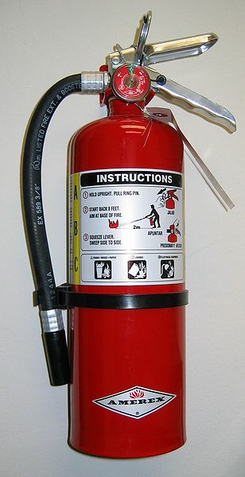
Typical Firefighting Concerns
Flashpoint
Flammability limits
Fire extinguisher awareness and training
Extinguishing media
Notes:
Question: What is the purpose of a fire extinguisher?
Answer: To put out small fires quickly so they do not spread. You cannot fight a large fire with a small extinguisher.

Slide 41
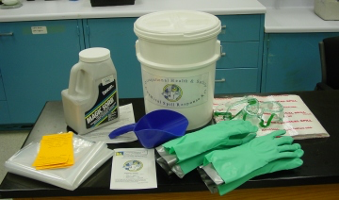
SDS / Section 6 Accidental Release
Personal Precautions
Environmental Precautions
Methods and materials for containment and cleaning up

Slide 42

SDS / Section 7 Handling and Storage
Storage procedures
Dispensing requirements
Handling requirements
Decontaminant
or antidote
Notes:
Note: OSHA’s HAZCOM Standard does not specify a minimum amount of material that requires an MSDS. Some chemicals are exceedingly dangerous in even milligram quantities while others may be safe for use and storage by the liter.

Slide 43
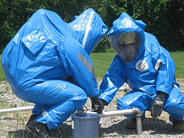
SDS / Section 8
Exposure Controls - Personal Protection
Exposure Guidelines
Appropriate Engineering
controls to prevent
Individual protection measures, such as PPE

Slide 44

SDS / Section 9
Physical and Chemical Properties
Molecular formula
Appearance and odor
Physical state
©Joe Sullivan

Slide 45


SDS / Section 10 Stability and Reactivity
Chemical stability
Possibility of hazardous reactions
Conditions to avoid

Slide 46
Other Information Found on an SDS
Section 11, Toxicological information includes routes of exposure; related symptoms, acute and chronic effects; numerical measures of toxicity.
Section 12, Ecological information*
Section 13, Disposal considerations*
Section 14, Transport information*
Section 15, Regulatory information*
Section 16, Other information, includes the date of preparation or last revision.
*Note: Since other Agencies regulate this information, OSHA will not be enforcing Sections 12 through 15(29 CFR 910.1200(g)(2)).

Slide 47

Finding Information Exercise
Notes:
Finding Information Exercise 1-6-1
Introduction: The purpose of this exercise is to allow students to practice finding information on SDS’s.
Distribute copies of the SDS’s previously selected for class discussion. Samples should include a nine and a sixteen section SDS.
Choose several items for students to find on the SDS’s.
Instruct students to find the specific information and be prepared to discuss their findings and share their comments. After students have become familiar with using and locating vital information on the SDS, distribute samples of product labels.
Instruct students to provide examples of what is right and what is wrong with the label.
Question: Which is most important to read prior to using a chemical, the SDS or the product label?
Answer: The label.
Note: Discussing SDSs is important, as are the product labels. The label quickly provides vital information at a glance. The SDS provides more in-depth information.

Slide 48
Spill Response
Specific procedures must be followed when hazardous materials spill or leak.
The first step generally is to contact your supervisor.
It may require a trained emergency response team.
The spill may require notification of government agencies. For example, the Environmental Protection Agency may need to be notified for emissions released into the air.

Slide 49
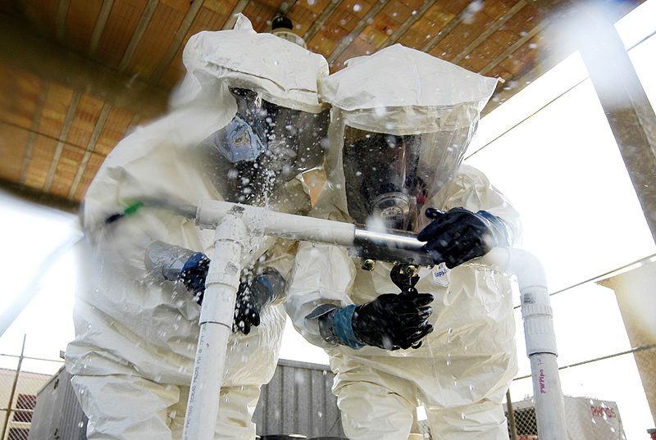
Spill Response
Handled by trained personnel only
Isolate the area
Contain the spill
Clean up the spill
Disposal procedures

Slide 50
Safe Hazardous Material Disposal
DO NOT dispose of hazardous chemicals in a trash compactor or in a landfill
  Liquid dyes
  Paint
  Florescent light bulbs (including CFLs)
Check with local authorities on proper disposal of these and other chemicals

Slide 51
Environmental Inspections
These may be done as part of safety inspection or stand-alone.
Test for anything that may cause air, ground or water pollution.
These serve as a review of proper waste disposal methods.
Recordkeeping is critical!
Workers exposed to environmental hazards are entitled to a review of their medical records.

Slide 52
Hazardous Material Transportation
It is regulated by Department of Transportation (DOT).
DOT requires that documentation listing hazards and emergency contact number must accompany all hazardous materials shipments.
Materials include explosive, flammable, combustible, toxic, flammable, radioactive, and corrosive.
If in doubt, get clarification first.

Slide 53
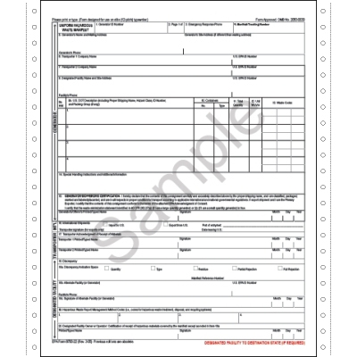
Cargo Manifest

Slide 54

United Nations (UN) Numbers are four-digit numbers used worldwide in international commerce and transportation to identify hazardous chemicals or classes of hazardous materials. These numbers generally range between 0000 and 3500 and are ideally preceded by the letters "UN" (for example, "UN1005") to avoid confusion with other number codes.

Slide 55
North American (NA) Numbers are identical to UN numbers. If a material does not have a UN number, it may be assigned an NA number; these are usually 4-digit numbers starting with 8 or 9 such as 9037 (or ideally, NA9037), the NA number for hexachloroethane.
UN/NA numbers are required for the shipment of hazardous materials. You have probably seen placards (such as the one above) that bear a UN/NA number on railway cars, trucks, shipping containers etc.

Slide 56
Summary
SDSs are the foundation of chemical safety
  24-hour access
Symptoms of exposure and first aid
Storage and handling
Personal protective equipment

