Slide 1

Domain 1: Safety Awareness
Foundations of
Manufacturing
Section 7:
Electrical Safety
CFR Part 1910 Subpart S
(§1910.301 to 1910.339)
Notes:
READ TO STUDENTS: Every production technician is expected to know how to recognize electrical hazards; therefore, this module will focus on the nature of electricity, safety issues, and requirements that pertain to electrical safety.

Slide 3
Learning Objectives
Understand electricity, what it is, how it works, as well as the hazards that exist and the safety precautions that must be observed when working with and around electrical equipment.
Discuss methods of training to reduce electrical hazards.
Describe the difference between qualified and unqualified workers.
Notes:
Direct students to turn to page 2-6-1 in their TBL Manufacturing Fundamentals, Unit 2: Safety Awareness, Module 6: Electrical Safety, Student Workbook and continue with the discussion.

Slide 4
Training to Prevent Electrical Hazards
OSHA requires that the training cover the following elements:
  How electricity works
  Contact with electricity and the harm it can cause to the human body
  Tasks and safety measures required by qualified worker
  Ways to identify potential electrical hazards
  Safe ways to use equipment and machinery that are powered by electricity

Slide 5
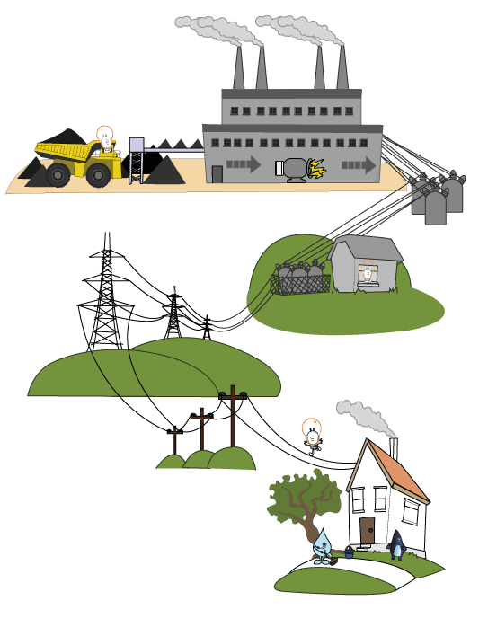
What is Electricity?
Flow of electrical charge
Secondary/Converted energy source- comes from consumption of other energy/fuels
Used to do many jobs

Slide 6
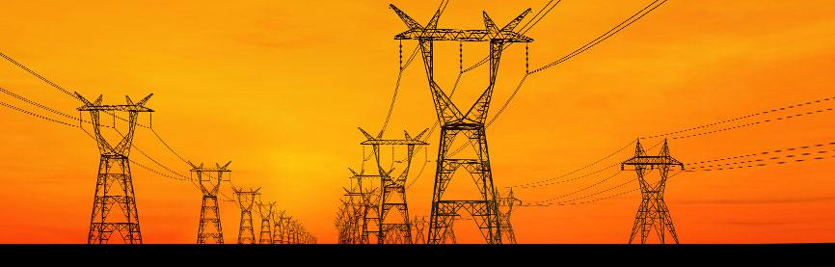
Understanding Electricity (Cont’d.)
Electricity is the energy made available by the flow of an electric charge through a conductor
Electrical energy is a common factor that can lead to fires and explosions at a plant
Three things are required for the flow of energy:
Electrical source
Electrical user (load)
Wires (path)

Slide 7
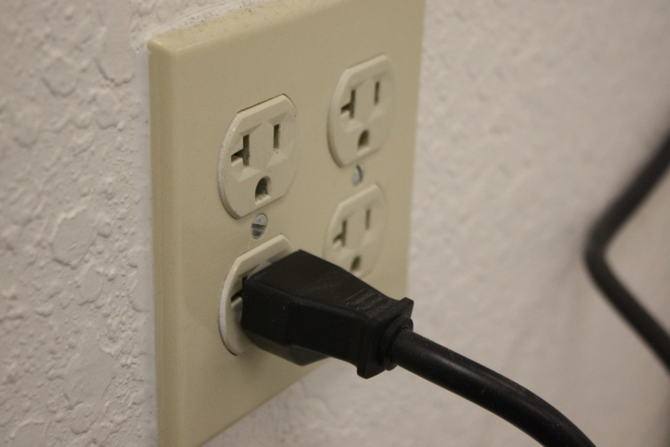
Electrical Circuits
Electrical source
  Power plant
Electrical user
  Device needing power
Wires
  Conduct the flow of current from one place to another
Switches
  Energize and de-energize the circuit (operator control)
Notes:
Question: What path will electricity usually take?
Answer: The path of least resistance.
Question: What three things does a basic electrical circuit need to function correctly?
Answer: A source, a user, and wires.

Slide 8
Understanding Electricity (Cont’d.)
Safety measures for electricity include:
Circuit Breaker or Fuse
The circuit breaker/fuse is designed to open the circuit if excessive amounts of energy are caused by a fault.
Grounding
All equipment and tools must be grounded. Grounding provides a path for current when a fault occurs.

Slide 9
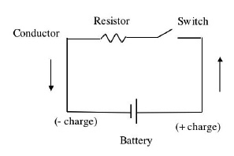
How Does Electricity Travel?
Electricity travels in a complete circuit
  Switch on: circuit is complete (closed)
  Switch off: circuit is broken (open)
Electricity travels path of least resistance
Short circuit potential
Importance of grounding

Slide 10
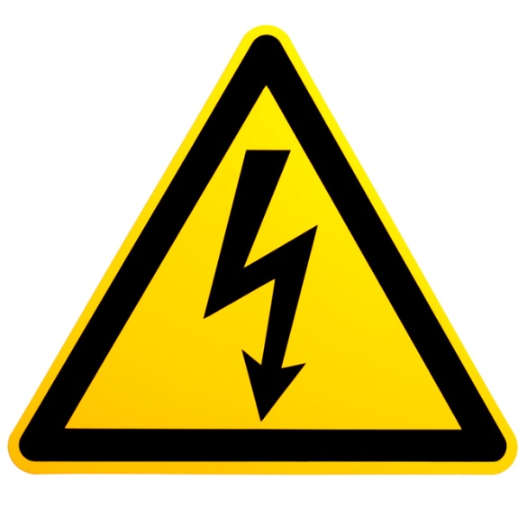
How is Electricity Measured?
Volts – pressure
Amps – amount of current
Resistance – impedes the flow of amperage
Watts – work done by the current under a certain voltage

Slide 11
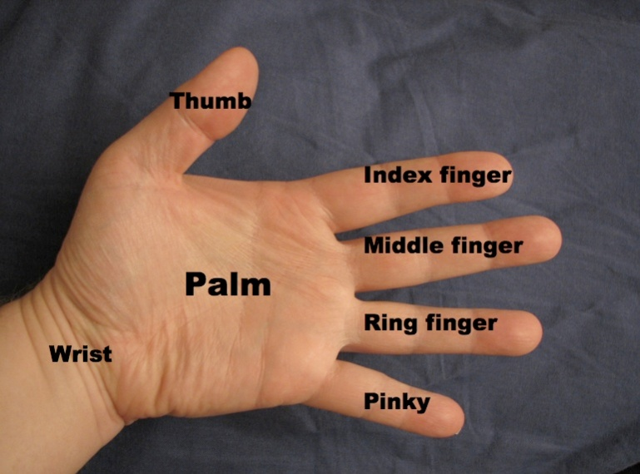
Body Resistance
Skin offers most of the body’s electrical resistance
Increased resistance
  Thick, callused, or dry skin
Decreased resistance
  Thin skin
  Wet or sweaty skin
  Broken or abraded skin
Notes:
Note: Never touch a person, with your bare hands, who is being shocked. Use a piece of dry, non-conducting material to pry and/or pull him or her away from the electrical current source.

Slide 12
Resistance Varies
Different levels of electrical resistance
for each person
Ranges from 500 ohms to many thousands
of ohms
The greater the body’s resistance, the less chance of harm
A similar voltage shock can be minor to
one person and deadly to another

Slide 13

Electricity’s Effects on the Human Body
1 mA: Can be felt by the body
2-10 mA: Minor shock, might result in a fall
10-25 mA: Loss of muscle control, may not be able to let go of the current
25-75 mA: Painful, may lead to collapse or death
75-300 mA: Duration lasting only a fraction
of a second is usually fatal
The longer the exposure, the greater the damage
Notes:
Question: Refer to Table 2-6-1. Which tools in the workplace have amps high enough to kill?
Answer: Any of the tools listed in the table could cause death. Notice that these are measured in amps, not milliamps.

Slide 14
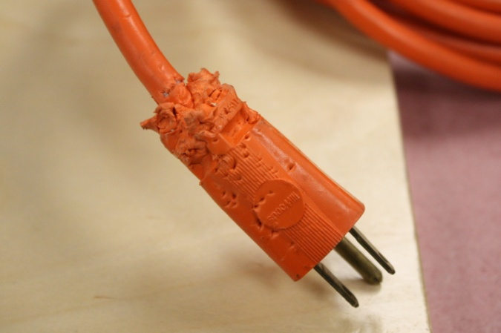
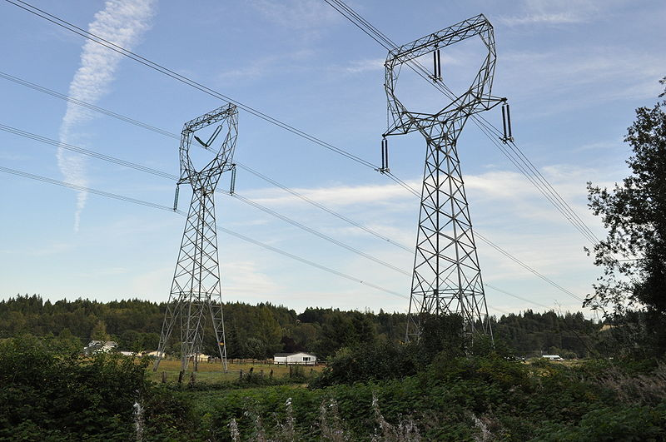
General Electrical Hazards
Stay 10 feet from high voltage lines
Avoid broken plugs and switches
Avoid flammable materials
Never modify tools
Never disable safety switches
Notes:
Question: If a dump truck touched high-voltage power lines when the operator raised the bed to unload the contents, would the driver be electrocuted?
Answer: No. The large rubber tires would prevent the voltage from reaching the ground and forming a completed circuit (much like birds sitting on a wire).
Question: Under what conditions would the driver risk his life?
Answer: If the driver were to step out of the truck, he would be electrocuted as soon as his foot touched the ground.
Question: When is it okay to disable safety switches?
Answer: Never.

Slide 15
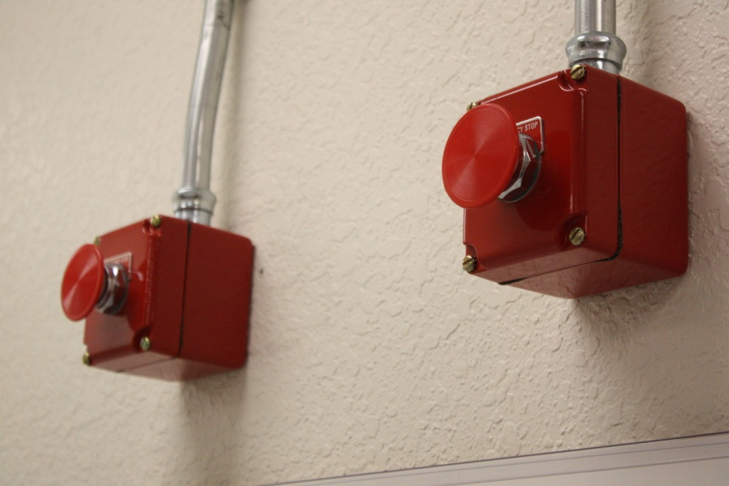
Circuit Protection
Energize or de-energize a circuit with appropriate switches or breakers.
Do not energize or de-energize with fuses.
If circuit protection device is tripped, investigate cause.
Notes:
Question: What are the devices to protect circuits called?
Answer: Circuit breakers and fuses.

Slide 16
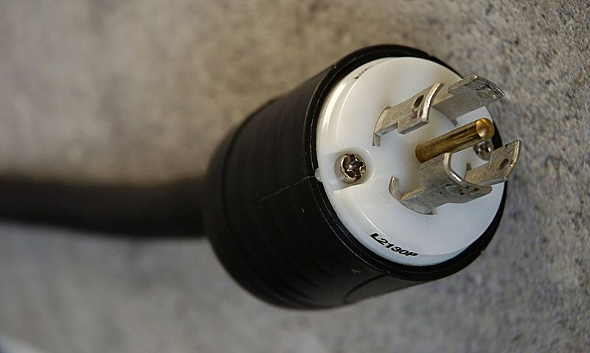
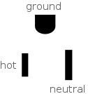
Grounding Equipment
Normal operation no current flows to ground
Faulty circuit diverts current to grounding conductor-this low resistance path causes fuse/breaker to open
Earth dissipates electrical charge
Notes:
NOTE: show Youtube video on Faraday Effect, High Power Electrical Transmission Line Service (several versions posted)

Slide 17
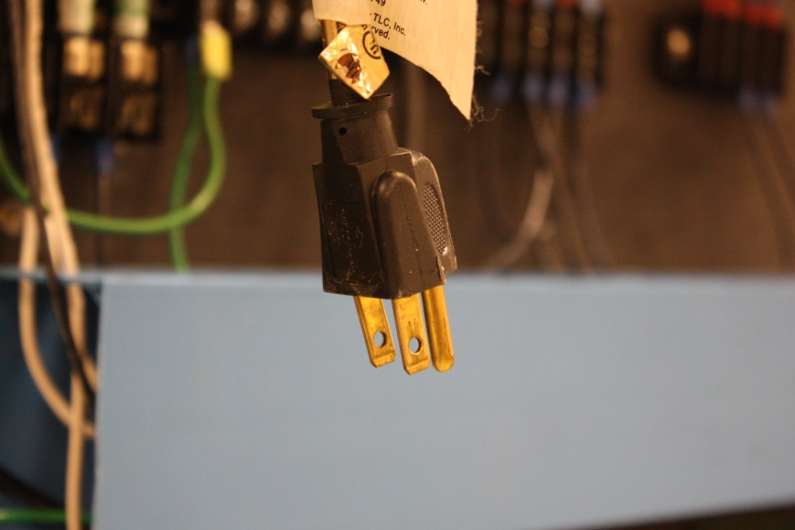
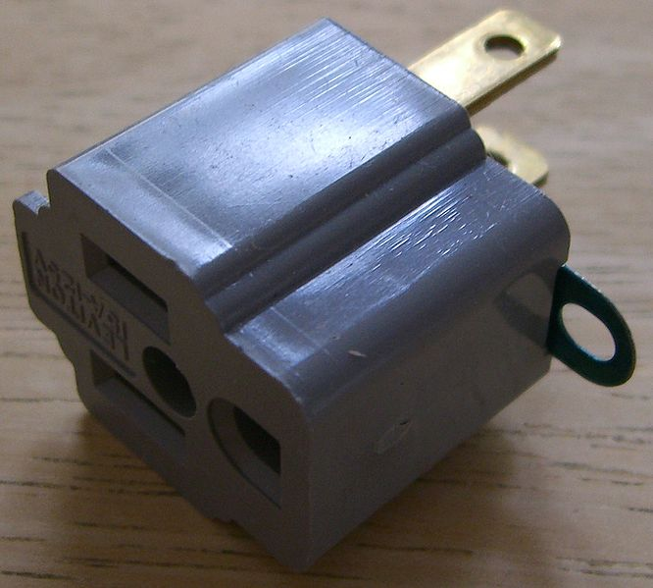
Three-Prong Power Plug
Common method of providing path to ground
Do not alter plug
Three-to-two prong adapter plug must have ground wire connected and completed-verified ground established
Notes:
Note- a three prong adapter is designed to be screwed into the center of the outlet, using the center screw through the adapter loop ground wire to the metal center frame of the outlet. That will work only if three conditions are met:
The screw is installed correctly into the center of the metal frame of the outlet;
The outlet is properly grounded to the electrical box, and
The box itself is properly grounded.

Slide 18
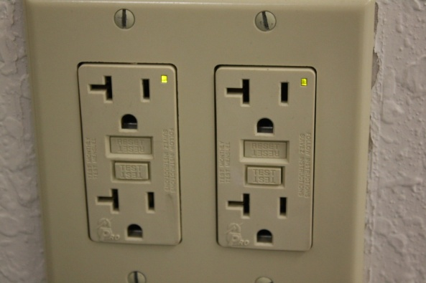
Ground-Fault Circuit Interrupter
GFCI reduces the risk of fatal shocks
Detects small imbalances of flow between circuit legs and automatically interrupts power
Used with extension cords and portable tools
Protects people, not equipment
Notes:
Question: Where should the GFCI be located?
Answer: At the power source, the receptacle.
Question: What does a GFCI protect?
Answers: A GFCI is designed to protect the user, not the tool.
Question: What does a GFCI do?
Answer: A ground-fault circuit interrupter senses a small amount of current and trips, or opens the circuit, to prevent damage.

Slide 19
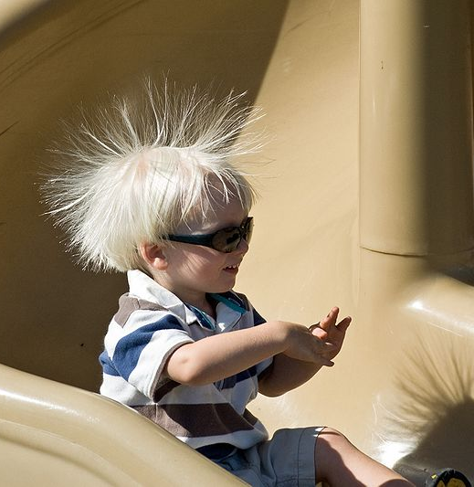
Static Electricity
Static electricity is an imbalance of electric charges within or on the surface of a material. The charge remains until it is able to move away by means of an electric current or electrical discharge.
Static electricity is named in contrast with current electricity, which flows through wires or other conductors and transmits energy.
Created when materials rub together
Causes shocks
Reduced or prevented by:
  Proper grounding
  Rubber matting
  Static control wristband
Notes:
Question: Can you prevent static electricity with a GFCI?
Answer: No. Static electricity does not always flow in a predictable established current pattern.
Question: Is static electricity essentially harmless?
Answers: No. Static electricity around electrical equipment or flammable gasses can cause equipment damage, gas explosions, and bodily harm.

Slide 20
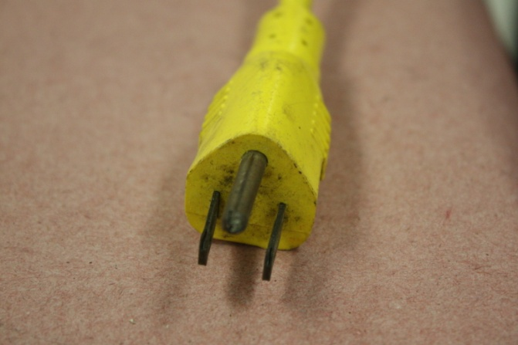

Extension Cords
Check rating - UL approved
For temporary work only
Do not use as a rope
to pull or lift objects
Should not be fastened
with staples or hung over hooks
Use correct cord for the job

Slide 21
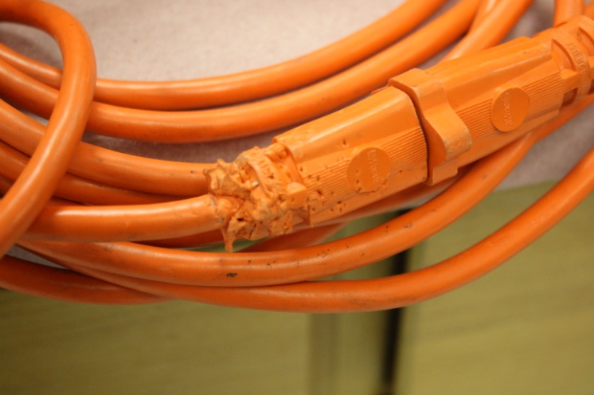
Inspection of Electrical Cords
Inspect for:
  Deformed or missing pins
  Damaged outer jacket or insulation (usually near plug)
  Evidence of internal damage
  If damaged, take out of service
DO NOT USE DAMAGED ELECTRICAL CORDS!
Notes:
29 CFR 1910.305(g)(2)(ii). The OSHA standard for Electrical Wiring Methods, Components, and Equipment for General Use states that “Flexible cords may be used only in continuous lengths without splice or tap. Hard-service cord and junior hard-service cord No. 14 and larger may be repaired if spliced so that the splice retains the insulation, outer sheath properties, and usage characteristics of the cord being spliced.”

Slide 22
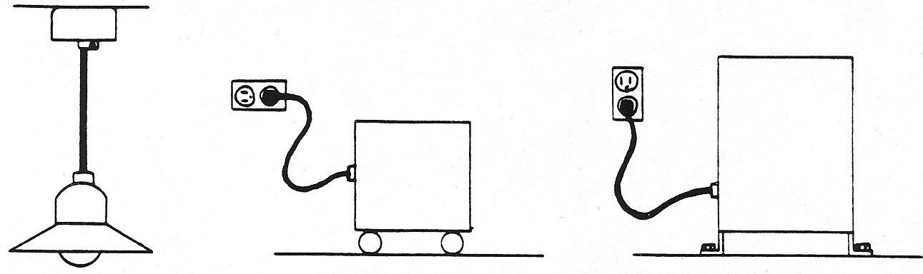
Permissible Uses of Flexible Cords
Examples
Pendant, or
Fixture Wiring
Portable lamps,
tools or appliances
Stationary equipment to facilitate interchange
Notes:
1910.305(g)(1)(i)
Other examples:
Elevator cables
Wiring of cranes and hoists
Prevention of the transmission of noise or vibration
Appliances where the fastening means and mechanical connections are designed to permit removal for maintenance and repair
Data processing cables approved as part of the data processing system

Slide 23
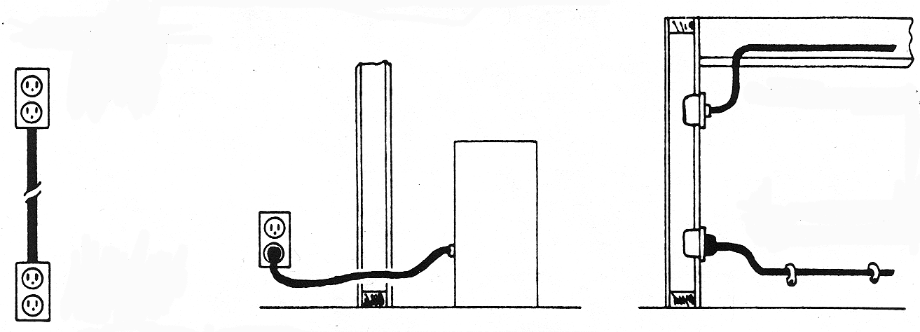
Prohibited Uses of Flexible Cords
Examples
Substitute for fixed wiring
Run through walls, ceilings, floors, doors, or windows
Concealed behind or attached to building surfaces
Notes:
1910.305(g)(1)(iii)

Slide 24
Training
Unqualified workers know:
  How electricity works
  Risks of working with energized equipment
  Which tasks can be performed only by qualified workers
  Identify hazards
Qualified workers also know:
  How to identify exposed energized parts
  How to safeguard or work on energized parts

Slide 25
Clues that Electrical Hazards Exist
Tripped circuit breakers or blown fuses
Warm tools, wires, cords, connections, or junction boxes
GFCI that shuts off a circuit
Worn or frayed insulation around wire or connection (at plug, inline)
Smell of burning components and/or visible smoke

Slide 26
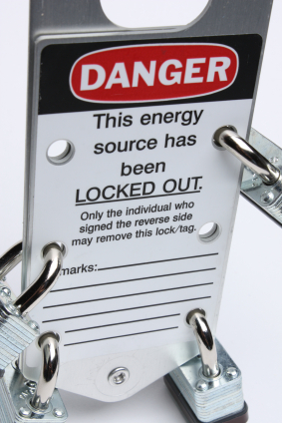
De-Energize
Disconnect power before servicing
LOTO by the book!
Notes:
LockOut/TagOut will be covered in Module 8

Slide 27
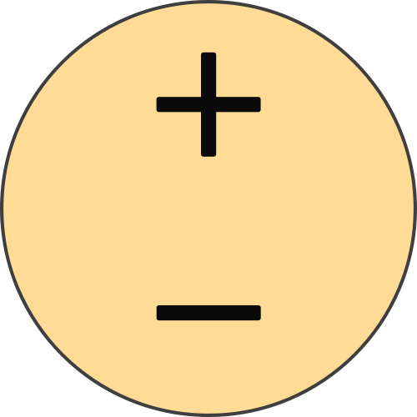
Summary
We discussed the following:
  Basic principles of electricity
  Electrical hazards and safety precautions
  Training methods for preventing hazards on the production floor

