Slide 1

Domain 1: Safety Awareness
Foundations of
Manufacturing
Section 8:
Hand and Power Tool Safety
CFR Part 1910 Subpart P
(§1910.241 to 1910.44)
CFR Part 1910 Subpart O
(§1910.211 to 1910.219)
Notes:
READ TO STUDENTS: We will discuss safety issues and requirements that pertain to hand and power tools. Every production technician is expected to know the value of the safe use of tools, how to inspect tools prior to use, and what the technician should do if he or she suspects that a tool is unsafe for use. Together, this knowledge of electrical and tool safety will save lives, decrease lost man-hours, and save the company money.

Slide 2
Learning Objectives
Understand the safety precautions that must be observed when working with and around hand and electrical tool equipment.
Discuss methods of training to prevent tool accidents.
Describe the hazards that exist when working with and around tools.
2/37
Notes:
Direct students to turn to page 1-8-1 in their Foundations of Manufacturing, Domain 1: Safety Awareness, Section 8: Hand and PowerTool Safety, Student Workbook and continue with the discussion.

Slide 3

Accident Example
Hit by a flying ratchet – 4 stiches to close wound.
Wearing safety glasses but no face shield.
3/37

Slide 4
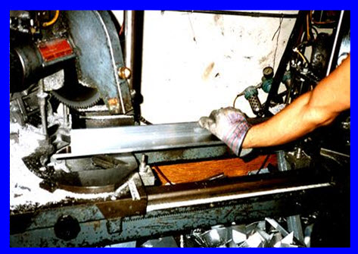
Procedures for Working with Tools
Avoid reaching in for debris or jammed parts
Follow lock-out and tag out procedures when maintaining machines
All operators must be thoroughly trained for operations and maintenance
Machine guards must be in place and functioning
4/37

Slide 5

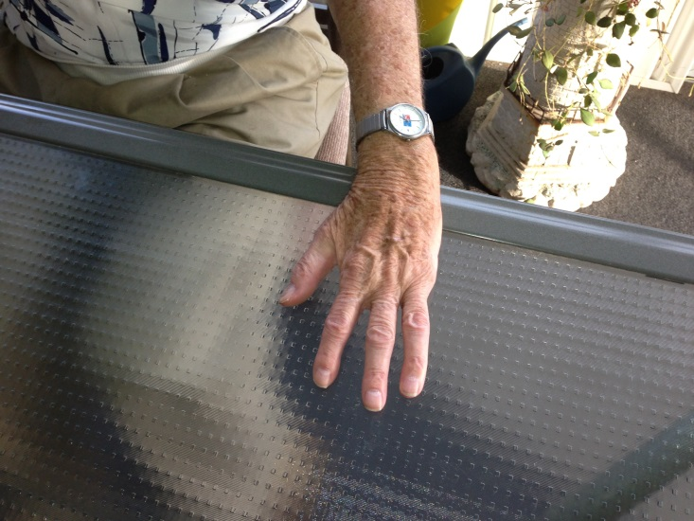
Recognizing Tool Hazards
Take no shortcuts! Use the right tool for the right job.
It’s difficult to spot hazards due to familiarity
Inspect the tools prior to
use. Sharpen as required.
5/37
Notes:
Question: Who is responsible for monitoring the safe use of tools?
Answer: Everyone

Slide 6
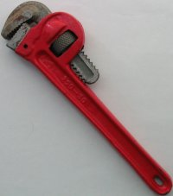
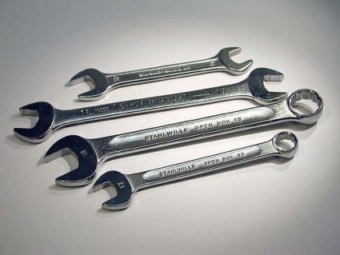
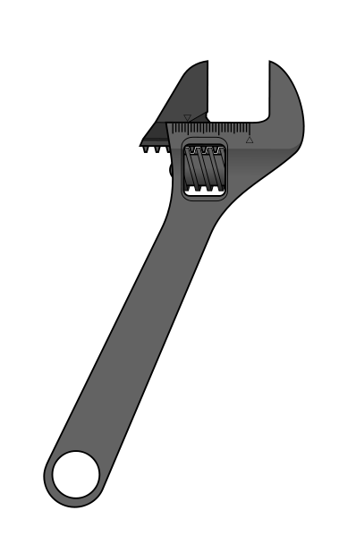

Types of Wrenches
Pipe Wrench
  Fits around plumbing and electrical
  piping and fittings (round objects)
General Use Wrench
  Nuts & bolts with flat parallel surface
Adjustable
  Monkey wrench, Crescent®
6/37

Slide 7
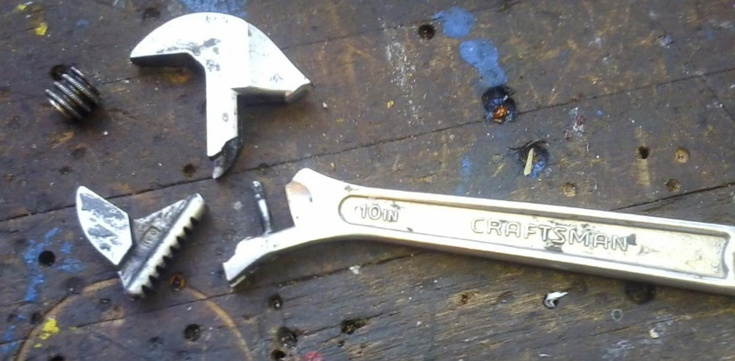
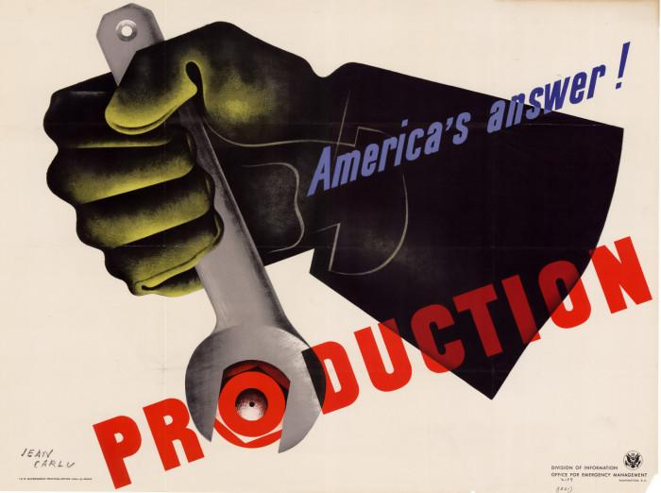
Wrenches
Do not:
Use wrench as a hammer
Hammer on a wrench to loosen bolts or nuts
Use wrench with sprung jaws
7/37

Slide 8
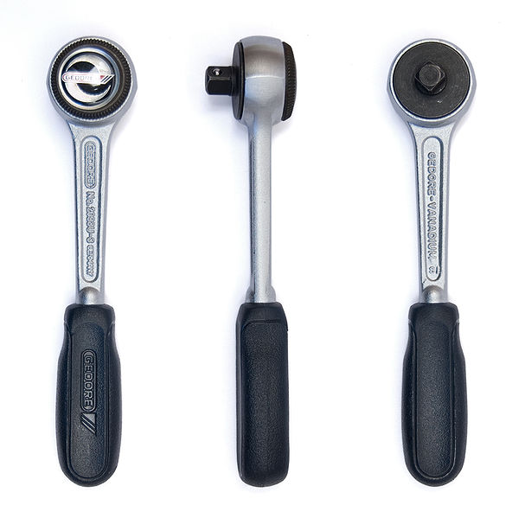
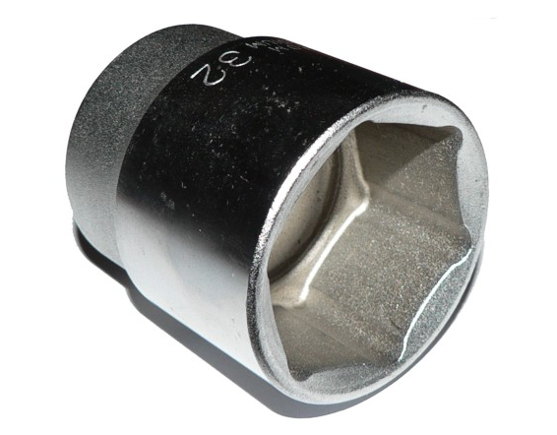
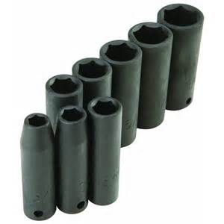
Socket Wrenches
Use correct socket for the job – do not use standard sockets when using an impact wrench
Ensure that wrench fits socket properly
Remember: a socket is a wrench, not a hammer
8/37
Notes:
Question: What is the advantage of using a socket wrench?
Answer: A nut or bolt can be tightened or loosened without removing and refitting the wrench after each turn.

Slide 9


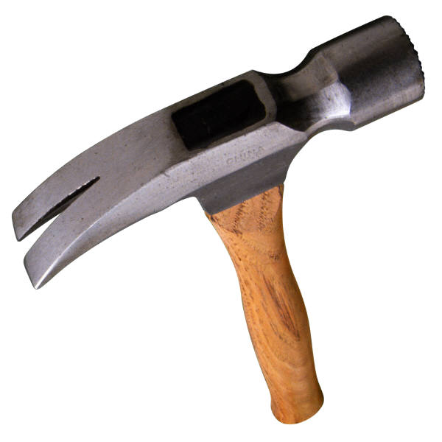
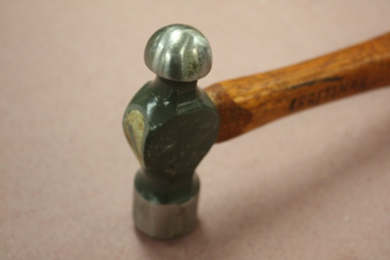
Hammers
Select correct hammer for the job
Striking face diameter
Firmly attached hammer head
Replace damaged handles
Strike properly
Wear PPE
9/37
Notes:
Question: Why must a hammer handle be properly fitted into the hammer head?
Answer: If not fitted properly, the hammer head may fly off and hit someone or even you in the face or head.

Slide 10

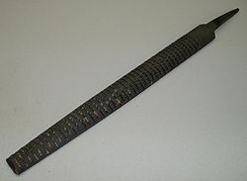

Files
A file (or hand-file) is a hand tool used to shape material by cutting. A file typically takes the form of a hardened steel bar, mostly covered with a series of sharp, parallel ridges or teeth. Most files have a narrow, pointed tang at one end to which a handle can be fitted.
The rasp is a related tool that is generally larger and has raised, pointed teeth on its surface rather than straight ridges.
A file card is a brush with metal bristles, used to clean the cutting grooves in a file.
10/37

Slide 11
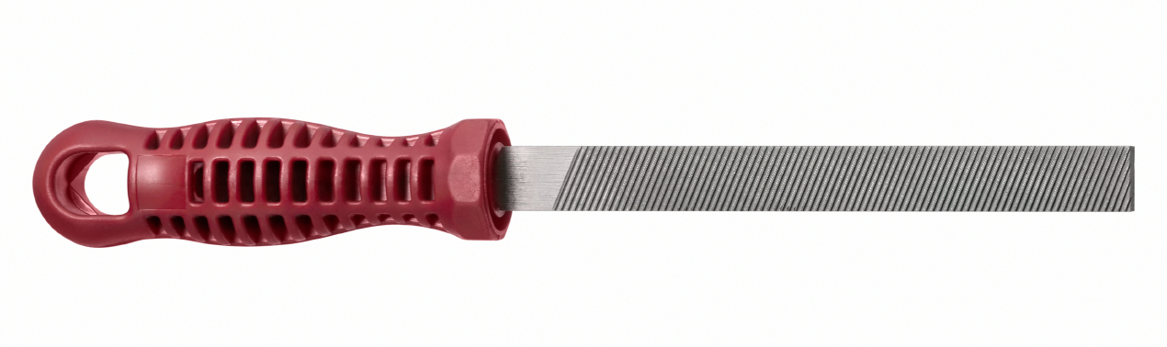
Files (Cont’d.)
Use the correct file for the job.
Wear proper PPE.
A file is not a chisel or a scraper.
11/37
Notes:
Question: What are files used for?
Answer: To smooth out rough edges on metal surfaces.

Slide 12
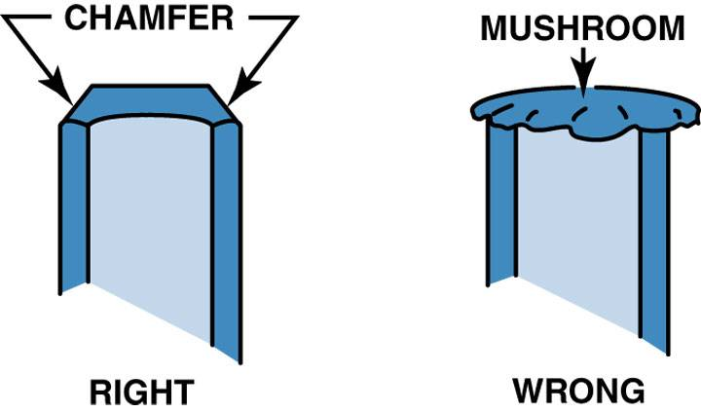
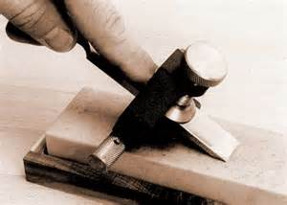
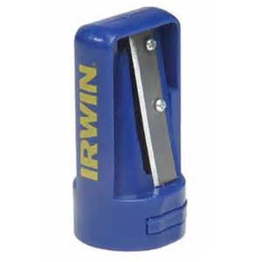
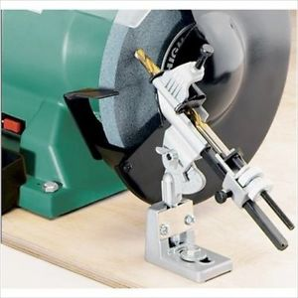
Tool Sharpening
A tool should be sharpened whenever an unacceptable surface is present
12/37

Slide 13
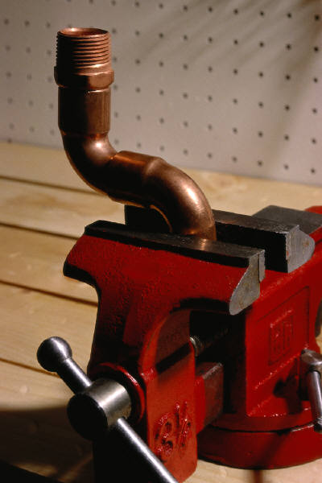
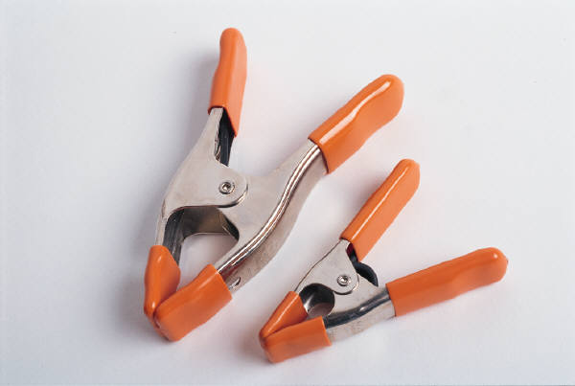
Clamps
Never:
Tighten the clamp with a section of pipe
Use a clamp for hoisting materials
Over-tighten clamp
13/37
Notes:
Question: Why not tighten a clamp with a section of pipe to extend the grip?
Answer: It can damage the clamp and/or the material secured by the clamp.

Slide 14

Safety Factors
General housekeeping
Use PPE
Use protection around flammables
Do not use tools near aisleways
Unsecured materials can become airborne
Be aware of surroundings
14/37

Slide 15
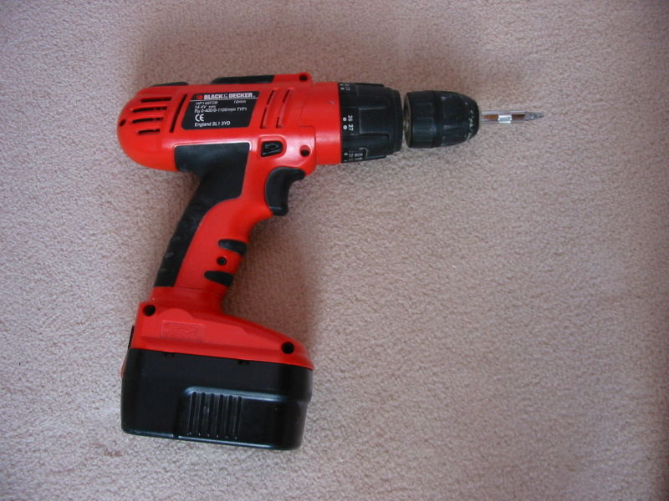
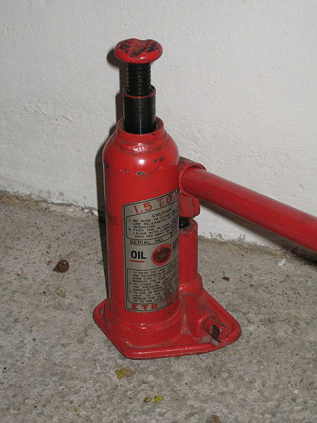
Power Tool Energy Sources
Electric – Powered by electricity
  Alternating current (AC), a wall plug
  Direct current (DC), such as a battery
Hydraulic – Powered by fluid pressure
  Manual or electric pumps
  Used to produce fluid
  pressure
15/37

Slide 16
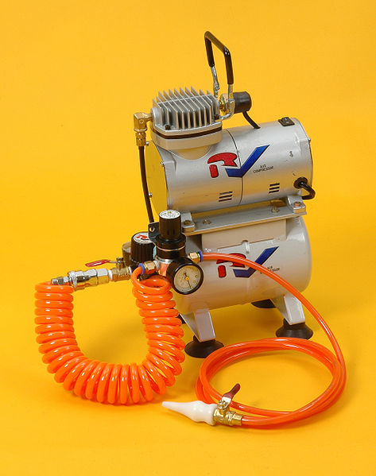
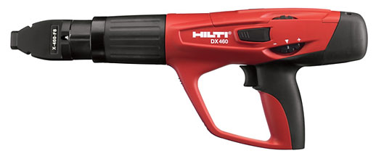
Power Tool Energy Sources (Cont'd.)
Pneumatic – Powered by air
  Compressors produce the air
  pressure
Powder-actuated – Powered by
gunpowder cartridge called boosters
  OSHA requires that all operators be qualified and certified by the
  manufacturer before use
16/37

Slide 17

Power Tool Precautions
Never carry a tool by the cord.
Never pull the cord to unplug it.
Keep cords out of water.
Disconnect tools when changing attachments or when not in use.
Keep tools properly maintained.
Do not wear loose clothing or jewelry.
17/37
Notes:
Question: What are the hazards of working with a tool that has loose wires?
Answer: Electric shock or fire.

Slide 18
Electrically Powered Tool Safety
Use PPE as required.
Operate within design limitations.
Do not use in wet or damp locations.
Do not use around combustible materials.
Work areas should be well-lit.
When not in use, store tools in a dry location.
18/37

Slide 19
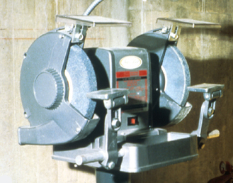
Abrasive Wheel Machinery
Work rests on offhand grinding machines must be kept adjusted closely to the wheel with a maximum opening of 1/8-inch to prevent the work from being jammed between the wheel and the rest, which may result in wheel breakage.
19/37
Notes:
1910.215(a)(4)

Slide 20
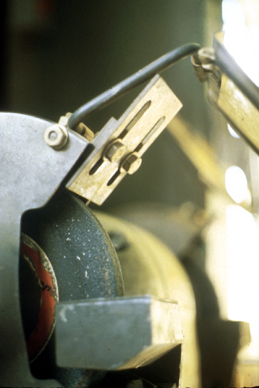
Abrasive Wheel Machinery
The distance between the wheel periphery and the adjustable tongue must never exceed 1/4-inch.
20/37
Notes:
1910.215(b)(9)

Slide 21
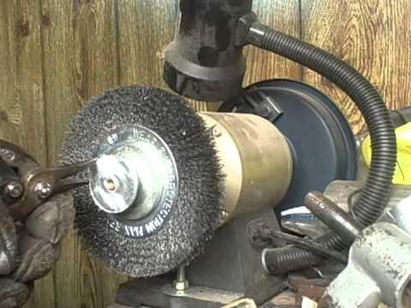
What’s Wrong With This Picture?
21/37
Notes:
See 1910.215 including:
No safety guard over spindle nut
No work rest
No wheel periphery guard at top of wheel
Also potential for housekeeping near grinder, potential for problem if grinder is running and user wearing gloves.

Slide 22
Bench Grinder Safety
OSHA requires use of both safety glasses with side shields and a face shield while using a bench grinder.
Hearing protection may be required.
Gloves – Do not wear if hands must be close to the wheel.
Respiratory protection may be required.
22/37
Notes:
The following is common PPE for operators:
Safety glasses with side shields or goggles
Face shield
Respirator
Hearing protection
Gloves
OSHA requires the use of personal protective equipment to protect against the abrasive grinding wheel hazards we discussed at the beginning of the session.
You must wear safety glasses with side shields or safety goggles when working on an abrasive wheel grinder to protect your eyes from flying chips and dust. You also need eye protection in the event a wheel disintegrates and broken pieces escape the wheel guarding.
A face shield is required in addition to eye protection when the job you’re doing is likely to create a large number of chips and particles.
Respiratory protection is also required to protect you from dusts and fumes that could harm your respiratory system. The type of respirator depends on the material you’re grinding.
In addition to eye, face, and respiratory protection, you also need hearing protection to protect your ears from the noise generated by grinding operations. You may choose to wear ear plugs, canal caps, or ear muffs, depending on the amount of noise. Ear muffs generally provide the best protection, but ear plugs work well, too, in most cases.
Although gloves will protect your hands from the sharp edges and burrs of the material that you’re grinding, they should be worn with caution. If your hands must be close to the wheel—for example, if you’re working on a small piece of material—do not wear gloves. The spinning wheel could grab a glove and pull your hand into the grinder.
Think about the personal protective equipment you use when working on an abrasive grinding wheel.

Slide 23
Grinder Safety - Wheel Condition
Inspect the abrasive wheel before mounting it to the equipment.
  Check the wheel for any visual damage.
  If damaged, do not use it.
Inspect the wheel for internal integrity; this is the "ring test.”
  Tap the wheel "gently with a nonmetallic implement." You can use the handle of a screwdriver or a wooden or plastic mallet for thicker wheels.
  You should hear a “ring”. If the sound is more of a “thud” or dead sound, you likely have a faulty, unusable wheel.
Further inspect to make sure the wheel's revolutions per minute (RPM) rating matches the RPM of the bench grinder.
23/37

Slide 24
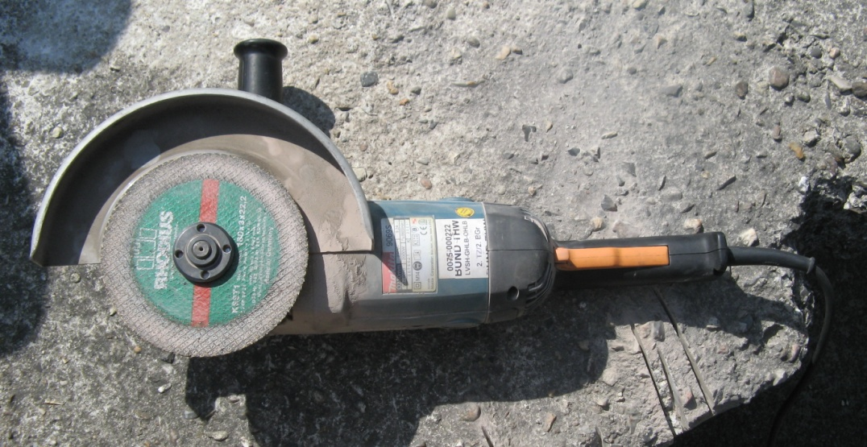
Electric Grinder Safety
Make sure the grinder is in good condition and the wheel is secured.
Always check the wheel for cracks before using.
Do not leave the grinder unattended once finished until the wheel comes to a complete stop.
24/37

Slide 25
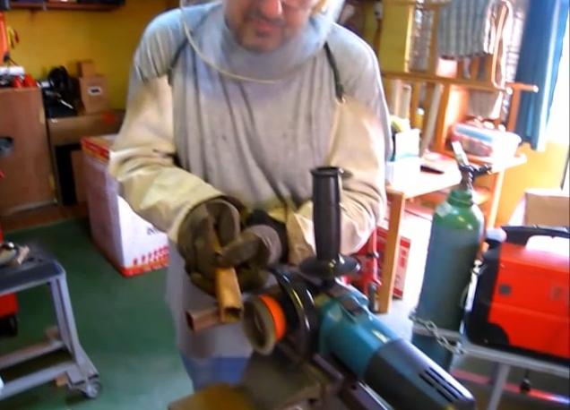
Powered Abrasive Wheel Tools
Always use eye protection.
Use both hands to hold the tool.
Make sure you have firm footing.
Make sure all guards are in place.
Never clamp a handheld
tool in a vise.
Disconnect the electric source when changing wheels.
25/37
Notes:
Question: What are the safety hazards associated with placing a hand held grinder in a vise?
Answer: The grinder will vibrate the vise and fall out. A person’s natural instinct is to try to catch it, which will result in cuts and abrasions or worse.

Slide 26
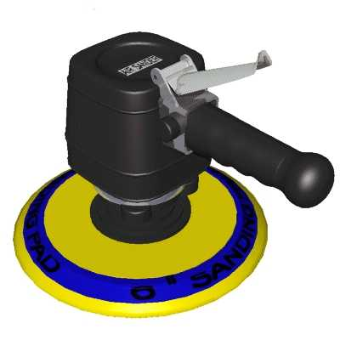
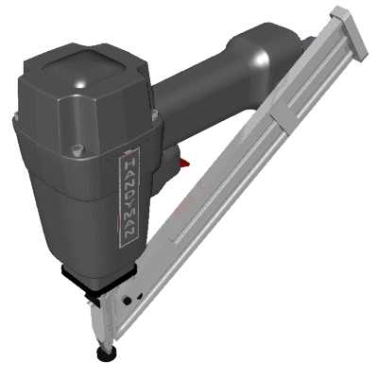
Pneumatic Tool Hazards
Not wearing proper PPE correctly
Being struck by attachments
Being struck by broken fasteners
Exceeding recommended operating pressure
Noise
26/37

Slide 27
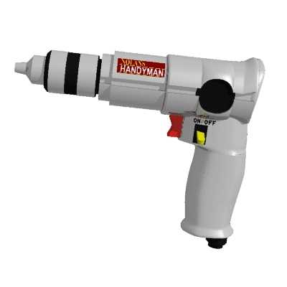
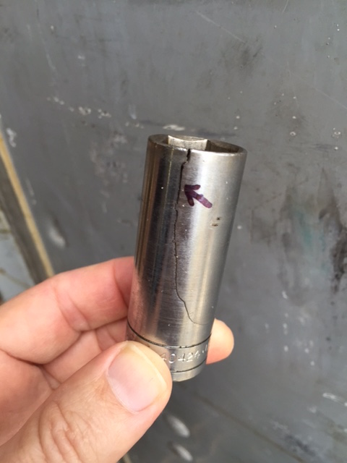
Pneumatic Tool Safety
Wear hearing protection.
Keep your body balanced.
Keep body parts away from working end.
Stay clear of whipping air hoses.
Only use accessories made
for pneumatic tools.
Impact wrenches use only
impact sockets.
27/37
Notes:
Question: What dangers exist when using pneumatic tools?
Answer: Air supply hoses can come loose and whip back and forth, which may cause injury to the user or a bystander.

Slide 28

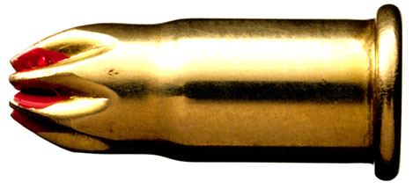
Powder-Actuated Tool
A tool powered by an explosive charge.
28/37
Notes:
Question: What is a “powder-actuated” tool?
Answer: It is a driver powered by a bullet-like charge, often in .22 or .25 caliber rounds, similar to gun bullets.

Slide 29
Powder-Actuated Tool Safety
Wear appropriate PPE
Inspect tool before each use
Only operated by trained personnel
Load the tool only when it is going to be used
Keep hands clear of the barrel end
29/37

Slide 30
Powder-Actuated Tool Safety (Cont'd.)
Never try to pry a cartridge from a powder-actuated tool.
Never hold your hand behind the material you are fastening.
Do not use in an explosive or flammable atmosphere.
Keep all body parts and co-workers away from the path of fire to avoid serious injury.
Keep the tool properly oiled.
30/37

Slide 31
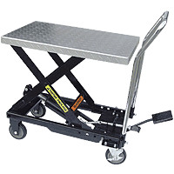
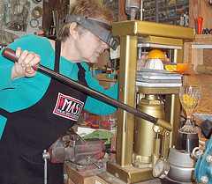
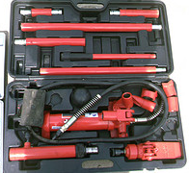
Hydraulic Tools
31/37
Notes:
Question: What is the number one safety hazard to be aware of when using a hydraulic powered tool?
Answer: A blown hose or seal could spray the user with highly pressurized, hot hydraulic fluid.

Slide 32
Hydraulic Jack Safety
Set up a jack so that the base rests on a firm, level surface.
Ensure that the jack is centered.
Ensure that the jack head is against a level surface.
Be certain the lift force is applied evenly.
Know the load restrictions.
32/37
Notes:
Question: Should you trust a hydraulic jack to hold the load after you lifted it to the desired height?
Answer: DO NOT trust the hydraulic jack alone. Use jack stands.

Slide 33
Five Basic Rules for Hand and Power Tool Safety
Regularly maintain all tools.
Use the right tool for the job.
Examine each tool before use for damage.
Operate tools according to manufacturer instructions.
Proper personal protective equipment must be used.
33/37

Slide 34
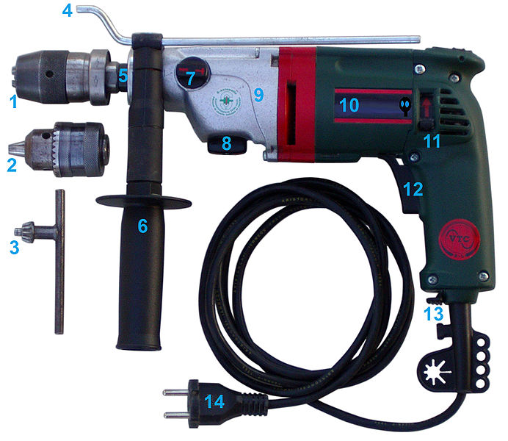
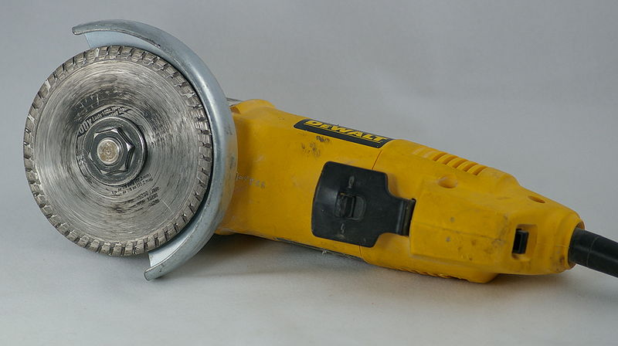
Power Tools with Momentary Switches
Electric drills
Electric screwdrivers
Fastener drivers
Horizontal, vertical, and angle grinders
34/37
Notes:
Question: What is a momentary switch?
Answer: It is an “on-off” switch that allows the equipment to work only when the trigger is engaged.

Slide 35
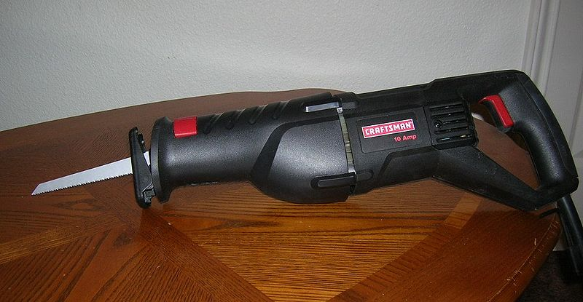
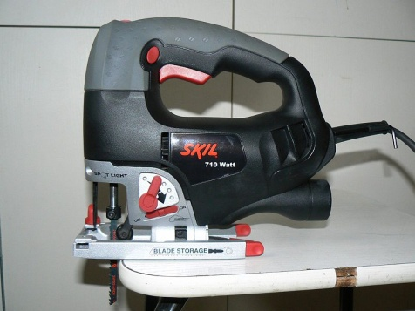
Power Tools with Momentary Switches (Cont'd.)
Disc and belt sanders
Reciprocating saws
Saber saws
Note: These tools can have a “lock-on” switch that turns off with a single finger motion.
35/37

Slide 36

Interlocks
Interlocking is a method of preventing undesired states in a machine, which in a general sense can include any electrical, electronic, or mechanical device or system.
Interlocks also serve as important safety devices in industrial settings, by protecting employees from devices such as robots, presses, and hammers.
36/37
Notes:
Examples of Interlock- two thumb safety switches on paper cutting machines, lever on lawn mower for blade actuation/brake.

Slide 37
Summary
  We discussed:
  What tools to use for what jobs
  What not to use some tools for
  How to select the necessary tools to
  complete a job
  The function and possible hazards of tools commonly used on the production floor
  Methods of training to use hand and portable power tools
37/37

