Slide 1

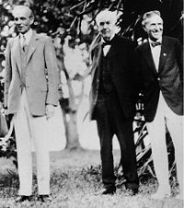
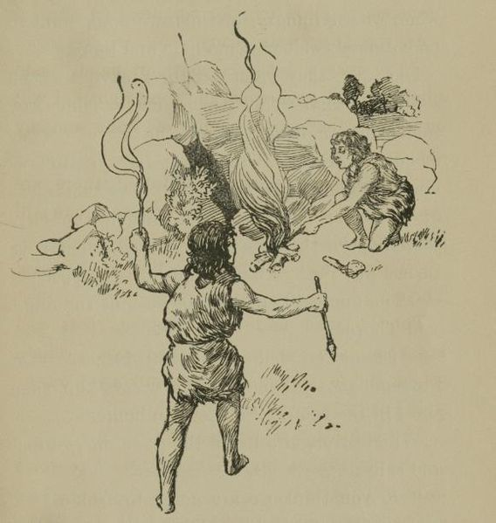
Domain 2: Production Processes
Foundations of Manufacturing
Notes:
READ TO STUDENTS:
Manufacturing is as old as the human race. To be an effective and valued production technician, you must understand the industry. You should understand the history and development of manufacturing. You should also understand the concept that any process that produces a product is considered manufacturing.
Pictured- (Left) Henry Ford, Thomas Edison, Harvey Firestone

Slide 2
Domain 2 Production Processes
Table of Contents
Section 1 Introduction to Manufacturing
Section 2 Production Process
Section 3 Manufacturing Essentials and Instruments
Section 4 Lean and Six Sigma
Section 5 Business Basics
Section 6 Supply Chain
Section 7 Machine Fundamentals

Slide 3

Domain 2: Production Processes
Foundations of Manufacturing
Section 1: Introduction to Manufacturing
Notes:
READ TO STUDENTS:
Manufacturing is as old as the human race. To be an effective and valued production technician, you must understand the industry. You should understand the history and development of manufacturing. You should also understand the concept that any process that produces a product is considered manufacturing.
Pictured- (Left) Henry Ford, Thomas Edison, Harvey Firestone

Slide 4
Manufacturing is as old as the human race. To be an effective and valued production technician, you must understand the industry. You should understand the history and development of manufacturing. You should also understand the concept that any process that produces a product is considered manufacturing.

Slide 5
Learning Objectives
Describe early manufacturing processes.
Discuss mass production and how it revolutionized manufacturing.
Identify the people who were key contributors to manufacturing processes.
Discuss current and future manufacturing processes.
Identify examples of manufactured products.
Notes:
Direct students to turn to page 2-1-1 in their Foundations of Manufacturing, Domain 2: Production and Processes, Section 1: Introduction to the Manufacturing Industry, Student Workbook and continue with the discussion.
Question: Why is the history of manufacturing important?
Answers:
Understand present manufacturing methodology.
Acceptance of changes due to technology.
Understand management’s attitude toward employee functions and skills.

Slide 6
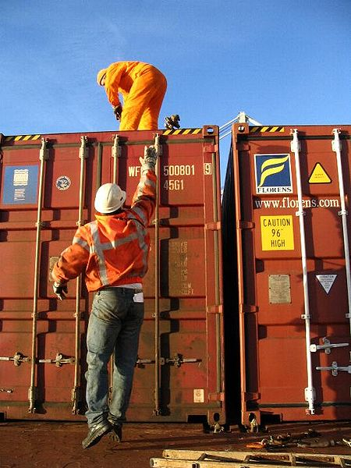

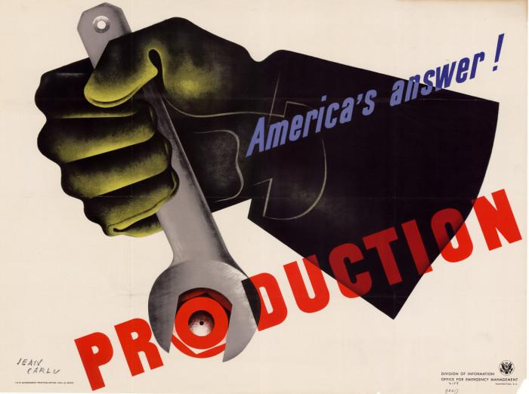
What is Manufacturing????
Input + Processes = Result
Quality + Quality = Quality

Slide 7
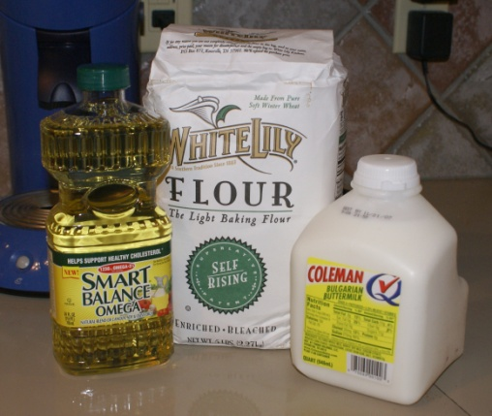
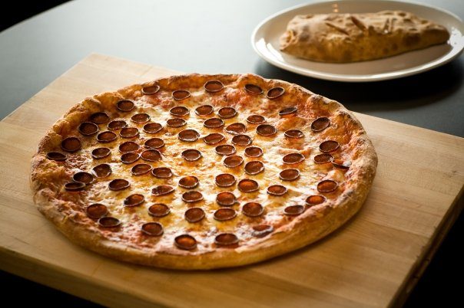
Never Worked in Manufacturing??
Made Pizza?? Short Order Cook??
Input + Processes = Result
Ingredients measure pizza
mix
knead
bake
Quality + Quality = Quality
Notes:
Ask students about their current jobs. Discuss the possibilities of manufacturing in what they currently do.

Slide 8



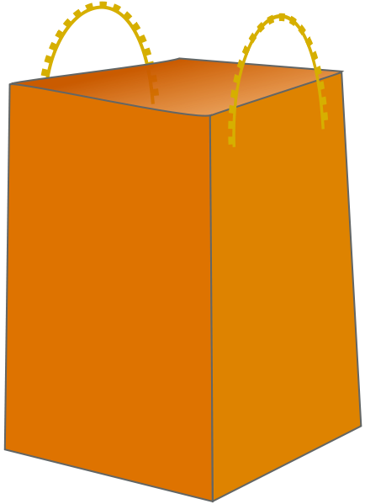



Who is the Customer?

Slide 9
Who Is The Customer?
A customer is some person or organization that uses an output from a different person or organization. Customers are defined as internal and external to an organization.

Slide 10
QUOTE
One thing we have discovered with certainty is that anything we do that makes the customer successful inevitably results in a financial return for us.”
---Jack Welch

Slide 11
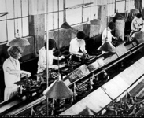
Internal Customer
Internal customers are persons or departments who rely on output from another department of the same organization to accomplish their own function.
In manufacturing, an internal customer is the next person in line in the assembly process.

Slide 12

External Customer
A typical example of an external customer is a grocery shopper who goes to a market to buy goods. This person is from outside the organization of the market.

Slide 13
Who Has an Interest in the Output?
Customers – those who buy the company’s products
Government Agencies – are charged with ensuring the produced products meet certain guidelines and requirements
Investors – those who specifically expect to gain financial returns, interested in profits
Stakeholders – those who have an interest in the company, not necessarily a financial gain.
An investor can be a stakeholder, but not all stakeholders
can be considered investors.

Slide 14

QUESTION
Why must the customer be involved in the production process?
Why must production keep the customer aware of changes?
Notes:
Keep production updated when customers needs change
Example: customer wants a change in the material; color, type, etc.
Production changes may impact customers schedule or plans

Slide 15
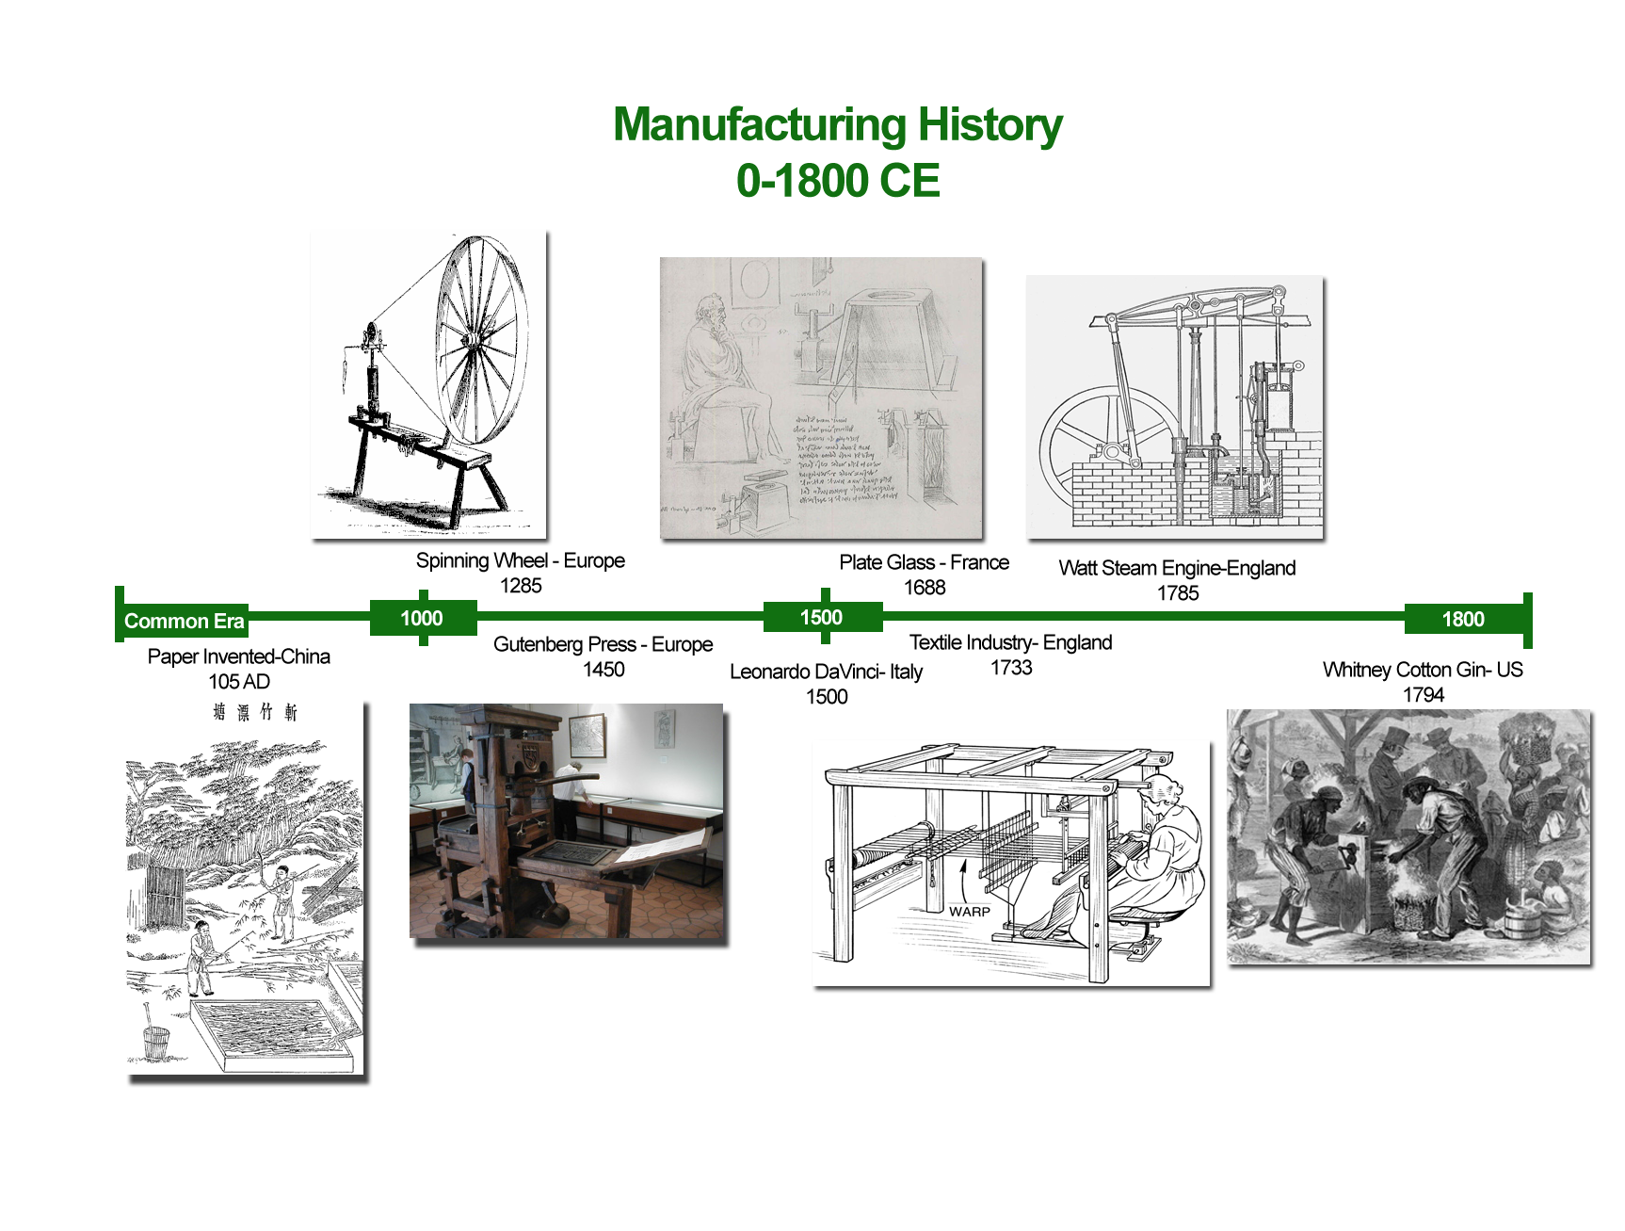

Slide 16
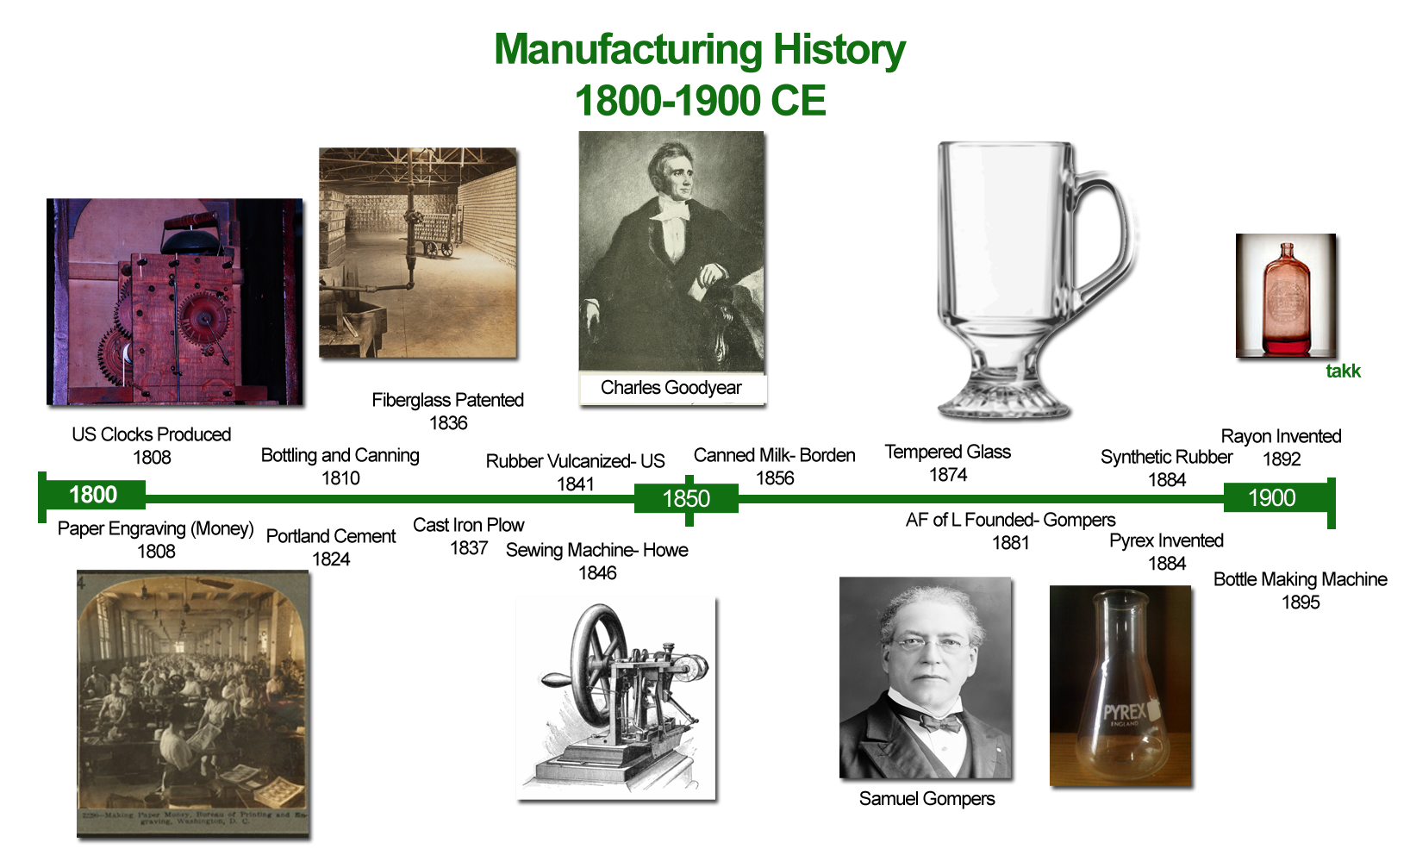

Slide 17
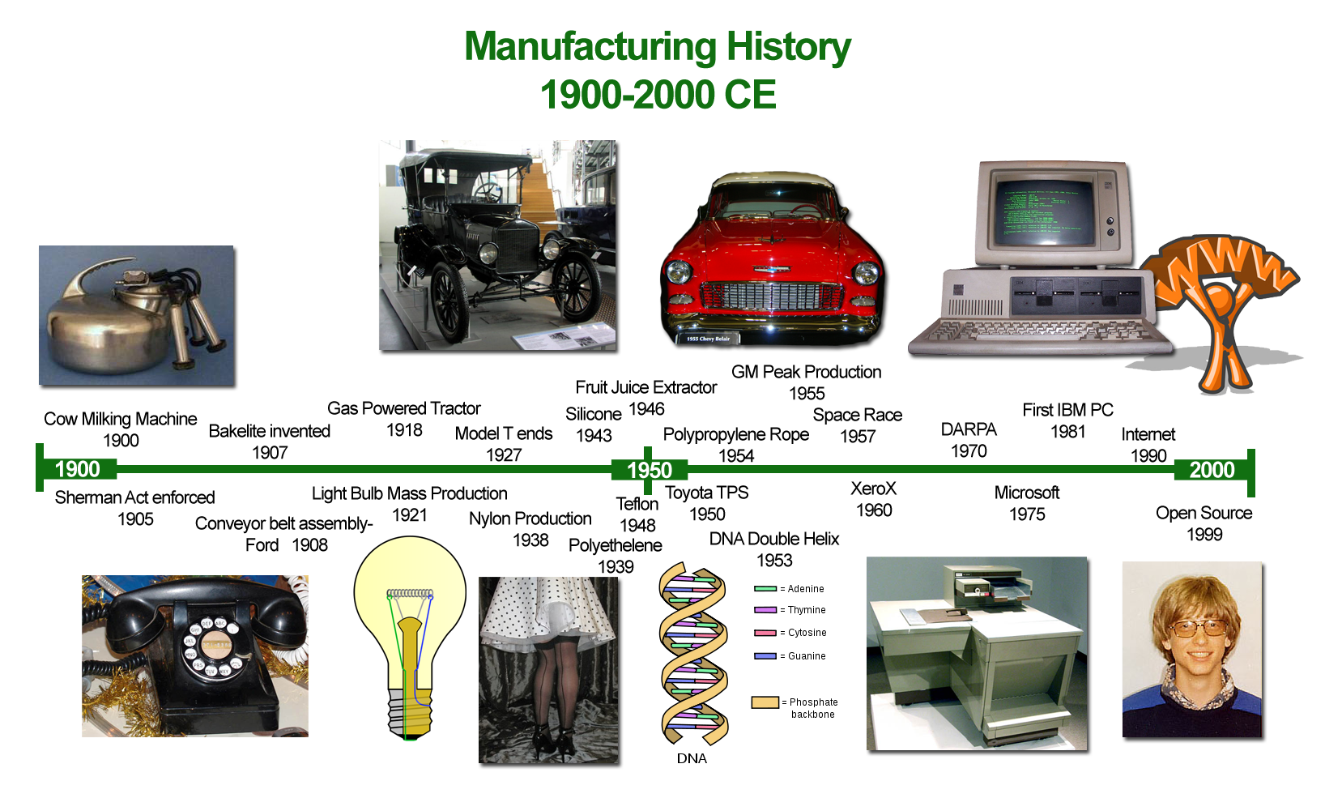

Slide 18

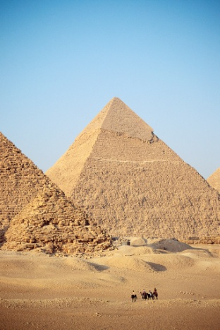
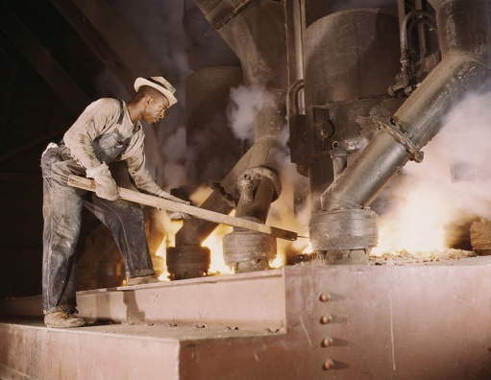
Early Manufacturing
Cavemen
Discovery of fire
Handcrafted goods
Egyptians
Industrial Revolution

Slide 19

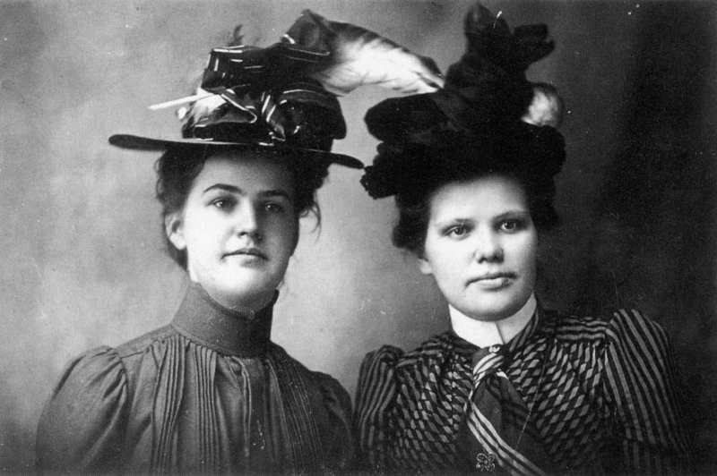
QUESTION
What do you think it would have been like to live without electricity?

Slide 20
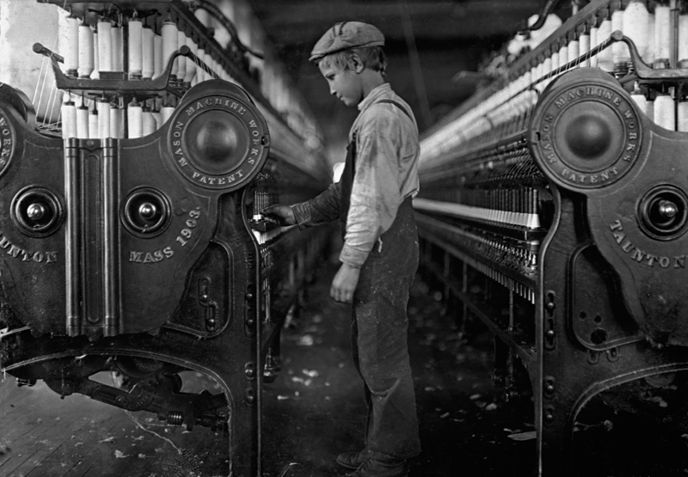
QUESTION
Why is the history of Manufacturing important?
  To understand manufacturing methodology
  To understand acceptance
  of changes due to technology
  To understand managements attitude toward employee functions and skills

Slide 21
Manufacturing Sub-industries
Chemicals
Electrical equipment and appliances
Computers and electronics
Food and beverage
Furniture
Machinery
Petroleum and coal
Nonmetallic minerals
Plastics and rubber
Printing
Primary and fabricated metals
Textiles and leather
Wood and paper
Transportation equipment
Notes:
Note: Some plastics are made from the same crude oil that becomes the gasoline you use to fuel your car.

Slide 22
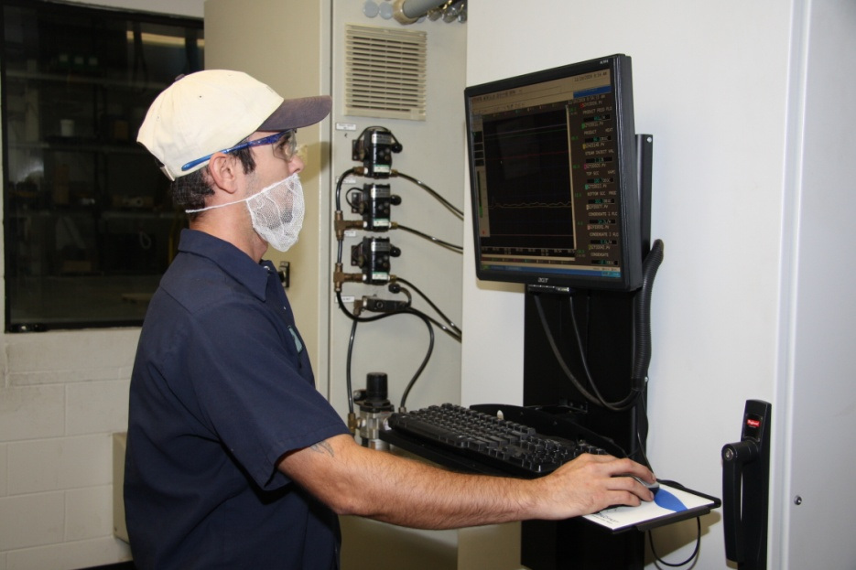
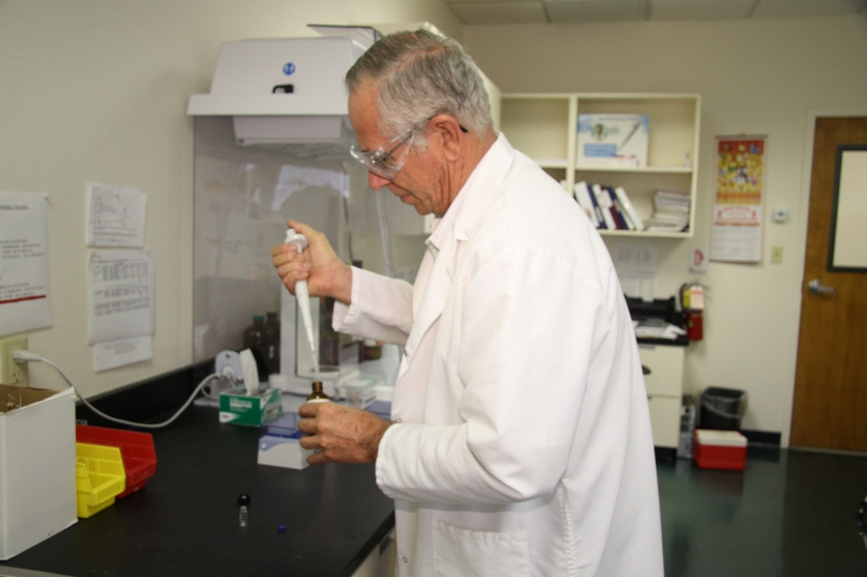
QUESTION
What types of industries are located in this area and what types of processes do they use?
Photos courtesy Treatt USA
Notes:
Photos are from Treatt USA in Lakeland, Florida.

Slide 23

QUESTION
Is an automotive body shop classified as an industry? Why? Why not?
  Yes, because it produces a product using several processes

Slide 24
Mass Production
Definition:
“A production system characterized by mechanization, high wages, and
large-volume output”
(Hounshell 305)
History:
  Venice Arsenal – 14th century – rapid ship production
  Johannes Gutenberg – mid-1400s – bibles
  Oliver Evans – 1784 – power-driven conveyors (beginnings of the concept of “continuous flow process”)
  Portsmouth Block Mills – early 1800s – ships pulleys
  Eli Whitney & Simeon North – 1855 – templates for parts

Slide 25
QUESTION
Name three items that are mass produced
How has technology enhanced mass production?
  Speed at which products are made in relationship to the numbers
  Reduction of labor intensive processes
  Cost of manufacturing

Slide 26
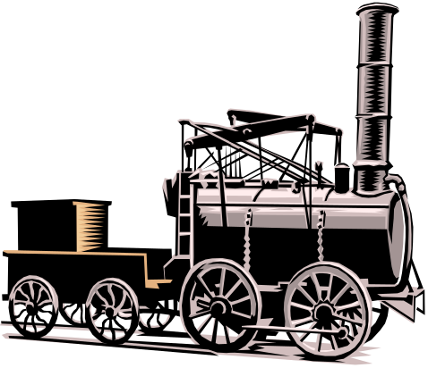

Key Participants in Manufacturing
James Watt – Steam engine
Eli Whitney – Cotton gin
Samuel F.B. Morse – Telegraph
Isaac Singer – Sewing machine
Thomas Edison – Electricity/Light bulb
Charles Stanhope – Stereotype printing
Henry Ford – Model T automobile
Notes:
Question: What other inventions helped start the industrial revolution?
Answers will vary, but should include:
Eli Whitney – interchangeable parts for muskets.
Robert Fulton – steamboat.
Alexander Graham Bell – telephone.

Slide 27
Operating Environment
Refers to: Production strategies based on demand, objectives, and profitability
Production Models:
  Make-to-stock – “off the shelf” goods
  Make-to-order – made after purchase order received
  Engineer-to-order – require design after order is received
  Job shops – handle specialized processes

Slide 28
Operating Environment (Cont’d)
  Continuous flow – produces part just in time and ultimately requires integration of all elements of the production system
  Batch/lot process – produces product in groups called batches or lots
  Dedicated repetitive flow – high-volume production of inexpensive finished goods

Slide 29
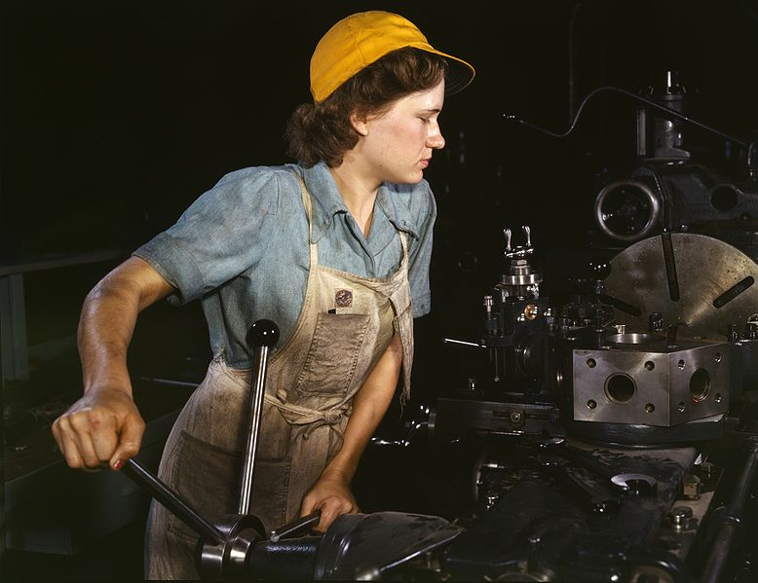
QUESTION
What determines a manufacturer’s production strategies?
  Costs
  Demand
  Profit
  Economy

Slide 30
Manufacturing Operations
Customer focus
Quality obsession
Continuous improvement
Unity
Involved employees
Teamwork
Education and training
Making use of science
Commitment

Slide 31
Manufacturing Process
Changing the nature of ingredients by applying heat or pressure, or by mixing, separating or chemical reaction.
Bottled water forces water through tiny filters to separate impurities from the finished product
Powdered detergents are made by spraying a mixture of chemicals and water into a warm air chamber, The heat causes the water to evaporate, leaving powder.
Chlorine is manufactured by passing an electric current through salt water, triggering a chemical reaction that changes the nature of the salt water

Slide 32
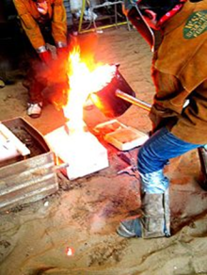
Manufacturing Processes
Casting:
Liquid material
  Plaster
  Resin
  Metal
  Concrete
Poured into mold
Complex shapes
Metal casting popular

Slide 33
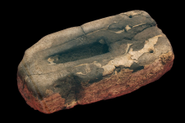
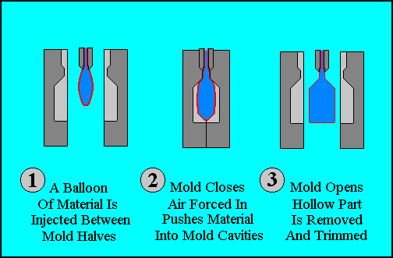
Manufacturing Processes (Cont’d.)
Molding:
Counterpart to casting
Pliable object, often liquid
Since the Bronze Age
Types of molding:
  Glass blowing
  Compression molding
  Foam molding
  Extrusion molding
  Expandable bead molding

Slide 34
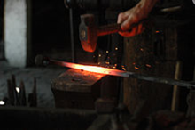
Manufacturing Processes (Cont’d.)
Forging:
more expensive to do, but stronger
Forming without adding or removing material
Types of forging:
  Compressive forming
  Tensile forming
  Combine compressive
  and tensile forming
  Bending
  Shearing

Slide 35
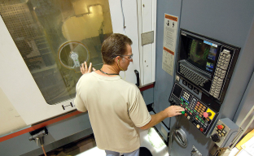
Manufacturing Processes (Cont’d.)
Machining:
Removing material to get final product
Types:
    Drilling
    Boring
    Sawing
    Planing
    Shaping
    Turning
    Reaming
    Tapping

Slide 36
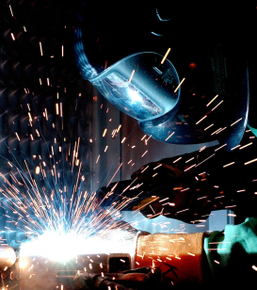
Manufacturing Processes (Cont’d.)
Joining:
Adding material to get final product
Types:
  Welding
  Soldering
  Brazing
  Sintering
  Fastening
  Adhesive bonding
  Press filtering

Slide 37
Manufacturing Processes (Cont’d.)
Machining – material removal processes with tight specified dimensional tolerances measured in micrometers
Presswork – progressive stamping
Packaging – enclosing of an object to protect from tampering
Electronic Assembly – enclosures and protective features built into the product itself

Slide 38
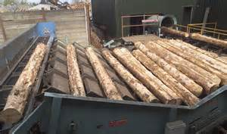
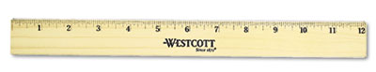
Primary and Secondary Processing
Processes to produce standard stock is known as primary processing. This prepares materials for further processing.
Secondary processing involves turning materials into products people can use.

Slide 39
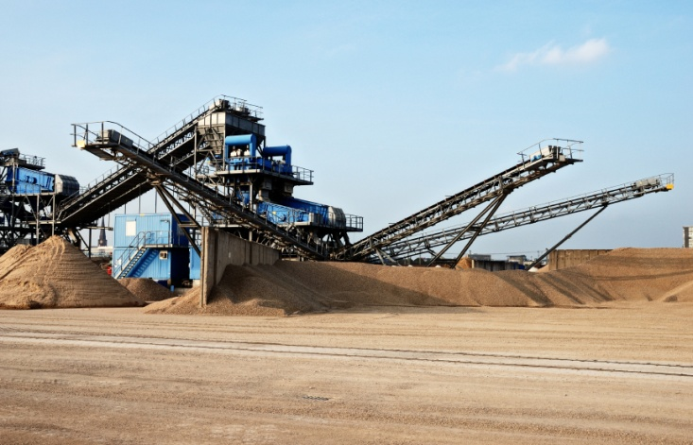
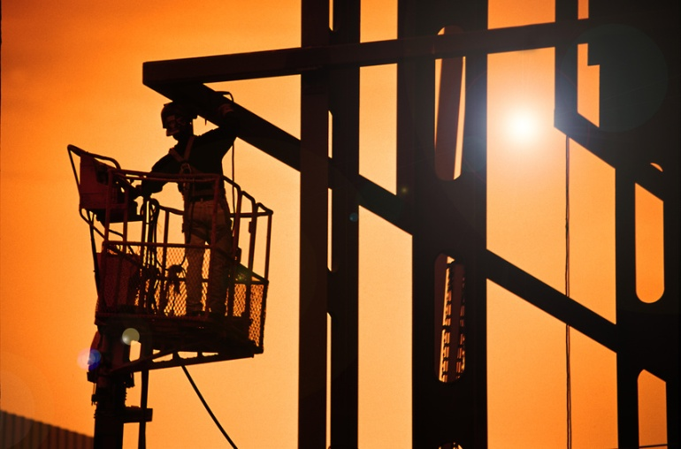

QUESTION
Name any product that requires more than one process to produce
Notes:
Question: Name a product that requires more than one process to produce.
Answers will vary, but might include:
Gasoline
Paint
Candy

Slide 40
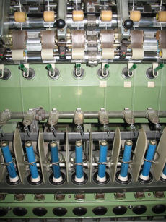
Examples of Manufactured Products
Top manufacturing industries in the U.S.:
Petroleum and coal products
Computers and electronics
Chemical
Food
Pharmaceuticals
Aerospace and defense
Electrical equipment and appliances
Machinery
Motor vehicles
Beverages

Slide 41
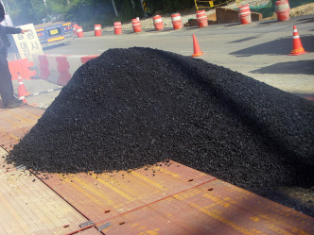
Petroleum and Coal Products
Asphalt
Uses Bitumen (tar) to bind Gravel
More than 6,000 products made from petroleum

Slide 42
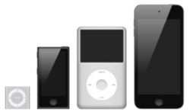
Computers and Electronics
iPods
Other examples:
  Computers
  Hard drives
  Smartphones

Slide 43
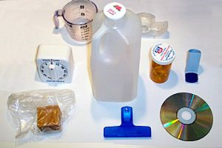
Chemicals
Plastics
Other products:
  Fertilizers
  Rubbers
  Nylon

Slide 44
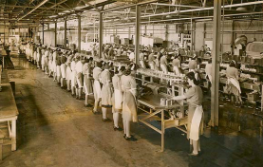
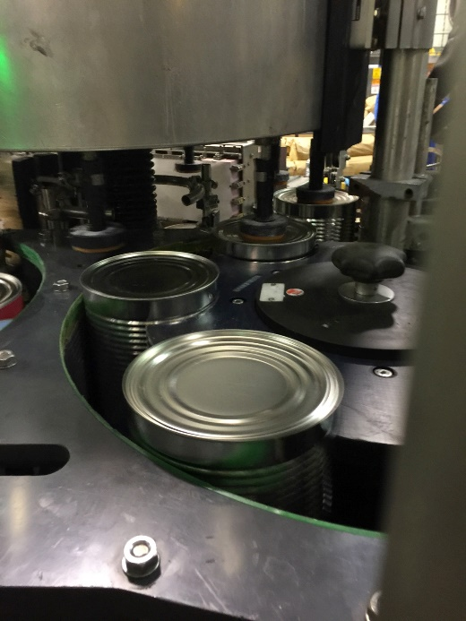
Food
Canning:
  Soups
  Vegetables
  Fruit
Other products:
  Dried beans and legumes
  Cheese
  Concentrated juice

Slide 45
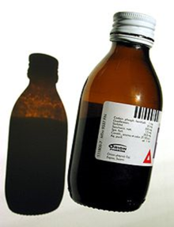
Pharmaceuticals
Cough medicine
Other products:
  Pain killers
  Heart medication
  Other drugs

Slide 46
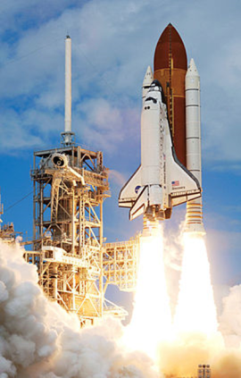
Aerospace and Defense
Space shuttle
Other products:
  Aircraft
  Engines
  Space vehicles
  Guided missiles
  Propulsion units

Slide 47
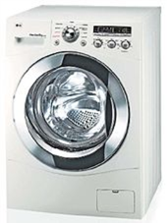
Electrical Equipment and Appliances
Washing machine
Other products:
  Refrigerators
  Blenders
  Toasters

Slide 48
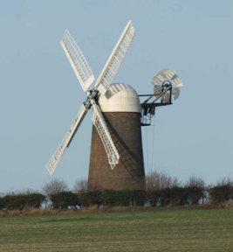
Machinery
Windmills
Other products:
  Watches
  Clocks
  Wheel & axle
  Engines

Slide 49

Motor Vehicles
Cars
Other products:
  Trucks
  Vans
  ATVs
  Buses
  Motorcycles
  Motorized bicycles

Slide 50

Beverages
Soft drinks
Other products:
  Juice
  Mineral water
  Sports drinks
  Alcoholic drinks

Slide 51
Metal Composition
Alloy – controlled mixture of two or more metals
Ferrous – contain iron oxide, prone to rust. Cracks in the surface of ferrous metal can be located with a magnaflux test.
Nonferrous – contain little or no iron, such as aluminum, copper, tin, zinc.
Powdered Metal – can be ferrous, nonferrous or a combination.

Slide 52


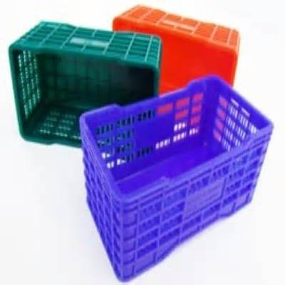
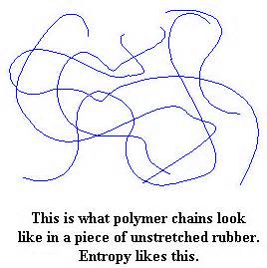
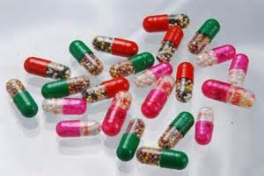
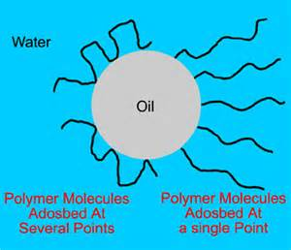
Polymers
Polymers are molecules that consist of a long, repeating chain of smaller units called monomers
  Wood –
  Textile
  Leather
  Plastic
  Elastomers

Slide 53
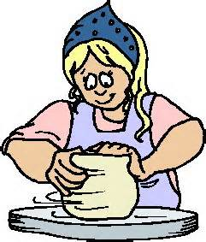
Ceramics
Hard, brittle, heat resistant and corrosion materials produced by shaping and firing a nonmetallic mineral at a high temperature.
Mainly made from clay, sand, rock and other elements in the earth.
  Glass
  Clay
  Abrasives
  Cements
  Refractories – withstand extremely high temperatures

Slide 54

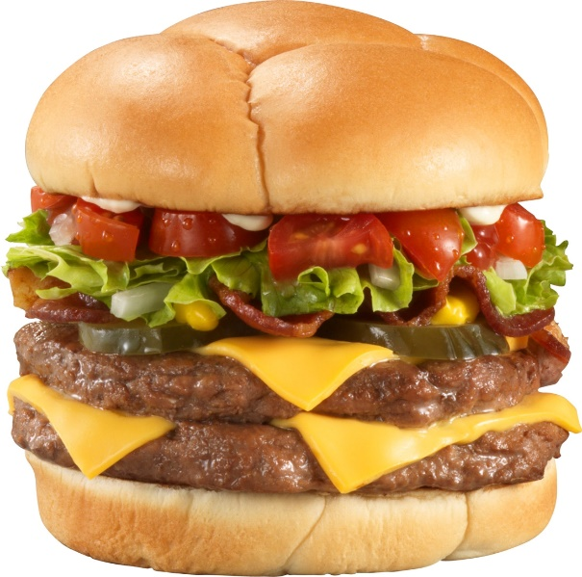

Other Materials
Composites
Finishing Materials – wood finishes, metal finishes
Chemicals
Food – items may be subject to decay or rot
Beverages

Slide 55
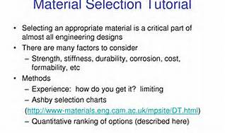
Selecting Materials
Performance
Safety and environment
Customer Preference
Cost Availability

Slide 56
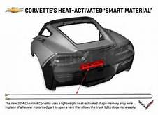
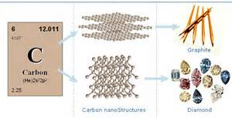
Developing New Materials
Smart Materials – respond to changes in environment
Nanomaterials – tiny materials manufactured atom by atom. A nanometer is one billionth of a meter. 10 nanometers is 1,000 times smaller than a human hair

Slide 57
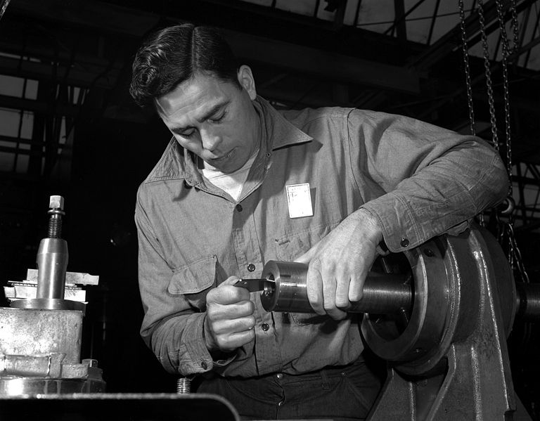
Rapid Manufacturing
Definition
“A process for producing solid objects by the sequential transferring of energy and/or materials to a specific point in order to produce an object.”
WW II – Manufacturing of aircraft
Examples
Assembly lines

Slide 58
QUESTION
What is the difference between simple mass production and Rapid Manufacturing, or is it the same with a different name?
  Rapid Manufacturing is the next generation of mass production and employs technology and robotics to improve on the assembly line of mass production.

Slide 59
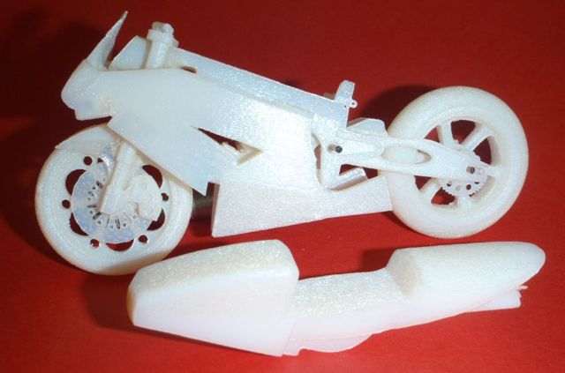


Rapid Prototyping
Examples
  3D printing

Slide 60

Additive Manufacturing

Slide 61

Subtractive Manufacturing

Slide 62


Vertical Integration
Definition “When a manufacturer produces all or most of the parts or subassemblies needed in production of the product”
At one time, Ford Motor Company mined ore to be used in manufacturing of their cars

Slide 63
Vertical Integration (Cont’d.)
Varieties
  Backward: companies set up subsidiaries that produce some of the elements used in the production of the product
  Forward: company sets up subsidiaries that distribute or market products to customers
  Balanced: company sets up subsidiaries that both supplies them with material and distributes their product
Notes:
backwards- Georgia Pacific owns or leases land for growing trees
solar panel manufacturers own sand mines for processing silica
forward- Apple owns stores to sell its products
balanced- Intel produces chips for their own computers, along with purchasing parts from other contractors
Nissan, Toyota, Honda plus US carmakers buy parts from contracted sources (MOPAR, AISIN, DELCO)

Slide 64

Vertical Integration (Cont’d.)
Major Advantages
  Input cost to output cost
  control
Others
  More stability in company
  Lower transaction costs

Slide 65

Vertical Integration (Cont’d.)
Disadvantages
  Speed of technology change makes some proven concepts and practices obsolete
  Higher monetary and organizational costs
  Monopolization of markets

Slide 66



QUESTION
Can you name a well-known company that uses vertical integration or partial integration?
  Wal-Mart
  Sears
  Intel
  Sam’s Club
  others

Slide 67

Lean Thinking
Five Stages
  Customer value
  Value stream
  Flow
  Pull
  Perfection
Notes:
NOTE: It is important that students understand the premise of lean manufacturing before asking the questions. Some may have a misconception of true lean manufacturing.

Slide 68

Lean Manufacturing
A management philosophy focusing on elimination of the “seven wastes”
Seven Wastes
  Transporting
  Unnecessary inventory
  Unnecessary motion
  Waiting
  Overproduction
  Inappropriate processing
  Defects
            See wisc on-line 8 wastes of lean
Notes:
NOTE: It is important that students understand the premise of lean manufacturing before asking the questions. Some may have a misconception of true lean manufacturing.
Question: Does your company use lean manufacturing methods? If so, what are they? If not, in your opinion, why not?
Answers will vary.

Slide 69

Lean Manufacturing (Cont’d.)
Implementing a Lean Process
Senior management’s lean vision
Identify project leader
Communicate lean plan
Form lean implementation team (5-7 people best)
Train the team
Select and run pilot
Disseminate pilot
Evaluation and feedback
Introduce next lean tool
See wisc on-line12 principles of lean
Notes:
Picture of Taichii Ohno, known as the father of the Toyota TPS System.
Question: Has anyone seen improvements on existing products?
Answers will vary.

Slide 70


Agile Manufacturing
Originally, the manufacturing industry was producer-led.
A quality revolution arose in 1997 because of the global marketplace.
Quick changes in manufacturing processes were needed to reflect customer likes and complaints.
Notes:
Henry Ford once told someone they could have their car in any color they wanted . . . So long as it was black. The Model T, which sold for over 20 years, only came in one color- Black. Today, with the Internet and online consumerism, companies must rapidly change, or risk obsolescence and failure (Name an example? How about Blockbuster?)

Slide 71
Agile Manufacturing (Cont’d.)
Four Components
  Deliver value to customer
  Be ready for change
  Value human knowledge and skills
  Form virtual partnerships

Slide 72


QUESTION
What is an example of agile manufacturing practices?
Has anyone seen improvements of existing products?
Notes:
June 29, 2007- iPhone released. Newest version (6, 6 Plus) released September 9, 2014.

Slide 73

Summary
Early manufacturing
Mass production
Rapid manufacturing
Lean manufacturing
Lean thinking
Agile manufacturing
Inventions

