Slide 1

Domain 2: Production and Processes
Foundations of Manufacturing
6σ
Section 4: Lean and Six Sigma Basics
Notes:
Read to Students: To ensure that a mutual understanding between the daily job tasks and the need to actively participate in group projects is effective, this training provides information on how Six Sigma manufacturing tools are used on the production floor.

Slide 2
Learning Objectives
  Understand the difference between the traditional manufacturing company and the lean manufacturing company.
  Identify the various tools used in Lean Manufacturing companies.
  Discuss the principles of Lean Manufacturing.
Notes:
Direct students to turn to page 2-4-1 in their Manufacturing TDI book for Advanced Manufacturing, Domain 2: Production and Processes, Section 4: Lean and Six Sigma Basics, Student Workbook and continue with the discussion.

Slide 3
Traditional Manufacturing vs. Lean Manufacturing
  Forecast vs. Kanban
  Inventory levels vs. no storage on production floor
  Excessive Inventory vs. Just-In-Time
  Parts produced on predetermined schedule vs. produced when needed
  Standard vs. Customization
  Inventory vs. what desired
  Push vs. Pull
  Sold from inventory vs. produced after ordered
Notes:
Note: Inventory levels in traditional manufacturing are typically high, whereas a Lean company practices “Just-In-Time” or pull inventory. Inventory arrives when it is needed and not before.
Note: Push lowers inventory by encouraging the customer to buy products based on incentives and deals. Examples are found in automotive industry’s year-end deals intended to reduce last year’s inventory.
Question: Why would customers prefer to pull inventory rather than have it pushed towards them?
Answer: Customers may want a different option but still want to receive it quickly. The automotive industry can fill a special order but it takes a great deal of time to receive it after it has been ordered.

Slide 4

Lean Principles
Waste elimination
5S – workplace organization
Continuous flow
Cycle Time
Takt Time
Pull production
Kanban

Slide 5
Lean Principles (Cont’d.)
Kaizen
Mistake Proofing (Poka-Yoke)
Just-In-Time (JIT)
Standardized Work
Total Productive Maintenance
Single Minute Exchange of Dies (SMED)
Value Stream Mapping (VSM)
Notes:
Question: What are some differences between traditional manufacturing and Lean manufacturing?
Answer: Forecasting and kanban are methods for material replenishment. Forecasting is a guess on what will be purchased, whereas kanban is based on actual consumption.

Slide 6

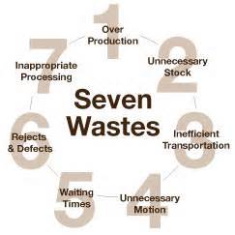
QUESTIONS
What is Waste?
Any activity that does not bring value to the customer.

Slide 7

Waste Elimination
Any action/inaction that consumes resources the customer will not pay for and can be eliminated without loss/customer dissatisfaction (activity without value)
Seven areas:
  Transporting
  Unnecessary inventory
  Unnecessary motion
  Waiting
  Overproduction
  Inappropriate processing
  Defects
Notes:
Question: What is waste?
Answer: Any activity that does not bring value to the customer.

Slide 8
Waste Elimination (Cont’d.)
Examples of waste:
  Searching for dies, tools, accessories, documents
  Waiting for parts, dies, cranes, drawings
  Moving parts, dies, hand tools
  Adjustments to dies, machines
  Paperwork
  Parts inspection and other verifications
  Reworking setups, parts, to bring non-conforming items into compliance
  abandoning a partial setup
  Die or machine breakdown when in production
Notes:
Question: Who determines value?
Answer: The customer.
Question: Why would you want to eliminate waste?
Answer: They are activities that the customer is not willing to pay for and causes unnecessary costs for the manufacturer. There is no return for the activity.

Slide 9

5 S
Eliminate clutter and reduce materials
Sort
Set in order
Shine
Standardize
Sustain
Notes:
Question: What is 5S?
Answer: It is a method of organizing the work area.

Slide 10
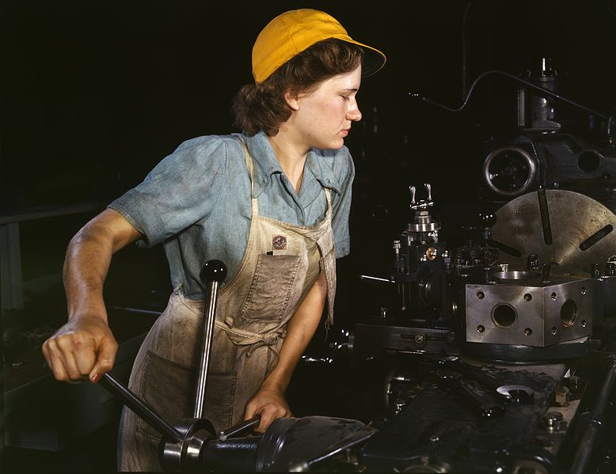
5 S (Cont’d.)
Benefits:
  Safety
  Efficiency
  Quality
  Waste Elimination
  Control over the workplace
Wisc on-line – 5S
Notes:
Question: Why is 5S a good tool?
Answer: It helps reduce waste resulting from people looking for tools or parts and having machines breakdown because they have not been cleaned. It helps to keep things organized over a long period of time.

Slide 11
Pull Production
Process downstream drives process upstream
  Customer initiated
  Production based on demand
In push production each department works to its own schedule

Slide 12
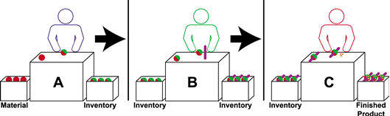
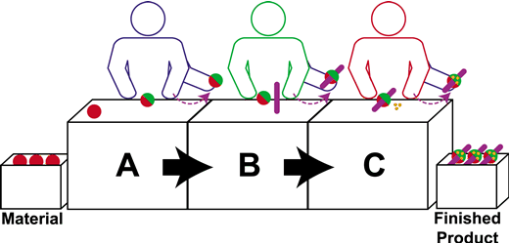
Continuous Flow
Traditional Batch Manufacturing
Single Piece or Continuous Flow Manufacturing
Notes:
Question: How does continuous flow differ from batch manufacturing?
Answer: Continuous flow is one piece at a time and that piece can be completed prior to the entire batch being completed. This makes the product available for sale sooner.

Slide 13
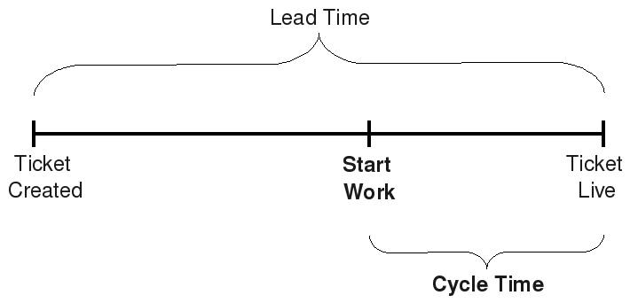
Cycle Time
Total time to move a part from beginning of the production process to the end

Slide 14
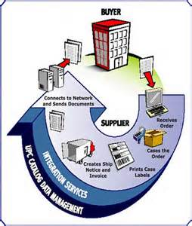
Order Lead Time
The time between placement of the order by the customer and the receipt of the merchandise.

Slide 15
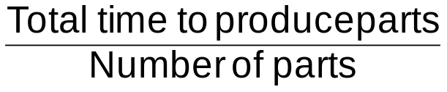
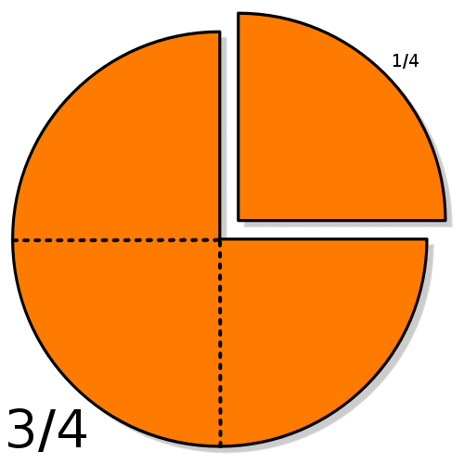
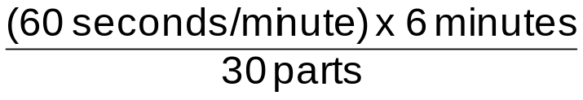
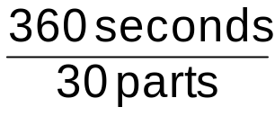
Cycle Time
Total time to move a part from beginning of the production process to the end
Calculation example for 30-part batch taking six minutes:
Cycle time =
=
=
= 12 seconds per part
Notes:
Question: Why is understanding Cycle Time important?
Answer: The Cycle Time gives you information on how many parts can be produced. It is also a baseline measurement so you can determine if you have improved the process.

Slide 16
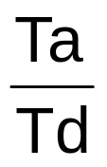
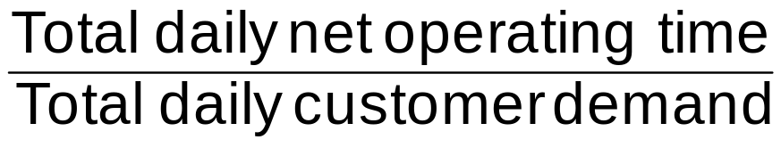
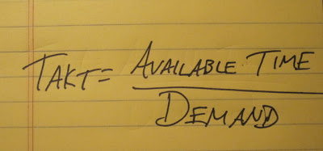
Takt Time
How fast (in seconds) to produce a part to satisfy a customer order
Takt time = =
It is the pace at which you need to produce
a product to meet the customer demand
Notes:
Question: What is Takt Time?
Answer: It is the pace at which you need to produce a product to meet the customer demand.

Slide 17
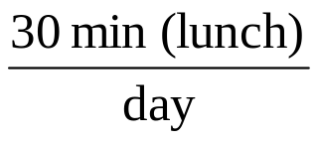

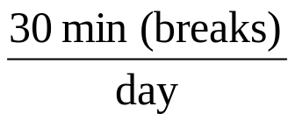
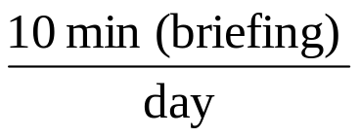
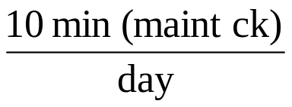
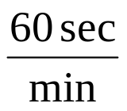
Takt Time (Cont’d.)
Ta =
8 hr/day x 60 min/hr
minus
minus
minus
minus
Total x
= 24,000 seconds per day

Slide 18
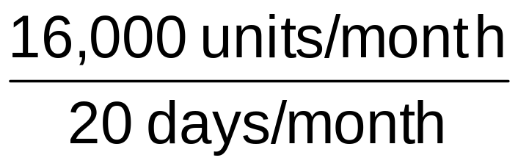
Takt Time (Cont’d.)
To determine Td, assume for this example that:
Td =
= 800 units per day

Slide 19
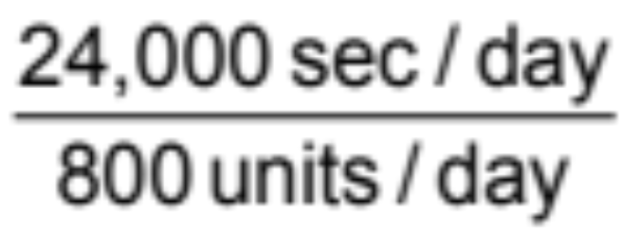
Takt Time (Cont’d.)
Takt time =
= 30 seconds per unit

Slide 20

Productivity
Defined as the number of good parts made divided by the number of hours it took to make them.
Worked 40 hours
Parts made 300
Good parts made 200
200 /40 = 5 per hour

Slide 21
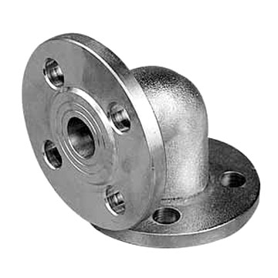
Manufacturing Costs Per Part
Cost of materials
Plus cost of labor
Plus overhead costs
Total
Divided by number of parts
Equals cost per part

Slide 22
Predicting Equipment Availability
Number of normal workdays available
  Minus scheduled downtime
  Minus estimated unscheduled downtime
Equals expected availability
Unscheduled downtime impacts productivity rating

Slide 23
QUESTIONS
What happens when the customer demand increases?
  Takt time should decrease
      Offer overtime
      Add another line
      Outsource some of the product manufacturing
What happens when customer demand decreases?
  Takt time increases
      Reduce number of people on production line

Slide 24

Kanban
Defined as signal to authorize bin quantity
  Kanban card
  Produce or withdraw
  Do what works best
  Metal placard
  Empty bin
  Line on wall
Wisc on-line – kanban your signal for action

Slide 25
Kaizen
A continuous improvement system based on regular, immediate, incremental change by a Kaizen team
Kai = Change
Zen = for the better
Kaizen teams trained in use of Kaizen tools such as 5S and Kanban
Wisc on-line - kaizen

Slide 26

Mistake Proofing (Poka-Yoke)
Pronounced “Poh-kah-yoh-keh".
Eliminates and avoids mistakes
Poka-Yoke method
  Devices that only allow correct installation
  Alarm sounds when part is not correct
  Using dissimilar parts
Wisc on-line – poka yoke
Notes:
Pick a process from a daily activity and discuss ideas on how to mistake proof that process.

Slide 27
Mistake Proofing (Poka-Yoke) (Cont’d.)
Poka-yoke can be implemented at any step of a manufacturing process where something can go wrong or an error can be made.
For example, a jig that holds pieces for processing might be modified to only allow pieces to be held in the correct orientation, or a digital counter might track the number of spot welds on each piece to ensure that the worker executes the correct number of welds.

Slide 28
Mistake Proofing (Poka-Yoke) (Cont’d.)
Shigeo Shingo recognized three types of poka-yoke for detecting and preventing errors in a mass production system:
The contact method identifies product defects by testing the product's shape, size, color, or other physical attributes.
The fixed-value (or constant number) method alerts the operator if a certain number of movements are not made.
The motion-step (or sequence) method determines whether the prescribed steps of the process have been followed.

Slide 29
Mistake Proofing (Poka-Yoke)(Cont’d.)
Either the operator is alerted when a mistake is about to be made, or the poka-yoke device actually prevents the mistake from being made. In Shingo's lexicon, the former implementation would be called a warning poka-yoke, while the latter would be referred to as a control poka-yoke.
Shingo argued that errors are inevitable in any manufacturing process, but that if appropriate poka-yokes are implemented, then mistakes can be caught quickly and prevented from resulting in defects. By eliminating defects at the source, the cost of mistakes within a company is reduced.

Slide 30

Just In Time
Inventory received
when it is needed
Keeps inventory
low, saves warehouse
space, reduces costs
Takt time-based production
Only good parts produced
Products made repeatedly
See www.detnews.com/autos/fordplant

Slide 31
Standardized Work
Standardized Work Instruction (SWI) - a step-by-step approach to completing a production task
  Repeats good parts every time in the right amount of time
Minimizes waste
Notes:
Question: What is standardized work?
Answer: Standardized work is the optimum combination of people, machines, and materials to ensure that a task is completed in the exact same manner each and every time and minimizes the opportunity for waste.

Slide 32
Total Productive Maintenance
Pioneered by Toyota to plan for and anticipate equipment/machinery downtime
An improvement process requiring:
  Cleaning machinery & equipment
  Inspection
  Implementing an oil and lubrication program
  Performing scheduled maintenance
  Performing root cause analysis on breakdowns to eliminate/correct future breakdowns
Wisc on-line - TPM
Notes:
Question: Why is TPM important?
Answer: Your equipment must produce good parts when you expect it to produce good parts.

Slide 33
Single Minute Exchange of Dies
Reduce setup time from one product to another
“Single minute” refers to a “single digit” amount of time
Major productivity gain for auto industry
Wisc on-line – set up production/quick changeover
Notes:
Question: Why is it important to be able to quickly change a machine over from one part to another?
Answer: Lean drives you to produce what you need when you need it. If the demand is for eight different parts on a machine per day, you need to change over quickly to meet those requirements.

Slide 34
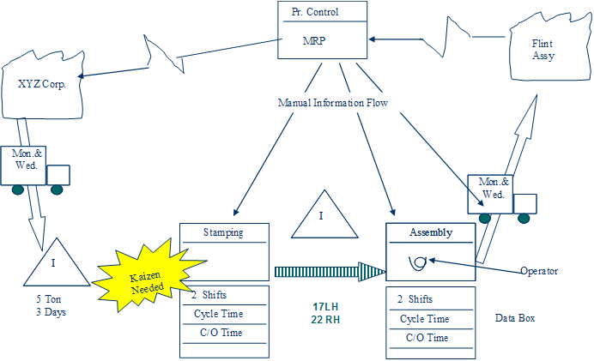
Value Stream Mapping
Big picture for improving whole process
How and why process works
Identifies areas of waste
Wisc on-line – value stream
Notes:
Question: What is a Value Stream Map?
Answer: Define all activities required to design, order, and provide a specific product, from concept launch, to delivery, to the customer. This includes:
information flow,
material flow,
work in process,
non-value added activities, and
transportation flow.

Slide 35

Lean Project
Identify requirements
Reverse-engineer the process
Draw the map
Draw the Future State Map

Slide 36
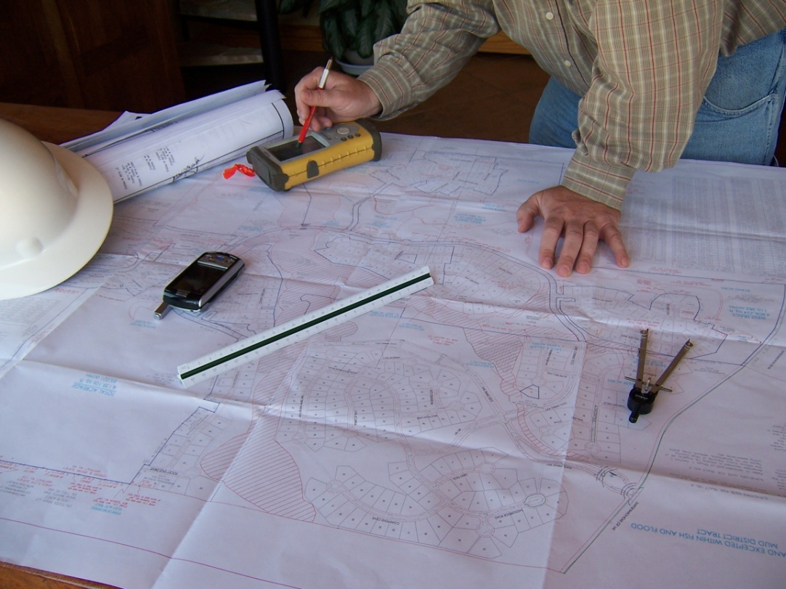
Goals of the Future Map
Reductions in:
  Lead time
  Inventory
  Costs
  Physical footprint
  Order time
Increase in
  Profits
  Capacity

Slide 37

Push vs. Pull Exercise
Do paper airplane exercise here
Notes:
NOTE: This activity takes a minimum of one (1) hour.

Slide 38
Lean Summary
Lean manufacturing
  Eliminates non-value added waste
  Speeds up process times
  Improves delivery performance

Slide 39
Six Sigma Learning Objectives
  Describe the attributes of a successful Six Sigma team.
  Examine the Six Sigma DMAIC model, how it is applied and how it is part of the production technician’s work responsibilities.
  Describe what a Six Sigma rating means in a variety of business processes.
  Calculate Cycle Time and Takt Time.
  Describe Lean Six Sigma as an integrated improvement tool.

Slide 40
Benefits of Six Sigma
Quality, process, financial improvement
Six Sigma is a method for:
  Defining problems (problems related to organizational costs)
  Developing an improvement strategy
  Evaluating plans

Slide 41
More About Six Sigma
“Six Sigma” as a term comes from statistics
  3.4 errors per every million opportunities for an error
  “Defects per Million Opportunities”
Management can use Six Sigma to minimize mistakes

Slide 42
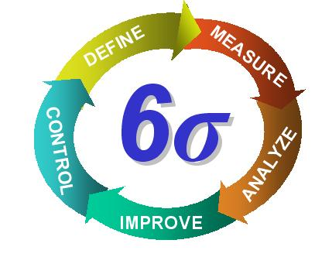
Six Sigma
Problem Solving methodology
Management tool
Process improvement
Statistics-based
Employee involvement
Notes:
Question: Is Six Sigma a way of eliminating all mistakes in any process?
Answer: No. Although the elimination of mistakes may be a goal, it is difficult to eliminate mistakes when people are involved. The more realistic goal is to minimize mistakes.

Slide 43
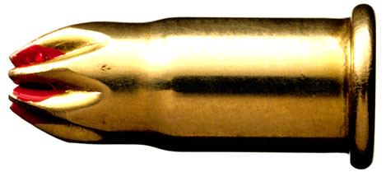
Six Sigma Myths
Six Sigma is not:
  only a tool for the production floor
  a “magic bullet’ for improvement
  only for engineers and managers
  difficult to use and understand
  only a statistical tool
Notes:
Question: Will Six Sigma fix all problems?
Answer: No. Six Sigma is a tool and like any tool, if it is not used correctly you do not get good results. Not all problems can be fixed because people and processes change, causing new problems.
Question: Will production technicians participate in a Six Sigma improvement project?
Answer: Six Sigma improvement project teams consist of everyone in the company, including production technicians.
Question: Does everyone on a Six Sigma team need to know how to develop statistics?
Answer: No. The team will assign members to perform/calculate the statistics. Other team members will use the information resulting from the analysis of the data.

Slide 44
Why Six Sigma?
Reduces/eliminates cost of poor quality
Targets variation in production
Recognizes opportunities and eliminates defects
Product variation is inevitable but must be controlled
Data-driven decision making
Quality tools used to solve problems
Wisc on-line – what is Six Sigma – Why Six
Notes:
Question: Why should Six Sigma be your target and not 3 or 4 sigma?
Answers will vary, but should include:
Saves time, money, and reduces potential customer dissatisfaction.

Slide 45
Six Sigma Comes from Manufacturing
The maturity of a process can be called a sigma rating
A Six Sigma process should produce:
  3.4 defects per million
  99.99966 percent without defects
DPMO refers to defects per million opportunities.
The product being manufactured has a number of opportunities to have a defect.

Slide 46
Six Sigma Ratings
Companies operating at Two to Three Sigma can lose 20-40 percent of sales
Six Sigma ratings can help a company reduce cost by reducing:
  Errors
  Scrap
  Rework

Slide 47
Sigma Performance Ratings/Levels
Sigma Level | Percent Defective | Defects per Million
1 | 69% | 691,462
2 | 31% | 308,538
3 | 6.70% | 68,807
4 | 0.62% | 6,210
5 | 0.02% | 233
6 | 0.00034% | 3.4

Slide 48
What Sigma Rating do You Want?
3.8 Sigma | Six Sigma
20,000 lost pieces of mail every hour | 7 lost pieces of mail every hour
5,000 surgical mistakes made each week | 1.7 surgical mistakes made each week
3 warranty claims for every new automobile | 1 warranty claim for every 980 automobiles produced
No electricity for almost 7 hours each month | 1 hour without electricity every 34 years
2 short or long landings at major airports every day | 1 short landing or long landing at major airports every five years

Slide 49
The Fundamentals of Six Sigma
Basic performance equation
  Y=f(x)+ε
  Y = is the outcome
  X = an input
  F = the function being performed on the input
  ε = factors that impact the outcome
Understand causes of variation and reduce them
Notes:
Discuss the costs of not having good quality in a company.

Slide 50
Who is Responsible for Six Sigma?
“The best Six Sigma projects begin not inside the business but outside it, focused on answering the question-how can we make the customer more competitive? What is critical to the customer’s success?...One thing we have discovered with certainty is that anything we do that makes the customer successful inevitably results in a financial return for us.”
---Jack Welch
Notes:
Who is Jack Welch? Former CEO of General Motors (1981-2000).

Slide 51

Who is Responsible for Six Sigma? (Cont’d.)
Six Sigma Champion
Six Sigma Black Belt
Six Sigma Green Belt
Six Sigma Yellow Belt
Wisc on-line – six sigma training & certification

Slide 52
Six Sigma Champion
Usually a mid- to upper-level manager who supports and promotes Six Sigma within the organization
  Energetic and passionate about Six Sigma and the company
  Can excite and mobilize many people
  Relate to Six Sigma to the customers needs and the company’s bottom line results
  Understands the technical and financial aspects of Six Sigma
  Can deliver results

Slide 53

Six Sigma Black Belt
Typically has been given Six Sigma projects as their full time job
  Positive thinkers
  Good coordinators
  Risk takers
  Leaders
  Respectful
  Process orientated
  Skilled in team building
  Good communicators
Notes:
Question: Why are these characteristics important for a black belt?
Answer: They will be responsible for managing the improvement project.

Slide 54

Six Sigma Green Belt
Trained in basics of Six Sigma and can work or lead an improvement team (frequently employees from production floor).
  Process experts
  Willing and eager to learn
  Experienced team players
  Flexible and adaptable
  Proponents of change

Slide 55

Six Sigma Yellow Belt
Employee typically has basic knowledge of Six Sigma.
  Often charged with process map development
  May run a small process improvement project using a quality tool, such as PDCA

Slide 56
Defining Owners and Stakeholders
Quality Improvement projects cannot happen without the appropriate decision-makers taking ownership of the project.
What is a stakeholder?
  A stakeholder is anyone who has an interest in the business. This broad group includes investors, customers, vendors, employees, employees' families, neighboring communities, as well as local, city, and federal government. Each stakeholder will have a different interest based on its relationship with the business.
What is an owner?
  Quality narrows the definition of owner to a process owner, a senior manager responsible for a process. This Process Owner will lead the improvement effort for his or her area of responsibility, identify all stakeholders within the process and thoroughly understand all the relevant process elements, process flows, and process boundaries as well as associated measurements to enable process improvement.

Slide 57
DMAIC
Wisc on-line – DMAIC steps

Slide 58

Six Sigma Methodology
DMAIC Process
  (D) Define
  (M) Measure
  (A) Analyze
  (I) Improve
  (C) Control
Notes:
Question: Who selects the Six Sigma project?
Answer: The black belt typically will select the project but it can be done by a number of other people in an organization. There is no one defined person or position.
Question: The production technician would normally hold what Six Sigma status in the company?
Answer: Most would be either a green belt or a yellow belt, but they can achieve black belt status.
Question: What is a good Six Sigma project?
Answer: Any project that reduces cost, improves value, and creates a financial return for the company. It must also be “doable” and align with the company’s goals and strategic direction.

Slide 59
DMAIC - Define
Define is the first step in the process.
Here are some things to define:
Problem
Project scope
Project schedule

Slide 60
DMAIC - Define (Cont’d.)
Determine the deliverable
Pick the team
Hold the project kickoff meeting
Map the process

Slide 61

Six Sigma Methodology (Cont’d.)
Define (D)
  Create project charter
  Analysis
  Sponsor involvement
  Agreement
  Link to company strategy
  Create project schedule
  Map the process

Slide 62
DMAIC - Measure
You measure the process in its current state. This step is also known as doing a baseline measurement.
To see if the team has successfully improved the process, they must first understand what it was before the changes.
Measurements are often called “metrics” or performance measures.

Slide 63
Typical Metrics
Profit
Inventory turnover
Return on assets
Return on investment
Customer satisfaction
Responsiveness
Customer turnover
On-time delivery
Reliability
Defect rate
DPMO
Takt time
Yield
Manufacturing cost
Sales per direct labor hour

Slide 64

Six Sigma Methodology (Cont’d.)
Measure (M)
  Baseline capability level
  Customer requirements
  Quality tools
Notes:
Question: Why is it important to measure the process before it is changed?
Answer: The data is used to understand if it is better or worse with the changes.

Slide 65
DMAIC - Analysis
Process and its measurements are analyzed
The understanding is gained from observation, data collection, and information collection
The team must understand what changes are being recommended and what effects they will have on the process
The analysis step is done with a variety of tools

Slide 66
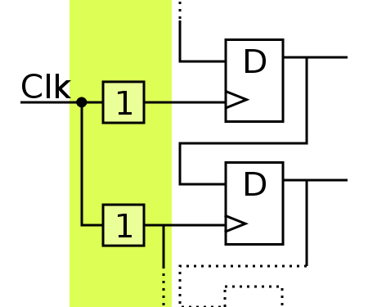
Six Sigma Methodology (Cont’d.)
Analyze
  Perform root cause analysis
  Analysis tools
  Select new process
Notes:
Question: Who does the statistical analysis of the data?
Answer: The black belt typically analyzes the data and reviews the findings, with the group, to see if they make sense.

Slide 67
DMAIC - Improve
The team will take all the information, data, and analysis on the process and develop an improvement plan
Brainstorming is a free form-thinking method in a group setting
The goal in this step is to define the new process and the operating conditions of the new process

Slide 68

Six Sigma Methodology (Cont’d.)
Improve (I)
  Eliminate root causes
  Improvement plan, develop
  Quality tools
  Confirm improvement plan
Notes:
Question: Why is it important for all the team members to understand the recommended changes?
Answer: Each team member has a different perspective and may have some knowledge about why the change may or may not be an improvement. All team members participate in all the steps of the projects.

Slide 69
DMAIC - Control
Once the new process is implemented, it must be standardized and be common practice of the person doing the work
The final part of the project is to document lessons learned throughout the project
The team will document their success and failures, recording anything learned by the team

Slide 70

Six Sigma Methodology (Cont’d.)
Control
  Develop monitoring plan
  Quality tools
  Standardize
  Procedures
  Ownership transfer
  Documentation
Notes:
Question: Why is the control step important to the project?
Answer: There is a tendency for people to move back towards what they understand. Changes often take time to be fully implemented and monitoring the process to be sure the changes are being followed helps make the new process more of a routine.

Slide 71
Companies Look at Variation
Understanding the causes of the variation and how to reduce it
Not every company will want or need to operate at Six Sigma levels

Slide 72
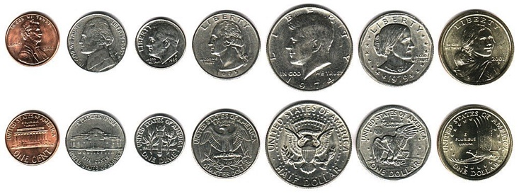
Variation and DPMO
Does every process have variation?
Yes. The problem is when the variation is outside of what is acceptable.

Slide 73
Six Sigma Terminology
Variation: difference between expected and actual
Mean: average value
Mode: most frequent data point
Median: number in the middle
Range: difference between highest and lowest
DPMO: defects per million opportunities

Slide 74
Variation
Common/normal: natural variation of the process; it cannot be eliminated, but it can be controlled; normal variation could be when you order a pizza for delivery, it takes about 30 minutes
Special: caused by something outside of the normal operation of the process; could be expressed as a pizza delivery taking 45 minutes due to an accident on the route

Slide 75
Mean
“Mean” in Six Sigma terminology refers to the the average value.
Adding all the numbers and then dividing them by the total number of data points gives the mean.
Mean = (1.95+1.75+1.80+2.05+2.25+2.05+2.1+2.00+2.00+1.85+2.05+2.50) / 12
  The mean or average for this data set is 2.03.

Slide 76
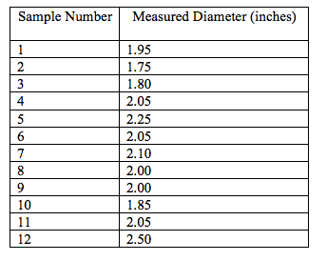
Mode
“Mode” in Six Sigma terminology refers to the most frequent data point that occurs when you measure a process.

Slide 77
Median
“Median” refers to the number in the middle. If you take the data set and put them in numerical order, the median is the number in the middle.
1.75
1.80
1.85
1.95
2.00
2.00
2.05
2.05
2.05
2.10
2.25
2.50
The middle number is between 2.00 and 2.05, so the median would be 2.00 + 2.05 / 2 or 2.025.

Slide 78
Range
“Range” in Six Sigma can also be called “spread” (or difference) and refers to the lowest number in the data set compared to the largest number.
1.75
1.80
1.85
1.95
2.00
2.00
2.05
2.05
2.05
2.10
2.25
2.50
The range is 1.75 to 2.50 or .75. We get this number by largest minus lowest as in the following: 2.50 – 1.75 = .75

Slide 79
Exercise
5
3
8
6
9
Calculate:
Mean =
Mode =
Median = Range =
6
2
4
7
10
6
6
5
2
2
4
7
3
3
5

Slide 80
Exercise Answers
5
3
8
6
9
Calculate:
Mean = 5.15
Mode = 6.00
Median = 5.00
Range = 8.0
6
2
4
7
10
6
6
5
2
2
4
7
3
3
5
Notes:
Add all numbers for total, divide by number of numbers to get mean
Arrange numbers by size; number appearing most often is mode
Count to middle number; that is median
Difference between lowest number and largest number is range

Slide 81
Lean Six Sigma
Next generation improvement methodology
Fusion of Lean and Six Sigma
Achieves fastest rate of improvement in:
  customer satisfaction
  costs
  quality
  production process speed
  invested capital
“Just speed” and “just quality” are no longer exclusive of each other.
Wisc on line – lean/sigma culture

Slide 82
Lean Six Sigma (Cont’d.)
Lean considers creation of value for the end customer as a goal
Resources spent on any other goal can be wasteful and possibly cut
Value is what customers are willing to pay for
Combining Lean and Six Sigma provides an integrated approach

Slide 83
Lean Six Sigma (Cont’d.)
  Use of Lean’s waste elimination processes that include transportation, inventory, motion, waiting, overproduction, over-processing, and defects
  A rate of 3.4 defects per million opportunities
  Use of Six Sigma’s
  Define-Measure-Analyze-Improve-Control phases

Slide 84
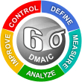
Six Sigma Summary
Six Sigma
  Uses statistical methods to reduce/eliminate variation
  Improves quality
  Reduces costs

Slide 85
Section Summary
Lean manufacturing
  Eliminates non-value added waste
  Speeds up process times
  Improves delivery performance
Six Sigma
  Uses statistical methods to reduce/eliminate variation
  Improves quality
  Reduces costs
Lean Six Sigma achieves balanced approach

