Slide 1

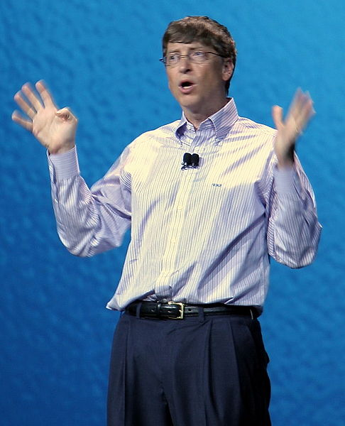
Foundations of Manufacturing
Domain 2: Production and Processes
Section 5:
Business Basics
Notes:
Read Lesson Link aloud to the students:
Production technicians must be able to participate in a variety of improvement projects. Measures of improvement take into consideration the financial benefit the improvements have on the company. Production technicians must have a fundamental knowledge of business basics to understand the financial results from their improvement project teams.

Slide 2
Business Basics
Section 5.1 - Business Terms
Section 5.2 - Human Behavior
Section 5.3- Principles of Ethics
Section 5.4 - Team Building
Section 5.5 - Communication Skills
Section 5.6 - Stress Management
Section 5.7 - Time Management

Slide 3

Foundations of Manufacturing
Domain 2: Production and Processes
Section 5.1:
Business Terms
Notes:
Read Lesson Link aloud to the students:
Production technicians must be able to participate in a variety of improvement projects. Measures of improvement take into consideration the financial benefit the improvements have on the company. Production technicians must have a fundamental knowledge of business basics to understand the financial results from their improvement project teams.

Slide 4
Learning Objectives
  Understand basic business principles.
  Describe business departments and their responsibilities.
  Describe the application of business principles in delivering products and improving profitability.
  Examine the concepts of accounting, finance, product marketing, economics, operations management, and human resources management.
  Identify the key elements of accounting, product marketing, human resources management and product improvement projects and how they relate to the production floor.
Notes:
Direct students to turn to page 2-5-1 in their Foundations of Manufacturing, Domain 2: Production and Processes, Section 5: Business Basics, Student Workbook and continue with the discussion.

Slide 5
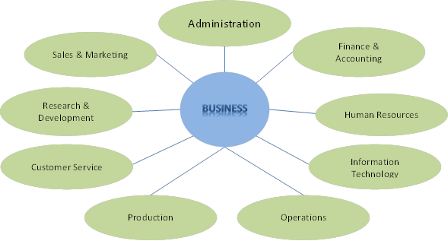
Business Departments and Responsibilities

Slide 6
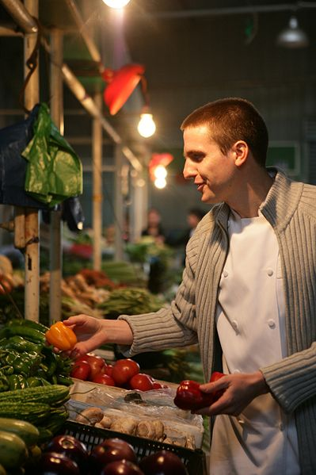
Business Departments
  Accounting
  Marketing
  Finance
  Economics
  Human resources management
  Operations management

Slide 7

QUESTION
What are some of the functions of the accounting department?
Understand how and where the money is spent.
Understand the profitability of the company.
Information and data is provided to the company.

Slide 8
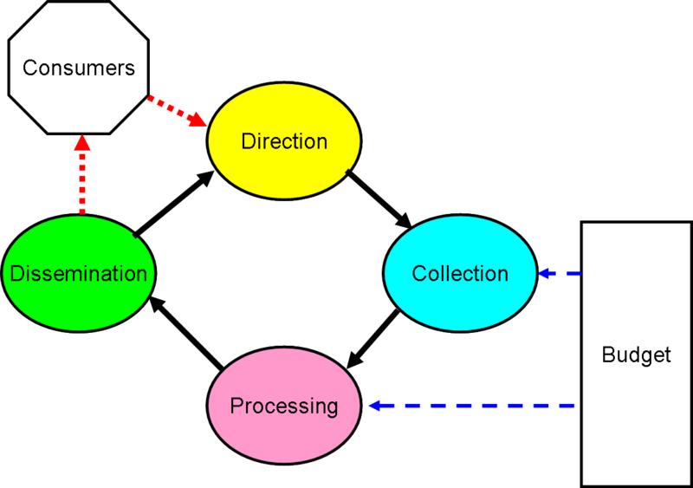
Business Departments (Cont’d.)
Accounting
  Invoices customers
  Pays the bills
  Analyses product sales, costs, profit, etc.
  Creates annual budget

Slide 9
Accounting Terminology
Sales
Revenue
Cost of goods sold (COGS)
Gross profit margin
Expenses
Net income
Financial statements
Expense categories
Cash cow
Notes:
Question: What is gross profit?
Answer: It is what is left after you subtract the COGS from the revenue.

Slide 10
Accounting Definitions
Sales – what a company charges the customer for the goods and / or services
Revenue – income received from the sale of the company products
Cost of goods sold (COGS) – how much it costs the company to produce the product
Gross profit – total revenue minus cost of good sold

Slide 11

Accounting Definitions (Cont’d.)
Expenses – all cost not directly tied to COGS
Net Income – amount of money remaining after all costs interest, taxes, and other expenses have been deducted from total sale
Cash Cow – generate large sales without much work
Notes:
Discuss the net income formula.

Slide 12


QUESTION
What are some of the functions of the marketing department?
  Product marketing
  Advertising
  Sales
  Customer service

Slide 13

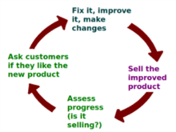
Business Departments (Cont’d.)
Marketing
  Marketing
  Advertising
  Sales/sales forecasting
  Customer service
  Product lifecycle

Slide 14
QUESTION
What is the product life cycle?
  It shows the statistical sales of a product over its lifetime on the market. When it is first introduced, sales are low. As it stays on the market, sales grow until the market is saturated or a new product is introduced. At that point, sales decline until the product is removed from the market.

Slide 15
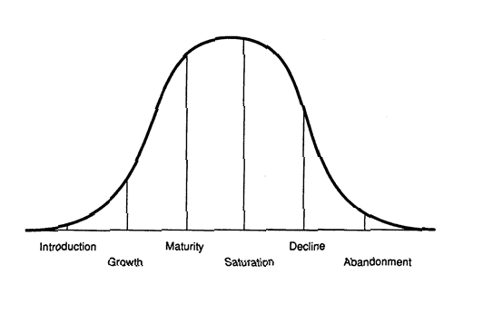
Business Departments (Cont’d.)
Product Lifecycle

Slide 16
Business Basics on the Production Floor (Cont’d.)
Product Market Growth Matrix
 |  | Market Share
 |  | High | Low
Market Growth | High | Rising Star Products | Problem Child
 | Low | Cash Cow | Dog
Notes:
Explain the product growth-share matrix.

Slide 17
QUESTIONS
What do the people who work in the finance department do?
  Find ways to invest the company money to yield a beneficial ROI
Are economy and economics the same idea?
  Economics is the study of business and the economy is a state at which business is operating, such as growth or recession

Slide 18

Business Departments
Finance
Frequently linked with accounting
Prepares and analyzes statements:
  The balance sheet
  The income statement
  The owner equity statement
  The cash flow statement

Slide 19
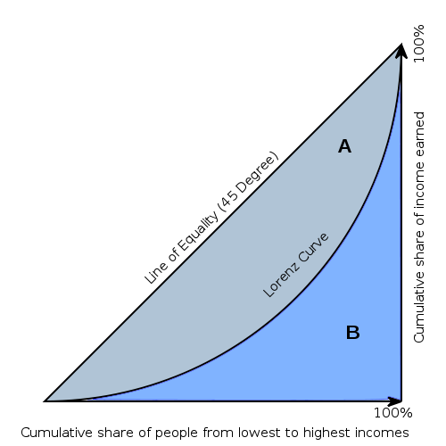
Finance Terms
Microeconomics – individual companies and their business cycles
Macroeconomics – manufacturing economy as a whole
Business cycle
  Inflation
  Recession
  Depression
  Growth

Slide 20
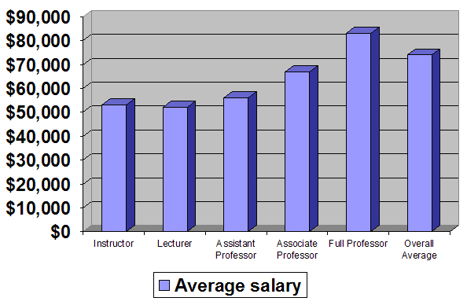
Business Departments (Cont’d.)
Human Resources Management
  Integrates HR functions with the company’s business strategies
  Employee benefits
  Applies federal and state employment/labor laws

Slide 21

HR Sub-Disciplines
Selection & Placement
  Attracting employees
  Developing employees
  Retaining employees
Training & Development – can increase consistency of work flow and quality. Saves company money

Slide 22


HR Sub-Disciplines (Cont’d.)
Planning
Compensation & Benefits
Industrial & Employee Relations
Occupational Safety

Slide 23

Human Resources Management
Looks for employees who are:
  Qualified
  Motivated
  Happy
  Properly trained
Results in:
  Lower rate of defects
  Higher quality
  Increased sales

Slide 24
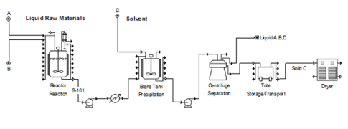
Business Departments (Cont’d.)
Operations Management
Aggregate planning
Inventory management
Production management
Supply chain management
Operations scheduling
Project management
Facilities layout and location
Quality and reliability

Slide 25

Business Departments (Cont’d.)
Operations Management
  Planning, scheduling, use, and control
  of the company’s production facilities, materials, and product delivery
  Break-even analysis (where investment to bring a product to market has been achieved and the product begins to show a profit)
  Crossover analysis (used to decide when a company should stop producing one product and cross over to a competing product so the company can earn more profit)
  Measuring and tracking progress (statistical process control)
Notes:
Question: Why is “breaking even” important?
Answer: Companies are in business to make profits. They need to know how many products they must sell to make a profit. If they think they will not sell what is needed, they may discontinue the new product.

Slide 26
Business Basics on the Production Floor
Profit = Revenue – Expenses
“What if…”
 | Start | Scenario 1 | Scenario 2 | Scenario 3
Revenue per Product | 125 | 125 | 126 | 128
Expenses per Product | 115 | 112 | 115 | 111
Profit per Product | 10 | 13 | 11 | 17
Notes:
Discuss the effect on profit that both revenue and expenses can have when changed, together or separately.
Discuss the profit formula.
Question: What happens to profits if sales increase but the company does not adjust expenses?
Answer: Profit should increase.

Slide 27
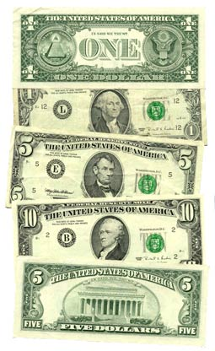
QUESTION
What are some expense categories for a product?
  Material costs
  Labor costs
  Scrap costs
  Rework costs

Slide 28


Business Challenges
Rising Customer Expectations
  Customized Products
Expansion of Global Economy
  Global Competition
  International Trade Rules
Regulations and Standards
  Health and Safety Practices
  Environmental Practices
  Protecting Worker Rights

Slide 29
Business Challenges (Cont’d.)
Maintaining production schedule
  It is important to meet delivery promises
  Unscheduled downtime can impact commitments
    May impact time available to do scheduled maintenance
Effective use of both management and leadership
  Management needed to produce key results
  Leadership establishes direction, aligns people and motivates and inspires others

Slide 30
QUESTION
The decision to continue to run equipment to failure or shut down to repair should be based on?
  Safety and system performance

Slide 31

Business Challenges (Cont’d.)
Internal and External Customer Treatment
Common Needs
  To be treated with respect
  To have all commitments honored
  To be dealt with in a professional, polite manner at all times
  To receive a quality product in a timely fashion

Slide 32
Business Challenges (Cont’d.)
Different Needs
  Internal:
    Part of team
    Proper training and resources
    Safe and healthful environment
    Receive reports, information, and tech help
  External:
    Good customer service
    Professional advice
    Informed of latest promotions and products

Slide 33
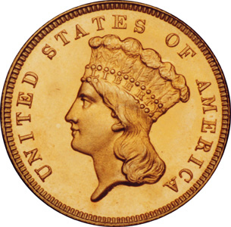
Summary
  The economics of business
  The human resources side of business
  Employee understanding of profit and loss

Slide 34
Domain 2 Business Basics
Foundations of Manufacturing
Section 5.2:
Human Behavior

Slide 35
Learning Objectives
Examine the “needs” theories of motivation.
Determine the difference between external and internal motivators.
Discuss the influence of motivation on self-development.
Define the basis of your personal value and ethics system.
Identify the concepts of values and ethical dilemmas in the manufacturing environment.
Understand how your value system helps or hinders you from excelling in the manufacturing industry.

Slide 36

QUESTION
Why should you try to understand
other people’s behavior?
To better understand their reasons for doing certain things.
To reduce conflict.
To gain a better understanding of ourselves and others.

Slide 37

QUESTION
How are motivation and behavior related?
Motivation activates human behavior.
Motivation directs behavior towards goals.
Motivation sustains behavior.

Slide 38

Job Expectations Exercise
Write down what you think is important in your job.
Notes:
Job Expectations Exercise 2-5-1:
Total time: Approx. 10 min.
Group size: Entire class
Preparation:
Set up an easel, flip chart, or whiteboard, at the front of the room.
Directions:
Instruct students to think of qualities they consider important in their jobs and to their feelings of job satisfaction. (2 min.)
Select one student to record all responses on the flip chart or whiteboard.
Record class responses by calling on individual students to provide examples of what job satisfaction means to them. (Approx. 8 min.)
Save and Post the list on the flip chart or whiteboard for students to refer to later in the lesson.
Sample responses to the job expectations exercise are as follows:
To be an efficient manager.
To think for themselves.
To be assigned interesting work, be challenged and see the end result.
To be informed, listened to, and respected.
To be recognized for their efforts.
To have an opportunity for increased skill development.
Resolve any questions about the list.

Slide 39
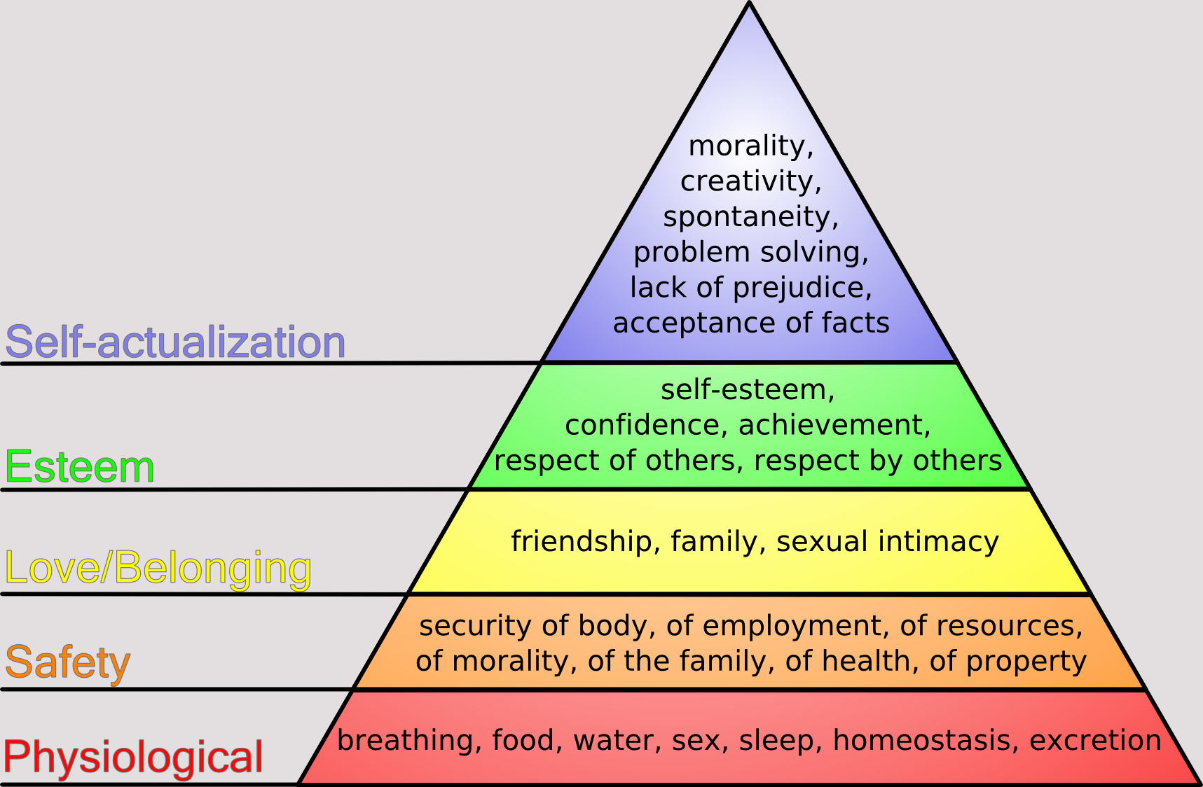
Maslow’s Hierarchy of Needs

Slide 40
QUESTION
Why do most people need a sense of belonging?
Why is self-esteem so important to people?
How does Maslow’s Theory fit in with our expectations list we created earlier?

Slide 41
Herzberg’s Theory
Directly relates to work satisfaction
The Two-Factor Theory = The Motivation-Hygiene Theory
Hygiene Factor = Dissatisfied
  Working conditions
  Production quotas
Satisfied = Motivated
  Challenging work
  Increased responsibility

Slide 42

QUESTIONS
Why would challenging work motivate you?
Why do you think pay is listed as a Hygiene/Maintenance factor instead of a motivating factor?
How would working conditions (i.e., clean spaces) factor into motivation?

Slide 43

McClelland's Needs Theory
Need for Achievement
  Do something better
  Be more efficient
Question - Why do some people always strive to go above and beyond the accomplishments of their peers?

Slide 44
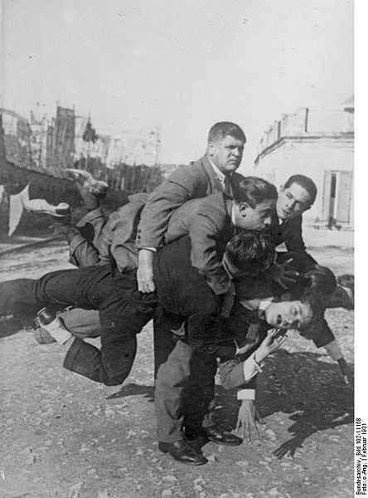
McClelland's Needs Theory (Cont’d.)
Need for Affiliation
      Maintain friendly relationships
  Desire to be liked
Need for Power
      Desire to control others
  Influence behavior of others
What results could come from a lack of affiliation?
Why are some people obsessed with gaining power?

Slide 45
QUESTION
How does McClelland’s Acquired Needs Theories relate to the list of job expectations we developed earlier?
Achievement equates to survival and prestige.
Affiliation equates to belonging.
Power equates to prestige and self-fulfillment.

Slide 46

Types of Motivation
External Motivation
  Outside of yourself
      Official or unofficial recognition
      Promotion/certification

Slide 47
QUESTION
What are some forms of positive external motivators? In other words, what can you do to motivate your people?
Comp time.
Official recognition.
Unofficial recognition, such as a pat on the back or word of encouragement.

Slide 48

Types Of Motivation (Cont’d.)
Internal Motivation
  Within yourself, an internal drive of rewards or discipline system
  You know when you have done a good job and you are proud of yourself (self motivation)
How can your internal motivation influence others?
Notes:
What motivates one person may not necessarily motivate another. Example - A free day or comp time, often seen as a positive external motivator, can be internally de-motivating to the workaholic, who gains personal satisfaction from achievements in the workplace. Driving that person away from work for the day could be perceived as punishment.
Example - promotions that include an increase in responsibility can be both positive and negative motivators. For the individual who craves more responsibility and self-satisfaction, the responsibilities are positive. For someone who prefers to remain behind the scenes or wants things to stay as they are, additional responsibilities could be perceived as negative, or as punishment.

Slide 49
Understanding Motivational Theories
+
-

Slide 50
QUESTION
How will understanding what motivates you help you motivate others?
It “puts you in their shoes.”
You think about a situation rather than simply reacting to it.

Slide 51
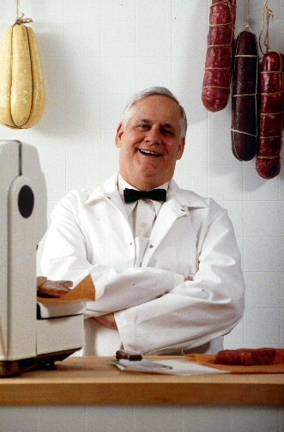
Case Study Exercise
“Basic Needs and Human Behavior”
Purpose - To describe motivation and how it relates to performance
Notes:
Refer students to the case study on page 2-5-23, “Basic Needs and Human Behavior,” in their student workbooks.
Total time: Approx. 30 min.
Group size: Entire class
Read introduction aloud to students.
Read directions aloud to students.
Allow students enough time to read the scenario. (Approx. 5 min.)

Slide 52
Case Study Questions
How do you think Andrea is motivated?
Is Andrea motivated internally or externally? Explain
Why do you think Martin is not motivated and productive?
Why do people need motivators?
Notes:
Solicit student responses. Use the questions after the case study as a catalyst to facilitate a class discussion of the case and its relevance to the manufacturing industry. Ensure that the discussion of each question focuses on the learning objective of the topic. (Approx. 15 min.)
Discuss the case study to ensure that students understand the situation. (Approx. 5 min.)
Answers will vary. Possible responses include:
Andrea is internally motivated because the plant has a positive work climate. She is satisfied with her job, confident about herself, and proud of her organization.
Internally.
Martin is not internally motivated. He is seeking awards and recognition from external sources.
To encourage them to continue to grow, to move forward, to succeed, to see life and work are purposeful and full of meaningful experiences.

Slide 53

Domain 2 Business Basics
Foundations of Manufacturing
Section 5.3:
Ethics

Slide 54
Principles of Ethics
Human worth
Fairness
Loyalty
Truth

Slide 55

QUESTIONS
What is a system of values?
A set of values based on multiple influences that form together to reflect our attitude and actions.
How do our personal values influence us?
Our values are the bedrock foundation to fall back on and live by in times of stress.
Values demonstrate who we are and guide our performance, conduct, and decisions.

Slide 56

Personal Values vs.
Societal Values
Ethnic
Family
Geographic
Organizational
Religious
Notes:
Ask questions for each unit mentioned above - next slide

Slide 57
Values Questions
What are some of the factors that can influence an individual’s values?
How does the family unit affect your values?
How does religion affect your values?
Why must we understand that people of different ethnic groups have different values?
Notes:
Parents, Friends, School, Church, Supervisors, Peers, Subordinates, Society or culture.
Family-
Parents instill their culture in their children from birth.
Single parent point of view.
Personality differences.
Respect, or lack of respect, for authority.
The way you act in public. The way you act within your family.
Diversity. Culture. Conflict may arise from misunderstanding.

Slide 58
Impact of Values
Behaviors
Attitudes
Values
Individuals are more likely to “like” a situation that supports their values and to “dislike” those situations that do not.
Notes:
Attitudes are internal thoughts or feelings. Behaviors are external actions.

Slide 59
Values Impact Questions
How can values affect attitudes?
Why does every place of employment have a different set of values?
59/188
Notes:
Individuals will like a situation that supports their value system and dislike those situations that do not.
Different leadership, different mix of ethnic units, Union vs. non-union, different region or country, different organizational function

Slide 60
Morals

Slide 61
Ethics
I want to turn this wallet in to you so it will be in a safe place. I found it on the floor. It has lots of money in it, but no ID.
Lost and Found
Doing what is right according to their values, regardless of personal costs.

Slide 62
Ethics Question
Why is a discussion of values and morals important to your professional development?
  Values influence behavior.
  Knowledge of the interrelationship between values and morals can help you change your behavior.
  Your values are continuously evaluated by peers, superiors, and subordinates and will impact the values within your company.

Slide 63

WRONG IS WRONG...
“Wrong is wrong, even if everyone agrees with it, and right is right, even if everyone disagrees with it.
(Anonymous)
Agree???
Disagree???
Notes:
Conversation about viewpoints . . .
If members of a group think it is acceptable to tease and make inappropriate comments to a gay individual, a woman, a Hispanic, or an African-American, they are mistaken. It is still wrong.
If members of a group think there is nothing wrong with taking company equipment home for personal use, they are, again, mistaken. It is stealing from the company.

Slide 64
Questions on Ethical Decisions
What are some examples of how our values are tested each day?
How do you handle illegal parking? Who sees you? What message does it send to your children?
Speeding? With your children in the car?
What are some possible long-term effects on an organization with leaders who demonstrate unethical behavior?
Notes:
4th bullet-
Legal action against the company and its employees.
Large personnel turnover (cost money).
Increase in accidents on the job.
Low employee morale.
Decreases in repeat customers.
Plant shutdown.

Slide 65
Questions on Ethical Decisions (Cont’d.)
Lying and backstabbing for professional gain?
Taking the credit when things work out – blaming others when they don’t?
Looking the other way when a wrong is committed?
Is taking no action when witnessing a wrong the same as committing the wrong?

Slide 66
Integrity
Doing what is right, even when no one is looking.
Why is integrity important to our system of values?
Notes:
A company without integrity will not stay in business for long.
Our peers, superiors, and subordinates will not trust someone who lacks integrity. Trust is essential to increased production and the establishment of Lean manufacturing.
How can you use these methods to align your values and make you a better supervisor worthy of further advancement within your organization?

Slide 67
Ethical Dilemma Questions-Case Study 2-5-35
What is the ethical dilemma?
What would you do in this situation?
What are some of the problems you face in this situation?
How are you going to handle the problems you may face after you make your decision?
Notes:
Case Study 2-5-35 in Student Guide
Read Introduction aloud to students.
Introduction – “In this case study, you must consider an ethical dilemma and decide how to handle the situation. “
Direct students to read the case study and answer questions individually (Approx. 10 min).
“Read the case study and write down, on a separate piece of paper, your responses to the questions that follow. Be prepared to participate in a class discussion on the issue.”
Scenario – “You have noticed that supplies are missing from your department’s inventory. Tools are missing from the tool locker, and the coffee fund is short again for the second month in a row. You have also noticed that one of your employees has been staying after work for no apparent reason. Yesterday you saw this same employee carry a box out of the supply room and walk to their car. This worker has been with the plant for two years and you have never had a problem with the employee’s performance. The worker is related to your boss. You know that this person is stealing from the company and the loss of supplies and tools is impacting your ability to meet productions quotas.”

Slide 68
Summary
Understanding motivation and how it relates to performance is a valuable asset.
Understanding your own needs will enable you to recognize the needs of your peers, seniors, and subordinates.
Understanding that individual needs influence attitudes, behaviors, and performances, will increase your ability to influence others.

Slide 69
Domain 2 Business Basics
Foundations of Manufacturing
Section 5.4:
Team Building

Slide 70
Learning Objectives
Examine the concept of team building.
Identify the elements of a team.
Describe team dynamics, types of teams, team development techniques.
Discuss methods of managing team activities and the benefits of consensus building.
Notes:
Read Introduction paragraph aloud to the students.
The purpose of this module is to provide you with the skills necessary to work within a team environment. Specifically, you should understand the meaning of being a team member, your responsibilities as a team member, team dynamics, types of teams and their purpose, and your responsibilities if you are assigned as a team leader. This information is important to the manufacturing environment because many manufacturers are moving to the team concept to increase productivity.

Slide 71
Definitions
“Team” refers to any group of people linked in a common purpose.
“Team building” refers to the process of establishing and developing a greater sense of collaboration and trust between team members.
“Teamwork” is the concept of people working together cooperatively.
Notes:
Question: What do you think defines a team?

Slide 72
Guiding Principles
Team building can lead to:
Good communications with participants as team members and individuals
Increased department productivity and creativity
Team members motivated to achieve goals
A climate of cooperation and collaborative problem solving

Slide 73
Guiding Principles (Cont’d.)
Higher levels of job satisfaction and commitment
  Common sense tells us that if the people around us are all compatible and working well together, everyone will be happier. A happy team takes pride in their work.
Higher levels of trust and support
  Well-formed teams trust each other and provide constant support to others. Poorly performing teams look for ways to “one-up” the other person and contribute to constant strife.
Diverse co-workers working well together

Slide 74
Guiding Principles (Cont’d.)
Clear work objectives – goals tied to company business plan
Better operating policies and procedures
Team building builds morale and focus among team members. As teams are supported and succeed, employees are happier, and fewer people decide to leave

Slide 75
Types of Teams
Interdependent – The success of the individual team member is bound to the success of the whole team.
Independent – The success of the individual team member is primarily due to their own efforts.
Virtual – Members are joined electronically. This type of team can be either interdependent or independent.
Project – A team used for a defined time period and purpose.
Cross-functional – a team made up of a group of people with different functional expertise.
Notes:
Question: What are some examples of an interdependent team?
Answers may be: football, planning teams
Examples of independent teams?
Answers: sales team, production teams
When would a virtual team be formed?
When team members are at different physical locations
What is a project team?
A team of personnel from different groups formed and utilized for a defined period of time and a clearly definable purpose

Slide 76
High Performance Work Teams
Groups of employees authorized to make a wide range of decisions about how they will handle issues regarding safety, quality, work scheduling, work allocation, goal setting, etc.
Usually are “self-directed”
Frequently select their own team leaders
Success depends on careful planning and training
Most success usually occurs when a new business or process is initiated
Transformation to self-management is a lengthy process and can lead to serious turmoil

Slide 77

Coaching
Coaches are seasoned individuals who use their experience to help others work through tasks and situations.
Coaches provide:
Guidance - To do this, a coach will need to have performed an identical task, or at least similar tasks, to the one the team is undertaking.
  Feedback - Proper feedback is critical. People need to know how they are doing and where they stand. Poor and untimely feedback is a trademark of a poor manager and coach.
  Direction - A good coach will lead you forward with confidence. S/he will identify a set of steps that needs to be performed to move forward as a group.
Notes:
Note: “Coaching” is a process where the facilitator or leader helps direct the individual towards a beneficial outcome.

Slide 78
Coaching (Cont’d.)
Coaches focus on:
  Building peak performance - Peak performance may vary by team and workplace. A good coach will recognize and use the talents each worker has.
  Driving team unity - Again, this is very important. If the team cannot get along together, the project is put in jeopardy.
  Setting realistic goals
  Recognizing diversity of team members - Recognizing team diversity allows a good coach to utilize everyone effectively and build morale
  Executing the team plan

Slide 79
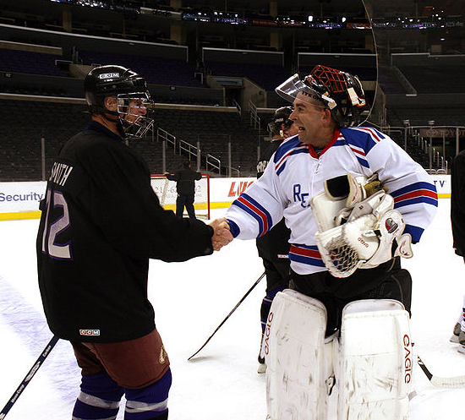
Team Player
What is a “Team Player”?
  Works well with others
  Does what is necessary to benefit the organization
  Politics
  Conforms to organizational “culture”
  Behaves within the “norms” or organization behavior and standards
  Team players are extremely valuable. Team players are either loved or hated. Team players bolster the organization’s ability to accomplish its goals.

Slide 80
Skills Needed for Teamwork
Listening
Questioning
Persuading
Respecting other team members
Helping
Sharing
Participating
Communication will help reduce conflicts
In summary, openness, helpfulness, and transparency are core values of teamwork. Individuals in all types of workplaces and disciplines can adopt these values and progress toward a successful team

Slide 81
Team Building Ingredients or Activities
Select team members
Establishing visions, goals, missions and/or objectives
Fairly distributed workload
Establish a timetable
Balance skill sets among members
Allocate roles within the team
Harmonize personality types
Train on how to work together
Know the skills of your team members!

Slide 82

Grab Bag Exercise
Purpose
Description
Instructions
Scoring criteria
Discussion
Notes:
Team Building Activity: “Grab Bag” Exercise
Total time: Approx. 1 hour.
Group size: Teams comprised of no more than six members
Supplies: One paper bag sealed (stapled or taped) with the following contents:
Rubber band
Pencil with eraser
Large office clip
Paper clip
12” of string or twine
Note: The “grab bags” should be assembled prior to teaching this module. Prepare one set per team.
Directions:
Place sealed paper bags (one for each team) on a table at the front of the room.
Number each bag (1 through …)
Number each team to correspond with grab bags. Remove excess bags from table.
Identify criteria for judging successful completion of the event.
At the conclusion of the ninety seconds, call “time.”
Have each team present their ideas to the rest of the class.
Duplications will be marked off each team’s summary sheet.
Award a rating for each team (use a scale of 1-10, with 10 being the highest, for each criterion). Highest possible score: 50.
Only original ideas (other teams did not provide the same response) can receive credit.

Slide 83
Grab Bag Discussion Questions
What were the factors contributing to or limiting your success?
How was team leadership determined?
What unique contributions did each member offer?
How did these contributions affect the outcome of the project?
How did the competitive nature of the event affect the quality of the project?

Slide 84

Team Development Model
Forming-Storming-Norming-Performing

Slide 85

Forming
    Individuals who have placed into teams, but may not have formed a unit may behave as follows:
    Members behave independently
    Members are relatively uninformed on the issues and objectives
    Members are focused on self
    On forming teams, members can be focused on
    gratifying their own pride and ambitions.
    This is because they are not quite familiar or
    comfortable with working with others.
Notes:
Question: What type of supervision should be used at the forming phase?
Answer: Directive.

Slide 86

Storming
Storming teams have advanced from the formative level and are ready to work together.
“Storming” teams work together to formulate solutions to problems being faced.
    Members determine what problems they are required to solve
    How they will function, independently or together
    What leadership model they will adopt
    Brainstorming occurs
    Conflict is inevitable
Notes:
Question: What difficulties may arise during the storming phase?
Answer:
Immature team members may compete for dominance and focus on the “small issues” to evade the actual issue.
Some members may feel uncomfortable.
Can become destructive to the team and lower motivation if hostilities are allowed to get out of control.
Question: What leadership model should be used at the storming phase?
Answers: Directive.

Slide 87
Storming (Cont’d.)
When brainstorming, differences in ideas will always occur. Not all members of teams have the same backgrounds, interests, or training. A difference of opinion is inevitable. However, a storming team will not sabotage itself like a forming team will. The coach or team leader will keep team members in check. The coach or team leader will be the individual who steps in to control the potential separation that may occur due to these differences.

Slide 88

Norming
    A fluid and natural working relationship develops.
    Members agree on rules, values, professional behavior, shared methods.
    Members begin to trust each other.
    Motivation increases.
    Groupthink may develop.
Notes:
Question: What is “groupthink”?
Answers:
Conformity in thought and behavior among the members of a group.
An unthinking acceptance of majority opinions
Question: What form of leadership should be utilized at the norming phase?
Answer: Participative.

Slide 89

Performing
    Many fewer teams actually perform. A performing team:
    Functions as a unit
    Operates smoothly and effectively
    Performing teams are the most effectively and smoothly operating groups in the workplace.
    Lack inappropriate conflict
    Makes decisions without supervision
    Members are competent and autonomous
  *Not all teams will make it to this stage.
Notes:
Question: Will all teams reach the performing phase? If not, why?
Answer:
Not all teams will reach this phase. Some teams may develop groupthink and cannot get beyond it. These teams should be disbanded and reestablished with new members.
Question: What form of leadership should be used at the performing phase?
Answer: Participative. The team makes most of the necessary decisions.

Slide 90

Adjourning
    Added in 1977, this phase entails:
    Completing the task
    Breaking up the team
    Completing documentation
    Assigning tasks to specific individuals
    Establishing timetable for completion
    Setting standards for reforming team
    Adjourning inherently means that the team will be picked up again. Adjourning happens with work groups, contractors, or other groups that do not work together constantly but work together at least fairly often.
Notes:
Question: What are some attributes of the “adjourning” phase?
Answer:
Completing the task and breaking up the team.
Documentation of team results.
Recognize individual and team efforts.
The feeling of loss.

Slide 91

Building Consensus
A consensus is a general agreement between team members.
  A compromise that everyone can accept
  A win-win process
Notes:
Question: To reach a consensus, does everyone on the team have to agree with the decision made?
Answer: No. It is a compromise.

Slide 92
Building Consensus (Cont’d.)
Benefits:
  Builds strong group involvement
  Builds group trust
  Brings diverse people together
  Encourages decision making
  Reduces conflict
  Encourages empowerment

Slide 93
Building Consensus (Cont’d.)
    Overcomes individual differences
    Promotes discussion
    Encourages ownership
    Invites individual accountability and commitment
    Eliminates distrust
    Encourages open discussion
    Building consensus does not always get everyone everything they want. Look at Congress for example: on some rare occasions they are able to all agree. However, this is very uncommon.
Notes:
Question: Why use consensus building to find a solution?
Why not take a hand count or roll call vote and let majority rule?
Answers will vary, but should include:
Overcome individual differences.
Promote discussion.
Encourage ownership.
Ensure accountability and commitment.
Eliminate distrust.
Encourage open discussion.

Slide 94
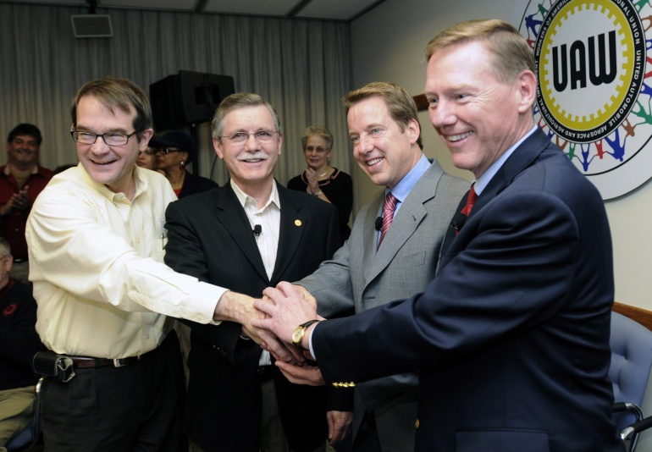
Guidelines for Consensus Building
To properly build a consensus, a team must assure that:
It is not competitive.
Team members must feel free to express their opinions.
Everyone contributes ideas.
Disagreements should be expressed respectfully.
It is not personal.
Do not rush to a decision.
Listen to understand.
Stay on task.
©Ford Motor Company 2007

Slide 95
Consensus-Building Process
Very rarely is a consensus formulated in an instant. In today’s world, an instant consensus is only brought on by some sort of emergency or obviously troubling issue.
Often, coming to an agreement we all can digest involves a process. This process can be a long and arduous one, but it generally works.
The process for building a consensus is as follows:

Slide 96
Consensus-Building Process (Cont’d.)
Identify the issue or problem to be resolved.
Stay on target.
Define objectives for the task at hand.
Schedule a meeting.
Establish the timetable.
Identify the participants in the decision making process.
Ensure that all participants understand the issues.
Assign a facilitator.

Slide 97
Consensus-Building Process (Cont’d.)
Determine what must be done to reach the established goals.
Define what the outcome of the process should be.
Solicit proposals from each participant.
Make a list of all possible proposals.
Discuss all proposals.
Solicit points of agreement or major disagreement on each proposal.

Slide 98
Consensus-Building Process (Cont’d.)
Eliminate proposals that generate major disagreement.
Revise the list and reduce the number of possible proposals.
Review each proposal.
Solicit points of major agreement or disagreement.

Slide 99
Consensus-Building Process (Cont’d.)
Retain proposals that are positive, with no major points of disagreement.
Reach a consensus on a proposal that satisfies the needs of the objective.
Assign individual accountability for each task involved in the proposal.
Notes:
Question: Why would the team want to assign individual accountability for each task involved in a proposal?
Answers:
Promotes understanding within the team.
Ensures that each task will be completed.
Each team member knows their responsibility.

Slide 100
Consensus-Building Process (Cont’d.)
Reach a consensus on accountability
Document the results, especially area of strong agreement and/or disagreement

Slide 101
Summary
Team building takes time and is comprised of many elements.
There are different types of teams and team development techniques.
There are different methods of managing team activities, including coaching.
Consensus decision making involves all members.

Slide 102
Summary (Cont’d.)
We examined the concept of team building.
We identified the elements of a team.
We described team dynamics, types of teams, and team development techniques.
We discussed methods of managing team activities and the benefits of coaching and consensus building.

Slide 103
Domain 2 Business Basics
Foundations of Manufacturing
Section 5.5:
Communication Skills

Slide 104
Learning Objectives
Describe the communication process and the elements of effective communication.
Determine the barriers to effective communication.
Discuss the use of operational definitions to improve clarity of communication.
Understand the importance of effective listening.
Examine basic reading comprehension strategies.
Discuss the importance of effective written communication skills, such as reading and writing.

Slide 105

QUESTION
Why should we spend time learning about communication concepts?
To enhance life skills.
To understand ourselves and others.
People with good communication skills are more successful both in their personal and professional lives.

Slide 106
Communication Elements
M
E
S
S
A
G
E
TRANSMISSION MEDIUM
Sender
FEEDBACK
Receiver
Source: Center for Naval Leadership; POIC

Slide 107
QUESTION
How can a message consist of more than just information?
Emotions are also conveyed.
Modification of meaning due to internal or external barriers to effective communication are included.

Slide 108

QUESTION
What are some of the things you do to send a message?
Formulate the message you intended to transmit, either orally or in writing.
Filter the message through internal barriers that may affect the message. Barriers may include knowledge and experience levels, language or terms, or feeling toward the subject or the intended receiver(s), beliefs, or biases.
Encode or form the message (or the words) you wish to use.
Transmit the message orally or in written form.

Slide 109

QUESTION
What are some ways to transmit information?
Verbally
By telephone or electronic mail (e-mail)
By memorandum or
written correspondence

Slide 110
QUESTION
What are some of the internal things you do when you receive an oral or written message?
Hear and/or see the message
Decode the message through assimilation (absorption) and interpretations, largely through the use of mental images
Interpret/convert those mental images into an understanding of the message

Slide 111
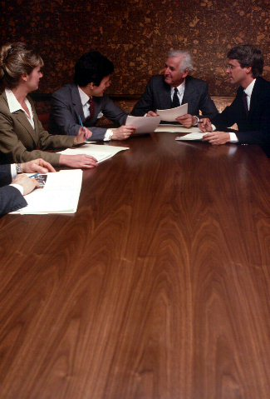
QUESTION
How can the sender overcome possible perception barriers in the receiver?
By soliciting feedback

Slide 112

QUESTION
Why is feedback important to communication?
The receiver must acknowledge message receipt and understanding.
The sender must ensure that the receiver understands the message as the sender intended.
Effective feedback determines whether the message sent was accurately received and interpreted as the sender intended.

Slide 113

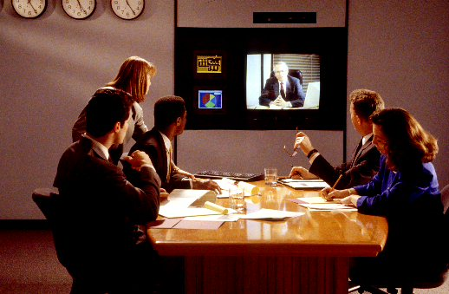
QUESTION
What forms can feedback take?
Written, oral, or nonverbal.

Slide 114





Non-Verbal Communication
Body Language
  Body positions
  Facial expressions
  Gestures
Paralanguage
  Vocal qualities
    Intonation, resonance, rhythm, speed, pitch, volume, inflection, and clarity

Slide 115
QUESTION
How does nonverbal communication distort the message being sent?
Your perception of what the person is saying or receiving can be obtained through the way the sender or receiver is talking or through their body position or facial expressions.
Nonverbal communication may give clues that the receiver can use to interpret verbal messages. Nonverbal communication is unconscious, but we can learn to be aware of our barriers and choose our intended nonverbal messages.

Slide 116


Body Language
Eye contact
Facial expressions
Hand positions or movements
Arm and leg positions or movements

Slide 117

QUESTION
How can you become more aware of your body language and the impact it has on others?
By asking subordinate/peers how they see you
By studying other people’s body language and their impact on others

Slide 118

QUESTION
Do you think finger drumming or
looking at your watch could mean something other than boredom?
Yes - habits, nerves, and anxiety

Slide 119
QUESTION
How do you feel or what do you do when someone does not look you in the eye when you are talking to him or her?
Try to get that person’s attention
Ask if anything is bothering that person
Get frustrated
Perceive that the person is not listening
Notes:
(Note: Some people are not bothered by this.)

Slide 120


QUESTION
What are some examples of facial expressions and what do they mean?

Slide 121

QUESTION
Can you project emotions with your voice? What are some examples?
Anger
Enthusiasm
Excitement
Sadness

Slide 122
Perceptions
Perception is the act of gaining knowledge through one of the senses: seeing, hearing, touching, smelling or tasting. Since perceptions differ, successful communication occurs only when the receiver successfully interprets the message as the sender intended.

Slide 123

Visual Perception
What do you see?
Notes:
Question: What do you see in the picture? A young or old woman? Both?
Show the class where both are on the slide.
Question: Why do some people move back when you get too close when you are speaking to them?
Answer: You have unknowingly entered their personal space.
Note: Allow students several minutes to answer.

Slide 124



Zones Of Interaction
Intimate zone
  18 inches
Personal zone
  1 to 4 feet
Social zone
  4 to 12 feet

Slide 125
QUESTION
Why do you think it is important to understand the different interaction zones?
Some people back away when you stand too close to talk with them – then they shut down and do not seem to hear what you are saying.
It is important to understand the effect you may have on other people who are more comfortable with a different zone than you. Pay attention to other people’s body language.

Slide 126
QUESTION
What are some examples of noise as a barrier to communication?
External construction sounds
Loud machinery
Too may people talking at once
Trying to hold a conversation on a telephone with a poor connection

Slide 127

Psychological Barriers
Lack of common core experience
Fear
Distractions
Filtering

Slide 128

QUESTION
What are some of the things you recall in relation to your fear of communication?
Fear of showing ignorance
Fear of disapproval
Fear of losing status
Fear of judgment
Fear of ridicule

Slide 129
QUESTION
What factors are indicated by the expression “lack of common core experience?”
Different background knowledge
Overuse of abstractions, concepts, ideas, or words not directly related to the matter at hand
Technical expertise levels are different

Slide 130
Operational Definitions
“Clean this table.”
For a working table…
For a table where people would be eating…
For a table where surgery will be performed…
Notes:
Question: To a child, what does “clean the table” mean? How about a gambler or poker player? How about an accountant?
Answers will vary but may include:
Throw everything in the sink.
Take all the dishes to the kitchen, put the scraps into the trash can, rinse the dishes and put them in the dishwasher (or wash them by hand), wipe the table down, put the uneaten food in the refrigerator, and so on.
A gambler wins every hand or takes all the money or chips off the table with a winning hand.
An accountant files away unnecessary numbers in cells on a spreadsheet or deletes unused rows or columns for a final printout.
Question: What does it mean if you tell your team to clean their work tables?
Answers will vary, but should be entirely different from the first response.

Slide 131

QUESTION
Why are operational definitions critical?
Understanding requires accuracy, specifically the meanings of words.

Slide 132

Effective Listening Questionnaire
HOMEWORK ASSIGNMENT
complete the questionnaire in your Student Workbooks. (Approx. 10 min.)
HOW WELL DO YOU LISTEN!
Notes:
Introduction: The purpose of this exercise is to gauge the student’s “Effective Listening Attitudes and Behaviors,” based on the results of the questionnaire.
When complete, use the table below to help students evaluate their listening skills.
Review: Provide time for students to ask questions and hear the opinions of others regarding the questionnaire. For those who scored as either excellent or good listeners, ask if any received formal training. For those indicating a need for improvement, ask which particular areas received a “No” answer and why they feel improvement might be important.
1 – 5 “NO” answers- You are an excellent listener. Keep it up!
6 – 10 “NO” answers- You are a good listener but can improve.
11 – 20 “NO” answers- Through practice you can become a much more effective listener in your business and personal relationships.

Slide 133

Effective Listening
Effective listening includes:
  Preparing to listen
  Focusing on comprehension
  Minimizing ineffective listening habits
  Minimizing personal filtering
  Focusing on the message, not the messenger
Listening is a skill – it must be practiced.

Slide 134
QUESTION
What are some of the possible effects of poor listening?
Poor two-way oral communication
Frustration because the speaker feels ignored
Missed messages

Slide 135

Listening Skills
We may be hearing, but are we really “listening”?

Slide 136
QUESTION
Do you think the concept of improving listening skills is ignored in education?
Listening is not taught because it is taken for granted.
People assume that listening is part of hearing.

Slide 137

QUESTION
What are some ways you can prepare to listen?
Eliminate distractions.
Get comfortable.
Relax.

Slide 138
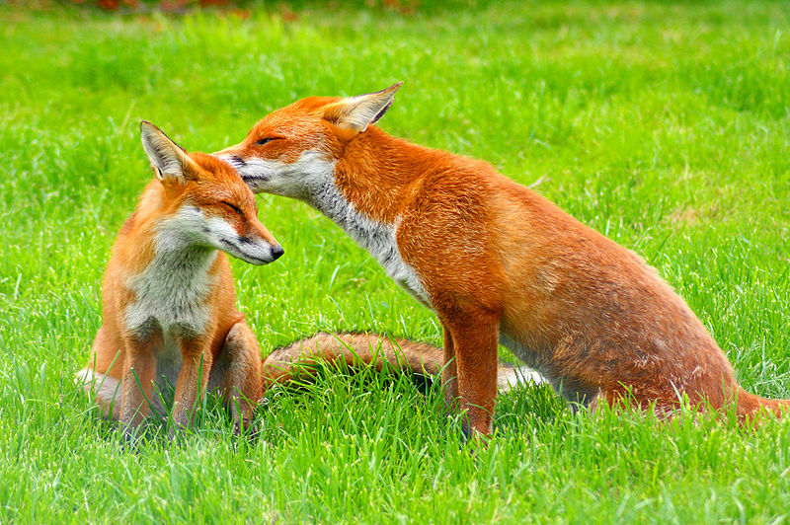
Filtering
Our experiences
Our education
Our beliefs
Our gender
Our age
Our schedule
Our opinions
Our position
Our health
Our status
Notes:
NOTE:
Filtering is the stuff that’s on our end- it’s all about me. What we use to screen out the pertinent from the trivial is our own viewpoint, imposed over what the speaker is saying. It’s the Rose-Colored Glasses that often jade our way of interpreting the message. Some filtering is for self-protection, like a coffee filter in a drip coffeemaker. Some filtering is based in prejudice and bias, resulting from past experiences or upbringing. Whichever form it takes, Filtering is a common way to misunderstand the message in its original form.
ASK: Can you think of things that influence the way you “hear” messages?

Slide 139
Language Pie

Slide 140

QUESTION
What do you do when you are listening to someone talk and you suddenly realize that you are daydreaming?
Ask the person to repeat the message.
Be honest. Apologize and let the person know that you were not paying attention.

Slide 141
QUESTION
Why should you stop talking?
The speaker may feel that you are not paying attention.
Continuing to talk shows lack of respect to the speaker.
If you are talking and not paying attention, you cannot hear the message.

Slide 142

QUESTION
What are common distractions?
Paperwork
Phone calls
Interruptions
Noise
The telephone

Slide 143
Being an Effective Communicator
Elements of an effective communicator:
  Recognize the elements of effective communication
  Practice effective listening skills
Being an effective communicator and listener takes hard work.

Slide 144

Feedback Exercise - Whisper!
Look at the picture.
Pass the information to your right.
Whisper only!
Keep passing info to your right.
Last person shares with the group.
Did the info change?
Notes:
One-way versus Two-way Communication – Feedback Exercise 1-3-3
Total time: Approx. 10 min.
Group size: Entire class
Introduction: The purpose of this exercise is to demonstrate the benefits of utilizing feedback to enhance communications.
Preparation: Provide an ambiguous photo or picture.
Directions:
Select one volunteer from the group.
Show the volunteer an ambiguous photo or picture.
The volunteer is instructed to note 10 things about the picture to share with the class. (The volunteer is permitted to write these 10 things on a separate sheet of paper.)
The volunteer then whispers the information to the person on their right.
The person listening can only take in the information without questions and without writing.
The information is repeated in this way until all students have participated.
The last person receiving the information tells the group what they heard.
The instructor then asks the group if they know what the picture is.
The volunteer reads the initial 10 things they wrote down while the instructor shows the picture.
Summarize the exercise using the communication exercise as a catalyst. Facilitate a class discussion on the following questions:
What went wrong with the message?
How could the message remain intact through the entire group?

Slide 145










Written Communications
Reading
  Preview
  Question
  Visualize
Writing
  Identify your purpose
  Consider your audience
  Be concise

Slide 146

Reading
Preview
Question
Visualize
Review

Slide 147
Written Communications
Writing
  Identify your purpose
  Consider your audience
  Be concise

Slide 148

Writing Skills Exercise
Phone Messages
Listen to the messages, as read aloud by the instructor (one time only).
Write down key information.
Discuss at end of exercise- notice the differences!
Notes:
Total time: Approx. 10 Min.
Class size: Entire class
Read the introduction aloud to students.
Introduction: Your ability to communicate in writing will help you find a job and perform the job well. Additionally, knowing how to effectively communicate in writing will allow you to get your ideas or recommendations recognized within your company. This exercise is designed to provide you with practice to improve your writing skills and will help you understand the importance of effective writing.
Read the scenario to the students, and then read one of the sample phone calls ONE TIME ONLY.
Scenario: You have been left in charge for the next three days while your supervisor, Jim Borrows, attends a focus group. You have been instructed to take messages on any calls received pertaining to the project for which your supervisor is the team leader. It is your responsibility to capture all the required information so that your supervisor can return these calls and provide the appropriate information to each caller.
Direct each student to write the message on the handout provided.
Provide three to five minutes to discuss the information that should be captured on the message.
Review and critique the student’s versions of the messages you read. Encourage student input during this process.
Call No 1: Received at 11:10 a.m. on Friday June 18
Hello. This is Mr. Smith from Smith Industries. I’m calling to get the agenda and the handouts for next month’s meeting. I will be out of town, but I would still like to provide my input. Have Jim email me the information. I can be reached at (813) 555-3322 between the hours of 9:00 a.m. and 2:00 p.m. on Mondays, Wednesdays, and Fridays. Have Jim call me when he returns. Thanks.
Call No. 2: Received at 3:45 p.m. on Wednesday, June 19
Hello. This is Janice Doe from Doe Foods. I received a message from Jim Borrows, at this phone number. I’m not sure what the call was about, but I hope that this has something to do with the Workforce project I volunteered to work on. I am very interested in being involved with this project and would like information on where the project is in meeting the goals discussed at the summit held last month. I would also like to know what I can do to help. Please have Jim call me at (904) 555-5577 to discuss this issue.
Call No 3: Received at 10:35 a.m. on Monday June 20
Hello. This is Mark Myers from Hiller Circuits. I received a message from Jim to speak at the next Workforce project meeting, and I need information on when and where the meeting will be held, what this project is about, who is involved, and what I need to discuss. My phone number is (352) 555-9285. Have Jim call me to set up a meeting.

Slide 149
Summary of Communication Skills
Strong communication skills are a powerful asset and characteristic of the production technician.
In this section we accomplished the following:
  Examined the elements and barriers of effective communications
  Discussed basic reading comprehension strategies and the importance of effective reading and writing skills.
  Identified the importance of effective listening skills.

Slide 150
Domain 2 Business Basics
Foundations of Manufacturing
Section 5.6:
Stress Management

Slide 151
Learning Objectives
Describe the concept of stress.
Identify stress reactions in yourself and others.
Understand the impact of unchecked stress.
Determine the methods to manage stress.

Slide 152
Stressors
Social
Environmental
Difficult decisions
Health issues
Change
Family
Pain
Chemical
Work
Disease
Commuting

Slide 153
Stress and Performance
HIGH
PEAK PERFORMANCE ZONE
LOW
Boredom
Panic
LOW
STRESS LEVEL
HIGH

Slide 154
QUESTION
What effect does having little or no stress in your life, have on your performance?
Low performance
Boredom

Slide 155
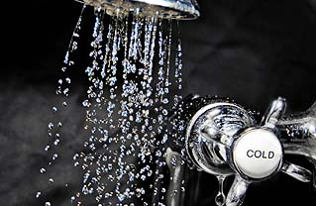
Stress and Performance
Understress – find ways to increase stress
  Looks for problems to solve
  Listen to upbeat music
  Take a cold shower
  Exercise
  Change work location
  Eat spicy foods

Slide 156

Stress and Performance (Cont’d.)
Overstress impairs physical and intellectual functioning
  Meditate
  Breathe deeply
  Relax your muscles
  Imagine a relaxing scene
  Listen to slow, melodic music
  Take a warm bath
  Lie on a soft bed
  Eat bland foods, drink warm milk

Slide 157

Stress and Performance (Cont’d.)
Peak performance lies between understress and overstress
  You feel energetic, enthusiastic, confident, and in control of yourself and events
  People become more creative, efficient, alert and responsive
  Speed, endurance, and reaction times are optimal

Slide 158
Factors of Stress
Genetics - Does heart disease or high blood pressure run in your family?
Personality - Are you obsessed with trying to do more in a shorter period of time? Are you unable to relax?
Demands - Are you in good physical and psychological shape or is your energy sapped by physical demands? Are the demands of your job or your personal problems overly stressful?

Slide 159

QUESTION
What are some examples of how you react to stress?
Clammy hands
Forgetfulness
Insomnia
Anger
©grafoo

Slide 160

Reactions to Stress
“The cornerstone of stress management is the knowledge that gaining control over our lives depends not so much on what is happening, but on how we choose to react.”
(Dr. Herbert Kindler)

Slide 161
Physical Responses to
Short-Term Stress
Physical Responses
  Fight or flight
  Dry mouth
  Shortness of breath
  Heart pounding
  Jaw/fist clenching
  Clammy hands or sweaty feet

Slide 162
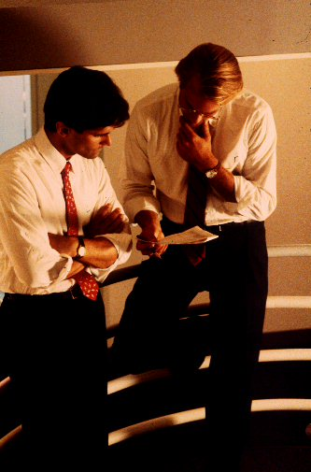


Stress Response
PHYSICAL
SOCIAL
EMOTIONAL
Notes:
QUESTION: What are physiological/physical symptoms of short-term stress?
REFER to previous slide.

Slide 163
Emotional Responses to
Short-Term Stress
Apprehension
Anger
Anxiety
Worry
Panic
Fear
Frustration
Guilt
Inability to concentrate
Violence
Notes:
Note: An excellent example of the body’s physical reactions to stress occurs when you are driving your vehicle and you see police lights flashing in your rear-view mirror.
Alarm: Your heart races, you break out in a cold sweat, you gear up for a confrontation.
Resistance: You may deny that you were speeding, your throat may become dry, and your mind may go blank.
Exhaustion: Afterwards, you may feel tired.

Slide 164
Responses to Long-Term Stress
Job burnout
Exhaustion
Irritability
Emotional outbursts
Fatigue
Alcohol or drug abuse
Weight gain
Workplace violence
Weight loss
Difficulty concentrating
Physical symptoms
  Headaches
  Arthritis
  Backaches
Feeling inadequate, worthless, suspicious

Slide 165
Personal Stress Management
Identify what is making you stressed
Identify your normal response to that stress
Build resilience to stress
Three strategies to self-empowerment
  Change your perception to the situation
  Address the problem verbally with others
  Exit

Slide 166
QUESTION
How do you personally deal
with stress?
Spend more time in activities that uplift your spirit, such as dancing, singing, praying, reading, or pursuing hobbies.
Improve family support structure.
Play.
Laugh and maintain your sense of humor.

Slide 167
Benefits of Exercise
Prepares the body to resist stress
Provides both physiological and psychological benefits, which include:
  Increases concentration
  Reduces blood pressure, anxiety and hostility
  Better sleep and weight control
Notes:
Question: What types of exercise activities would you benefit from?
Answers will vary, but may include:
Basketball.
Running.
Aerobic class.
Swimming.
Golf.
Walking.

Slide 168
Benefits of Good Nutrition and Rest
Mental alertness
Increased proficiency on the job
Ability to perform your job more efficiently
  Take your vacation in small chunks and use to rest and rejuvenate
Notes:
Question: What are the benefits of good nutrition and adequate rest?
Answers will vary, but should include:
Mental alertness.
Increased proficiency.
Ability to perform your job more efficiently.
Note: Using your vacation time is an excellent way to get away from stressful work situations and relax. Vacation time should be broken up into small chunks, taken regularly and used for rest, relaxation, and rejuvenation.

Slide 169
Relaxation Techniques
Do regularly
Deep breathing
Muscle relaxation
Development of cooperative support systems
Notes:
Question: Why is relaxation the most difficult technique to implement?
Answers will vary, but should include:
It takes time.
It is difficult to find a quiet place.
It is hard to concentrate.
Note: If quiet time is not available other ways can help, such as learning deep breathing and muscle relaxation techniques.

Slide 170
Case Study
“Can We Strike A Balance?”
Notes:
Introduction – Stress is part of our lives. We need to recognize how people
react to stress as well as the symptoms of unchecked stress. This case study
will help you understand that if we do not manage stress, it can affect not only
us, but those around us
Directions – Read the case study and write down your responses to the
questions that follow. Be prepared to participate in a class discussion on the
issues.
(3) Scenario – For the past several months a co-worker named Cindy has been
having problems at home. She talks about her problems all the time while at
work. From what you have gathered from her remarks, she argues a lot with
her spouse over money. Occasionally, when she comes in to work, she slams
doors and throws things. When Cindy is like this, she is disruptive for a while,
but then she settles down to work. You do not mind her talking, but it is getting
hard to complete your job. The problem is that the two of you work together
and your work is dependent on hers. Things seem to be getting worse.
Lately, Cindy has been explosive and hard to work with. She is also not
producing like she used to, which is affecting your output. You have
considered reporting Cindy to your supervisor; however, you are hesitant
because she is normally a good worker. Cindy’s attitude and short fuse are
making it hard to communicate with her, and the distractions are making it
difficult for you to complete your work.
Answers will vary. Allow time for discussion. The following are examples of possible responses to the questions:
You are worried and distracted. Cindy is explosive/short-fused and uncommunicative.
Cindy is making the work environment uncomfortable and difficult to accomplish your work.
If health care is part of your benefits package, recommend she seek professional assistance to relieve her stress. Discuss options for financial counseling.
Let her know that she is causing you stress and encourage her seek outside assistance for a professional.
Yes, no, I don’t know.

Slide 171
Case Study
What are indications of your stress?
Of Cindy’s stress?
How is Cindy’s stress causing your stress?
What would you suggest Cindy do to relieve her stress?
Should you talk to your supervisor about the situation?
Notes:
Answers will vary. Allow time for discussion. The following are examples of possible responses to the questions:
You are worried and distracted. Cindy is explosive/short-fused and uncommunicative.
Cindy is making the work environment uncomfortable and difficult to accomplish your work.
If health care is part of your benefits package, recommend she seek professional assistance to relieve her stress. Discuss options for financial counseling.
Let her know that she is causing you stress and encourage her seek outside assistance for a professional.
Yes, no, I don’t know.
Solicit student responses. Use the questions after each case study as a catalyst to facilitate class discussion. Ensure that the discussion of each question focuses on the learning points of the topic. (Approx. 10 min.)
Review case study by ensuring that questions are answered according to the module objectives. (Approx. 5 min.)

Slide 172
Summary
Unchecked stress can lead to a variety of adverse problems.
  Physical
  Psychological
  Social
Being physically fit and maintaining a nutritious diet will contribute to your ability to control stress.

Slide 173

Summary (Cont’d.)
Knowing how to relieve stress in your life will lead to better health, and a much happier you.

Slide 174
Domain 2 Business Basics
Foundations of Manufacturing
Section 5.7:
Time Management

Slide 175

Goal Setting-Hitting the Mark
Set the Goal (write it down!)-
  New job
  Grade in School
  Buy a car/bike/gadget?
Make the “To-Do” List
  Step-by-step plan to achieve the goal (s)
Prioritize the List
  Select the order of activities on the List

Slide 176


Definitions
Time- measurement of events in sequence
Management- working with and through others to accomplish objectives
Time Management- art of setting and achieving goals or plans on a schedule

Slide 177
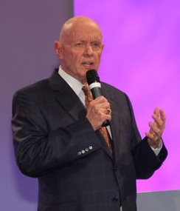
Dr. Stephen Covey
Author, Seven Habits of Highly Effective People, Principle-Centered Leadership
Hekerui

Slide 178
Covey’s Quadrants of Urgency
Four Quadrants
I- Urgent and Important
II-Not Urgent but Important
III-Urgent but Not Important
IV-Not Urgent and Not Important
IDEAL
Notes:
Note: Time management becomes priority management as you work to prioritize your daily life, roles and goals. By determining what’s important to you, you are free to schedule your life based on what really matters to you, not what others think is vital or important.
By doing less of the not important and focusing on things of strategic importance (non-urgent) we will fight less fires and crate more fire breaks

Slide 179

Generations of Time Management
First generation – “crisis manager”
Second generation – “calendar king”
Third generation – “prioritizer”
Fourth generation – “balanced manager”
But there’s one more Generation . . .
Notes:
Note: The first generation Crisis Manager reacts moment by moment, compared to the second generation Calendar King who schedules but does not plan. The Priortizer does just that, but excludes the opportune and unforeseen. The Balanced Manager uses a values based approach, looking not to manage time and things, but to manage outcomes and relationships.
Note: Some people may go their entire lives completely missing out on important things (like spending time with their children before they have grown up) because it was never "urgent. “The point is not to ignore urgent things, but to embrace important things without waiting for them to become urgent.
CAT IN THE CRADLE SONG

Slide 180
The Fifth Generation
Identify the dimensions of a full life (holistic).
  holos, a Greek word meaning all, entire, total
Plan around the most important things.
Create and allocate around priorities-must/should/could/like to.
Look for synergy-combine and accomplish.
Open up spaces for new and exciting possibilities.
Notes:
What does your full life look like? What is the balance of your time spent doing to make you happy and fulfilled?
The key is to keep the main thing the main thing.
Don’t let the great suffer at the expense of the good or the ok. Plan your day around the things that matter most first.
Find ways to make the must-do’s dovetail with the like-to-do’s and you find more time to enjoy life. Example- include others in activities you must do, sharing the load and spending time developing relationships while working on a goal or task.
White space- the times when nothing vital has to be done because all the important tasks have been accomplished. Time to recharge, recreate or renew.

Slide 181
Components of Effective
Time Management
Get organized.
Set priorities.
Set up a system.
Schedule.
Beat deadlines.
Notes:
Question: How can you get organized?
Answers will vary.

Slide 182
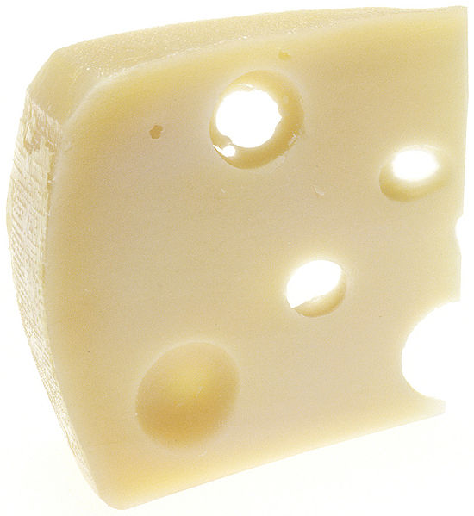
Techniques for Setting Priorities
ABC or 1, 2, 3 Method
Pareto Principle (80/20 method)
Swiss Cheese Method
Notes:
Note: The Pareto Principle is also known as the 80/20 method.
Question: Why do you think this method is called the “Swiss Cheese Method”?
Answer: Because you “punch holes” in the project by completing a little at a time until the project is completed.
Note: Use the Swiss cheese method to complete the remaining 20% of the tasks.

Slide 183
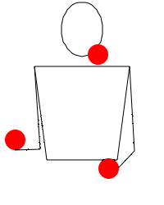
Setting Priorities
Six Factors to Consider
  Family obligations
  Project deadlines
  Anticipated stress involved
  Project length
  Location
  Degree of difficulty
Notes:
Using effective time management techniques will assist you in keeping yourself on track so that you don’t get stressed because you missed an important deadline or meeting. You will know when something is going happen and have a reminder system in place to assist you.

Slide 184
Advantages of Using a “To-do” List
It’s easy.
It’s manageable.
It gives you peace of mind.
You won’t forget important things you need to accomplish.
It’s measurable.
DON’T FORGET TO SCHEDULE TIME FOR YOURSELF TO RELAX
Notes:
Question: What are some advantages to using a “to do” list?
Answers will vary, but should include the following:
Goals are written down.
Checked off as tasks are complete.
Feeling of accomplishment.
Question: Why is it important to make time for yourself?
Answers will vary.

Slide 185
When Are You Most Productive?
In the morning?
Just before lunch?
Just after lunch?
In the late afternoon?
In the evening?

Slide 186
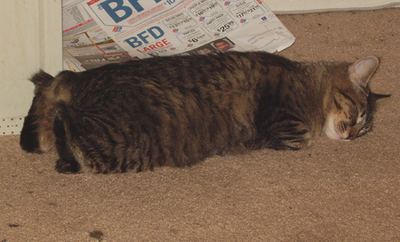
Tips for Young Production Workers
Prepare for work ahead of time.
Set multiple alarms.
Go to bed earlier.
Get a wake-up call.
Car pool.
Notes:
Discuss each bullet with students. You will find many issues to talk over.

Slide 187
Summary
Managing priorities is the key step to successfully managing time (First Things First!).
Employing effective time-management techniques will reduce the stress in your life, making you a better production technician, improving your quality of life, and allowing you to enjoy your work, your family, and friends.
Never let the good take the place of the great!
Never let the important (control) suffer at the demands of the urgent (crisis).

Slide 188
D2SG5 Summary
Business Basics- Who, What, Where, Why
Human Behavior
Principles of Ethics
Team Building
Communication Skills
Stress Management
Time Management

