Slide 1


Foundations of Manufacturing
Domain 2: Production and Processes
Section 6: Supply Chain
Notes:
Read Lesson Link aloud to the students:
Obtaining the materials you need to produce the products manufactured by your company is essential to you and your company’s success. You will need a basic understanding of how raw materials are obtained, how much you need on hand at any given time, and what other supplies you need (e.g., paper, ink, pens, and so on,) to ensure that orders are filled, paperwork is completed, and personnel receive the materials they need to operate the equipment. The supply chain keeps the company open for business.

Slide 2
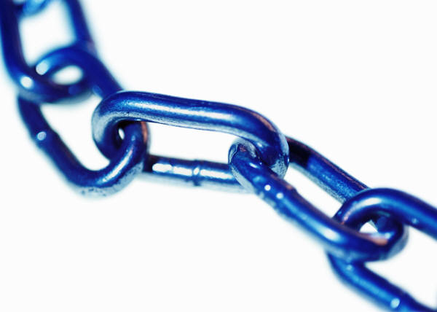
Learning Objectives
  Know the basic principles of the supply chain and supply chain management as they pertain to manufacturing production and processes, as well as the answers to the following:
  What is a supply chain?
  What information is a key part of the supply chain?
  How is the supply chain changing?
  What are some supply chain management
  challenges?
  How does the supply chain affect
  the production technician?

Slide 3
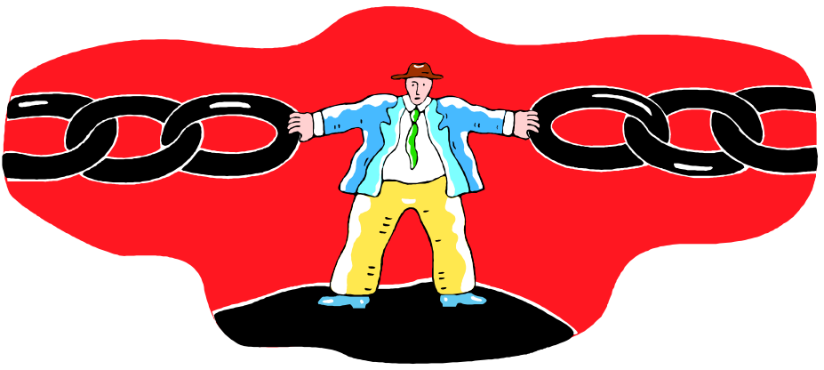
Learning Objectives (Cont’d.)
  Examine the concepts of the supply chain, supply chain management, the value chain and its relationship to lean manufacturing.
  Identify the key processes that are part of supply chain management.
Notes:
Direct students to turn to page 2-6-1 in their Foundations of Manufacturing, Domain 2: Production and Processes, Section 6: Supply Chain, Student Workbook and continue with the discussion.

Slide 4

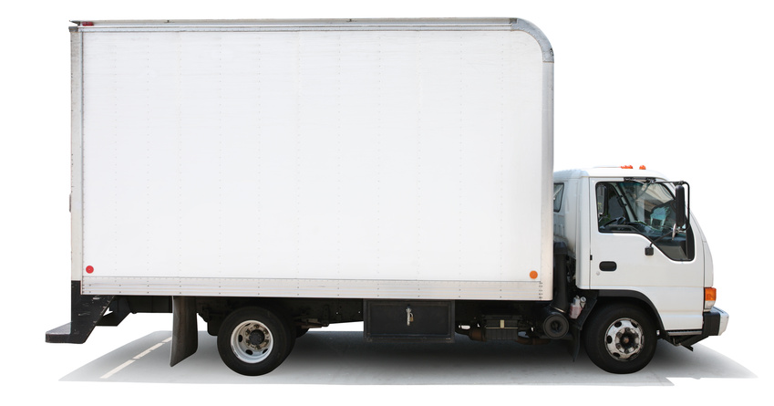
QUESTION
What is the supply chain’s function?
  It is the process of providing raw materials to the manufacturer so that they can get the product to the customer.

Slide 5
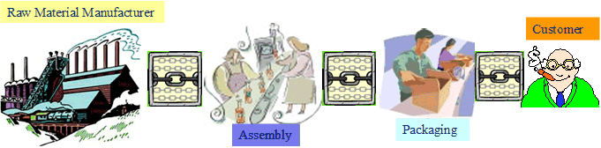
The Supply Chain

Slide 6
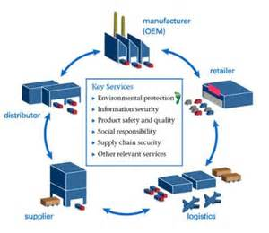
The Supply Chain
Consists of
  Materials suppliers
  Material inventory
  Production
  Finished goods inventory
  Distribution
  Delivery
  Tracking
  Customer

Slide 7

QUESTION
How does the manufacturer communicate with companies along the supply chain?
  They communicate via their orders, but communication is often not clear, which causes problems in the supply chain.
Initial Supplier
Supplier
Customer
Final Customer
Manufacturer

Slide 8

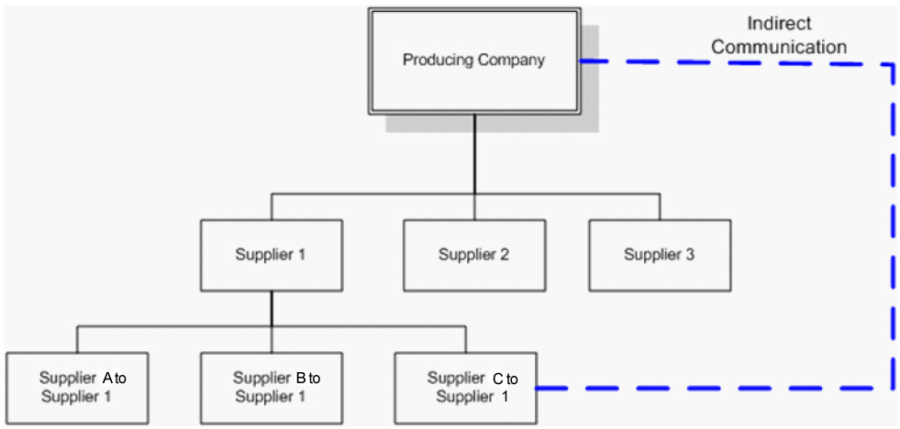
The Supply Chain Informal
Communication Needs

Slide 9
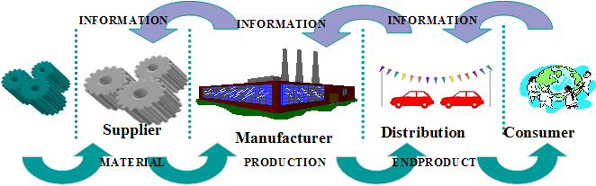
Supply Chain Information Loop
Notes:
Discuss the need for information to flow in all directions of the supply chain to make it more effective.

Slide 10
QUESTION
Why is information important to the supply chain?
  The manufacturer’s material supplier are sometimes so far removed from the customer, information is the only method to notify the supply chain when and how to react to demand
What could have prevented the “green car” problem?
Notes:
Note: Story from Student Guide pages 2-5 about green car manufacturing.
Discuss the automotive manufacturer story.
Question: How could this have been avoided?
Answers will vary, but the point is to have better communication between the manufacturer and the dealerships.

Slide 11
The Changing Supply Chain
Importance of information
Business processes and the supply chain
  Customer relationship management (CRM)
  Customer service management
  Demand management
  Order fulfillment
  Manufacturing flow management
  Procurement
  Product development
  Product returns
Notes:
Discuss each of these processes.

Slide 12
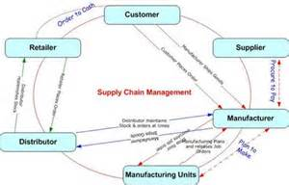
Why Are Supply Chains Difficult To Manage?
Failures in the supply chain cause:
  Holds placed on orders
  Cancelled orders
  Expedited orders
  Material substitution
  Rework
  Repair
  The HOT LIST
  Bottlenecks
  Missing information
  Specification problems
  Changing schedules
  Missed delivery dates
Notes:
Question: Why are supply chains difficult to manage?
Answers include:
The links are dependent on people and data. Both of these can be unreliable at times and both are subject to the interpretation of the person receiving the information.
Companies do not have integrated systems between themselves and they are not integrated with their suppliers. The supplier is dependent on the information but has no control over the quality or timeliness of the data.
Question: How do problems in the supply chain affect the production technician?
Answers will vary, examples include:
May cause over or under production issues.
May cause work stoppage, or a failure to receive necessary raw materials.
May result in equipment failure-spare parts not received.

Slide 13
QUESTION
You are out of a given material needed to produce a part. A similar material is available.
What should you do?
  Use it
  Stop until proper material is received
  Notify the customer that the order will be late
  Inform your supervisor and request guidance

Slide 14
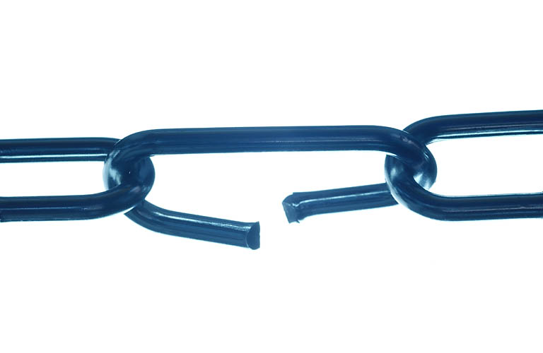
Cost of Poor Supply Chain Management
Additional costs for shipping (inbound and outbound)
Overtime to meet delivery requirements
Missed deliveries
Lost sales
Incentives and promotions for customer satisfaction
Loss of suppliers
Product returns
Notes:
Question: Can supply chain problems cause financial issues for a company?
Answer: Yes. Problems increase costs, causing lost orders and customers, increasing their returns, and creating warranty issues.
Question: Are supply chain problems ever part of an improvement project?
Answer: In many cases, yes. The value stream map looks at both the customer side of the map and the supplier side of the map.

Slide 15
Preparing the Product for Shipping or Distribution
  Objectives:
  Packaging materials meet packaging and shipping specifications, including proper labeling and safety requirements.
  Completed documentation of customer packaging and shipping instructions accompany product to next destination.
  Product availability is communicated to the proper parties in a timely manner.
Notes:
Lift up the box that is highly damaged, asking the class: “How many of you have ever received a package like this?” Ask for a show of hands. “How did you feel about it?” Encourage responses from students.
Welcome to Preparing the Final Product for Shipping class. My name is _________ and I’ve been with the company for __ years as a ________. I’ve also worked with _______. [Provide basic information on your background.]
I’d like to go around the room so we can get to know each other. It’s an opportunity for me to find out what you hope to gain from the class. Please tell me your name, what background you have in shipping, and what you hope to learn today.
Let’s take a look at why we are here today….
Read through objectives

Slide 16
Preparing the Product for Shipping or Distribution (Cont’d.)
  Product and all relevant information--such as quantity, destination, and packaging instructions--are checked against the work order.
  Product is correctly stored or staged for shipping.
  All laws and regulations with regard to labeling, packaging, and transport are followed.
  Material handling procedures are followed to prevent product damage. Damage caused by careless forklift operation is costly.
Notes:
Continue to read through objectives

Slide 17
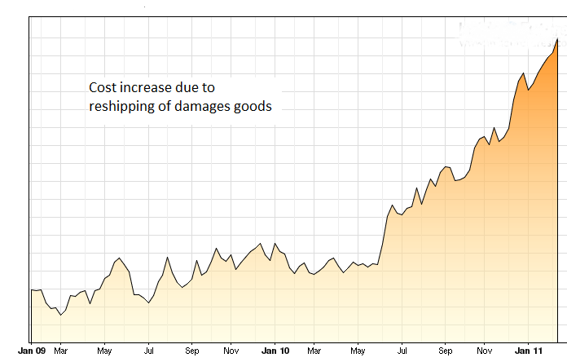
Shipping Damages Are Expensive
Notes:
Why is it important that you are here today in order to learn how to prepare shipping properly? Shipping is an important part of our business. And it can be expensive, especially if products have to be replaced and shipped out again. You can see by the chart here that over a one-year period, shipping costs can rise dramatically because of damaged goods. Companies must review procedures and develop better practices to avoid that situation.
Now that you have a basic understanding of what we are going to cover in class and why it is so important, let’s look at the material.

Slide 18

Packaging Materials
Packaging specifications are created to minimize product damage when shipping!
Use correct size box and packing materials. Incorrect box sizing can damage the product
Notes:
Packaging specifications are created to prevent product damage. A properly sized box helps keeps the merchandise from moving around or being too crowded. It also avoids waste and excess shipping charges. Always select the correct size box and packing material for the merchandise that you are shipping.
After you have selected the proper box, you must prepare its shipping label.

Slide 19
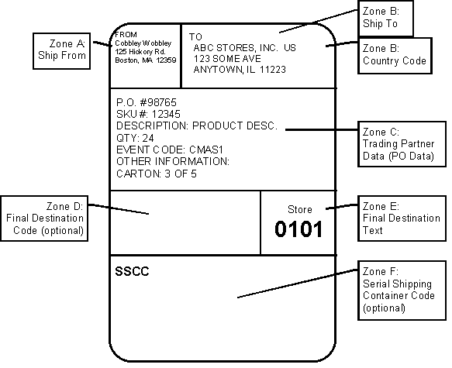
Packaging Materials (Cont’d.)
Labels communicate important information!
Notes:
Labels for the packages are an important step in proper packaging. The shipping labels have required fields that must be completed for each package. This slide illustrates the required and optional fields. Let’s take a few minutes to look at the fields of the shipping label. The area that says “to” shows where the shipment is going. It must match the work order. Keep in mind that shipping addresses may be different from billing addresses. You will see the merchandise description, quantity, and PO data. If there are multiple cartons with this order, it will be indicated as well. In addition to the shipping label, other shipping and handling information must be placed on the outside of the box.

Slide 20







Packaging Materials (Cont’d.)
Symbols are instructions to follow and must be clearly marked on container!
Notes:
The system of universal packaging symbols identifies the care and contents of the package. This slide shows a sample of common handling requirement symbols.
How many of them you can describe? (Ask the class to explain the symbols and be prepared to explain any they do not cover themselves.)
You have been able to identify some of the symbols that are for hazardous materials. There are several categories of these materials. It is very important to communicate hazardous contents, and proper handling, to the destination receiving the package. When flammable items are shipped, the information should be clearly marked on the container. Shipping manifests are used to identify the materials loaded onto a truck and the hazards associated with that material.
Next, we’re going to look at how you communicate the package contents by completing the proper documentation.

Slide 21

Documentation of Customer Packaging
The information you will need to check includes:
A packing slip that describes the size of the order
The tracking number
The handling requirement symbols we just talked about, when they are appropriate
A shipping manifest, used to identify the materials loaded onto a truck and the hazards associated with that material.
If any of the above documentation does not match the merchandise quantity, type, or labeling, you
must and notify your supervisor!
Notes:
It is important that you verify all documentation for each package. The information you will need to check includes:
A packing slip that describes the size of the order
The tracking number
The handling requirement symbols we just talked about, when they are appropriate
A shipping manifest, used to identify the materials loaded onto a truck and the hazards associated with that material
If any of the above documentation does not match the merchandise quantity, type, or labeling, you must STOP and notify your supervisor. Other situations could arise even before your package gets to you.

Slide 22

Product Communication
Prompt communication reduces problems !
Notes:
Packaging delays may be encountered. Occasionally, you may notice damaged products. You may also notice a missing label or improperly pulled products. In any of these situations, you should promptly communicate the issue to the supervisor. When the production schedule cannot be met, it must be communicated to the supervisor. It is the shipping or materials department’s responsibility to communicate with the customer if product availability issues arise. Good communication can help reduce shipping issues or keep a small issue from escalating into a larger problem!

Slide 23

Product and all relevant information
--such as quantity, destination, and packaging instructions-- are checked against the work order
Practice Package Exercise
Notes:
Before you ship a product, you must conduct a final check of your box, making sure the packaging material, content, documentation, and label are all complete. Everything should be checked against the work order. Remember, if the work order is incorrect, the supervisor should be notified immediately. If everything is in order, then you are ready to ship the product.
Now, we are going to practice what we’ve learned. You will have five minutes to prepare one package for shipping, then we will switch work stations and your group will prepare the second one for the next 5 minutes. (Instructor: discuss how well the class did the exercise)
Now that you have correctly packaged the merchandise, we are going to look at proper storing and staging for shipping.

Slide 24

Product Stored or Staged for Shipping
Practice moving packages safely !
Notes:
When you move packages to the storage or the staging area, be sure that the shipping labels are as visible as possible. Always practice proper lifting procedures, and use hand carts correctly when moving packages. Pay attention to the markings on the floor to insure that the aisles have been left clear. Shelving areas may have additional instructions to follow. As we just learned, it is very important to check the documentation on the package. An inspection label indicates the approved or rejected status. You may see the symbols that we already looked at on a package. The instructions indicated on the labels must be followed.
The laws and regulations for the movement of packages do not only apply to single packages. Fork lift operators should also follow correct storage procedures to contribute to maintaining product quality.

Slide 25


Labeling, Packaging, and Transport
Regulations require proper handling!
Documentation is then filed according to company policy.
Notes:
In fact, every single package you prepare has regulations that must be followed by everyone who handles the package on the way to its final destination. Take time with each order to prevent damages and verify documentation. There are regulations to follow for all means of transportation, whether it is airplanes, trains, trucks, or boats. Should a problem occur, it is important to be able to communicate quickly and accurately about the contents of all packages.
Once an order is shipped, all appropriate documentation should be stored in a safe location.

Slide 26
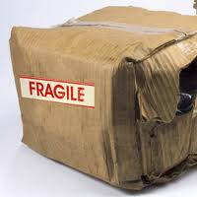

Material Handling Procedures
Regulations require proper handling!
Notes:
The shipping documentation is a very important piece of communication. It has to be complete and filed correctly. A supervisor must be able to locate it quickly in order to take a corrective action on any issue. These procedures have been developed to prevent damage, but problems do arise. We have learned and practiced each of these steps to help avoid packages like the one shown here. Prompt communication and corrective actions will help minimize service issues with our customers. By taking care with each of the steps we’ve outlined here today, our customers will receive complete orders in a timely manner, and in the best possible condition.
I’ve concluded this portion of the class and can take your questions now.

Slide 27

Summary
Supply chain improvement activities
Supply chain understanding is important for improvement
Company success is dependent on supply chain success

