Slide 1


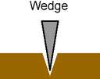

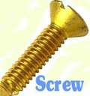
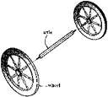

Foundations of Manufacturing
Domain 2: Production and Processes
Section 7: Machine Fundamentals
Notes:
Read Lesson Link aloud to students:
Simple/compound machines, as used in manufacturing, are devices that perform or assist in performing useful work on the production line. They normally require an energy source (“input”) and accomplish some sort of mechanical work (“output”). Moreover, since automation is an integral part of modern day production standards, many forms of machines are computer controlled. For example, computer numerical controllers (CNCs) are devices designed to enhance or replace what is currently being done with more conventional machines. It is vital for the contemporary production technician to understand the fundamental concepts of these machines, their functions (e.g., machining), their operational characteristics, the computerized aspects that may control them, and how to maintain these machines to ensure effectiveness, efficiency, and minimal downtime on the production line.

Slide 2
Learning Objectives
Examine the concept of ratios and proportions.
Examine the concept and components of simple/compound machines.
Identify the purpose and functions of simple/compound machines.
Describe components and mechanical advantage of simple/compound machines.
Discuss terms associated with simple/compound machines.
Discuss the purpose and functions of machining.

Slide 3
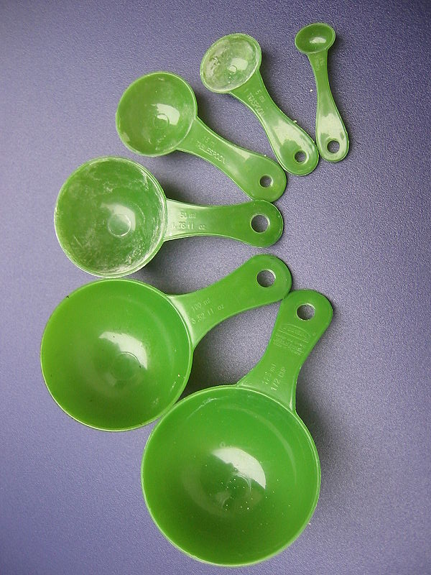
Ratios
Magnitude of one quantity relative
to another.
Example:
  4 parts flour to 1 part sugar (4:1)
  5 parts concrete to 2 part water (5:2)
  Roof pitch 4ft rise in 12ft run (4 in 12)

Slide 4
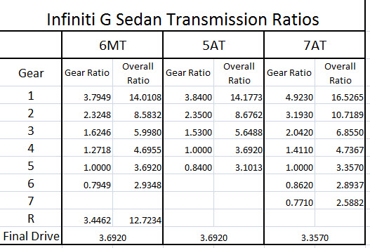
Ratios (Cont’d.)
Expressing ratios
Writing ratios
Units in ratios

Slide 5
Ratios (Cont’d.)
A machine produces 2,000 parts. Out of these, 400 parts are defective. What is the ratio of defective parts to total parts?
Defective parts = __400_______
Total parts = ___2000____
Ratio = _400/2000 =
What is the ratio of defective parts to acceptable parts?
Defective parts = _400____
Acceptable parts = __1600____
Ratio = _400/1600 =
1:5
1:4

Slide 6

Ratios (Cont’d.)
Any ratio can be expressed as a decimal and a percentage by multiplying the decimal ratio by 100.
  ¼ = 0.25 x 100 = 25%
  ½ = 0.50 x 100 = 50%
  ¾ = 0.75 x 100 = 75%
  ⅓ = 0.333 x 100 = 33.3%

Slide 7

What is a Simple Machine?
A device that applies a force
to perform work
It makes work more efficient
or effective by:
  Transferring force position
  Changing force direction
  Increasing force’s distance or speed

Slide 8
Simple Machine Overview
All machines are developed from:
  Lever
  Wheel and axle
  Inclined plane
    Wedge
    Screw
  Pulley
Notes:
Invite students to describe the simple machines they have used in their jobs.

Slide 9
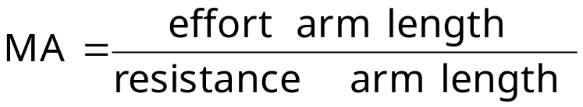
Simple Machines (Cont’d.)
Lever
A basic lever is a rigid object (e.g., a bar) that is used with a fixed pivot point
Three types of levers:
      First class
      Second class
      Third class
To find the MA of a lever:
Notes:
Invite student to describe the types of levers they have used in their jobs.

Slide 10
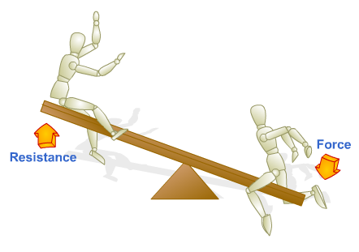
Simple Machines (Cont’d.)
Lever
1st Class Lever – the fulcrum is located between the effort and the resistance
Fulcrum

Slide 11
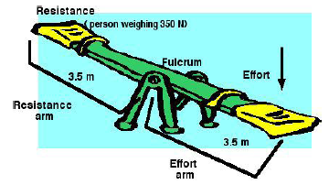
Simple Machines (Cont’d.)
Lever
1st Class Lever
MA = 3.5/3.5 = 1
Effort to balance = 350

Slide 12
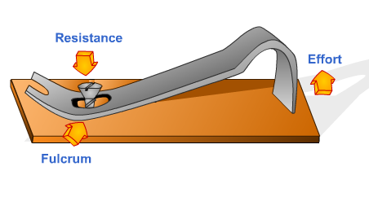
Simple Machines (Cont’d.)
Lever
2nd Class Lever – the resistance is located between the fulcrum and the effort

Slide 13
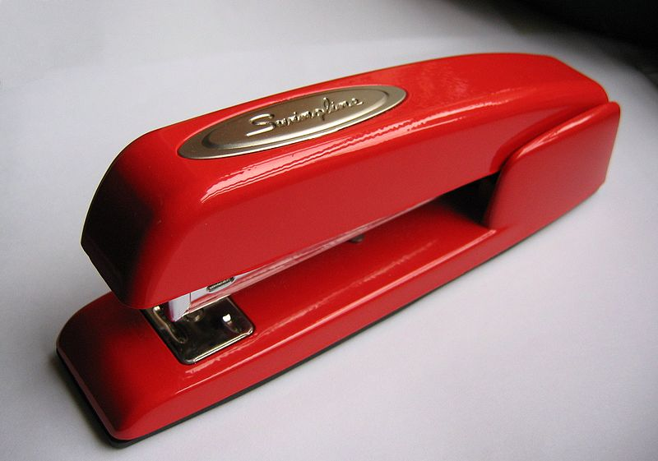
Simple Machines (Cont’d.)
Lever
effort
3rd Class Lever – the effort force is applied between the fulcrum and the resistance
resistance
fulcrum

Slide 14
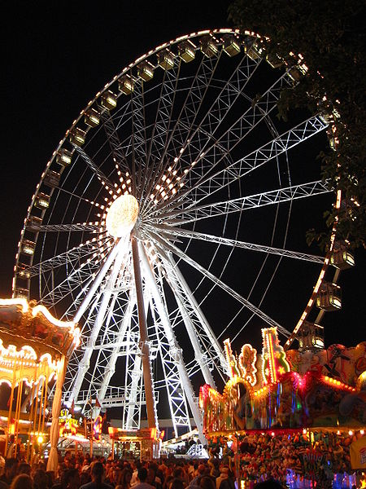
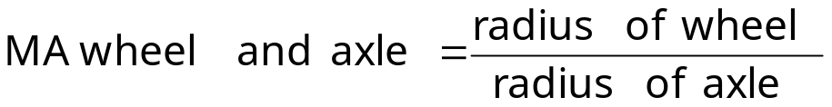
Simple Machines (Cont’d.)
Wheel and Axle
A simple machine that is comprised of a wheel that turns on an axle.
Ferris wheel, wheels of a car.
To find the MA of a wheel and axle:

Slide 15
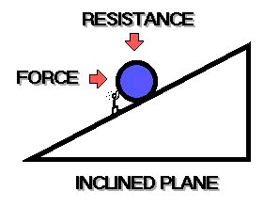
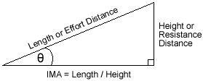
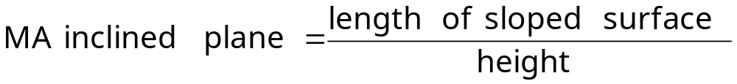
Simple Machines (Cont’d.)
Inclined Plane
A slanted surface or ramp used to move objects up to another height.
To find the MA of an inclined plane:
Notes:
Question: Is it easier to pull a load along the ground with rope or push the load in a wheelbarrow?
Answer: Using the wheelbarrow is easier.
Question: Would you rather pick up a barrel of solvent and put it on a three-foot high loading dock instead of rolling the barrel along the inclined plane to the top of the deck? Why?
Answers will vary.

Slide 16
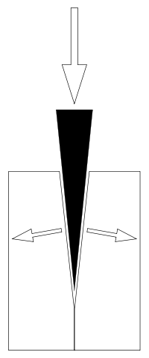
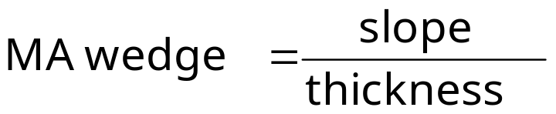
Simple Machines (Cont’d.)
Wedge
A portable inclined plane turned
on its side
Helps push things apart
To find the MA of a wedge:
Notes:
Question: What are some common uses for a wedge?
Answers will vary, but may include:
To split something apart.
To lift an object.
To hold an object in place.

Slide 17
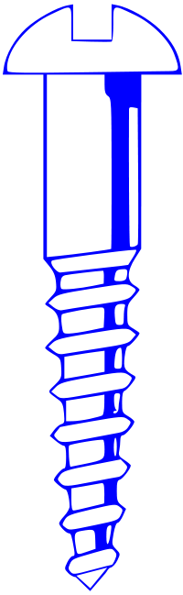
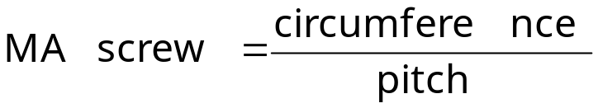
Simple Machines (Cont’d.)
Screw
A helical inclined plane that converts a rotational force to a linear force.
Holds objects together.
Wedge causes an increase in rotational force and/or reduction in insertion rate
To find the MA of a screw:

Slide 18
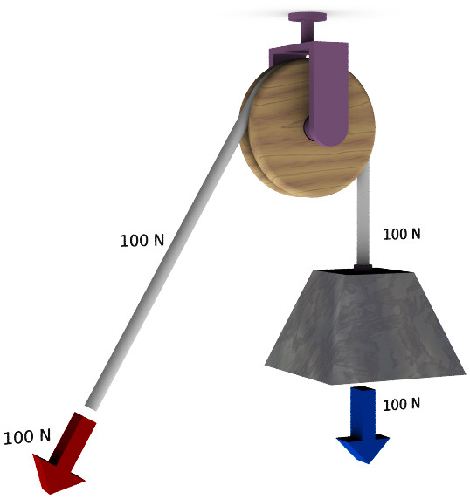
Simple Machines (Cont’d.)
Pulley
A rope wrapped around a freely turning, grooved wheel, attached to a frame (or block).
Used to lift and lower
objects.
Three types of pulleys
  Fixed
  Moveable
  Pulley system
Notes:
Question: Where do we find pulleys?
Answers will vary.

Slide 19
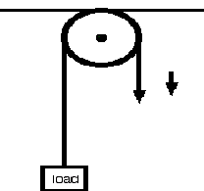
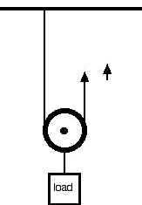
Simple Machines (Cont’d.)
Fixed Pulley
  wheel rotates and is attached to ceiling. Force is same. Direction changes only
Moveable pulley
  force in same direction as the effort, but the amount of the force is reduced

Slide 20
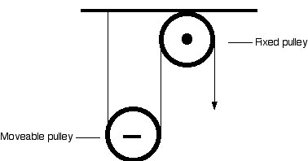
Simple Machines (Cont’d.)
Pulley system
  A fixed and moveable pulley used in combination
Notes:
Question: What is a disadvantage of a pulley system such as a block and tackle?
Answers will vary, but should include the fact that you have to pull the rope a long distance relative to the load being moved.

Slide 21
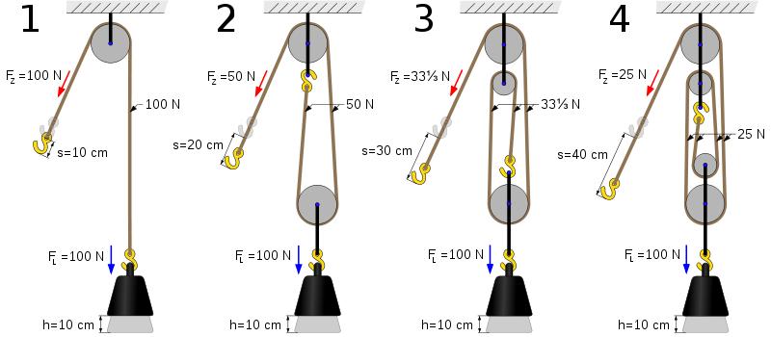
Mechanical Advantage

Slide 22
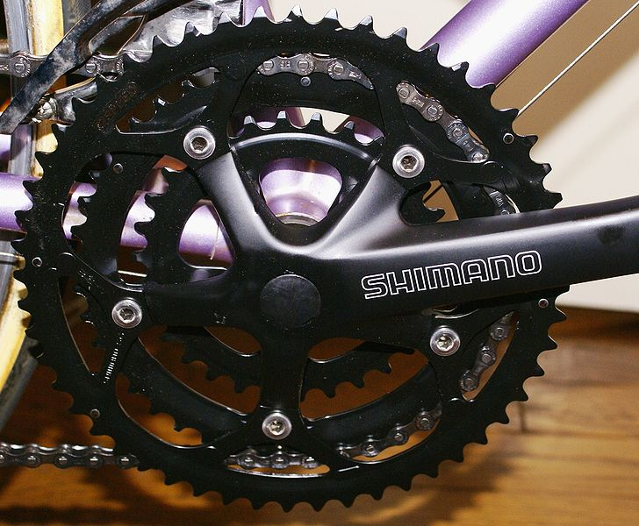
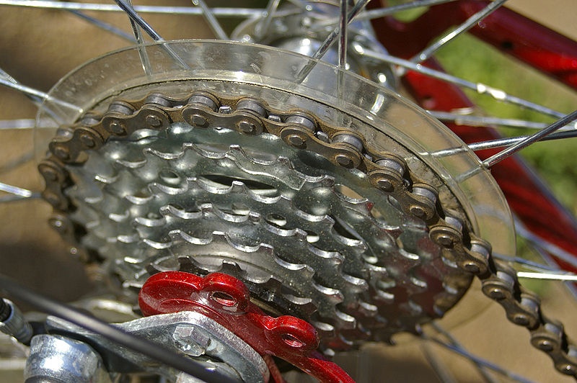
QUESTION
If a small gear turns a larger gear then…?
Torque decreases
There is no change in torque
Torque increases

Slide 23
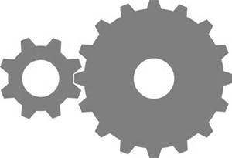
QUESTION
Assume the smaller gear has 12 teeth and is the driver gear. It has 240 ft-lbs. torque on its shaft. The larger driven gear has 36 teeth. What is the torque on the driven shaft?
720 ft-lbs. torque
36 is to 12 as ? is to 240.

Slide 24
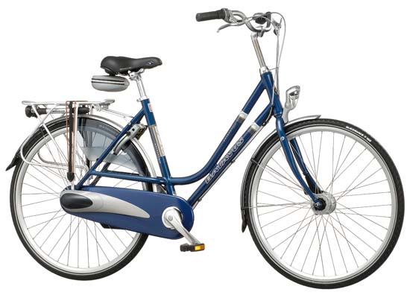
Compound Simple Machine
Consists of two or more simple machines put together.
Can do more difficult jobs than simple machines alone.
One example of a compound machine is a bicycle.

Slide 25
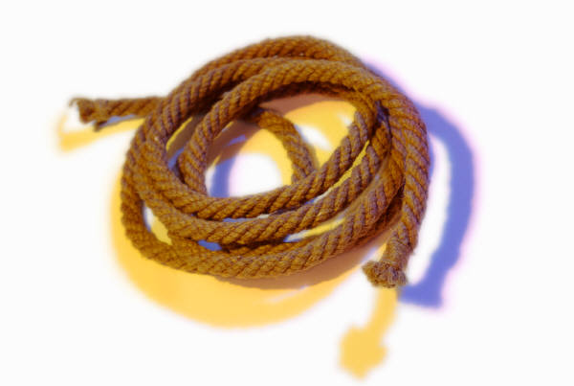
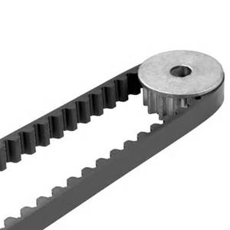
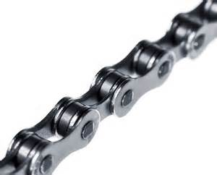
Associated Elements of Compound Machines
Rope
  A length of fibers, twisted or braided together
  Tensile strength
  Compressive strength
Belt
  A looped strip of flexible material
  Links two or more rotating shafts
Chain
  A series of connected links typically made of metal

Slide 26
QUESTION
What do ropes, belts and chains have in common?
All three are used to transfer power from one point to another
Notes:
All three are used to transfer power from one point to another

Slide 27
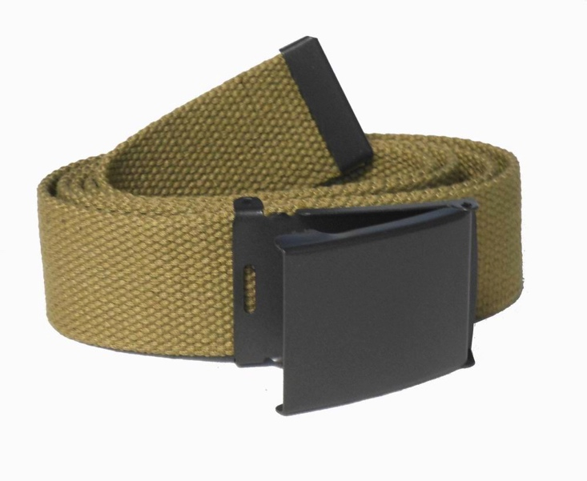
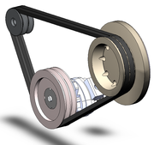
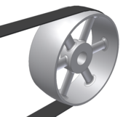
Belts
Pants belt
V-belt
Flat belt

Slide 28
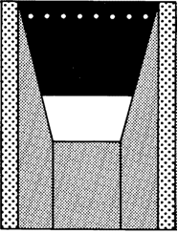
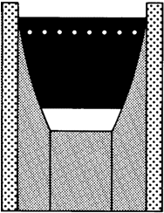
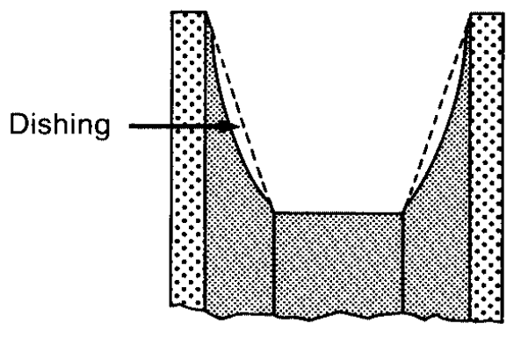
Belts
Good
Bad
During an alignment check, to be sure that the two pulley flanges (sheaves) are in good condition, measure each pulleys groove angle.
Since the belt should never rest on the bottom of the pulley groove, this situation would indicate that the pulley is beyond its useful life-span
Groove Angle
Pulley flange
Notes:
NOTE- a sign that a pulley is worn is when the belt rides in the bottom of the pulley grooves.

Slide 29
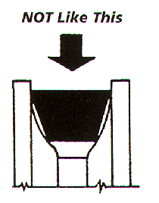
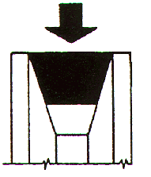
Sheave Wear
Good, like this
To check for sheave wear, measure each groove angle.

Slide 30

Belts
In an emergency, 5L belts can be used to replace B belts
A 5L belt is a light duty belt, even though it can have the same dimensions of the B belt, the 5L is cheaper to buy, but the B belt will usually last longer, provided all is properly aligned and belt tension is correct. A "5V" belt is a Higher HP belt (stronger then even the "B" series... A "BX" and a "5VX" belt are cogged belts of the "B" and "5V" series of those belts, they are cogged to allow themselves to go around a smaller then normal pulley diameter and still grip the pulley fine.

Slide 31
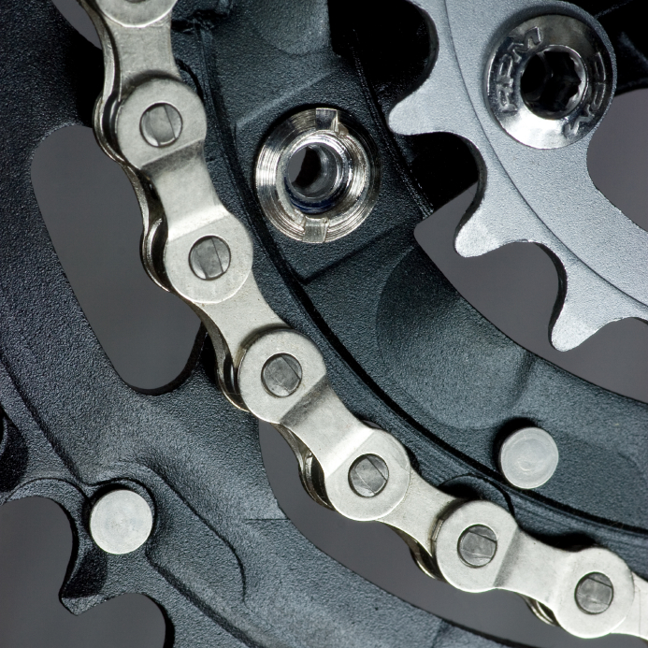
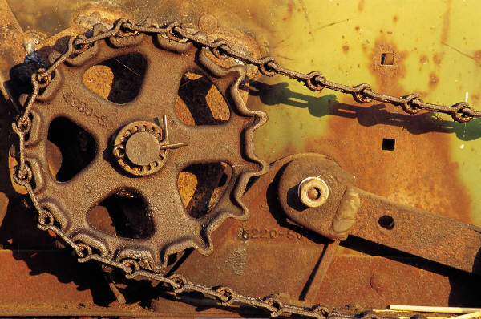
Chains
A double pitch chain has side plates that are twice as LONG.
Chain Pitch is measured in 1/8”. A pitch of 30 is 3/8”; a pitch of 40 is 1/2“ (4/8); a pitch of 50 is 5/8, etc.
When a chain is stretched more than 3% of its original length it should be replaced
Notes:
NOTE: discuss chain stretch- at what point would a chain need to be replaced?

Slide 32


Chain “Stretch”
Good Link
Worn Link

Slide 33
Fastener Grades
No Marks on Bolt Head
SAE Grade
1 or 2
64,000-PSI
Tensile Strength
Notes:
“Tick marks” or small line markings on the head of a bolt identify its grade.
The bolt in this example has no tick marks on the head of the bolt.
An SAE Grade 1 or 2 bolt has no marks on the bolt head.
This grade bolt is rated at 64000 PSI Tensile Strength

Slide 34
Fastener Grades (Cont’d.)
SAE Grade 5
3 Marks on Bolt Head
105,000-PSI Tensile Strength
SAE Grade 6
4 Marks on Bolt Head
130,000-PSI Tensile Strength
SAE Grade 8
6 Marks on Bolt Head
150,000-PSI Tensile Strength
Notes:
The bolts in this example have 3, 4 or 6 tick marks on the head of the bolt.
An SAE Grade 8 bolt has 6 marks on the bolt head.
This grade bolt is rated at 150,000 PSI Tensile Strength

Slide 35
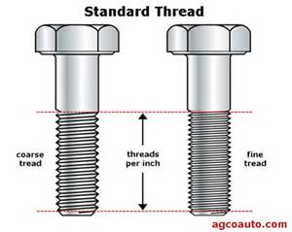
Threads

Slide 36
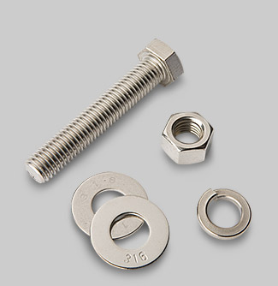
Nut and Bolt Usage

Slide 37
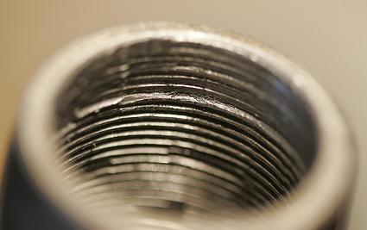
Causes of Fastener Failure
Tightened beyond yield point (over-torque)
Loose fasteners; insufficient joint tension (improper torque)
Lateral shear forces (sideways movement)
Damage during assembly (threads)
Cross-threading
Poor fastener/material selection (import?)
Notes:
Tightening a fastener beyond its yield point is imparting a load greater than the fastener is capable of exerting. Fasteners that fail upon installation can injure personnel and damage equipment.
Loose or improperly torqued fasteners fail because insufficient tension creates an unstable joint. This allows part movement that promotes fastener failure. (See Lateral Shear Forces, below).
Lateral Shear Forces are perpendicular to the fastener’s axis. A fastener retains its load best parallel to its axis.
Cross-threaded pullers or nuts, worn or improperly-sized sockets, and corrosion/paint can cause damage to fasteners during assembly.
Selection of low grade fasteners for high load applications invites failure. Some fastener materials may be incompatible with certain applications . Ferrous nuts corrode in an acidic environment. Mixing fasteners of dissimilar materials can cause cathodic corrosion. Stainless studs can seize in ferrous joints.

Slide 38
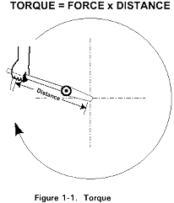
What is Torque?
ONE POUND OF FORCE APPLIED TO WRENCH (FORCE)
1 POUND (FORCE)
x 1 FOOT (DISTANCE)
= 1 FOOT-POUND (TORQUE)
WRENCH IS ONE FOOT LONG
(DISTANCE)
Notes:
Application of 1 pound of force to a wrench 1 foot long is equal to 1 foot-pound of torque.
Application of two pounds of force to a wrench one foot long is equal to two foot-pounds of torque.
Ask the students to create other examples using different values and units.

Slide 39
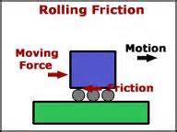
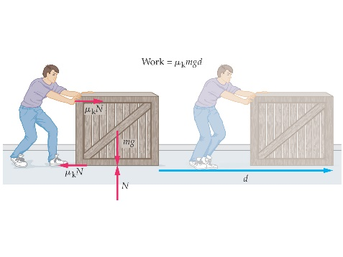
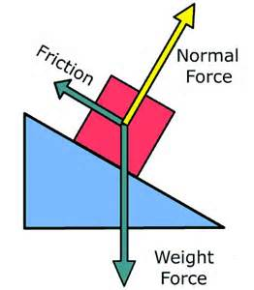
Friction Definitions
Rolling friction – friction between a rolling object and a surface.
Kinetic friction – sliding friction
Static friction - frictional force that
prevents or slows movement.

Slide 40
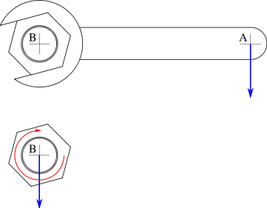
Loosening a Fastener
Factors that require more torque to remove a bolt:
Lubricant or anti-seize degradation
Coatings on assembly (paint)
Corrosion of nut, bolt or flange
Notes:
Lubricant/anti-seize failure due to time, temperature and environment. A harsh environment can quickly degrade anti-seize or lubricant.
Paint coatings on fasteners can increase breakout torque significantly.
Oxidation of any contact points may increase breakout torque. Nut can rust to bolt and nut can rust to flange.

Slide 41
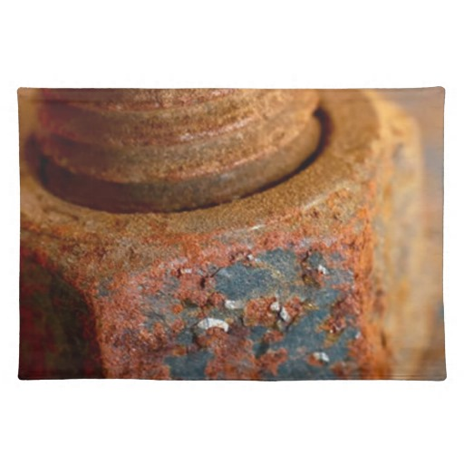
Fastener Corrosion and Torque
Corrosion increases breakout torque of fasteners:
Humidity corrosion = 2X torque
Chemical corrosion = 2.5X torque
Sea Water = 2.5X torque
Heat corrosion = 3X torque
Notes:
Ask the students: “How much does fastener corrosion effect torque?”.
Humidity corrosion requires 2 times make up torque to free fastener
Chemical/salt corrosion requires 2.5 times make up torque to free fastener
Heat corrosion requires up to 3 times make up torque to free fastener

Slide 42

Torque Distribution Facts
Only 10% of applied torque effort results in useful bolt load
50% is wasted overcoming nut face friction
40% is wasted overcoming nut and bolt thread friction
Notes:
The information from the graph on the previous slide is repeated here verbally.
Only 10% of applied torque effort results in useful bolt load
50% is wasted overcoming nut face friction
40% is wasted overcoming nut and bolt thread friction
Data from www.integra-home.com/h_torquing_services.htm

Slide 43
Tightening Sequence (8 Bolts)
5
1
4
7
8
3
2
6
Notes:
Tighten a 6 bolt flange in a criss-cross/basket weave pattern.
Note that 3 consecutively tightened bolts form a triangular pattern that rotates around the flange.

Slide 44



Drill Bits
Wood (with pilot)
Paddle (wood)
Metal (carbide)
Concrete (masonry)
Hole Bit (door locks)
Earth (oil, water)
hansgroebe

Slide 45

Drill Bits (Cont’d.)

Slide 46

Drill Bits (Cont’d.)

Slide 47

QUESTION
What part of a drill bit wears during use?
  Margin
What does the wear cause?
  The hole to be drilled undersize
Where is the size stamped on the drill bit?
  Shank

Slide 48


Drilling
Counterbore
Countersink

Slide 49

Countersunk and Counterbore Screws
49/58

Slide 50


Tapping A Hole
Use a drill bit 85-90% of the size of the threaded tap
Example: to tap a hole for ½ X 20 TPI, use a drill bit size of 29/64

Slide 51

Tap Charts

Slide 52

Tapping Example

Slide 53

Useful Formulas

Slide 54

Cam Dwell
The part of the cam cycle that describes when the cam follower does not change position is called dwell.

Slide 55



Woodruff Keys
A good way to mount a gear to a shaft

Slide 56



Woodruff Keys

Slide 57

Milling Machine
Used to create complex features in rectangular parts
Finish boring is a machine process used to make a hole more precise

Slide 58

Summary
Understanding the concepts of basic machines and systems, and their uses will assist you in understanding how more complex machines work, as well as what you must look for when operating and maintaining these machines.

