Slide 1

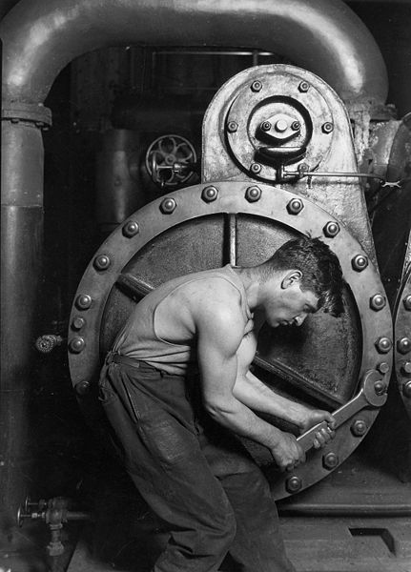
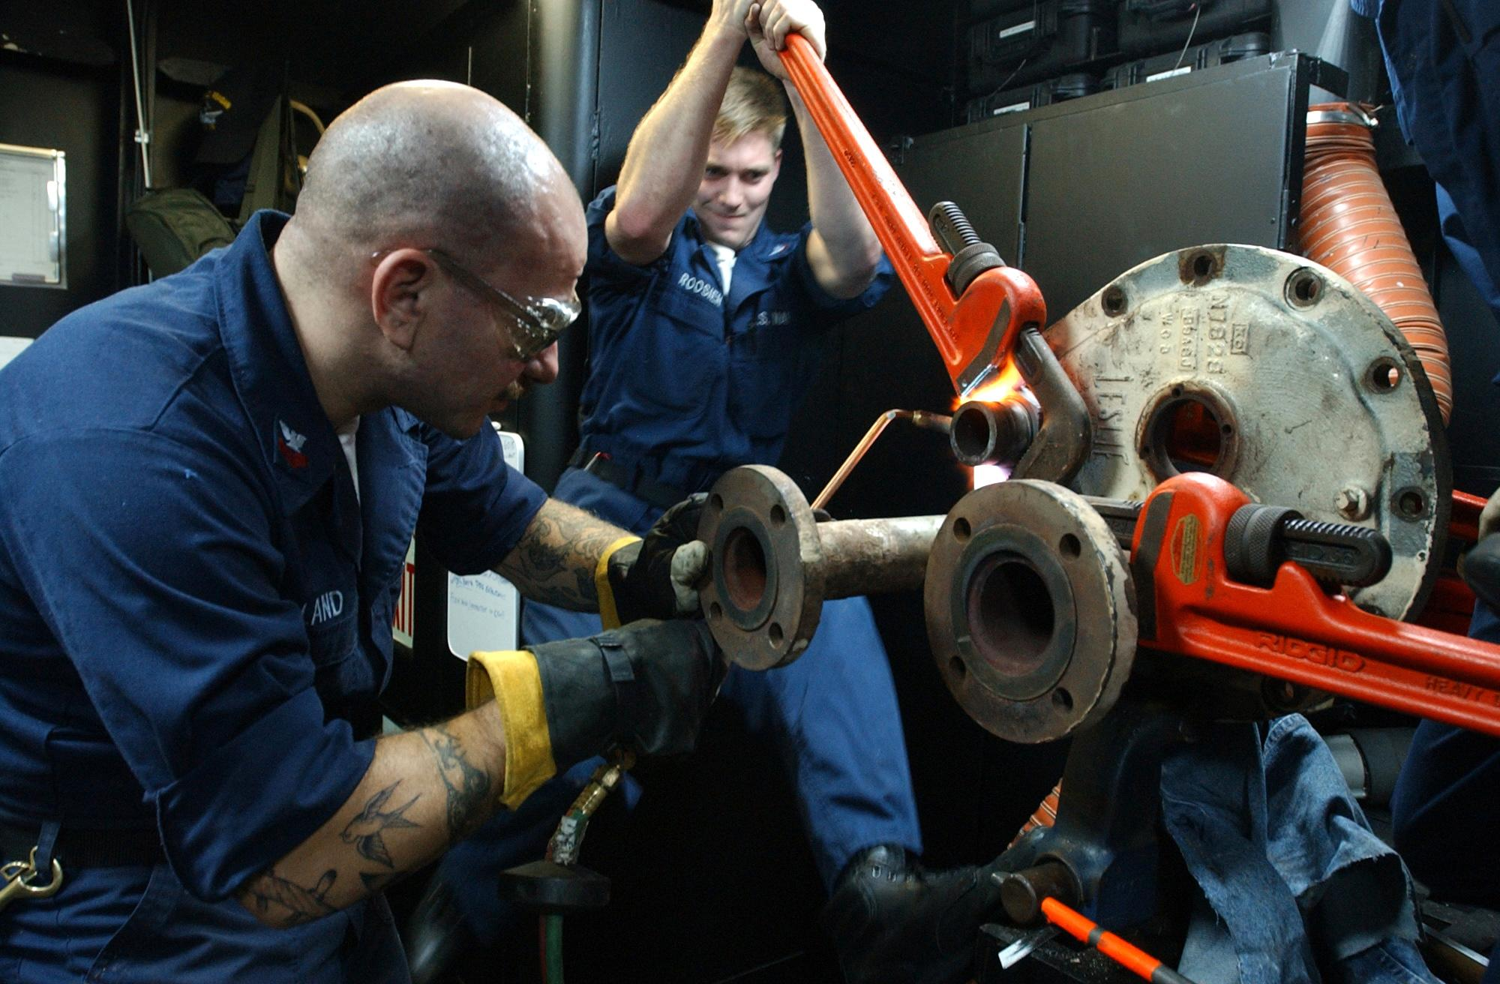
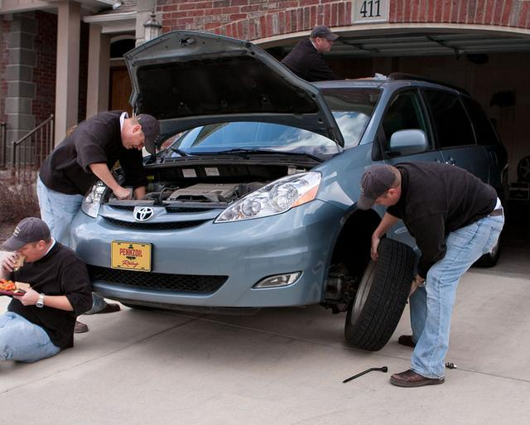
Domain 3: Maintenance Awareness
Foundations of Manufacturing
Section 1: Maintenance Principles
Notes:
READ TO STUDENTS:
Maintenance of our equipment is required to keep it running. In manufacturing we count on our production equipment in order to produce our product on schedule.

Slide 2

Domain 3 Maintenance Awareness
Table of Contents
Section 1 Maintenance Principles
Section 2 Mechanical Systems
Section 3 Electrical Systems
Section 4 Fluid Systems
Section 5 Maintenance Safety

Slide 3
Maintenance Principles
Section 1.1 Unscheduled Maintenance
Section 1.2 Scheduled Maintenance
Section 1.3 Predictive Maintenance (PdM)
Section 1.4 Total Productive Maintenance (TPM)

Slide 4
Learning Objectives
The purpose of this Domain is to provide an introduction to industrial maintenance principles and practices that extend the useful life of production equipment, reduce maintenance cost and increase reliability.
Discuss different philosophies used to maintain equipment operation
Identify activities associated with Routine, Preventive and Predictive Maintenance

Slide 5
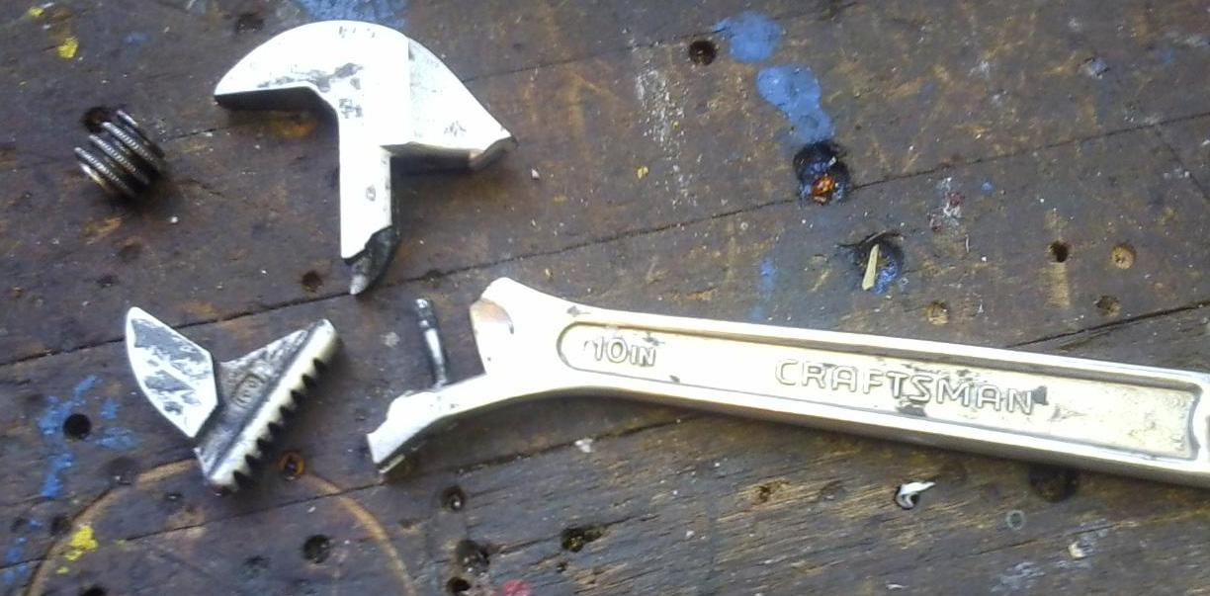
Maintenance is:
1. All activities required or undertaken to continue, as long as possible, the function of and performance of production equipment
2. Maintenance is an expense that, unlike capital improvement, is not capitalized
3. Necessary to sustain equipment operation over its useful life
Notes:
source: http://www.businessdictionary.com/definition/maintenance.html#ixzz3MKQ3s7d0

Slide 6
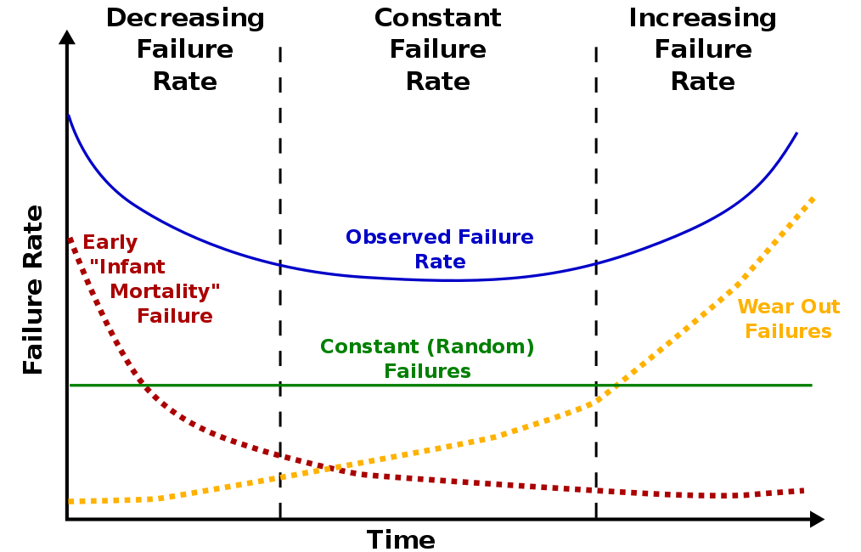
Equipment Life Cycle
Notes:
Bathtub curve.
The need for maintenance is caused by normal wear and component failure.

Slide 7

Reliability
The ability of an apparatus, machine, or system to consistently perform its intended or required function or mission, on demand and without degradation or failure.
Reliability is measured as Mean Time Between Failure (MTBF)
Notes:
Ref: http://www.businessdictionary.com/definition/reliability.html#ixzz3MKObmT90

Slide 8
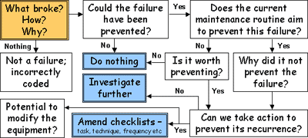
Equipment Failure

Slide 9
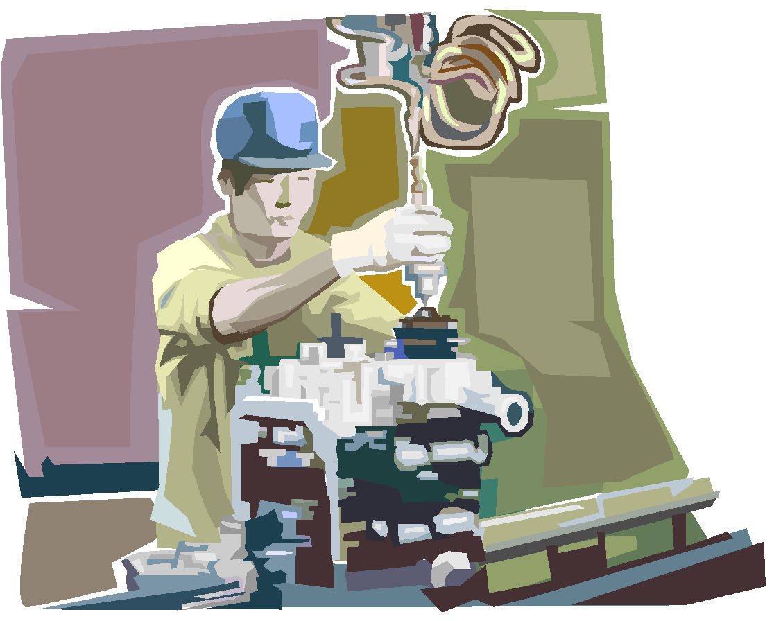
Types of Maintenance Programs
Unscheduled/Unplanned
  Breakdown (Run to Failure/Reactive)
  Unsafe conditions
Scheduled/Planned
  Preventive (PM)
    Routine
    Predictive
  Total Productive (TPM)
Notes:
All Maintenance is either
unscheduled – impromptu required service
scheduled - planned

Slide 10
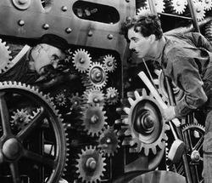
Breakdown Maintenance
Costs include:
Downtime
Labor
Expediting parts
Costs associated with breakdown maintenance are unpredictable. Breakdown maintenance is the least desirable. It can occur at any time, but can be prevented, or at least reduced, through proper, periodic, preventive maintenance. Breakdown maintenance is considered reactive and would be classified as an unplanned downtime maintenance activity.

Slide 11
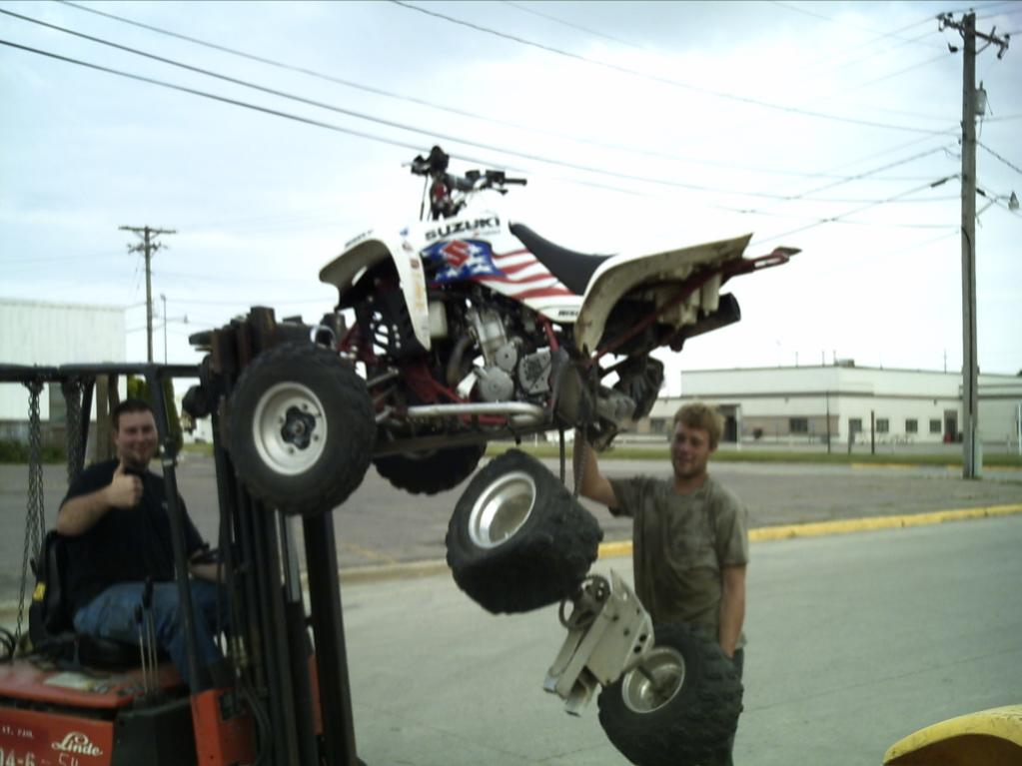
Unplanned - Reactive
Notes:
Instructor Note: Point out the wear and age of the old part as compared to the new part. The old part was clearly not checked or maintained to standard, thus causing an imminent breakdown.

Slide 12


QUESTION
Machine breakdown that keeps recurring at regular intervals should result in:
An Analysis of the history that determines the cause and anticipates the frequency.

Slide 13
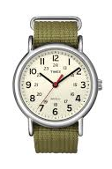
Preventive Maintenance (PM)
Preventive maintenance (or Preventative Maintenance) is maintenance that is regularly performed on a piece of equipment to lessen the likelihood of it failing. The maintenance is scheduled based on a time or usage trigger.
- Replacement of worn parts at a specified run time
- Monthly calibration/service

Slide 14
Preventive Maintenance
There are two types of preventive maintenance:
Periodic: scheduled to be performed at timed intervals
Predictive: equipment testing to estimate future failure
Preventive maintenance takes less time (than unscheduled) because instructions, tools, parts, and supplies are available at the time of each planned maintenance event. The proper maintenance personnel will also be available to perform scheduled preventive maintenance.

Slide 15

Functions of a Preventive
Maintenance Program
Periodic inspections
Preplanned maintenance activities
Non-destructive testing
Maintenance to correct deficiencies noted during PM
Calibration of measurement and alignment instruments
Equipment overhaul intervals

Slide 16
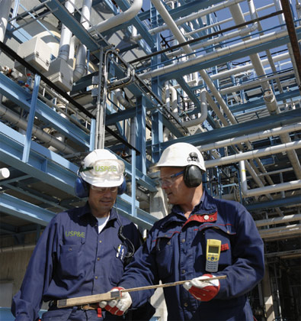
Benefits of Preventive Maintenance
Reduce production downtime
Better conservation of parts/materials
Reduce overtime costs
Timely and routine repairs
Reduce repair costs
Reduce product rejections
Decrease excessive maintenance costs
Improve safety and quality
SAVE TIME AND MONEY
Prevention is key!

Slide 17
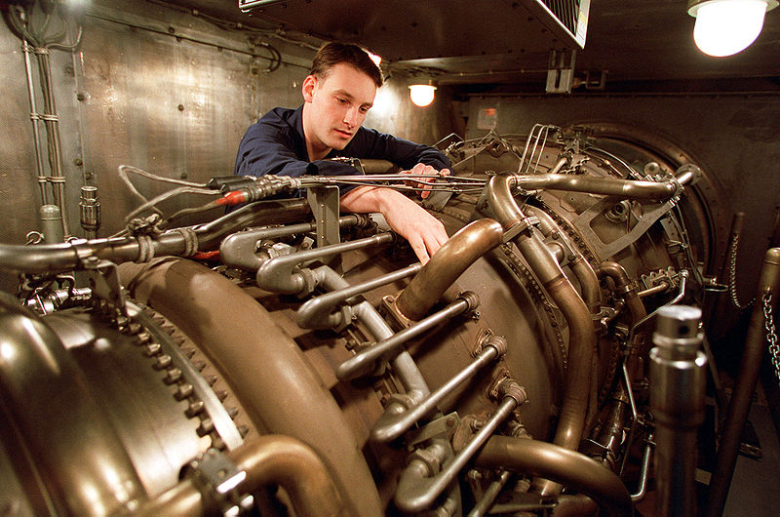
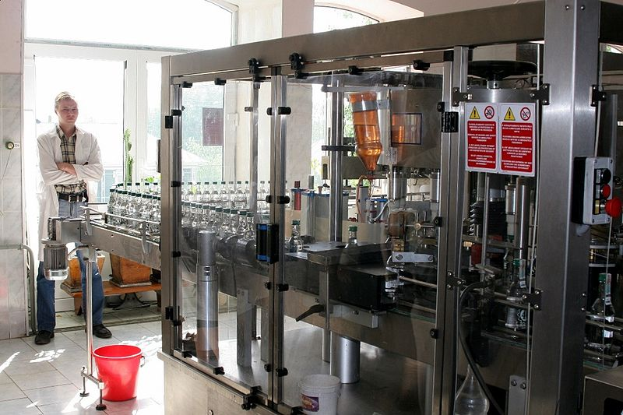
Using Your Senses
You are familiar with your machine and can know if a problem exists. You are the first line of defense to preventing breakdown.
Use your five senses to notice a problem:
Sight: spotting leaks or loose parts in a system
Sound: screeching, humming or grinding parts or accessories
Touch: warmth in a motor casing, or vibrations in a pipeline
Smell: burnt electrical components, foul odors of slipping belts
Taste: (along with sense of smell) oils and lubricants
Do not ingest anything toxic! If you have questions, contact a manager.
Notes:
NOTE: oils and lubricants contain many toxins and other harmful ingredients. DO NOT INGEST.

Slide 18

Daily (Routine) Maintenance
Daily maintenance involves the following from each worker:
Daily upkeep
Cleaning
Visual inspection
General attention paid to machines
Daily maintenance should be recorded because recurring events can be analyzed to troubleshoot future problems.

Slide 19
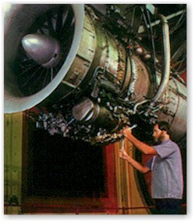
Daily (Routine) Maintenance (Cont’d.)
Periodic maintenance includes:
Inspecting
Cleaning
Lubricating equipment (key planned activity)
Changing fluids
Replacing belts and minor parts
Notes:
Instructor Note: The instructor should explain that this technician is performing periodic maintenance to the jet engine.

Slide 20

Planning Preventive Maintenance
Preventive maintenance can be successful with quality planning.
Ask the following:
What essential work is executed during the shutdown?
What is the impact on the budget?
Is appropriate shutdown time available?
  Holidays
  Slower production times

Slide 21
Scheduling Preventive Maintenance
Again, the importance of scheduling preventive maintenance cannot be overstressed.
Appropriate scheduling includes the following:
Coordinating shutdown logistics
  What will be down and when?
Knowing how to best use key maintenance personnel
Identifying planning deficiencies
Prioritizing work
Prioritize work in a manner that flows and is consistent with production goals.
Procuring appropriate materials to perform maintenance activities
Developing steps to perform the work
Indicating the frequency that the work is to be performed

Slide 22
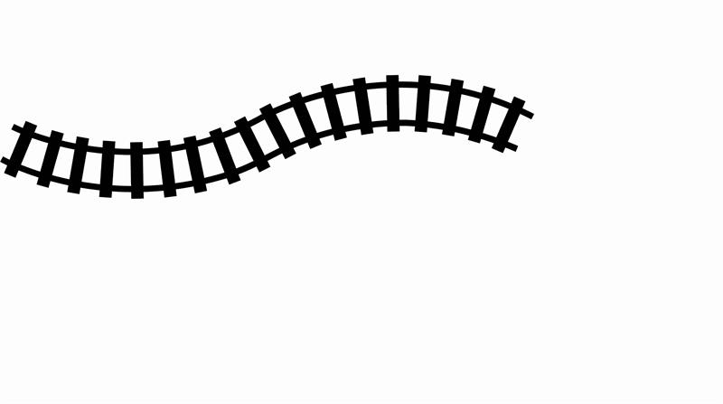
Tracking Preventing Maintenance
Critical Path Method:
List of all activities to be performed
This list should include everything necessary to completely finish the work.
Outline of time durations needed
List of dependencies (Do any repairs or tasks have to precede others?)
If any repairs or tasks require that other tasks be completed beforehand, those tasks must be scheduled or listed in a manner that indicates such.
Necessary Steps:
Set work order completion dates
Set work order sign-offs (Which managers will approve the work?)
Set work order audits
  Audits assure that the repairs were made in a timely and appropriate manner

Slide 23

Periodic Maintenance Scheduling
Scheduling the frequency of periodic maintenance should consider:
Equipment manufacturer recommendations
Hours of use: the frequency with which the machine is used
Repair history for similar equipment
Criticality of operation to maintaining production
Available manpower for maintenance actions

Slide 24
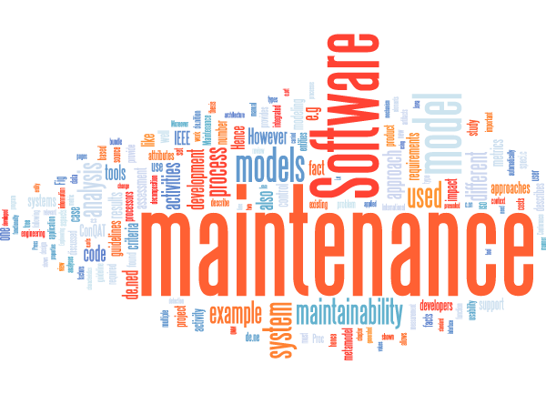
Maintenance Software
Maintenance software can play an essential role in tracking maintenance activities and assuring that processes are efficient.
Some facilities use maintenance software to perform the following functions:
Manage equipment costs
Track equipment history (maintenance log contains PM schedule, inspections, and test results)
Organize and track inventory (parts and raw materials)
Schedule preventive maintenance
Maintain confidential labor records

Slide 25
Maintenance Software Functions (Cont’d.)
Allocate resources
Generate work orders
Project equipment failure summary
Purchasing and related costs
Maintenance history
Schedule maintenance based on equipment classification
Software can manually or automatically schedule maintenance based on the level of use and overall importance of the equipment to the operation.
Software applications have the ability to send calendar and email alerts to the appropriate personnel.

Slide 26
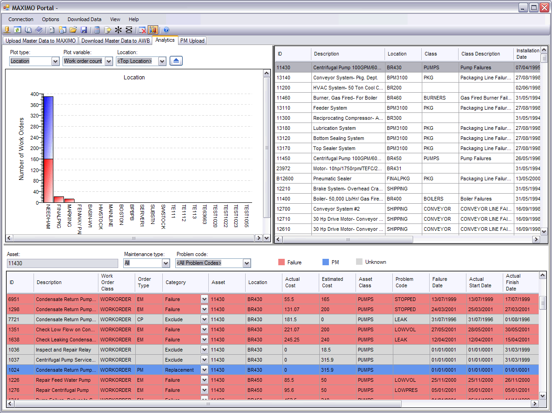
Maintenance Software
The following is a list of software applications used to support TPM.
Types of maintenance software used to support TPM:
CMMS: computerized maintenance management system
SAP: relational database that holds facility maintenance information
MP2: used to assess maintenance needs
Maximo: used by Mosaic

Slide 27
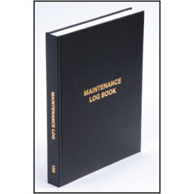
Preventive Maintenance Documentation
Before discussing the types of documentation used in preventive maintenance, it is important to note that:
All documents pertaining to preventive maintenance should be kept in safe and secure files.
Do not allow anyone not involved in the process to circulate or handle these files. In the following slides, we will discuss exactly why this is important. We will define and discuss the following terms:
Work orders
Maintenance Logs
Standard Operating Procedures

Slide 28

Work Orders
Maintenance work orders should refer to Standard Operating Procedures (SOPs)
Prior to shutting down a machine for PM the Maintenance tech. must arrange for needed tools and supplies
Work orders must be signed off and dated by the performing individual
Employee closing out the work order verifies that the work has been completed
Proper communication is essential.
Often, the employee closing out the PM work order also verifies that preventive maintenance was completed.
‹#›/64

Slide 29
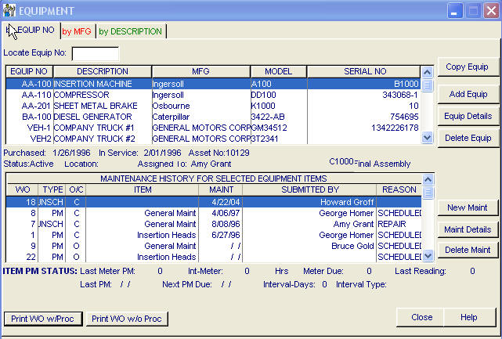
Maintenance Logs
Maintenance logs should be kept for each specific piece of equipment. The log contains the following:
Maintenance schedules | Summaries of equipment failures
Inspection and test results | Labor allocated to the maintenance task
Inventory used to correct problem | Length of shut down (if applicable)

Slide 30
Timeliness of Reporting
Any maintenance and related shutdown should be documented in a timely manner to the appropriate individual(s)/managers.
Best practices indicate that maintenance should be reported as close to immediately as possible.
Many manufacturers are on a production schedule, meaning that a certain number of approved goods (correct size, shape, specifications) need to be produced.

Slide 31
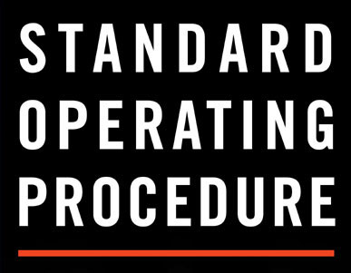
Standard Operating Procedures
SOPs are generated in-house for a variety of reasons, including, but not limited to the following:
A company may have a trade secret that sets them apart from their competition. Trade secrets are usually trademarked or patented and cannot be shared with the public. In fact, most employees who work in facilities that use such techniques must sign a confidentiality clause.
As each process and work location may be different than those at/of other like facilities, the SOP must reflect these differences.
Sometimes it may simply be easier to create a form tailored to your facility rather than attempt to use a generic form.
SOPs documents may be included in the following:
Route sheets
Log books
Facility/company computers

Slide 32
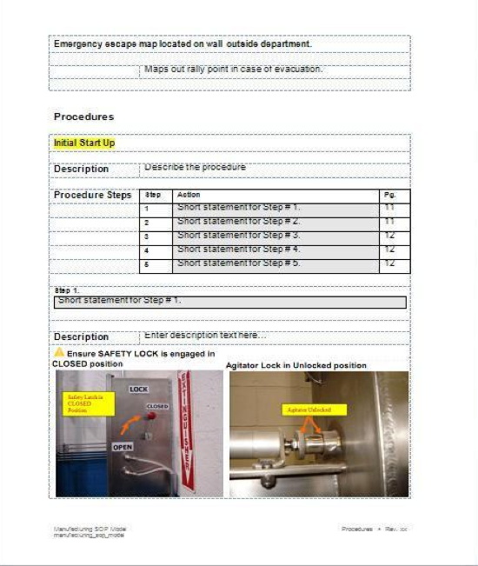
Standard Operating
Procedure Example
‹#›/64

Slide 33
Follow-Up
Proper follow-up is critical to tracking maintenance and improving quality. It can be the last step in determining if maintenance and repairs have been done properly. A manager or other authorized team member should perform the follow-up, not the same person who originally completed the work.
During follow-up the authorized personnel should discuss which maintenance activities were performed and compare these changes to the written SOP. Once it is established that the maintenance technician has performed the task properly and that the machine will once again function as it was designed, the authorized person will sign off on the work order. Failure to provide timely follow-up on the completion of a task will result in confusion and process errors.
‹#›/64

Slide 34
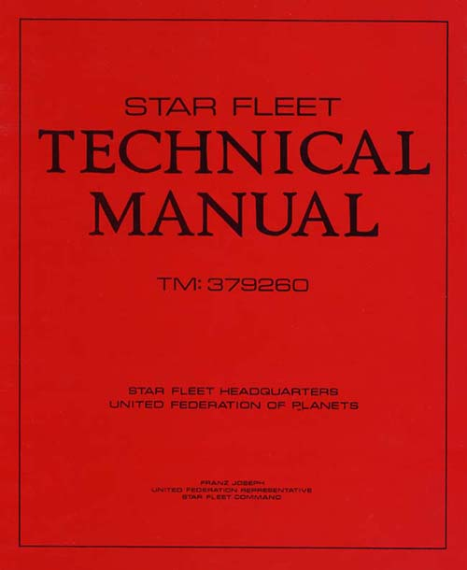
Technical Manuals
Technical manuals are provided by the equipment manufacturer and include the following:
A list of replacement parts
Machine-specific safety information
Contact information (for non-routine service and replacement parts)
Your supervisor/manager should know
the location of the technical manual that
pertains to your machine or device.
‹#›/64
Notes:
Please explain every line in detail to the best of your ability. The explanation should be thorough enough to be able to be tested.

Slide 35
Replace Parts and Emergency Repairs
Technical manuals do not include the cost of equipment or parts. They simply tell you how to use the parts and machines you should already have.
If the cost of a part or service is needed, contact the machine manufacture by:
Calling
Referring to your current technical manual
In most situations, a specific employee in your facility is tasked with being knowledgeable in machine parts and service. You should become familiar with them and use them as a resource.
‹#›/64

Slide 36
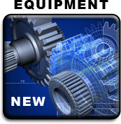
New Equipment
After an initial break-in period new equipment should perform at optimal levels
This is the best time to record machine performance characteristics - baseline
The baseline can then be used to track changes in performance
Goal is to keep equipment performing as it did when new
‹#›/64

Slide 37
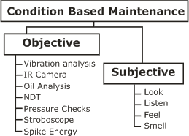
Condition-Based Maintenance (CBM)
One prominent maintenance philosophy is that of condition-based maintenance, or CBM. CBM differs from preventive and periodic maintenance as it is much more reactive.
Maintenance is only performed as key performance and/or condition indicators deteriorate to a point that would signal that maintenance is necessary.
‹#›/64

Slide 38
CBM Program
A CBM program is an active condition monitoring approach. This requires:
Regularly monitoring the operational condition of all critical production equipment
Identifying outstanding problems
Unlike breakdown maintenance and preventive maintenance, predictive maintenance is an active condition monitoring approach rather than a reaction or time-based approach to maintenance.
‹#›/64

Slide 39
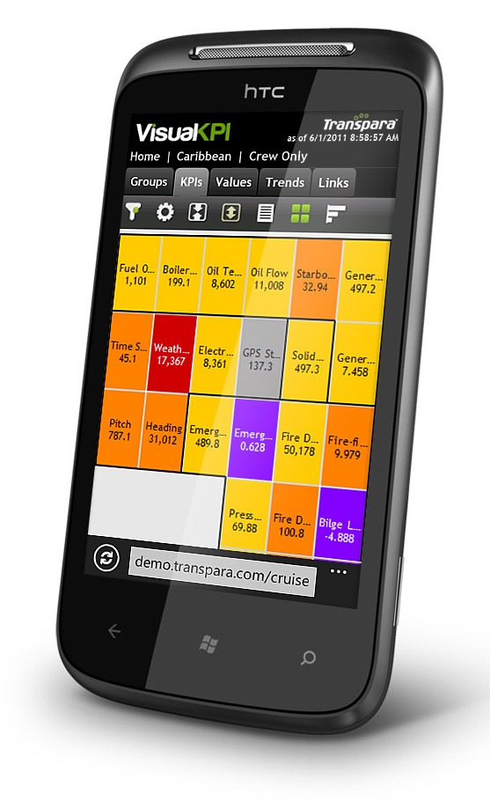
The Principles of CBM
There are several underlying principles of CBM.
Identifies machines that have potential problems
Identifies the nature and severity of each problem
Helps to predict the most likely outcome of each problem
Allows the user to make better maintenance and
repair recommendations on the best course of
action to solve the problem
Identifies repeat failures and provides information
that helps improve maintenance practices, which directly and positively impacts organization goals
KPI=Key Performance Indicators
‹#›/64

Slide 40
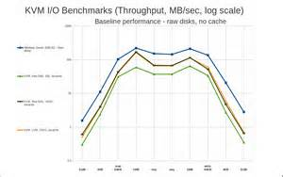
Equipment Baseline
Equipment baseline activities:
Refer to any action that would extend the reliability and up time of production equipment, including routine care and servicing of equipment to prevent failures before they occur
Involve routine service, tests, measurements, adjustments, and part replacements to prevent equipment faults from occurring
‹#›/64

Slide 41
QUESTION
A drive belt was replaced as scheduled maintenance. The baseline after break-in recorded production at 100 ppm. The production rate after belt replacement should now be __________.
100 PPM
‹#›/64
Notes:
100 ppm

Slide 42
Equipment Performance Indicators
Overall equipment effectiveness (OEE)
Equipment downtime
Equipment capacity, utilization, running speed, or performance efficiency
Mean time between failure (MTBF) for pumps, motors, compressors, etc.
List of worst-performing equipment
Set-up or change-over times
Start-up and shut-down times
Monthly costs for each type of equipment (pumps, motors, compressors, etc.)
Monthly costs for each asset center
‹#›/64

Slide 43
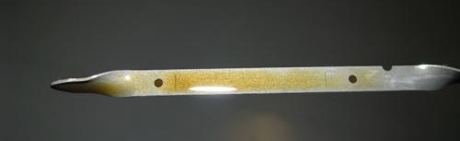
Condition-Based Maintenance Indicators
Physical machine characteristics are identified that collectively indicate the current condition of the machine
Each of these characteristics is measured, analyzed, and recorded so that trends can be recognized
The goal is to identify anomalies in the characteristics being measured, which may indicate a change in equipment health
‹#›/64

Slide 44
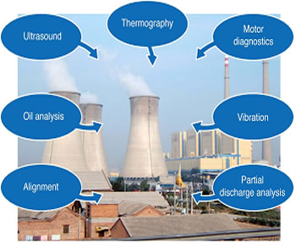
Equipment Condition Monitoring
Equipment condition monitoring is done through several methods, including:
Vibration analysis
Temperatures (thermography)
Fluid analysis (tribology)
Visual inspection
Magnaflux
Changes in noise or sounds
Ultrasonic
Operational-dynamics analysis
Electrical monitoring
Motor circuit testing
Failure analysis
‹#›/64

Slide 45
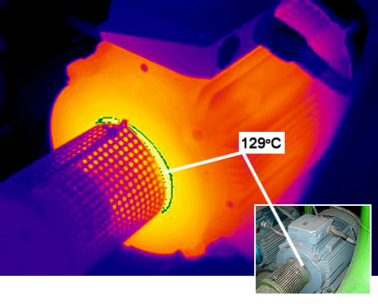
Predictive Maintenance (PdM)
PDM uses techniques that are designed to help determine the condition of in-service equipment in order to predict when maintenance should be performed. This approach promises cost savings over routine or time-based preventive maintenance, because tasks are performed only when warranted.
- Thermography (IR)
- Ultrasound
- Oil analysis
- Magnaflux
‹#›/64

Slide 46
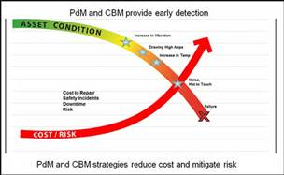
Predictive Maintenance
Predictive maintenance:
Identifies machine component parts before failure
Uses available technologies and methods
Assists in the goal of zero downtime or
unscheduled maintenance
Predictive maintenance prevents excessive wear, such as a V-belt pulley that is worn beyond usefulness (when the belt is touching the bottom of the groove).
Proper predictive maintenance will help your
facility maintain spare parts and pieces in
stock, at all times.
‹#›/64

Slide 47
Predictive Maintenance Methods
Predictive Maintenance:
Measures and calculates the operational condition of manufacturing equipment
Improves quantity and quality of equipment output
Detects and corrects problems before equipment fails
The operative word here is “before.” We absolutely want to prevent all breakdown maintenance. Predictive Maintenance is essentially our way of nipping a machine’s problems in the bud.
Lowers maintenance costs as follows:
  Reduction in parts cost
  Reduction in overtime
  Extended time between equipment overhauls
‹#›/64

Slide 48

Predictive Maintenance Technologies
Predictive Maintenance can be assisted through the use of several modern technologies, which we will explain in the coming slides.
A predictive maintenance program may use one (or all four) of the following:
Tribology (oil analysis)
Thermography (hot spots
Ultrasonics (sound reflection)
Vibration analysis (bearing failure)
Magnaflux (cracks in ferrous metal)
‹#›/64

Slide 49
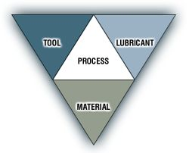
Tribology
  Study of interaction of sliding surfaces
  Focuses on friction, wear, and lubrication
  Involves the analysis of lubricating oil to detect wear of machine components
  Tribology is often used to analyze the effect of movement and friction on various lubricants (gels, oils, etc.).
  One important category of oil analysis is oil viscosity
‹#›/64

Slide 50
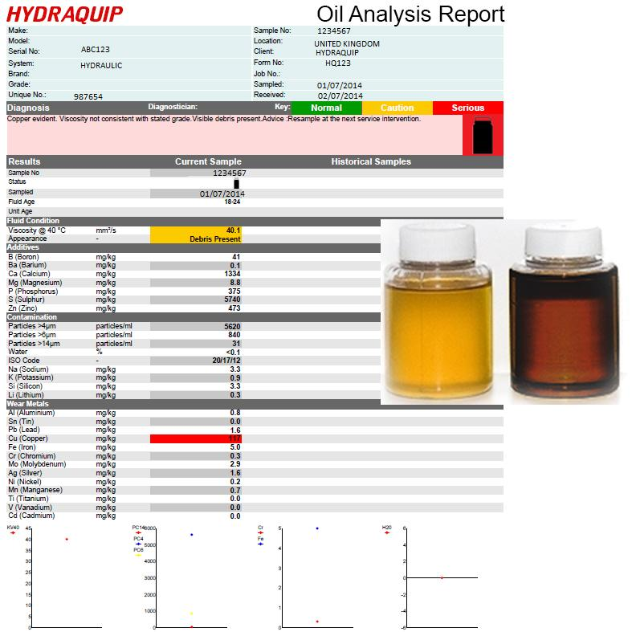
QUESTION
If suspended metal products were found in an oil analysis, it would likely indicate _______________ .
bearing problems
‹#›/64
Notes:
Answer - Bearing problems

Slide 51
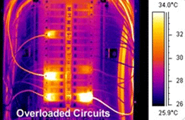
Thermography
Thermographic technology is based on the following facts:
All objects emit infrared (IR) radiation (a.k.a. light)
IR radiation (light) is emitted at different frequencies (light spectrum)
The frequency of IR radiation, or color of light, is related to temperature
‹#›/64

Slide 52
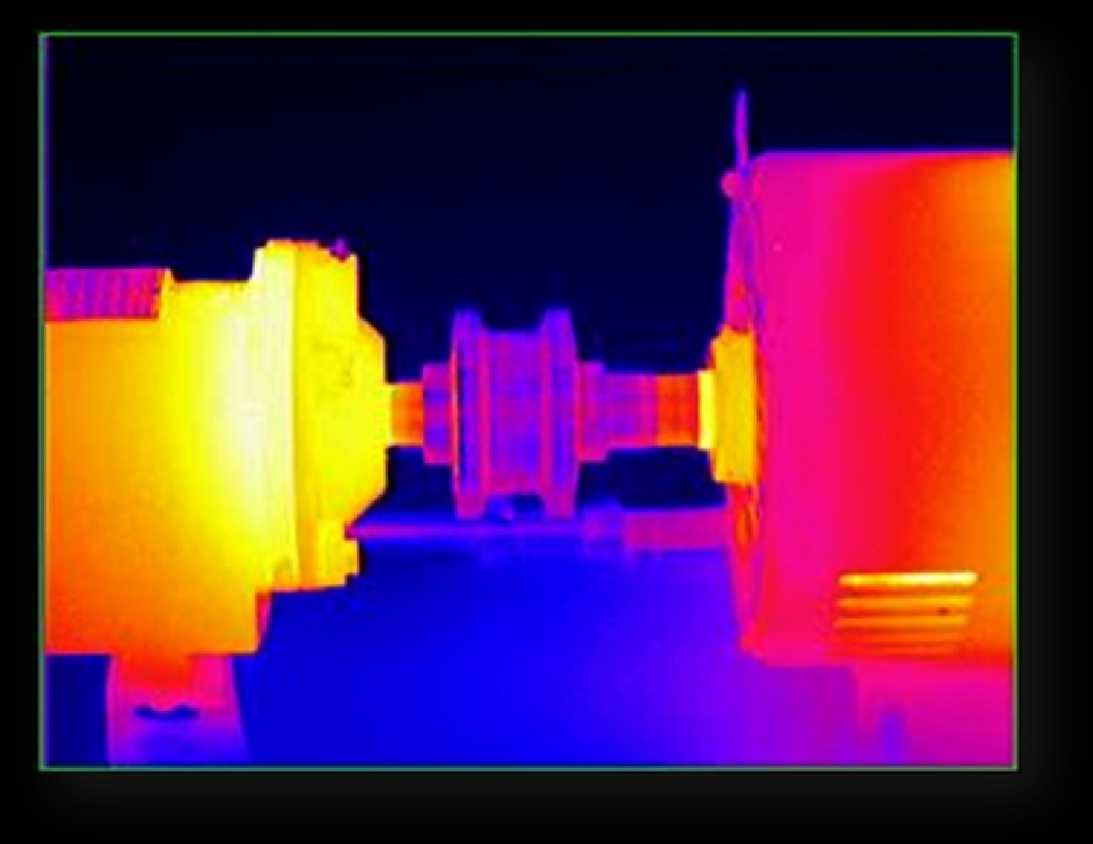
Thermography (Cont’d.)
This slide shows a thermographic image of a motor and gearbox (lighter colors denote more heat).
‹#›/64
Notes:
Be sure to point out where the motor and gearbox are lighter colored and, thus, where more heat is being produced. Emphasize that this heat will play a role in how quickly the parts wear as compared to the other, cooler, parts of the machine.

Slide 53
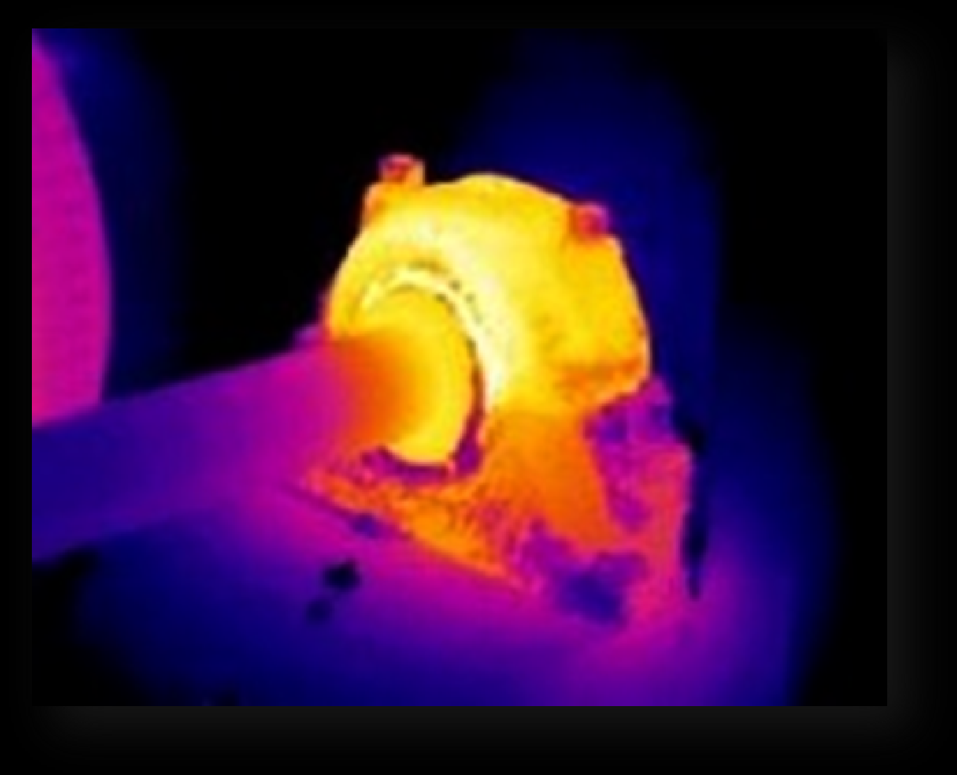
Thermography (Cont’d.)
This image is of a bearing assembly.
‹#›/64
Notes:
Instructor Note: Point out that there is more heat on the bearing assembly because there is friction and pressure. It is also a moving part.

Slide 54
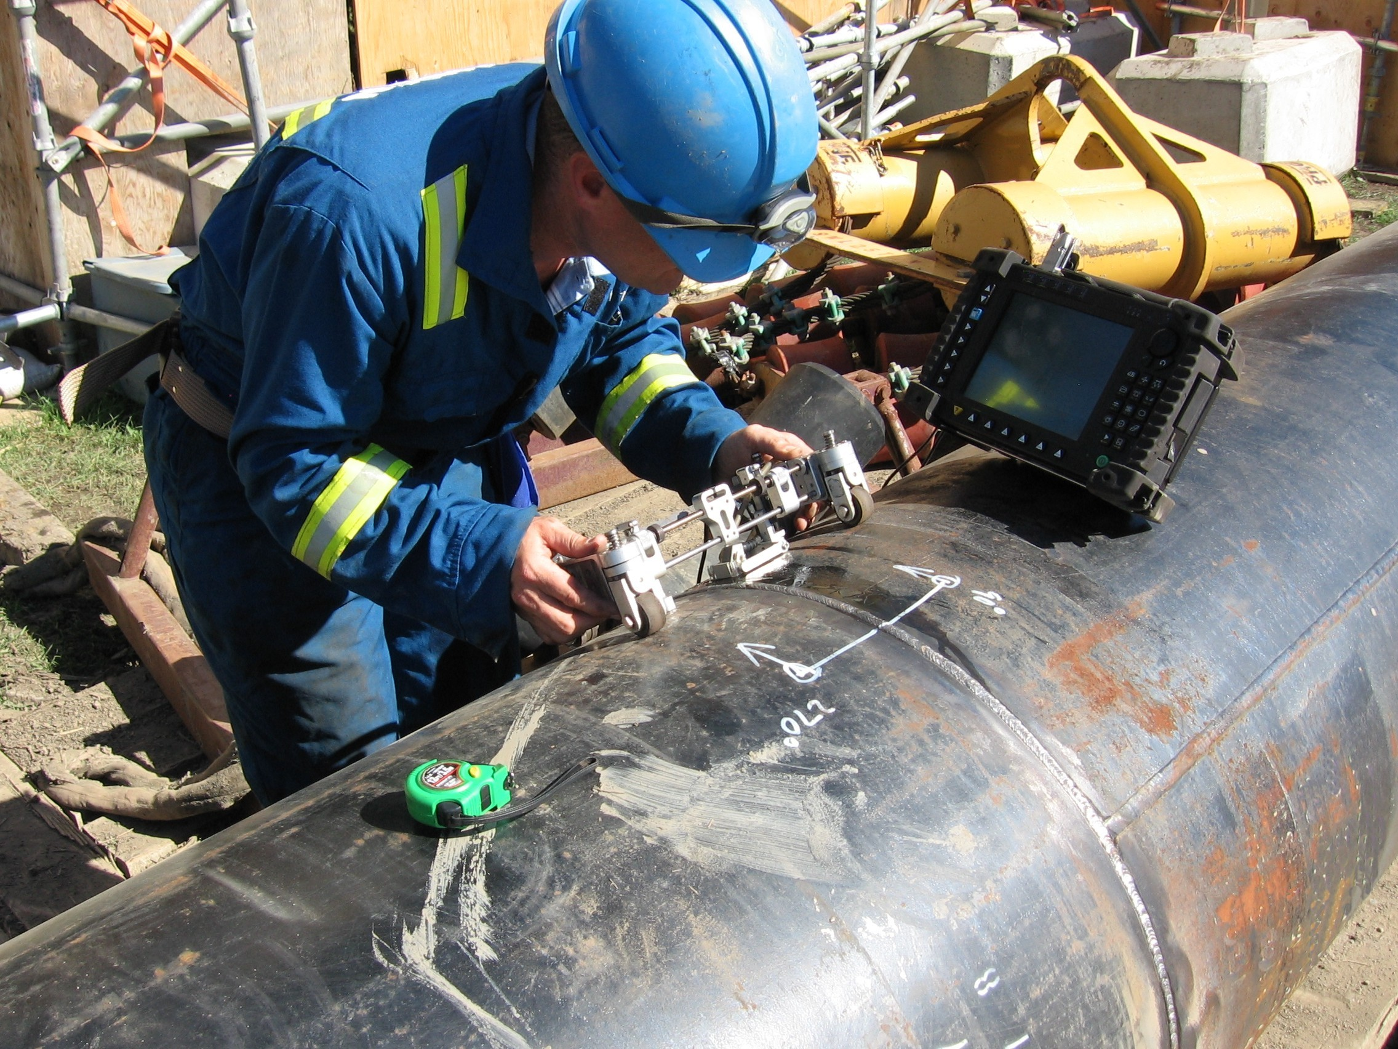
Ultrasonics
Ultrasonic devices detect reflected sound waves.
Ultrasonic devices are typically used to:
Detect leaks in systems under pressure
Detect leaks in systems under vacuum
‹#›/64
Notes:
Class Participation: Can you think of any other situations where ultrasonics may be useful? Have you used them in your workplace? Please explain how.

Slide 55
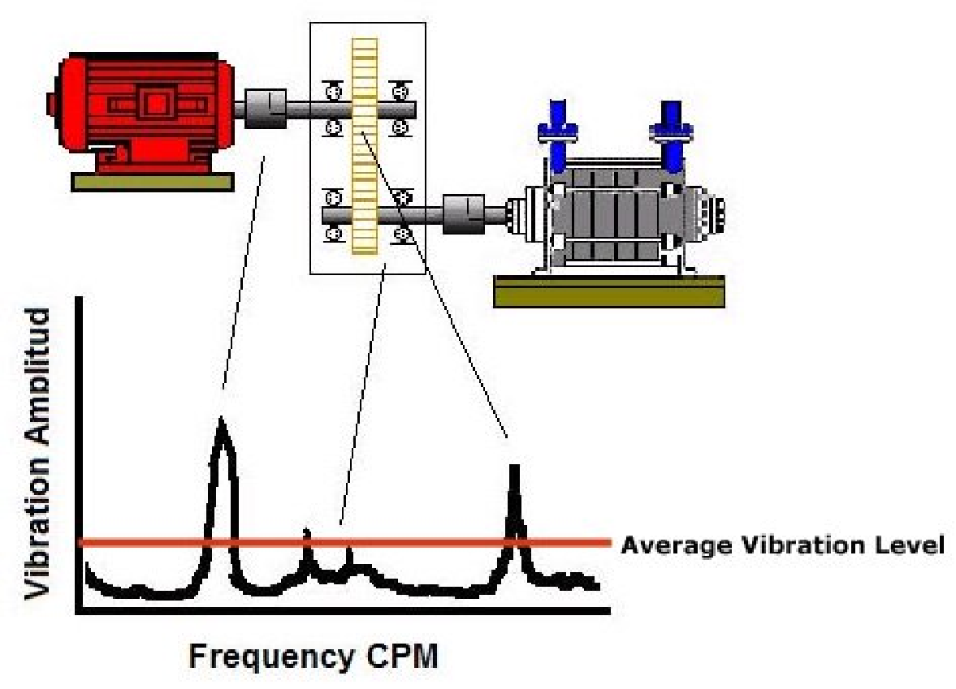
Vibration Analysis
Vibration analysis monitors the condition of equipment and diagnoses faults.
If machine parts or belts are worn excessively, vibration may be more severe than usual.
‹#›/64
Notes:
Instructor Note: Please explain the diagram on the slide, pointing out the vibration that is caused by the use of the belt by both machines. The graph shows vibration over time. Mention to the students that vibration may be more severe at some times and not at others.

Slide 56
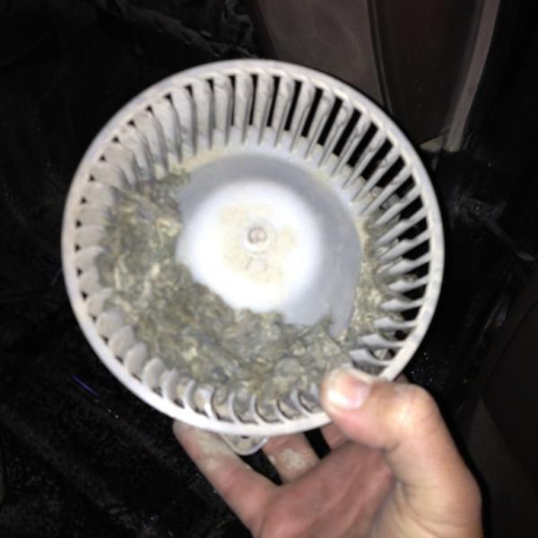
QUESTION
The most common cause of fan vibration is
___________________ .
Sediment / product buildup
‹#›/64
Notes:
Answer - Sediment / product buildup

Slide 57
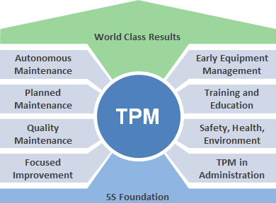
Total Productive Maintenance
TPM is a system of maintaining and improving the integrity of production and quality systems through the machines, equipment, processes, and employees that add business value to the organization
‹#›/64

Slide 58
Total Productive Maintenance
Total Productive Maintenance (TPM) is the ideal framework for performing efficient and effect maintenance activities on the manufacturing floor.
Basically, a Total Productive Maintenance framework encompasses all of the steps needed by a facility to reach their maximum effectiveness as it pertains to maintenance. Find the right tool for the job in 30 seconds.
An effective TPM program focuses on cooperation between operators and maintenance specialists, each of whom perform vital maintenance tasks.
The primary goal of TPM is zero breakdowns, and zero defects.
‹#›/64

Slide 59

Why TPM?
As the goal of TPM is zero errors, accidents, or losses, accomplishing this goal will bring recognition to your facility and workers.
To be successful, we need:
  ZERO WASTE
  ZERO DEFECTS
  ZERO BREAKDOWNS
  ZERO ACCIDENTS
Avoiding waste, defects, breakdowns, and accidents will significantly improve your company’s bottom line. Ultimately, the facility and the owners make more money, which can allow them to provide incentives and a more comfortable workplace for employees.
‹#›/64

Slide 60
The Concept of “Zero”
The concept of “Zero” is at the crux of Total Productive Management.
To make the program successful, we must strive to eliminate all unnecessary expenditures and waste, and eliminate interruptions
in the production process.
One measure of proper maintenance is the time interval each machine will run without suffering a problem
Only by eliminating wastes, breakdowns, and malfunctions COMPLETELY are we able to successfully fulfill the client’s production needs and maximize profit.
‹#›/64

Slide 61
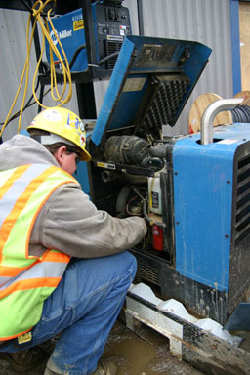
Five Goals of TPM
TPM is a goal-oriented endeavor. The five main goals of TPM are to:
Maximize equipment effectiveness
Develop a system of productive maintenance
Involve all departments
Involve all employees
Promote TPM through motivational management
As will be discussed in our module, TPM starts with upper management and can reach all employees. You MUST have management support for this approach to work.
‹#›/64

Slide 62
TPM works best when:
It is supported by top management
Again, Total Productive Management will only succeed if it is supported by top management and the rest of the workforce. Management personnel must be on board first and foremost. Their participation is critical to the success of a TPM program. No management participation or approval means no success with TPM.
Employees are cross trained to understand others’ responsibilities
A cross-trained employee does not shrink the workforce, improve efficiency, or quality
‹#›/64

Slide 63
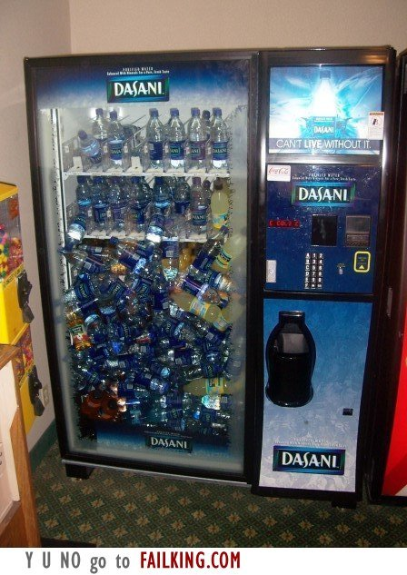
QUESTION
What is wrong with running a piece of equipment until it fails?
‹#›/64

Slide 64

Summary
Unscheduled
Breakdown maintenance (run to failure)
Scheduled
  Preventive
  Predictive
  Total Productive Maintenance
‹#›/64

