Slide 1

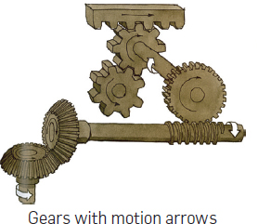
Domain3: Maintenance Awareness
Foundations of Manufacturing
Section 2: Mechanical Systems
Notes:
READ TO STUDENTS:
There are several systems in a modern manufacturing facility. The interaction of drives, chains, belts, controllers, fluids and materials produces the finished products our customers demand, and the proper function of the components is essential to manufacturing success. As a Production Technician, you need to be aware of the parts and pieces you will see every day on the plant floor, and how to properly diagnose issues as they arise. To do so, you must have a clear understanding of how each piece works, how to maintain it, and how to recognize when it requires more service than you are able to provide.
Mechanical systems are the hands and feet of any manufacturing system. It’s the physical way things get made, and your understanding of the systems will help keep your plant operational and profitable.

Slide 2
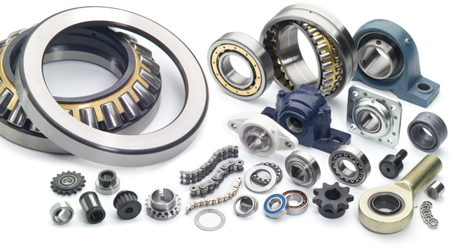
Mechanical Systems
Section 2.1 - Fasteners
Section 2.2 - Bearings and Shafts
Section 2.3 - Couplings
Section 2.4 - Shaft Alignment
Section 2.5 - V Belt drives
Section 2.6 - Chain Drives
Section 2.7 - Gear Drives
Section 2.8 - Lubrication
Section 2.9 – Conveyors

Slide 3
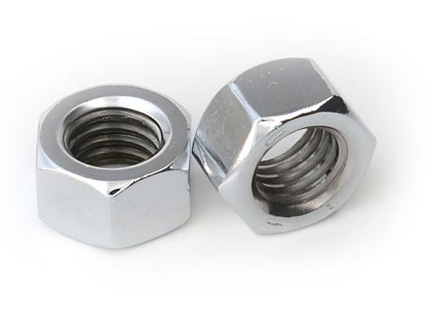
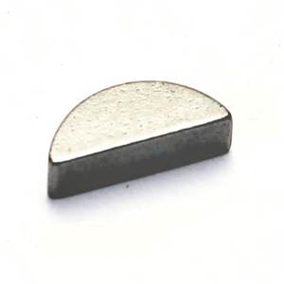
Section 2.1: Fasteners
Fasteners & Anchors
Threaded Fasteners
  Grade Markings
Installing Threaded Fasteners
The various types of keys
The application of the keys
Assembling the shaft to the hub using a key

Slide 4
Fasteners and Anchors
Fasteners are used to assemble and install different types of equipment, parts, and materials.
Fasteners include: Screws, Bolts, Nuts, Pins, Clamps, Retainers, Tie Wraps, Rivets and Keys
Primary categories of fasteners:
  Threaded Fasteners
  Non-Threaded Fasteners
Different types and sizes of each category.
Each type is designed for a specific application.
Failure of fasteners can cause a number of problems, therefore it is important to use: the correct type, correct size and proper installation

Slide 5






Threaded Fasteners
Most commonly used fasteners.
Many are used with nuts and washers.
Hex Head Bolt
Square Head Bolt
Hex Head Cap Screw
Hex Socket Head Cap Screw
Double-End Stud
Continuous Thread

Slide 6
Thread Identification
Uses standard method.
Nominal size – approximate diameter
Number of threads per inch (TPI)
Thread series symbol – Indicates Unified standard thread type (UNC, UNF, or UNEF)
Thread class symbol: Indicates the closeness of fit between the bolt threads and the nut threads.
Left hand thread symbol: LH
Example: 3/4 – 10 – UNC – 2A – LH

Slide 7
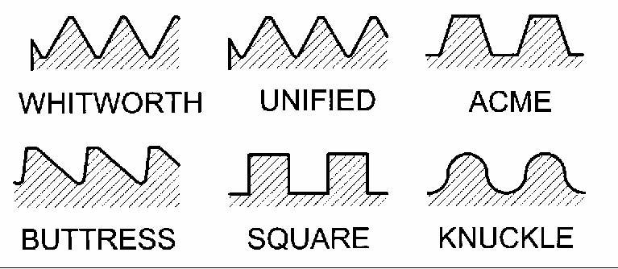
Thread Design
Thread design used depends on the purpose of the fastener.
Power transmission threads are used to move machine parts for:
  Adjusting
  Setting
  Transmitting power
Common transmission threads are:
  Buttress thread
  Square thread
  Acme thread

Slide 8
Fastener Grades
Markings on head can be used to determine quality.
SAE and ASTM developed standards for these markings.
Fasteners made from higher quality steel have a greater number of markings.
Unmarked fasteners are generally made from mild steel.
SAE Grade 5 Bolt
3 Marks on Bolt Head
105,000-PSI Tensile Strength
Notes:
The bolts in this example have 3, 4 or 6 tick marks on the head of the bolt.
An SAE Grade 8 bolt has 6 marks on the bolt head.
This grade bolt is rated at 150,000 PSI Tensile Strength
ASTM International, known until 2001 as the American Society for Testing and Materials (ASTM), is an international standards organization that develops and publishes voluntary consensus technical standards for a wide range of materials, products, systems, and services. Some 12,575 ASTM voluntary consensus standards operate globally.The organization's headquarters is in West Conshohocken, Pennsylvania, about 5 mi (8.0 km) northwest of Philadelphia.

Slide 9
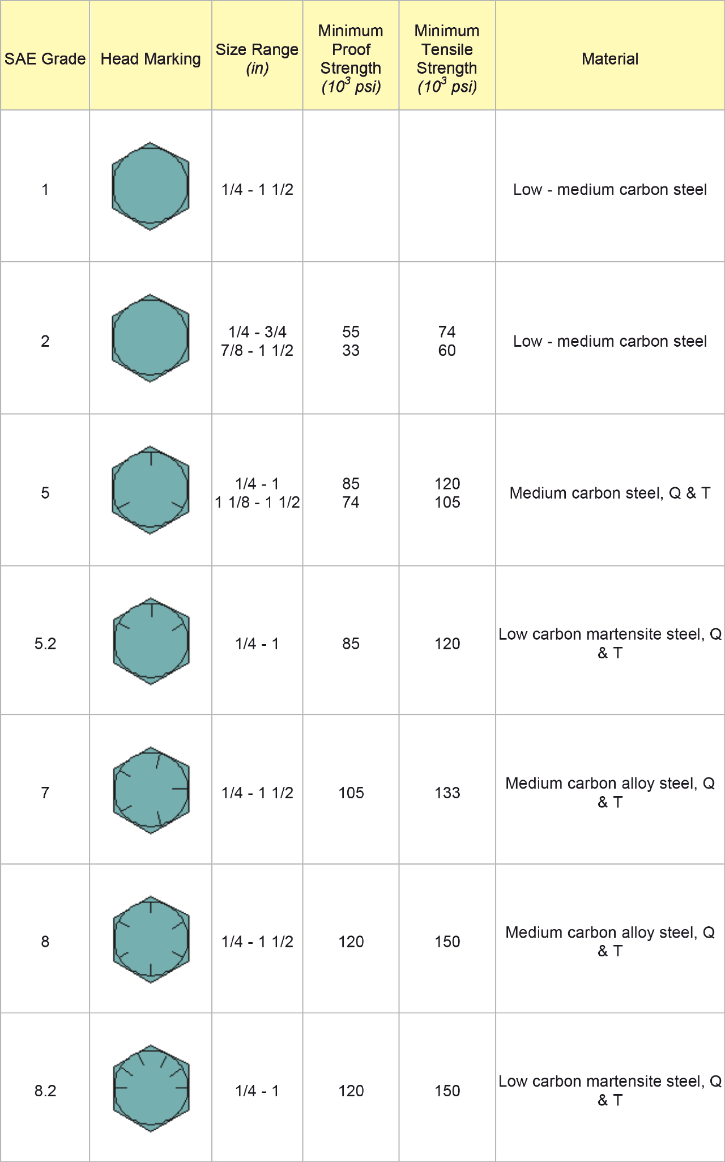
Bolt and Nut Grades
This slide displays some common characteristics of bolts and nuts used in manufacturing.
‹#›/191

Slide 10
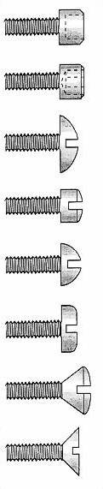
Machine Screws
Available in a variety of types.
Available in diameters from 0 (0.060) to ½ inch.
Lengths range from 1/8 inch to 3 inches, also made in metric sizes.
Make sure proper screwdriver or power tool bit is used.
Different head shapes such as:
  Flat
  Oval
  Pan
  Round
  Fillister
  Truss
  Hex socket
  Torx® socket

Slide 11

Machine Screws (Cont’d.)
Different slot types, such as:
  Slotted
  Cross Recess Type 1
  Cross Recess Type 2
  Clutch
  Hex Socket
  Torx® socket

Slide 12
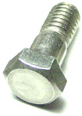
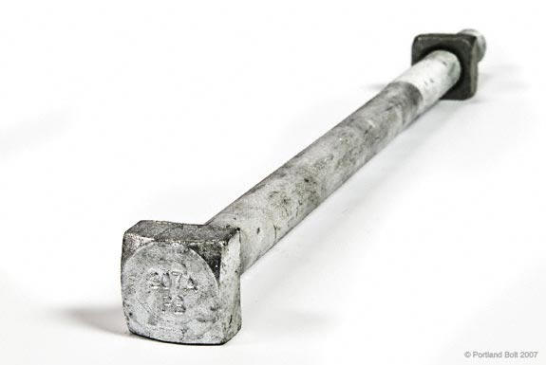
Machine Bolts
Generally used where close tolerances not required.
Have either square or hexagonal heads.
Diameters range from ¼ inch to 3 inches.
Lengths range from ½ inch to 30 inches.
Nuts normally the same shape as head.
Hex Head Bolt
Square Head Bolt

Slide 13





Set Screws
Heat-treated steel normally used.
Head style and point style typically used to classify.
Common uses:
  Preventing pulleys from slipping.
  Holding collars in place.
  Holding shafts in place.
Hex socket, slotted, and square most common heads.
Cup
Cone
Flat
Half Dog
Oval

Slide 14
Nuts
Used with threaded fasteners.
Generally used with bolts having the same shaped head.
Classified as:
  Regular: only threads machined.
  Semi-finished: threads and bearing face machined.
  Finished: made to closer tolerances

Slide 15



Castellated, Slotted and Self-Locking Nuts
Castellated and slotted nuts:
  Slotted across the top and flat on the bottom.
  Used where little or no loosening can be tolerated
  After tightening a cotter pin is placed through a hole in the bolt and on set of slots in the nut. This keeps the nut from loosening.
Self-locking nuts:
  Also used in applications where loosening cannot be tolerated.
  Contain a nylon insert or are deliberately deformed to prevent loosening.
  No hole is needed in the bolt.
Castellated
Slotted
Self-Locking

Slide 16
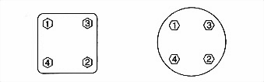
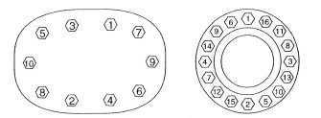
Procedure for Installing Threaded Fasteners

Slide 17
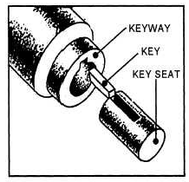
Keys, Keyways & Key Seat
KEYS, KEYSEATS, AND KEYWAYS: A key is a small wedge or rectangular piece of metal inserted in a slot or groove between a shaft and a hub to prevent slippage. The three types of keys are the flat bottom, round bottom, and square. A keyseat is a groove into which a key fits. A keyway is an exterior sleeve surrounding the keyseat, which prevents movement of all parts.
Six Types of Keys
  Sunk Key
  Saddle Key
  Tangent Key
  Round Key
  Taper Pin
  Serrated Shaft & Spline

Slide 18
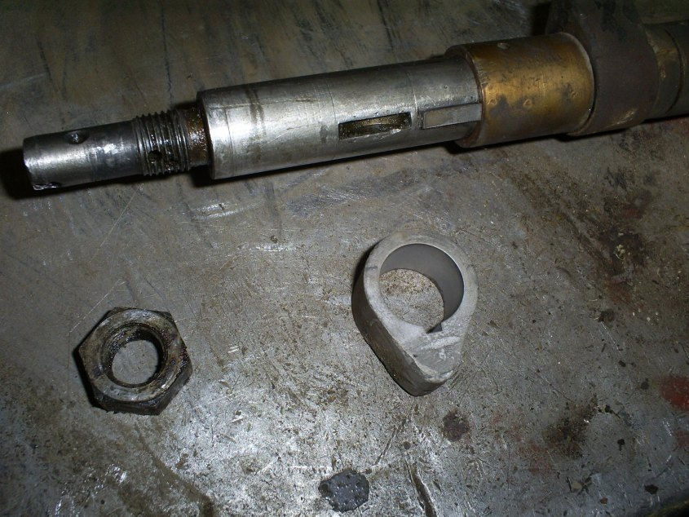
Keyed Cam /Shaft Mount

Slide 19
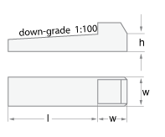
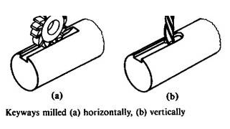
Sunk & Saddle Keys
There are two basic types of key:
(a) Saddle keys, which are sunk into the hub only. These keys are suitable only for light duty, since they rely on a friction drive alone.
(b) Sunk keys, which are sunk into the shaft and into the hub for half their thickness in each. These keys are suitable for heavy duty, since they rely on positive drive.

Slide 20
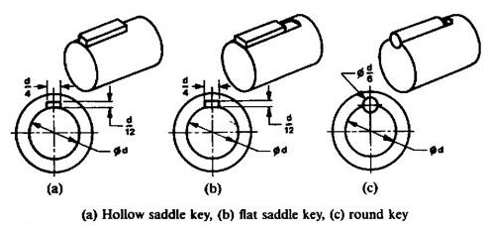
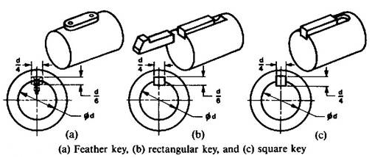
Sunk & Saddle Keys (Cont’d.)
Hollow saddle keys are used for very light duty, fig.(a) on right.
Flat saddle keys are used for light duty, fig. (b) on right.
Round keys are used for medium duty, fig. (c) on right.
Feather key is used when the hub is required to slide along the shaft. It is lightly fitted or secured by means of screws in the shaft keyway, and is made
to slide in the hub keyway, fig. (a) on right.

Slide 21


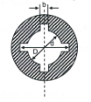
Round & Taper Pin Key
Serrated Shaft & Spline
Round & Taper Pin Key
  Round keys are drilled to fit in holes partly in the shaft and partly in the hub.
  The advantage with this type is they can be drilled after the mating parts are assembled.
  Most appropriate for low power drives.
  Taper pins held in place by friction fit.
Serrated Shaft & Spline
  This type of key may be an integral part of the shaft.
  Used when a large amount of force must be transmitted
  Typical application automobile transmission.

Slide 22
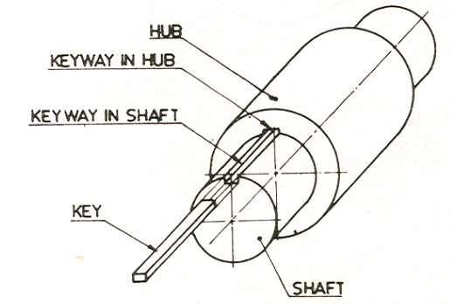
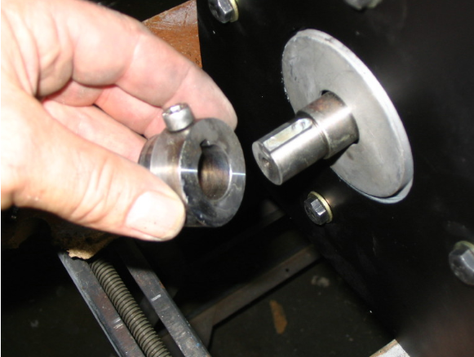
Assembling the Hub to the Shaft
Variety of ways to assemble based on the type of key.

Slide 23

End Section 2.1
Fasteners
Questions

Slide 24
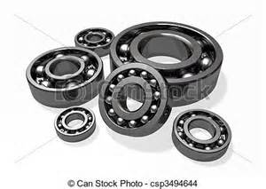
Section 2.2: Bearings
  A bearing is a machine element that reduces friction between moving parts and constrains relative motion to only the desired direction.
  The term "bearing" is derived from the
  verb "to bear"; a bearing being a machine
  element that allows one part to bear
  (i.e., to support) another.

Slide 25
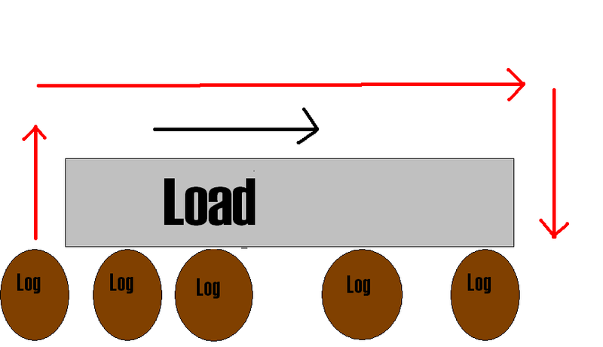
What is a Bearing?

Slide 26
Common Bearing Types
There are various types of bearings but we are covering the most commonly used:
Antifriction Bearings
Roller Bearings
Plain Bearings

Slide 27
Bearings
Plain bearings are solid, and the moving shaft slides against the bearing material. The surface of both the part and the bearing must be extremely smooth, or friction will be too high.
Antifriction bearings have rolling elements, either balls or rollers, or are magnetic bearings or fluid-filled bearings, between the moving part and the bearing housing.
Since rolling causes less friction than sliding, antifriction bearings are more efficient than plain bearings.
This section will explain some of the most common types of bearings.

Slide 28
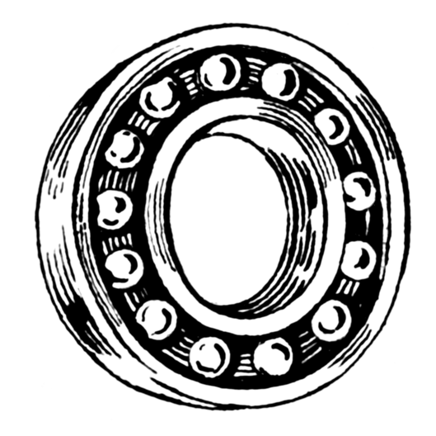
Antifriction (Ball) Bearings
Self Alignment Ball Bearing
Ball Thrust Bearing
Ball Bearing
Single Row Bearing
Double Row Bearing
Radial Thrust Bearing

Slide 29
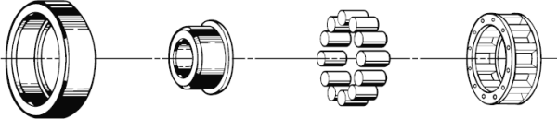
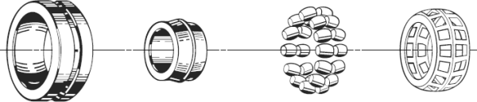
Roller Bearings
1. Cylindrical Roller Bearing
2. Spherical Roller Bearing

Slide 30
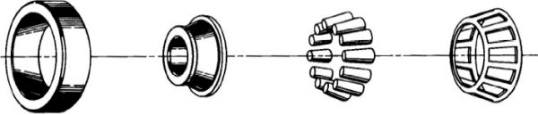
Roller Bearings (Cont’d.)
3. Taper Roller Bearing

Slide 31
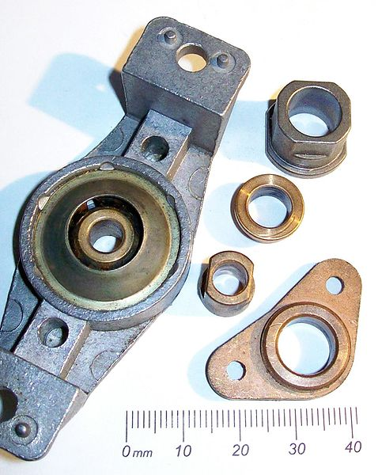
Plain Bearings
Solid Bearing
Half Bearing
Split Bearing
Synthetic Bearing

Slide 32
Rated Life of Common Bearings
Machine Usage Type | Life Required of Bearings (Hours)
household appliances — intermittent use | 300 - 3000
hand tools, construction equipment — short period use | 3000 - 8000
lifts, cranes — high reliability for short periods | 8000 - 12000
8h/day gears, motors — full day partial use | 10000 - 25000
8h/day machine tools, fans — full day full use | 20000 - 30000
continuous use | 40000 - 50000

Slide 33
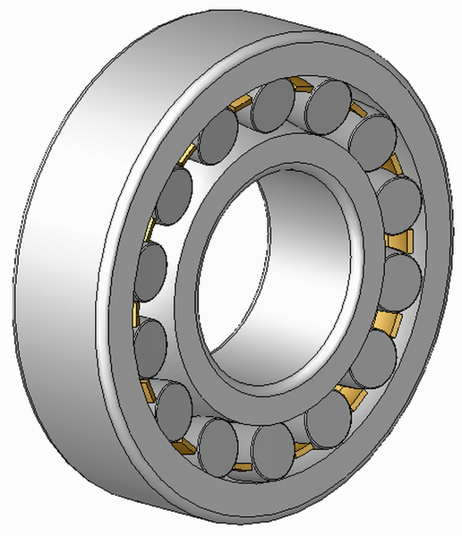
Bearing Loads
Radial Load
Combination Load
Thrust Load

Slide 34
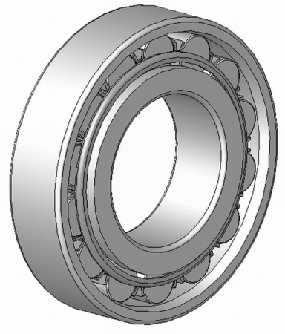
Radial Load
The Radial load of a bearing means that the pressure of the load being applied to the bearing is perpendicular to the axis of the shaft the bearing is mounted to. In this case the load is 90 degrees from the shaft itself.

Slide 35
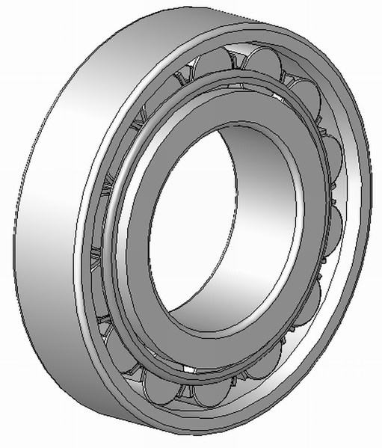
Axial Load
The Axial load is when the pressure being applied to the bearing is parallel to the axis of the shaft.

Slide 36
Radial-Axial Load
The Radial-Axial Load is when the pressure is being applied to the bearing from both the parallel and perpendicular to the axis of the shaft at the same time.

Slide 37
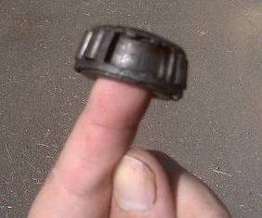
Reasons for Bearing Failure
High Temperature
Moisture
Improper Lubrication
Overloading
Misalignment
Electric Current Flow
Contamination

Slide 38
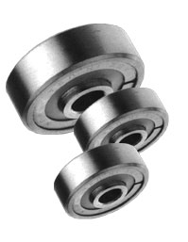
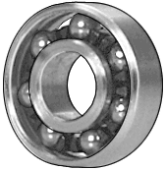
Bearing Construction
Two Styles of Bearing being constructed
Sealed Bearing Open Face Bearing

Slide 39
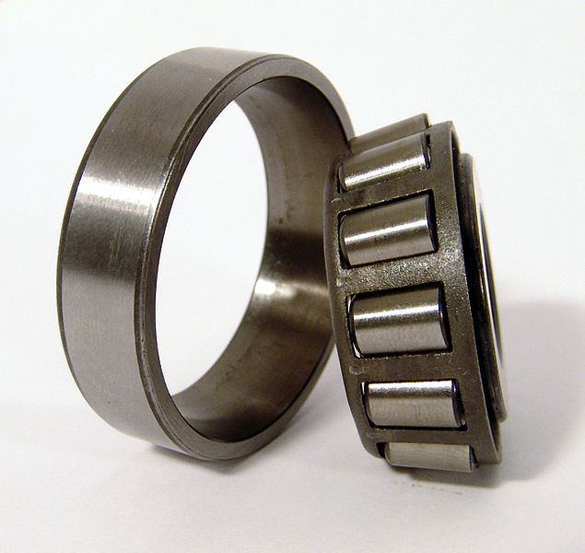
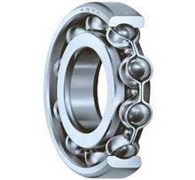
Bearing Construction (Cont’d.)
Bearings are constructed of eight parts:
Rolling Element
Ring (2): Inner and Outer
Raceway (2): Inner and Outer
Shoulder
Retainer
Cages

Slide 40
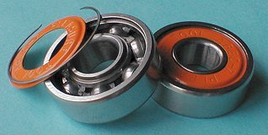
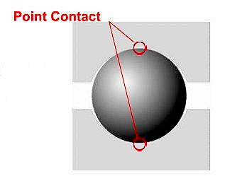
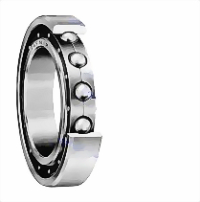
Sealed Bearings
Shields are protective covers on the outside of the bearing, usually on one end only, to keep foreign matter out of the races.
Seals are enclosures installed so as to keep the lubricant in, as well as to exclude foreign matter.
Sealed bearings are pre-lubricated; all other bearings require routine preventive maintenance.
Outer Ring
Ball
Inner Ring
Cage

Slide 41
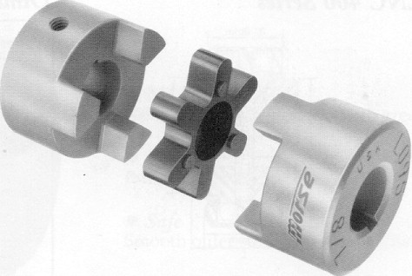
Section 2.3: Couplings
Any rotating machinery has some connection
between the driver and the driven shafts.
Couplings are used to transfer power between shafts.
  They may be held in place with key and setscrew, taper-lock clamping hubs, or clamping rigid sleeves.
  The couplings themselves may be rigid, allowing no significant misalignment, or they may be flexible, allowing a considerable degree of misalignment.

Slide 42
Introduction - Couplings
Couplings are used to connect the shaft of a driver, such as a motor, to the shaft of a driven device, such as a pump.
Couplings are manufactured in many types and sizes.
It is also very important that the equipment be properly aligned and the coupling properly installed. Misaligned couplings can cause vibration in machinery.

Slide 43
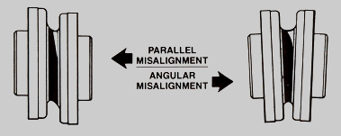
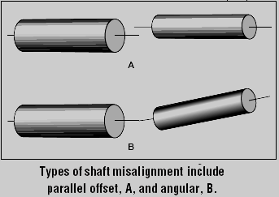
Selecting Couplings
When selecting a coupling for a particular application, a minimum of three factors must be considered: horsepower, size, and speed of the equipment being coupled.
  Additional factors that should also be taken into account include the following:
    Any keyways that might be required
    Size of the keyways required
    Any taper existing on the shaft
    Materials composing the shaft
    Torque
    Angular misalignment
    Offset misalignment
    Axial travel
    Distance between shaft ends
    Operating temperature
    Space limitations
    Any other unusual conditions

Slide 44
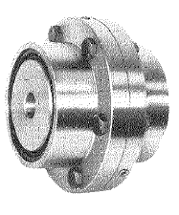
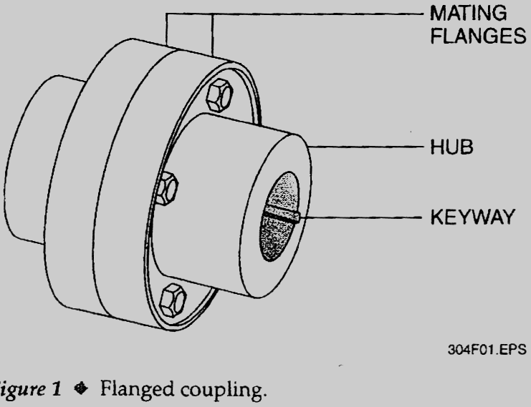
Rigid Flange Coupling
Also known as a Split Coupling
Each Half is Mounted to the Shaft to be Coupled
Does not Allow for Much Mis-Alignment
Used for Heavy Duty Applications

Slide 45
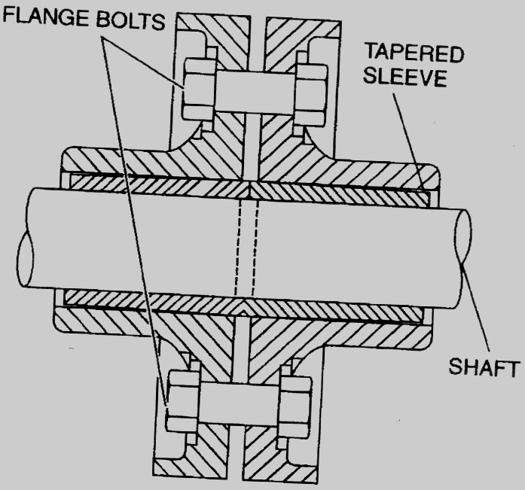
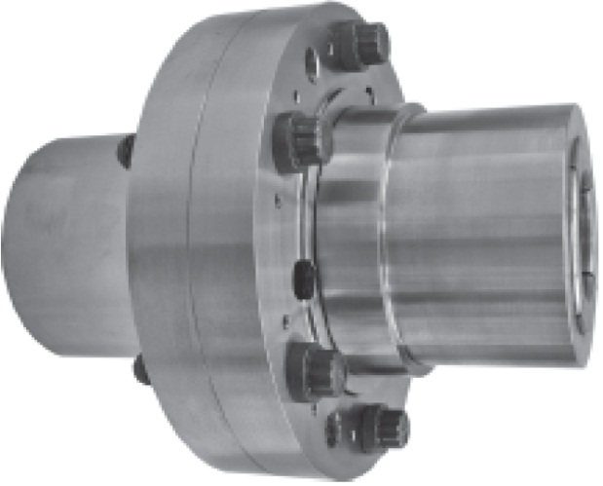
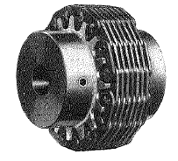
Flanged Couplings
Silent Chain Couplings

Slide 46
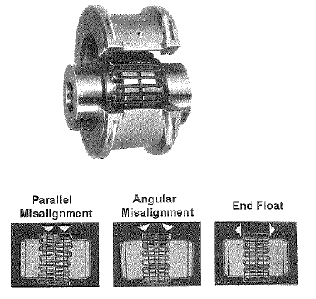
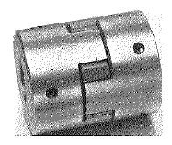
Metallic Grid & Elastomeric Couplings
Metallic Grid Coupling
  Two Hubs that Resemble Gears
  S Shaped Springs Replace Gears
  Very Forgiving Coupling
Elastomeric Couplings
  Use Non-Metallic Inserts
  Inserts Loaded Either in Compression or Shear
  Can Withstand More Mis-Alignment
  Good Shock Absorber

Slide 47
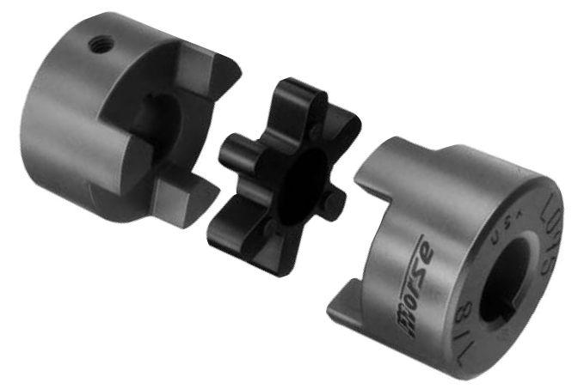
Jaw Type Coupling
More widely used coupling
Easy to install and maintain
Can be replaced without complete disassembly
Can accommodate a moderate amount of mis-alignment

Slide 48
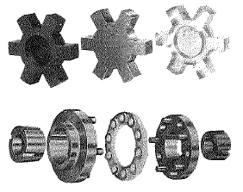
Pins and Disk Coupling
Newer type coupling
Has polyurethane components
Can withstand higher temperatures
Chemical resistant
Handles mis-alignment do to its ability to flex

Slide 49

Spring Couplings
A spring coupling (shown), also known as a Bellows coupling, has two coupling hubs and a spring.
  The hubs fit on the driver and the driven shafts,
  and the spring is fastened between the hubs.
  As the coupling rotates, the misalignment
  is compensated for by the flex in the spring.
  A spring coupling will compensate for a great
  deal of misalignment, but the greater the
  misalignment, the more the spring must flex,
  which reduces coupling life.
  One advantage of the spring coupling is that
  the spring can be replaced without moving
  the hubs on the shafts.

Slide 50

Spacer Couplings
A spacer coupling (shown) is a small spacer that is placed between two flexible couplings.
  Spacer couplings are commonly used on centrifugal pumps.
  The spacer can be removed and the flexible couplings disassembled without moving the pump or motor on the base.
  This eliminates the need to realign the couplings after reassembly.

Slide 51


Donut Couplings
A donut coupling (shown) has a toothed spacer that is placed between two flexible couplings with matching teeth.

Slide 52



Universal Joint Couplings
A universal joint coupling is used
to transmit high torque under conditions of severe misalignment.
  Universal joint couplings come in two basic styles: single joint and double joint.
  A special splined sleeve, as shown in the figure to the right, can be used if movement of the driver or the driven is expected to occur.
  Universal joints are used extensively in vehicles.

Slide 53

Overload Clutches
Designed to protect equipment if something jams or binds in the machinery.

Slide 54

Clutch-Style Couplings
Clutch-style couplings have a drum, brake linings, and weights.
  They allow the driver to come up to partial speed before the load is engaged.
    When the drive motor is started, centrifugal force causes the weights of the coupling to press against the brake linings, which in turn engage the drum, transmitting force to the driven.
    The weights may be spring-loaded in some couplings.
    Spring-loaded weights exert force on the linings only after a certain speed has been reached.

Slide 55

Clutch-Style Couplings (Cont’d.)
Clutch-style couplings allow for minor misalignment, but they will slip when overloaded.
Slippage must be controlled, since a coupling that is slipping generates a great deal of heat.
  The excessive heat will damage the coupling,
  so heat-sensing devices are commonly
  installed on clutch-style couplings.
    The heat-sensing device shuts off
    the power when the clutch is slipping.

Slide 56
End Section 2.3
Couplings
Questions

Slide 57

Alignment Overview
Reasons for Proper Alignment
  Reduced vibration
  Longer bearing life
  Lower maintenance cost
Notes:
Begin class exercise by discussing reasons for performing proper alignments. Discussion should also address the implications of performing alignments improperly.

Slide 58

Section 2.4: Shaft Alignment
Shaft misalignment can be either
  Angular Misalignment or
  Parallel Misalignment (offset)
Angular - the axes of the two shafts cross each other
Parallel - the axes of the two shafts do not cross each other
Both can occur in the horizontal and the vertical plane
    Vertical Offset
    Horizontal Offset
    Vertical Angularity
    Horizontal Angularity

Slide 59
Coupling Alignment Terminology
Offset
Side View
Top View
Motor
Vertical
Pump
Motor
Horizontal
Pump
Angularity
Side View
Top View
Motor
Vertical
Pump
Motor
Horizontal
Pump
Notes:
Alignment - The action which ensures that two or more pieces of equipment have concentric, co-linear rotational centerlines at their couplings
Offset:
Distance between rotational centerlines at any given normal plane
Normally Measured at the coupling midpoint
Gap:
The value obtained by subtracting the opening between two coupling faces from the opening 180 degrees around the coupling
Angularity:
The angle between two machine shaft centerlines

Slide 60

Motor Base
Making sure that the motor base is level will reduce the number of shims needed to level the shaft (parallel to the driven equipment).
Notes:
Note jack screws for horizontal adjustment
Shims are used for vertical adjustments

Slide 61



Methods of Alignment
Straight Edge (use 4 point method)
Dial Indicator (for both run-out and alignment)
Laser Alignment
‹#›/191
Notes:
Straight Edge:
Utilizes a straight edge and/or feeler gauges.
Procedure involves checking offset and angularity using a straight edge and/or feeler gauge
The goal is to produce an alignment that is within 10 mils per inch of coupling diameter
Quick and can produce reasonably good results
Only useful as a rough alignment to get the equipment aligned within the measurement capabilities of more accurate systems.
Single Dial Indicator:
Rim and face method takes an offset reading with a radial indicator and measures the angularity with an axial (or face) indicator
Higher degree of accuracy than utilizing a straight edge
Can be effected by bar sag
Laser Alignment:
A laser emitter is attached to one shaft and a position detecting sensor/receiver to the other shaft
Both the laser and receiver are separately mounted to the shafts by means of a rigid bracketing system.

Slide 62

Straight Edge
Utilizes a straight edge and/or feeler gauges
  Procedure involves checking offset and angularity using a straight edge and/or feeler gauge
  The goal is to produce an alignment that is within 10 mils per inch of coupling diameter
  Easy to preform
  Only useful as a rough alignment to get
  the equipment aligned within the
  measurement capabilities of more
  accurate systems.
  Needs 4 points of contact
‹#›/191

Slide 63

4 Point Contact
IF rotation of one pulley changes the number of contact points, then a shaft is probably bent.

Slide 64

Single Dial Indicator
  Rim and face method takes an offset reading with a radial indicator and measures the angularity with an axial (or face) indicator
  Higher degree of accuracy than utilizing a straight edge.
  Can be effected by bar sag
  Note: Dial Indicators are delicate
  instruments and should be removed
  during adjustments
‹#›/191

Slide 65
Dial Indicator - Face Alignment
Side View
Top View
Motor
Vertical
Pump
Motor
Horizontal
Pump
Notes:
The amount the two shafts are out of parallel.
Dial indicator face alignment can be Vertical or Horizontal Misalignment.
Important Note:
When measuring with a dial indicator the reading you receive is twice the actual misalignment
When using a Laser alignment tool the reading is the actual misalignment

Slide 66
Dial Indicator-Rim Alignment
Side View
When checking out of round and only one shaft can be turned – mount the dial indicator on the one that cannot be turned.
Motor
Vertical
Pump
Top View
Motor
Horizontal
Pump
Notes:
Two areas of alignment to check are the elevation of the pump shaft in relation to the motor shaft and the Side to Side Alignment of the two shafts.

Slide 67
Dial Indicator
Face Alignment
Side View
Top View
Motor
Vertical
Pump
Pump
Motor
Horizontal
Rim Alignment
Side View
Top View
Motor
Vertical
Pump
Motor
Horizontal
Pump

Slide 68



Dial Indicator-Bar Sag
Bar Sag can result in incorrect measurements
‹#›/191
Notes:
Bar Sag is the deflection of the measuring instrument due to the force exerted by the weight of the dial gauge at the end of the lever arm (bar)
Bar Sag can result in incorrect measurements of alignment.
Bar Sag can occur even when using a relatively stiff and short bar.

Slide 69
Single Dial Indicator
  Run out: The total movement (positive and negative) of the pointer on a dial indicator when the rotating object that it is measuring is turned through 360 degrees.
  Checking shaft run out is the 1st step to assure proper alignment
Radial Wobble Axial Wobble
‹#›/191

Slide 70

Laser Alignment
A laser emitter is attached to one shaft and a position detecting sensor/receiver to the other shaft
Both the laser and receiver are separately mounted to the shafts by means of a rigid bracketing system.
‹#›/191

Slide 71

Soft Foot
The occurrence of “Soft Foot” is when one or more of the mounts are not mounted flush and tight to the base plate. It can be discovered by “rocking” the motor.

Slide 72
End Section 2.4
Shaft Alignment
Questions

Slide 73

Section 2.5: V Belt & Synchronous Drives
Pitch, Pitch Circle, Pitch Diameter & Pitch Length
Calculating Pulley Speed & Drive
Calculating Torque
V Belt Configurations
Installing & Aligning V Belts
Adjusting & Measuring Belt Tension
Bushings
  QD Bushings
  Taper Bushings
V Belt Size & Type
Maintenance & Troubleshooting
Operation, Selection and Installation of High Torque Drive (HTD)
Operation, Selection and Installation of Timing Belt and Pulleys
Troubleshooting Synchronous Belt Drive System

Slide 74

V Belt
V belts are commonly known as V-belts or wedge ropes. The name “vee belt” stems from the trapezoidal shape of the belt tracks in a mating groove in a pulley. The belt tends to wedge into the groove of a pulley as the load increases: the greater the load, the greater the wedging action, which leads to improved torque.
‹#›/191

Slide 75

Wedging
Here we see how the principle of wedging works
‹#›/191

Slide 76



Belts
Good
Bad
During an alignment check, to be sure that the two pulley flanges are in good condition, measure each pulleys groove angle.
Since the belt should never rest on the bottom of the pulley groove, this situation would indicate that the pulley is beyond its useful life-span
Groove Angle
Pulley flange
Notes:
NOTE- a sign that a pulley is worn is when the belt rides in the bottom of the pulley grooves.

Slide 77


Sheave Wear
To check for sheave wear, measure each groove angle

Slide 78

V Belt Construction
This diagram labels the sections of a V-belt.
1. Tension section - specially woven stress-relived fabric
2. Cords - synthetic high modulus cord to carry high loads with minimal stretch
3. Compression section - Stiflex rubber compound and precision molded cogs increase flexibility and supports cords
4. Raw edge side walls - provide uniform anti-slip surface, greater flexibility, and allow more cord
‹#›/191

Slide 79

Banding V-belts
V-belts can also be banded together for more durability and usability.
‹#›/191

Slide 80

V-belt Drives
V-Belts are available in thousands of sizes and configurations.
‹#›/191

Slide 81

Flat Belt
Flat belts, also known as toothed, notch, cog, or synchronous belts, are positive transfer belts and can track relative movement.
‹#›/191

Slide 82


Round Belts
‹#›/191

Slide 83
Advantages of Belt Drives
They are simple and economical
Parallel shafts are not required
Overload and jam protection are provided
Noise and vibration are damped out; machinery life is prolonged because load fluctuations are cushioned (shock-absorbed)
They are lubrication-free and require low maintenance
They are highly efficient (90 to 98 percent, usually 95 percent) and some misalignment is tolerable
They are very economical when shafts are separated by large distances
‹#›/191

Slide 84
Disadvantages of Belt Drives
The angular-velocity ratio is not necessarily constant or equal to the ratio of pulley diameters because of belt slip and stretch
Heat buildup occurs
Speed is limited to usually 7000 feet per minute (35 meters per second); power transmission is limited to 370 kilowatts (500 horsepower)
Operating temperatures are usually restricted to –31 to 185°F (–35 to 85°C)
Some adjustment of center distance or use of an idler pulley is necessary for wear and stretch compensation
A means of disassembly must be provided to install endless belts
‹#›/191

Slide 85
Belt Drive Maintenance
A comprehensive, effective program of preventive maintenance consists of several elements:
Maintaining a safe working environment
Conducting regularly scheduled belt drive inspections
Following proper belt installation procedures
Doing belt drive performance evaluations
Having belt product knowledge
Following proper belt storage and handling
Troubleshooting
‹#›/191

Slide 86
How Often to Inspect
The following factors influence how often to inspect a belt drive.
Critical nature of equipment
Drive operating cycle
Accessibility of equipment
Drive operating speed
Environmental factors (dirt and contamination is a major problem)
Temperature extremes in environment
‹#›/191

Slide 87
Preventive Maintenance Checklist
The following steps are necessary for preventive maintenance on belt drives:
Always turn off the power to the drive. Follow correct LOTO procedures Make sure the power is turned off for the correct drive.
Verify correct circuit has been turned off.
Place all machine components in a safe (neutral) position. Make sure that moving components are locked down or are in a safe position. Ensure that fans cannot unexpectedly freewheel.
Remove guard and inspect for damage. Check for signs of wear or rubbing against drive components. Clean and realign guard to prevent rubbing if necessary.
Inspect belt for wear or damage. Replace as needed.
Inspect sheaves or sprockets for wear and misalignment. Replace if worn.
‹#›/191

Slide 88
Preventive Maintenance Checklist (Cont’d.)
Inspect other drive components such as bearings, shafts, motor mounts, and take-up rails.
Inspect static conductive grounding system (if used) and replace components as needed.
Check belt tension and adjust as needed.
Recheck sheave or sprocket alignment.
Reinstall belt guard.
Turn power back on and restart drive. Look and listen for anything unusual.
‹#›/191

Slide 89
Recommended Storage
Proper preventive maintenance includes correct storage procedures. Regardless of the belt type, proper storage should be followed.
Premature belt failures can often be traced to improper belt storage procedures that damaged the belt before it was installed on the drive. With common sense steps, these types of belt failures can be avoided.
Belts should be stored in the following conditions:
Cool and dry environment (ideally <85°F and 70% relative humidity)
No direct sunlight
On shelves or in boxes or containers
Hanging on a wall rack on a saddle or sufficient diameter
Bent to proper diameter
Kept in natural position
‹#›/191

Slide 90


Belt Storage Don’ts
Belts should not be:
Stored near windows
Stored near heaters or heating devices
Stored near any ozone generators
Exposed to solvents
Stored on the floor
Crimped during handling or storage
‹#›/191

Slide 91

Calculating Pulley Speed & Drive
Formula:
PDm x Nm
Nd = ------------
PDd
Where:
Nd = driven pulley speed
PDm = drive pulley diameter
Nm = drive pulley speed (RPM)
PDd = driven pulley diameter
Notes:
This is simply the ratio of the pulley diameters times the RPM of the driver to get the RPM of the fan

Slide 92
Measuring Motor Shaft Speed
Strobe Light Method
  Mark the shaft so it can be seen - Chalk is a good marking medium.
  Set the Strobe Lights to the “Flashes” per second or minute.
  Start the electric motor or similar device and let it come up to full speed.
  Shine the Strobe Light onto the shaft where you placed the mark. Adjust the dial on the Strobe Light until the mark illuminates and appears to stand still. The speed should be adjusted until the mark appears in the center of the light. Once that is obtained, read the speed on the Strobe Light. This is the speed the shaft is rotating.

Slide 93

Calculating Torque
Torque is measured at a distance from the motor shaft center.
The farther the force is from the center, the greater the torque.
T=F x d
Torque=Force x distance

Slide 94

Fractional Horsepower Belts
Fractional horsepower (FHP) belts are light-duty belts that are used in appliances and small machines in industry and in the home.
  They are generally used singly instead of in sets
FHP belts are measured on the outside surface of the belt.
  FHP belts (shown below) come in the following standard width and thicknesses:
  2L – 2/8-inch (or ¼ inch) wide
  3L – 3/8-inch wide
  4L – 4/8-inch (or ½ inch) wide
  5L – 5/8-inch wide
Notes:
The size of FHP V-belts is Indicated by a code printed on the outside of the belt.
The first number and letter in the code tell the width of the belt in eighths of an inch.
The next three numbers in the code tell the length of the belt in inches, with the last number indicating tenths of an inch.
For example, a belt that is coded 4L300 is 4/8-inch wide and 30 inches long.

Slide 95

Belt Sizing
Standard multiple belt size is indicated by a code printed on the belt.
  A letter indicates the width of the belt and a number indicates the length of the belt. A belt coded A42 is ½-inch wide and 42 inches long
  Standard belts length is measured on the inside surface of the belt.
  Standard multiple belts (see figure) come in various lengths for each width size, and in the following standard widths:
    A – ½-inch wide
    B – 5/8-inch wide
    C – 7/8-inch wide
    D – 1¼-inches wide
    E – 1½-inches wide

Slide 96
Wedge Belts
The wedge belt is an improved V-belt design allowing a reduction in size, weight, and cost of V-belt drives.
  It has a smaller cross section per horsepower rating than standard V-belts.
  Also, it can be used on smaller diameter sheaves with shorter center distances than the standard belt.
  Wedge belts are not interchangeable with standard multiple belts and should not be run on sheaves for standard belts.
Code markings for wedge belts are similar to the markings for FHP belts.
  The first number and letter of the code indicate the width in eighths of an inch and the cross section of the belt.
  The last three numbers indicate the length of the belt.

Slide 97
Wedge Belts (Cont’d.)
A belt coded 3V500 is defined as a 3V width and a 50 inches long cross section
The length of a wedge belt is measured along the pitch line, which runs along the center of the belt thickness.
  Wedge belts come in the following widths:
    3V – 3/8-inch wide
    5V – 5/8-inch wide
    8V – 8/8-inch (or 1-inch) wide
Another code, called a match code, is separate from the regular belt number, and is used to match multiple belts.
Notes:
The match code includes the belt codes and the manufacturer’s name.
It is used to ensure that replacement belts in a multiple belt application are all the same length.
When selecting belts for a multiple-belt application, the belts must be made by the same manufacturer and have the same match code.

Slide 98

Double-Angle Belts
Double-angle belts are used on multiple-sheave drives that cause the belt to have reverse bends that would damage standard V-belts.
  Double-angle belts are V-shaped on both sides.
  They can handle reverse bends and still transmit the required power (see below).

Slide 99

Joint Belts
Joined belts (see below) are standard or wedge V-belts that have a common back that joins them.
  They are used to provide extra stability on applications that experience severe shock loads.
  They do this by preventing the belts from turning over in the sheaves.
  The extra support of the common back also helps keep all the belts in the multiple series the same length.

Slide 100

Notched Belts
Notched belts (see below) are V-belts that have notches along the inner surface.
  The notches allow for more bend in the belt and relieve some of the bending stress.
  Notched belts are used on applications in which the sheaves are very small.

Slide 101


Synchronous Belts
Synchronous (timing), belts are used as a standard method of power transmission.
  They have teeth molded into them and are used to synchronize, (time) the action of pulleys and related devices as the action of the teeth and the toothed pulleys prevents the belt from slipping.
The two types of synchronous belts are the single-sided and dual-sided.
The single-sided synchronous belt has teeth on one side only, and it rims on the outside of toothed pulleys.
  It is the most common type of timing belt.
  .
Single-sided Synchronous Belt

Slide 102

Installing Belt Drives
Belt drives are designed to give many hours of service.
Service life of belt drives depends on the quality of materials used to manufacture the belts and the proper installation and maintenance of the drives.
Belt drive failure can often be traced to improper installation procedures.
  The most frequent cause of drive failure is excessive misalignment.
    The basic types of misalignment are angular, parallel, and sheave groove.
    The figure on the following slide shows several types of misalignment.
  Another cause of premature failure is improper belt tension.
    All belts should be tensioned according to the manufacturer’s instructions.

Slide 103


Sheave Alignment
Straight Edge System Laser

Slide 104
Installing & Aligning V Belts
Never force a belt on with a pry bar or run on the belt by jogging the motor
The center distance should always be reduced so the belt can be slipped on by hand
Align the belt and check after running
Tighten to correct tension (ideally to lowest manufacturers recommended specification without slippage)
Install belt guards
Recheck after 24 to 48 hours of operation

Slide 105



Slide 106




Adjusting & Measuring Belt Tension
Too little tension causes slippage
Belt deflection method – 1/64 deflect per 1 inch of belt span
Visual method – look for belt looseness
Maintenance & Troubleshooting
Check belt tensioning every 1000 hours of operation
Inspect sheaves for wear, nicks, damage or cracks
Belts should be clean and free of oil or grease
Belts stretch with time. adjust tensioning as required
Tension Gauge Tensiometer

Slide 107
End Section 2.5
V Belt & Synchronous Belts
Questions

Slide 108

Section 2.6: Chain Drives
Another way of transmitting mechanical power from one place to another
Often used to convey power to the wheels of a vehicle, particularly bicycles and motorcycles
Used in a wide variety of machines besides vehicles
Most often, the power is conveyed by a roller chain, known as the drive chain, passing over a sprocket gear, with the teeth of the gear meshing with the holes in the links of the chain
The gear is turned and this pulls the chain putting mechanical force into the system
‹#›/191

Slide 109

Common Uses
The common bicycle is probably the most prevalent example of a chain drive.
Energy is transferred from the pedal through the chain to the gears in order to propel the vehicle forward.
The system continually transfers energy to allow the bike to remain in perpetual motion, as long as the energy source (the human) continues to pedal.
‹#›/191

Slide 110



QUESTION
If a small gear turns a larger gear then…?
Speed decrease, Torque increases proportional to gear ratio

Slide 111
Chain Drive Maintenance Schedule
Regular chain maintenance is extremely important to getting maximum life out of your chains.
In a correctly sized and installed drive, a chain can be expected to last for approximately 15,000 hours.
The follow preventive maintenance schedule is suggested:
After three months:
  Check chain adjustment and rectify if necessary
Change oil, oil filter, and clean the sump
‹#›/191

Slide 112
Annual Chain Maintenance Schedule
Carry out the preventive checks (from last slide)
Check for wear on sideplates
Check for chain elongation
Check cleanliness of components:
  Remove any accumulation of dirt or foreign materials
Check for shaft and sprocket alignment
Check for wear on sprockets
Check the condition of the lubricant
Check the lubrication system:
Feed pipes are not clogged
Lubrication schedule is being followed (manual lubrication)
Drip rate is sufficient (drip system)
Oil level is correct (drip, bath, and disc systems)
Pump is working (stream system)
‹#›/191

Slide 113

Chain Lubrication
Chain drives should be protected against dirt and moisture and lubricated with good quality, non-detergent, petroleum-based oil.
A periodic change of oil is desirable. Heavy oils and greases are generally too stiff to enter the chain’s working surfaces and should not be used.
The table below indicates the correct lubricant viscosity for various ambient temperatures. With increasing temperature, the viscosity of a liquid decreases slightly.
‹#›/191

Slide 114

Chain Drives
Components of a Chain Drive
  Sprocket Gear
  Roller Chain (most common)
  Shaft
  Drive Mechanism
Roller Chain consists of:
  Roller
  Roller Link
  Side Bar
  Pin Link
  Connecting Link
  Offset Link

Slide 115

Roller Chain Sizing
Roller chain sizing is also standardized.
  The three principal dimensions used to size roller chains are pitch, chain width, and roller diameter.
  Pitch is the center-to-center distance from one hinged point to the next (see next slide).

Slide 116
Roller Chain Numbers
The numbering system for roller chains is also standard and provides a complete identification of the chains by number
(see Table 2 on slide 118).
  The first one or two digits in the number denote the pitch in eighths of an inch.
    A 2 indicates 2/8- (or ¼-) inch pitch, and a 12 indicates 12/8- (or 1½-) inch pitch.
  The right-hand digit of the number indicates the type of chain.
    A right-hand digit of zero (0) indicates that the chain is of standard proportions.
    A right-hand digit of 1 indicates a lightweight chain, and 5 represents a rollerless bushing chain.

Slide 117
Roller Chain Numbers (cont’d.)
If the chain is a multiple-row chain, the number has a hyphenated digit at the end of the chain number.
  A -2 at the end of the number indicates a 2-row chain, and -3 denotes a 3-row chain.
Size charts are used to identify and select chains (next slide).
  For example, the number 30 denotes a 3/8-inch chain of standard proportions.
  The number 25 represents a rollerless link 2/8- (or ¼-) inch chain.
  The number 120-4 indicates a 4-row, 12/8- (or 1½-) inch chain of standard proportions.
  And the number 60H-3 signifies a 3-row, 6/8- (or ¾-) inch heavy series chain.

Slide 118
Table 2 Roller Chain Numbers
Chain Numbers | Pitch (inches) | Type of Roller Chain Link
25 | 2/8 = 1/4 | Rollerless link
30 | 3/8 | Standard link
35 | 3/8 | Rollerless link
40 | 4/8 = 1/2 | Standard link
41 | 1/2 | Light duty, narrow link
50 | 5/8 | Standard link
60 | 6/8 = 3/4 | Standard link
60H | 3/4 | Heavy series link
80 | 1 | Standard link
100 | 10/8 = 1¼ | Standard link
120 | 12/8 = 1½ | Standard link
140 | 14/8 = 1¾ | Standard link
160 | 16/8 = 2 | Standard link
180 | 18/8 = 2¼ | Standard link
200 | 20/8 = 2½ | Standard link
240 | 24/8 = 3 | Standard link

Slide 119
Installing Chain Drives
Connect the ends of the chain, using a connecting link – also known as a master link or a half link – to make it an endless chain.
Adjust the chain drive so that all of the chain slack is on top of the drive.
  Place a straightedge on the chain from one sprocket to the other, and measure from the straightedge to the chain to check the chain tension.
  The sag should be measured midway between the sprockets (see figure next slide).
  Chain tension should be such that the chain sags approximately 2% of the distance between the shaft centers.
  If the sprockets are too far apart to use a straightedge, piano wire can be used instead.
Notes:
NOTE; Do not confuse 2% chain tension with replacement when chain length exceeds 3% of original length.

Slide 120

Chain Tension
Adjust the chain tension until the required 2% sag is achieved.
Lock the adjusting screws in position.
    The adjusting screws are usually locked with a jam nut.
Lubricate the chain according to the manufacturer’s recommendations.
Install all safety guards.

Slide 121




Chain Tools
Specialized tools are used for working on roller chains.
Sprockets can be checked for alignment with a magnetically attached laser that makes the alignment operation a one-person job.
The removal and replacement of chain links is done with a chain breaker and riveter.
The riveter holds the chain in place while it pushes the pin out, or it rivets the end of the pin in place.
chain breaker chain riveter

Slide 122


Chain Wear
Chains wear with time and use, and this wear is referred to as “chain stretch”.
Gauges, calipers for measurement

Slide 123


Chain “Stretch”
Good Link
Worn Link

Slide 124


Chain Summary
A double pitch chain has side plates that are twice as long.
Chain Pitch is measured in 1/8”. A pitch of 30 is 3/8”; a pitch of 40 is 1/2“ (4/8); a pitch of 50 is 5/8, etc.
When a chain is “stretched” more than 3% of its original length it should be replaced
Notes:
NOTE: discuss chain stretch- at what point would a chain need to be replaced?

Slide 125
End Section 2.6
Chain Drives
Questions

Slide 126

Section 2.7: Gear Drives
Introduction
  Gears are used to transmit mechanical energy positively from one shaft to another by means of successively engaging teeth.
  Gears may be used to increase or decrease speed to decrease or increase torque on the driven member.
  Gears may be also used to change the direction of rotation.
DN DR
DR DN
Underdrive Overdrive
Notes:
DR = Driver
DN = Driven

Slide 127






Pitch Circle & Pitch Diameter
Outside Circle
Pitch Circle
Root Circle
Pitch
Diameter
Outside
Diameter

Slide 128


Pitch Diameter (pd) and Outside Circle (dia.).
Outside
Circle
Pitch
Diameter
Circular Pitch - Diametral Pitch (Dp)
Circular Pitch Pitch
3.1416 inches
Diametral Pitch – number of teeth in 3.1416”

Slide 129

Gear Tooth Loads
Tooth Loads Tooth Action
Slide
Roll
Slide
Tooth Load
Compression
Bending
14.5 degrees
20 degrees
14.5, 20 degrees

Slide 130

Calculate Gear Speed & Ratio
Gear ratio and gear speed is based on the driver gear and the driven.
The number of teeth on both is also part of the calculation
Formula
T1 x N1
N2 = -------------
T2
Where
N2 = speed in driven gear
T1 = number of teeth on drive gear
N1 = speed of drive gear
T2 = number of teeth on driven gear
Gear ratio is always stated something to one (1:1, 2:1, 3:1, .25:1, .5:1 etc…)
Input RPM’s divided by Output RPM’s
Number of revolutions to turn output shaft one revolution
Number of teeth on DN divided by number of teeth on DR.
Input
IN
RPM’s
Ratio
OUT
RPM’s

Slide 131


Calculating Gear Ratio
Ratio is Driven Gear to Driver Gear
Speed is dependent on number of teeth
DRIVEN
DRIVER
Exercise
1) Input (DR) RPM 1800
Output (DN) RPM 300
ratio =
2) DR RPM 900
DN RPM 3600
ratio =
3) DR RPM 1800
DN RPM 200
ratio =
6:1
1:4
9:1

Slide 132

Shaft Speed (RPM) & Torque
HP = Torque x RPM ÷ 5252
TORQUE is defined as a FORCE around a given point, applied at a RADIUS from that point.
TORQUE is one pound-foot, while the unit of WORK is one foot-pound.
Example 1: How much TORQUE is required to produce 300 HP at 2700 RPM?
since HP = TORQUE x RPM ÷ 5252
then by rearranging the equation:
TORQUE = HP x 5252 ÷ RPM
583.5
Notes:
583.5

Slide 133
Electric Motor
An electric motor converts electrical energy to mechanical energy (torque).
Horse Power x Constant = Torque
Rpm

Slide 134
Calculating Horse Power
Formulas:
HP = Ft. Lbs: Ft. Lb. Torque x Rpm
5252
HP = Inch Lbs: In. Lb. Torque x Rpm
63000
Rule of Thumb: A 1 HP motor @ 1800 RPM
generates 3 Ft. Lb. Torque.

Slide 135
Twisting Force
Torque
1”
Inch Lb.
1 lb
12” or 1 ft.
Foot Lb.
1 lb

Slide 136

Gear Rotation & Ratios
The direction is dependent on the driver and the driven gear and the number of gears
Gears with equal diameters rotate at the same speed
The ratio is dependent on the number of teeth
Gear Ratios
Speed Reducer means we would always divide the speed (RPM) by the ratio:
Example: A speed reducer with a 10:1 ratio means for every 10 revolutions of the input shaft, the output shaft would rotate 1 revolution.
Input shaft 1800 Rpm divided by a 10:1 ratio
= 180 output Rpm.
1800
10
= 180

Slide 137

Gear Ratios
Speed Reducer means we would always divide the speed (RPM) by the ratio, but multiply the input torque times the ratio:
Example: Input shaft torque 30 Ft. Lbs X 10:1 ratio = 300 Ft. Lbs. output torque.
DN
DR
20 T 10:1 200T
30 ft lb. x 10:1 = 300 ft lb.

Slide 138

QUESTION
Assume the larger gear has 36 teeth and is the driver gear. It has 240 ft-lbs. torque on its shaft and rotates at 12 RPM. The smaller driven gear has 12 teeth. What is the speed and torque of the driven shaft?
RPM = 36 TORQUE = 80 ft-lbs.
36 is to 12 as ? is to 240.

Slide 139



Backlash

Slide 140

Axial Thrust Load
The following determines the direction of axial load:
Hand of Cut
Direction of Rotation
Driver
Axial
Load
Axial
Load
DRIVER

Slide 141

Gear Lubrication
The lubrication in any gear assembly has several purposes:
  REDUCES FRICTION REDUCES WEAR CARRIES AWAY HEAT
It is very important to use the right lubricant. Factors such as the following such be explored to determine the proper gear lubrication:
  Temperature
  Speed
  Load
  Friction Type
  Contamination
  Method of lubricating gears
Gear lubricating systems
  Splash
  Idler Immersion system
  Intermittent Lubrication System
1/3 – 1/2 (full)

Slide 142
End Section 2.7
Gear Drives
Questions

Slide 143
Section 2.8: Lubrication
High quality lubrication is essential to modern machinery. Lubrication is defined as:
“a substance, usually a liquid, introduced between two moving surfaces to reduce friction and wear between them” (Webster).
Lubrication provides a protective film that allows two touching surfaces to be separated, thus lessening friction. In addition to reducing friction, lubricants perform the functions of heat transfer, carrying away contaminants, preventing corrosion, and protecting against wear.
Lubricants fall under four categories: liquids, solids, greases, and pastes. Each is generally composed of base oil and additives to impart desirable characteristics
‹#›/191

Slide 144

Liquid Lubricant
Liquids, including emulsions and suspension, most commonly used are:
Automotive fluids
Hydraulic fluids
Compressor oil
Gear oil
Other liquid lubricants include:
  Water
  Mineral oil
  Vegetable oil
  Synthetic oil
‹#›/191

Slide 145

Sight Glass
Used to visually indicate the level of liquid lubricant
‹#›/191

Slide 146

Solid Lubricants
Solids, including graphite, Teflon®, and molybdenum disulphide, are used to lubricate dissimilar metallic surfaces, such as a brass gear meshing with an aluminum gear.
‹#›/191

Slide 147

Greases
Greases are much more viscous than oils or liquid lubricants. This substance is thickened by adding an agent similar to soap.
Grease is used where dripping oil from a part such as a bearing would be undesirable, or where moving surfaces have non-continuous operation and it would be difficult to maintain a separating film between the two.
‹#›/191

Slide 148

Paste Lubricant
Pastes include silicone grease, a water-proof lubricant (grease) of silicone with a thickener of amorphous-fumed silica.
This substance is normally found in the form of a white translucent paste. It is used when exposure to moisture or water is a consideration, such as with rubber parts, “O” rings, and other non-friction applications. This grease will not cause rubber to swell, soften, or deteriorate. Additionally, it is often used as a corrosion inhibitor in some caustic applications.
‹#›/191

Slide 149
Lubrication “Do” and “Don’t”
If you are given the task of lubricating a machine, be sure to adhere to the following:
DO NOT substitute lubricants
DO follow manufacturer instructions
ALWAYS follow the manufacturer’s instructions. ALWAYS.
DO clean up any excess
DO NOT throw away old lubrications
DO store in proper containers
DO read and observe the Safety Data Sheet (SDS)
‹#›/191

Slide 150

Lubricating a Bearing
The worst mistake one can make when lubricating a bearing is allowing dirt to get in. Dirt causes multiple problems with bearings including increased friction, poor fit, increased wear of the bearing facility, and (often) dramatically decreased functionality of the bearing mechanism.
‹#›/191
Notes:
Ask the class, “What is the worst mistake one can make when lubricating a bearing? Why?”

Slide 151


Lubrication Breakdown
Causes of lubrication failure:
Overheating – causes a burnt odor
Over- Lubrication – Damage to seals/contamination
Under-lubrication – causes seizing
Water in the oil – causes a milky color
‹#›/191

Slide 152


Scenarios
Question: What should be done
when an employee witnesses a
pool of oil under a machine?
Answer: Tell a supervisor.
Question: An employee comes to work on a rainy day and finds water dripping on the repair bench. What should the employee do?
Answer: Report the situation to the supervisor.
‹#›/191

Slide 153

Lubrication
Tribology
  Study of the interaction of sliding surfaces
  Involves the analysis of equipment lubricating oils to detect wear of machine components
  The three categories of oil analysis are:
    fluid properties analysis (viscosity, flashpoint, etc.)
    fluid contamination
    machine wear

Slide 154
Oil Analysis
Oil Analysis –
  Some indications of problems that can be determined through oil analysis are:
    Water in the oil (milky appearance)
    Overheating (burnt smell)
Viscosity
  the property of resistance to flow in a fluid or semifluid
  Measured with a “Viscosimeter”; generally 95% - 99% accurate
  As temperature rises, viscosity lowers

Slide 155

Functions of a Lubricant
Lubricate
  Main function is to make it easier for one surface to slide over another
  Reduce friction and wear
  Save energy
Cool
  Reducing friction will also reduce the heat generated
  when two surfaces rub together
  Lubricants are also often used to transfer heat from
  a hot area to a cooler one
Corrosion Protection
  Lubricants cool metal surfaces to give a physical barrier
  against shock
  Lubricants may contain inhibitors (bases) to neutralize
  any corrosive chemicals (acids)
Surfaces in contact
Lubricant film

Slide 156

Functions of a Lubricant (Cont’d.)
Seal Out Contaminants & Maintain Cleanliness
  A machine will operate less efficiently if it is contaminated with dust or dirt
  Lubricants can flush these contaminants out
  and remove them through a filter
  Some lubricants contain detergents which
  “suspend” dirt particles in the oil
Power Transmission
  Used as a medium to transfer fluid energy
  into mechanical energy (e.g. hydraulics)
FILTER ELEMENTS

Slide 157



Lubricants
For Industrial purposes, there are three classifications for lubricants:
  Liquid lubricants - Oils
  Semisolid lubricants - Greases
  Solid lubricants – Granules and powders
Friction and wear between moving surfaces is reduced when a film of lubricant is applied to the surfaces.
There are four levels of lubricant film protection:
  Dry friction
  Mixed film lubrication
  Boundary lubrication
  Fluid film lubrication

Slide 158
Lubricant Protection
It is necessary to understand what happens when metal surfaces that are not lubricated slide against each other. When there is no lubricant and metal surfaces are not contaminated by an oxide film or other substance that offers lubrication, the metal surfaces tend to adhere to each other. This is very strong for some types of metal and weaker for others.
Common metals guidelines are:
  Identical metals in contact have a stronger tendency to adhere to each other than dissimilar metals.
  Softer metal have a stronger tendency to adhere than harder metals
Nonmetallic alloying elements, such as a high content of carbon in cast iron, tend to reduce adhesion.
Iron and its alloys have a low tendency to adhere to lead, silver, cadmium, and copper and a strong tendency to adhere to aluminum, zinc, titanium, and nickel

Slide 159

Dry Friction
Dry friction occurs when each surface is unprotected from the abrasion of the other surface by any lubricant.
Dirt and other materials trapped on the surfaces can keep friction from being exactly the same everywhere, but no intentional lubrication is present.

Slide 160

Mixed Film Lubrication
Mixed film lubrication occurs when surfaces are partially lubricated.
Metal to metal contact occurs between the high points of mating surfaces.
  Part of a load is relieved when mixed film lubrication occurs, but the high points take most of the load. This creates friction and wear of the surfaces. Mixed lubrication may occur in the following situations:
    At low operating speed
    During operations with frequent starts and stops
    When using a low viscosity lubricant
    With heavy load on mating surfaces
    When a bearing is misaligned
    When a shaft isn’t straight
    When mating surfaces are not machined properly

Slide 161

Boundary Lubrication
Metal to metal contact occurs between the high points of surfaces but less friction is generated than with mixed film lubrication because they are covered with a heavier film.
Usually occurs when a machine starts up and film contains impurities
Continues until operating speed is reached
Once at operating speed, fluid film lubrication is achieved.
Some equipment, such as compressor cylinders, are designed to work continuously with boundary lubrication.

Slide 162
Fluid Film Lubrication
Fluid film lubrication is the ideal condition. Moving surfaces contact only the lubricant film and high points of mating surfaces are kept apart.
Hydrodynamic fluid film lubrication occurs when the movement of mating parts forces lubricant between the surfaces. Pressure is created by lubricant resistance to this movement and the compression of the lubricant. This pressure causes the two surfaces to lift and separate.
As the shaft starts to rotate, a lubricant wedge forms between the shaft and the bottom of the bearing. As motion increases, the shaft slides up on the wedge of lubricant. The lubricant resists the effort of the shaft to squeeze out the lubricant because of the confined space. This resistance is the pressure that keeps the surfaces separated.
Hydrostatic fluid film lubrication has pressure supplied by an outside source, like a pump, instead of by the action of the rotating parts. Hydrostatic fluid film lubrication’s main advantage is being able to control the pressure of the lubricant. The pressure determines the amount of clearance between moving parts.

Slide 163

Properties of Lubricants
Lubricants have unique properties that determine how well the lubricant can reduce or control friction.
Properties to consider when selecting lubricants:
  Viscosity
  Viscosity Index (VI)
  Pour point
  Flash point
  Fire point
  Oxidation resistance
  Emulsion resistance

Slide 164

Lubricant Viscosity
Viscosity is a liquid’s resistance to flow
  Viscosity affects a liquid’s thickness
  High viscosity liquids are hard to pour
  Low viscosity liquids are easy to pour
  Temperature affects viscosity
    Heat decreases viscosity
    Cold increases viscosity
Viscosity is measured in centistokes (cSt)
  Two rating systems for viscosity:
    Society of Automotive Engineers (SAE) for automotive applications
    Saybolt Universal Seconds (SSU, SUS) ISO for industrial use. ISO specifications exist for lubricants in extreme industrial environments.

Slide 165
Viscosity Index
  Viscosity index (VI) measures the rate viscosity changes when temperature changes
  Low VI–viscosity changes rapidly with changes to temperature
  High VI–viscosity changes slowly with changes of temperature
  Temperature change must always be considered before selecting a lubricant.

Slide 166

Grease
Grease is a non-liquid lubricant with at least 3 ingredients:
  Oil
    Greases for high-temperature, low-speed applications are made with a high viscosity oil.
    Greases for low temperature, high speed applications are made with low viscosity oil.,
  A thickening agent. The most common thickening agent is soap. The soap’s function is to hold the oil and release it at a slow rate to provide the lubricating action
  An additive. Additives help keep the grease from undergoing chemical changes and protect metal parts from corrosion.
Grease is pasty, thick and sticky.
Types of Grease:
  Aluminum – General Purpose/Bearing/White Grease used in Food Processing
  Calcium – Low temp application
  Lithium – Automobiles
  Sodium – Appliances

Slide 167

Safety Data Sheets
SDS are a guide for working safely with a hazardous chemical.
Each SDS provides technical information about one chemical hazard.
  Describes hazards of single chemical or mixture of chemicals
  Describes composition, characteristics, and health
  hazards of the chemical(s)
  Explains how to safely handle and store a chemical(s)
Under the Hazard Communications standard an employer
must:
  Ensure SDS are available for each hazardous chemical
  used or produced
  Employee must be permitted to use SDS at any time
Always check the SDS when you are unsure of the hazards of a material.

Slide 168

EPA Waste Control
There is a three-part program for wastes developed by
the Environmental Protection Agency (EPA).
The program:
  Helps states establish and implement regulations to ensure proper management of waste from production to final disposal
  Conducts investigations to identify dangerous, abandoned, or uncontrolled dump sites or illegal releases
  Provides funds to state and local governments to help clean up hazardous dump sites and spills when responsible party can’t be identified and when no other funds available
It’s important to know the EPA requirements for proper handling and disposal of any waste or hazardous material.
  If unsure how to handle or dispose of a material, ask a supervisor.

Slide 169

Lubricant Storage
Proper storage is important to prevent contamination, fires, spills, accidents, and unnecessary waste.
Store in fireproof room or building
  Ensure storage area has sprinkler system that produces fine spray, OR a CO₂ extinguishing system which can be activated either automatically or manually
  Ensure that a Class “C” CO₂ fire extinguisher is in the room
  Position storage racks so they can be easily reached
  Store large drums horizontally on racks, with a drip-proof valve, or vertically with a pump
  Plainly mark all containers to identify contents and store so markings can be clearly seen
  Store small cans of grease on shelves or on floor in upright position
  Ensure there are as few flammable objects in room as possible, dispose of oily rags in a flame proof container
  Repair leaks promptly and clean up minor spills immediately
  For major spills, try to contain the material
  Ensure the storage room is well-ventilated
  Keep the storage room clean and uncluttered at all times

Slide 170

Guidelines for Outside Storage
Place containers on racks, pallets, or other dunnage, not on ground
Do not store containers in an area where standing water accumulates
Store where there’s minimal dust and dirt
Store barrels horizontally, if possible, with bungs at 3-o’clock and
9-o’clock positions
Cover containers to protect them from weather
Store containers in small shed, or cover with canvas or plastic sheet
If drum is stored upright, place a block of wood under one side so drum will be tilted for water to run off
Do not store lubricants in an area where there is
welding, cutting, or an open flame
Keep a Class “C” fire extinguisher in the storage area

Slide 171

Selecting Lubricants
Two main factors to consider:
  Speed
  Load
Other factors:
  Temperature
  Other substances in the environment
  Special situations

Slide 172
Selecting Lubricants
Load and Speed:
  Load is the amount of pressure exerted on the lubricant when the system is operating. The greater the load, the greater the possibility that the molecules in a lubricant will break up. If the speed is high, the lubricated surfaces will wear faster because the amount of heat caused by friction tends to be higher.
  For greater loads, a high viscosity lubricant is needed.
  For high speed operations, a low viscosity lubricant is needed.
Temperature
  Low temperatures cause a lubricant to thicken
  High temperatures cause a lubricant to thin

Slide 173
Selecting Lubricants (Cont’d.)
Substances in the environment
  In highly corrosive areas, chemicals in the air can cause a lubricant to break down.
  Water in a system requires a lubricant to be emulsion resistant
Special considerations
  Product - An example would be a watch’s mechanisms. They require low friction and need a very low viscosity oil
  Machinery - An example would be open gears and chains. They need a tacky oil or grease because the lubricant may be thrown off the moving parts.

Slide 174

Bearing Lubrication
When selecting a bearing lubricant, it’s important to consider:
  Operating temperature
  Bearing load
  Bearing speed
  Shaft and bearing clearances
Most common problem with lubricating bearings is over-lubrication. Too much will increase operating temperature and a decrease in viscosity. If lubricant becomes too thin, it can’t carry the load inside the bearing causing bearing failure. Too much lubricant can burst bearing seals and cause the lubricant to escape from the bearing and allow contaminants to enter.
Lubrication charts are provided by the manufacturer.
  Designed for specific machine and can’t be used for other machines
  Before lubricating any machine, must follow lubrication chart in operating manual
Caution: The correct lubrication chart must be used to prevent bearing damage.

Slide 175

Lubrication Chart Sample
Notes:
Lubrication chart sections identify index numbers, components to be lubricated, the number and type of lube points, the lubricant to be used, the method of lubricating and the schedule for applying the lubricant.
Each lube point that required lubrication is numbered on the illustration (next slide). These numbers are the index numbers and are listed on the chart in the first column. The second column lists the names of the parts identified by the index numbers. The third column lists the number and type of lube point found on the part indicated on by the index number. These are referred to as grease fittings or fill plugs. Lube points that require lubrication that don’t have fittings are shown as N/A. The last column lists how often a lubricant must be applied to each lube point. The notes section explains any special precautions and/or recommendations.

Slide 176


Lubrication Points Sample
ZERK FITTING

Slide 177
End Section 2.8
Lubrication
Questions

Slide 178

Section 2.9: Conveyor Systems
Belt Conveyor
  Allows for mechanical power, torque, and speed to be transmitted across axes.
Belt Conveyor Systems
  Transports items with irregular bottom surfaces, small items or bags that would fall between rollers.
    Snake sandwich belt
    conveyor
    Vibrating conveyor
    Flexible conveyor
    Pneumatic conveyor
    Screw

Slide 179


Types of Conveyor Systems
  Vibrating Conveyor
Screw Conveyor
Notes:
Question: Where are some places you will find a belt conveyor system?
Answers will vary, but should include:
The luggage carousel in an airport.
A manufacturing filling station.
A coal strip mine.
Other types include:
Flexible conveyor
Pneumatic conveyor

Slide 180

Conveyor System Maintenance
Inspection and preventive maintenance increases life span of components.
  Manual take-ups are commonly over-tensioned
  Maintain pulleys at peak performance by keeping bearings in good shape.
Notes:
Question: How are the components of a belt conveyor system maintained?
Answers will vary, but emphasize the point that improper maintenance of any of the components could unexpectedly shut down the system.

Slide 181

Conveyor System Maintenance (Cont’d.)
Maintenance checklist
  Test hubs and bushings
  Look for:
    circumferential or longitudinal rim cracks
    bad rim seal welds
    bad rim-to-end disc welds
    excessive pulley wear (Check for cracks around each pulley's hub and end disc weld.)

Slide 182

Conveyor System Maintenance (Cont’d.)
Pulley failure often spurred by end disc failure.
To prevent end disc failure, minimize the load.
Lagging can extend life of the pulley, and increases the effective service time of the belt.

Slide 183

Conveyor System Maintenance (Cont’d.)
Consider operating conditions before making modifications/alterations.
System modifications can fail to take horsepower, speed and belt type into account.

Slide 184

Conveyor System Maintenance (Cont’d.)
Alignment basics
  Components must be square, relative to each other.
  Belting material must be squarely spliced, free of deformities, and operating at proper tensions.

Slide 185
Conveyor System Maintenance (Cont’d.)
Misalignment or tracking problems include:
  Belting’s construction, type, and condition
  Power and tension levels
  Accuracy of alignment of each rolling component
  Accuracy of belt splices relative to squareness
  Presence of dirt and water on backside of belting
  Direction of loading and centering of load at loading point
  Belts used intermittently in both directions of belt travel require much higher level of alignment accuracy
Notes:
Question: Is belt alignment really that critical to a conveyor system’s operation?
Answer: Yes. If the belt is not tracking properly, the system could perform erratically or even cause a shutdown.

Slide 186

Conveyor System Maintenance (Cont’d.)
Belt Composition
  No two belts behave exactly the same.
  Deformation from storage, internal deterioration from older belts, variances at splice points, adds to unique behavior of belting.

Slide 187
Conveyor System Maintenance (Cont’d.)
Belt Tension
  Proper tension is important to tracking behavior.
  Too much tension causes:
    Premature failure of rolling components
    Curling of belt edges
    Cupping
    Premature failure of splices
Notes:
Question: Like belt alignment, is belt tension also critical to conveyor system operation?
Answer: Yes. Too little tension can cause erratic operation due to slippage. Too great of a tension can cause components to fail and/or the belt to break, shutting the system down.

Slide 188

Conveyor System Maintenance (Cont’d.)
Belt Tracking
  Diagnosing and improving tracking
    Mark area of misalignment.
    Only one person makes alignment decisions and adjustments.
    Leave complex alignments to experienced specialists.
Notes:
Question: What effect does overloading have on a conveyor system?
Answer: The belt will not track properly, resulting in erratic operation and/or system shutdown.

Slide 189

Conveyor System Maintenance (Cont’d.)
Basic Rules For Conveyor Belt Tracking
  Basic rule of tracking - belt moves toward the end of the roller that it contacts first.
  The conveyor structure must be "true" and level.
Notes:
Question: How can a production technician ensure that the belt on a conveyor system tracks properly?
Answers will vary.
Note: Purposely angling a rolling component, such as an idler, “out of square” to adjust belt alignment – commonly referred to as knocking – is a relatively crude way to make alignment adjustments and is inferior to more fundamental methods. The knocking approach can work, but it tends to address the symptom rather than the root cause of misalignment.

Slide 190
Conveyor System Maintenance (Cont’d.)
Basic Rules For Conveyor Belt Tracking (Cont’d.)
  Pulleys, snub rollers, carrying idlers and return idlers must be square with frame and parallel to each other.
  Belt tension must be great enough to:
    Prevent slippage between the drive pulley and the belt
    Force the belt to conform to the crown on the crowned pulleys.
  Cleanliness is essential.
  The conveyor belt must be straight, and ends must be squared and laced properly.

Slide 191

Summary
Fasteners
Bearings and Shafts
Couplings
Alignment
Belts
Chains
Gear Drives
Lubrication
Conveyors

