Slide 1


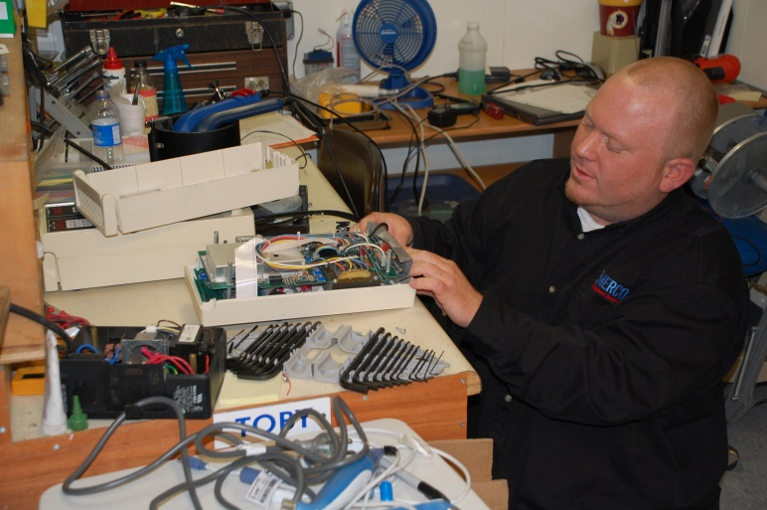
Domain 3: Maintenance Awareness
Foundations of Manufacturing
Section 5: Maintenance Safety
Notes:
READ TO STUDENTS:
This section is intended to point out some of the safety concerns that effect maintenance workers. It is not a complete safety module and may review some of the safety information contained in Domain 1 Safety awareness.

Slide 2
Learning Objectives
Understand the safety precautions that must be observed when working with and around hand and power tools
Identify Special Hazards encountered by Maintenance personnel.
Discuss safety practices as related to equipment maintenance tasks.
Review the requirements to work on energized equipment

Slide 3

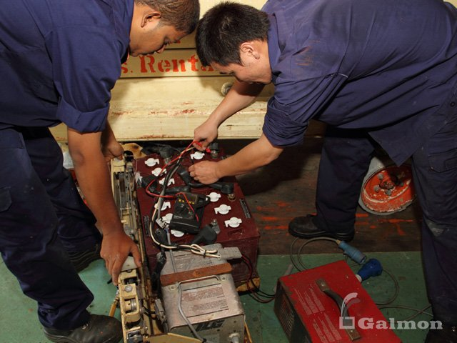
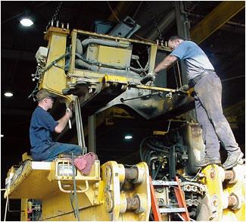
QUESTION
Maintenance workers are exposed to Hazards beyond that of regular production workers.
Can you name some of those hazards and the tools to mitigate those risk?
Notes:
Possible answers:
Guards Removed – interlocks, LOTO
Exposed electric conductors – insulated tools, PPE
Falling Objects – hard hats, LOTO
Chemical Exposure – MSDS
Hot or Cold objects - gloves, PPE
Power Tools – Grounded connections

Slide 4
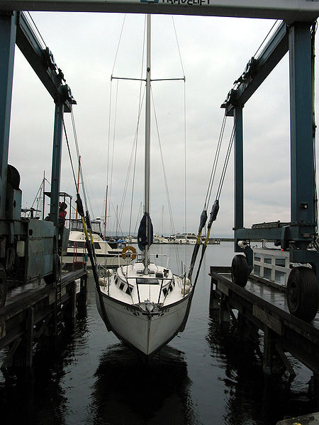
Lifting
See any hazards here?
Notes:
Sling capacity
Sling angle
Center of gravity
Unknown boat weight – (is it full of water?)

Slide 5
Lifting
Manually handling materials
  When lifting objects, lift with your legs, keep your back straight, do not twist, and use handling aids
Using cranes, forklifts, and slings to move materials
  Watch for potential struck by and crushed by dangers
  For slings, check their load capacity, inspect them, and remove them from service when they display signs of stress or wear
Also
  Keep work areas free from debris and materials
  Store materials safely to avoid struck by/crushed by hazards

Slide 6
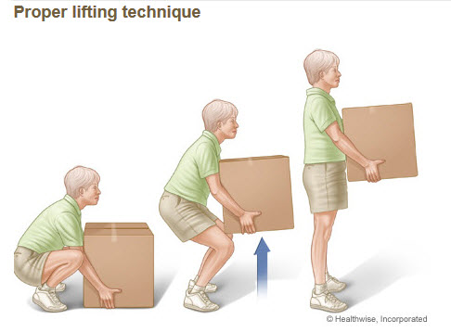
Proper Lifting Technique to Avoid Injuries
Eyes forward and not facing down
Knees slightly wider than shoulder width, feet close to object
Point toes outward at 45 degrees
Bend at knees, going down to grasp object
Look upward while pressing up with thigh muscles; back straight, shoulders back, stomach tight
With object lifted, keep back straight, avoid twisting, move with small steps
Reverse procedure to lower object

Slide 7
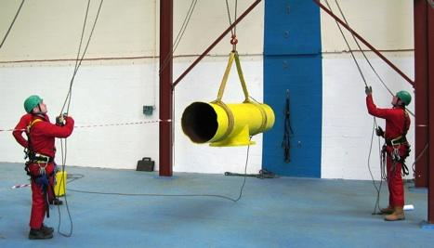
Safe Lifting Practices
Size, Weight and Center of Gravity
Number of Legs and Angles with the Horizontal
Rated Capacity of the Sling
History of Care and Usage of the Sling

Slide 8



Three Hitches
Vertical
  Least capacity
Choker
Basket
  Most capacity
Notes:
Straight: A sling is used to link a lifting hook to its load. The entire lifting capacity of the sling may be used, but cannot be surpassed. To keep the load from rotating, a tagline is used. When a spreader bar or more than one leg is used, the entire assembly must be balanced equally among the slings.
Choker
Choker: A hitch whereby the sling wraps around or "chokes" a load. The diameter of the load is critical in determining the capacity of this hitch. Choker hitches have reduced capacity compared to straight or basket-type hitches. The "choke" must be tight and secure prior to the lift.
Basket
Basket: A "cradle" -style hitch where the fittings or eyes are attached to the lifting device such as a crane hook. The effect is to increase capacity from a straight lift and provide greater load bearing and stability to a lift.

Slide 9

NEVERS
…allow more than one control person
…raise load more than necessary
…leave load suspended in the air
…work under a suspended load
Attempt to lift a load greater than
the rating of the hoist
Allow an untrained person to operate a crane

Slide 10
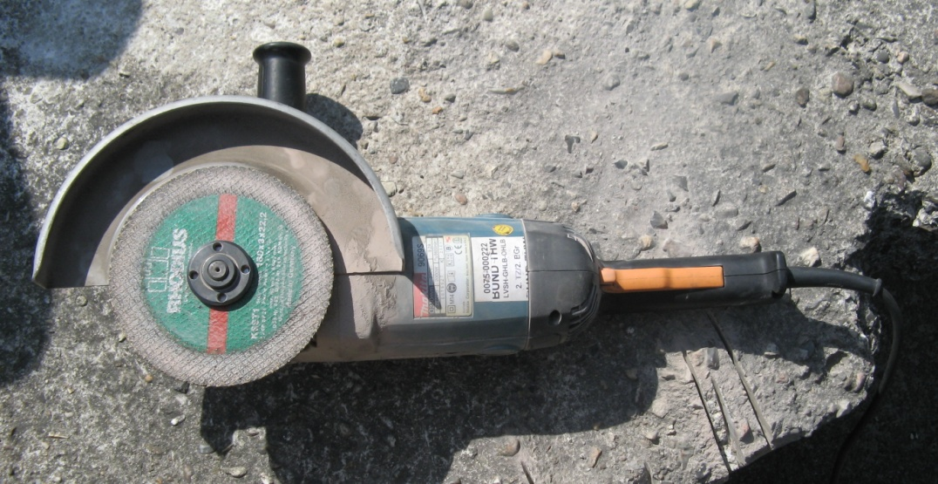
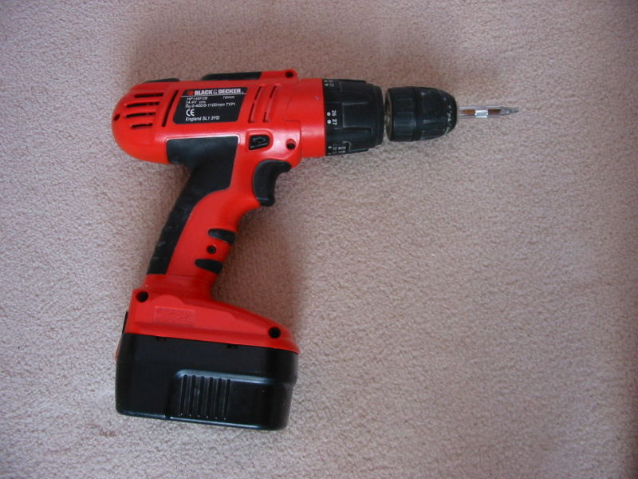
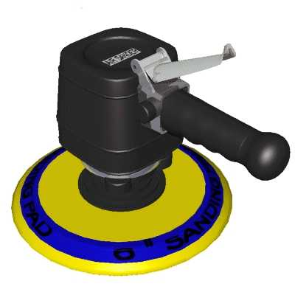
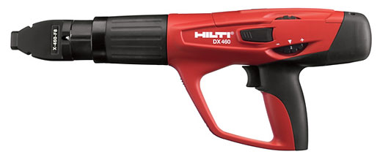
Power Tools

Slide 11
Five Basic Rules for Hand and
Power Tool Safety
Regularly maintain all tools.
Use the right tool for the job.
Examine each tool before use for damage.
Operate tools according to manufacturer instructions.
Proper personal protective equipment must be used.
Notes:
If the worker does not have the proper PPE, DO NOT work with power tools until PPE is obtained

Slide 12

Power Tool Precautions
Never carry a tool by the cord.
Never pull the cord to unplug it.
Keep cords out of water.
Disconnect tools when changing attachments or when not in use.
Keep tools properly maintained.
Do not wear loose clothing or jewelry.
Notes:
Question: What are the hazards of working with a tool that has loose wires?
Answer: Electric shock or fire.

Slide 13
Electrically Powered Tool Safety
Use PPE as required.
Operate within design limitations.
Do not use in wet or damp locations.
Do not use around combustible materials.
Work areas should be well lit.
When not in use, store tools in a dry location.

Slide 14
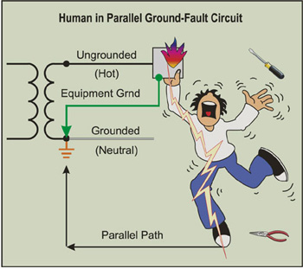
Grounding
The most common cause of electrical shock is IMPROPER GROUNDING
Notes:
Parallel ground circuit is shown
Current will follow the path of least resistance – equipment ground

Slide 15
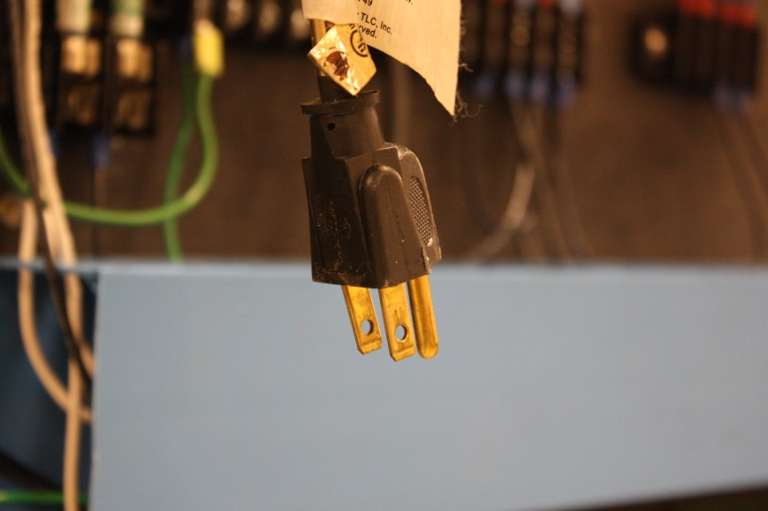
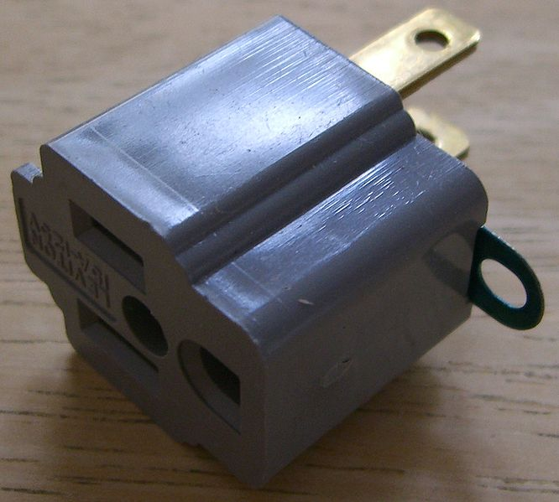
Three-Prong Plug
Common method of providing path to ground
Do not alter plug
Three-two prong adapters must have ground wire connected
If you find the ground prong broken off – remove the cord from service

Slide 16
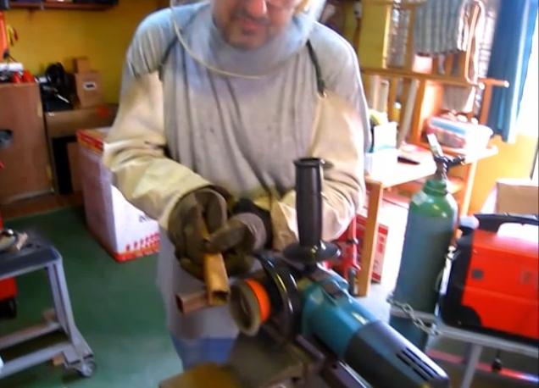
Powered Abrasive Wheel Tools
Always use eye protection. If your face shield is missing do not work without one.
Use both hands to hold the tool.
Make sure you have firm footing.
Make sure all guards are in place.
Never clamp a handheld
tool in a vise.
Disconnect the electric source when changing wheels.
Notes:
Question: What are the safety hazards associated with placing a hand held grinder in a vise?
Answer: The grinder will vibrate the vise and fall out. A person’s natural instinct is to try to catch it, which will result in cuts and abrasions or worse.

Slide 17
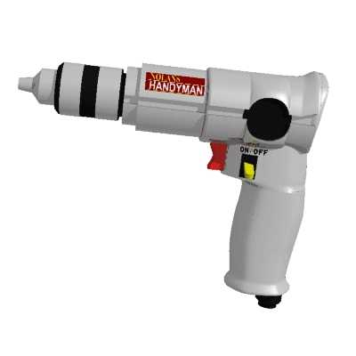
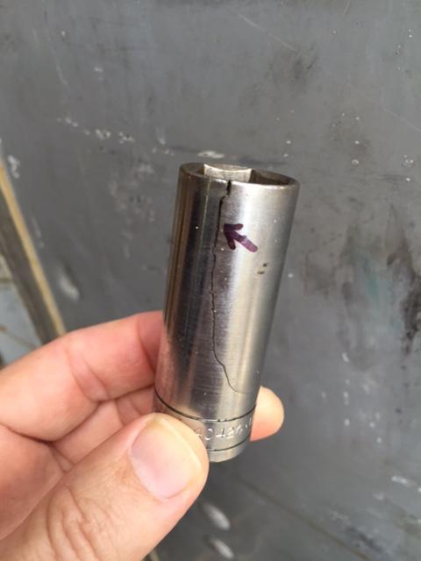

Pneumatic Tool Safety
Wear hearing protection.
Keep your body balanced.
Keep body parts away from working end.
Stay clear of whipping air hoses.
Only use accessories made
for pneumatic tools.
Impact wrenches use only
impact sockets.
Notes:
Question: What dangers exist when using pneumatic tools?
Answer: Air supply hoses can come loose and whip back and forth, which may cause injury to the user or a bystander.

Slide 18
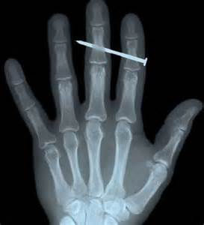
Powder-Actuated Tool Safety
Wear appropriate PPE
Inspect tool before each use
Only operated by trained personnel
Load the tool only when it is going to be used.
Keep hands clear of the barrel end.

Slide 19

Powder-Actuated Tool Safety (Cont'd.)
Never try to pry a cartridge from a powder-actuated tool.
Never hold your hand behind the material you are fastening.
Do not use in an explosive or flammable atmosphere.
Keep all body parts and co-workers away from the path of fire to avoid serious injury.
Keep the tool properly oiled.

Slide 20


Your Right to…
Employers must have a written, complete hazard communication program that includes information on:
  Container labeling,
  Safety Data Sheets (SDSs), and
  Worker training. The training must include the physical and health hazards of the chemicals and how workers can protect themselves; including specific procedures the employer has implemented to protect workers, such as work practices, emergency procedures, and personal protective equipment.
Notes:
Refer to Handout #3: SDS Example for student. Use Appendix A: SDS Explanation if needed.
NOTE: Safety Data Sheet: The Hazard Communication Standard (HCS) requires chemical manufacturers, distributors, or importers to provide Safety Data Sheets (SDSs) (formerly known as Material Safety Data Sheets or MSDSs) to communicate the hazards of hazardous chemical products. As of June 1, 2015, the HCS will require new SDSs to be in a uniform format.
Sum up the exercise by emphasizing that the SDS provides important information to workers about hazardous chemicals in the workplace.

Slide 21
What is a SDS (Safety Data Sheet)?
Document that contains information about a chemical product, specifically:
  Potential hazards
  Safe use of the chemical
Additional information in the SDS includes:
  Use, storage, handling, and emergency procedures related to the chemical’s hazards
The supplier of the chemical prepares the SDS

Slide 22
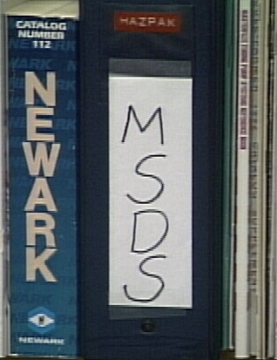
SDS Purpose
Identifies the hazardous ingredients
Describes physical and
health hazards
Discusses procedures and
equipment that enable you
to work safely with the chemical

Slide 23

Chemical Safety
Before Handling oil and grease, maintenance workers should refer to the SDS for information on:
  Health Hazard
  Handling Procedures
  Safety Precautions

Slide 24
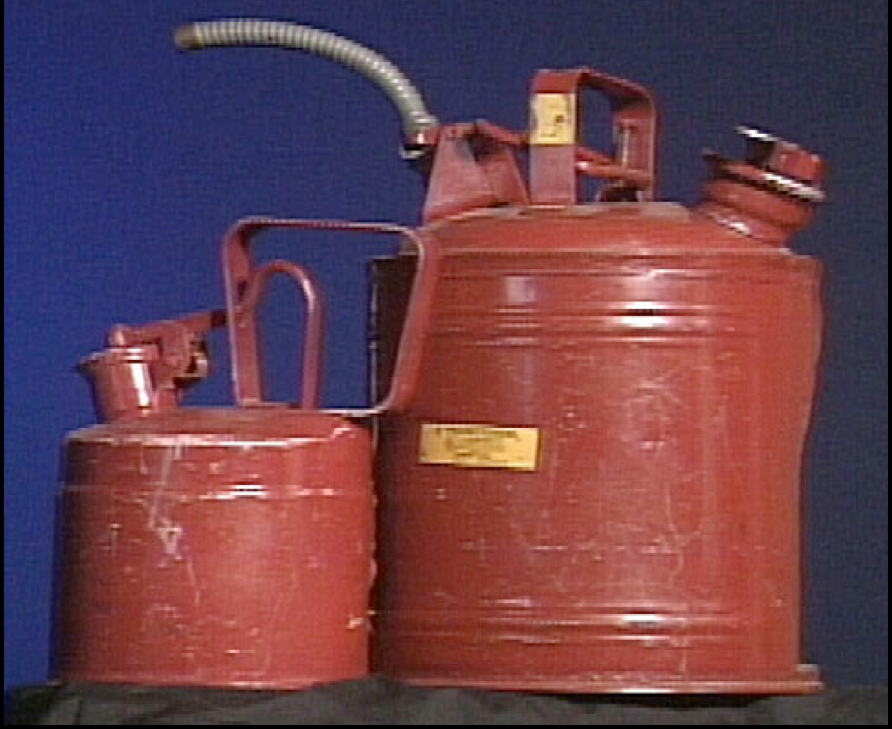
Flammable Liquids
Common flammable liquids include:
Isopropyl alcohol (rubbing alcohol)
Propane (including propane used for cooking/grilling)
Acetone (commonly included in cleaning)
Methyl ethyl ketone (MEK or butanone)
Paint thinner
Gasoline and kerosene
Aerosol cans (spray paint, pressurized cleaners, dusting spray, etc.)
Many of these common flammable liquids are used in maintenance tasks.
‹#›/46

Slide 25

Combustible Liquids
Common combustible liquids include:
Oils
Greases
Lubricants
Oil-based paints
‹#›/46

Slide 26
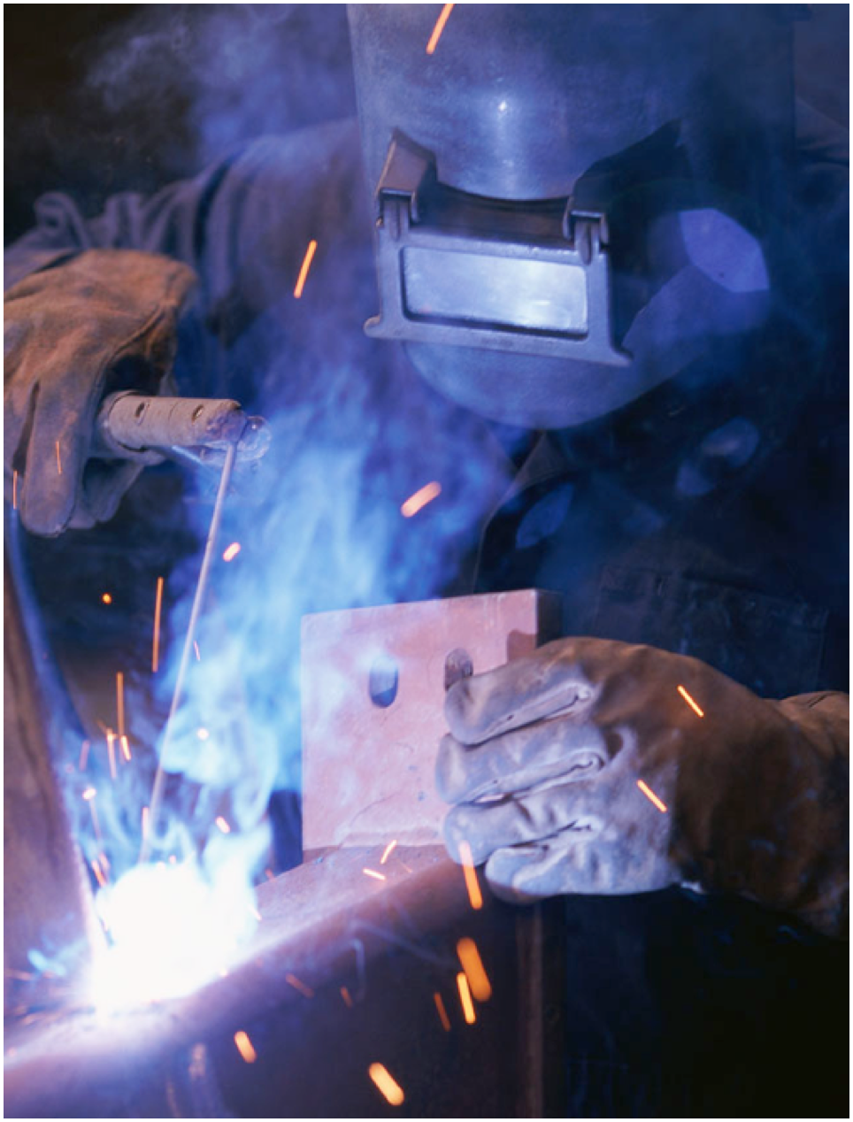
Sources of Ignition
Common sources of ignition include:
Lit cigarettes
Welding and cutting
Static electricity
Sparks from machinery or combustion engines
Hot equipment
Electrical equipment
NEVER smoke around flammable or combustible materials.
‹#›/46

Slide 27
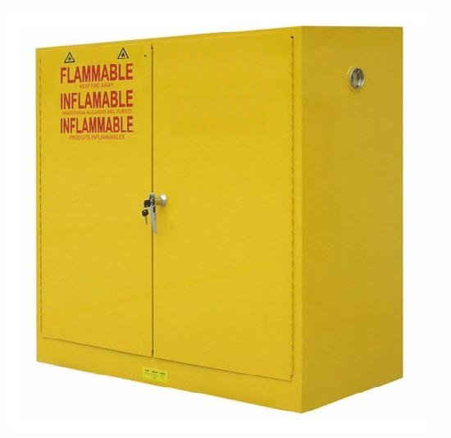
Paint Storage
Paint cans should be stored in sealed containers and inside a metal cabinet
  Follow OSHA guidelines for storage of flammables and combustibles liquids
‹#›/46

Slide 28
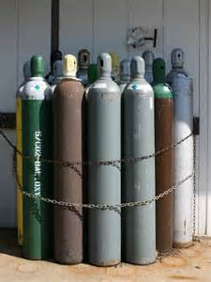
Compressed Gases
Includes oxygen and acetylene
Must be stored upright
Must be capped
Must be chained in approved racks
Must be at least 20 feet or a solid barrier between stored oxygen and stored acetylene containers
Must be stored in well ventilated area away from heat sources
‹#›/46

Slide 29
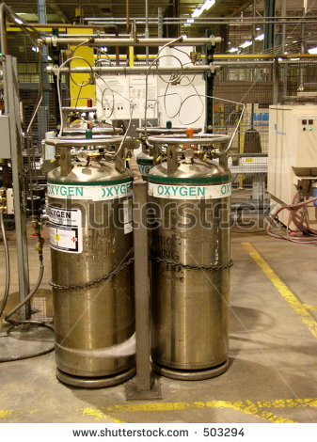
Material Storage
Oxygen Cylinders should be kept 25 ft. away from points of combustion
‹#›/46
Notes:
Recommended practice

Slide 30
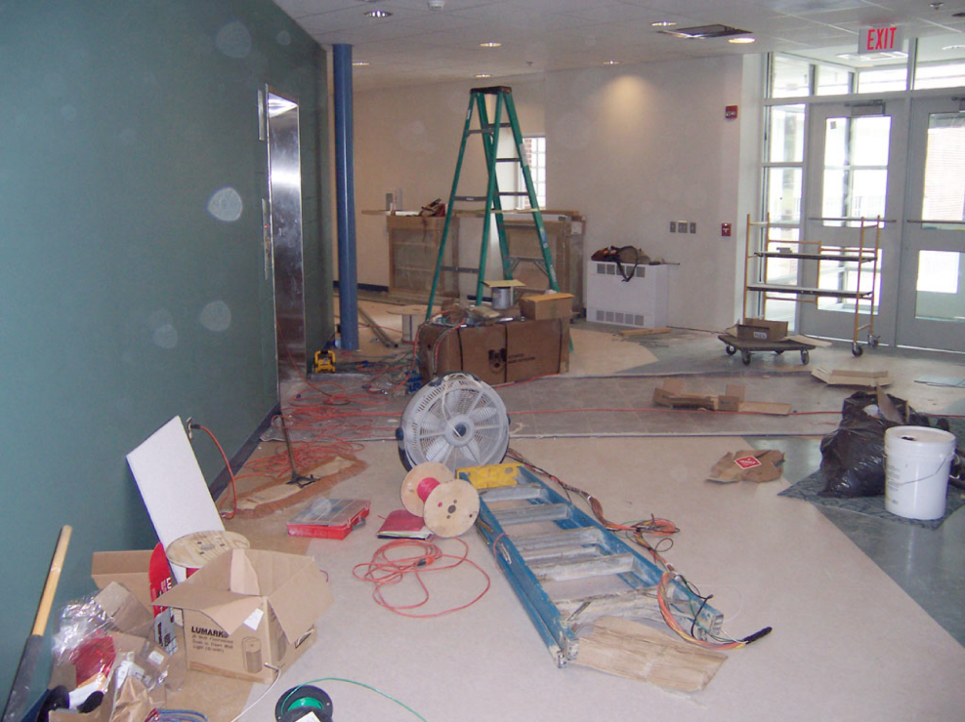
Housekeeping – Potential Hazards
First impressions?
‹#›/46
Notes:
Emergency exit
Trip hazards
Door blocked
No clear pathway

Slide 31
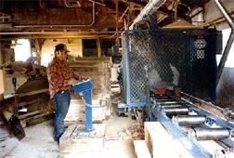
General Requirements
Housekeeping
Workplaces must be kept clean, orderly, and sanitary
Workroom floors must be maintained as clean and dry as possible
Report spots on the floor that appear to be hazardous chemicals to your supervisor – Hazard Response Teams may need to be called in to clean up
‹#›/46
Notes:
Some of the most frequently cited violations in Subpart D involve housekeeping [1910.22(a)].
Drainage must be maintained and gratings, mats or raised platforms must be provided where wet processes are used.
Every floor, working place and passageway must be kept free from protruding nails, splinters, holes, or loose boards to facilitate cleaning.

Slide 32
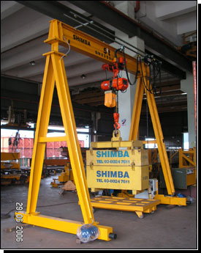
Trip Hazards
Obstructions in walkways
Damaged or uneven
floor surfaces
No Electrical cords or air hoses on Workstation Floors
Running
Poor lighting
‹#›/46

Slide 33

Unsafe Conditions are Identified and Reported Promptly
Inspections are a powerful tool for maintaining quality and process control as well as housekeeping.
Inspections are one of the best ways to identify potentially fatal or harmful situations. Once these hazards have been identified, they can be properly addressed. It is essential inspections take place regularly.
‹#›/46

Slide 34

Inspection Process
Inspections help:
  Maintain a safe work environment
Control unsafe acts and conditions
Ensure operational efficiency
Maintain proper housekeeping
‹#›/46

Slide 35
What Is Inspected?
The entire workplace should be inspected regularly, including the interior and exterior work environment. Inspections should take place at regular, planned intervals and should be done in a uniform manner (e.g., using an inspection form).
“Workplace” means all buildings and structures must be inspected. If you have a building that you break down into several different inspections, all the different inspections must be completed to receive credit for that inspection.
‹#›/46

Slide 36
Inspections
Types of inspections include:
Formal
Daily
Weekly
Special Function
Formal inspections are those that are scheduled in advance.
Daily, all employees are required to conduct informal visual inspections of their work areas prior to beginning operations.
Special function inspections are conducted after accidents and upon the introduction of new equipment or new procedures.
‹#›/46

Slide 37

Inspection Checklist
An inspection checklist should be tailored to your operation.
However, a checklist should, at minimum, include the following:
Building safety
Office safety
Fire safety
Electrical safety
Emergency equipment
Storage methods
If you have specialized areas that are hazardous and/or high risk, add them to your checklist.
‹#›/46

Slide 38

What to Look For
Equipment operation and maintenance practices
Unsafe conditions (Floor clean and free of debris)
Unsafe acts (practices)
Ensure that safety guards or safety devices on machines, equipment, etc., are not removed or modified in any way.
Unsafe conditions include slip, trip and fall hazards, electrical hazards, or any condition that can cause injury.
When conducting your inspections, observe employees performing their job tasks.
‹#›/46

Slide 39
Who Can Conduct Inspections?
Employees
Supervisors
Safety Coordinators
Management
Safety Committee members
Outside vendors/insurance companies
Housekeeping inspections and audits should include unbiased auditors or inspectors.
Daily, all employees should make a visual inspection of their workplace prior to beginning work.
‹#›/46

Slide 40
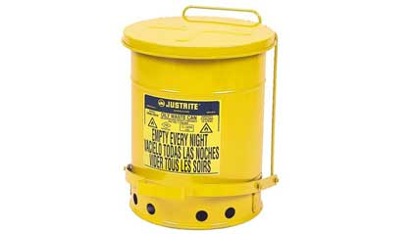
Hazardous Waste
All solvent waste, oily rags, and flammable liquids shall be kept in fire resistant covered containers until removed from worksite.
‹#›/46

Slide 41
LOTO Shift Change
OSHA requires that the continuity of LOTO protection between off-going and on-coming employees be maintained
On-coming employees should verify energy states then attach their locks
After the on-coming locks are attached the
off-going employees may remove their locks
‹#›/46

Slide 42

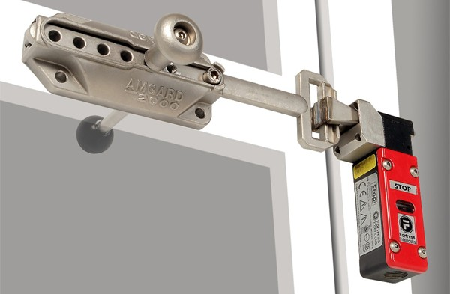
Interlocks
Interlocking is a method of preventing undesired states in a machine, which in a general sense can include any electrical, electronic, or mechanical device or system.
Interlocks also serve as important safety devices in industrial settings, by protecting employees from devices such as robots, presses, and hammers.
‹#›/46
Notes:
Examples of Interlock- two thumb safety switches on paper cutting machines, lever on lawn mower for blade actuation/brake.

Slide 43
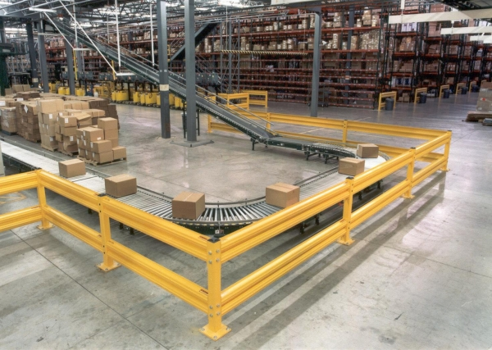
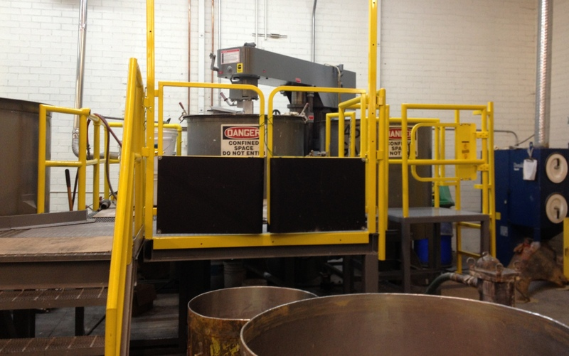
Interlocks (Cont’d.)
To prevent entry during machine operation a machine enclosure may use:
  Safety Zones
  Railings
‹#›/46
Notes:
Examples of Interlock- two thumb safety switches on paper cutting machines, lever on lawn mower for blade actuation/brake.

Slide 44
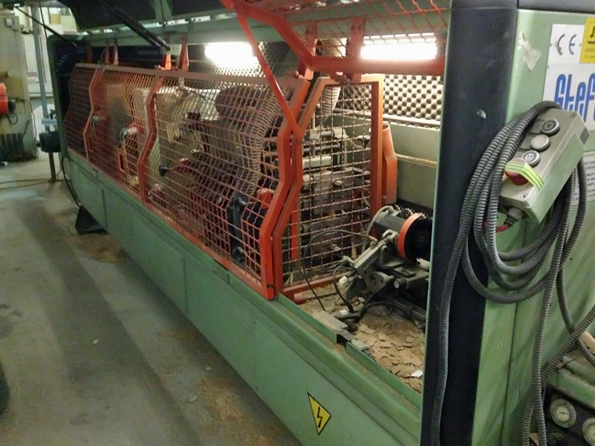
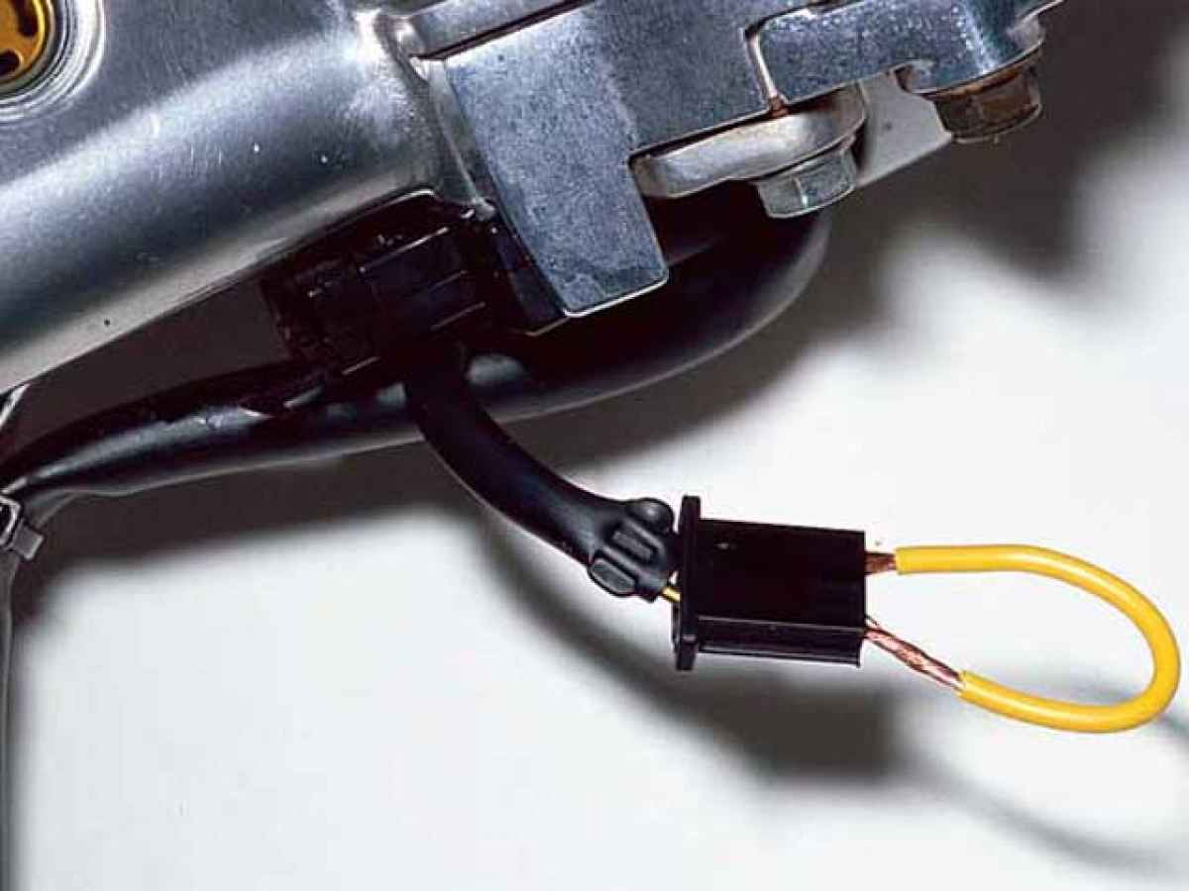
Bypassed Interlocks
Examples
‹#›/46

Slide 45
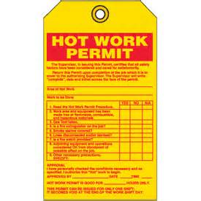
Hot Work Permits
Some maintenance work cannot be performed without machine Power-on, guards removed, or interlocks bypassed
In these cases a risk assessment and Hot Work permit should be obtained
Steps should be taken to minimize employee risk
‹#›/46

Slide 46

Summary
Housekeeping/Inspections
Power Tools
LOTO
Safety Data Sheets
Interlocks
Lifting
Chemical Handling
‹#›/46

