Slide 1


Foundations of Manufacturing
Domain 4: Quality Assurance
Notes:
Read Lesson Link aloud to the students:
In this section, you will begin to understand what elements and values are included in an effective quality management system. While we all have our own perception on what makes a quality product or service, a customer-wide perspective of quality is what determines a manufacturer’s operating strategy. If manufacturers fail to provide the right product and service to their customers, they will go out of business. This quality management system involves everyone in the production process, not just the manufacturing company, but also the suppliers of the raw materials used to make the product. A production technician is responsible for providing quality products and services. In this section, we will examine what elements are included in a quality management system, and the core tasks involved in this system.

Slide 2
Domain 4 Quality Assurance
Table of Contents
Section 1 Introduction to Quality Management
Section 2 Measuring Process Quality
Section 3 Quality Improvement Systems
Section 4 Industrial Print Reading
Section 5 Problem Solving

Slide 3

Foundations of Manufacturing
Domain 4: Quality Assurance
Section1:
Introduction to Quality Management

Slide 4
Learning Objectives
Identify and describe elements of a quality management system used in manufacturing.
Determine the need for continuous quality improvements.
Examine the cost of poor quality.
Examine the use of graphical data.
Notes:
Read Introduction paragraph aloud to the students. As we delve deeper into the “Quality” topic, you’ll see certain terms, phrases, ideas and concepts again and again.

Slide 5

QUESTIONS
What is Quality?
What experiences have you had as a consumer with quality products?
  Have they been good or bad?
Who was responsible for these quality-related experiences?
Notes:
Note: Don’t linger too long on these question. Use them to get participants to begin discussions about “Quality.” More detailed discussions will take place with the next slide.

Slide 6
What Does Quality Mean to You?
Exercise 4-1-1
Total time: 20 minutes
Class size: Entire class
  Divide into teams.
  Write your quality definitions, include examples.
  Discuss examples.
  Present findings.
Notes:
Total time: 20 minutes
Group size: Entire class
Introduction: The purpose of this exercise is for students to explore definitions and examples of quality.
Divide the class into teams of three or four students per team.
Direct students to:
Write their definition of quality on a piece of paper.
Provide examples to illustrate their point.
Instruct students to share their definitions. Write down the main points on the whiteboard or flip chart. At least three students or one person from each group should be given the opportunity to state their results.
Responses will vary. Encourage students to give examples from their personal experience as consumers. Typical responses are:
A product works the first time I use it.
The product does what I want it to do (fitness for use).
The product lasts a long time, is reliable, and worth the money I paid for it.
Discuss student examples. Provide four minutes to provide personal examples and six minutes to discuss these examples with the other team members.

Slide 7
Quality Has Many Meanings
General Theme
  Ability of a product or service to meet customer needs
Webster
  The degree of excellence of a thing
David Garvin, author of Managing Quality: The Strategic and Competitive Edge
  Fitness for intended use
American Society for Quality
  Totality of features and characteristics of a product or service that bears on its ability to satisfy stated or implied needs.
Notes:
Question: Are the experts’ definitions similar to the ones that you just identified and discussed?
Answers will vary.

Slide 8
Quality Categories
User/customer based/focused
  Defined by consumer and focuses on performance, features, or improvements
  Manufacturing based/focused
  Focuses on ensuring that the product conforms to design standards or specifications
  “Making it right the first time”
  Product based/focused
  Following precise and measurable variables in the attribute design of the product
Notes:
Question: Looking at the students’ definitions of quality, can we identify which of the three categories some of them fall into?
Answers will vary.

Slide 9
Quality System
A “quality system” is a systematic method to address concerns and issues. It includes continuous improvement policies and procedures.
A good “Quality System” works in any type of Quality Category.
  Customer Focused – most important measure
  Manufacturing Focused
  Product Focused

Slide 10
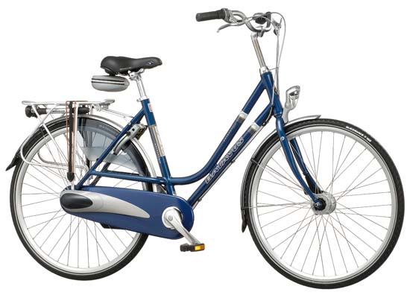


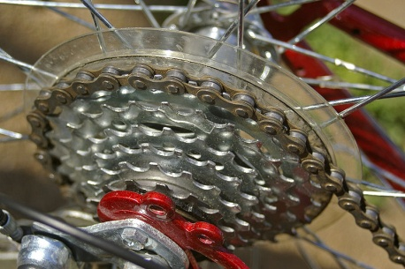
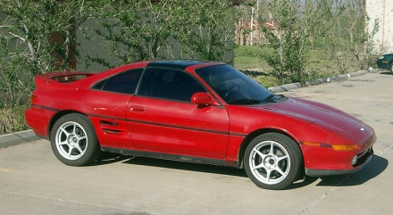
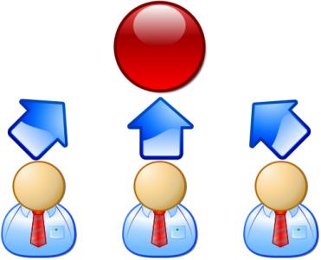

Customer Focus
Quality
(conform, reliable,
performance)
Price
(cost)
Delivery
(dependable)
Flexibility
(design, volume)
Speed
Product Design
(broad, features, performance)
Service
(before and after sale)

Slide 11
Manufacturing Focused
  A product is designed
  A system or process is put in place to make the product
  The company works to make the product as intended.

Slide 12
Product Focused
  A product is designed
  During manufacture, the product is inspected to ensure it is made to specification
  When it is not made to specification, it is called variation

Slide 13
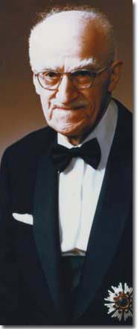
Joseph Juran’s Quality System
Juran was not readily accepted by American companies, but the Japanese readily accepted him. His teachings, along with W. Edwards Deming are the foundation of the Toyota Production System (TPS) and more recently “LEAN” manufacturing, which has been so successful in manufacturing industries.
Quality = Fitness for Use
Quality Trilogy
- Planning
- Control
- Improvement
Photo: Juran Institute
Notes:
Note: This slide helps participants understand the starting point of the quality improvement process. Juran was not readily accepted by American companies, but the Japanese readily accepted him. His teachings, along with W. Edwards Deming are the foundation of the Toyota Production System (TPS) and more recently “LEAN” manufacturing that has been so successful in manufacturing industries.

Slide 14


QUESTION
What is an example of “fitness for use?”
Notes:
Answers will vary, but may include:
A laptop computer works well under normal usage, but it is not intended to be used as a server.

Slide 15

QUESTION
Based on Juran’s Quality Trilogy, what are three elements from your own experiences or our examples?
Everything must have a plan, and we use control or measurements to see if we are meeting the plan.
Everything the production technician does is either control or improvement.
  Control is keeping the status quo.
  Improvement is making things better.

Slide 16
Quality Planning
Determines and defines customer requirements
Incorporates a quality control plan
Identifies quality acceptance criteria and product-related responsibilities
Identifies quality planning tools
Incorporates a process improvement plan

Slide 17

QUESTIONS
Have you ever experienced a product or process and you asked yourself, “What were they thinking?”
Have you ever started a job and were not told how to perform your duties? What happened when you are the customer and you asked a store employee for something they normally do not provide?
Notes:
Answers will vary, but examples include:
A portable drill that is too heavy to hold, which makes it difficult to drill straight (product based issue – poor design)
A picture frame with a hanger on it, but when you hung the on the wall it was crooked? (manufacturing based issue – poor assembly fixture).

Slide 18
Why Quality?
A recent study indicated:
  Twenty cents of every dollar of revenue in manufacturing is lost to poor quality.
  Thirty cents of every revenue dollar in service is lost to poor quality.
  Seventy cents in healthcare
  Government: everyone agrees it’s north of 70%.
  And this 20% (30%, 70% or more) is available to every company without raising prices, or finding new customers. Twenty percent to the bottom line!”
Notes:
Quality Program Sees Value-to-Cost Ratio of 820:1
In a 2012 study, economists Albert N. Link and John T. Scott (of the University of North Carolina and Dartmouth College, respectively) put a value on a well-known quality program. ASQ CEO Paul Borawski discussed the study and the value of quality in his most recent post on the “A View From the Q” blog Jan 16, 2012.

Slide 19
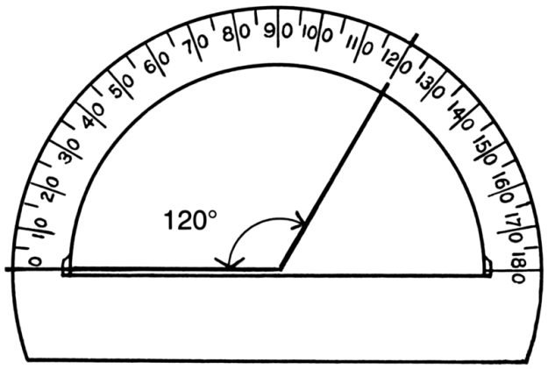
Quality Control
Measure important parts of the product or service.
Determine if measurements meet the standard.
Take action if standards are not met.

Slide 20

QUESTION
What does a manufacturer use to set the standard?
  Standards should be set using the “customer’s requirement.”
Notes:
Direct students to write answers in their Student Workbooks.

Slide 21
Quality Improvement
  Plan
  Do
  Check
  Act
Continuous quality improvement
  Drives customer satisfaction
  Controls costs
  Keeps a business competitive
Originated with Shewhart’s
PDCA Cycle
Deming emphasized building quality
into production, not depending
on mass inspections
Importance of gathering and analyzing production process data
Notes:
Note: The Apple iPod, for example, continues to get smaller while at the same time the memory is increased for storing more music and video. Competitors continue making smaller MP3 players, but the iPod keeps up with the challenge because the manufacturer continuously builds quality into the product.

Slide 22
15 Points for Implementing
Quality Improvements
Consistence of purpose for improvement
Adopt new philosophy
Cease inspection dependency
Move toward single suppliers based on trust
Continuously improve product, process, quality and service
Institute OJT
Empower leadership to do a better job

Slide 23
15 Points for Implementing
Quality Improvements (Cont’d.)
Drive out fear
Break down barriers between departments
Eliminate slogans and workforce targets
Substitute leadership for establishing work standards
Substitute leadership for management by objectives, numbers or goals

Slide 24
15 Points for Implementing
Quality Improvements (Cont’d.)
Remove barriers between workers/ management and right to pride of workmanship
Institute education/self-improvement program
Put everyone in company to work on transformation

Slide 25
QUESTIONS
When customer’s needs change, is quality improvement necessary?
  Yes. Whenever customer’s needs change we must reassess the requirements and make sure the product standards adhere to them.
Why does quality improvement never end?

Slide 26
QUESTIONS
Is quality improvement dependent on data?
  Yes. Good data is the basis upon which you build the quality improvement plan.
How do you gather data?
  Inspection
  Audit

Slide 27


Gathering Data by Inspection
Creating quality by mass inspection is wasteful and expensive
Gathering data at intermediate stages of work-in-process is more efficient
Compare data to standards (metrics)
Less wasteful/expensive to fix a problem early in the process rather than later
Perform final inspection to measure outgoing product quality and capability of the production process

Slide 28
QUESTION
If a production technician finds a problem during inspection, what should he or she do?
  Notify the production technician from the prior operation before proceeding.
  Stop the process and fix it before continuing.
  Adjust or repair the product or process.
  Separate the bad products from the good
  Scrap the bad product.
  Substitute or change returned product for good product.
  Notify the supervisor to determine corrective action

Slide 29
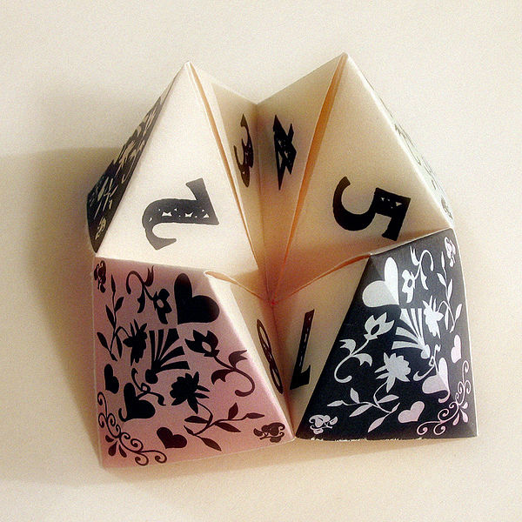
Gathering Data by Audit
A systematic examination of production process
Internal or external
Four phases
  Prepare
  Perform
  Report
  Follow-up

Slide 30

Audits
Internal
Done by own department
  cheap, but results may be biased
External
Done by another department within company
  results may still be biased
Done by someone outside organization (third party)
  more expensive, but probably more accurate picture
Auditors use checklists to obtain uniform inspection results
  same procedures used on all items reviewed

Slide 31
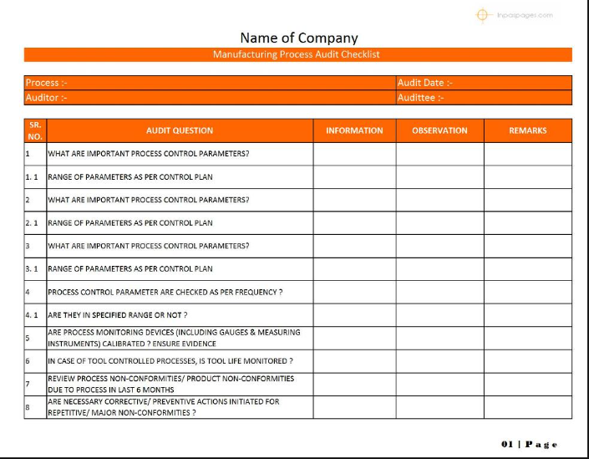
Audit Checklist

Slide 32


QUESTIONS
Why do we do audits?
If corrective action is immediately taken during an audit, should the deficiency still be identified on the audit?
Who has been involved in any kind
of audit?
To ensure that desired processes and procedures are followed
Yes, or the audit will not accurately reflect the findings
Notes:
Answers will vary.
Discuss and classify examples as external or internal audits.
Invite those students who were involved in an audit to share what they learned, if anything. Often, you received confirmation that you are doing things right. At other times, the auditor will find something that needs improvement. Point out to students that this is no different in the manufacturing industry.

Slide 33
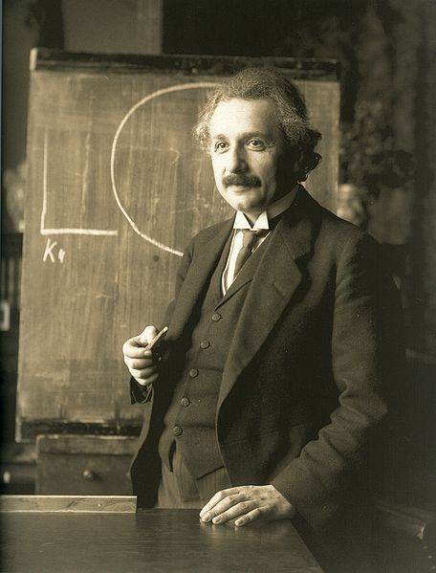
Analyzing Data
Review objectives
Perform data review
Determine statistical tests to use
Verify test assumptions
Draw conclusions

Slide 34
QUESTION
Why is collecting and analyzing data important to quality improvements?
Without data analysis, you do not know if the standards are being met.
When there are problems, you cannot solve them without data to work from.

Slide 35
QUESTION
What is a “nonconforming product?”
Simply put, a “nonconforming product” is a good or service that doesn’t meet the quality standard or customer expectation.

Slide 36
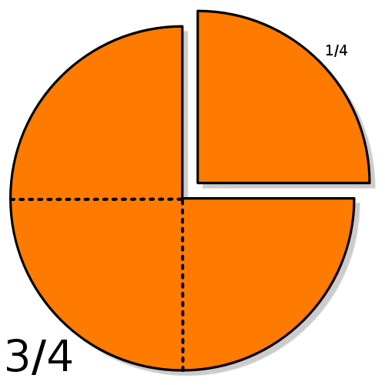
Control of Nonconforming Products
Identify and document nonconforming products
Review and disposition
Re-verification
Post delivery

Slide 37
QUESTIONS
How does your company control nonconforming products?
Does it cost more to package, ship, warranty repair, or just dispose of and replace the product?
What do you do when you find nonconforming products in your home?
What do you do when you have a service company repair something in your house or you take your car in for service?
Notes:
Answers will vary.

Slide 38
QUESTION
Can a non-conforming part be shipped to a customer?
  Only if it does not impact safety or reliability of the product.
  If the part does not meet the customer’s specifications, the customers permission is needed

Slide 39
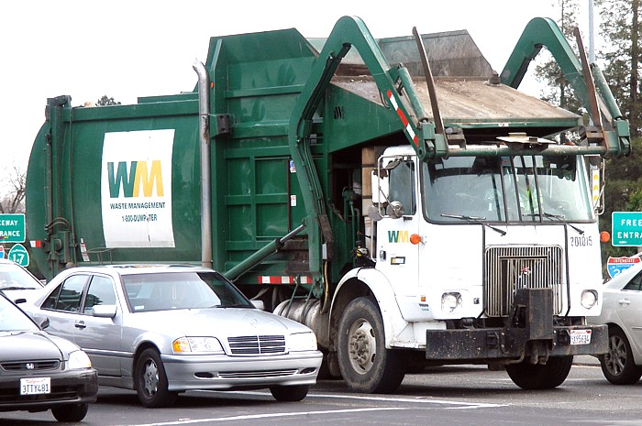
Corrective Action Plans
When a nonconforming product is found:
Investigate the root cause through analysis
Select appropriate action to correct nonconformity
Apply controls to ensure actions taken and are effective
Implement and record changes
Notes:
Question: Have you ever taken your car to a repair shop only to find out that the problem was not fixed? If so, what did you do afterwards?
Answers will vary, but have students consider the effects on their company’s customers after receiving a nonconforming product.

Slide 40
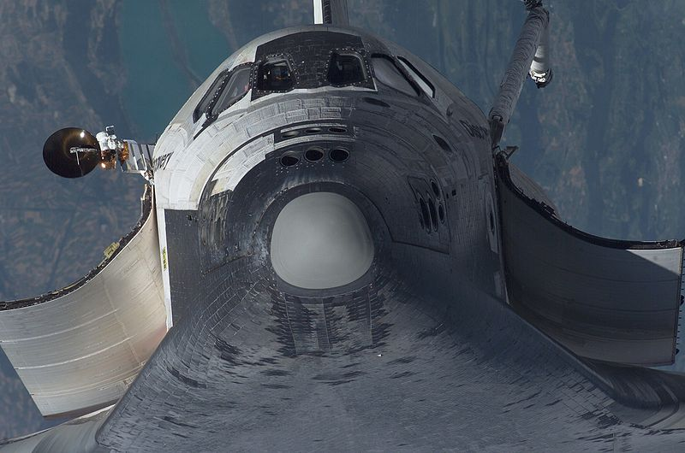
Verification and Testing
After taking action, follow-up is always necessary to ensure that the problem is eliminated
Present correction plan to supervisor
Follow-up with verification and testing

Slide 41
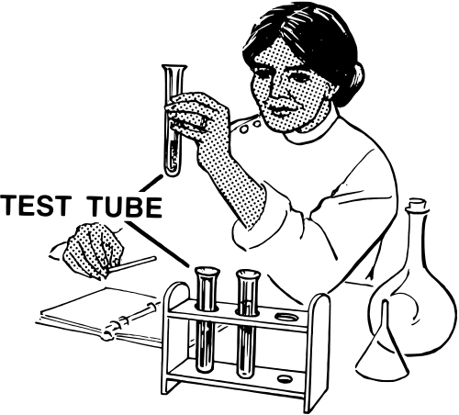
Prevention
Eliminates/prevents reoccurrence of causes of “potential” nonconformities
Take action based on available information
Determine preventive action steps
Incorporate action
Follow-up for effectiveness

Slide 42
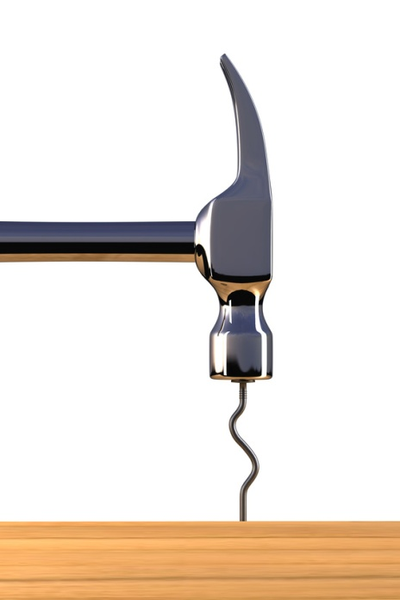
QUESTION
Would you rather keep correcting problems on the production line or periodically work to prevent problems from happening?
A proactive cost to prevent poor quality is better than a reactive cost to correct poor quality
Notes:
Answers will vary.

Slide 43

Cost of Poor Quality
Overtime/Rework
Scrap
Visible Costs
Warranty Work
Excess Inventory
Invisible Costs
Rush Orders
Excess Setup
Excess Documentation
Lost Sales
Handholding

Slide 44

Quality is Free
In the book Quality is Free, Phil Crosby’s response to the quality crisis in American Manufacturing, was the principle of “doing it right the first time.”
  Definition of quality is conformance to standards
  System of quality is prevention
  Performance standard is zero defects
  Measurement of quality is price of
  nonconformance

Slide 45
QUESTIONS
Is it possible to make products more economically if a company does not invest in quality?
What are some examples of costs of poor quality in your company or your own personal experiences?
Notes:
Question 1 answers will vary, but should address the fact that, in the short term, the cost of producing the product might be cheaper, but in the long term, costs will be significant due to warranty claims, scrap, rework, and lost sales.

Slide 46
PDCA Cycle
  Plan
  Do
  Check
  Act
Notes:
Question: Who has used the PDCA Cycle before? Can you describe how you used it?
Answers will vary.

Slide 47
PDCA Cycle (Cont’d.)
PLAN— identify the potential improvement, generate ideas, and plan the solution to a product or process problem. Good place to use a Cause and effect diagram.
DO—implement change slowly
CHECK--trial run of the improvement is performed and summarized. Measurements and frequency determined during planning stage.
ACT--describing the applicable process ownership changes, detailing the plan, outlining steps for continuous improvement

Slide 48
Examples of Data Gathering Tools
That Help Analysis
Check Sheet
Control Chart
Trends
Run Chart
Pareto Chart
Cause and Effect Diagram (Fishbone )
Scatter Diagram
Histogram
Statistical Process Control
Notes:
Note: Data gathering tools need to be used in conjunction with one another. You won’t need to use them all for each quality problem you find, so you’ll need to select the best tools to use.

Slide 49
Check Sheet
Check sheet is used:
  In any stage of the project that involves collecting data
  To collect data with little effort on the part of the data collector
  To convert raw data through data analysis into useful information
  To translate what is allegedly happening into what is actually happening

Slide 50
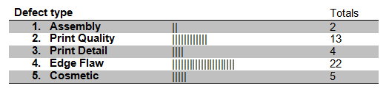
Check Sheet Sample

Slide 51
QUESTION
What aspects of a check sheet might make it a quality tool of choice?
  Versatility
  Ease of use
  Helpful in determining the “real” from the “perceived” problem

Slide 52
Control Chart
Not a “first choice” data analysis tool unless the QC team:
  Can clearly identify the process
  Can identify a process that appears to be out of control and/or
  Has data to support an in-depth investigation of the process that demands control – used to determine process capability
  Analyzes output of work processes
  Provides historical data

Slide 53
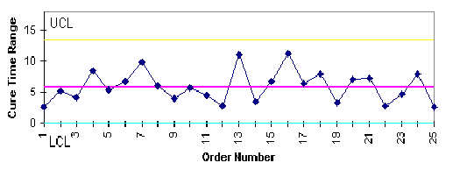
Control Chart Sample
Does this data reflect an “in-control” or “out-of-control” process?
In control
An “in-control” process is a capable process

Slide 54
QUESTION
What is a control chart useful for?
  Distinguishing between common and special causes
  Fine-tuning a process
  Identifying root causes of process variations

Slide 55
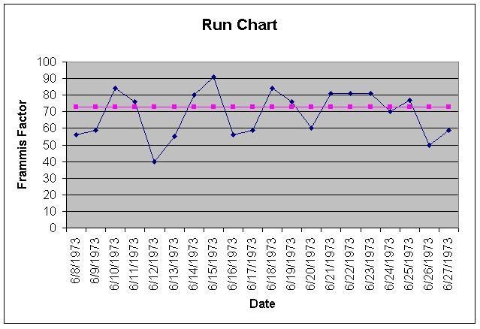
Run Chart
Graphic representation of the changes of a process measurement with respect to time

Slide 56
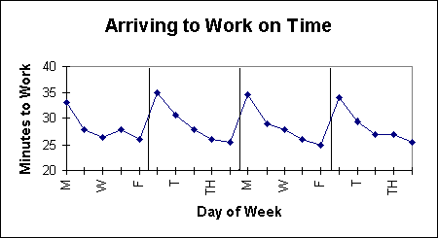
Run Chart Sample
What does this chart tell you?
Notes:
Question: What is a baseline reference in a run chart?
Answer: Time

Slide 57
Pareto Chart
Graphically depicts the separation of “vital few” data from the “trivial many” data.
80% of the trouble comes from 20% of the problems
  Separate select few problems
  Arrange data according to priority
  Determine which problems are most important
  Quickly build team consensus

Slide 58
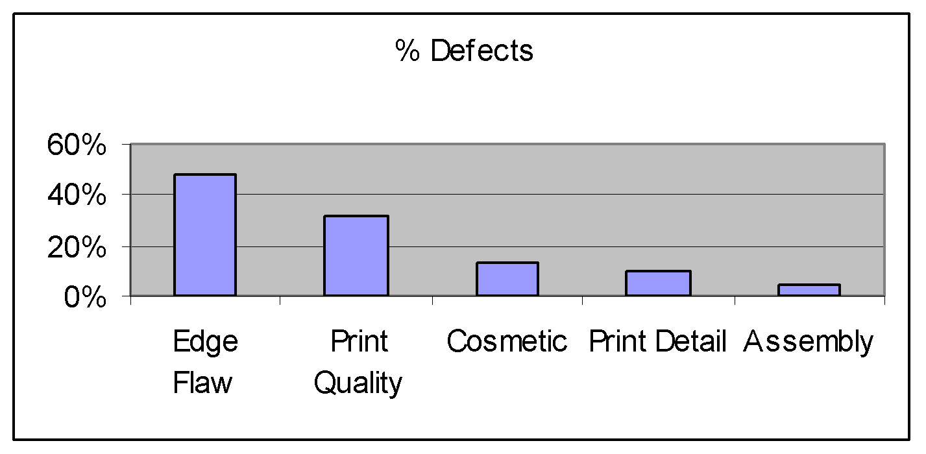
Pareto Chart Sample
Pareto charts reflect that 80% of the trouble
comes from 20% of the causes
Notes:
Question: Based on the data portrayed on the slide, what is the most important problem?
Answer: Edge flaws.

Slide 59
Fishbone Diagram
Graphic representation of the relationship between a given outcome and all of the possible factors affecting the outcome
  Determine factors responsible for a positive or negative outcome
  Focus on a specific process issue without the need for complaints or wasted time
  Identify area under study lacking data

Slide 60
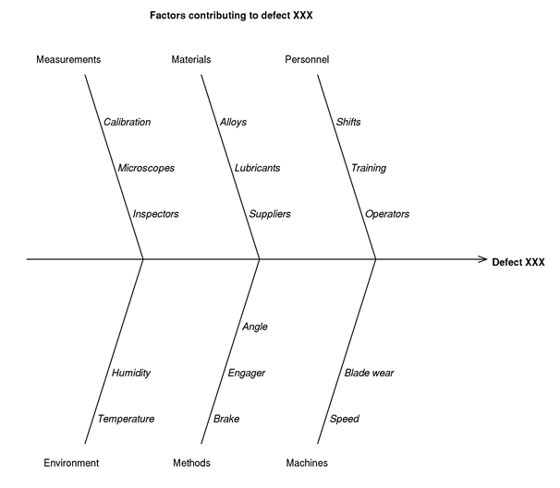
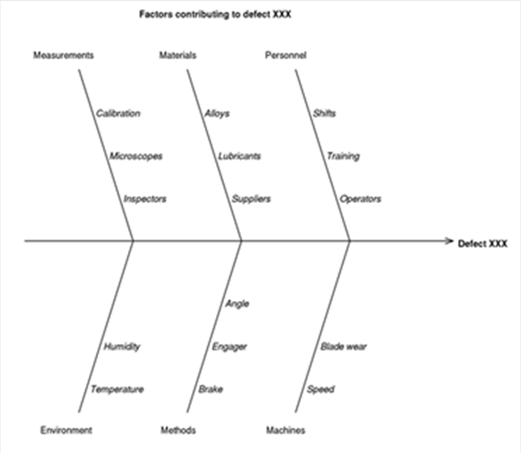
Fishbone Diagram Sample
Notes:
Question: Does a fishbone diagram portray only those factors that contribute to a problem?
Answer: No. It can also depict factors contributing to a desired/positive outcome.

Slide 61
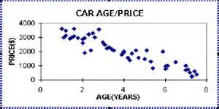
Scatter Diagram
Graphic depiction of the possible relationships between two variables
  X axis represents measurement variables
  Y axis represents measurements of values of the second variable

Slide 62
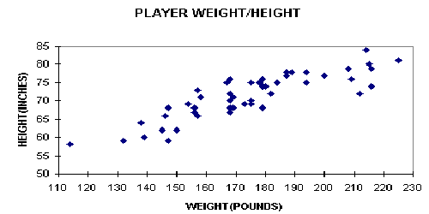
Scatter Diagram Sample
PRODUCT WEIGHT/HEIGHT
HEIGHT (INCHES)
WEIGHT (POUNDS)
Notes:
Question: Does a scatter diagram portray exact problems?
Answer: No, only possible causes of problems.

Slide 63
Histogram
Shows the nature of the distribution of the data as well as central tendency and variability
Used to:
  Present quality improvement data when the amounts of data are small and vary considerably
  Display limits to show what portion of the data does not meet specifications

Slide 64
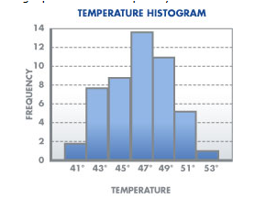
Histogram Sample
Reflects what proportion of collected data falls into each of several specified categories.
This chart reflects normal distribution
Notes:
Question: When would you use a histogram?
Answer:
To present small amounts of data that vary a lot.
To show a portion of data that does not meet specification.
A Histogram with a Bimodal Distribution is an indication of:
Alternating center points
A skewed distribution
Normal distribution
2 distinct data sets – (think bi=2)

Slide 65


Trend
A trend is evident in a set of data when
you look at:
  3 dots
  2 dots
  7 dots
  5 dots

Slide 66
Statistical Process Control (SPC)
Determines process control status
Determines process variation
Identifies reasons for variations
Process variation is normal
Variation produces waste
Variation reduction is beneficial
Variations based on statistics
Notes:
Question: How do you control production processes at your company?
Answers will vary.

Slide 67

Summary
The main theme in this section is to introduce the importance of quality, its costs, its definitions and how systems support a company to meet customer specifications or standards.
The overall meaning of quality was discussed along with tools used to manage a quality system.
Brainstorming, root cause analysis, and cause and effect diagrams are effective problem analysis tools

