Slide 1

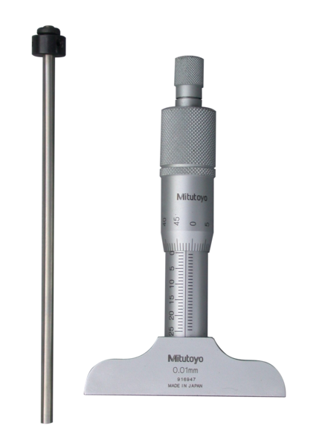
Foundations of Manufacturing
Domain 4: Quality Assurance
Section 2:
Measuring Process
Quality
This is a depth micrometer -----🡪
Notes:
Read Lesson Link aloud to students:
In this section, we will discuss the methods companies use to measure process quality. This is a very broad topic and varies based on the specific needs of each company. It is not the intent of this training to make you an expert on quality measurement. Rather the goal is to help you understand the basics. Many of today’s manufacturing companies use different tools and customize various approaches to suit their product and process needs. The general principles are covered here to introduce and prepare you for what you may experience in a future manufacturing career.
As a production technician, one of your responsibilities is to know how to use the appropriate equipment to measure your process requirements and to control that process so it produces quality products. As this measurement information is gathered, we use charts to summarize and track history, as well as identify further actions and improvements that may be needed. In the previous module, we started calculations and charting, and we discussed some basic SPC principles. We will now examine more closely how technicians collect this data and use these measurements to attain quality.

Slide 2
Introduction to Measuring Process Quality
Learning Objectives
Identify and describe the concepts used to measure the quality of a manufacturing process.
Identify and describe statistical process control (SPC) tools used in manufacturing.
Demonstrate the use of measurement principles and equipment.
Identify and describe mistake-proofing methods.
Notes:
Direct students to turn to page 4-2-1 of their Foundations of Manufacturing, Domain 4: Quality Assurance, Section 2: Quality Measuring Process, Student Workbook and continue with the discussion.
Read Introduction paragraph aloud to students.

Slide 3
Introduction to Statistical Process Control (SPC)
Determines process control status
Determines process variation
Identifies reasons for variations
Process variation is normal
Variation produces waste
Variation reduction is beneficial
Variations based on statistics
Notes:
Note: This is a refresher slide that was seen in the introduction section

Slide 4
Introduction to Statistical Process Control (SPC)
(Cont’d.)
Pareto Chart
Graphically depicts the separation of “vital few” data from the “trivial many” data.
  80% of the trouble comes from 20% of the problems
Helps users to categorize issues into a select few problems
  Graphically identifies which issues are causing most of the problems
  Helps determine which problems are most important and need to be addressed first
  Quickly build team consensus
Notes:
Note: The User must build the proper X/Y axis. Any measurable data could be used. Examples include:
Cost
Downtime
Return rate
Energy usage
Labor hours
Accident rates

Slide 5
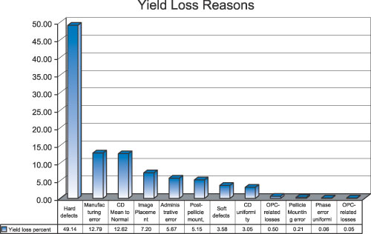
Introduction to Statistical Process Control (SPC) (Cont’d.)
Pareto Chart Uses
  Separate “vital few” data from “trivial many” data (80-20 principle)
  Prioritize data analysis
Pareto Chart Construction
  Brainstorm
  Collect data
  Label chart units and plot data
  Calculate and plot percentage values
  Analyze the small set of problems
Notes:
Question: What is the 80-20 principle, better known as the Pareto Principle?
Answers will vary, but should include:
It is the basis for Pareto charts.
Eighty percent of the trouble comes from twenty percent of the causes.

Slide 6
Introduction to Statistical Process Control (SPC) (Cont’d.)
Run Chart
Graphic representation of the changes of a process measurement with respect to time
Notes:
Note: This was seen in the introduction section.

Slide 7
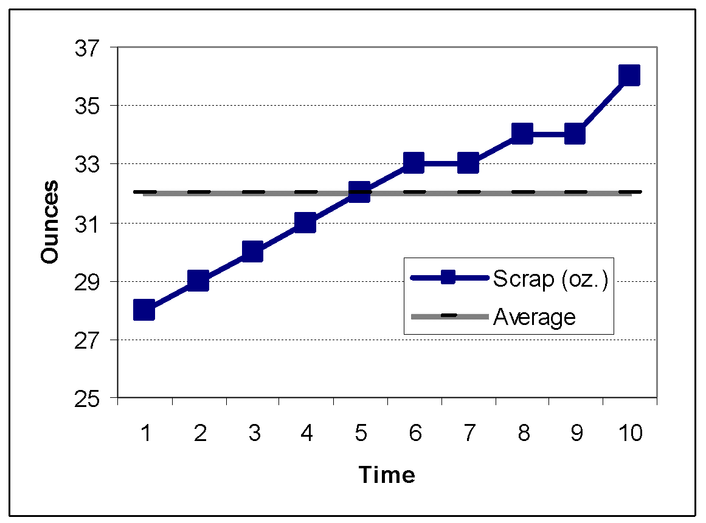
Introduction to Statistical Process Control (SPC) (Cont’d.)
Run Chart Uses
  Determine abnormal patterns/trends in the production process
  Identify special cause variations
Run Chart Construction
  Label “X” and “Y” axis with data and time-period, respectively
  Collect data
  Plot data and draw centerline
  Analyze the data by focusing on patterns/trends
Notes:
Question: Why do we use a run chart?
Answers will vary, but should include:
To determine if there are abnormal patterns/trends in the production process
To identify special cause variations

Slide 8
Run Chart – Exercise 4-2-1
Tool for seeing measurements gathered over a period of time at a glance.
  Displays trends in measurements
Suppose we are studying scrap aluminum in our process (measured in ounces) and log the following results: 28, 29, 30, 31, 32, 33, 33, 34, 34, 36
See Figure 4-2-2 in your Student Guide to review the run chart for this problem.
Discuss any special observations about the process you can make from viewing your chart.
Notes:
Run Chart Exercise 4-2-1
Note: This exercise only appears in the Student Workbook slide presentation.
Introduction: The purpose of this exercise is to determine if a pattern in process variation can be identified by examining data values.
Read aloud to students:
Suppose we are studying how much scrap aluminum our process is generating (measured in ounces) and log the following results:
28, 29, 30, 31, 32, 33, 33, 34, 34, 36
The total of these ten measurements equals 320 ounces. We divide 320 by 10 to get the average, which equals 32 ounces, or 2 pounds.
Instruct students to create a run chart draw the individual measurements as points on a run chart, with the average in the middle.
Note: Allow students to draw this conclusion on their own. They must think of this by applying the principles that lead into control charting.
Refer students to Figure 4-2-2 where they will see that there is a definite pattern or run in the data. The values are constantly increasing, which indicates that a problem exists which is causing an increase in the amount of scrap. Variation should occur randomly around the mean. When the pattern stops being random the process is experiencing problems.

Slide 9
Introduction to Statistical Process Control (SPC) (Cont’d.)
Scatter Diagram
Graphic depiction of the possible relationships between two variables
  X axis represents measurement variables
  Y axis represents measurements of values of the second variable
Notes:
Note: This was seen in the introduction.

Slide 10
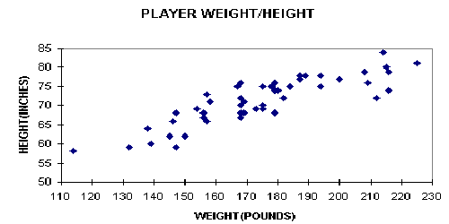
Introduction to Statistical Process Control (SPC) (Cont’d.)
Scatter Diagram Uses
  Determine relationships (positive, negative, none) between variables
Scatter Diagram Construction
  Collect data pairs
  Label “X” and “Y” axis
  Plot data
  Analyze the data by focusing on data pair relationships
PRODUCT HEIGHT/WEIGHT
HEIGHT (INCHES)
WEIGHT (POUNDS)

Slide 11
Introduction to Statistical Process Control (SPC) (Cont’d.)
Histogram
Shows the nature of the distribution of the data as well as central tendency and variability on X & Y axis.
Helpful when viewing the distribution of values in a data set.
Used to:
  Present quality improvement data when the amounts of data are small and vary considerably
  Display limits to show what portion of the data does not meet specifications
Notes:
Note: Histogram was seen in the introduction.

Slide 12
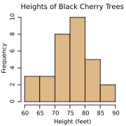
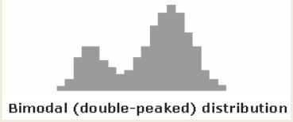
Introduction to Statistical Process Control (SPC) (Cont’d.)
Histogram (BAR CHART) Uses
  Shows distribution/variations/patterns and average of data
  Determines if process is within specification
  Can contain two data sets (bimodal dist)
Histogram Construction
  Identify, collect, and plot the data
  Total the number of points collected
  Label the “X” and Y” axis
  Determine the number of required intervals (see Table 5-2-1 in SW)
  Calculate the dataset range, interval width, and interval starting points
  Total data points in each interval and plot them
  Analyze the data by focusing on data position and diagram width and shape

Slide 13
Introduction to Statistical Process Control (SPC) (Cont’d.)
Control chart
  Primary SPC tool for monitoring and improving process quality
  Compares descriptive statistics to sampled in-control distributions
  Detects unusual process variations – data outside of upper/lower control limits
  Chart variable attribute data
Must have a clearly identified process that appears to be out of control
Does the data to support an in-depth investigation of the process that demands control?

Slide 14
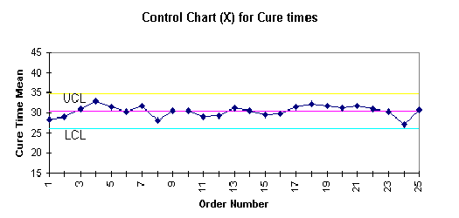
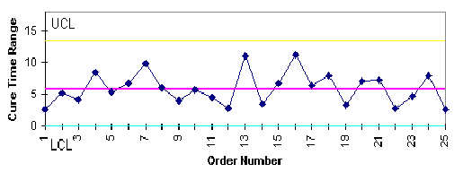
Introduction to Statistical Process Control (SPC) (Cont’d.)
Control Chart Uses
Plot continuous data such as dimension, weight or volume
Control Chart Construction
X-Bar chart: based on data subgroup average
R-chart: based on data subgroup range

Slide 15
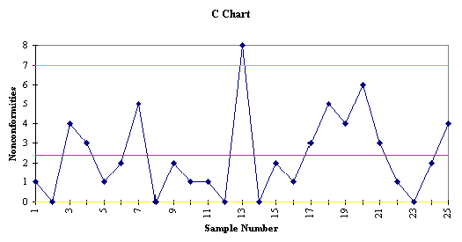
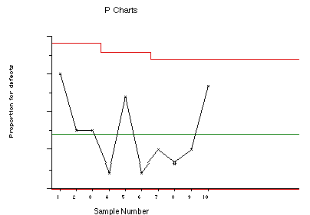
Introduction to Statistical Process Control (SPC) (Cont’d.)
Control Chart
Chart attribute (discrete) data
  Discrete data: good or bad, such as nonfunctioning pump, misaligned control shaft
  C-bar chart depicts actual number of nonconformities
  P-chart similar to X-Bar chart, except p-chart depicts a sample proportion and X-Bar chart depicts the sample average

Slide 16
Introduction to Statistical Process Control (SPC) (Cont’d.)
Control charts can point to the Seven warning signals for special cause variation.
  One or more data points outside control limits
  Seven or more consecutive data points on one side of centerline
  Six or more data points in a row steadily increasing or decreasing
  Fourteen data points alternating up and down
  Two of three consecutive data points in outer third portion of control region
  Fifteen data points in a row within center third of control region
  Eight data points on both sides of CL with none in center third of control region

Slide 17
Measurement Systems
The English System or the Metric System is used for most measurements. It varies depending on:
  The industry
  The location of a company
  The customer location
  Products manufactured
  The production process
Almost everyone BUT the United States uses the metric system
Notes:
Question: What are some examples of good or bad measurement systems you may have experienced?
Answer will vary, but may include the following:
A gage is reliable to 0.001, but the process specification has a tolerance of 0.0005 (bad). The gage cannot accurately measure that process variation tolerance.
FOOTNOTE: Although the UK formally adopted the metric system for use in the mid-1980’s, many systems of measurement are still observed. For example, gasoline (petrol) is sold in liters, while distances between places is measured in miles. Here in North America, both Americans and Canadians use both systems of measurement; we buy gas by the gallon or liter but soda in a 2-liter bottle or a 12-ounce can! Go figure!

Slide 18

Measuring Equipment
Varies by the:
  Units of measure:
    Metric system – 1 mm = .039”
              1 kg = 2.2 lbs
    English system – 1 in = 25.4 mm
              1 lb = .4 kg
  Level of precision or tolerances needed
    Tightness of a range or several decimals
  Applications or characteristics measured
    Variety of needs (i.e. solid, liquid, gas, etc.)
    Company’s needs may be broad and dynamic
Notes:
Question: What are some examples of good or bad measurement systems you may have experienced?
Answer will vary, but may include the following:
A gage is reliable to 0.001, but the process specification has a tolerance of 0.0005 (bad). The gage cannot accurately measure that process variation tolerance.

Slide 19
QUESTIONS
If a box weighs 30 kilograms, what is the weight of the same box in pounds? ________
66 pounds
101.6 mm
How many millimeters are in 4 inches? ________

Slide 20


Rulers
May use metric or English Units
  Metric rulers use larger lines for centimeters and smaller lines for millimeters.
    10 millimeters equals 1 centimeter
  English rulers are trickier and divide an inch into fractions.
    Here is a 1/16th scale in which 1 inch is divided into 16 equally spaced portions.
Photos courtesy of: www.onlineconversion.com/faq_05.htm
Notes:
Question: What is the difference between the English system and metric system?
Answer:
English measures in fractions of an inch.
Metric measures using decimals based on increments of 10.
Project Slide 4-2-20 onto a whiteboard.
Place a mark at several points on the rulers and invite students to read the measurements. If no whiteboard is available, use a pointer in the projection area.

Slide 21
Measure it! Exercise 4-2-2
Using a ruler, measure the height and width of your Student Guide.
Compare your measurements with that of your team mates.
Record your measurements in English and metric units.
Notes:
Ruler Exercise 5-2-2
Distribute rulers to the students and instruct them to measure the height (length) and width of their Student Workbooks using both English and metric units. Discuss any variances between readings.
Question: What happens if the ruler is not aligned properly?
Answers will vary. The measurement will be incorrect.

Slide 22
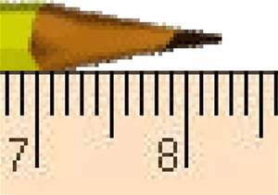
QUESTION
How long is the pencil in the below illustration?
8 5/20”
Notes:
Also known as 8 ¼ IF the scale is in inches.

Slide 23
Tolerances
Since no process is exactly the same every time, (although we like to keep variation very small), each measurements we take will be a little different. This difference can come from:
  The output of the process. For instance, a diameter of a hole that we drilled might be a little larger or smaller than the specification.
  The skill of the person taking the measurement
  The accuracy of the measuring tool
Notes:
Note: Think of tolerances as plus or minus a certain value (which is given in the specifications). If the measurement is outside the limits, a defect may exist.

Slide 24
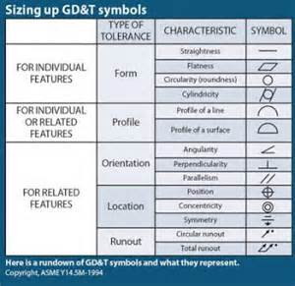
Geometric Dimensioning and Tolerancing (GD&T)
A system for defining and communicating engineering tolerances
  Controls
    form
    profile
    orientation
    location
    run out

Slide 25
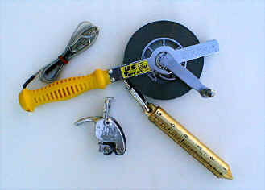
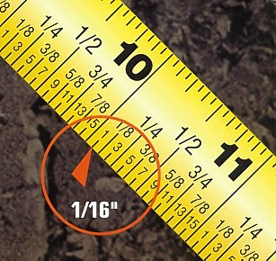
Tape Measures
For larger items
Includes inches and feet (or meter and centimeter if metric)
End hook is intentionally loose
Scale in 1/16 inch increments
Photo courtesy of: www.channelsupplies.com/gauging.htm
Photo courtesy of: www.asktooltalk.com/home/qanda/faq/tools/tapemeasure.htm
Notes:
‹#›
A tape measure blade is marked both in inches and in feet. The end hook always appears to be loose and this is intentional. It's designed to slide a distance equal to its own thickness so both inside and outside measurements will be accurate. The upper scale is in 1/16-inch increments, so it reads 1/16, 1/8, 3/16, 1/4, 5/16, 3/8, 7/16, 1/2, 9/16, 5/8, 11/16, 3/4, 13/16, 7/8, 15/16, and 1-inch. The bottom scale reads in 1/16-inch increments as well, so it reads 1/16, 1/8, 3/16-inch, and so on.
Distribute tape measures to students and allow them sufficient time to become familiar with their function.
Question: Referring to Slide 5-2-20, what measurement on the yellow tape is the red arrow pointing to?
Answer: 10 1/16 of an inch.

Slide 26
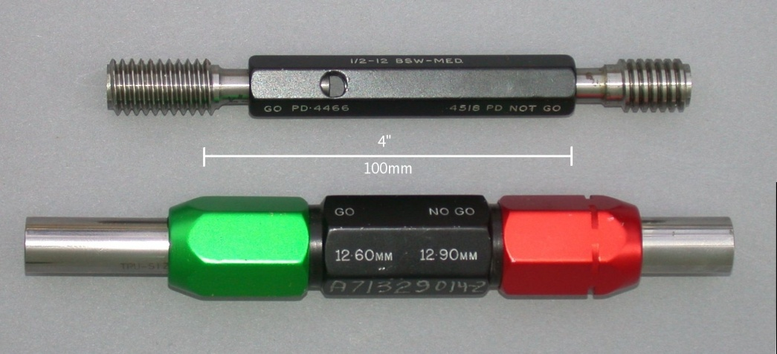
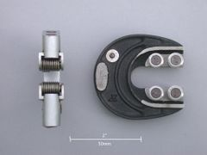
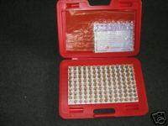
Plug Gages
Also called “go-no-go” gages
Used to evaluate various sizes, shapes and depths of holes (with or without threads)
Gage tolerance allows one side to fit:
(go = upper tolerance) if correct and other side should not fit (no go = lower tolerance)
Thread Plug Gage
Gap Gage
Pin Gage Set
Plug Gage
Photos courtesy of: www.cgi.ebay.com
Notes:
‹#›
A Go NoGo gage (or Go/no go) refers to an inspection tool used to check a workpiece against its allowed tolerances. Its name derives from its use: the gage itself has two tests; the check involves the workpiece's having to pass one test (Go) and 'fail' the other (No Go).
It is an integral part of the quality process that is used in the manufacturing industry to ensure interchangeability of parts between processes, or even between different manufacturers.
A Go NoGo gage is a measuring tool that does not return a size in the conventional sense, but instead returns a state. The state is either acceptable (the part is within tolerance and may be used) or it is unacceptable (and must be rejected).
They are well suited for use in the production area of the factory as they require little skill or interpretation to use effectively and have few, if any, moving parts to be damaged in the often hostile production environment.
These gages are referred to as plug gages; they are used in the manner of a plug. They are generally assembled from standard parts where the gage portion is interchangeable with other gage pieces (obtained from a set of pin type gage blocks) and a body that uses the collet principle to hold the gages firmly. To use this style of gage, one end is inserted into the part first and depending on the result of that test, the other end is tried.
In the right hand image, the top gage is a thread gage that is screwed into the part to be tested, the labeled GO end will enter into the part fully, the NOT GO end should not. The lower image is a plain plug gage used to check the size of a hole, the green end is the GO, red is the NO GO. The tolerance of the part this gage checks is 0.30mm where the lower size of the hole is 12.60mm and the upper size is 12.90mm, every size outside this range is out of tolerance. This may be initially expressed on the parts drawing in a number of styles.
These images illustrate an alternative type of gage. The gap gage has four anvils or jaws, the first one or pair (outermost) are set using the upper limit (tolerance) of the part and the inner set adjusted to the lower limit of the part.
The usage of this gage may be more intuitive than the plug type. A correctly machined part will pass the first set of jaws and stop at the second — end of test. In this manner a part may be checked in one action, unlike the plug gage that needs to be used in the correct sequence and flipped to access the second gage.
The left image is a plain gap gage used to measure outside distances (diameters), the right hand image shows two views.

Slide 27
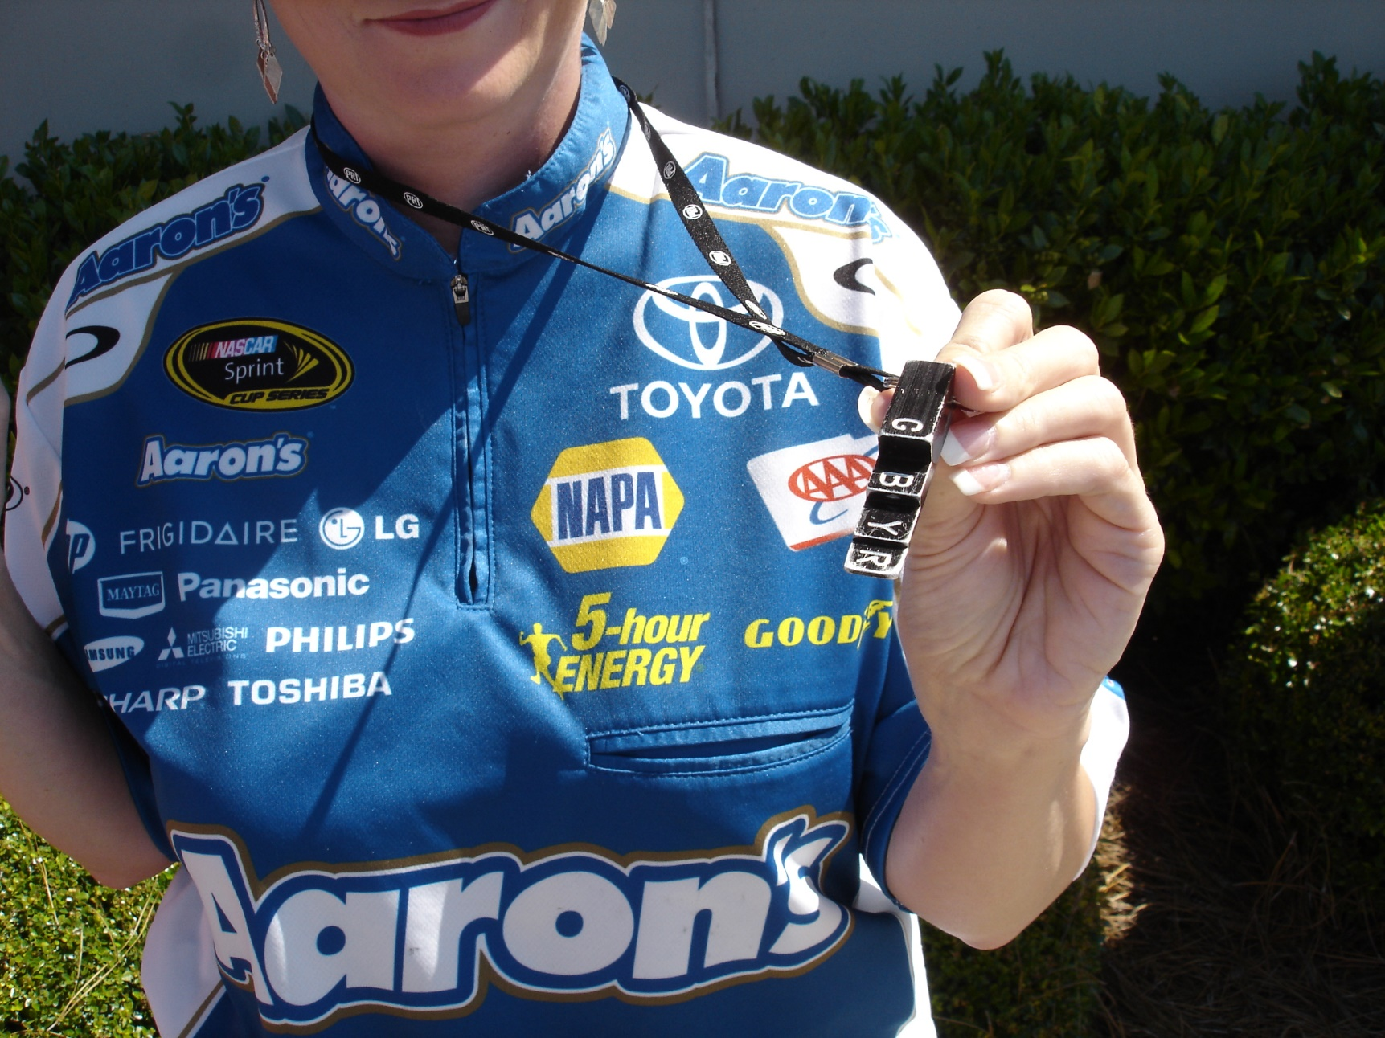
Go-No-Go Gage

Slide 28
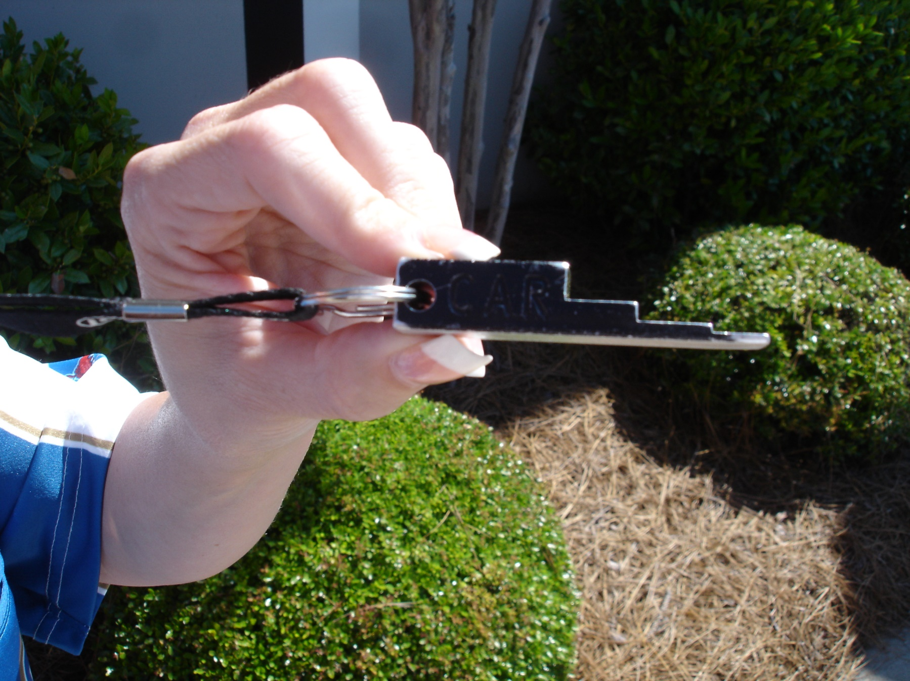
Go-No-Go Gage (Cont’d.)

Slide 29
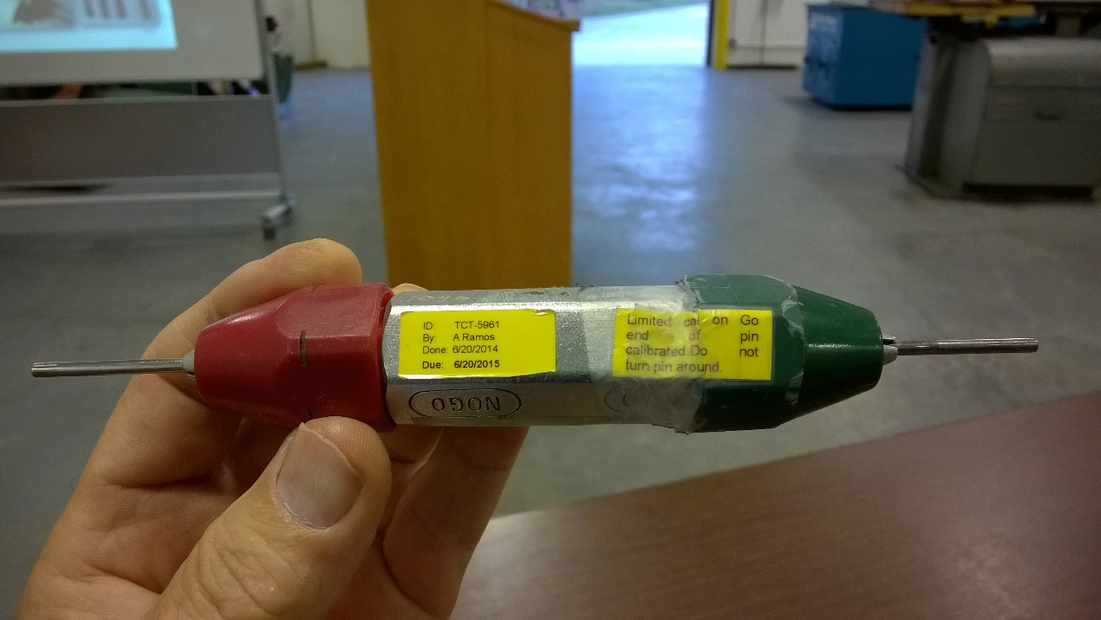
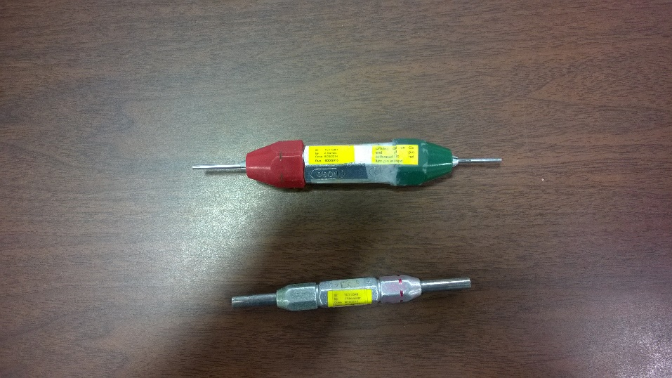
Go-No-Go Gauges (Cont’d.)

Slide 30
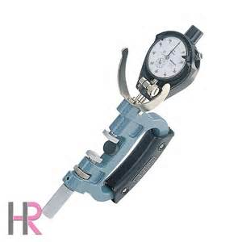
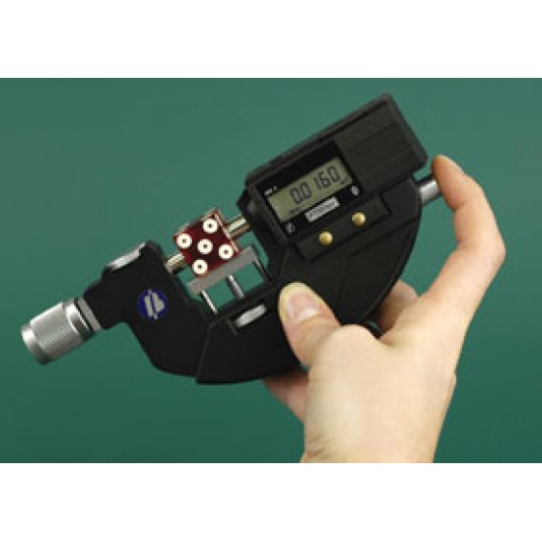
Snap Gauges
Micrometer and snap gauge
Dial indicator and snap gauge
A snap gauge is a form of Go/no go gauge.

Slide 31
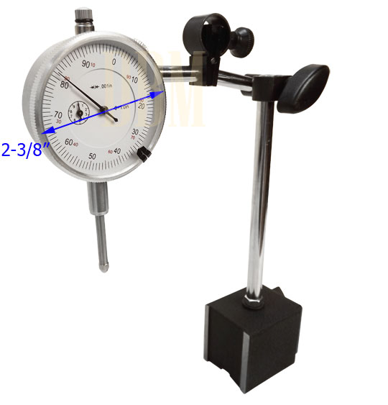
Dial Indicators
An instrument that measures small distances; used especially to check the tolerance of machined parts

Slide 32
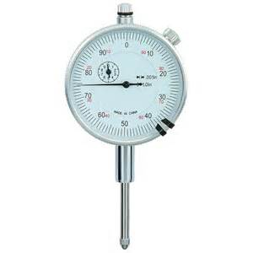
Dial Indicator
This dial indicator is being used on a part that was referenced (zeroed) at 3.20 inches.
What is the actual reading of the part ______
3.274

Slide 33
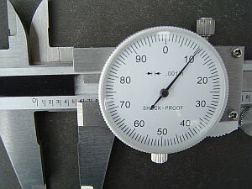
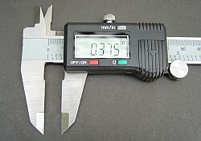
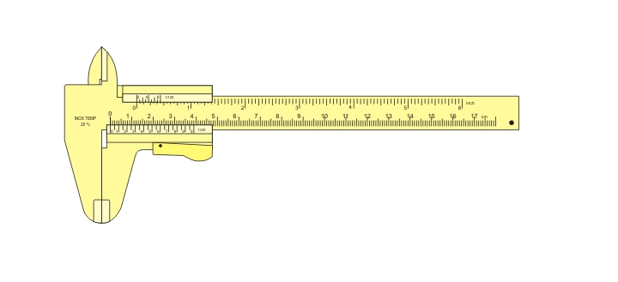
Calipers
Used to measure outside dimensions, inside dimensions, or depths of holes
3 Types
  Vernier (slide),
  dial
  digital models
They can take very small measurements, generally to .001
Created by Joaquim Alves Gaspar
en.wikipedia.org/wiki/Calipers
Photos courtesy of:
www.woodjig.com/Gage%20tips2.htm
Notes:
‹#›
Measuring With Calipers
The bottom scale on both the direct reading and digital (automatic) calipers runs up to 6 inches and is divided into .1 (1/10) inch increments.
The dial on the direct reading calipers is divided into .001 (thousandths) inch units.
To get accurate measurements, numbers from the bottom scale and the dial must be read and added together.
If the caliper does not fall on an exact .1 section, then the dimension will be the lowest complete tenth plus the reading on the dial.
Example: Bottom scale mark is between the .4 and .5, and the dial is pointing to 22. This means the scale line is .400 (4/10) and the dial reading is .022 (22/100). Adding the two readings together equals:
Scale line = .400 inches
+ Dial = .022 inches
Total Dimension = .422 inches
These readings are used for wall thickness, outer dimensions, inner dimensions, and depth.
Sometimes, small holes have pin gages to check much like go-nogo. But they can be useful to measure with calipers also.
We will most often measure outside diameters. One jaw of the caliper is fixed, and the other jaw moves and is connected to the vernier.
Check that the vernier caliper correctly reads zero when the jaws are closed. (if not, check with the lab instructor.)
Close the jaws around the object but do not over tighten. The jaws should exert a firm pressure on the object.
When both locking screws are tightened the caliper can be removed from the object and read without worrying if the jaws will shift position.
You can read the main scale to the nearest tenth of a centimeter.
The vernier consists of 50 divisions, meaning that 0.1 cm is divided into 50 parts and the final least count is 0.1 cm/50 = 0.002 cm = 1/50 mm. Read the vernier as described in the previous section, with a result like 1.4 or 1.6 or 2.0. A reading of 1.6 from the vernier really means 0.016 cm which is added to the main scale reading to give the final diameter of 3.216 cm.
NOTES CONTINUED AFTER NEXT PAGE

Slide 34
Calipers (Cont’d.)
The caliper’s “jaws” are the parts of the tool into which the part being measured is inserted
One jaw is fixed in place
The other moves and is connected to a Vernier, dial, or a digital screen that shows the measurement
Created by Joaquim Alves Gaspar
en.wikipedia.org/wiki/Calipers
Photos courtesy of:
www.woodjig.com/Gage%20tips2.htm
Notes:
‹#›
Ask: Who can point to the “jaws” of these calipers

Slide 35
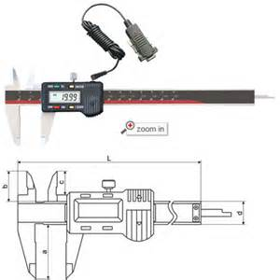
Digital Caliper
Can be hooked to computer for effortless data recording on a spreadsheet
  https://www.youtube.com/watch?v=ZGcYacpZTko&t=10

Slide 36
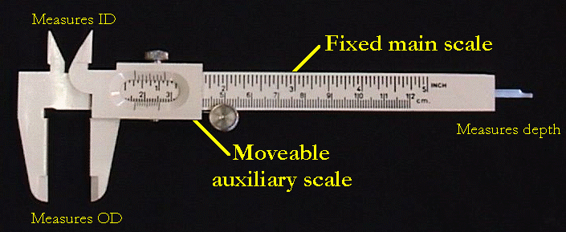
Vernier Caliper
Photo courtesy of Clemson University’s Physics Lab – CUPOL - Instructions
Notes:
Calipers with a dial are much easier to read than the old dial-less slide vernier calipers.
Dial Calipers - read the dial or the scale. They eliminate the eye strain. Always double check a caliper reading!
Vernier calipers with a dial can jump a setting. Even better are digital calipers below.
The above caliper reading is .510 thousandths. Dial vernier calipers should be stored in a dry, humid free location, and
checked often for correct calibration. They can be wiped off with oil, but any
build-up of oil will collect dirt. Also the tips should be checked for wear.
Digital calipers are becoming more popular, probably because they have less
tendency to skip gears. Digital vernier calipers are very accurate and the batteries
last a long time on most brand units. Electronic Digital Calipers - read the digital display.
Plastic is good for artifacts since it reduces the chance of scratching. The plastic type are inexpensive, usually under $10 for vernier and under $30 for dial calipers. Digital calipers can run anywhere from $100 up into the hundreds of dollars. Don't feel like you need them, take a look in Kent Weeks book, "The Lost Tomb". You'll see a picture of Susan Weeks, Artist/ Technical Illustrator on the project using a set of plastic vernier calipers. Save your money!

Slide 37
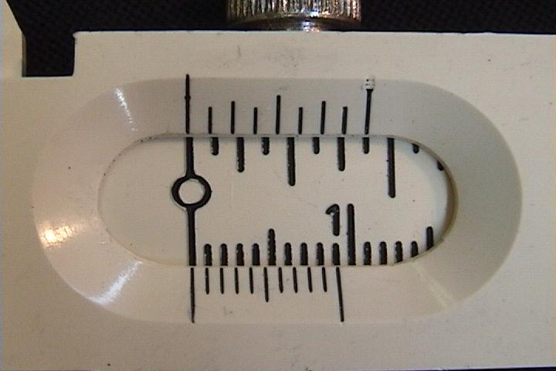
Zeroing a Vernier Caliper
First, zero the Vernier caliper by making sure that the jaws are closed and the first mark on the main scale is aligned with the first mark on the auxiliary scale. (The last mark on the auxiliary scale lines up with the 9mm mark on the main scale. ) The photo below shows a reading of 0 millimeters.
Photo courtesy of Clemson University’s Physics Lab – CUPOL - Instructions

Slide 38
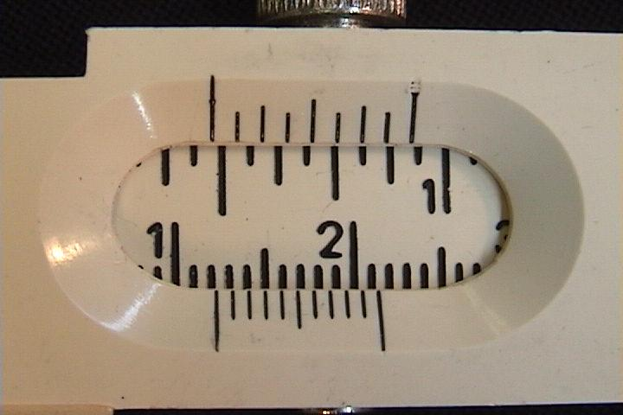
Reading a Vernier Caliper

Slide 39
Reading the Vernier Scale
Digital calipers are popular because the manual Vernier scale can be a bit tricky to read.
Look at the lower (auxiliary) scale. Its first mark lines up between 1.2 and 1.3 (tenths) mm on the main scale. (Think of how you read your watch using the minute hand.)
The next digit in the measurement (hundredths of a millimeter) is determined by finding where the auxiliary scale and the main scale line up the best. Here it is on the third line, so the measurement is 1.23 millimeters.

Slide 40
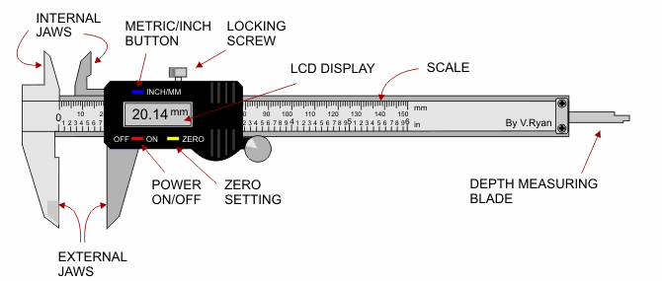
Digital Caliper
Picture courtesy of www.TechnologyStudent.com World Association of Technology Teachers
Notes:
Outer Edges
Take a look at the vernier calipers. See that bump on the bottom edge? That is a grip for your thumb. Slide it back towards the tail end of the calipers and the jaws open as shown on the dial calipers. If you are measuring the outer edge of an object, like, let's say the head of an ushabti figure, you would open the jaws of the calipers and slide them carefully over the head of the ushabti. Read the sliding scales along either top or bottom or read the dial to see the size of the head. Care must be taken to assure that your calipers are straight. Even a slight angle throws off your measurements. Remember this is highly precise work and readings must be taken very, very carefully to assure proper dimension and accurate drawings.
Remember, it takes a lot longer to correct your work and find a mistake than to take the time to do it right the first time!
Inner Edges
Take a look at the top edge of the dial calipers. See those blade like edges sticking out the top? Those are to take measurements of the inside of holes like on the opening of a jar. Put them inside the opening and carefully spread them using the thumb grip. They will widen simultaneously as the jaws open. Be careful that you are taking your reading from the widest diameter (distance across).
Bear in mind that hand made objects will have variance unlike the machine made objects of our time. Take several readings and make notes!
Depth
Now look at the tail end of the dial calipers. See that little thing sticking out the bottom? As you move the thumb grip, simultaneously as the jaws open and the blades spread, that rod will move out the bottom. That is a depth gage which you can put into a vessel and measure its depth. Open the calipers until you hit bottom and take your reading.

Slide 41
Zeroing a Digital Caliper
Take measurements only after the caliper has been zeroed.
Turn on the display via the on/off switch. (There is a battery inside the digital caliper.)
Bring the external jaws together until they touch.
Press the zero button.

Slide 42
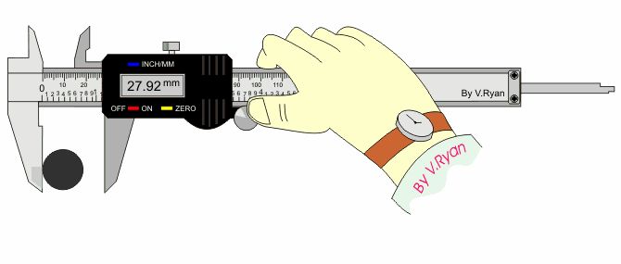
Taking a Digital Measurement
Put the object to be measured between the jaws.
Close the jaws so they are touching the object.
Tighten the locking screw, then read the scale.
Picture courtesy of: www.TechnologyStudent.com : World Association of Technology Teachers
Notes:
Many digital calipers contain digital displays that can be switched between centimeters, millimeters, and inches.
They are
Accurate to within:
0.001 in (0.02 mm.)
Precision of:
0.0005 inches (0.01 mm.)
Digital calipers are commonly made in 6-in., 8-in., and 12-in. versions
The accuracy for longer/bigger measurements declines as the measurements increase.
For example, for 200-300 mm. measurements, the accuracy declines to 0.0015 in. (0.04 mm.)
Many digital calipers contain some type of “reading hold” feature that allows the reader to view the measurement, even in awkward locations where the display cannot be seen.
Some digital calipers results can be imported directly into a computer software in order to collect data for Statistical Process Control (SPC) data using:
Excel
Access
Statistical Software (SPSS, SAS, R, etc.)

Slide 43
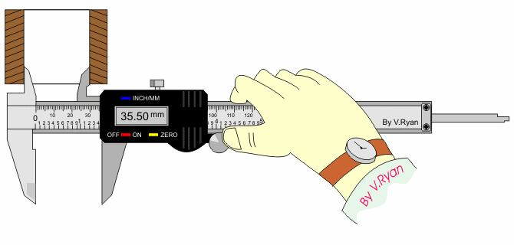
Taking Internal Measurements
Picture courtesy of: www.TechnologyStudent.com World Association of Technology Teachers

Slide 44
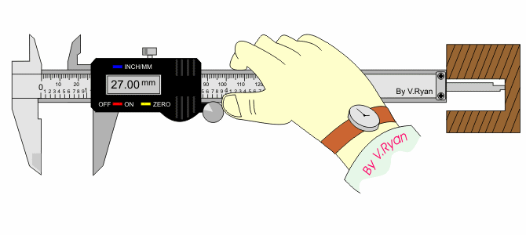
Taking Depth Measurements
Picture courtesy of: www.TechnologyStudent.com World Association of Technology Teachers

Slide 45
Handling
If the jaws are closed and the vernier caliper will not read zero, do not use this caliper for measuring because it is not accurate.
Take this caliper to the maintenance department for re-calibration so that it can be used to take accurate measurements again.

Slide 46
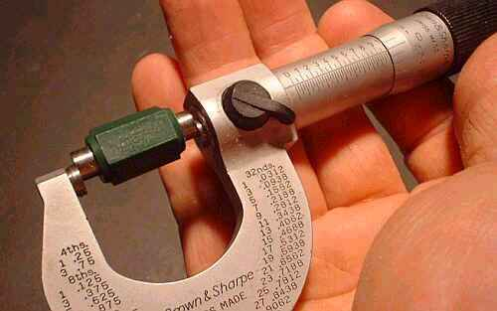
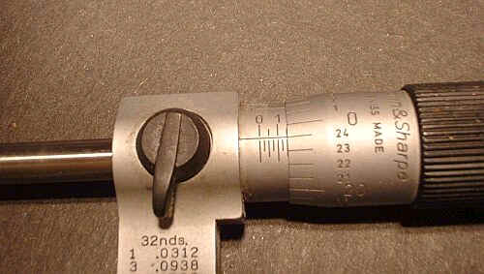
Micrometers
A measuring tool that incorporates a calibrated screw to take precise, small measurements
Similar in use to Vernier calipers but more precise, can take readings to .0001
Photos courtesy of: www.woodjig.com/Gage%20tips.htm
Notes:
‹#›

Slide 47
Micrometers (Cont’d.)
Measure outside length or diameter
Different styles, shapes, and sizes
  Most read the same
10 times more accurate than calipers
Rub clean by sliding paper between spindle and anvil when closed
Photos courtesy of: www.woodjig.com/Gage%20tips.htm
Notes:
‹#›
A micrometer allows a measurement of the size of a body. It is one of the most accurate mechanical devices in common use. The thimble is rotated, causing it to move right or left. It is connected to the right-hand measuring rod, which also moves right or left. The measured size of the pencil is the distance between the two measuring rods when they are just in contact with the sides of the pencil. You should always use the friction screw or its equivalent to close the rods on an object. Otherwise incorrect measurements will result! There is also a locking lever which fixes the position of the thimble and right-hand measuring rod.
To clean a micrometer, close them all of the way, clamping a piece of
paper. Then pull the paper out rubbing the tips of the spindle and anvil clean.
Checking a micrometer...
Seen above is a 1 inch master gage for checking and setting micrometers.
Micrometers are calibrated in multiples of 25.
The above micrometer reading is .149 - one hundred and forty nine thousandths.
Did you know that steel expands when hot? Wood expands in humid weather?
Round steel often shrinks .001-.003 when frozen. Some tools like shafts are often frozen in order to be installed. The cold shrinks them, making installation possible in a tight fit.

Slide 48
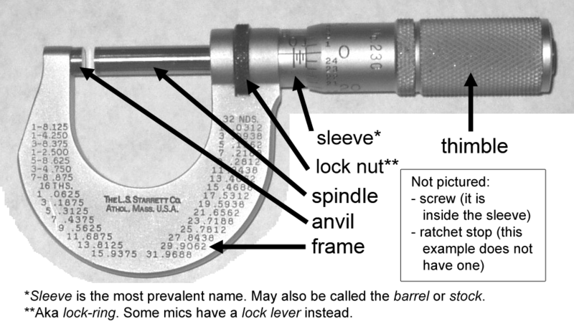
Micrometer Parts
‹#›/84

Slide 49
Micrometers in the U.S. System
The spindle of a U.S. system micrometer has 40 threads per inch
One turn moves the spindle 0.025 inches (1 ÷ 40 = 0.025), which is equal to the distance between two marks (or “graduations”) on the instrument’s frame
The 25 graduations on the thimble allow for the 0.025 inch graduations to be broken down further, so that turning through one graduation moves the spindle 0.001 inch (0.025 ÷ 25 = 0.001).
‹#›/84

Slide 50
Micrometers in the Metric System
The spindle of a typical metric micrometer has 2 threads per millimeter
One revolution of the spindle moves the lock 0.5 millimeters
The line on the frame is graduated with 1 millimeter divisions
The thimble provides another 50 graduations, each representing 0.01 millimeters. Therefore, the micrometer’s reading would be given by the number of millimeter divisions.
‹#›/84

Slide 51
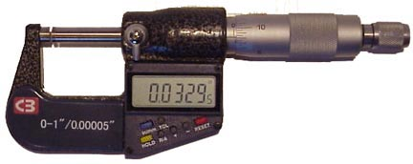
Digital Micrometer
Digital micrometers are more popular today because technological advances have resulted in price decreases. They also take some of the variation out of measurements and allow direct input of measurements into computer programs and SPC charting software.
‹#›/84
Notes:
.

Slide 52
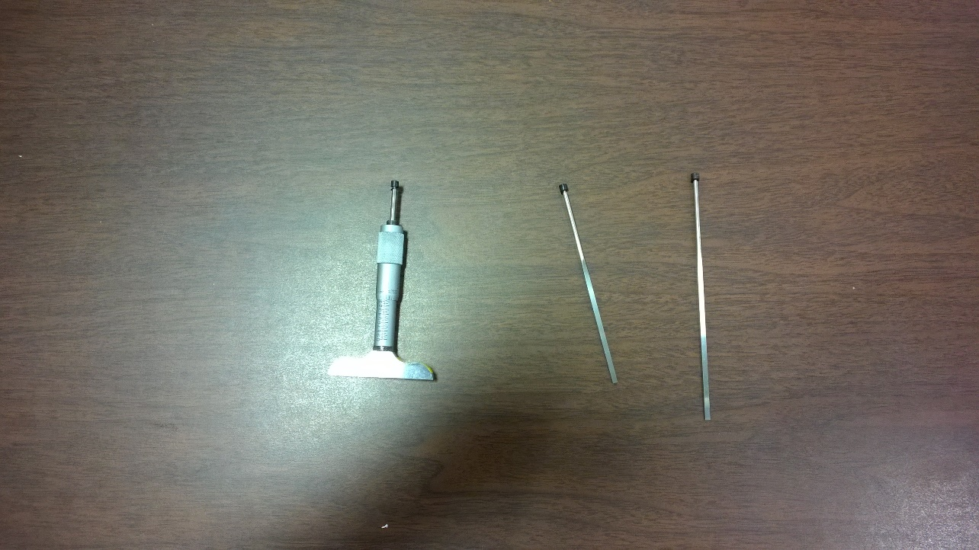
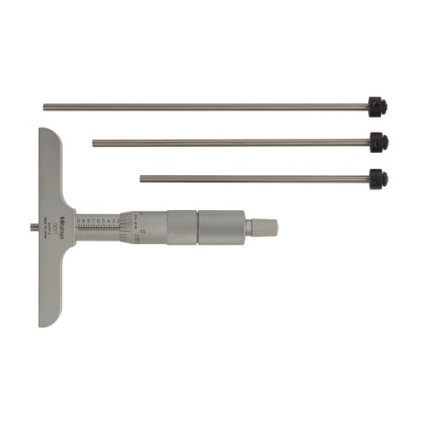
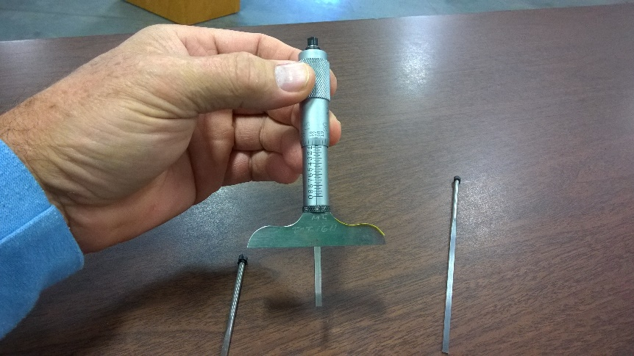
Depth Micrometer
‹#›/84

Slide 53
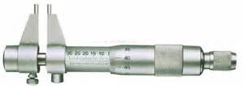
Inside Micrometer
‹#›/84

Slide 54
Micrometers Tips
Take very small measurements
Highly accurate when clean
Handle with care! Micrometers are precision instruments
Ensure that the micrometer can be zeroed so that the reading will be accurate
‹#›/84

Slide 55
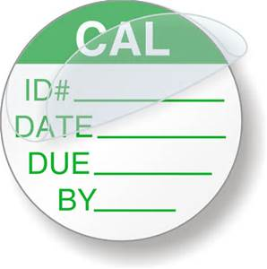
TOOL CALIBRATION
Calibration is defined as “adjusting a tool to a standard.”
Used to ensure continued accuracy of the measurement device on a periodic basis.
Documented on tool.
Intervals determined by
company standards based
on reliability needs
DUE DATE is most important
‹#›/84
Notes:
Note: GO/NO Go Gauges, Calipers and Micrometers must be calibrated for accuracy

Slide 56
Calibration
NIST controls US standards and requires traceability to its standards
Master gages are often used for within processes verification of measuring equipment
Measurement tools can be very sensitive to misuse. They should be re-calibrated whenever their accuracy is in doubt.
‹#›/84
Notes:
‹#›
Question: Have you ever used something to make a decision and later realized that the item you used was not performing correctly?
Answers will vary, but most people will agree that the answer is yes.
Question: What did that mean about the decision you made?
Answers will vary, but most will say that it was not reliable or was probably wrong.
Question: Do we still see measurement issues in products?
Answer will vary, but may include: shoes or clothes from different companies vary in size. This is a good example of an industry that has not accepted world-wide measurement standards.
Calibration refers to the process of determining the relation between the output (or response) of a measuring instrument and the value of the input quantity or attribute, a measurement standard. In non-specialized use, calibration is often regarded as including the process of adjusting the output or indication on a measurement instrument to agree with the value of the applied standard, within a specified accuracy. For example, a thermometer could be calibrated so the error of indication or the correction is determined, and adjusted (e.g. via calibration constants) so that it shows the true temperature in Celsius at specific points on the scale. Calibration also can refer to judgments made by a prognosticator, for example, a weather-forecaster who states that "there is an 80% chance of rain today," if properly calibrated, will say this on precisely 80% of the days during which it rains.
In the United States, the National Institute of Standards and Technology, a part of the federal government, maintains standards and is considered the arbiter and ultimate (in the U.S.) authority for values of SI units and industrial standards. NIST also provides traceability to its standards by calibration, by which an instrument's accuracy is established by comparing, in an unbroken chain, to higher level standards, e.g. the standards maintained by NIST. For each step in the process, the measurement uncertainty is evaluated.
Master gages are used to perform the periodical zero-setting and calibration of the gage.

Slide 57
QUESTIONS
The total amount by which a given dimension is allowed to vary and still be acceptable is called ____________.
Tolerance
A part measures 16.075mm. If the tolerance for the part is +/- 0.008, would a part measuring 16.084 be acceptable? _________
NO
‹#›/84

Slide 58
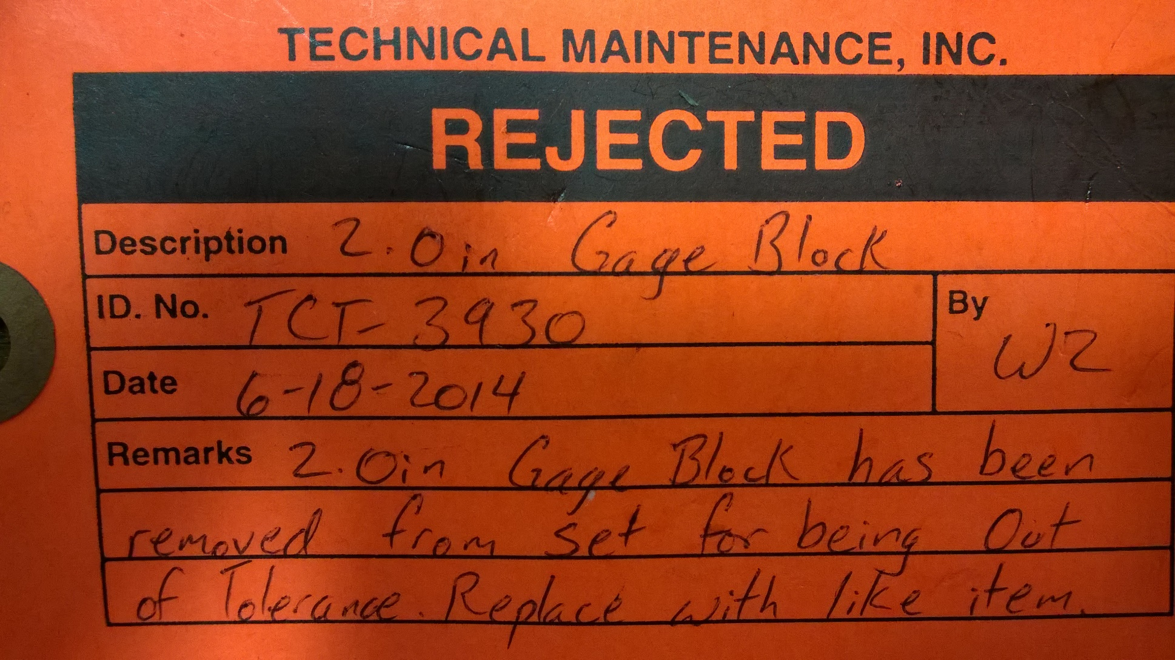
Rejected Calibration
‹#›/84

Slide 59
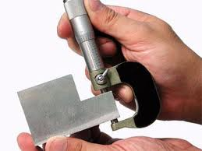
Micrometer Calibration
Gage blocks used to calibrate a micrometer
‹#›/84

Slide 60
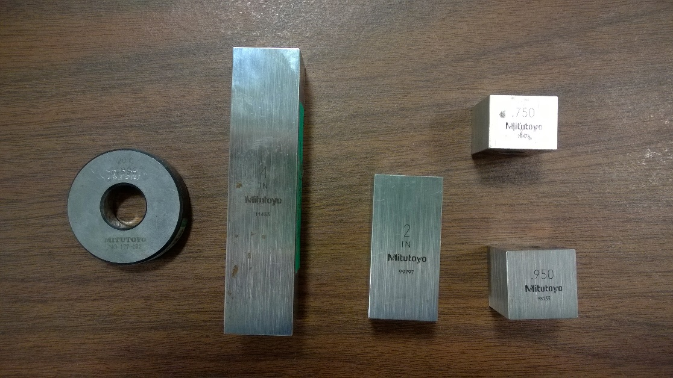
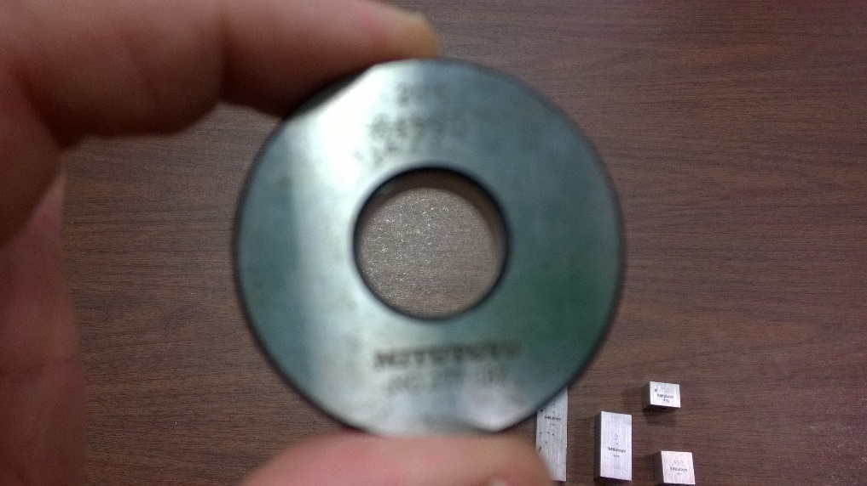
Gauge Block Examples
‹#›/84

Slide 61
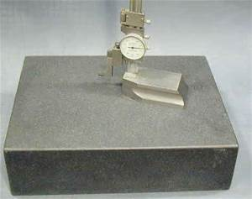
Surface Plates
A surface plate is a solid, flat plate used as the main horizontal reference plane for precision inspection, marking out (layout), and tooling setup.
‹#›/84

Slide 62

Surface Plate
‹#›/84

Slide 63






Temperatures
Use of various thermometers
  Different uses of technology
  Contact versus non-contact measures
Different scales or units of measure
Liquid in Glass
Infrared
Radiation
Thermocouple - probe
Photo courtesy of: www.sumanexports.com and www.atecorp.com
‹#›/84
Notes:
‹#›
Many methods have been developed for measuring temperature. Most of these rely on measuring some physical property of a working material that varies with temperature. One of the most common devices for measuring temperature is the glass thermometer. This consists of a glass tube filled with mercury or some other liquid, which acts as the working fluid. Temperature increases cause the fluid to expand, so the temperature can be determined by measuring the volume of the fluid. Such thermometers are usually calibrated, so that one can read the temperature simply by observing the level of the fluid in the thermometer. Another type of thermometer that is not really used much in practice, but is important from a theoretical standpoint is the gas thermometer.
Big differences exist between different temperature sensor or temperature measurement device types. Using one perspective, they can be simply classified into two groups, contact and non-contact.
Contact temperature sensors
Contact temperature sensors measure their own temperature. One infers the temperature of the object to which the sensor is in contact by assuming or knowing that the two are in thermal equilibrium; that is, there is no heat flow between them.
Many potential measurement error sources exist, especially from too many unverified assumptions. Temperatures of surfaces are especially tricky to measure by contact means and very difficult if the surface is moving. It is wise to be careful when using such sensors on new applications.
Most commercial and scientific noncontact temperature sensors measure the thermal radiant power of the infrared or optical radiation that they receive from a known or calculated area on its surface, or a known or calculated volume within it (in those cases where the object is semitransparent within the measuring wavelength passbad of the sensor).
Liquid-in-glass
This is the most commonly used thermometer to measure air temperature.
Inexpensive to make and easy to use.
Have a glass bulb attached to a sealed glass tube.
A very thin opening, called a bore, extends from the bulb down through the center of the tube.
The bulb is typically filled with either mercury or red-colored alcohol and the liquid is free to move from the bulb into the tube.
When air temperature increases, the liquid in the bulb expands, forcing it to rise up the tube.
When air temperature decreases, the liquid cools and contracts, drawing it out of the tube and back into the bulb.
When temperature is measured with a common liquid in glass thermometer, it is important to keep the instrument shaded. It is impossible to measure air temperature accurately in direct sunlight because the thermometer absorbs radiation from the sun in addition to the kinetic energy being transferred from the air molecules in contact with the glass. Energy transferred to the liquid from both of these sources will result in a temperature reading that is greater than the actual air temperature.
Electrical
Used for highly accurate temperature measurements.
One type of electrical thermometer is an electrical resistance thermometer.
This thermometer does not actually measure temperature, but resistance in a platinum or nickel wire, whose resistance changes as temperature changes.
An electrical meter measures the changes in resistance, which is related to temperature using a technique called calibration.
In order to use calibration, you must determine in advance exactly how the resistance of the metal varies with changes in temperature.
A second type is called a thermistor.
Thermistors are electrical resistance thermometers that use ceramic materials whose resistance increases as temperature increases.
The thermistor is used on radiosondes which are attached to balloons to measure temperature in the upper atmosphere.
A third type is called a thermocouple.
The thermocouple works on the principle that a metal will react to temperature changes by affecting the amount of electrical current that flows through it.
If two different metals are connected, then their response to temperature changes will be different.
By measuring the change in an electrical current that passes across these two metals, the actual temperature can be determined using calibration.
Radiometers
This type of thermometer actually measures the amount of emitted radiation (usually infrared) and the wavelength of maximum emission of a particular substance.
Bimetallic
This type of thermometer consists of two different metals (usually iron and brass), which are welded together to form a single strip.
As the temperature changes, one metal will expand more than the other, causing the strip to bend.
This bending is amplified by a series of levers that are attached to a pointer on a scale.
Your household thermostat is an example of a bimetallic thermometer. Bimetallic thermometers are not nearly as accurate as the thermometers discussed above.
Question: What kind of thermometers have you used (or seen used)? What did you measure?
Answers will vary.

Slide 64

Liquid Volumes
Liquid volumes are often measured using graduated cylinders
Graduated cylinders vary in precision
  Some may have 5 marks per 10 milliliters, while some may have 2 or 10 marks
Photos courtesy of: dl.clackamas.cc.or.us/ch105-02/volume_meas.htm
‹#›/84
Notes:
‹#›

Slide 65


Liquid Volumes (Cont’d.)
How do you read a liquid volume?
  Estimate between etched or printed lines
  Meniscus or curve (glass containers) measured at horizontal center or inside part of curve.
Photos courtesy of: dl.clackamas.cc.or.us/ch105-02/volume_meas.htm
‹#›/84
Notes:
‹#›
Question: Referring to Slide right picture, and assuming that we are using metric measurements, what is the volume of the liquid in cylinder 3?
Answer: 49 milliliters.
You should be able to measure the volume of liquids in a graduated cylinder. How precisely you can measure volume depends on the size and type of graduated cylinder you use. Generally, you should be able to estimate between the etched or printed lines. It is important to notice what each line or interval on the graduated cylinder represents. Different kinds of graduated cylinders are set up differently. A 10 milliliter cylinder, for example, usually has one tenth of a milliliter for each graduation, but some have two-tenths milliliter for each graduation. The way to check this is to count the divisions between consecutive numbers. Here we have the usual 10 divisions from one number to the next; therefore, the volume increment for each of those lines is a tenth of a milliliter. Estimating your measurements by reading between the lines, you should be able to measure to a hundredth of a milliliter.
A characteristic of liquids in glass containers is that they curve at the edges. This curvature is called the meniscus. You measure the level at the horizontal center or inside part of the meniscus. With water in glass, the meniscus will curve up at the edges and down in the center, so you would read the bottom of the meniscus. There are some materials where the curve goes the other way. Still, you read the horizontal center of the meniscus. In this case it would be the top of the meniscus. In some plastic cylinders water has a flat surface. In that case top or bottom doesn't matter, but we can still say use the center rather than the edges. The visibility of the meniscus can be enhanced by using a card with a dark stripe on it, placed behind the cylinder. Adjusting the placement of the card gives either a white meniscus against a black background or a black meniscus against a white background.

Slide 66

Advanced Measurement Systems
Optical comparator
An instrument that projects a magnified image of a part feature onto a screen for inspection.
Also known as an optical projector.
Optical inspection uses sight, light, and magnification to inspect the features of a part. Projection magnification lens projects an illuminated image onto the optical comparator screen.
Photo from: www.msi-viking.com
‹#›/84
Notes:
‹#›
Optical comparator - Projection magnification lenses come in a variety of different magnifications. This enables a direct measurement method that allows an inspector or operator to use a hand-held instrument to directly measure a part feature on the optical comparator screen.

Slide 67

Advanced Measurement Systems (Cont’d.)
Vision System - An instrument that uses a type of video camera to magnify part features for inspection.
Video/Vision Systems
Photo: www.ncmeas.com/vision.aspx
‹#›/84
Notes:
‹#›

Slide 68

Advanced Measurement Systems (Cont’d.)
Portable X-Ray Inspection
  Suitable for virtually any quality inspection application. Electronics and material analysis, quality inspection, proto design, failure analysis, manufacturing process validation, rework verification, etc.
  Portable (fits through standard
  doors)
  Exceptionally easy-to-use
  Low cost of ownership
  Low maintenance
  Perfect complement to rework
Photo: www.focalspot.com
‹#›/84
Notes:
‹#›

Slide 69


Mistake-Proofing Systems
A system that takes measurements, records them and creates reports without worker manual effort.
Automated inspection can be built-in with a mistake-proofing system (or poka-yoke in Japanese).
  An example of a common poka-yoke is the shape of a connector. It must be in the proper position to plug in.
‹#›/84

Slide 70
Mistake-Proofing (Cont’d.)
Mistake-Proofing involves:
Controls or features in the product or process to prevent or mitigate the occurrence of errors and/or;
Requires simple, inexpensive inspection (error detection) at the end of each successive operation to discover and correct defects at the source
‹#›/84

Slide 71
Mistake-Proofing (Cont’d.)
There are six mistake-proofing principles or methods. These are listed in order of preference or precedence in fundamentally addressing mistakes:
Elimination
Seeks to eliminate the possibility of error by redesigning the product or process so that the task or part is no longer necessary.
Example: product simplification or part consolidation that avoids a part defect or assembly error in the first place.
‹#›/84

Slide 72
Mistake-Proofing (Cont’d.)
There are six mistake-proofing principles or methods. These are listed in order of preference or precedence in fundamentally addressing mistakes:
Replacement
Substitutes a more reliable process to improve consistency.
Examples: use of robotics or automation that prevents a manual assembly error, automatic dispensers or applicators to ensure the correct amount of a material such as an adhesive is applied.
‹#›/84

Slide 73
Mistake-Proofing (Cont’d.)
Prevention
Engineers design the product or process so that it is impossible to make a mistake at all.
Examples: Limit switches to ensure a part is correctly placed or fixtured before process is performed; part features that only allow assembly the correct way, unique connectors to avoid misconnecting wire harnesses or cables, part symmetry that avoids incorrect insertion.
‹#›/84

Slide 74
Mistake-Proofing (Cont’d.)
4. Facilitation
Employs techniques and combining steps to make work easier to perform.
Examples: visual controls including color coding, marking or labeling parts to facilitate correct assembly; exaggerated asymmetry to facilitate correct orientation of parts; a staging tray that provides a visual control that all parts were assembled, and locating features on parts.
‹#›/84

Slide 75
Mistake-Proofing (Cont’d.)
5. Detection
Involves identifying an error before further processing occurs so that the user can quickly correct the problem.
Examples: sensors in the production process to identify when parts are incorrectly assembled, and built-in self-test (BIST) capabilities in products.
‹#›/84

Slide 76
Mistake-Proofing (Cont’d.)
Mitigation
Seeks to minimize the effects of errors.
Examples: fuses to prevent overloading circuits resulting from shorts; products designed with low-cost, simple rework procedures when an error is discovered; and extra design margin or redundancy in products to compensate for the effects of errors.
‹#›/84

Slide 77
Mistake-Proofing (Cont’d.)
Ideally, mistake-proofing should be considered during the development of a new product
  maximizes opportunities to mistake-proof through design of the product and the process (elimination, replacement, prevention and facilitation)
Once the product is designed and the process is selected,
  mistake proofing opportunities are more limited (prevention, facilitation, detection and mitigation)
‹#›/84

Slide 78
Mistake-Proofing (Cont’d.)
Mistake-proofing opportunities can be prioritized by performing design and process failure modes and effects analysis (FMEA).
Alternately, a mistake-proofing technique(s) can be developed for every process step in the manufacturing or service process.
‹#›/84

Slide 79


Computerized Automated Examples
In-line
              Probes
Photo:
www.marposs-machine-tool-probes.com/product/products.htm
Photo:
www.renishaw.com/client/product/UKEnglish/PGP-141.shtml
‹#›/84
Notes:
‹#›
Note: The benefits must outweigh costs before companies can adopt these advanced technological methods.
In-line – measure critical dimensions on ground or turned parts and may generate compensation feedback signals to the machine tool control. These systems may include standard and special measuring devices, using electronic units with statistical capability. These can be simple or sophisticated systems, dedicated or flexible, manual or automatic, stand-alone or fully integrated with process automation and robots.
Probe – possibility to continuously check working process by means of a wide range of sensors on board. These are designed to resist the most severe working conditions in the machine tool environment, while at the same time being capable of guaranteeing maximum precision using electronic units with statistical capability. These can be simple or sophisticated systems, dedicated or flexible, manual or automatic, stand-alone or fully integrated with process automation and robots.
The adopted solution includes two ND probes (opposing each other at 180°) and two or four pneumatic jets (opposing each other at 90°). This allows, in only one cycle, inspection of: surface defects such as porosity and cracks; diameter; taper and ovality.
The advantages resulting from the integrated ND and pneumatic technologies are significant:
shorter inspection time; cost reduction; and reduced space.

Slide 80


Computerized Automated Examples (Cont’d.)
Laser
(no contact)
Electric
Current
(non destructive)
Photo from:
www.midaprobing.com/laser_en.htm
Photo from:
www.marposs.com/site/schede.asp?IDscheda=77
‹#›/84
Notes:
‹#›
Note: The benefits must outweigh costs before companies can adopt these advanced technological methods.
Laser – for non contact (rather than probe) needs:
Tool identification - Tool breakage check - Presetting of unknown tools - Dynamic tool length and diameter measurement – Tool wear compensation - Tool cutting edge profile integrity check - Machine axis thermal drift compensation - Tool cutting edge radius measurement
Electronic – The manufacturing process of cylinder bores of automobile engines can often cause the formation of porosity (resulting from fusion in aluminum or cast iron cylinder bores) or cracks in steel cylinder liners. The need of both a Non-Destructive inspection to detect superficial defects as well as the typical dimensional controls has driven the integration of Eddy Current and pneumatic technology in a single plug.
The adopted solution includes two ND probes (opposing each other at 180°) and two or four pneumatic jets (opposing each other at 90°). This allows, in only one cycle, inspection of: surface defects such as porosity and cracks; diameter; taper and ovality.
The advantages resulting from the integrated ND and pneumatic technologies are significant:
shorter inspection time; cost reduction; and reduced space.

Slide 81



Other Examples
Simulation
Fixture Design
Microscopes
    (in-process)
Photo from:
www.vestaweb.com/quality/in_process_inspection.htm
Two-door and four-door models are produced on this line. The fixture is built so that it is impossible to put a four-door part in place when the fixture is set-up for a two-door model and vice-versa. Notice the limit switch in center-right which helps ensure proper orientation. If correct part is turned backward or upside down, it will not fit.
Vericut Photo from:
www.cgtech.com/PDF/inspection_sequence.pdf
Photo from:
www.npd-solutions.com/mistake.html
‹#›/84
Notes:
‹#›

Slide 82

QUESTION
What are some poka-yoke devices you may encounter every day?
  Circuit breakers - power
  Robotics (such as automatic glue dispensers)
  Limit switches - range of motion
  Visual controls - IR/Optics
  Sensors to identify correct parts
  Safety switches (example: lawnmower handles or seats. When you release the handle or get off the seat, the machine shuts off to reduce injury.)
‹#›/84

Slide 83

Standard Operating Procedures (SOP)
A best practice approach to task execution
Written document detailing steps of a process
Must be validated and
approved for accuracy
‹#›/84

Slide 84

Summary
This section focused on:
  Understanding basic measurement equipment as well as how this measurement information is charted to evaluate whether a process is in control or not.
  Statistical Process Control (SPC) concepts and how they help production technicians identify issues and pursue corrective action and improvements.
‹#›/84

