Slide 1


Foundations of Manufacturing
Domain 4: Quality Assurance
Section 3:
Quality Improvement and Assessment
Notes:
Read Lesson Link aloud to the students:
In this section, we will build upon your understanding of quality. At a minimum, quality products must meet defined specifications with as little variation from the center of the specification as possible. Variations result from materials, equipment, people, environment, measurements, methods, and many other factors. During production, variation might exceed specifications and impact product features. Just as critical are the factors within the processes and systems used to create these products. These factors can represent considerable costs to the manufacturer. Today’s manufacturers continuously seek ways to make the improvements needed to eliminate or reduce these problems.

Slide 2
Quality Improvement
Learning Objectives
Describe a quality management system audit and the assurances it provides.
Describe the root cause failure analysis process and how to facilitate the process.
Identify and describe corrective and preventive actions.
Identify and describe the CAPA (Corrective and Preventive Action) System process.
Identify the steps in documenting a CAPA Report.
‹#›/60
Notes:
Direct students to turn to page 4-3-1 in their Foundations of Manufacturing, Domain 4: Quality Assurance, Section 3: Quality Improvement Systems, Student Workbook and continue with the discussion.

Slide 3
Quality Improvement Systems
Learning Objectives (Cont’d.)
  Identify and describe the components of the Toyota Quality System House and the ISO 9000 Process.
  Identify manufacturing quality awards.
  Describe a typical benchmarking process.
  Describe the design of experiment process.
  Identify and describe the elements of a process capability study.
  Describe the objective of measurement system analysis.
‹#›/60

Slide 4

Understanding Quality
Quality products must meet defined specifications with as little variation from the center of the specification as possible.
Variations result from many factors such as:
  Materials
  Equipment
  People
  Environment
  Measurements
  Methods
During production, variation might exceed specifications and impact product features.
‹#›/60

Slide 5
Understanding Quality (Cont’d.)
Just as critical are the factors within the processes and systems used to create these products. These factors can represent considerable costs to the manufacturer.
Today’s manufacturers continuously seek ways to make the improvements needed to eliminate or reduce these problems.
‹#›/60

Slide 6
Causes of Quality Variations
Unapproved process adjustments can increase opportunity for variation. Always check with a supervisor first.
If in doubt about the process or the Standard Operating Procedure (SOP), check with a supervisor
‹#›/60

Slide 7


QUESTION
What is the best measurement of Quality?
Product performance as viewed by the customer
‹#›/60
Notes:
Note: Discuss the various improvements made since the Model T, such as selection of models and features, life cycle, pollution controls, power, comfort, fuel economy, sound systems and more. Point out that sometimes quality is “in the eyes of the beholder.”

Slide 8
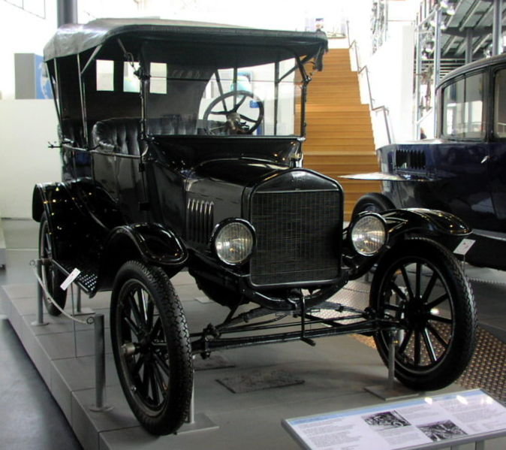
QUESTIONS
If your favorite U.S. automotive manufacturer stopped improving their products, would you switch to a different manufacturer?
Have you ever worked in an ideal manufacturing environment?
  No. Perfection is not achievable, but “nearly perfect” is.
‹#›/60
Notes:
Note: Discuss the various improvements made since the Model T, such as selection of models and features, life cycle, pollution controls, power, comfort, fuel economy, sound systems and more. Point out that sometimes quality is “in the eyes of the beholder.”

Slide 9

When Does Quality Improvement End?
When we have achieved a stable process (in control) AND we are meeting customer requirements (specifications) have we finished the job of improving that process?
NO
‹#›/60
Notes:
When Does Quality Improvement End? Exercise 4-3-1
Divide class into groups of two to three people
Instruct students to answer the question: “When does quality improvement end?”
If the group is large, have each group select a spokesperson for this exercise. If the group is small, each student should be prepared to answer the question in class. Ensure that sufficient time is provided to allow for discussion so students can formulate their own answers and present them to the class.
Ask for examples of how quality improvement never ends. Some examples include:
Apple introduces new iPod/iPad/iPhone models, featuring smaller sizes, better quality, greater storage capability, and reduced prices.
Toyota strives to continually increase the gas mileage of the Prius. Who else came out with hybrid cars?
Quality improvements are constantly being made to computers (faster, more memory), televisions (flat screens), cars (AC, radios, mileage), cell phones (smart phones), and more.
Many Florida manufacturers have incorporated improvement processes to decrease costs and improve their operating environment:
Orange juice manufacturing
Phosphate production
Electronic device companies
Transportation
Aviation and aeronautics
Plastic and metal fabricators and assemblers

Slide 10

Customer Expectations
If you have higher priorities than meeting your customers’ expectations, you are in a whole lot of trouble
No book is going to bail you out.
You must constantly improve
‹#›/60

Slide 11

Benefits of Continuous Improvement
Reduced costs
Increased customer satisfaction
Innovation
Keeping up with competition
Enhanced products
Expedited deliveries
Reduced prices
‹#›/60

Slide 12
QUESTION
Why are production technicians key to successful continuous improvement efforts?
  Closest to process so they best know problems
  Usually enjoy participating in the improvement process
  Motivated to make improvements since it will make their job easier
  Unlocks their creativity
  Involvement makes them more supportive of changes
‹#›/60

Slide 13

Quality Management System Audits
Affirm quality standard
Internal and external audits
Assure that:
  Quality plans are successfully implemented
  Product conformance
  Compliance/conformance with standards, regulations, and procedures
  Data system is accurate and adequate
  Deficiencies are identified and corrective action taken
  Improvement opportunities addressed properly
‹#›/60
Notes:
Note: Auditors should avoid making an atmosphere of blame. Audit should summarize observations made during the audit and provide recommendations for improvement and corrective actions.

Slide 14
QUESTIONS
Have you ever heard an unusual sound in your car? What did you do?
  Ignored it?
      May have broken down or forced to pay for emergency repairs
  Tried to find the cause?
      Taken action to initiate repairs before they became too expensive
  Defects should be reported to the appropriate contact
‹#›/60

Slide 15
Design Failure Mode Effect Analysis
Objective
Design and sell products so that in the future the customer returns,
NOT THE PRODUCT!
When performing DFMEAs on existing or new products:
Identify ways the product design can fail. Do this early as possible in the design process!
Rationally prioritize potential failures so that corrective/preventive action and/or redesign can be accomplished before the escalation of risk and cost.
Strive for smoother production ramp ups.
Enhance system reliability once countermeasures are implemented.
Reduce development, production and warranty cost.
Push for higher customer and end-user satisfaction.
‹#›/60

Slide 16
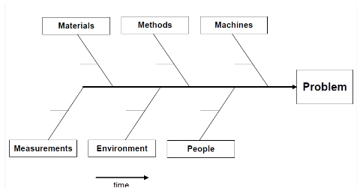
Root Cause Failure Analysis
Problems can be obvious or obscure
Potential causes:
  Faulty procedures
  Defective materials
  Poor process design
  Equipment malfunction
  Not following procedures
  Poor training
  Poor communication
  Past fix action did not address root cause
‹#›/60

Slide 17
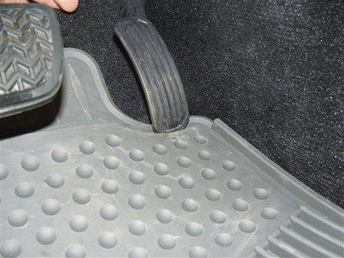
QUESTION
How could RCFA be used on a product, such as a car?
‹#›/60
Notes:
Discuss the recent automobile manufacturer recalls:
Toyota recall: stuck gas pedals and floor mats
GM recall: key and ignition switch

Slide 18

Root Cause Failure Analysis (Cont’d.)
Performing an RCFA
Examine data to identify problem
Analyze data to identify possible causes
Brainstorm and verify
Take corrective action
Follow-up
Document actions
‹#›/60
Notes:
NOTE: It is important that you don’t hide the problem or put a band aid on the problem. Look to find the “real” cause of the problem, then fix that. Remember vampire movies? Sunlight make the vampire hide, but a stake through the heart kills the vampire. Root Cause Failure Analysis help you find the true cause of your problem, so that you can then drive a stake through the heart of the problem.

Slide 19
Facilitate the RCFA Process
Root Cause Failure Analysis (Cont’d.)
Does process need revision?
Who is included?
What other deficiencies are there?
How do you determine root cause?
How can you ensure action was effective?
‹#›/60

Slide 20
Corrective and Preventive Action
(CAPA) System
    “Corrective action” describes the process of responding to a current problem (or nonconformity) and correcting the problem
Systematic approach, not just a quick fix action
Corrective actions should
  Identify “existing” problem
  Identify root cause
  Develop a solution to correct and prevent future
  Fix it
  Follow-up
    Perhaps add to or shorten audit time
‹#›/60
Notes:
NOTE: Corrective Action is a term used to describe the process of responding to a current problem and fixing it. Remember to document the corrective action taken.

Slide 21
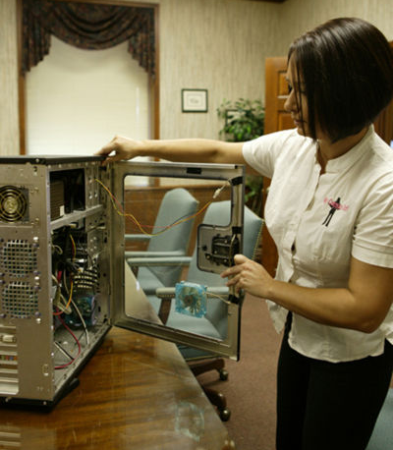
CAPA System (Cont’d.)
“Preventive action” refers to the process of detecting a potential problem (or nonconformity) and striving to eliminate it.
Preventive action should
  Identify “potential” problem
  Identify root cause
  Develop a solution to prevent it
  Implement preventive action
  Follow- up
‹#›/60
Notes:
NOTE: Preventive action is a term used to describe the process used to detect potential and preventable problems, then eliminating it. Remember to document preventive actions taken.

Slide 22
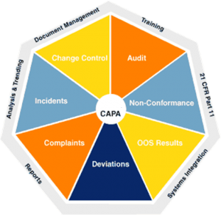
CAPA System Process
Essential tool in quality improvement program
Catalogs critical historical data on actions taken
Traces & tracks nonconformities
Records dispositions
Notify process owner
‹#›/60
Notes:
NOTE: Corrective and Preventive actions are similar. But….corrective actions are a response to an existing problem, and preventive actions are designed to keep potential problems from occurring.

Slide 23
CAPA System Process (Cont’d.)
Identifies and provides evidence of a problem
Analyzes root/potential cause
Determines corrective or preventive action
Performs “results based” corrective & preventive actions
Verifies through follow-up
Documents effort (see next slide)
‹#›/60

Slide 24
CAPA System Process (Cont’d.)
Potential problems are typically noticed through (what could be called) glitches that are discovered by the technician
Noticed through data that is currently being collected through inspections, control charts, and audits
All employees should be aware of potential issues with the manufacturing process
Each employee knows how their part of the process should look and feel
Anything that seems “off” should be mentioned to your supervisor
Confront the problem early
‹#›/60

Slide 25
CAPA System Process (Cont’d.)
Critical that the technician understands the difference between corrective and preventive actions
The CAPA system can allow you to predict, identify, and take action to correct problems and eliminate a potential problems.
‹#›/60

Slide 26
CAPA System Process (Cont’d.)
Should be discovered during the creative problem-solving process
Managers and supervisors should give approval for each necessary action before they implement them.
DO NOT take corrective actions upon yourself.
Unapproved process adjustments are extremely difficult to verify.
Wait until you are certain that a change is approved.
‹#›/60

Slide 27
CAPA Steps
Identify, clearly define, and provide evidence pertaining to the existing and/or potential problem.
Analyze the root (or potential) cause of the problem.
Determine the corrective or preventive action needed to eliminate the root cause.
Perform the corrective or preventive action.
Verify (through follow-up) that the action taken prevented recurrence of the problem.
Document any actions pertaining to the process in a Corrective/Preventive Action Report.
‹#›/60

Slide 28
Corrective/Preventive
Action Report (CAR or PAR)
The Corrective and Preventive Action Report
  Is an essential tool in any quality improvement program
  Provides a historical database of quality problems and their solutions
  Data from past issues can be used to confront those currently happening
‹#›/60

Slide 29
Corrective/Preventive
Action Report (CAR or PAR) (Cont’d.)
Documentation includes:
  List of personnel who worked on problem
  Problem description
  Root cause analysis to include collected data
  Action needed to correct and eliminate problem
  Verification that effort was sufficient
    What were the results and how was this demonstrated?
  CAR or PAR processed through channels
‹#›/60

Slide 30
Corrective/Preventive
Action Report (CAR or PAR) (Cont’d.)
The CAR/PAR is designed to:
  Track nonconformities
  Assign priorities
  Record dispositions
  Note the version of the product that was corrected
  Notify the process manager or material supplier of any issues and actions taken
  Produce needed management reports
‹#›/60

Slide 31
CAR & PAR Recommendations
Include both CAR and PAR (if necessary). If are included it’s called a Corrective Action & Preventive Action Report (CAPA Report).
List of problems
List of solutions
Provides evidence & data
Data either supports or rejects possible solutions
Each action should be presented in written form and kept as part of CAPA and quality records
Actions should be written clearly and concisely
  Actions may include to decrease audit time intervals to ensure problem does not reoccur
‹#›/60

Slide 32
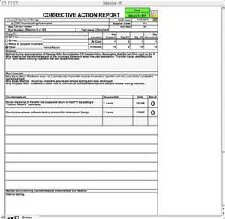
Corrective Action Report
‹#›/60

Slide 33
QUESTIONS
Who is responsible for corrective action ideas and recommendations?
EVERYONE
Who benefits from tracking, communicating and correcting defects?
EVERYONE
‹#›/60

Slide 34
Total Quality Management System
Based on:
  Committed and involved management
  Focus on customer
  Involvement of total workforce
  Continuous improvement
  Materials’ suppliers partnering and participating in process
  Performance measures used to evaluate progress and identify improvement needs
‹#›/60

Slide 35
QUESTIONS
What have you purchased that you
were not satisfied with?
How will this experience affect future purchasing decisions?
One objective of TQM is to provide customers with a higher quality product at a lower price.
Does it work?
‹#›/60
Notes:
NOTE: Remember our earlier discussions about Toyota? Let’s look at that again.

Slide 36

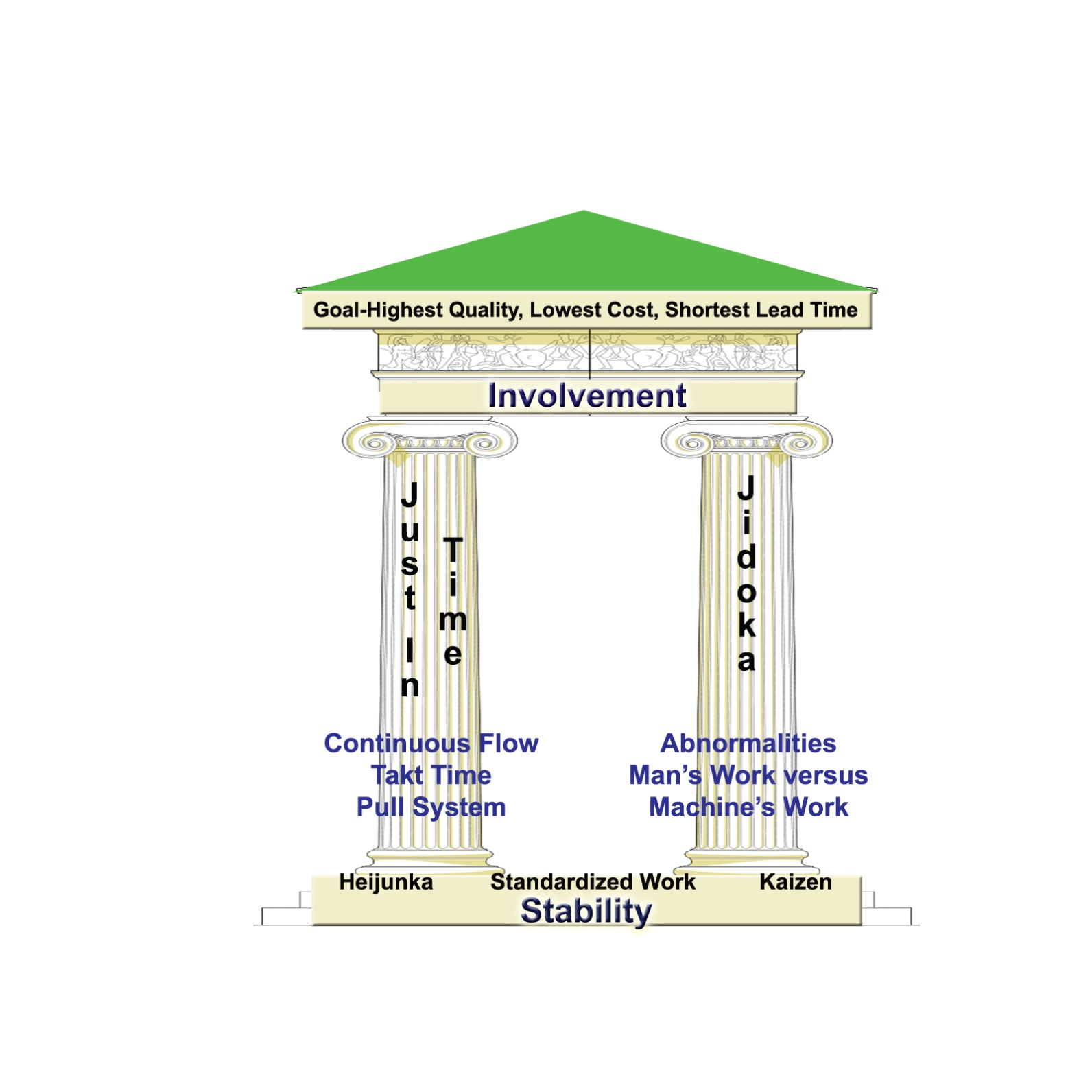
Toyota’s Quality System
Toyota Motor Corporation® is well-known for its quality system, the Toyota Production System (TPS).
"Lean Lexicon" adapted from: www.lean.org
‹#›/60

Slide 37

QUESTION
Why is a house used to symbolize their quality system?
  Foundation is stability across the 4M’s
    Man/people
    Machine/equipment
    Material
    Methods
‹#›/60

Slide 38
QUESTION
What are some examples of the 4M’s that you might see at McDonalds®?
  Man/people –
    consistent customer service
  Machine/equipment –
    layout of tables, restrooms, kitchen and drive through
    Food prep areas are very similar
  Material –
    menu items are fairly consistent
  Methods –
    food prepared the same at all locations so you always get what you expect
‹#›/60

Slide 39

TQS (Cont’d.)
The pillars or walls are JIT and
jidoka (automation with a human touch)
JIT focuses on:
  Produce only what customer ordered
  Level demand so work flows smoothly
  Link processes to the customer with visual tools
  Maximize flexibility of people and equipment
Jidoka implies that intelligent employees and machines are identifying errors and taking quick countermeasures
‹#›/60
Notes:
Question:
Does anyone remember what JIT stands for?
Answer: JIT- “Just In Time”
Remember, sometimes people make mistakes and machines fail/break. The use of Jidoka in a production system prevents these errors from becoming defects that are passed on to customers.

Slide 40
QUESTION
What are some example of JIT and Jidoka that you might see at McDonalds?
  JIT
    Incorrect item at drive thru and you have to move ahead or pull to the side to get it corrected
  Jidoka
    Service person is able to stop what they are doing and correct a problem
‹#›/60

Slide 41
TQS (Cont’d.)
What does the roof represent?
The Goal (such as)
  Best quality
  Lowest cost
  Shortest lead time
  Anything needed to be competitive
To get there, involvement is needed.
  It’s the interconnected nature of all the systems and core concepts.
‹#›/60

Slide 42

ISO Standards
Acronym for “International Organization for Standardization”
Universally accepted system of standards and requirements
Prevent nonconformities
Third party registration
ISO 9000 directs and controls quality system
  Sets standards for record keeping
  Sets fundamentals of quality management systems
  Establishes eight management principles that are the basis for quality control programs and policies
Companies apply for certification in order to show they comply with quality standards
‹#›/60

Slide 43
ISO 9000
ISO quality standards are based on eight quality management principles:
  Customer focus
  Meeting the customer’s current and future needs.
  Leadership
  The quality system will be successful only if all levels of management are committed and involved.
  Involvement
  Quality is everyone’s job. All employees must be involved in the quality system.
  Continuous improvement
  Always improving so that the company stays competitive and reduces costs.
‹#›/60
Notes:
NOTE: Company processes related to these items must be in writing with evidence that the company follows these processes.
Question: What kind of company uses the ISO 9000 standard? Describe how the company uses it.
Answers will vary.

Slide 44
ISO 9000 (Cont’d.)
  Systems approach
  Operating so that all processes are seen are connected to one another.
  Decisions based on facts
  Decisions are based on measurements and data. Decisions not based on gut feel and opinion only.
  Cooperation with suppliers
  The suppliers and customers work together to ensure that raw materials and components going into the production process meet quality standards and continue to improve.
  Process focus
  The entire production process is considered in the quality system instead of specific product details.
‹#›/60

Slide 45
ISO 9000 (Cont’d.)
Process Focus
Clause | Title
1 | Scope
2 | Normative References
3 | Terms and Definitions
4 | Quality Management System
5 | Management Responsibility
6 | Resource Management
7 | Product Realization
8 | Measurement Analysis and Improvement
‹#›/60

Slide 46


Quality Awards
Quality Assessments: evaluation of a company’s quality system
Goal: customer satisfaction
JD Power awards are based on customer ratings
Shingo Prize for Excellence in Manufacturing
‹#›/60
Notes:
NOTE: Manufacturers pursue quality awards as proof of their focus on quality. Awards are sponsored by different organizations. Most assess the quality systems that the companies have established.
JD Power and Associates—surveys of millions of consumers around the world
Shingo Prize—North American premiere manufacturing award that recognizes the value of using and expanding lean ideas and world class manufacturing practices.

Slide 47

Malcolm Baldrige National Quality Award
Quality Awards (Cont’d.)
Presented by the US National Institute for Standards and Technology (NIST)
Purpose: to enhance quality, competitiveness, and productivity of US organizations
Self-assessment of the quality system can be done for general improvement as well as assessment by independent examiners for award consideration.
‹#›/60

Slide 48
Quality Awards (Cont’d.)
Malcolm Baldrige Categories
  Leadership
  Strategic planning
  Customer and market focus
  Measurement, analysis, and knowledge management
  Workforce focus
  Process management
  Results
‹#›/60

Slide 49
Quality Awards (Cont’d.)
Malcolm Baldrige helps companies
  Deliver ever-improving value to customers
  Improve overall company effectiveness
  Align their performance with key business indicators
‹#›/60

Slide 50
Benchmarking
The process of constantly measuring and comparing a company’s performance against other companies inside and outside a given industry. As a quality improvement tool, it:
Identifies a company’s product/process problem areas
Identifies other sub-industries with similar processes
Identifies leading competitors
Solicits best practices of others
Results in adopting best practices
Helps companies improve competitiveness!
‹#›/60

Slide 51

QUESTIONS
Have you ever seen someone do something that brought them success?
What was it?
What did you do?
  If you used it as a guide or model, you performed benchmarking.
‹#›/60

Slide 52
Design of Experiments (DOE)
Design of Experiments is a method that identifies parameters that reduces variation by using a statistically designed experiment. Differences are discovered using this experimental method.
Design of Experiments is any information-gathering exercises where variation is present, whether under the full control of the experimenter or not
‹#›/60

Slide 53
DOE Steps
Step 1: Investigate the problem (What happened?)
Step 2: Form a hypothesis (Why do you think it happened?)
Step 3: Select a measurable outcome/response (Will it prove or disprove your hypothesis?)
Step 4: Select variables as input factors (What are the changes that you want to test?)
‹#›/60

Slide 54
DOE Steps (Cont’d.)
Step 5: Design the experiment (What do you want to test)
Step 6: Conduct the experiment (What is the actual change and what is the result?)
Step 7: Analyze the results (What is the data that you gathered during the experiment?)
Step 8: Verify the results by running the experiment again (Does the same thing happen?)
Step 9: Implement the changes
‹#›/60

Slide 55
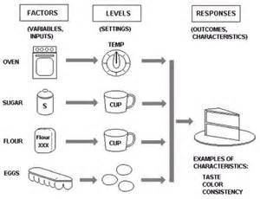
Example of Design of Experiment
.
‹#›/60

Slide 56
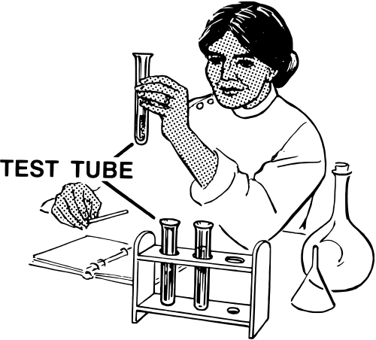
Design of Experiments (Cont’d.)
Process
  Investigate problem
  Formulate objective
  Select measurable output
  Select variable inputs
  Design the experiment
  Conduct the experiment
  Analyze results
  Verify analysis
  Make changes
‹#›/60
Notes:
Invite students to describe experiments they’ve performed and the outcomes of those experiments.
REMIND students that before conducting a DOE, you must conduct a process capability study and a measurement system analysis. This study allows the production tech to quantify how well the targeted production process can provide the intended outcome, which is a quality, conforming product.

Slide 57
Design of Experiments (Cont’d.)
Process capability study
Establishes the feasibility of the proposed change prior to implementation.
  Select parameters
  Collect data
  Establish control of process
  Analyze data
  Establish process monitoring system
The goal is to improve the process!
‹#›/60

Slide 58
Design of Experiments (Cont’d.)
Measurement System Analysis (MSA)
Identifies and quantifies the different variation that affect a measurement system.
Evaluates the test method, measurement instruments and the method for obtaining measurements.
It ensures the
  Accuracy of measurement equipment
  Precision of measurement equipment
  Stability of measurement equipment
‹#›/60

Slide 59
Design of Experiments (Cont’d.)
MSA’s enable the user to
Select the correct measurement approach
Assess a measuring device
Assess operations and procedures
Assess any measurement interactions
Calculate the uncertainty associated with individual measurement devices and/or measurement systems
‹#›/60

Slide 60

Summary
Quality improvement systems have a central theme, which is to reduce the number of defects
Change equates to successfully competing
in a global marketplace
Assess and improve
‹#›/60

