Slide 1

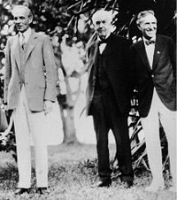
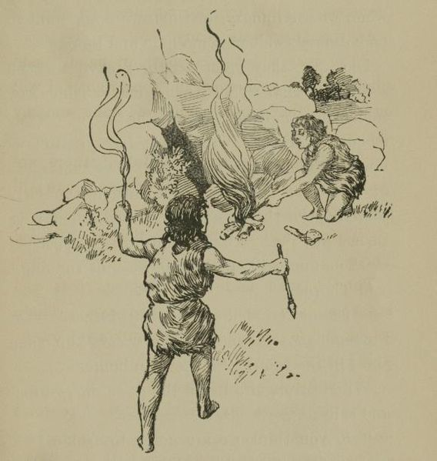
Domain 4 : Quality Awareness
Foundations of Manufacturing
Section 4: Print Reading
Notes:
READ TO STUDENTS:
Manufacturing is as old as the human race. To be an effective and valued production technician, you must understand the industry. You should understand the history and development of manufacturing. You should also understand the concept that any process that produces a product is considered manufacturing.
Pictured- (Left) Henry Ford, Thomas Edison, Harvey Firestone

Slide 2
Learning Objectives
Discuss use of scales.
Identify fundamentals of blueprint reading
  1. Objects are effectively visualized in drawing.
  2. Blueprint features are correctly identified.
  3. Dimensions of an object in a technical drawing are accurately read and understood.
  4. The functions of sectional drawings are recognized.
Examine skills essential for manufacturing.
‹#›/81
Notes:
Direct students to turn to page 4-4-1 in their Foundations of Manufacturing, Domain 4: Quality Awareness, Section 4: Print Reading, Student Workbook and continue with the discussion.
Read Introduction paragraph aloud to the students:
The purpose of this module is to ensure that production technicians can effectively read and interpret industrial prints during the performance of their job.

Slide 3
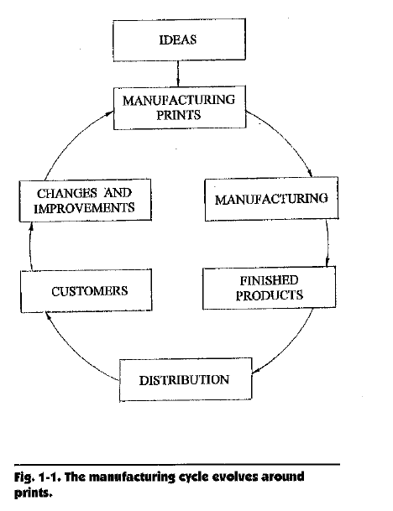
Manufacturing Cycle
‹#›/81

Slide 4
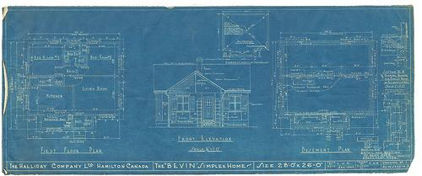
Basic Industrial Print Reading
Scales
Terms associated with blueprints
Symbols
‹#›/81

Slide 5
Industrial Print Reading
Industrial Prints
  Display a language of the draft person, engineer, or tool designer and indicate the physical requirements of a part or process.
  Three language standards are used in industrial prints.
‹#›/81

Slide 6
Industrial Prints
Industrial prints are manufacturing instructions
Called “blueprints” because they were originally printed on blue backgrounds with white lines
Manufacturing prints are copies of original drawings that were either drawn on paper or plotted on a computer
The common blueprint has three basic elements:
  Drawing
  Dimensions
  Notes
‹#›/81

Slide 7
Language Standards
Three similar language standards are used in the drafting of industrial prints are as follows:
  American Society of Mechanical Engineers (ASME) Y14.5M-1994
  American National Standards Institute
  (ANSI) Y14.5 (American standard)
  International Standard Organization (ISO) R1 101
‹#›/81

Slide 8
Industrial Prints
The main part of the blueprint is the drawing
Designed to specify and show the exact shape of the part
Consists of several versions of the same part from different angles
‹#›/81

Slide 9
Standard Lines
Object lines
Hidden lines
Center lines
Dimension
Cross section
1 1/2
‹#›/81

Slide 10
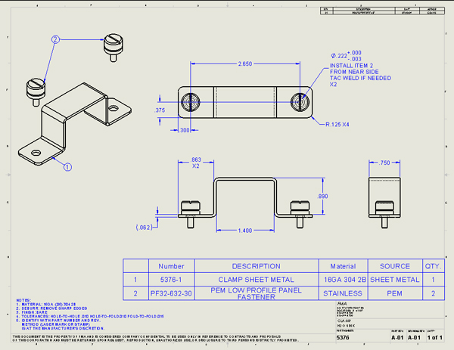
Basic Industrial Print Reading Example 1
‹#›/81

Slide 11
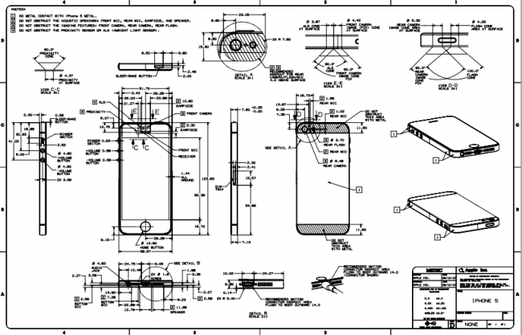
Basic Industrial Print Reading Example 2
‹#›/81

Slide 12
Object Lines
Object lines are solid lines that form the shape and size of the parts being drawn on the blueprint. They outline all of the parts features that would be visible at a certain view.
______________________________________ Object Line
‹#›/81

Slide 13

Hidden Lines
Hidden lines are shown as short dashes. They represent features that are not visible in the view of the blueprint (e.g., the back of a part).
‹#›/81

Slide 14

Center Lines
Center lines are dashed lines that alternate between long and short dashed. They indicate the center of symmetrical objects.
‹#›/81

Slide 15
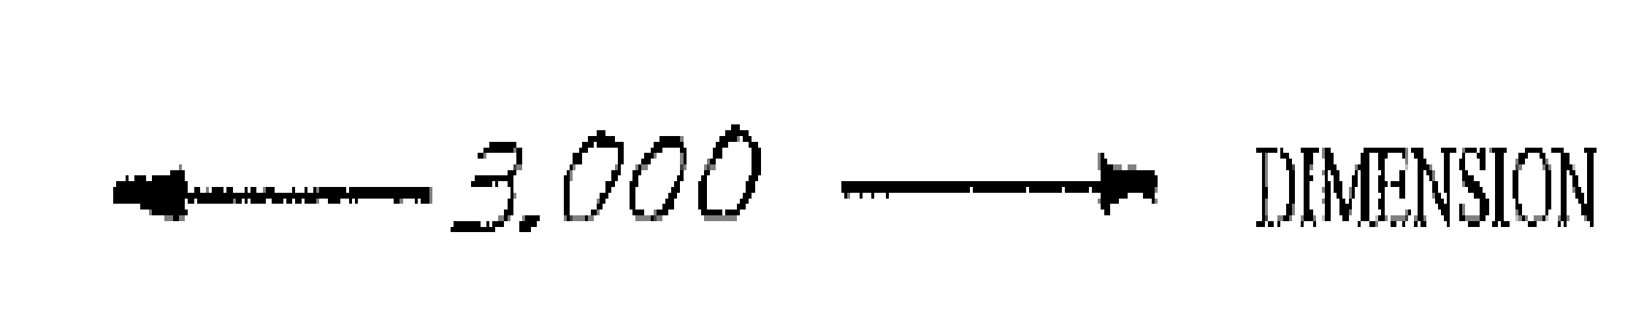
Dimension Lines
Dimension lines establish a dimension (length, width, etc.), between two extensions. Dimension lines give the actual measurement that the part must meet to be functional.
‹#›/81

Slide 16
Extension Lines
Extension lines extend from an object’s surface to establish a size for the dimension line. They extend out from the object and establish a visible interval for measurement
‹#›/81

Slide 17

Leader Lines
Leader lines have a reference box at one end and an arrow at the other. They are generally used to label features of the blueprint.
‹#›/81

Slide 18
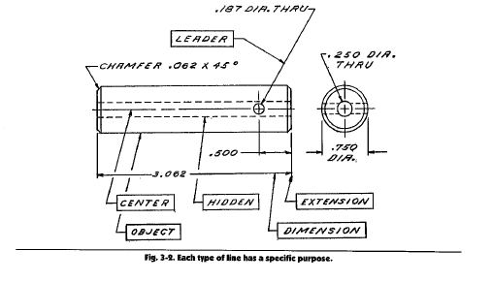
Leader Line Example
‹#›/81

Slide 19
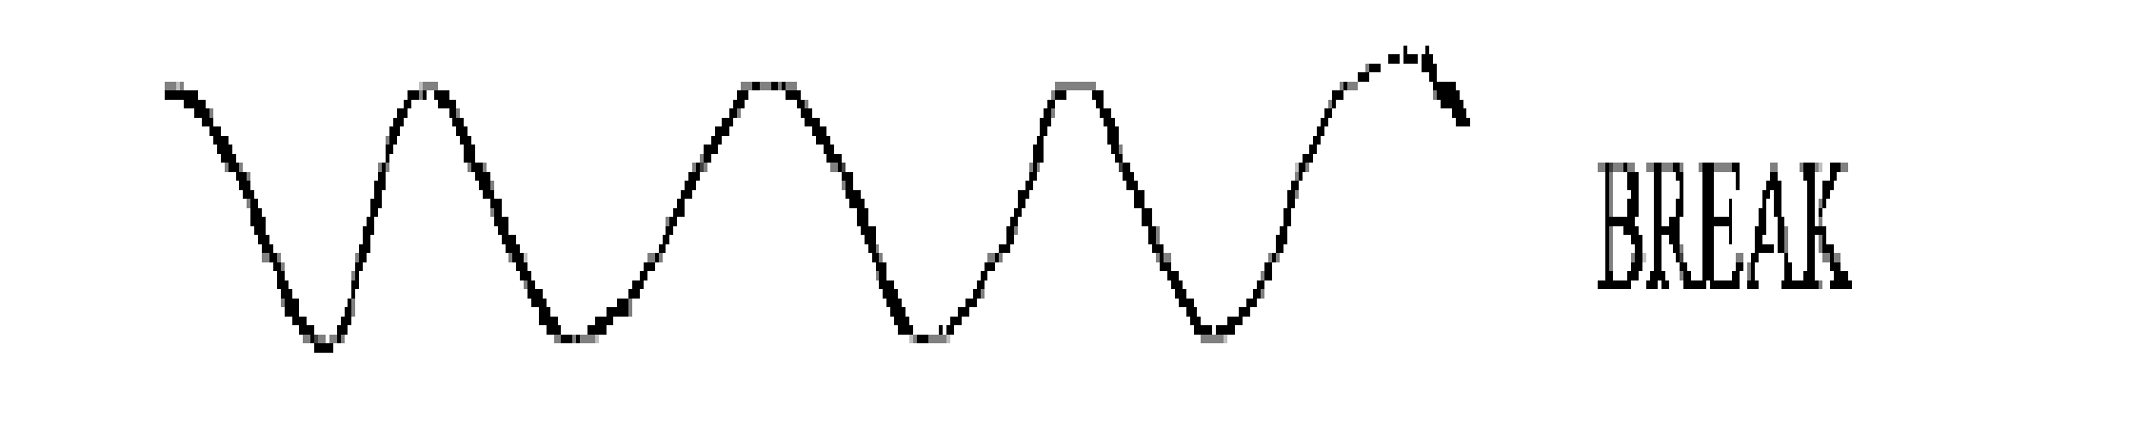
Break Lines
Break lines are irregular, “squiggly” lines that indicate an imaginary break in the drawing.
‹#›/81

Slide 20
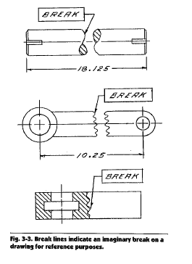
Break Line Example (Cont’d.)
‹#›/81

Slide 21

Cutting Plane Lines
A cutting plane line dissects a part so that we can view it as if it were open or divided in some way. They are generally heavy and seen as a long dash with two short dashes. Arrowheads are used at the end of the cutting plane lines
‹#›/81

Slide 22
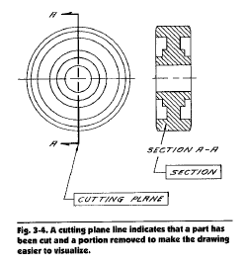
Cutting Plane Example (Cont’d.)
‹#›/81
Notes:
Note that cutting plane lines use arrowheads

Slide 23
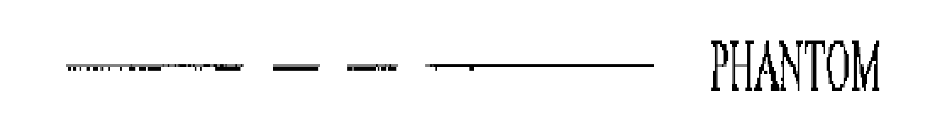
Phantom Lines
Phantom lines have the same appearance as cutting plane lines (long dash with two short dashes). However, they indicate repeated details, alternate positions of moving parts, and the material to be used on or for a part before machining.
‹#›/81

Slide 24
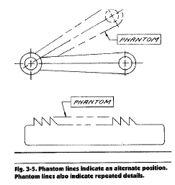
Phantom Line Example (Cont’d.)
‹#›/81

Slide 25
Sections
Many times, it is not possible to see all of the many features of a part or product at once, nor it is possible to draw all necessary features using one view
Often necessary to view the piece in parts called sections
‹#›/81

Slide 26
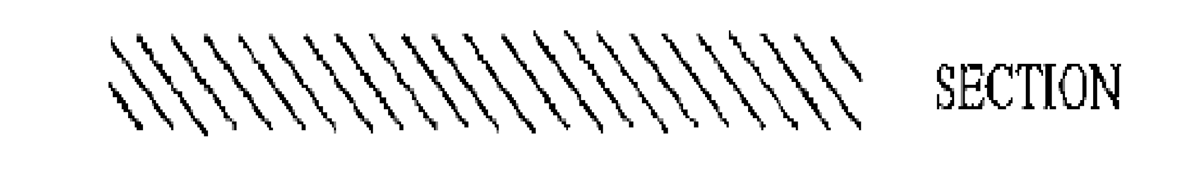
Section Lines
Section lines (or crosshatch lines) indicate the section to be viewed in a section view. They are composed of lines that are close together and are typically set at a 45 degree angle.
‹#›/81

Slide 27
Full Section
Shown using an imaginary cut along the full length of the object; shown as a cutting plane line
Uses arrow heads and letters located at both ends
‹#›/81

Slide 28
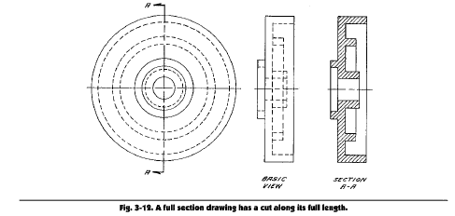
Full Section View
‹#›/81

Slide 29
Half Section
Used primarily for symmetrical parts
Similar to a full section, except only half of the object is cut and removed
‹#›/81

Slide 30
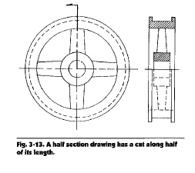
Half Section View
‹#›/81

Slide 31
Offset Section
Cut at an angle or position to the part that allows the reader to view features that are not in a straight line
‹#›/81

Slide 32
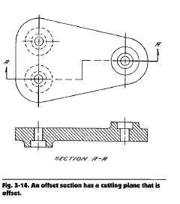
Offset Section View
‹#›/81

Slide 33
Broken-out Section
Used to show a portion of an object
Drawn only when a specific area needs to be illustrated for clarification
‹#›/81

Slide 34
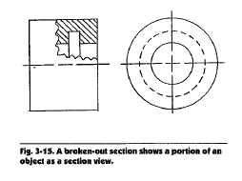
Broken-out Section View
‹#›/81

Slide 35
Revolved Section
Revolved section – A revolved section is a bit more complicated than the previous types of section drawings. It is drawn as if the object were cut and turned at right (90 degree) angles within the same view.
‹#›/81

Slide 36
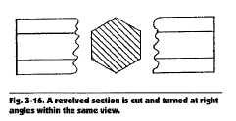
Revolved Section View
‹#›/81

Slide 37
Other Industrial Print Features
Fasteners and threads are not broken into sections; more easily recognized by their exterior form
Thin parts are often shown as heavy lines
‹#›/81

Slide 38
Holes
Labeled with varying dimensions depending on the blueprint’s view of the part
If a view of the object is taken from directly overhead, only the diameter or radius of that hole should be shown
Must view it at least a number of times that would allow the viewers to see all dimensions (depth, width/radius, etc.) of the hole
‹#›/81

Slide 39
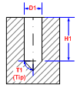
Simple Hole
Bored straight into the part or product with no other features
‹#›/81

Slide 40
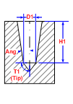
Tapered Hole
Tapers to its opening
Needs angle measurement
‹#›/81

Slide 41
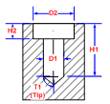
Counterbore Hole
A section above the hole is bored for a fitting or topping for the object to be inserted into the hole
Needs the height and dimension of the counter bore
‹#›/81

Slide 42
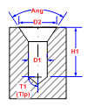
Countersink Hole
Has a tapered bore above the simple hole
Tapered area can only fit a tapered screw or fitting
Needs the measurement of the angle for the tapered opening
‹#›/81

Slide 43
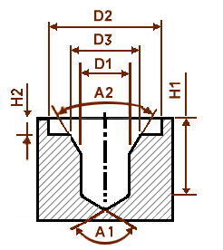
Counterdrilled Hole
More complex
Components of all of the above
Made for special fittings
‹#›/81

Slide 44
Material Identification
The blueprint reader will encounter different types of lines serving as section lines to tell the viewer that different materials are being used
Lines should NEVER be used to identify any type of material
‹#›/81

Slide 45
Engineering Change Note (ECN)
The Engineering Change Note, or ECN can be found in the change block. When changes are made to the drawing, the ECN is also updated.
The title block can be found on the bottom-right portion of the print; contains information on the title and authorship
‹#›/81

Slide 46
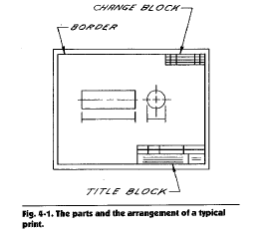
Engineering Change Note
‹#›/81

Slide 47
Dimensions
Dimension on a blueprint indicate measurements of parts
Typically given in inches without the inch marking (e.g., 11.5 or 11 ½ instead of 11.5” or 11 ½”)
Normally made up of two extension lines, a dimension, and a measurement number
‹#›/81

Slide 48
Dimension Reading
A dimension on a blueprint is normally portrayed as two extension lines, a dimension line, and a measurement number.
If a group or “cluster” of parts is found to be out of spec, the production worker or quality manager should notify the appropriate management employees to investigate the issue.
‹#›/81

Slide 49
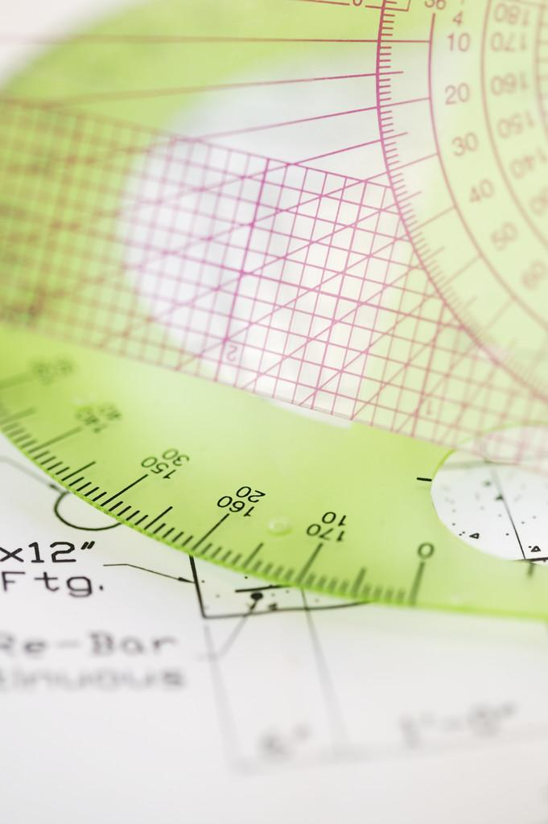
Drafting Terms
Limits:
  Largest and smallest allowable dimensions of a part such as maximum 0.750” and a minimum is 0.740”.
Tolerance:
  Permissible variation of size of the part is a range within the overall limits. Using the limits here is an example of possible tolerance range such as 0.745”± 0.003”.
‹#›/81

Slide 50
Specifications
Specs are the dimensional (length, width, height, etc.) measurements that must be met for each part in order for an entire product to fit together and function correctly
Specs are usually comprised of geometric dimensions and tolerances (+ 0.001 or + 0.005)
‹#›/81

Slide 51
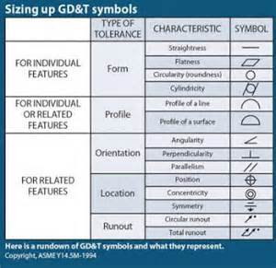
Geometric Dimensioning and Tolerancing (GD&T)
A system for defining and communicating engineering tolerances
  Controls
    Form
    Profile
    Orientation
    Location
    Runout
‹#›/81

Slide 52
Maximum Material Condition
When a part feature, such as an attached screw or bolt, contains the maximum amount of material allowed within the specified tolerances, it is said to be in maximum material condition (MMC).
An external feature, such as a fastener, is said to be at maximum material condition when it’s at its upper size limit
An internal feature, such as a hole, is at its maximum material condition when it’s at its lower size limit
‹#›/81

Slide 53
Least Material Condition
When a part feature contains the least amount of material that is allowed within its specific size limits, it’s said to be in least material condition (LMC).
‹#›/81

Slide 54
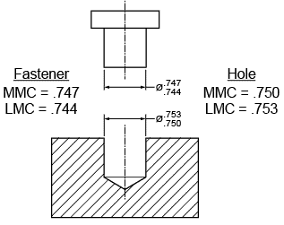
Example
‹#›/81

Slide 55

QUESTION
The length of a part is given as 5.456 inches (- .004). Indicate which of the follow parts are ok to ship?
  5.460 ________
  5.056 ________
  5.458 ________
  5.452 ________
‹#›/81

Slide 56
QUESTION
The length of a part is given as 2.995 inches (+/- .005). Indicate which of the follow parts are in/out of spec?
  2.974 ________
  3.005 ________
  2.995 ________
  2.998 ________
‹#›/81

Slide 57
Conforming or Non-conforming Parts
    Spec –Width: 3.75 in wide + 0.1 in; Actual part is 3.75 in wide
    Spec – Length: 4.00 + 0.005 in long; Actual length is 4.01 in
    Spec – Length: 4.00 + 0.01 in and Width: 2.00 + 0.001; Actual length: 4.01, Actual width: 2.02
‹#›/81

Slide 58
‹#›/81

Slide 59
Wisc-on Line Exercises
Schematics diagrams
Basic elements of dimensions
Title block tolerances
Basic engineering symbols
Print reading
Interpreting engineering drawings
Analyzing a part drawing
‹#›/81

Slide 60
Common Mechanical Symbols
Angularity
Between
Conical taper
Counter bore
Countersink
Depth/deep
Diameter
Perpendicularity
‹#›/81

Slide 61
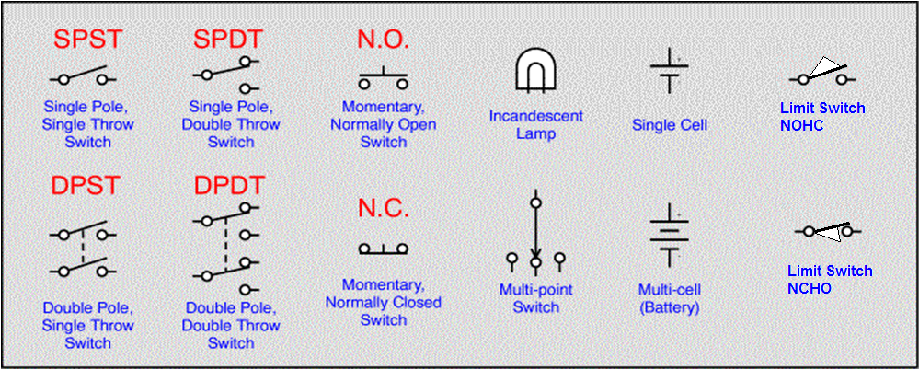
Common Electrical Symbols
KNOW THESE LIMIT SWITCHES
Figure 4-2-1: Electrical Symbols
‹#›/81
Notes:
NOHC – Normally open held close
NCHO – normally closed held open

Slide 62
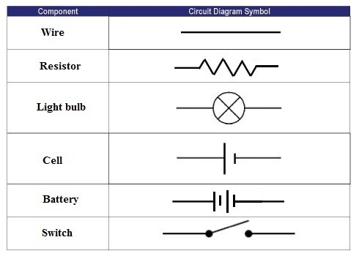
Basic Schematic Reading
Name three symbols you use in your workplace that represent an idea or concept.
‹#›/81

Slide 63
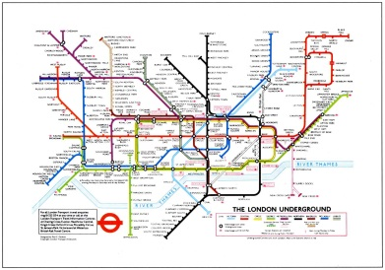
Basic Schematic Reading (Cont’d.)
20
‹#›/81

Slide 64
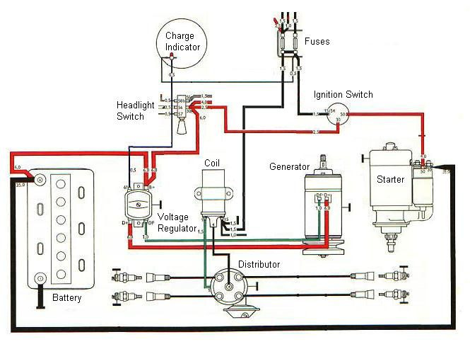
Basic Schematic Reading (Cont’d.)
22
‹#›/81

Slide 65
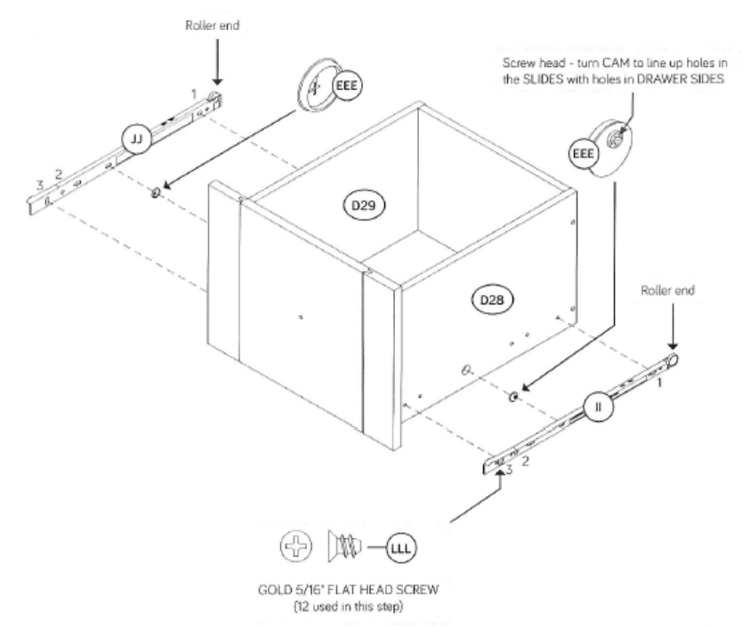
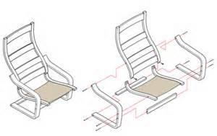
Assembly Drawings
Exploded
Detailed
‹#›/81
Notes:
The difference is in the amount of detail provided.

Slide 66
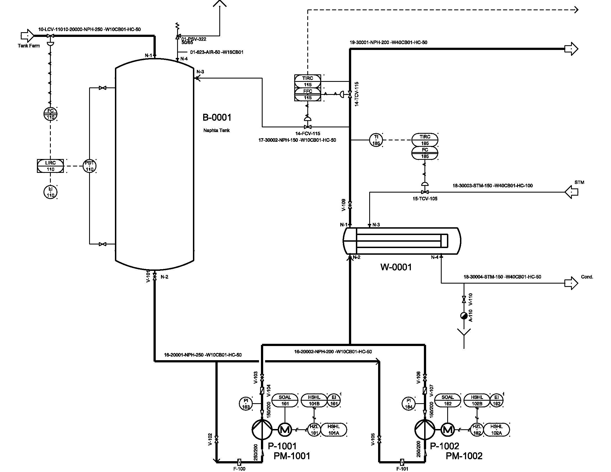
  Piping & Instrumentation Drawing (P&ID)
Process flow diagrams of fluid systems
Show process locations
of:
  Blowers
  Condensers
  Compressors
  Heat exchangers
  Process instrumentation
  Pumps
  Tanks
  Valves (manual and control)
‹#›/81

Slide 67
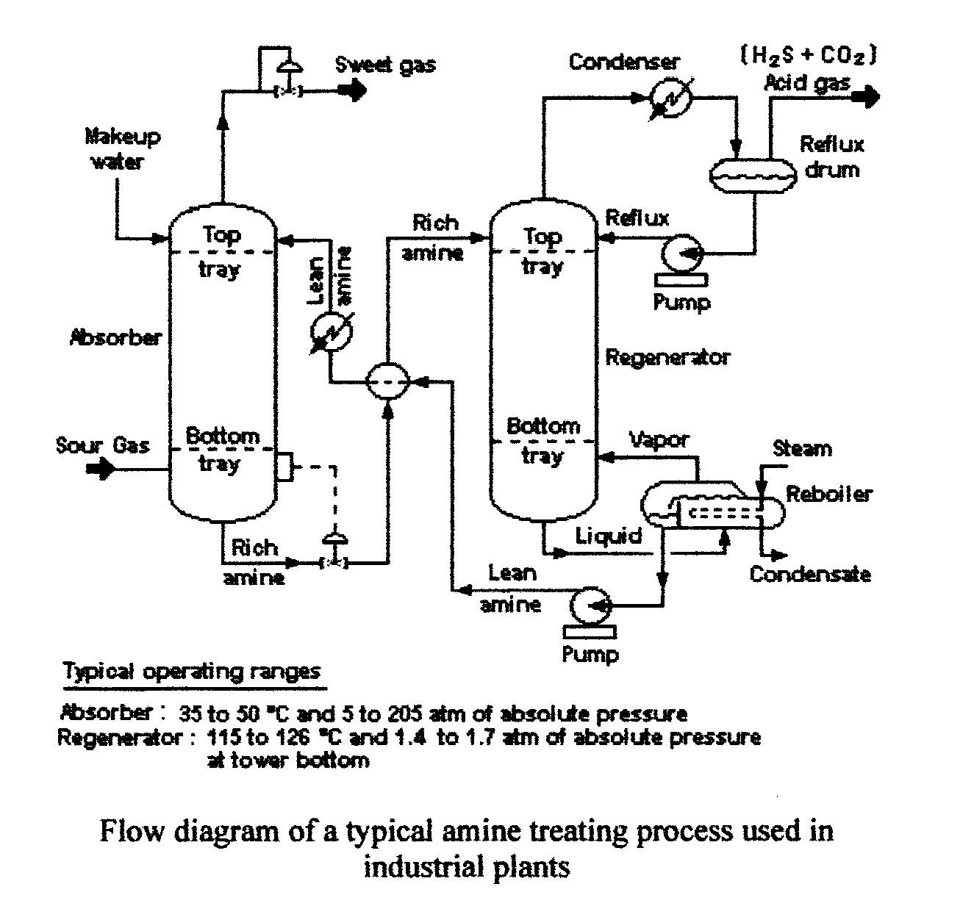
Piping & Instrumentation Drawing (Cont’d.)
‹#›/81

Slide 68
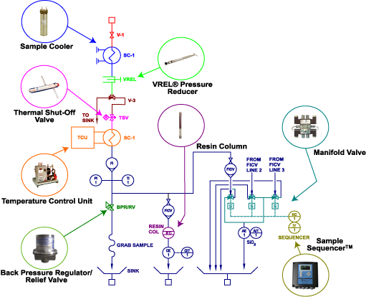
  Piping & Instrumentation Drawing (Cont’d.)
Figure 4-4-5: P&ID
‹#›/81
Notes:
Note: The drawing on Slide 4-4-68 and Figure 4-4-5 is unusual, in that industrial prints do not normally contain enlarged graphics as show in the “blow-out” circles.

Slide 69
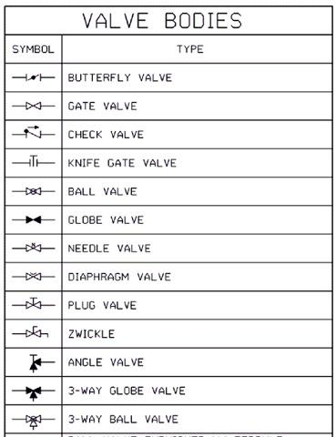
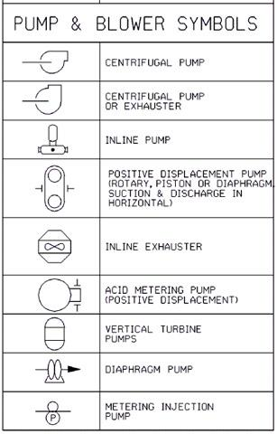
P&ID Symbols
‹#›/81
Notes:
Note: These are the most common symbols, but these lists are not all inclusive.

Slide 70
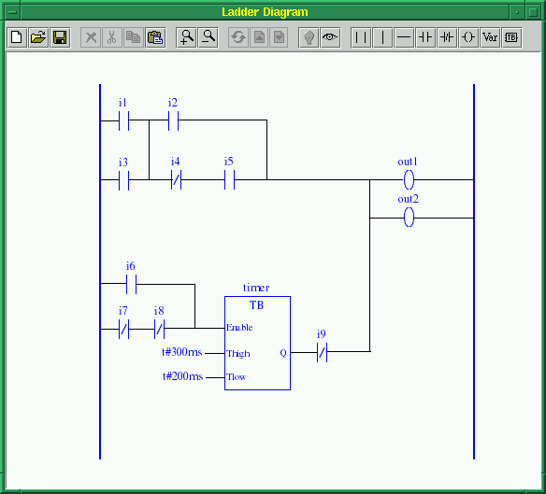
  Ladder Diagrams
Ladder logic drawings are used to document and to troubleshoot programmable logic controller (PLC) systems.
‹#›/81

Slide 71
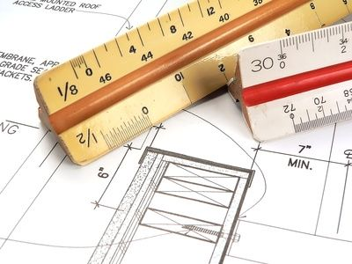
Basic Industrial Print Scales
27
‹#›/81

Slide 72
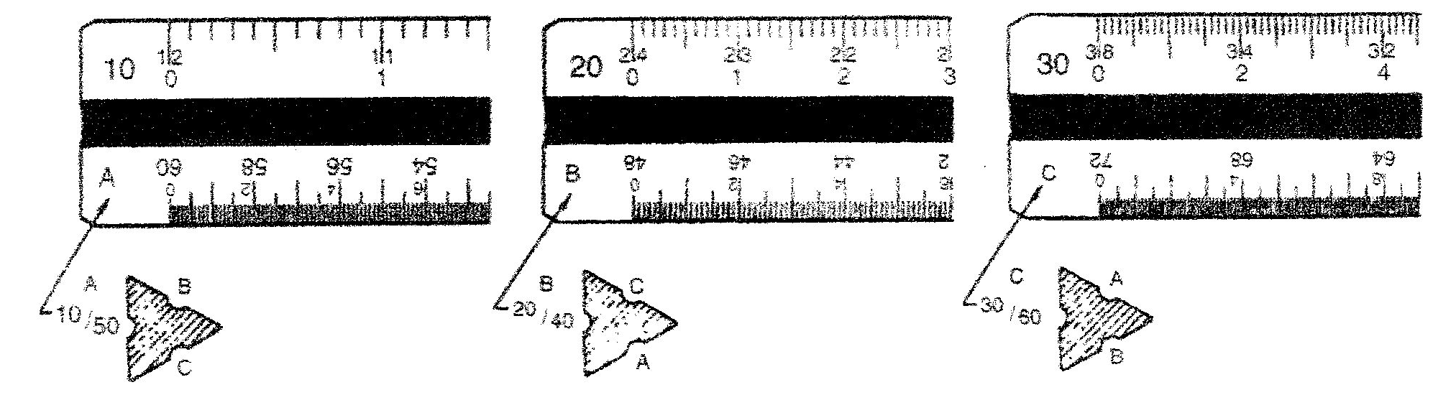
Basic Blueprint Scales
Architectural- Standard Scales
Engineering- Metric Scales
‹#›/81

Slide 73
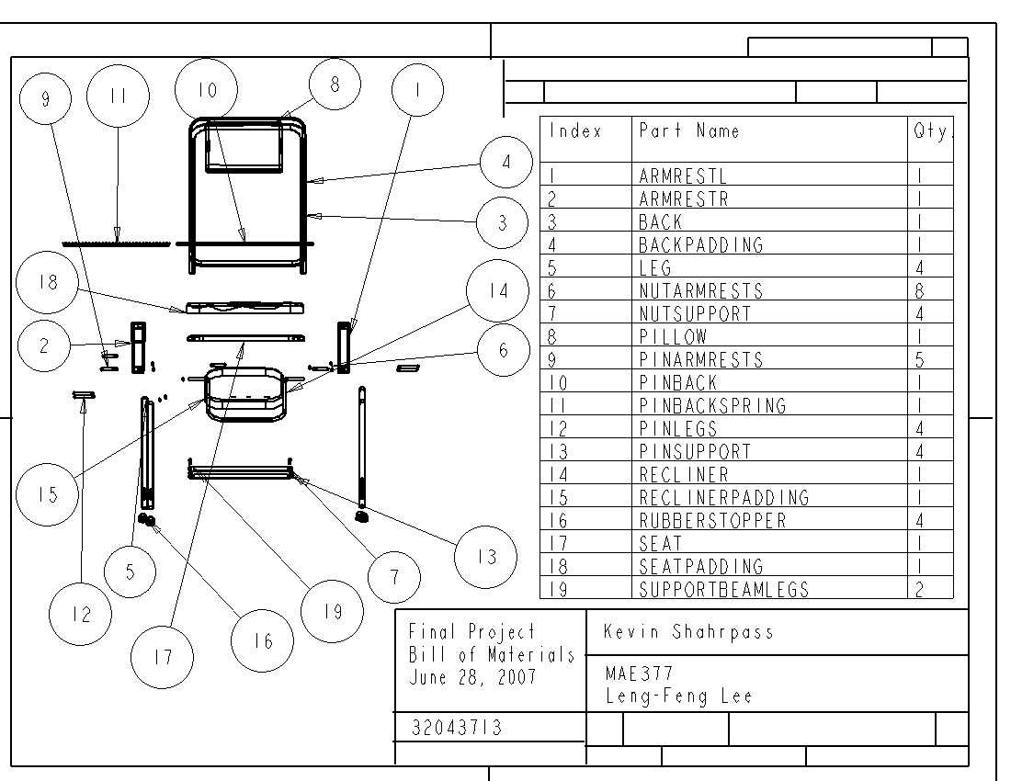
Bill of Material (BOM)
Engineering: reflects product as designed by engineering; ECN’s note change to design
Manufacturing: reflects product as planned by manufacturing, listing parts, materials, and tools
‹#›/81

Slide 74
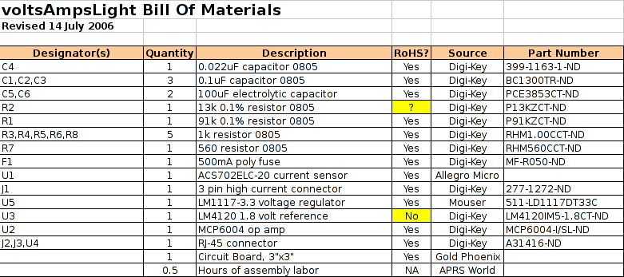
Bill of Material Example
14
‹#›/81

Slide 75
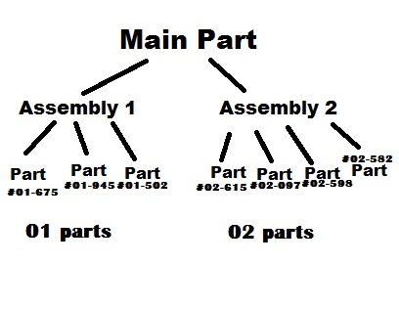
BOM Sub-Parts
16
‹#›/81

Slide 76
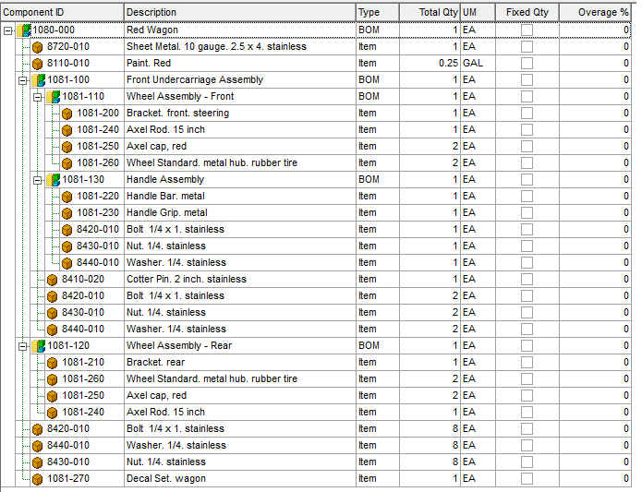
BOM Showing Parts and Sub-Parts
17
Part level numbers reflect assemblies and sub assemblies
‹#›/81

Slide 77
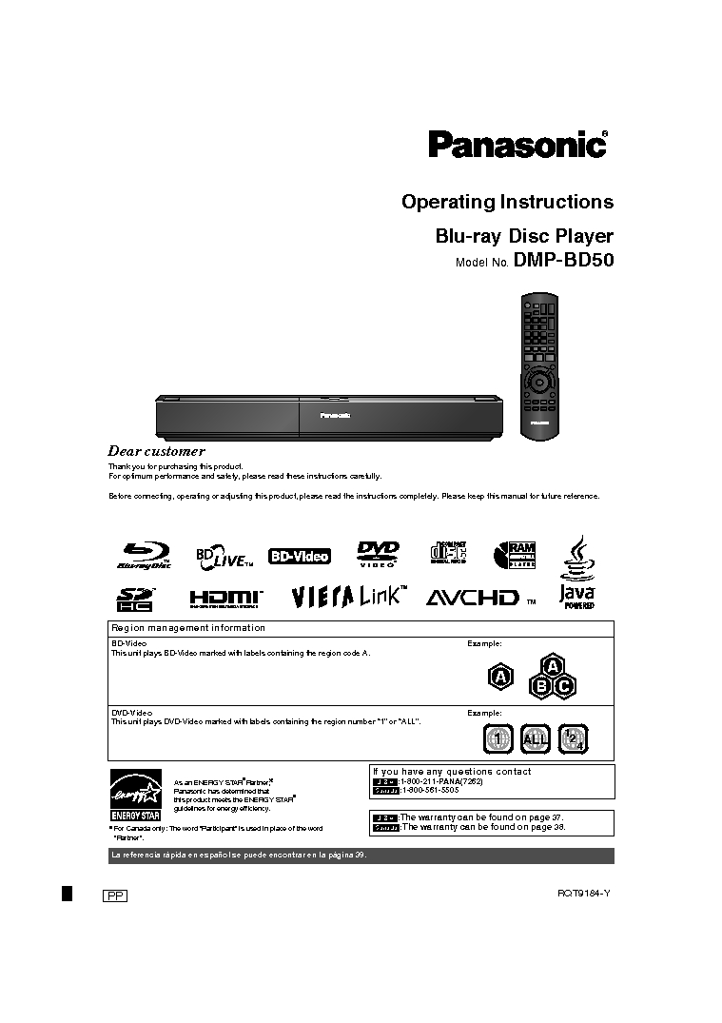
Operating Instructions
Contain tool and equipment requirements for particular part numbers
‹#›/81

Slide 78
Computer-Aided Manufacturing (CAM)
Does not eliminate the need for skilled professionals
Leverages the value of skilled professionals
Builds skills of new professionals
‹#›/81

Slide 79
Terms Associated with
Computer-Aided Manufacturing
CAD – Computer Aided Design
CAE – Computer Aided Engineering
CNC – Computer Numerical Control
NC – Numerical Control
G-Code – Program commands for CNC
PLM – Product Lifecycle Management
CIM – Computer Integrated Manufacturing
ISO – International Standards Organization
‹#›/81

Slide 80
Summary
Provided a knowledge of basic blueprint features and functions
Identified several types of lines, views, and holes commonly found on blueprints
Identified the function of material condition measurements
Taught you to read a basic blueprint
‹#›/81

Slide 81
Summary
Skills essential for manufacturing
Basic schematic reading
Basic blueprint reading
Bill of material (BOM)
Material requirements planning (MRP)
Enterprise resource planning (ERP)
‹#›/81

