Slide 1

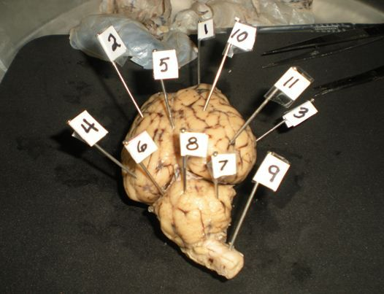
Welcome to Forensic Science!
Mr. Fernandez – Room 119
Catalyst (Bell Work):
1. Using your powers of observation, to determine the organ shown in this image.
2. Name as many of the labeled parts of this organ as possible.
3. This organ was removed from what animal?
(Hint: this animal has a mass of 45-100 kg or 100 to 220lbs.)

Slide 2
Today’s Agenda
Mr. Fernandez’s Background
Student handbook/Course Syllabus/Expectations
Partner Perceptions
Investigator Dossier

Slide 3
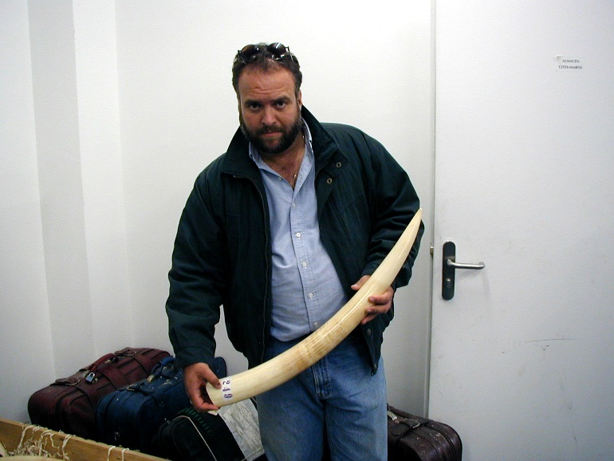
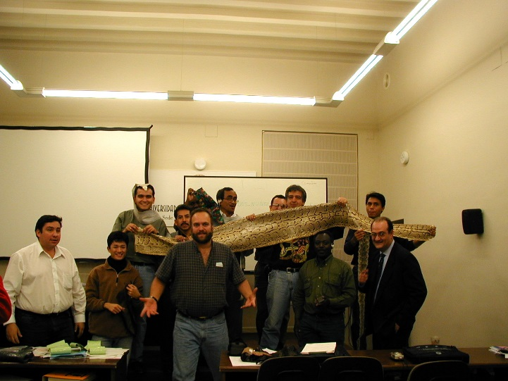

General Science
Who is Mr. Fernandez?
Paleontologist
Archaeologist
MSSC CPT
Investigator
PADI RESCUE DIVER
Researcher
Conservation
Electronics Ecology
MPA’s
Teacher
ETC.

Slide 5
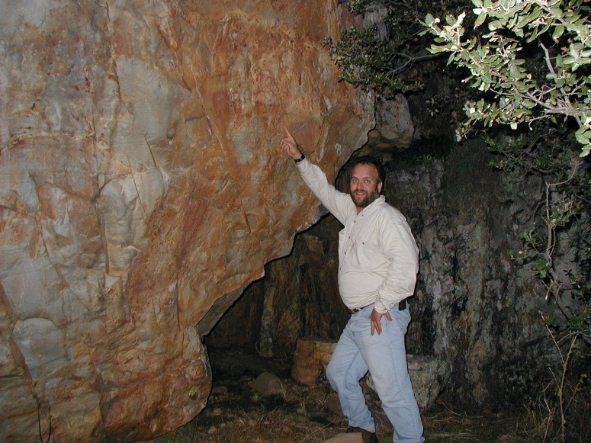
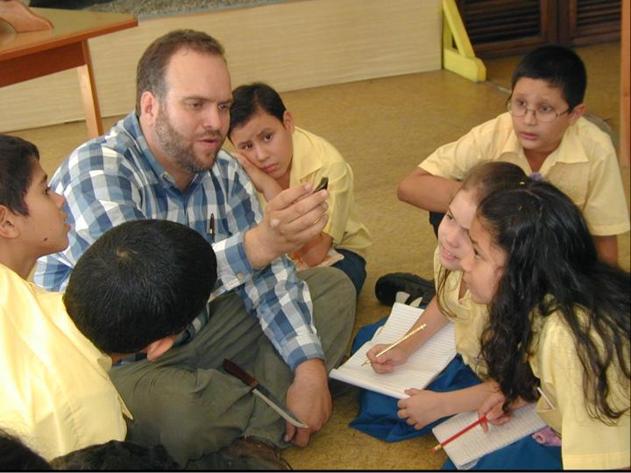
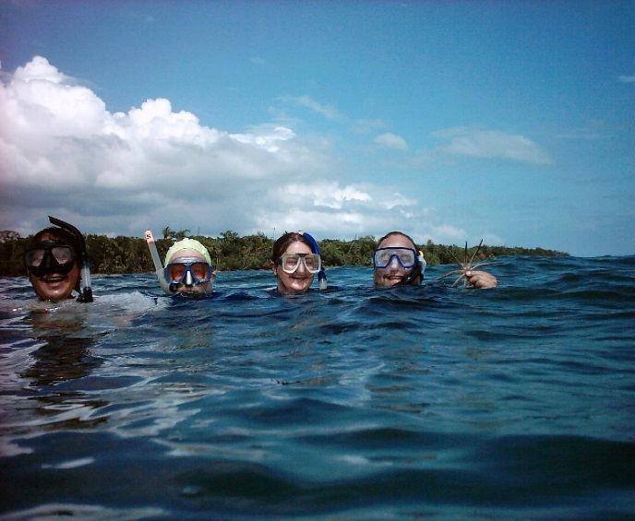
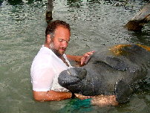

Slide 6




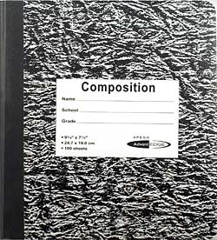
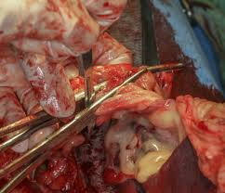
Course Syllabus & Expectations
Materials
Course Content
Expectations

Slide 7
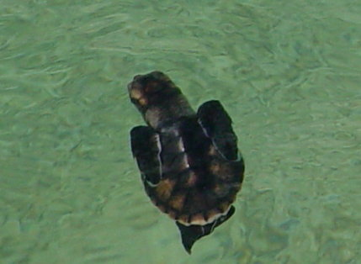
Course Syllabus & Expectations
Grading
Attendance
Passes
Classroom Behavior

Slide 8
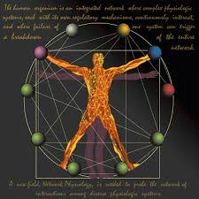

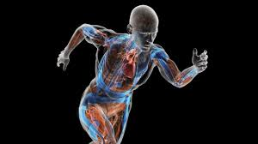
Course Syllabus & Expectations
Any questions?

Slide 9
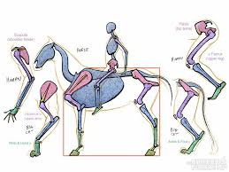
Observation Activity
Follow my Instructions

Slide 10
Investigator Dossier
Now that you have had a *brief* taste of how perceptions affects observations, I want to see your perception of yourself by filling out an investigator dossier.
Reminders
Agreements: Due Friday, September 4, 2015
Investigator Dossier: Due Monday, September 7, 2020
Essential Questions: Due Friday, September 11, 2020
Have a great rest of the day and week!

