Slide 1
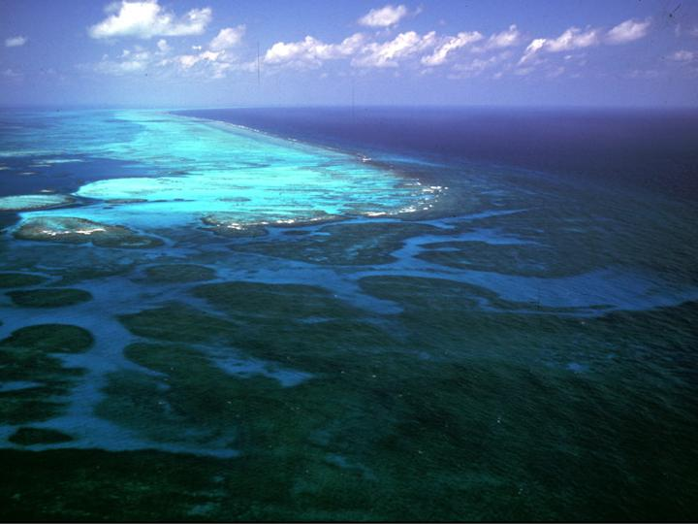
Welcome to
Marine Science
Gladden Spit, MBRS, Belize
Notes:
‹#›

Slide 2
Today’s Agenda
Mr. Fernandez’s Background
Student handbook/Course Syllabus/Expectations
Partner Perceptions
Investigator Dossier

Slide 3
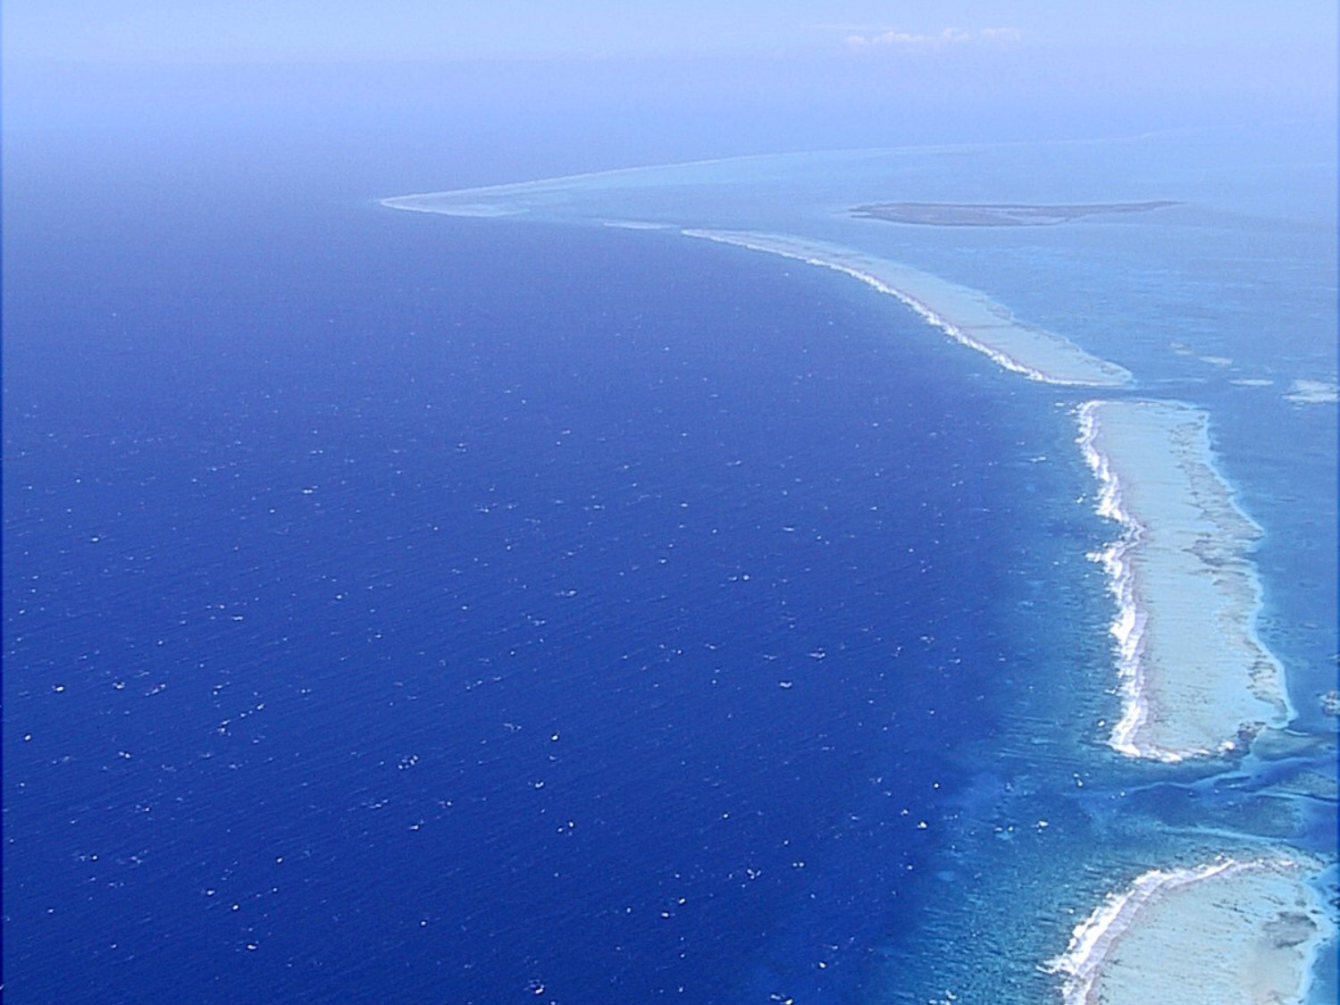
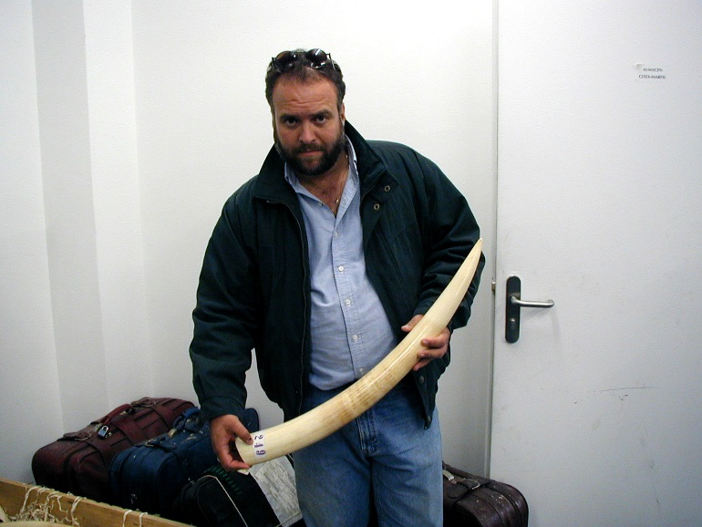
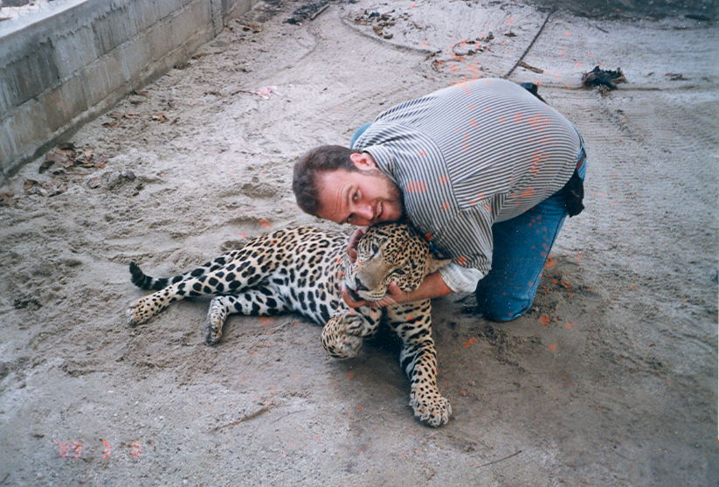
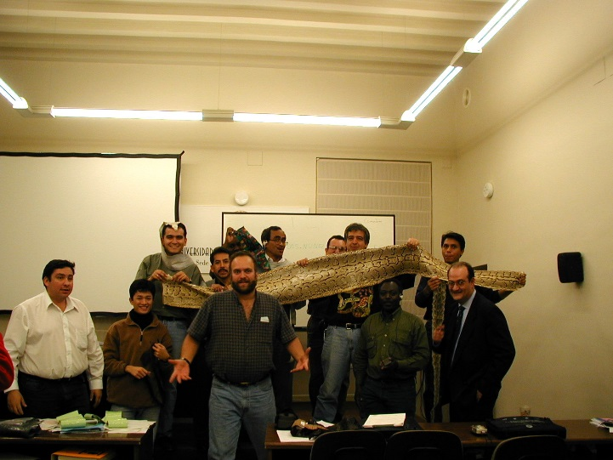

General Science
Who is Mr. Fernandez?
Paleontologist
Archaeologist
Investigator
PADI RESCUE DIVER
Researcher
Conservation
Electronics Ecology
MPA’s
Teacher
ETC.

Slide 4
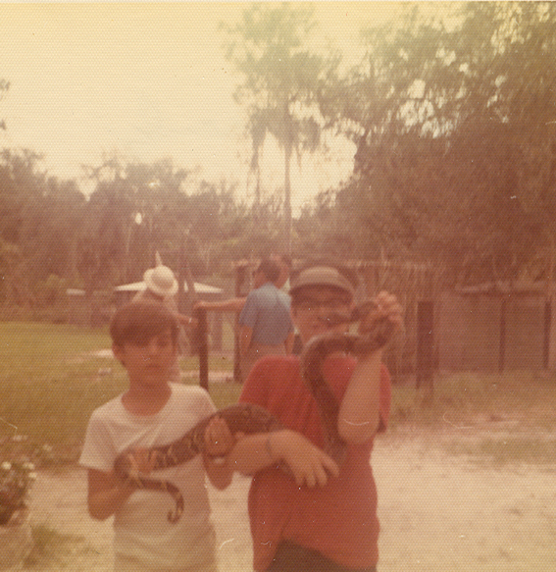
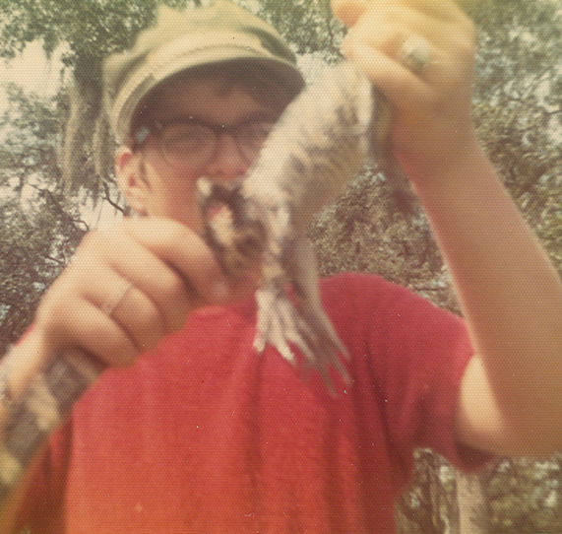
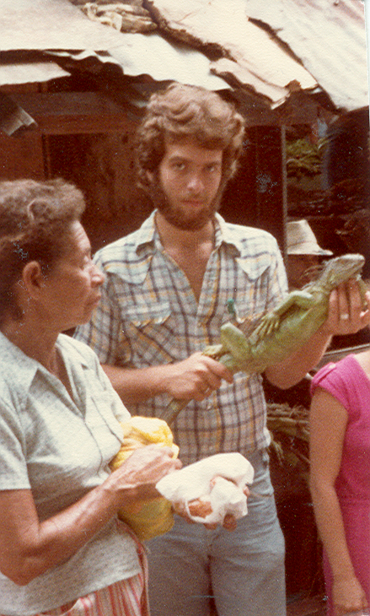
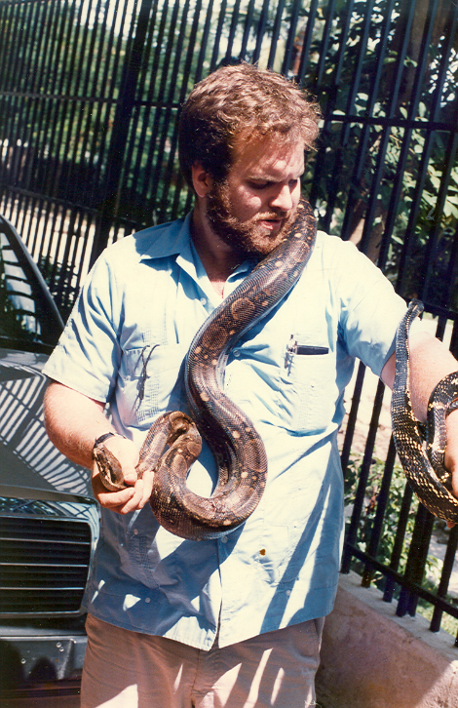
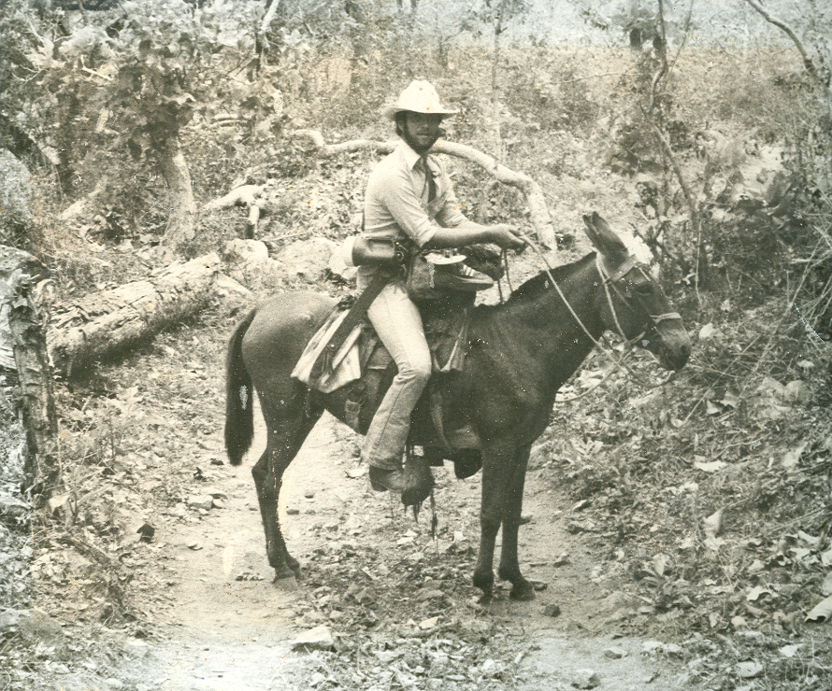

Slide 5
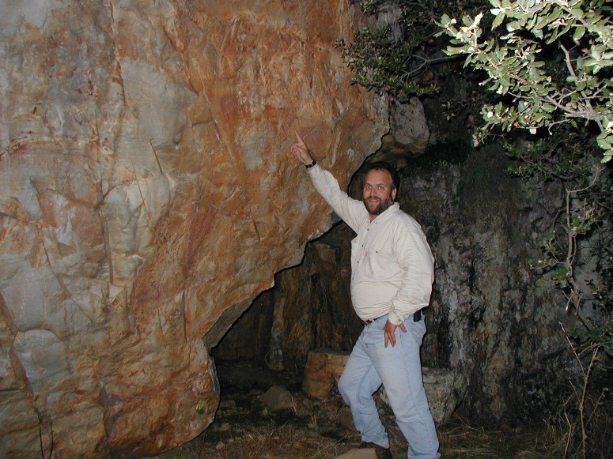
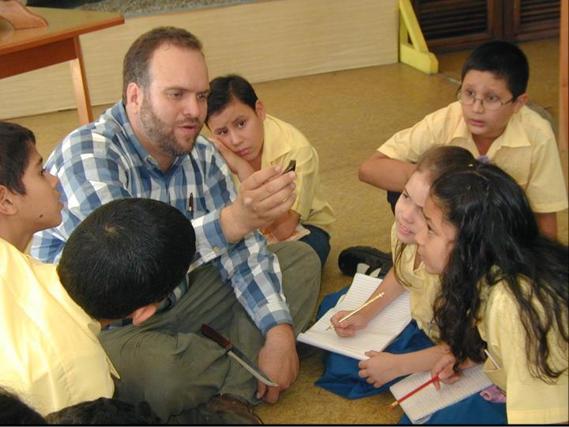
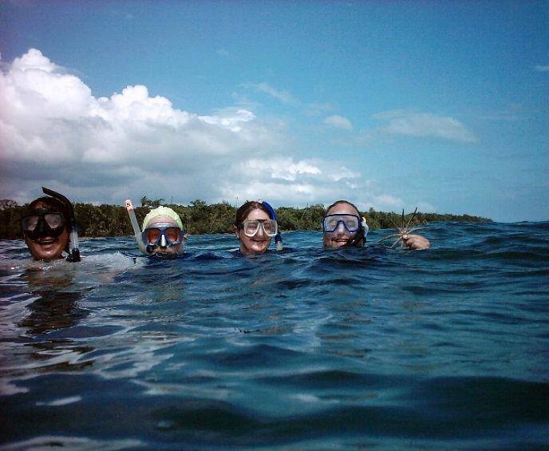
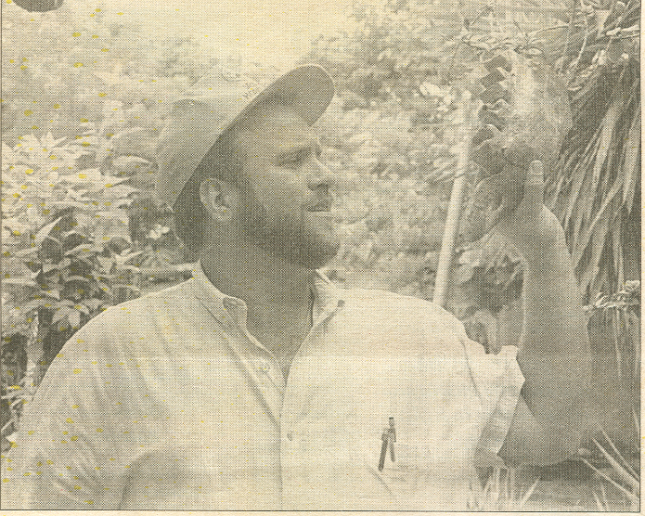
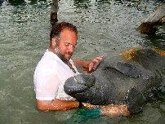

Slide 6
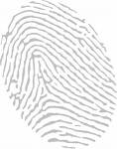
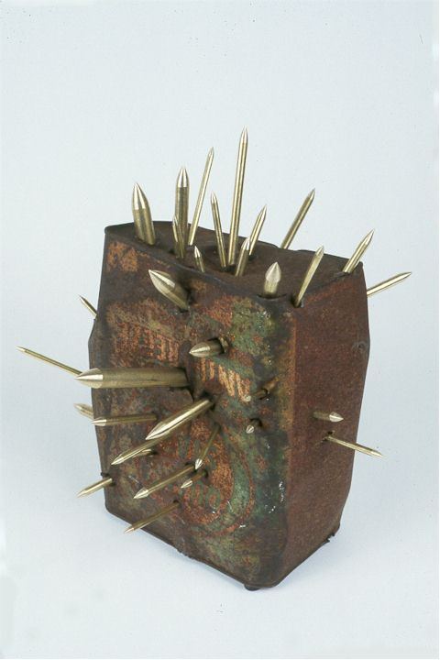

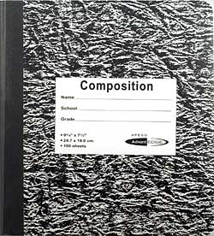
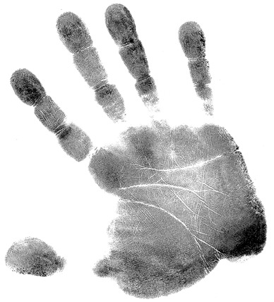
Course Syllabus & Expectations
Materials
Course Content
Expectations

Slide 7
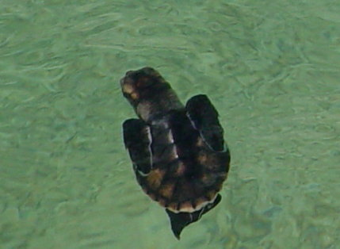
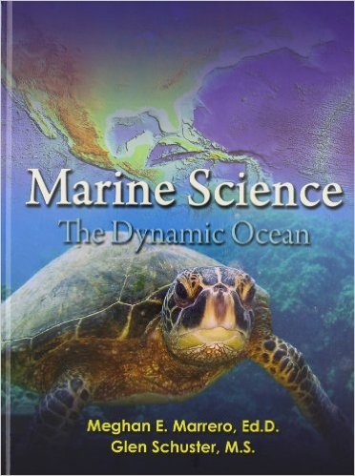
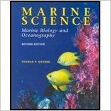
Course Syllabus & Expectations
Grading
Attendance
Passes
Classroom Behavior

Slide 8


Course Syllabus & Expectations
Any questions?

Slide 9
Do Now
What is the first thing that comes to mind when you hear, or see, the word “Marine”?
Notes:
‹#›

Slide 10

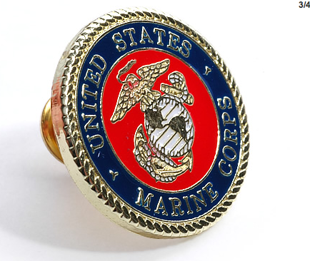
Was it this???
Notes:
‹#›

Slide 11
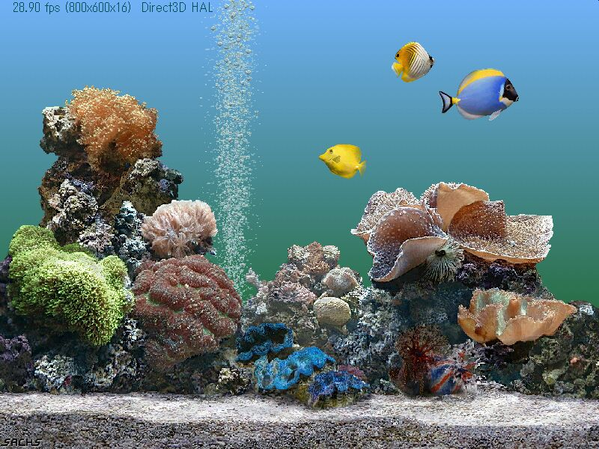
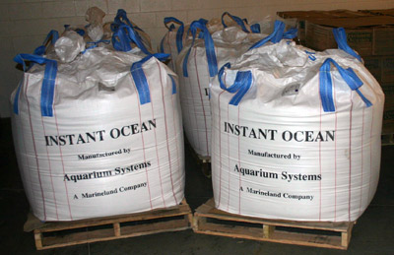
Or was it this??
Notes:
‹#›

Slide 12
The word “Marine”:
Refers to; anything of, found in, or produced by the sea.
Notes:
‹#›

Slide 13
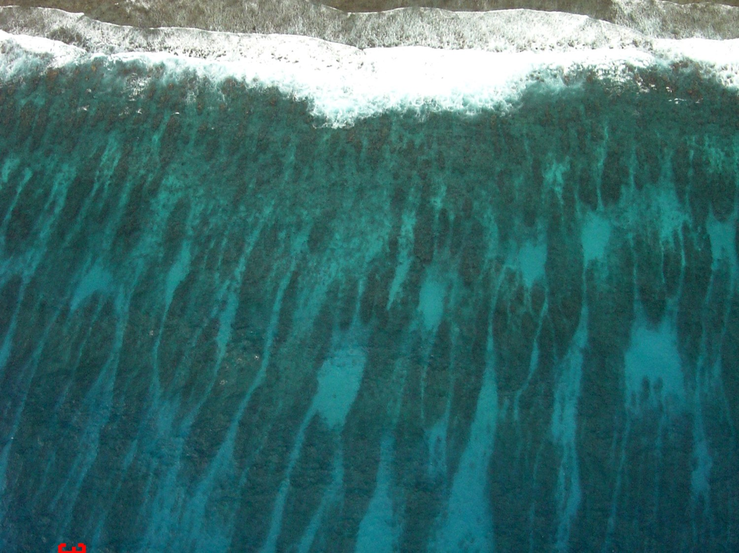
Oceanography vs Marine Biology
Marine Science, Oceanography or Oceanology is the branch of Science that Studies the oceans.
Marine Biology is the study of life in the ocean.
Sir Charles Thompson is considered to be the “Father of Oceanography”.
Notes:
‹#›

Slide 14
Four Fields in Marine Science
Marine Physics
Marine Chemistry
Marine Geology Marine Biology
Other important subfields:
Marine geography
Marine Technology
including Remote Sensing

Slide 15
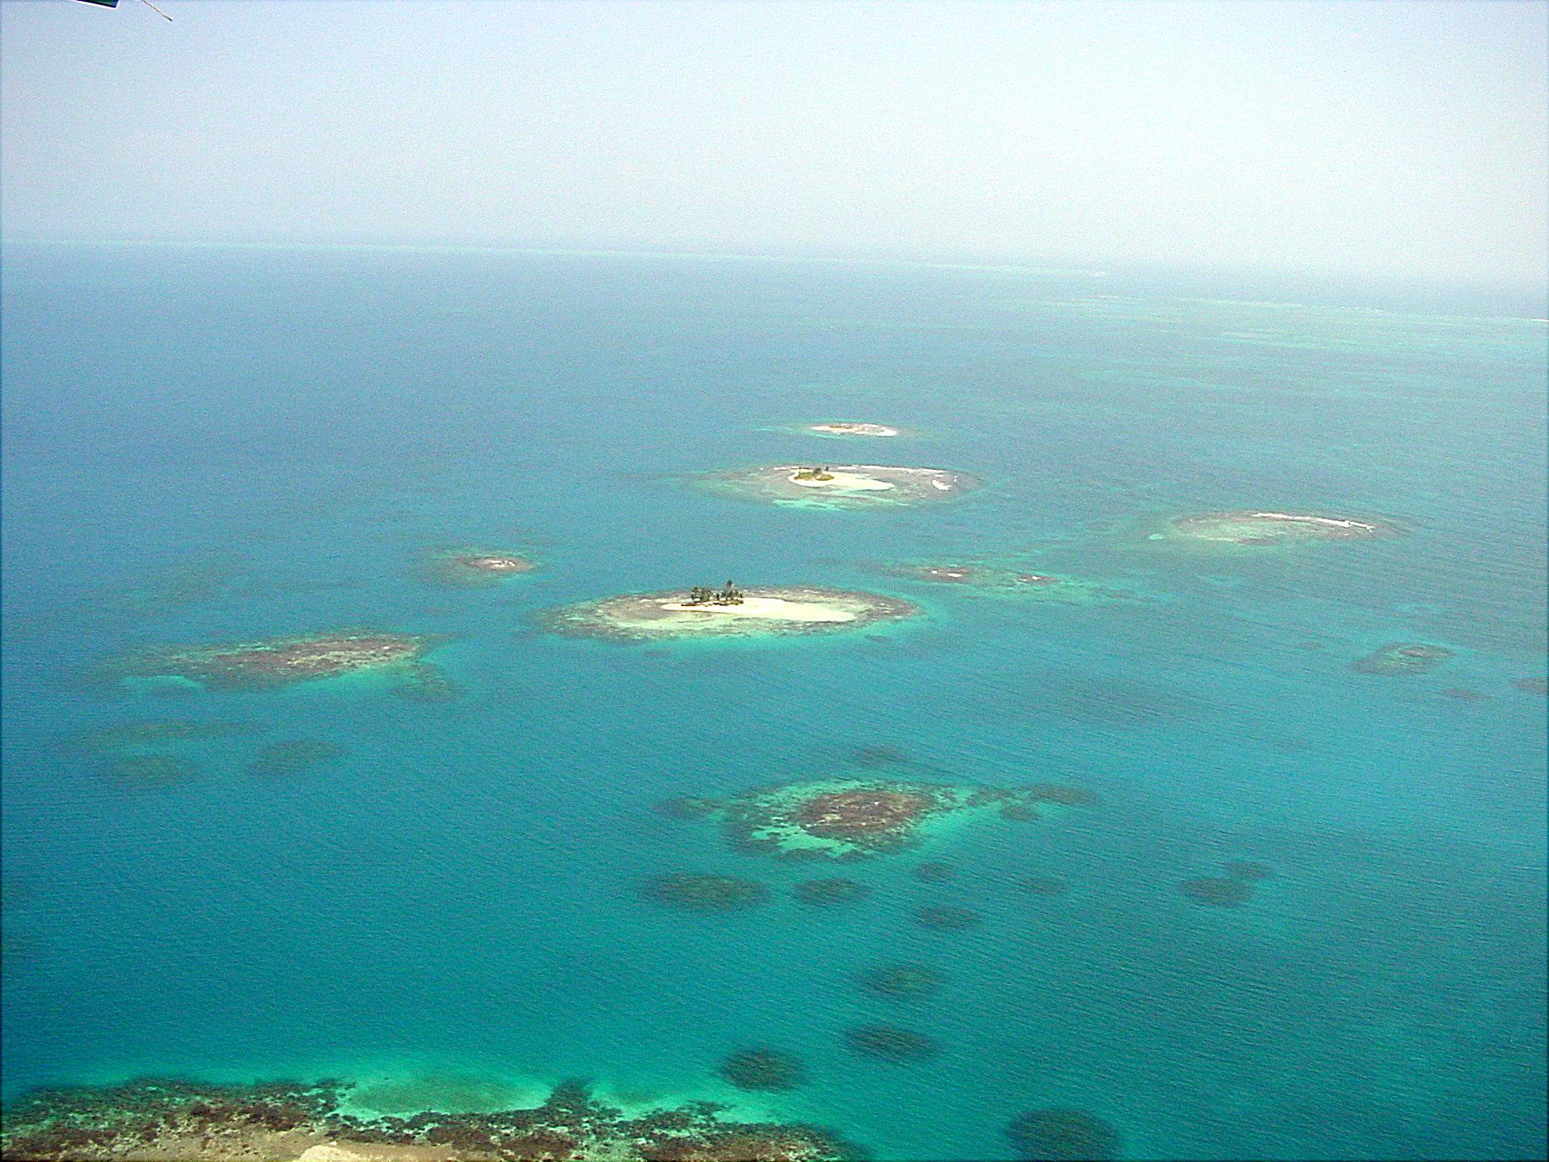
Physical Characteristics of Water
Color
Temperature
Turbidity- cloudiness
Salinity- saltiness
Pressure
Currents
Density

Slide 16
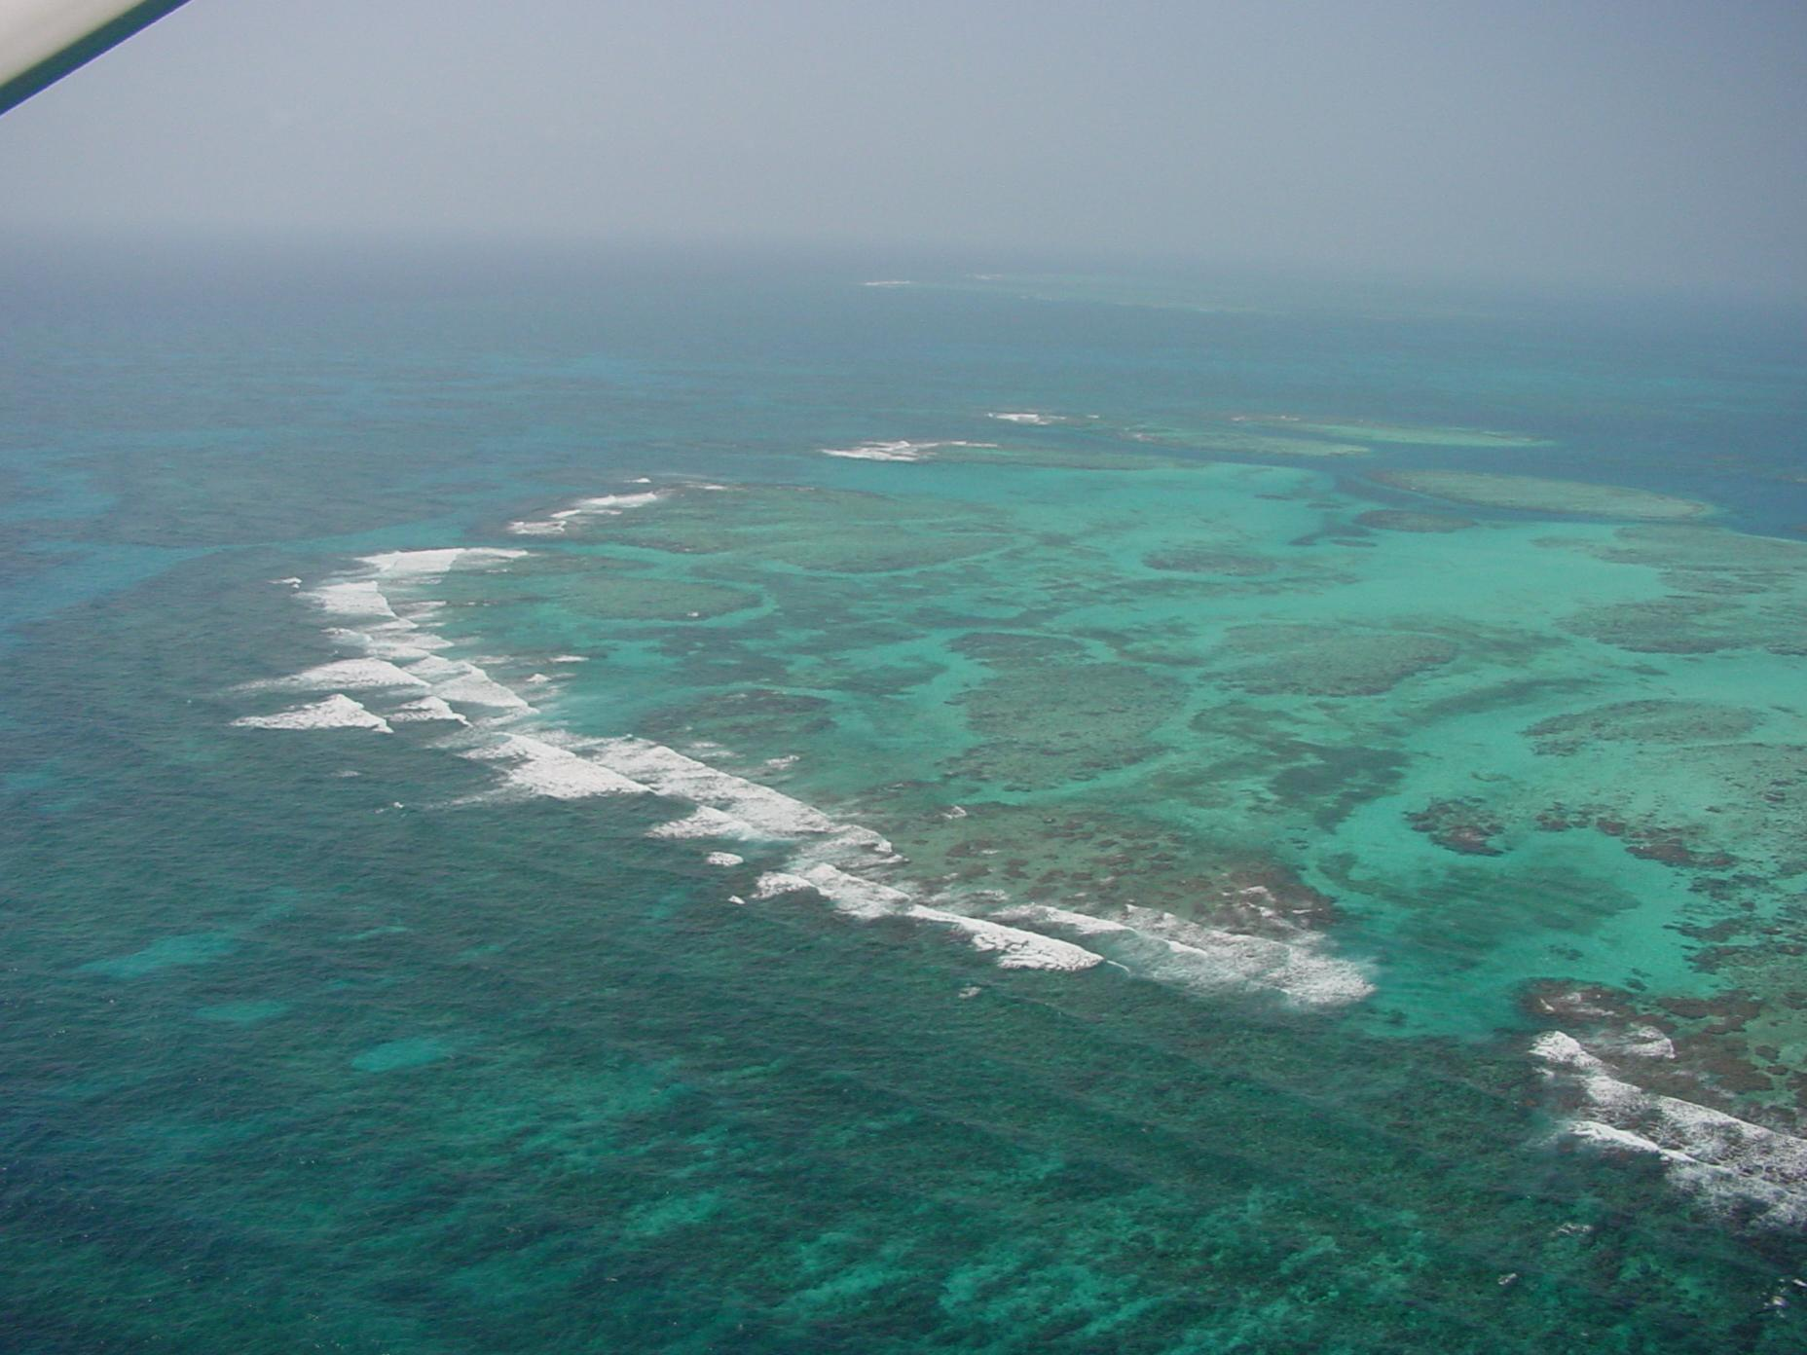
The Water Planet
Our Earth is made up of 71% water.
Most of that water is marine (salt).
Less than 10% of the Earth’s water is freshwater.
Of that 10% less than 3% is drinkable! What is the other 7%?
Notes:
‹#›

Slide 17
Do Now
Think of 3 things, that are of, found in, or are produced by the sea!
Notes:
‹#›

Slide 18
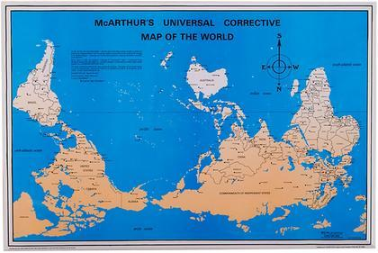

Slide 19

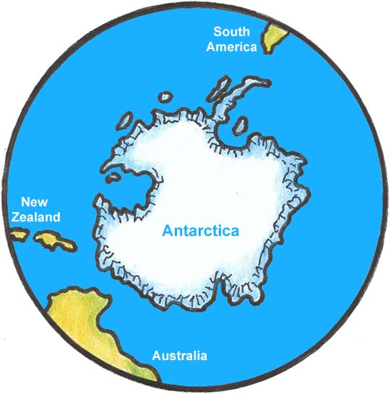

Slide 20
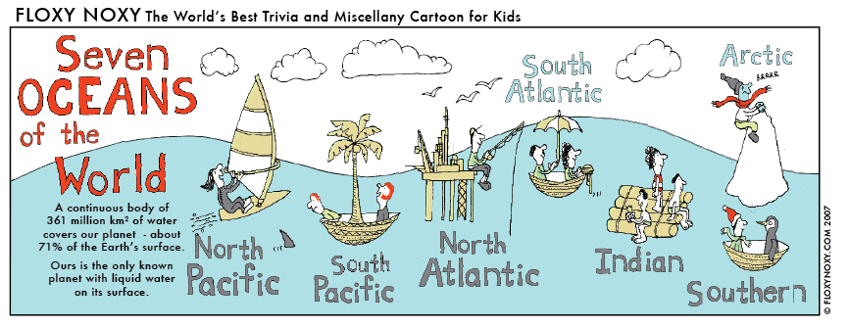
Oceans 7!
Notes:
‹#›

Slide 21
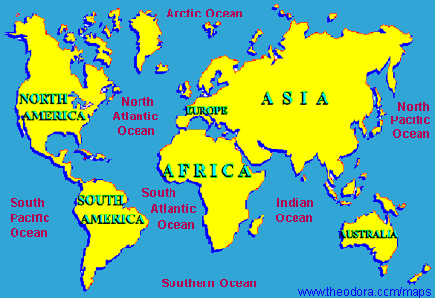
Where are they Found?
Notes:
‹#›

Slide 22
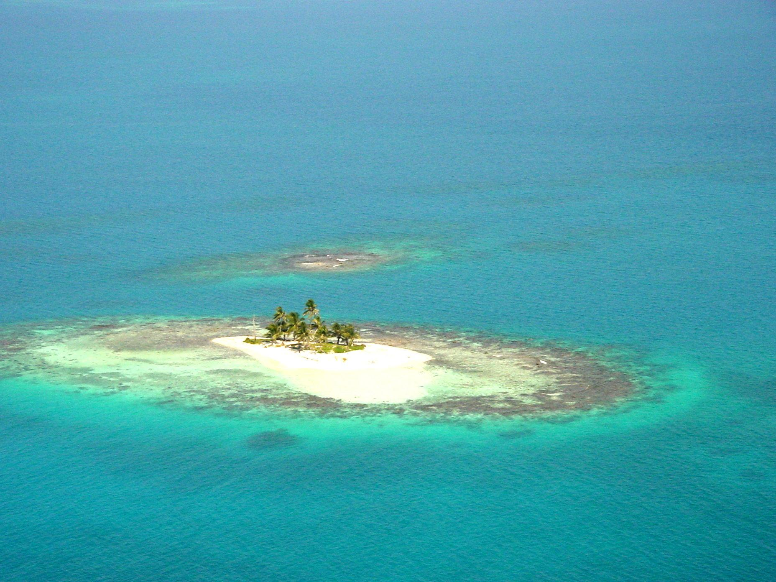
Let’s Review
What is the difference between Marine Biology and Oceanography Also called Marine Science?
How much of our planet is covered by water? How much of that is freshwater?
Define the word Marine.
How many Oceans are there? Name them.
Notes:
‹#›

Slide 23
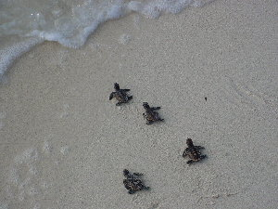
Now, sit back and let me introduce you to some of my “friends”………..

Slide 24
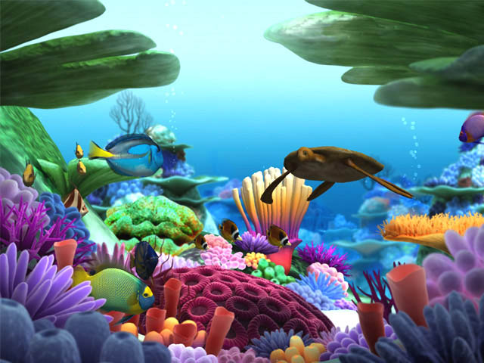

A Tribute to the Undersea World
Notes:
‹#›

Slide 25
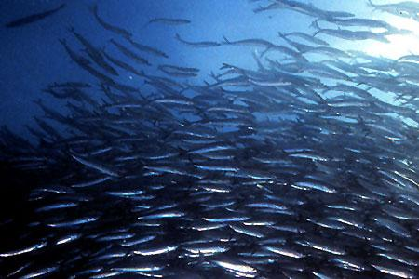
Notes:
‹#›

Slide 26
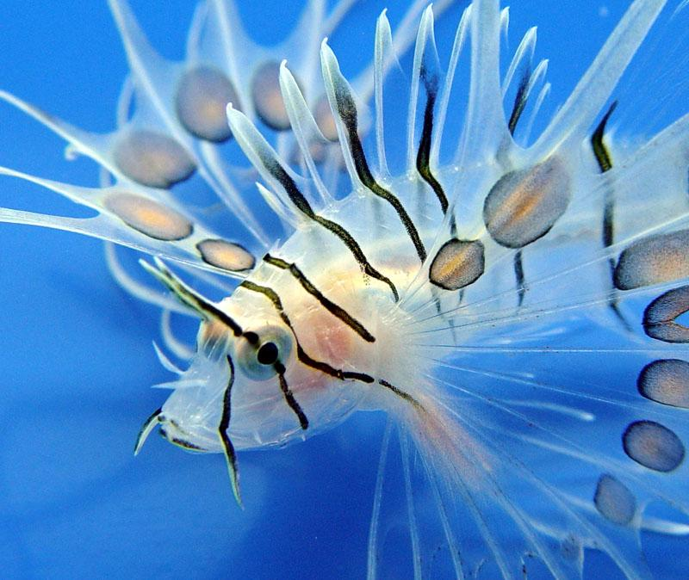
Notes:
‹#›

Slide 27
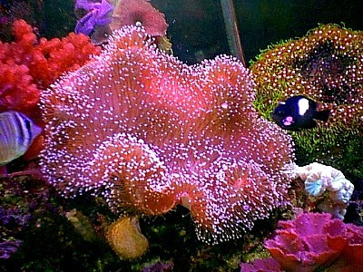
Notes:
‹#›

Slide 28
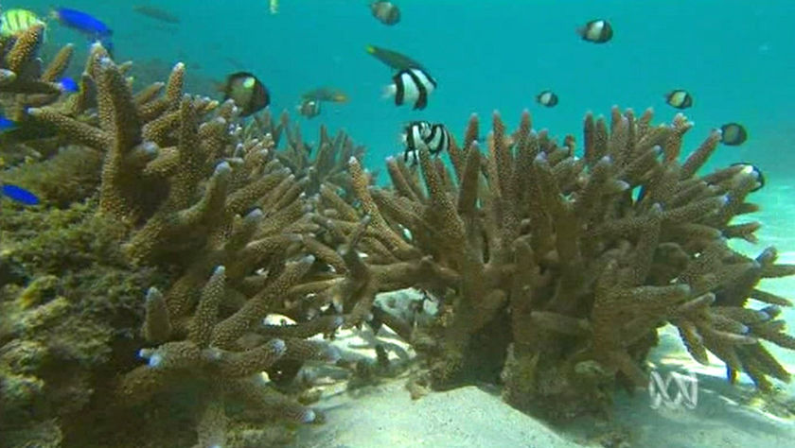
Notes:
‹#›

Slide 29
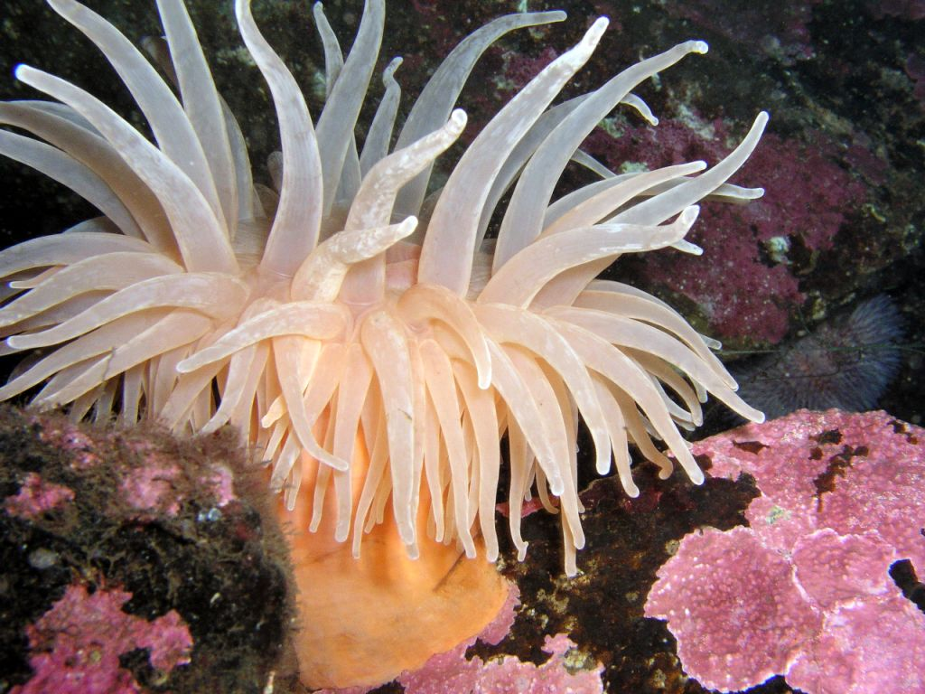
Notes:
‹#›

Slide 30
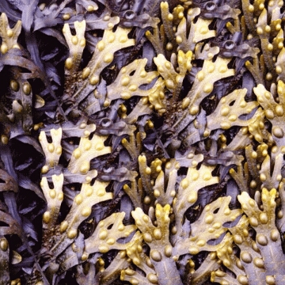
Notes:
‹#›

Slide 31
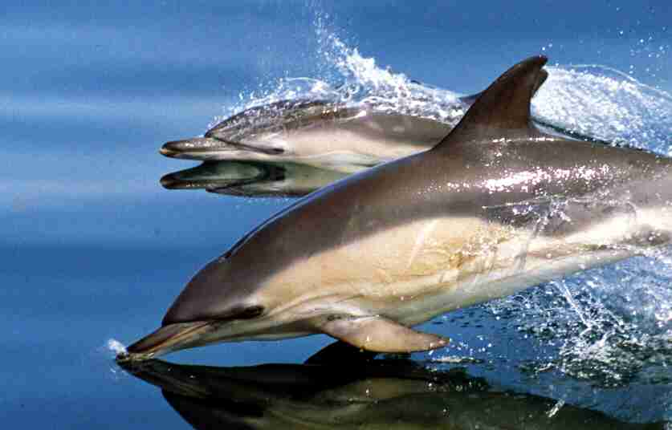
Notes:
‹#›

Slide 32
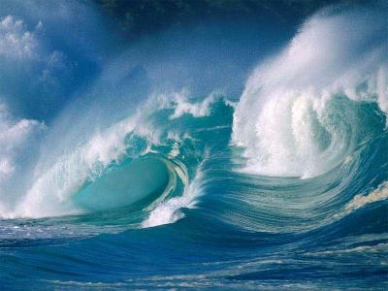
Notes:
‹#›

Slide 33
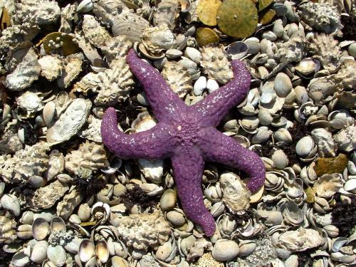
Notes:
‹#›

Slide 34
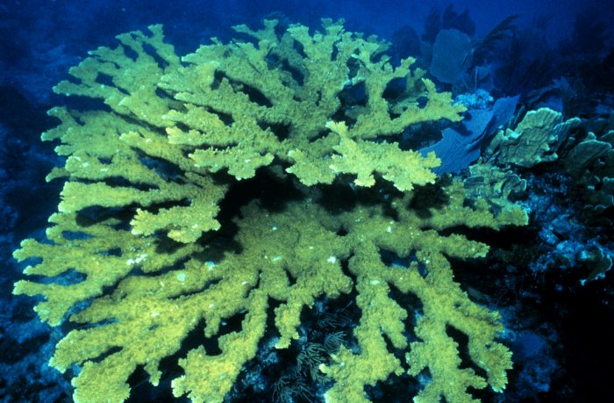
Notes:
‹#›

Slide 35
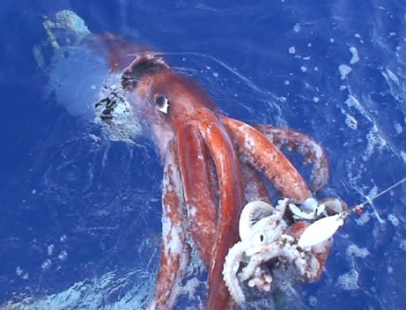
Notes:
‹#›

Slide 36
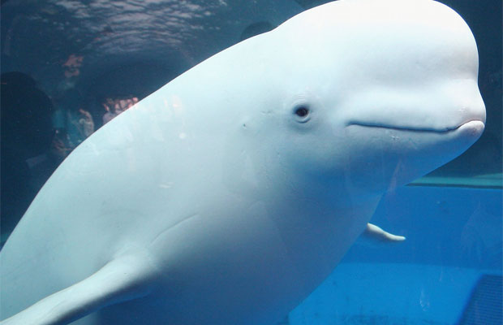
Notes:
‹#›

Slide 37
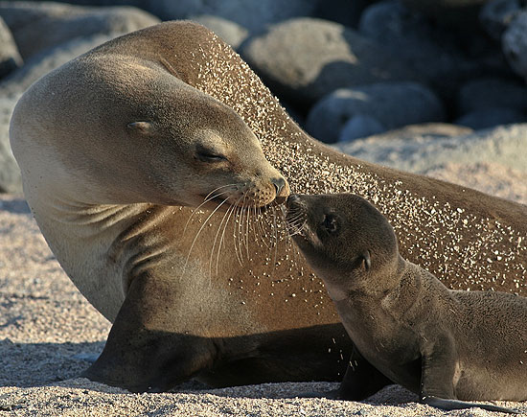
Notes:
‹#›

Slide 38
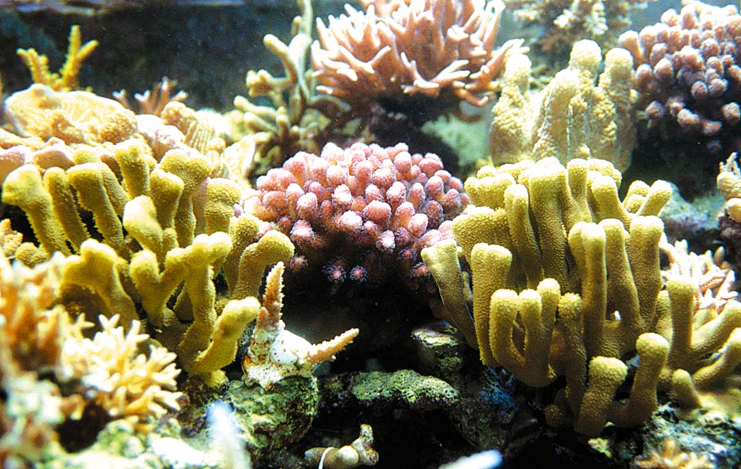
Notes:
‹#›

Slide 39
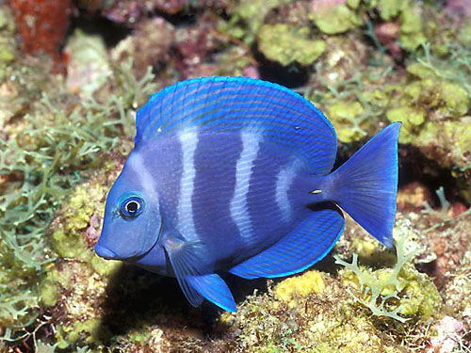
Notes:
‹#›

Slide 40

Notes:
‹#›

Slide 41

Notes:
‹#›

Slide 42

Notes:
‹#›

Slide 43

Notes:
‹#›

Slide 44

Notes:
‹#›

Slide 45

Notes:
‹#›

Slide 46

Notes:
‹#›

Slide 47

Notes:
‹#›

Slide 48

Notes:
‹#›

Slide 49

Notes:
‹#›

Slide 50

Notes:
‹#›

Slide 51

Notes:
‹#›

Slide 52

Notes:
‹#›

Slide 53

Notes:
‹#›

Slide 54

Notes:
‹#›

Slide 55

Notes:
‹#›

Slide 56

Notes:
‹#›

Slide 57

Notes:
‹#›

Slide 58

Notes:
‹#›

Slide 59

Notes:
‹#›

Slide 60

Notes:
‹#›

Slide 61

Notes:
‹#›

Slide 62

Notes:
‹#›

Slide 63

Notes:
‹#›

Slide 64


Notes:
‹#›

Slide 65

Ocean Explorers and Navigators
Notes:
‹#›

Slide 66
Explorers/Navigators
Vikings | Scandinavian Countries | Newfoundland, Canada
Columbus | Spain/Italy | Bahamas
Balboa | Spain | Panama
Magellan | Portugal | Americas to Philippines
Verrazano | Italy | North America
Notes:
‹#›

Slide 67
Why Did They Explore?
A sense of adventure
Opportunities to expand trade routes
Conquer new lands
Obtain great wealth
Notes:
‹#›

Slide 68
Diving
Through the Ages
Notes:
‹#›

Slide 69



What do you think each piece of equipment is used for?
Notes:
‹#›

Slide 70


How difficult is it to see underwater without a facemask? Why?
Notes:
‹#›

Slide 71

History of Diving
4500 years ago the ancient Greeks were the first to “dive”.
They used newly developed glass, it was very primitive and difficult to see through.
They dove for ornamental shells.
Notes:
‹#›

Slide 72

Diving Chamber
The diving chamber was a huge barrel that contained a limited supply of air!
It was attached to a ship, limited movement.
Was made of metal so you couldn’t see through it
Notes:
‹#›

Slide 73

Diving Suit
The Diving Suit (1873)was made of watertight canvas
had a heavy metal helmet into which air was pumped from the surface.
Limited movement, still attached to the ship.
Notes:
‹#›

Slide 74

“12 Steps to Honor”
Notes:
‹#›

Slide 75

SCUBA
SCUBA- self contained underwater breathing apparatus (aqualung) was developed by Jacques Cousteau and his partner Emil Gagnan in 1942.
It allowed for greater movement and freedom underwater.
Notes:
‹#›

Slide 76

Jacques Cousteau
Notes:
‹#›

Slide 77

SCUBA Gear
Notes:
‹#›

Slide 78
Summary
Advances in technology, especially in the past 150 years, have given people the ability to explore the ocean:
at greater depths
for longer periods of time
with more safety and mobility
Notes:
‹#›

Slide 79
Do Now
Read pages 15 (bottom)- 20.
Answer section review questions 1-3 on page 20.
Notes:
‹#›

Slide 80
Submersibles and
Sonar
Notes:
‹#›

Slide 81
Why were scuba divers not used to locate the resting place of the Titanic?
Notes:
‹#›

Slide 82
How was the Titanic located?
Using sonar and submersibles.
1934 Dr. William Beebe reached a depth of 900 meters in a steel chamber called a Bathysphere ( fits 2 people).
In 1960 a Swiss team of Auguste and Jacques Piccard, made the deepest dive in a submersible (bathyscaphe) to the bottom of the Mariana Trench (10,852 meters- 4 hrs.).
Alvin is a submersible that has logged in over 1000 dives. It holds a crew of 3.
Dr. Sylvia Earle holds the record for the deepest solo dive- 380 meters. (Jim Suit)
Notes:
‹#›

Slide 83




Beebe’s Bathysphere

Slide 84





The Jim Suit
Notes:
‹#›

Slide 85
How do Modern Submersibles Explore the Ocean Floor?
Using unmanned vehicles called Robots.
Using personal submersibles.
Using high tech submersibles specially outfitted to withstand the cold temperatures and high pressure of the deep ocean.
Using Sonar (sound navigation and ranging).
Notes:
‹#›

Slide 86




Alvin

Slide 87
Sonar
Sonar stands for sound navigation and ranging.
Sonar uses a beam of sound waves and directs them downward.
After the sound wave hits the bottom of the ocean (ocean floor), or an object, it will bounce off and return back causing an echo.
This is then recorded on a depth recorder on the ship.
Some marine organisms use Echolocation, which is a form of sonar (dolphins, whales, porpoises).
Notes:
‹#›

Slide 88


Sonar

Slide 89
Summary
The development of advanced technology, in the form of submersibles, robot vehicles, and sonar equipment has opened up the fields of Marine Biology and Oceanography in a way we could never have imagined!

Slide 90
HW
Study for exam on Chapter 1.
Review powerpoints.
Review homework questions.
Exam is 25 questions (multiple choice, fill-ins, and short answer).

Slide 91
Buoyancy
Notes:
‹#›

Slide 92
Why did the Titanic Sink?
Notes:
‹#›

Slide 93
Buoyancy
Why do some objects float, while other objects sink?
A coin sinks because it weighs more than the water it displaces.
The aluminum ball floats because it contains air within its folds.
Air weighs less than water, so the ball weighs less than the water it displaces.
Notes:
‹#›

Slide 94
Buoyancy
Archimedes was an ancient Greek scientist who discovered that floating objects are supported by an upward force called buoyancy. ( P.S.- he discovered this while taking a bath, and decided to run through the streets shouting out “Eureka, Eureka!”)
Buoyant force is equal to the weight of the liquid that the force displaces.
The theory concerning buoyancy is called Archimedes Principle.
Notes:
‹#›

Slide 95
Why did the Titanic Sink?
After it hit the iceberg, water began to fill the air filled compartments on the ship.
The added weight of the water, combined with the weight of the ship became greater than the buoyant force supporting the ship.
We all know what happened after that!
Notes:
‹#›

Slide 96

Let’s go to the Video!
Notes:
‹#›

Slide 97
HW
Answer chapter review questions on pages 9-12 on page 24.
Read pages 7-10 (top of page).
Answer section review questions 1-3 on page 10.
Notes:
‹#›

